Slide 1
Data Structures and Algorithms (ESO207A)
Lecture 18:
Solving recurrences
that occur frequently …
in the analysis of algorithms.

Slide 2

Homework from the last class
Suitably modify the Merge procedure to compute ${count}_{III}$ .

Slide 3




Relook Merging A[$i..mid$] and A[$mid+1..k$]
Sorted
Sorted
A
x
x
$$i$$
$$j$$
$$k$$
>x
C

Slide 4

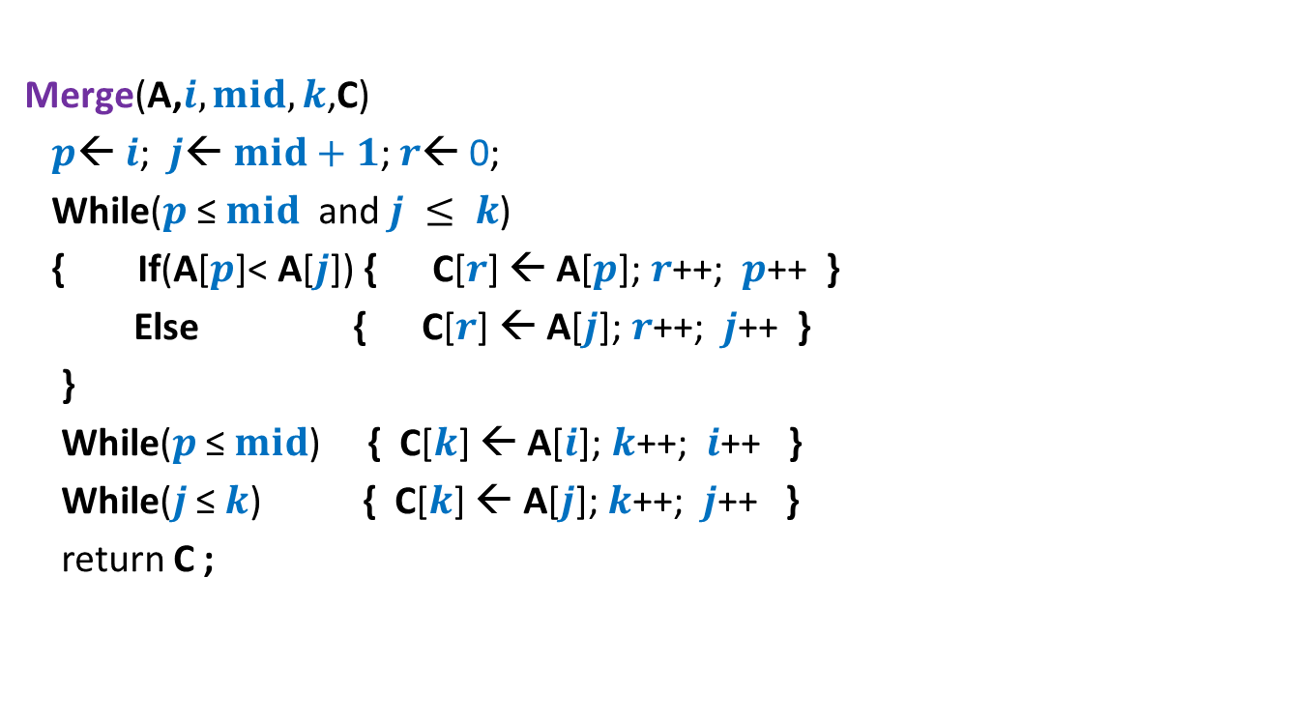
Pesudo-code for Merging two sorted arrays
Merge(A,$i,mid,k$,C)
$p$← $i$; $j$← $mid+1$; $r$← 0;
While($p$ ≤ $mid$ and $j ≤ k$)
{ If(A[$p$]< A[$j$]) { C[$r$] ← A[$p$]; $r$++; $p$++ }
Else { C[$r$] ← A[$j$];$r$++; $j$++ }
}
While($p$ ≤ $mid$) { C[$k$] ← A[$i$]; $k$++; $i$++ }
While($j$ ≤ $k$) { C[$k$] ← A[$j$]; $k$++; $j$++ }
return C ;
We shall make just a slight change in the above pseudo-code to achieve our main objective of computing ${count}_{III}$. If you understood the animation shown in the previous slide, can you guess it now ?

Slide 5

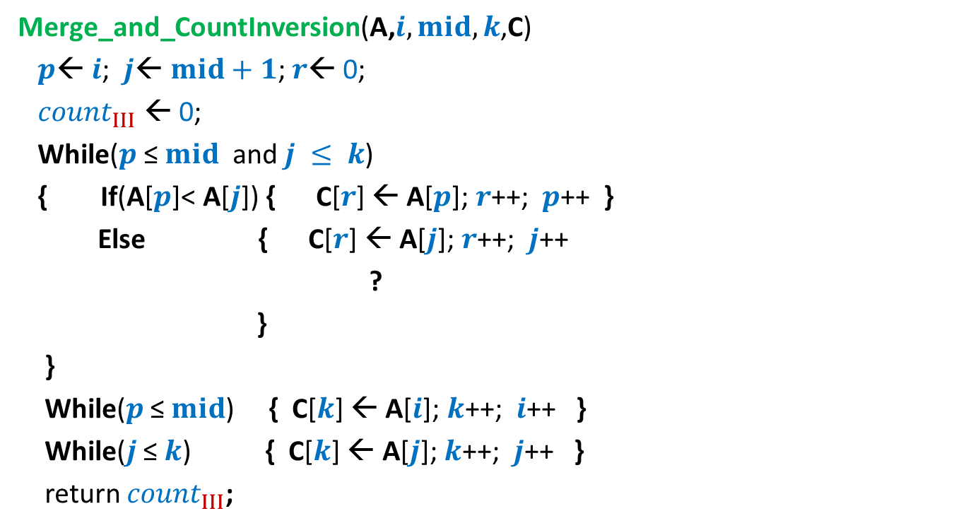

Pesudo-code for Merging and counting inversions
Merge_and_CountInversion(A,$i,mid,k$,C)
$p$← $i$; $j$← $mid+1$; $r$← 0;
${count}_{III}$ ← 0;
While($p$ ≤ $mid$ and $j ≤ k$)
{ If(A[$p$]< A[$j$]) { C[$r$] ← A[$p$]; $r$++; $p$++ }
Else { C[$r$] ← A[$j$];$r$++; $j$++
?
}
}
While($p$ ≤ $mid$) { C[$k$] ← A[$i$]; $k$++; $i$++ }
While($j$ ≤ $k$) { C[$k$] ← A[$j$]; $k$++; $j$++ }
return ${count}_{III}$;
${count}_{III}$ ← ${count}_{III}$ + ? ;
($mid−p+1$);
Nothing extra is needed here.

Slide 6

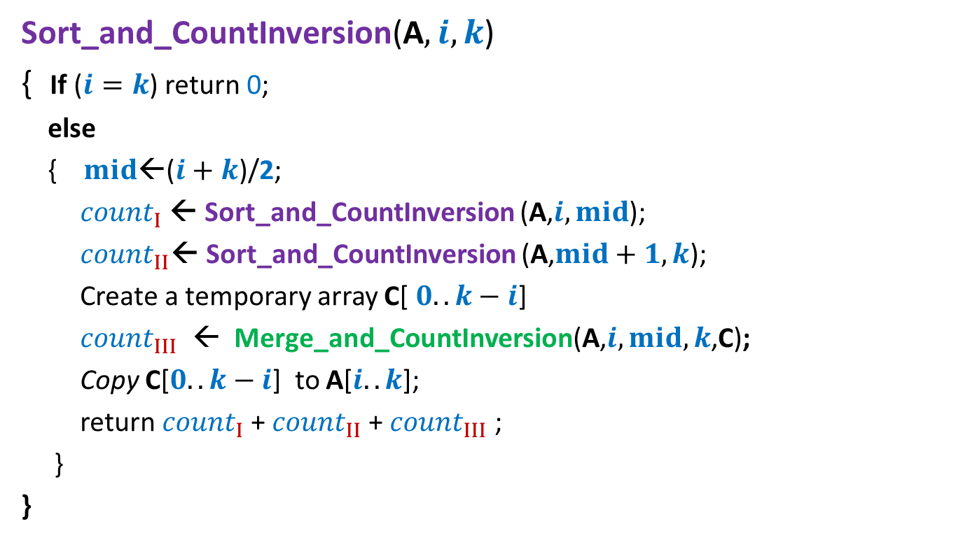

Counting Inversions Final algorithm based on divide & conquer
Sort_and_CountInversion(A$,i,k$)
{ If ($i=k$) return 0;
else
{ $mid$←($i+k$)/2;
${count}_{I}$← Sort_and_CountInversion (A,$i,mid$);
${count}_{II}$← Sort_and_CountInversion (A,$mid+1,k$);
Create a temporary array C[ $0..k−i$]
${count}_{III}$ ← Merge_and_CountInversion(A,$i,mid,k$,C);
Copy C[$0..k−i$] to A[$i..k$];
return ${count}_{I}$+ ${count}_{II}$+ ${count}_{III}$ ;
}
}
$2$ T($n/2$)
O($n$)

Slide 7
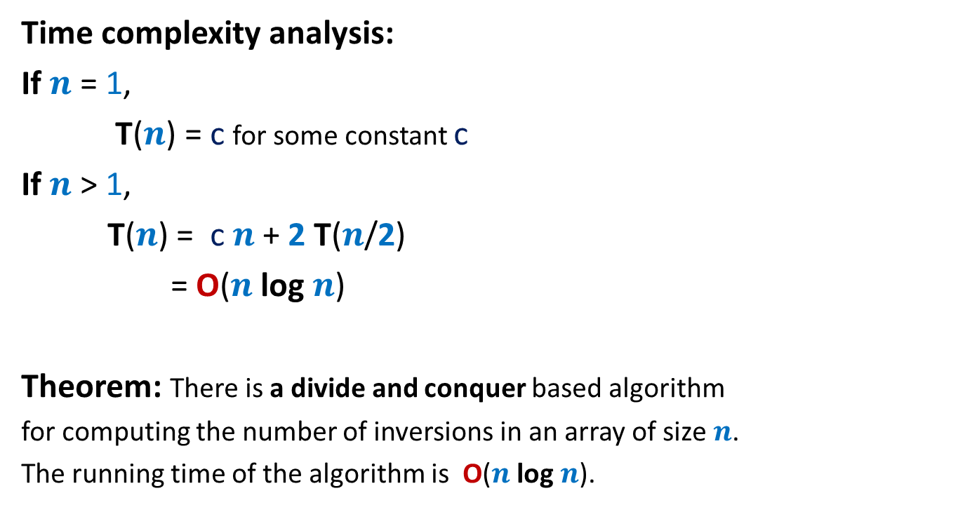
Counting Inversions Final algorithm based on divide & conquer
Time complexity analysis:
If $n$ = 1,
T($n$) = c for some constant c
If $n$ > 1,
T($n$) = c $n$ + 2 T($n$/2)
= O($n$ log $n$)
Theorem: There is a divide and conquer based algorithm
for computing the number of inversions in an array of size $n$.
The running time of the algorithm is O($n$ log $n$).

Slide 8
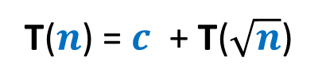
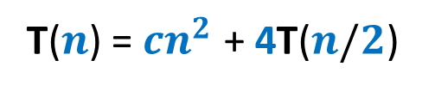
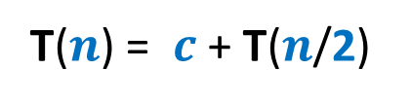
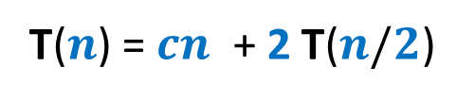
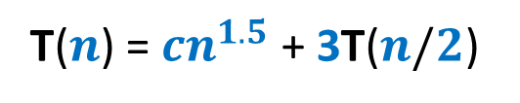
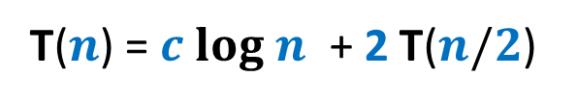
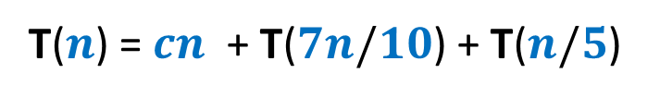
Commonly occurring recurrences
T($n$) = $c$ + T($\sqrt{n}$)
T($n$) = $cn$ + T($7n/10$) + T($n/5$)
T($n$) = $c log n$ + 2 T($n/2$)
T($n$) = $cn$ + 2 T($n/2$)
T($n$) = ${cn}^{2}$ + 4T($n/2$)
T($n$) = ${cn}^{1.5}$ + 3T($n/2$)
T($n$) = $c$ + T($n$/2)

Slide 9
Methods for solving Recurrences
commonly occuring in
algorithm analysis

Slide 10
Methods for solving common Recurrences
Unfolding the recurrence.
Guessing the solution and then
A General solution for a large class of recurrences
proving by induction.
(Master theorem)

Slide 11
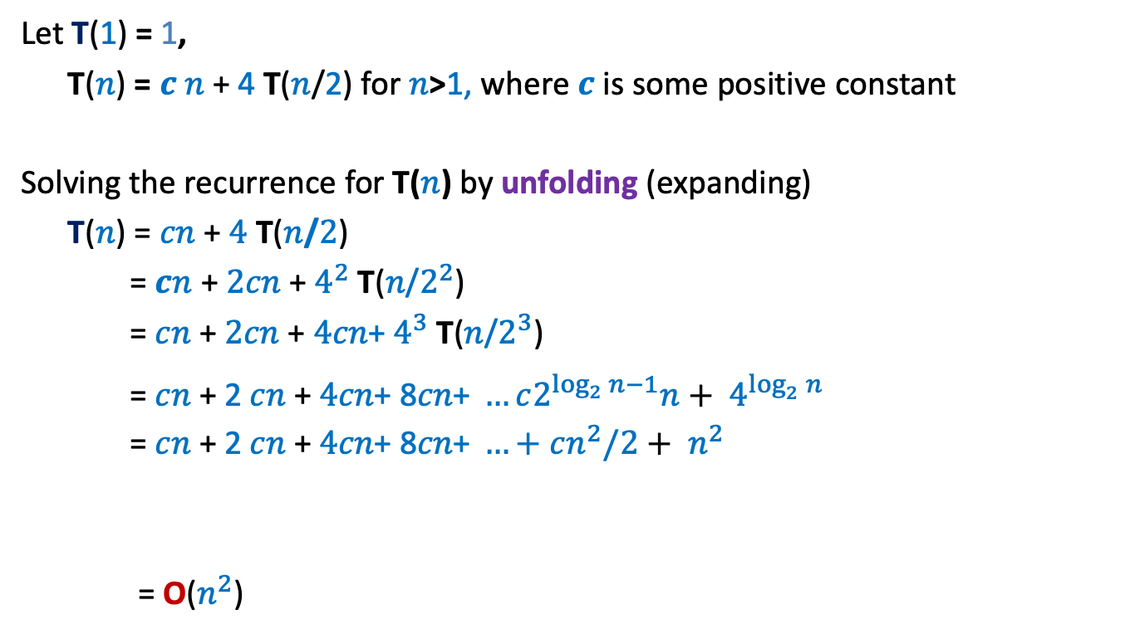
Solving a recurrence by unfolding
Let T(1) = 1,
T($n$) = $c$ $n$ + 4 T($n$/2) for $n$>1, where $c$ is some positive constant
Solving the recurrence for T($n$) by unfolding (expanding)
T($n$) = $cn$ + $4$ T($n$/$2$)
= $cn$ + $2cn$ + $4^{2}$ T($n$/$2^{2}$)
= $cn$ + $2cn$ + ${\text{4}cn\text{+} 4}^{3}$ T($n$/$2^{3}$)
= $cn$ + 2 $cn$ + ${\text{4}cn\text{+ 8}cn\text{+ }…c2^{\log_{2}{n}−1}n+ 4}^{\log_{2}^{}n}$
= $cn$ + 2 $cn$ + ${\text{4}cn\text{+ 8}cn\text{+ }…+cn^{2}/2+ n}^{2 }$
= O($n^{2}$)
A geometric increasing series with log $n$ terms and common ratio 2

Slide 12
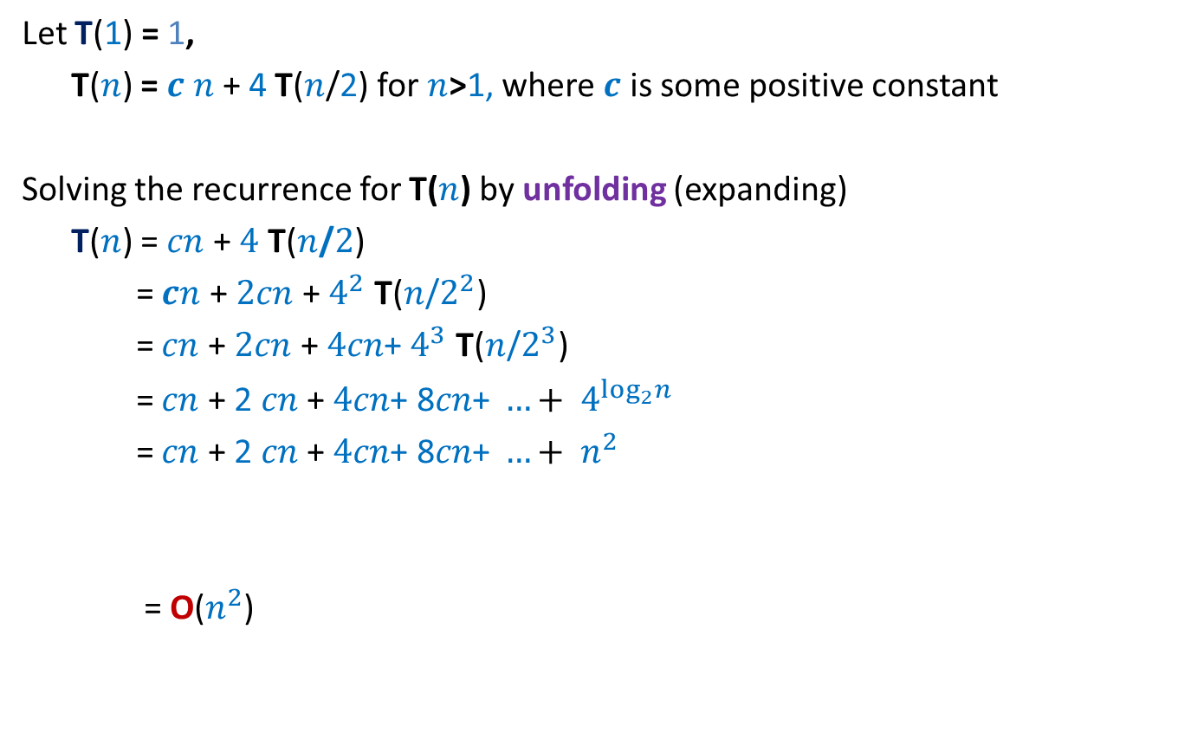
Solving a recurrence by unfolding
Let T(1) = 1,
T($n$) = $c$ $n$ + 4 T($n$/2) for $n$>1, where $c$ is some positive constant
Solving the recurrence for T($n$) by unfolding (expanding)
T($n$) = $cn$ + $4$ T($n$/$2$)
= $cn$ + $2cn$ + $4^{2}$ T($n$/$2^{2}$)
= $cn$ + $2cn$ + ${\text{4}cn\text{+} 4}^{3}$ T($n$/$2^{3}$)
= $cn$ + 2 $cn$ + ${\text{4}cn\text{+ 8}cn\text{+ }…+ 4}^{\log_{2}^{}n}$
= $cn$ + 2 $cn$ + ${\text{4}cn\text{+ 8}cn\text{+ }…+ n}^{2 }$
= O($n^{2}$)

Slide 13

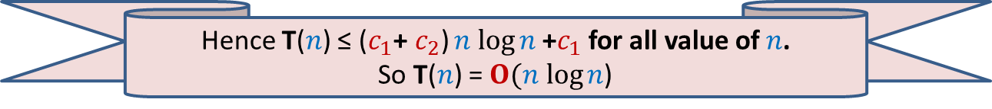
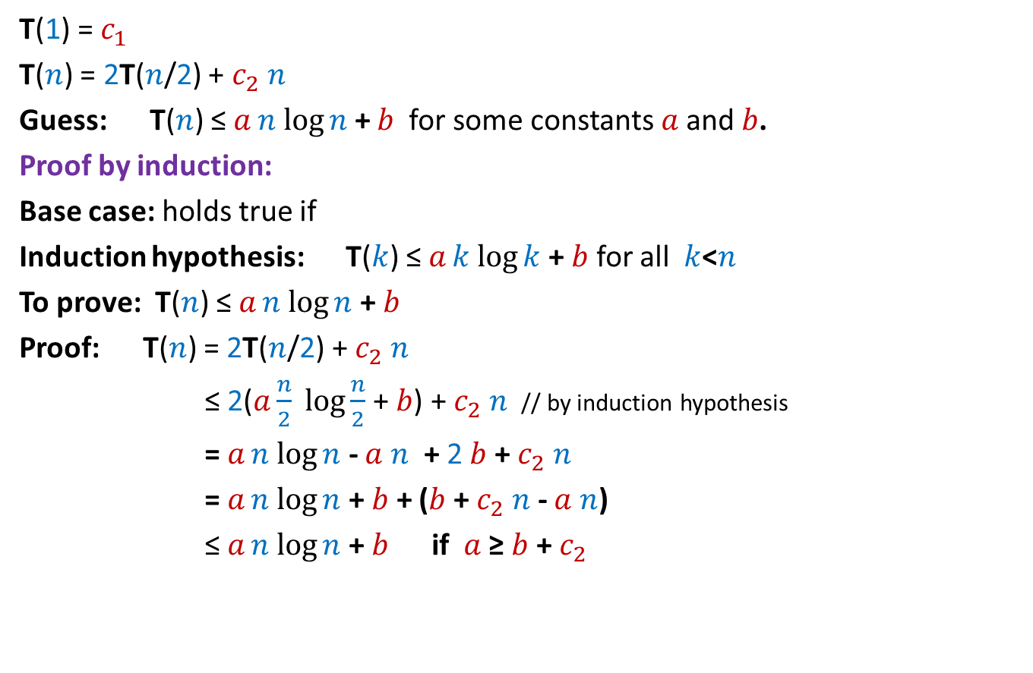

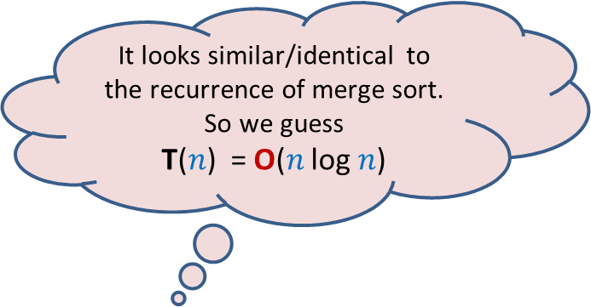
Solving a recurrence by guessing and then proving by induction
It looks similar/identical to the recurrence of merge sort. So we guess
T($n$) = O($n$ log $n$)
T(1) = $c_{1}$
T($n$) = 2T($n$/2) + $c_{2} n$
Guess: T($n$) ≤ $an log{n}$ + $b$ for some constants $a$and $b$.
Proof by induction:
Base case: holds true if
Induction hypothesis: T($k$) ≤ $ak log{k}$ + $b$ for all $k$<$n$
To prove: T($n$) ≤ $an log{n}$ + $b$
Proof: T($n$) = 2T($n$/2) + $c_{2} n$
≤ 2($a\frac{n}{2}\log{\frac{n}{2}}$ + $b$) + $c_{2} n$ // by induction hypothesis
= $an log{n}$ - $a$ $n$ + 2 $b$ + $c_{2} n$
= $an log{n}$ + $b$ + ($b$ + $c_{2} n$ - $a$ $n$)
≤ $an log{n}$ + $b$ if $a$ ≥ $b$ + $c_{2}$
$b$≥ $c_{1}$
These inequalities
can be satisfied simultaneously
by selecting
$b$= $c_{1} and$
$a$=$c_{1}$+ $c_{2}$
Hence T($n$) ≤ ($c_{1}\text{+} c_{2}\text{)}n log{n}$ +$c_{1}$ for all value of $n$.
So T($n$) = $O(n log{n}$)

Slide 14
Solving a recurrence by guessing and then proving by induction
Key points:
You have to make a right guess (past experience may help)
What if your guess is too loose ?
Be careful in the induction step.

Slide 15
A General Method for solving a large class of Recurrences

Slide 16
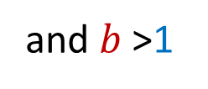

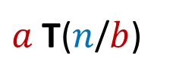
Solving a large class of recurrences
T(1) = 1,
T($n$) = f($n$) +
Where
$a$ and $b$ are constants
f($n$) is a multiplicative function:
f($xy$) = f($x$)f($y$)
AIM : To solve T($n$) for $n$ = $b^{k}$
$a$ T($n$/$b$)
and $b$ >1

Slide 17

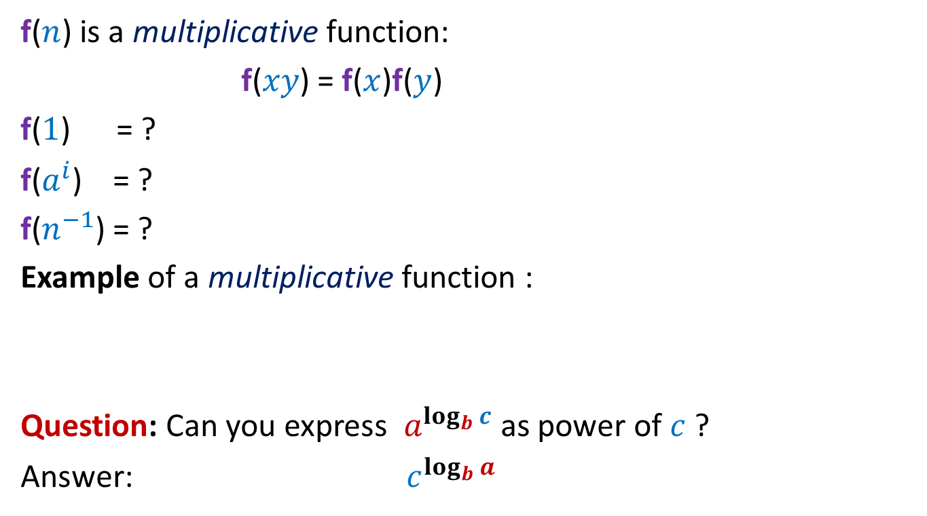

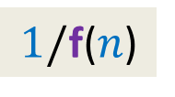
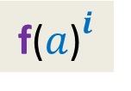
Warm-up
f($n$) is a multiplicative function:
f($xy$) = f($x$)f($y$)
f($1$) = ?
f($a^{i}$) = ?
f($n^{−1}$) = ?
Example of a multiplicative function :
Question: Can you express $a^{\log_{b}{c}}$ as power of $c$ ?
Answer: ${ c}^{\log_{b}{a}}$
$$1$$
$${\text{f}\text{(}a\text{)}}^{i}$$
$$1/\text{f}\text{(}n\text{)}$$
f($n$) = $n^{α}$

Slide 18
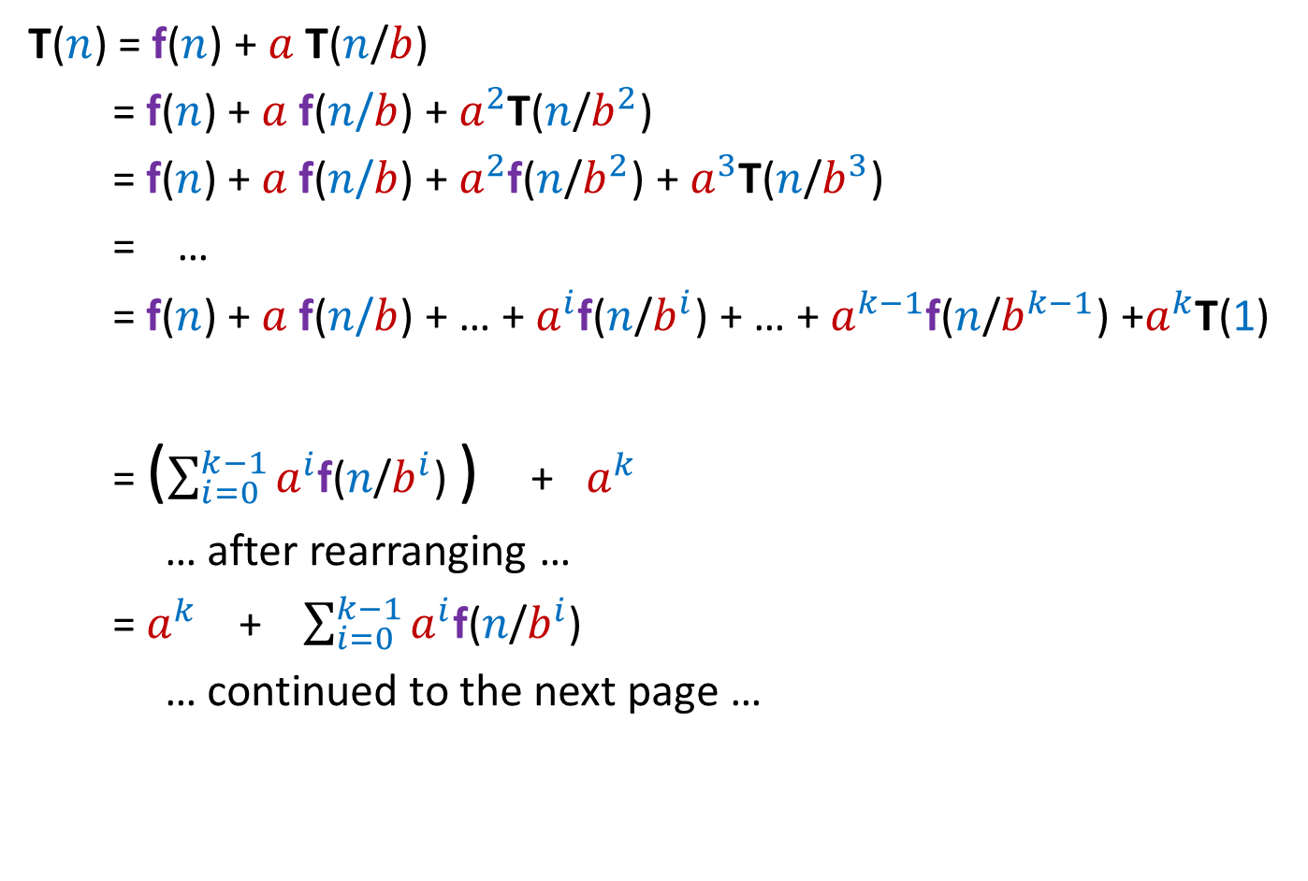
Solving a slightly general class of recurrences
T($n$) = f($n$) + $a$T($n$/$b$)
= f($n$) + $a$ f($n$/$b$) + $a^{2}$T($n$/$b^{2}$)
= f($n$) + $a$ f($n$/$b$) + $a^{2}$f($n$/$b^{2}$) + $a^{3}$T($n$/$b^{3}$)
= …
= f($n$) + $a$ f($n$/$b$) + … + $a^{i}$f($n$/$b^{i}$) + … + $a^{k−1}$f($n$/$b^{k−1}$) +$a^{k}$T(1)
= ($\sum_{i=0}^{k−1}{a^{i}\text{f}\text{(}n\text{/}b^{i}\text{)}}$ ) + $a^{k}$
… after rearranging …
= $a^{k}$ + $\sum_{i=0}^{k−1}{a^{i}\text{f}\text{(}n\text{/}b^{i}\text{)}}$
… continued to the next page …

Slide 19

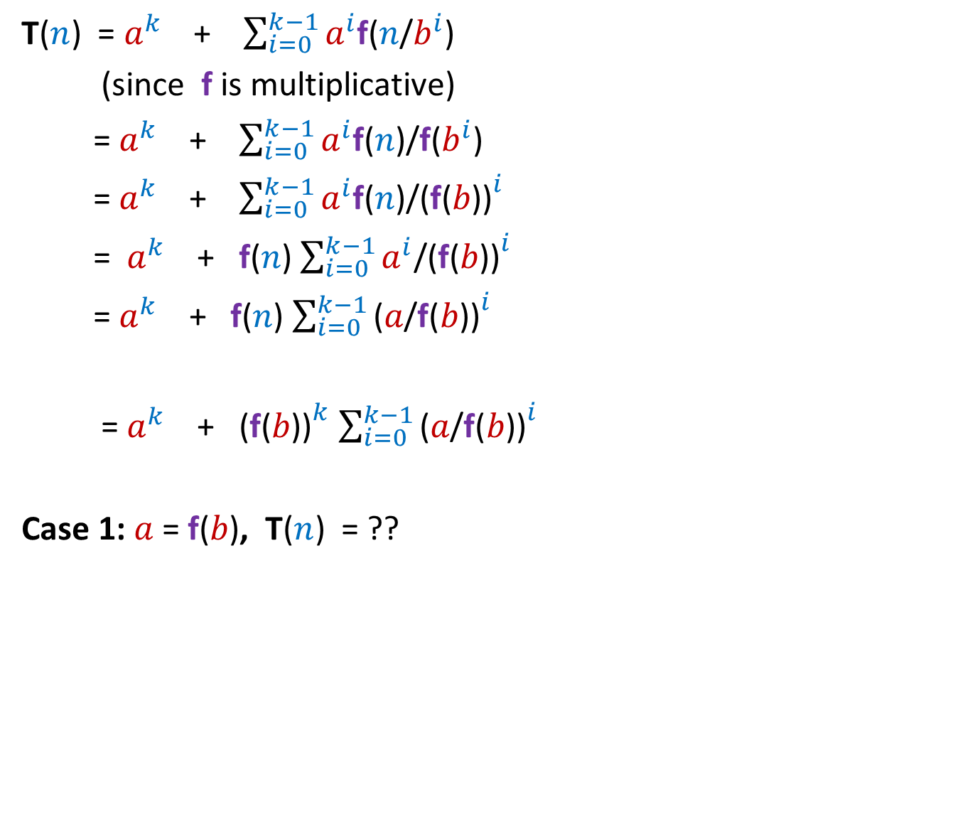


T($n$) = $a^{k}$ + $\sum_{i=0}^{k−1}{a^{i}\text{f}\text{(}n\text{/}b^{i}\text{)}}$
(since $\text{f}$ is multiplicative)
= $a^{k}$ + $\sum_{i=0}^{k−1}{a^{i}\text{f}\text{(}n\text{)}\text{/}\text{f}\text{(}b^{i}\text{)}}$
= $a^{k}$ + $\sum_{i=0}^{k−1}{a^{i}\text{f}\text{(}n\text{)/}\text{(}\text{f}\text{(}{b\text{))}}^{i}}$
= $a^{k}$ + $\text{f}\text{(}n\text{)}$ $\sum_{i=0}^{k−1}{a^{i}\text{/(}\text{f}\text{(}{b\text{))}}^{i}}$
= $a^{k}$ + $\text{f}\text{(}n\text{)}$ $\sum_{i=0}^{k−1}{\text{(}a\text{/}\text{f}\text{(}{b\text{))}}^{i}}$
= $a^{k}$ + ${\text{(}\text{f}\text{(}b\text{))}}^{k}$ $\sum_{i=0}^{k−1}{\text{(}a\text{/}\text{f}\text{(}{b\text{))}}^{i}}$
Case 1: $a$ = $\text{f}\text{(}b\text{)}$, T($n$) = ??
A geometric series
$$a^{k}(k+1)$$
$${ =\text{O}\text{(}a}^{\log_{b}{n}}\log_{b}{n}\text{)}$$
$${ =\text{O}\text{(}n}^{\log_{b}{a}}\log_{b}{n}\text{)}$$

Slide 20


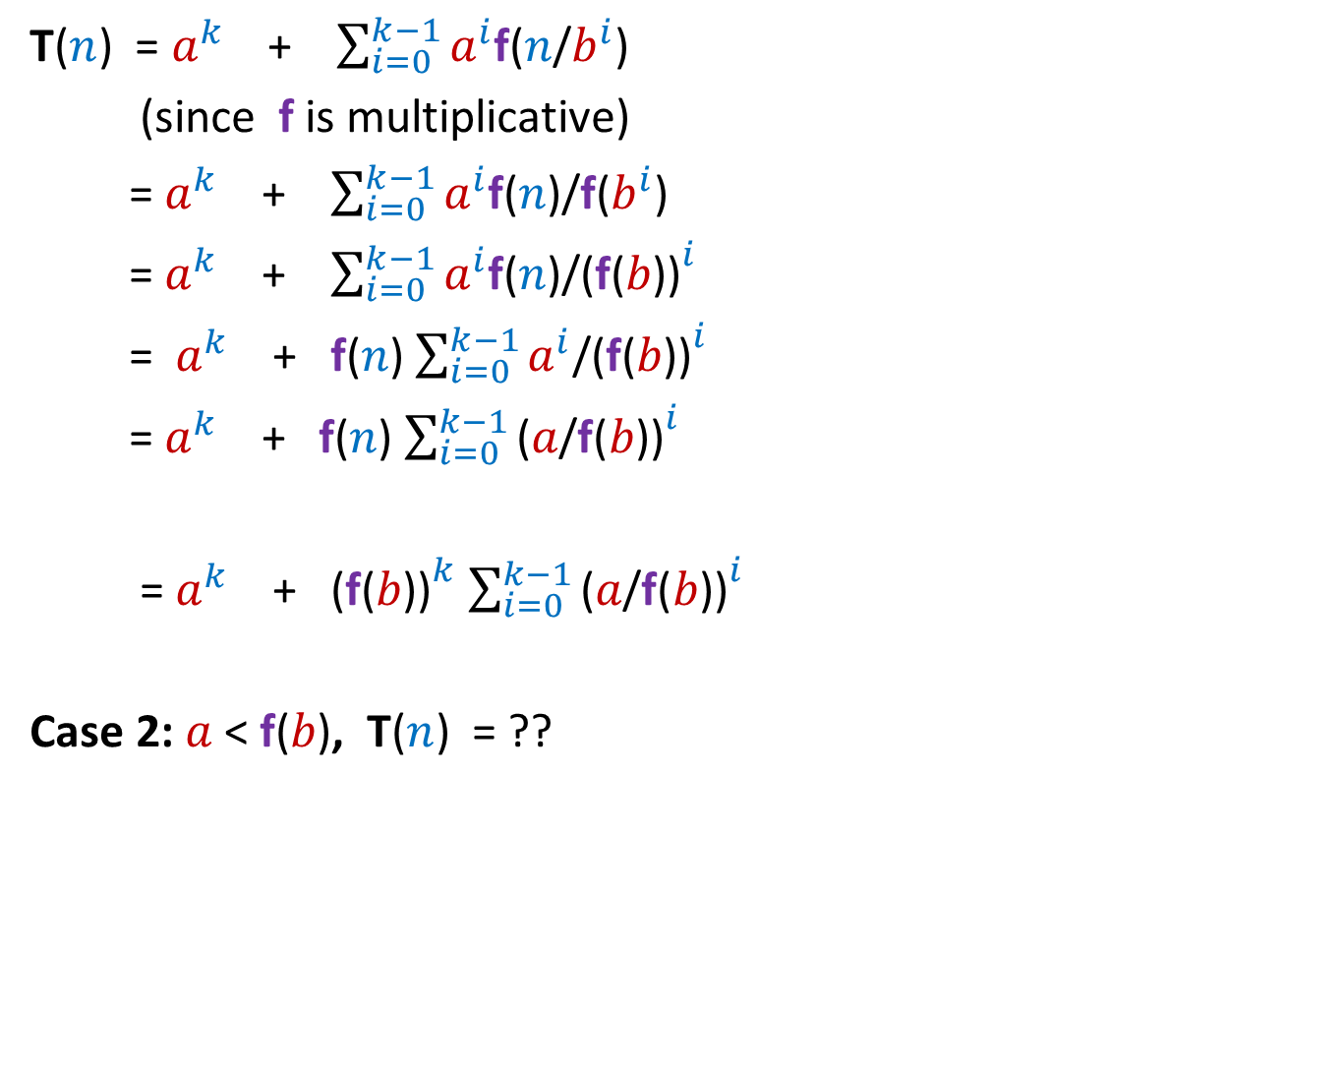



T($n$) = $a^{k}$ + $\sum_{i=0}^{k−1}{a^{i}\text{f}\text{(}n\text{/}b^{i}\text{)}}$
(since $\text{f}$ is multiplicative)
= $a^{k}$ + $\sum_{i=0}^{k−1}{a^{i}\text{f}\text{(}n\text{)}\text{/}\text{f}\text{(}b^{i}\text{)}}$
= $a^{k}$ + $\sum_{i=0}^{k−1}{a^{i}\text{f}\text{(}n\text{)/}\text{(}\text{f}\text{(}{b\text{))}}^{i}}$
= $a^{k}$ + $\text{f}\text{(}n\text{)}$ $\sum_{i=0}^{k−1}{a^{i}\text{/(}\text{f}\text{(}{b\text{))}}^{i}}$
= $a^{k}$ + $\text{f}\text{(}n\text{)}$ $\sum_{i=0}^{k−1}{\text{(}a\text{/}\text{f}\text{(}{b\text{))}}^{i}}$
= $a^{k}$ + ${\text{(}\text{f}\text{(}b\text{))}}^{k}$ $\sum_{i=0}^{k−1}{\text{(}a\text{/}\text{f}\text{(}{b\text{))}}^{i}}$
Case 2: $a$ < $\text{f}\text{(}b\text{)}$, T($n$) = ??
For $a$ < $\text{f}\text{(}b\text{)}$, the sum of this series is bounded by
?
$\frac{1}{1 − \frac{a}{\text{f}\text{(}b\text{)}}}$ = O(1)
$a^{k}$+${\text{(}\text{f}\text{(}b\text{))}}^{k} ∙$O(1)
= O$\text{(}{\text{(}\text{f}\text{(}b\text{))}}^{k}$)
$$\text{=} \text{O}\text{(}\text{f}\text{(}n\text{)}\text{)}$$

Slide 21
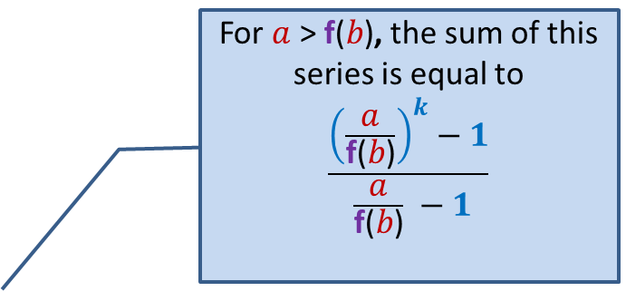

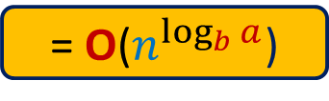
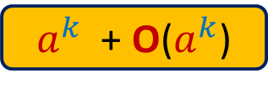
T($n$) = $a^{k}$ + $\sum_{i=0}^{k−1}{a^{i}\text{f}\text{(}n\text{/}b^{i}\text{)}}$
(since $\text{f}$ is multiplicative)
= $a^{k}$ + $\sum_{i=0}^{k−1}{a^{i}\text{f}\text{(}n\text{)}\text{/}\text{f}\text{(}b^{i}\text{)}}$
= $a^{k}$ + $\sum_{i=0}^{k−1}{a^{i}\text{f}\text{(}n\text{)/}\text{(}\text{f}\text{(}{b\text{))}}^{i}}$
= $a^{k}$ + $\text{f}\text{(}n\text{)}$ $\sum_{i=0}^{k−1}{a^{i}\text{/(}\text{f}\text{(}{b\text{))}}^{i}}$
= $a^{k}$ + $\text{f}\text{(}n\text{)}$ $\sum_{i=0}^{k−1}{\text{(}a\text{/}\text{f}\text{(}{b\text{))}}^{i}}$
= $a^{k}$ + ${\text{(}\text{f}\text{(}b\text{))}}^{k}$ $\sum_{i=0}^{k−1}{\text{(}a\text{/}\text{f}\text{(}{b\text{))}}^{i}}$
Case 3: $a$ > $\text{f}\text{(}b\text{)}$, T($n$) = ??
For $a$ > $\text{f}\text{(}b\text{)}$, the sum of this series is equal to
$$\frac{{\left(\frac{a}{\text{f}\text{(}b\text{)}}\right)}^{k}−1}{ \frac{a}{\text{f}\text{(}b\text{)}} −1}$$
$a^{k}$ + $\text{O}\text{(}a^{k}\text{)}$
= $\text{O}\text{(}n^{\log_{b}{a}}$)

Slide 22
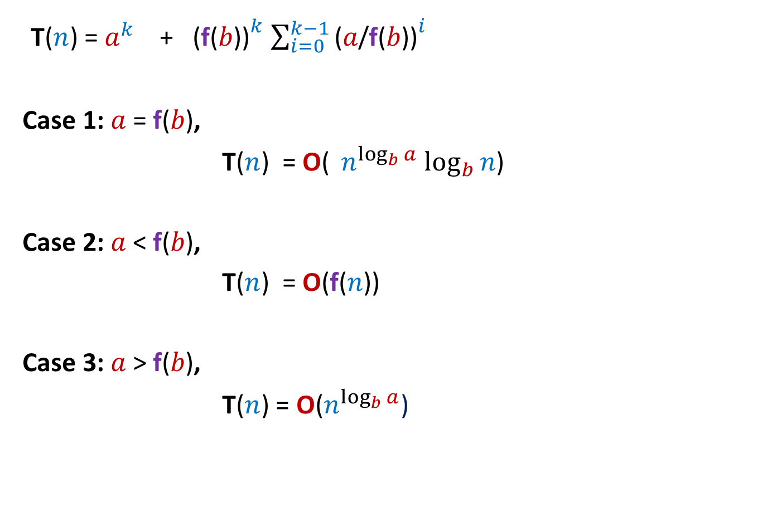
Three cases
T($n$) = $a^{k}$ + ${\text{(}\text{f}\text{(}b\text{))}}^{k}$ $\sum_{i=0}^{k−1}{\text{(}a\text{/}\text{f}\text{(}{b\text{))}}^{i}}$
Case 1: $a$ = $\text{f}\text{(}b\text{)}$,
T($n$) = $\text{O}\text{(}{ n}^{\log_{b}{a}}\log_{b}{n}$)
Case 2: $a$ < $\text{f}\text{(}b\text{)}$,
T($n$) = $\text{O}\text{(}\text{f}\text{(}n\text{))}$
Case 3: $a$ > $\text{f}\text{(}b\text{)}$,
T($n$) = $\text{O}\text{(}n^{\log_{b}{a}}$)

Slide 23
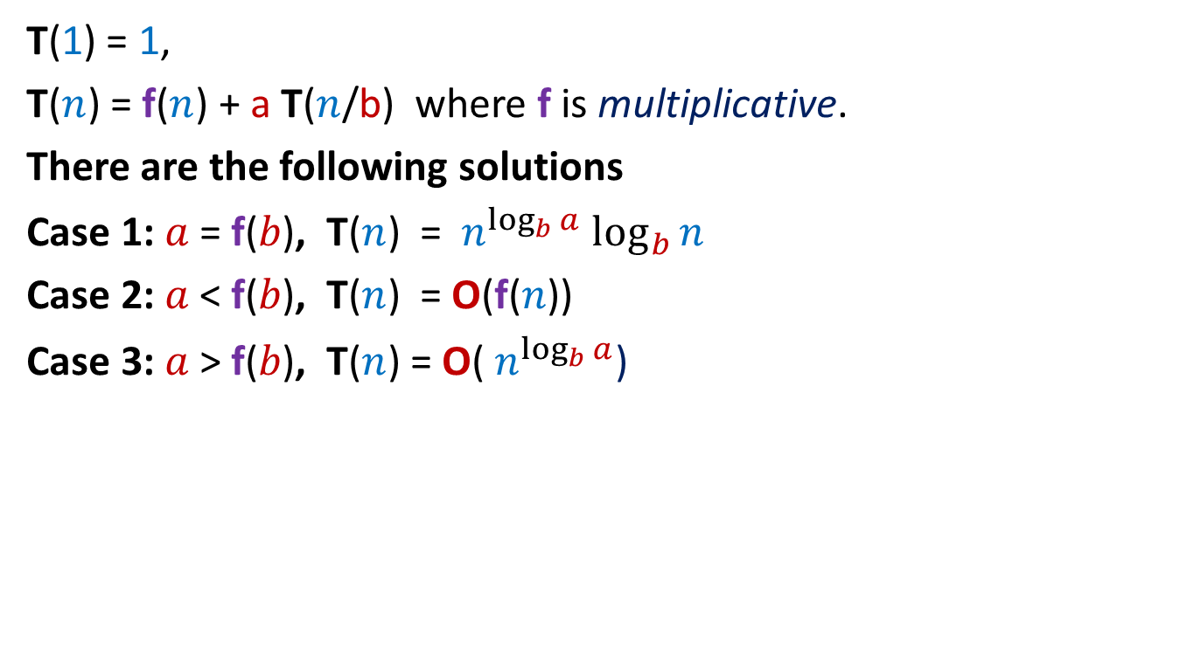
Master theorem
T(1) = 1,
T($n$) = f($n$) + a T($n$/b) where f is multiplicative.
There are the following solutions
Case 1: $a$ = $\text{f}\text{(}b\text{)}$, T($n$) = ${ n}^{\log_{b}{a}}\log_{b}{n}$
Case 2: $a$ < $\text{f}\text{(}b\text{)}$, T($n$) = $\text{O}\text{(}\text{f}\text{(}n\text{))}$
Case 3: $a$ > $\text{f}\text{(}b\text{)}$, T($n$) = $\text{O}\text{(}{ n}^{\log_{b}{a}}$)

Slide 24
Examples

Slide 25

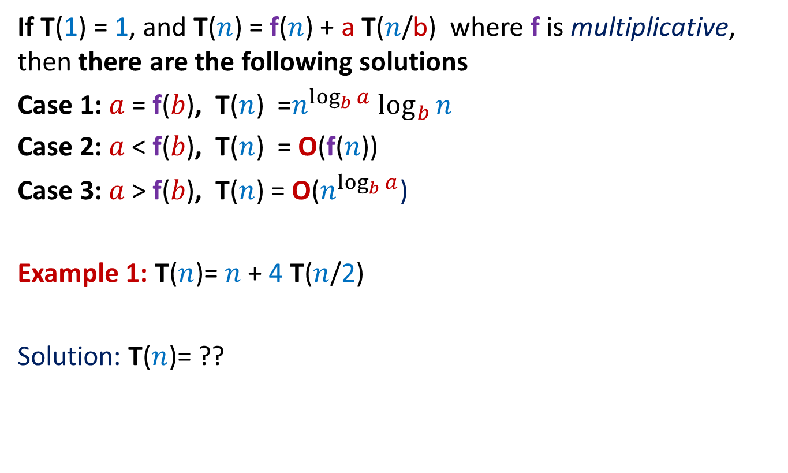
Master theorem
If T(1) = 1, and T($n$) = f($n$) + a T($n$/b) where f is multiplicative, then there are the following solutions
Case 1: $a$ = $\text{f}\text{(}b\text{)}$, T($n$) =$n^{\log_{b}{a}}\log_{b}{n}$
Case 2: $a$ < $\text{f}\text{(}b\text{)}$, T($n$) = $\text{O}\text{(}\text{f}\text{(}n\text{))}$
Case 3: $a$ > $\text{f}\text{(}b\text{)}$, T($n$) = $\text{O}\text{(}n^{\log_{b}{a}}$)
Example 1: T($n$)= $n$+ 4 T($n$/2)
Solution: T($n$)= ??
This is case 3
$$\text{O}\text{(}{ n}^{2}\text{)}$$

Slide 26

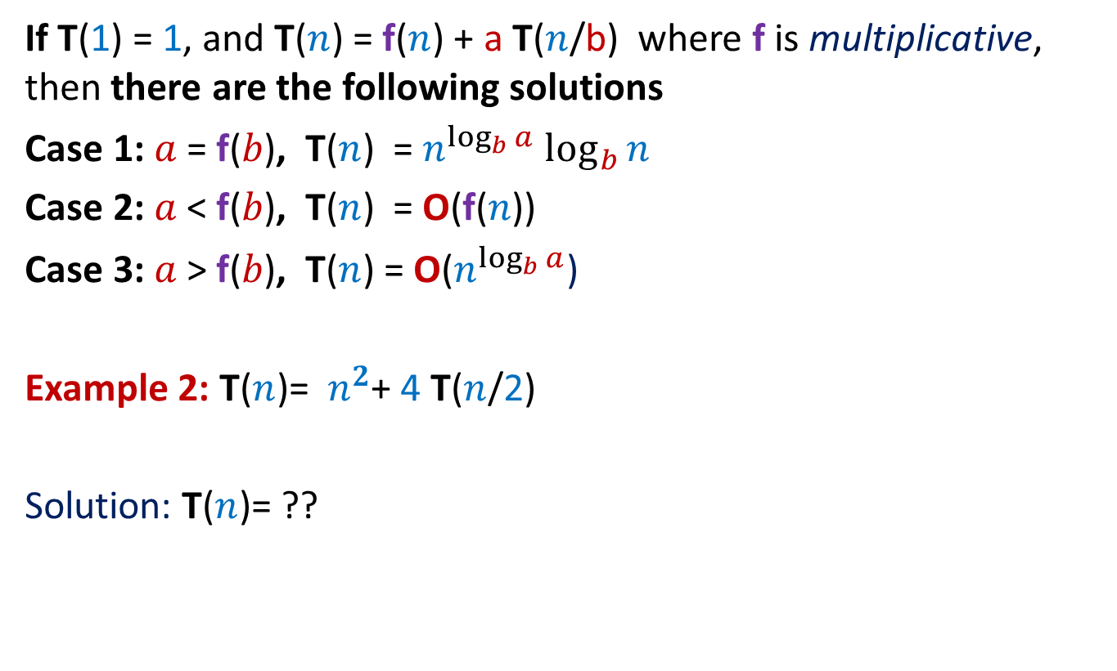
Master theorem
If T(1) = 1, and T($n$) = f($n$) + a T($n$/b) where f is multiplicative, then there are the following solutions
Case 1: $a$ = $\text{f}\text{(}b\text{)}$, T($n$) =${ n}^{\log_{b}{a}}\log_{b}{n}$
Case 2: $a$ < $\text{f}\text{(}b\text{)}$, T($n$) = $\text{O}\text{(}\text{f}\text{(}n\text{))}$
Case 3: $a$ > $\text{f}\text{(}b\text{)}$, T($n$) = $\text{O}\text{(}n^{\log_{b}{a}}$)
Example 2: T($n$)= ${ n}^{2}$+ 4 T($n$/2)
Solution: T($n$)= ??
This is case 1
$$\text{O}\text{(}{ n}^{2}\log_{2}{n}\text{)}$$

Slide 27


Master theorem
If T(1) = 1, and T($n$) = f($n$) + a T($n$/b) where f is multiplicative, then there are the following solutions
Case 1: $a$ = $\text{f}\text{(}b\text{)}$, T($n$) =${ n}^{\log_{b}{a}}\log_{b}{n}$
Case 2: $a$ < $\text{f}\text{(}b\text{)}$, T($n$) = $\text{O}\text{(}\text{f}\text{(}n\text{))}$
Case 3: $a$ > $\text{f}\text{(}b\text{)}$, T($n$) = $\text{O}\text{(}{ n}^{\log_{b}{a}}$)
Example 3: T($n$)= ${ n}^{3}$+ 4 T($n$/2)
Solution: T($n$)= ??
This is case 2
$$\text{O}\text{(}{ n}^{3}\text{)}$$

Slide 28
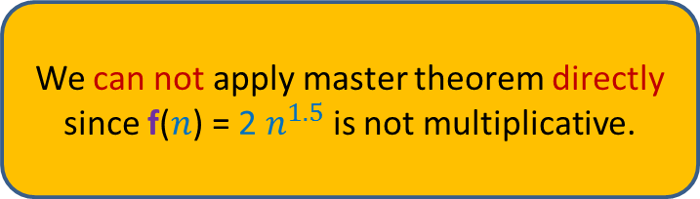
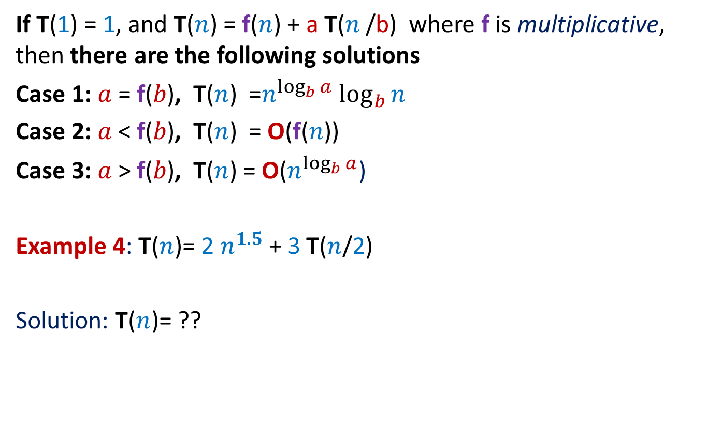
Master theorem
If T(1) = 1, and T($n$) = f($n$) + a T($n$/b) where f is multiplicative, then there are the following solutions
Case 1: $a$ = $\text{f}\text{(}b\text{)}$, T($n$) =$n^{\log_{b}{a}}\log_{b}{n}$
Case 2: $a$ < $\text{f}\text{(}b\text{)}$, T($n$) = $\text{O}\text{(}\text{f}\text{(}n\text{))}$
Case 3: $a$ > $\text{f}\text{(}b\text{)}$, T($n$) = $\text{O}\text{(}n^{\log_{b}{a}}$)
Example 4: T($n$)= 2 $n^{1.5}$+ 3 T($n$/2)
Solution: T($n$)= ??
We can not apply master theorem directly since f($n$) = 2 $n^{1.5}$is not multiplicative.

Slide 29
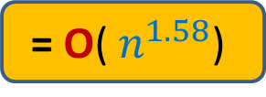
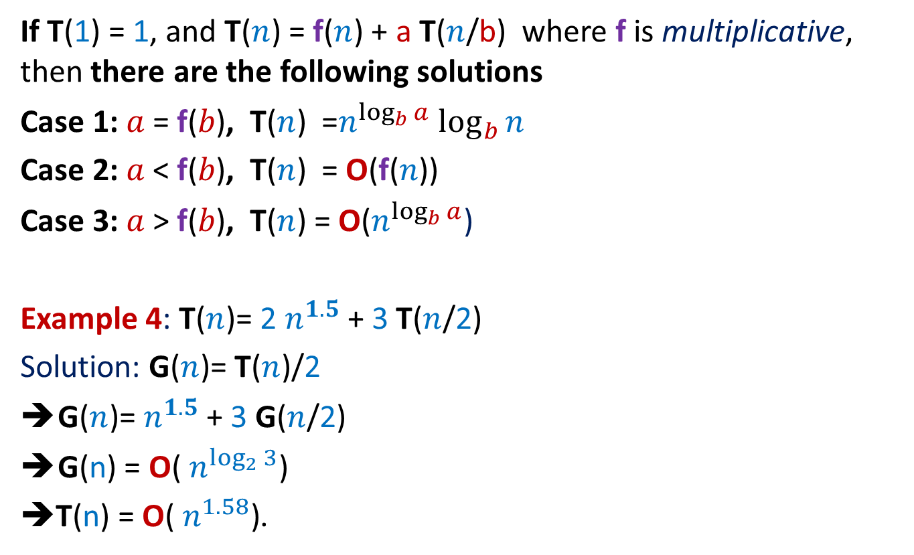
Master theorem
If T(1) = 1, and T($n$) = f($n$) + a T($n$/b) where f is multiplicative, then there are the following solutions
Case 1: $a$ = $\text{f}\text{(}b\text{)}$, T($n$) =$n^{\log_{b}{a}}\log_{b}{n}$
Case 2: $a$ < $\text{f}\text{(}b\text{)}$, T($n$) = $\text{O}\text{(}\text{f}\text{(}n\text{))}$
Case 3: $a$ > $\text{f}\text{(}b\text{)}$, T($n$) = $\text{O}\text{(}n^{\log_{b}{a}}$)
Example 4: T($n$)= 2 $n^{1.5}$+ 3 T($n$/2)
Solution: G($n$)= T($n$)/2
G($n$)= $n^{1.5}$+ 3 G($n$/2)
G(n) = $\text{O}\text{(}{ n}^{\log_{2}{3}}\text{)}$
➔T(n) = $\text{O}\text{(}{ n}^{1.58}\text{)}$.
This is case 3
$$\text{=} \text{O}\text{(}{ n}^{1.58}\text{)}$$

Slide 30
Master theorem
If T(1) = 1, and T($n$) = f($n$) + a T($n$/b) where f is multiplicative, then there are the following solutions
Case 1: $a$ = $\text{f}\text{(}b\text{)}$, T($n$) =$n^{\log_{b}{a}}\log_{b}{n}$
Case 2: $a$ < $\text{f}\text{(}b\text{)}$, T($n$) = $\text{O}\text{(}\text{f}\text{(}n\text{))}$
Case 3: $a$ > $\text{f}\text{(}b\text{)}$, T($n$) = $\text{O}\text{(}n^{\log_{b}{a}}$)
Example 4: T($n$)= 2 $n^{1.5}$+ 3 T($n$/2)
Solution: G($n$)= T($n$)/2
G($n$)= $n^{1.5}$+ 3 G($n$/2)
G(n) = $\text{O}\text{(}{ n}^{\log_{2}{3}}\text{)}$
➔T(n) = $\text{O}\text{(}{ n}^{1.58}\text{)}$.
$$\text{=} \text{O}\text{(}{ n}^{1.58}\text{)}$$

Slide 31

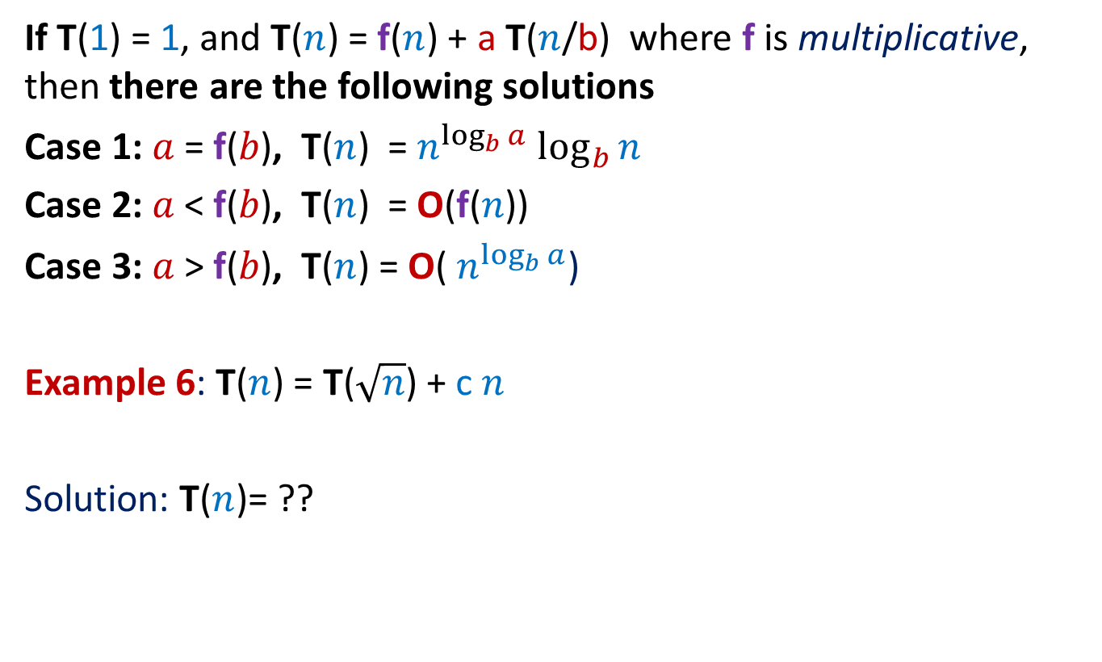
Master theorem
If T(1) = 1, and T($n$) = f($n$) + a T($n$/b) where f is multiplicative, then there are the following solutions
Case 1: $a$ = $\text{f}\text{(}b\text{)}$, T($n$) = $n^{\log_{b}{a}}\log_{b}{n}$
Case 2: $a$ < $\text{f}\text{(}b\text{)}$, T($n$) = $\text{O}\text{(}\text{f}\text{(}n\text{))}$
Case 3: $a$ > $\text{f}\text{(}b\text{)}$, T($n$) = $\text{O}\text{(}{ n}^{\log_{b}{a}}$)
Example 6: T($n$) = T($\sqrt{n}$) + c $n$
Solution: T($n$)= ??
We can not apply master theorem directly
since T($\sqrt{n}$) <> T($n$/$b$) for any constant $b$.

Slide 32



Solving T($n$) = T($\sqrt{n}$) + c $n$ using the method of unfolding
Can you guess the number of terms in this series ?
T($n$) = c $n$ + T($\sqrt{n}$)
= c $n$ + c$\sqrt{n}$+ T($\sqrt[4]{n}$)
= c $n$ + c$\sqrt{n}$+ c $\sqrt[4]{n}$+ T($\sqrt[8]{n}$)
= c $n$ + c$\sqrt{n}$+ … c $\sqrt[i]{n}$ + … + T(1)
= O($n$)
A series which is decreasing at a rate
faster than any geometric series
$$\left\lceil \log{\log{n}}\right\rceil$$

Slide 33
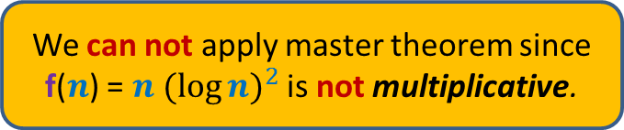
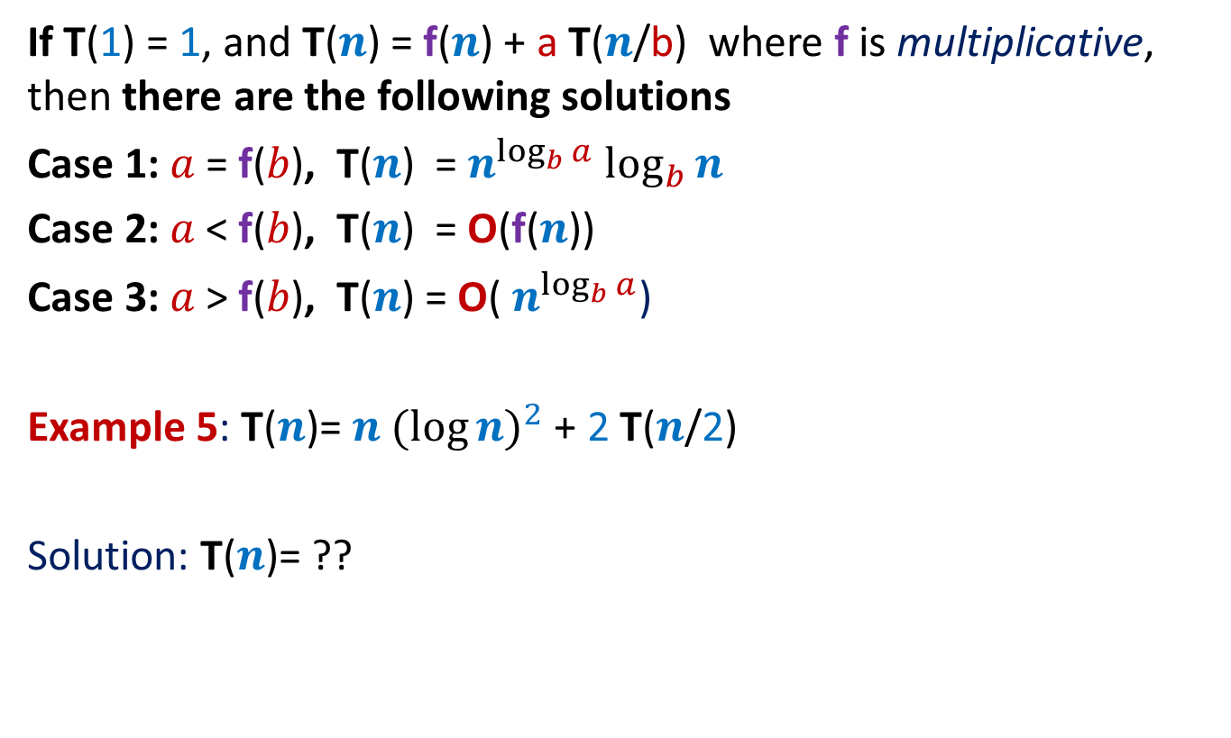
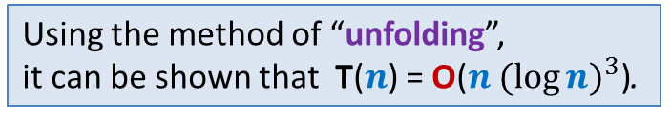
Master theorem
If T(1) = 1, and T($n$) = f($n$) + a T($n$/b) where f is multiplicative, then there are the following solutions
Case 1: $a$ = $\text{f}\text{(}b\text{)}$, T($n$) =${ n}^{\log_{b}{a}}\log_{b}{n}$
Case 2: $a$ < $\text{f}\text{(}b\text{)}$, T($n$) = $\text{O}\text{(}\text{f}\text{(}n\text{))}$
Case 3: $a$ > $\text{f}\text{(}b\text{)}$, T($n$) = $\text{O}\text{(}{ n}^{\log_{b}{a}}$)
Example 5: T($n$)= $n {(\log{n)}}^{2}$+ 2 T($n$/2)
Solution: T($n$)= ??
We can not apply master theorem since f($n$) = $n {(\log{n)}}^{2}$is not multiplicative.
Using the method of “unfolding”,
it can be shown that T($n$) = $\text{O}\text{(}n {(\log{n)}}^{3}\text{)}$.

Slide 34
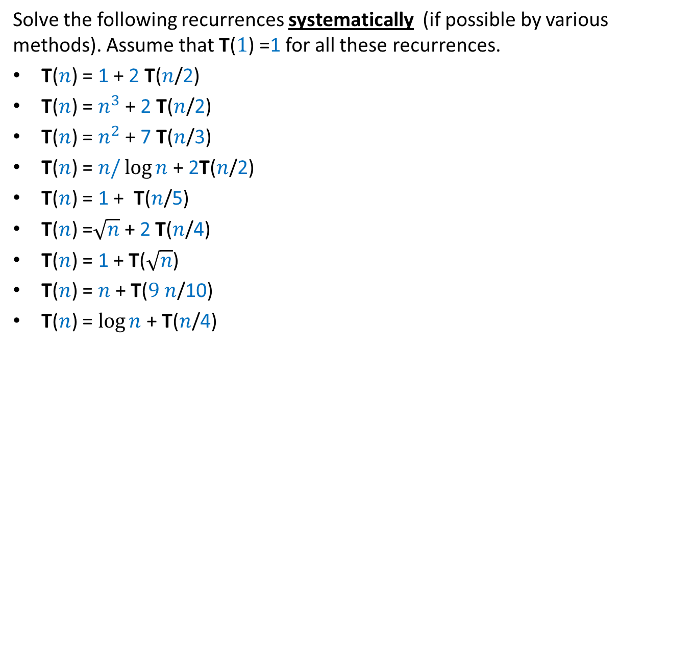
Homework # 1
Solve the following recurrences systematically (if possible by various methods). Assume that T($1$) =1 for all these recurrences.
T($n$) = 1 + 2 T($n$/2)
T($n$) = $n^{3}$ + 2 T($n$/2)
T($n$) = $n^{2}$ + 7 T($n$/3)
T($n$) = $n/\log{n}$+ 2T($n$/2)
T($n$) = 1 + T($n$/5)
T($n$) =$\sqrt{n}$ + 2 T($n$/4)
T($n$) = 1 + T($\sqrt{n}$)
T($n$) = $n$+ T($9 n$/10)
T($n$) = $\log{n}$+ T($n$/4)

Slide 35
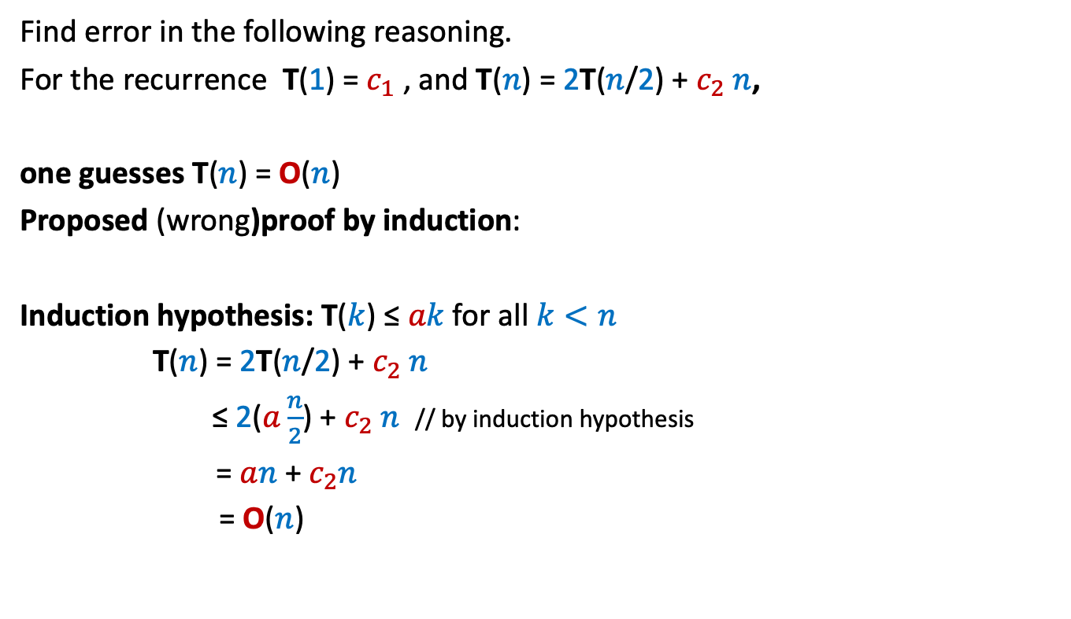
Homework # 2
Find error in the following reasoning.
For the recurrence T(1) = $c_{1}$ , and T($n$) = 2T($n$/2) + $c_{2} n$,
one guesses T($n$) = O($n$)
Proposed (wrong)proof by induction:
Induction hypothesis: T($k$) ≤ $ak$ for all $k<n$
T($n$) = 2T($n$/2) + $c_{2} n$
≤ 2($a\frac{n}{2}$) + $c_{2} n$ // by induction hypothesis
= $an$ + $c_{2}n$
= O($n$)

Slide 36
Proof of correctness
Algorithm for majority element

Slide 37








The Algorithm at the end of $i$th iteration
$$i−1$$
Question: What assertion holds at the end of $i$th iteration ?
Answer:
P($i$) :
Question: What is P($n$) ?
Answer:
➔ $x$ $=$ $α$
$a b c c c z c a b b c c c c d c$
$$x$$
count
{$x$,…count times…,$x$,A[$i$],…,A[$n−1$]}
$α$ is a majority element of {A[$0$],A[$1$],…,A[$i−1$]}
$x$ is a majority element of {A[$0$],A[$1$],…,A[$i−1$]}
$α$is a majority element of … ? …
$α$is a majority element of {$x$,…count times…,$x$}
We need count > 0 at the end of the while loop for drawing this inference.

Slide 38


The Algorithm at the end of $i$th iteration
$$i−1$$
Question: What assertion holds at the end of $i$th iteration ?
Answer:
P($i$) :
So we have multiple assertions that hold.
$a b c c c z c a b b c c c c d c$
$$x$$
count
After cancelling pairs of distinct element,
{$x$,…count times…,$x$} remains.

Slide 39

The Algorithm at the end of $i$th iteration
$$i−1$$
Question: What assertion holds at the end of $i$th iteration ?
Answer:
If A[$0$],…,A[$n−1$] have a majority element, it must be $x$.
$α$ is the majority element of {$x$,…count times…,$x$,A[$i$],…,A[$n−1$]}
After cancelling pairs of distinct elements from A[$0$],…,A[$i−1$],
the multiset {$x$,…count times…,$x$} remains.
$a b c c c z c a b b c c c c d c$
$$x$$
count

Slide 40

Conclusion
Which of these assertions will suffice as proof of correctness ?
Do we need any other lemma ?
What about the following lemma ?
Lemma: If there is a majority element, say $α$, after any sequence of
cancelling pairs of distinct elements from A, a nonzero copies of $α$ will always survive.
Do you use this lemma to establish validity of one of the assertions ?
[You surely do not require it at least for one assertion].
Can you use this lemma and one of the assertions to prove correctness of algorithm ?
Is there an alternate way to prove the correctness of the algorithm without P($i$) ?
Ponder over these questions,
without fea,r
without aversion

Slide 41
Proof of correctness of an algorithm is a delicate and nontrivial concept.
Take your time to internalize it. Do not worry or feel anxious.
[No question will be asked in the mid sem exam on the proof of correctness.]
But you can not avoid it ☺
It does not require any formula.
Just formalizing the right understanding of the algorithm.
Best wishes ☺

