Slide 1
Data Structures and Algorithms (ESO207A)
Lecture 19
Height balanced BST
Red-black trees

Slide 2
Binary Search Tree
root
Definition:
A Binary Tree T storing values is said to be Binary Search Tree
if for each node v in T
If left(v) <> NULL, then
If right(v)<>NULL, then value(v) < value of every node in subtree(right(v)).
46
v
28
67
5
35
49
2
25
31
41
48
53
value(v) > value of every node in subtree(left(v)).

Slide 3
Binary Search Tree
Height
Height(T):
The maximum number of nodes on any path from root to a leaf node of T.
Recall from the past lectures on BST:
Height of a BST is the most crucial parameter to measure its efficiency.

Slide 4

Searching and inserting in a perfectly balanced BST
T
O( log $n$) time
46
28
67
5
35
49
83
2
25
31
41
48
53
73
96

Slide 5


Searching and inserting in a skewed BST on $n$ nodes
T2
Therefore, we introduced …
48
39
23
19
11
O($n$) time !!
14
18

Slide 6
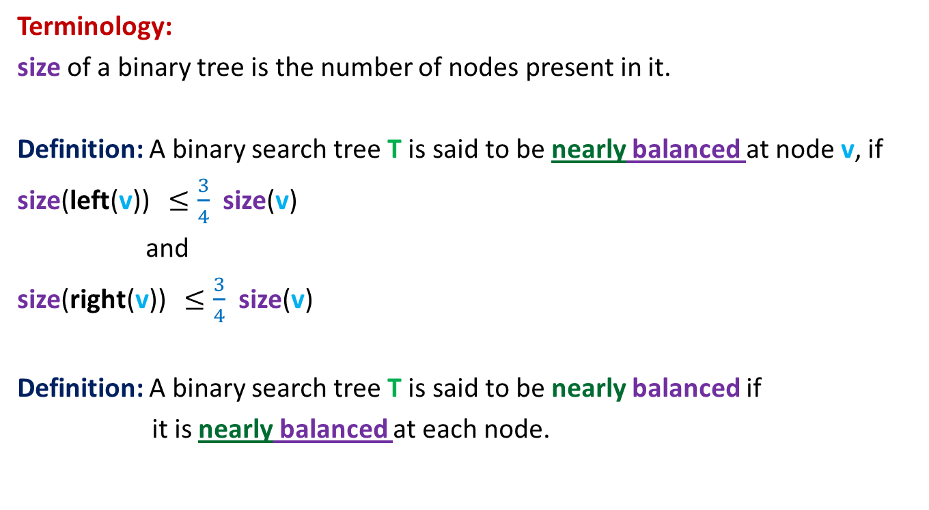
Nearly balanced Binary Search Tree
Terminology:
size of a binary tree is the number of nodes present in it.
Definition: A binary search tree T is said to be nearly balanced at node v, if
size(left(v)) $≤\frac{3}{4}$ size(v)
and
size(right(v)) $≤\frac{3}{4}$ size(v)
Definition: A binary search tree T is said to be nearly balanced if
it is nearly balanced at each node.

Slide 7

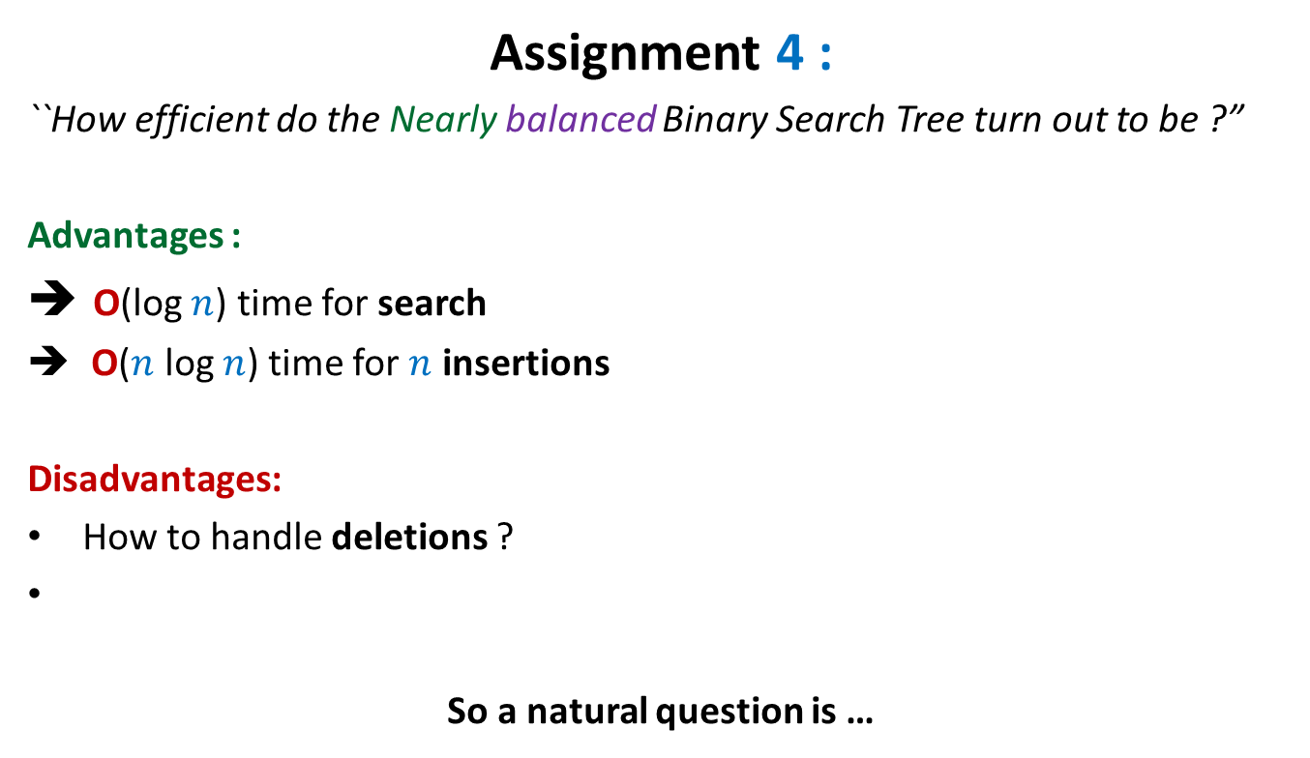
Nearly balanced Binary Search Tree
Assignment 4 :
``How efficient do the Nearly balanced Binary Search Tree turn out to be ?”
Advantages :
O(log $n$) time for search
O($n$ log $n$) time for $n$ insertions
Disadvantages:
How to handle deletions ?
So a natural question is …
Some insertions may take O($n$) time ☹

Slide 8

Can we achieve O(log $n$) time for search/insert/delete ?
AVL Trees [1962]
Red Black Trees [1978]

Slide 9
Terminologies

Slide 10
Full binary tree
A binary tree where
every internal node has exactly two children.
This node has exactly one child. So the current tree is not a full binary tree.

Slide 11
Complete binary tree
A full binary tree where
every leaf node is at the same level.

Slide 12
Binary Search Tree
Family of a node
root
Grandparent
46
parent
28
67
Uncle
sibling
5
35
v
49
Cousin
2
25
31
41
48
53
Left child
Right child

Slide 13
Binary Search Tree
A slight change
root
This transformation is merely to help us in the analysis of red-black trees. It does not cause any extra overhead of space. All NULL nodes correspond to a single node in memory.
Henceforth, for each NULL child link of a node in a BST, we create a NULL node.
➔ 1. Each leaf node in a BST will be a NULL node.
2. the BST will always be a full binary tree.
46
28
67
5
35
49
2
25
31
41
48
53

Slide 14
Red Black Tree A height balanced BST

Slide 15
Rotation around a node
An important tool for balancing trees
Each height balanced BST employs this tool which is derived from the flexibility which is hidden in the structure of a BST.
This flexibility (pointer manipulation) was inherited from linked list ☺.

Slide 16
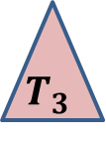





Rotation around a node
Homework:
Write a neat code for right rotation and left rotation.
x
x
p
Right rotation
Left rotation
v
u
u
v
$$T_{3}$$
$$T_{1}$$
$$T_{2}$$
$$T_{3}$$
$$T_{1}$$
$$T_{2}$$
Note that the tree T continues to remain a BST even after rotation around any node.

Slide 17
Red Black Tree
Red-Black tree is a binary search tree
satisfying the following properties:
Each node is colored red or black.
Each leaf is colored black
Every red node will have
No. of black nodes on a path from root to each leaf node is same.
and so is the root.
both its children black.
black height

Slide 18
A binary search tree
head
46
28
67
5
35
49
2
25
31
41
Can you color the nodes to make it a red-black tree ?

Slide 19
A binary search tree
head
46
28
67
5
35
49
2
25
31
41
A Red Black Tree

Slide 20




Why is a red black tree height balanced ?
$T$ : a red black tree
$h$: black height of $T$.
Question: What can be the height of $T$ ?
Answer: $≤2h−1$
Homework: Make use of this hint to prove that $T$ has $≥2^{h}−1$elements.
What is this “green structure” ?
$$T$$
$$h$$
?
$$2h−1$$

Slide 21
Insertion in a Red Black tree
All it involves is
playing with colors ☺
and rotations ☺

Slide 22
Insertion in a Red Black tree

Slide 23
Insertion in a red-black tree
Let us insert 83 into T.
T
46
28
67
5
35
49
83
2
25
31
41
What color should we assign to the new node ?
We shall assign every newly inserted node a red color. (give reason)

Slide 24
Insertion in a red-black tree
Let us insert 54 into T.
T
46
28
67
5
35
49
83
2
25
31
41
54
We have again a red black tree.
In order to remove the color imbalance try flipping the colors of parent (and uncle) of the new node with the grandparent
Color imbalance

Slide 25
Insertion in a red-black tree
T
46
28
67
5
35
49
83
2
25
31
41
54

Slide 26
Insertion in a red-black tree
Let us insert 44 into T.
T
46
28
67
5
35
49
83
2
25
31
41
54
44
In order to remove the color imbalance try flipping the colors of parent (and uncle) of the new node with the grandparent
Color imbalance

Slide 27
Insertion in a red-black tree
T
46
28
67
5
35
49
83
2
25
31
41
54
44
Do the same trick again.
Color imbalance

Slide 28
Insertion in a red-black tree
We can color it black.
T
Color imbalance is removed. But the root is red now.
46
28
67
5
35
49
83
2
25
31
41
54
44

Slide 29
Insertion in a red-black tree
T
46
28
67
5
35
49
83
2
25
31
41
54
44

Slide 30
Insertion in a red-black tree summary till now …
Let p be the newly inserted node. Assign red color to p.
Case 1: parent(p) is black
nothing needs to be done.
Case 2: parent(p) is red and uncle(p) is red,
Swap colors of parent (and uncle) with grandparent(p).
This balances the color at p but may lead to imbalance of color at
grandparent of p. So p← grandparent(p), and proceed upwards similarly.
If in this manner p becomes root, then we color it black.
Case 3: parent(p) is red and uncle(p) is black.
This is a nontrivial case. So we need some more tools ….

Slide 31
Handling case 3

Slide 32
Description of Case 3
p is a red colored node.
parent(p) is also red.
uncle(p) is black.
Without loss of generality assume: parent(p) is left child of grandparent(p).
(The case when parent(p) is right child of grandparent(p) is handled similarly.)

Slide 33
Handling the case 3 two cases arise depending upon whether p is left/right child of its parent
x
x
g
g
d
k
p
d
k
p
f
b
Can you transform Case 3.2 to
Case 3.1 ?
Case 3.1:
p is left child of its parent
Case 3.2:
p is right child of its parent

Slide 34
Handling the case 3 two cases arise depending upon whether p is left/right child of its parent
x
x
g
g
left rotation
f
k
d
k
d
3
1
f
1
2
2
3
Case 3.2:
p is right child of its parent
Vow!
This is exactly Case 3.1

Slide 35
We need to handle only case 3.1

Slide 36
Handling the case 3.1
x
g
p
d
k
Can we say anything about color of node f ?
3
black
b
f
?
1
2

Slide 37
Handling the case 3.1
x
g
p
d
k
3
b
f
1
2

Slide 38
Handling the case 3.1
x
x
Right rotation
g
p
d
p
d
k
b
g
3
1
b
f
f
k
1
2
2
3
Now every node in tree 1 has one less black node on the path to root ! We must restore it. Moreover, the color imbalance exists even now. What to do ?
Change color of node d to black

Slide 39
Handling the case 3.1
x
x
g
p
d
p
d
k
b
g
3
1
b
f
f
k
1
2
2
3
Color node g red
The number of black nodes on the path to root are restored for tree 1. Color imbalance is also removed.
But the number of black nodes on the path to root has increased by one for trees 2 and 3. What to do now ?

Slide 40
Handling the case 3.1
x
x
g
p
d
p
d
k
b
g
3
1
b
f
f
k
1
2
2
3
The black height is restored for all trees.
This completes Case 3.1

Slide 41
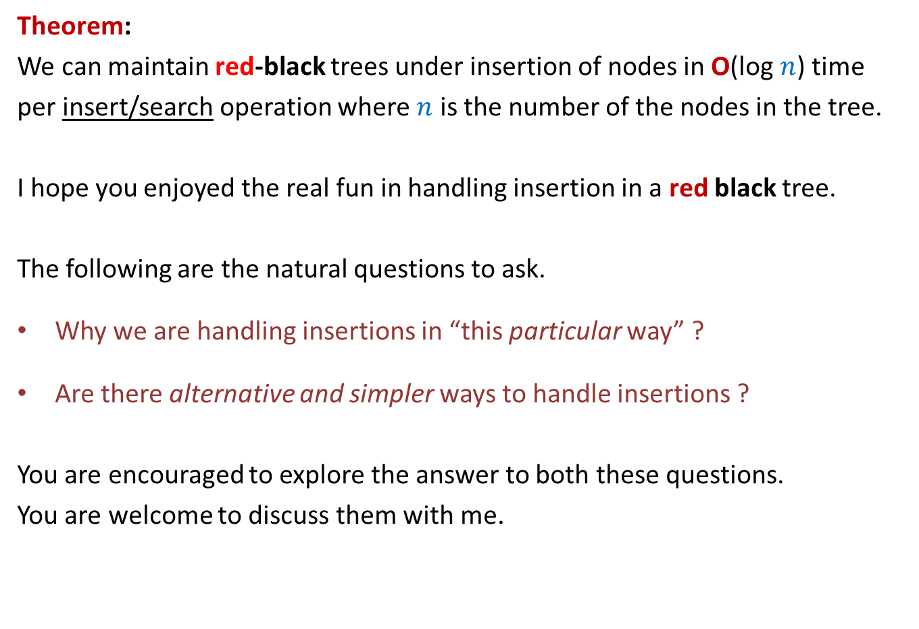
Theorem:
We can maintain red-black trees under insertion of nodes in O(log $n$) time
per insert/search operation where $n$ is the number of the nodes in the tree.
I hope you enjoyed the real fun in handling insertion in a red black tree.
The following are the natural questions to ask.
Why we are handling insertions in “this particular way” ?
Are there alternative and simpler ways to handle insertions ?
You are encouraged to explore the answer to both these questions.
You are welcome to discuss them with me.

Slide 42
Homework
Please solve the 2 problem on the following slide.

Slide 43
How to insert 4 ?
Do it as Homework
11
2
14
1
7
15
5
8

Slide 44
An alternate way to handle case 3.1
In the following slide, we demonstrate an alternate algorithm to handle case 3.1. Please spot error, if any, in this algorithm.

Slide 45
Handling the case 3.1
x
x
Right rotation
g
p
d
p
d
k
b
g
3
1
b
f
f
k
1
2
2
3
Now every node in tree 1 has one less black node on the path to root ! We must restore it. Moreover, the color imbalance exists even now. What to do ?
Change color of node b to black

Slide 46
Handling the case 3.1
x
x
g
p
d
p
d
k
b
g
3
1
b
f
f
k
1
2
2
3

Slide 47
How do will we handle deletion ?
This is going to be a bit more complex.
So please try on your own first before coming to the next class.
It will still involve playing with colors and rotations ☺
Do not miss the next class ☺

