Slide 1
Data Structures and Algorithms (ESO207A)
Lecture 21
Height balanced BST
Red-black trees - III

Slide 2
Red Black Tree
Red Black tree:
a full binary search tree
and satisfying the following properties.
Each node is colored red or black.
Each leaf is colored black and so is the root.
Every red node will have both its children black.
No. of black nodes on a path from root to each leaf node is same.
with each leaf as a null node
black height

Slide 3
The tools we played with
Rotations
Color swap
Transforming one case to another case
Family members (father, uncle, grandparent) always help !

Slide 4
Handling Deletion in a Red Black Tree

Slide 5
An insight
We need to handle only the following case:
p
q

Slide 6
An insight
We need to handle only the following case:
q

Slide 7
Three cases
p
p
p
q
q
q
Nothing needs to be done
Color q Black
Case 1
Case 2
Case 3

Slide 8
Handling Case 3
p
s
q

Slide 9


Handling Case 3
Remember: we discussed the case when the deleted node is left child of its parent.
The other case (deleted node is the right child of its parent) is exactly symmetric and has to be handled along similar lines.
q
s
$$−$$
q
s
$$−$$

Slide 10
Handling Case 3
q
s
$$−$$

Slide 11
Handling the difficult case
The overview
Color of s ?
s is red
reduction
s is black
Both children of s are black
At least one child of s is red
right(s) is red
reduction
left(s) is red and right(s) is black

Slide 12
Handling the case “left(s) is red and right(s) is black”

Slide 13

Handling the case: left(s) is red and right(s) is black
r
q
s
$$−$$

Slide 14
Handling the case: left(s) is red and right(s) is black
r
q
s
$$−$$
3
1
2

Slide 15

Handling the case: left(s) is red and right(s) is black
r
r
q
q
s
Right rotation
swap colors
s
$$−$$
1
$$−$$
3
2
3
1
2
The number of black nodes on the path from root to any leaf node in tree 1 has now reduced by one although it is the same for trees 2 and 3. What should we do ?

Slide 16
Handling the case: left(s) is red and right(s) is black
r
r
q
s
q
s
Right rotation
s
$$−$$
1
$$−$$
3
2
3
1
2
Notice that now the new sibling of q has its right child red. So we have effectively reduced the current case to the case which we know how to handle.

Slide 17
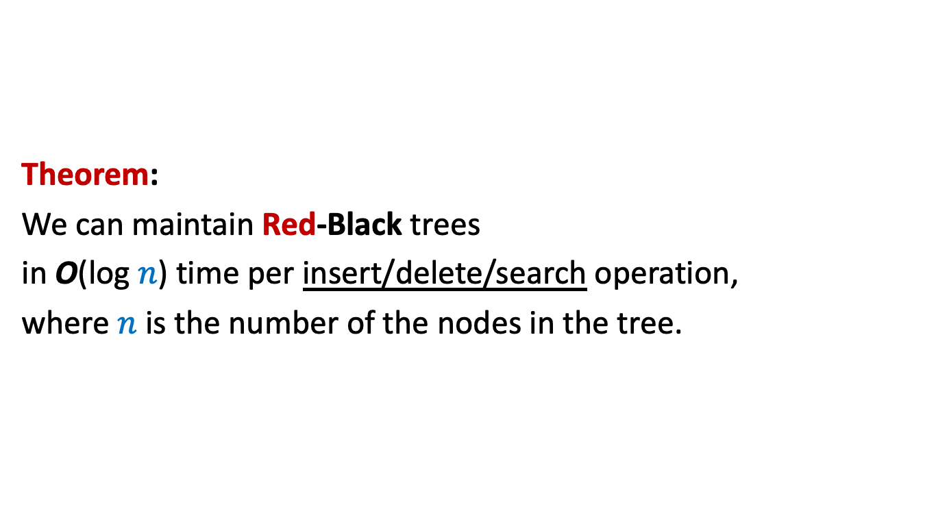
The conclusion
Theorem:
We can maintain Red-Black trees
in O(log $n$) time per insert/delete/search operation,
where $n$ is the number of the nodes in the tree.

Slide 18
A practice problem
On deletion in
Red-Black trees

Slide 19
How to delete 9 ?
root
All the steps of the solution
is on the following slides.
But watch it only after trying your best.
3
15
9
26
5
11
19
37
17
20

Slide 20
How to delete 9 ?
root
Swap `9’ with its predecessor `5’.
3
15
9
26
5
11
19
37
17
20

Slide 21
How to delete 9 ?
root
3
15
5
26
p
s
q
9
11
19
37
17
20

Slide 22
How to delete 9 ?
root
Case: s is black and so are its children
3
15
q
5
26
s
9
11
19
37
17
20

Slide 23
How to delete 9 ?
root
Case: s is black and only its left child is red
3
15
Right rotation
q
5
26
s
9
11
19
37
17
20

Slide 24
How to delete 9 ?
root
3
15
q
s
swap colors
5
19
9
11
17
26
20
37

Slide 25
How to delete 9 ?
root
Case: s is black and its right child is red
3
r
Left rotation
15
q
s
5
19
9
11
17
26
20
37

Slide 26
How to delete 9 ?
root
3
swap colors
19
s
15
26
q
5
17
20
37
9
11

Slide 27
How to delete 9 ?
root
Color s black.
3
19
s
15
26
q
5
17
20
37
9
11

Slide 28
How to delete 9 ?
root
We are done.
3
19
s
15
26
q
5
17
20
37
9
11

Slide 29
A Red Black Tree is height balanced
A detailed proof from scratch

Slide 30
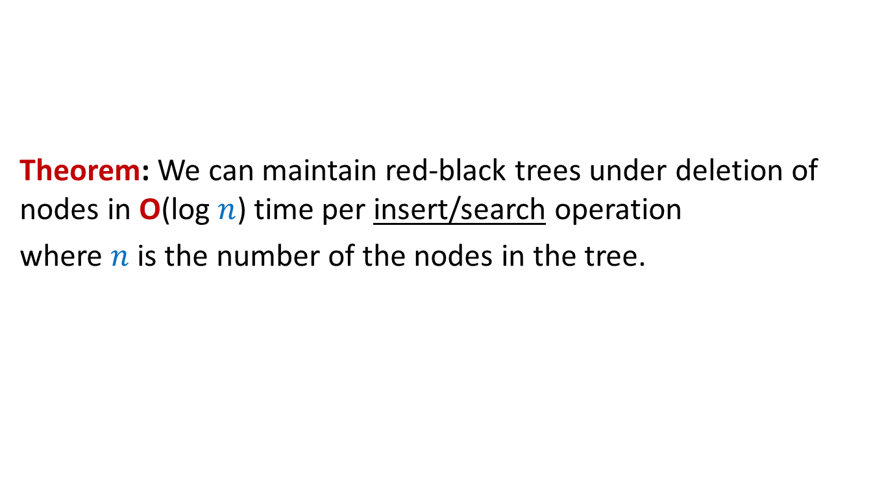



Why is a red black tree height balanced ?
$T$ : a red black tree
$h$: black height of $T$.
Question: What can be height of $T$ ?
Answer: $≤2h−1$
$$T$$
$$h$$
?
$$2h−1$$

Slide 31
Terminologies
Full binary tree:
A binary tree where every internal node has exactly two children.
This node has exactly one child. So the current tree is not a full binary tree.
This is now a full binary tree.

Slide 32
Red-black tree: as a Full Binary Tree
root
46
28
67
5
35
49
2
25
31
41
48
Ignore the values

Slide 33
Red-black tree: as a Full Binary Tree
root
Ignore the distinction between internal nodes and leaf nodes

Slide 34
Red-black tree: as a Full Binary Tree
root

Slide 35
Properties of a Red-Black Tree viewed as a full binary tree
Relationship between
Number of leaf nodes and
Number of internal nodes

Slide 36
A full binary tree
This node must have a left child since the tree is a full binary tree
Any deepest node
This node must be a leaf node. Give reason.
Otherwise this node won’t be the deepest node.

Slide 37
A full binary tree
What happened to the number of internal nodes ?
What happened to the number of leaf nodes ?
Is it still a full binary tree ?
Yes.
Reduced by one
Reduced by one

Slide 38

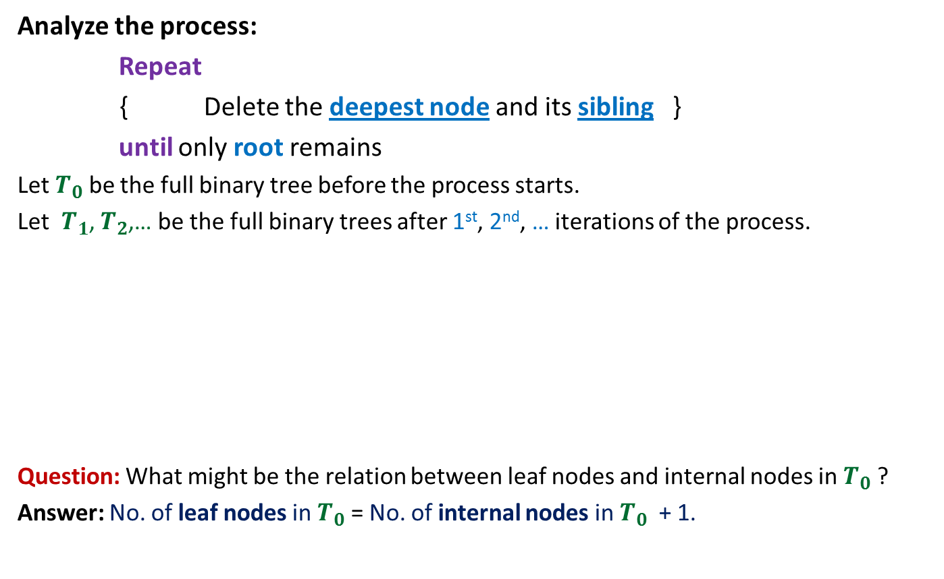
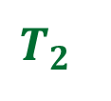

A full binary tree
Analyze the process:
Repeat
{ Delete the deepest node and its sibling }
until only root remains
Let $T_{0}$ be the full binary tree before the process starts.
Let $T_{1}$, $T_{2}$,… be the full binary trees after 1st, 2nd, … iterations of the process.
Question: What might be the relation between leaf nodes and internal nodes in $T_{0}$ ?
Answer: No. of leaf nodes in $T_{0}$ = No. of internal nodes in $T_{0}$ + 1.
Finally only
root node remains
$$T_{0}$$
# leaf nodes reduce by 1
$$T_{1}$$
# leaf nodes reduce by 1
$$T_{2}$$
# internal nodes reduce by 1
# internal nodes reduce by 1

Slide 39

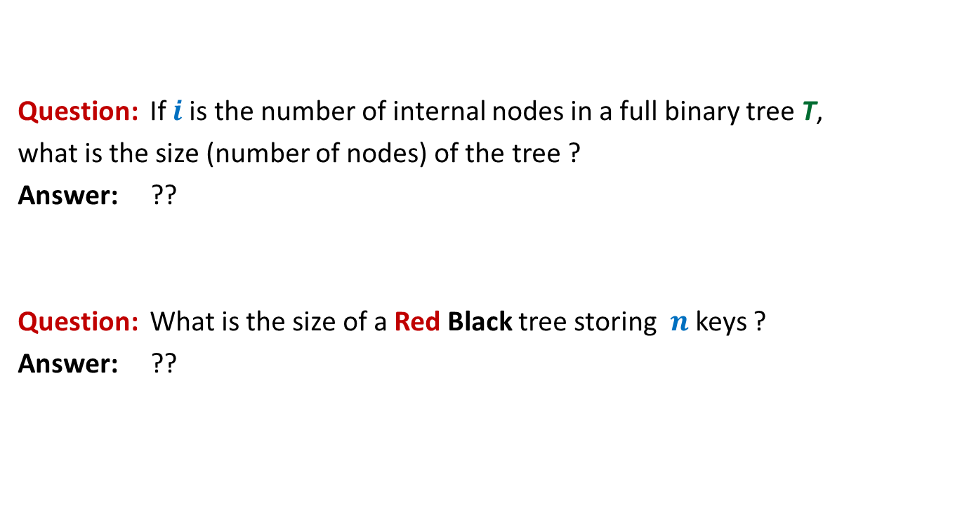

A full binary tree
Question: If $i$is the number of internal nodes in a full binary tree T,
what is the size (number of nodes) of the tree ?
Answer: ??
Question: What is the size of a Red Black tree storing $n$ keys ?
Answer: ??
$$2i + 1$$
$$2n + 1$$

Slide 40

A complete binary tree of height $h$ and its Properties

Slide 41
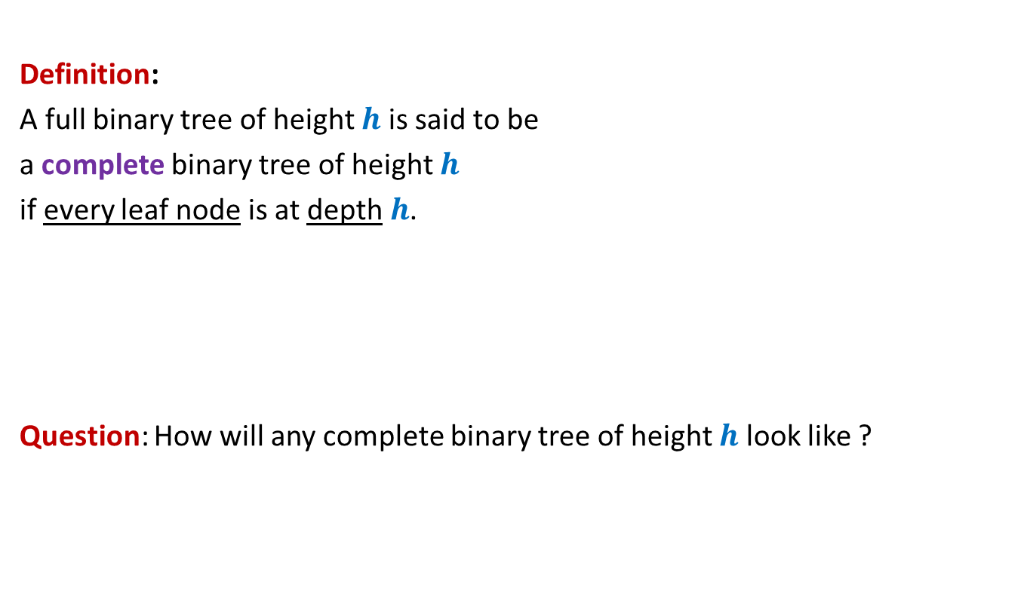


A complete binary tree of height $h$
Definition:
A full binary tree of height $h$ is said to be
a complete binary tree of height $h$
if every leaf node is at depth $h$.
Question: How will any complete binary tree of height $h$ look like ?
There is no reason to believe at this stage that there is a unique complete binary tree of height $h$.

Slide 42
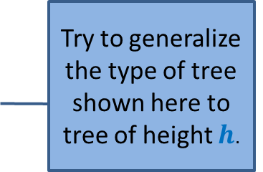
A complete binary tree of height $h$
Complete binary tree of height 1 ?
Complete binary tree of height 2 ?
Complete binary tree of height 3 ?
Try to generalize the type of tree shown here to tree of height $h$.

Slide 43





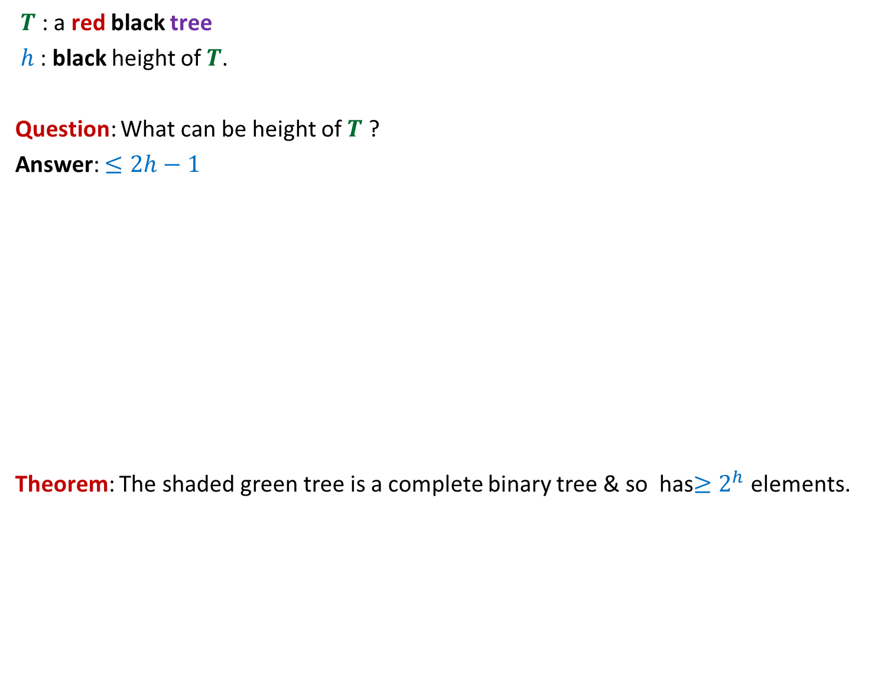

A complete binary tree of height $h$
No. of
nodes
Level
Total number of nodes =
1
$$1$$
$2^{h}$ - 1
2
$$2$$
i
$$2^{i−1}$$
$$h$$
$$2^{h−1}$$
Certainly this tree is a complete binary tree of height $h$ We shall now show that this is the only possible complete binary tree of height $h$.

Slide 44
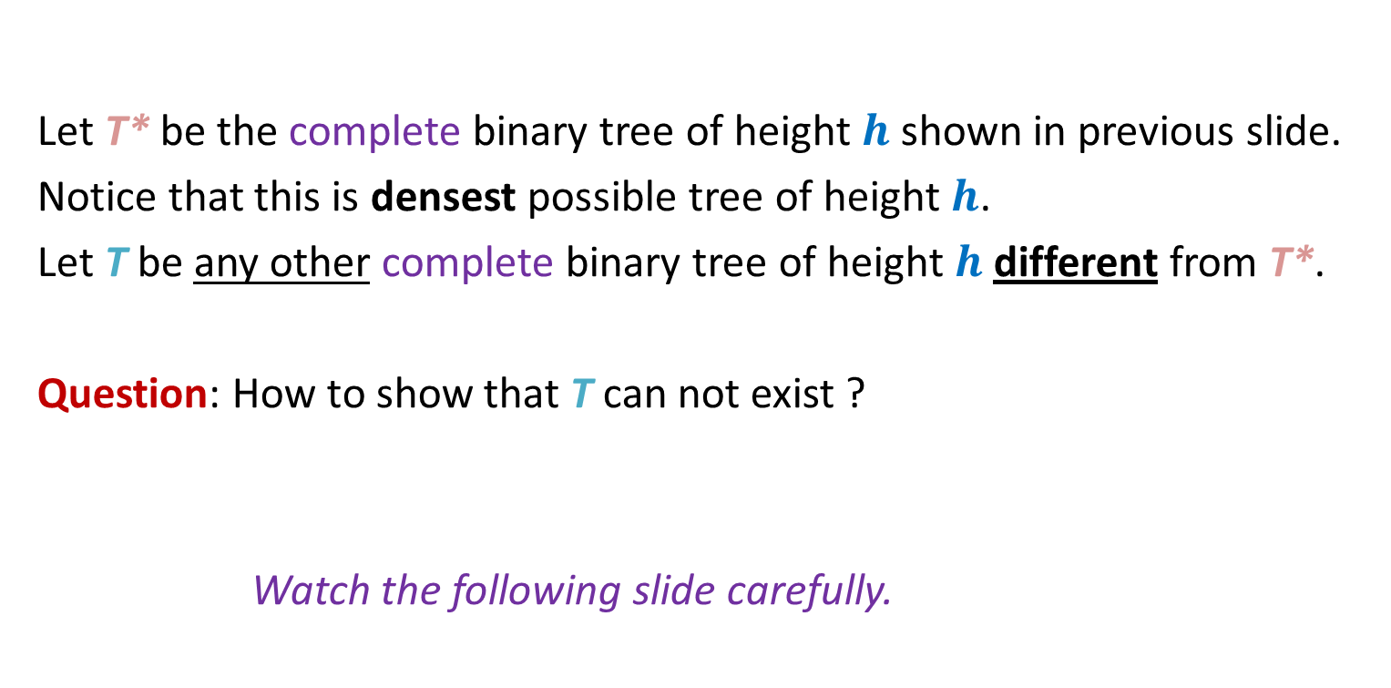

Uniqueness of a complete binary tree of height $h$
Let T* be the complete binary tree of height $h$ shown in previous slide.
Notice that this is densest possible tree of height $h$.
Let T be any other complete binary tree of height $h$ different from T*.
Question: How to show that T can not exist ?
Watch the following slide carefully.
Think over this question carefully.

Slide 45
Uniqueness of a complete binary tree of height $h$
x
At least one node present in T*
but absent in T
T*
T
Just place T symmetrically above T*.
If T is different from T*, then what will you see ?

Slide 46
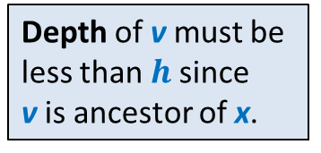


Uniqueness of a complete binary tree of height $h$
Since T is a full binary tree and right child of v is missing,
➔ v can not be an internal node in T .
➔ v must be leaf node.
1
Trace the path from x to root until we reach a node present in both T* and T.
Such a node v
must exist since both both T* and T meet at least at the root.
Note that one child (in this case the right child) of v is missing in T.
v
2
?
Depth of v must be
less than $h$since
v is ancestor of x.
i
x
Any node present in T* but absent in T
h
Hence v is a leaf node of T at depth < $h$
Hence
T is not a compete binary tree of height $h$

Slide 47
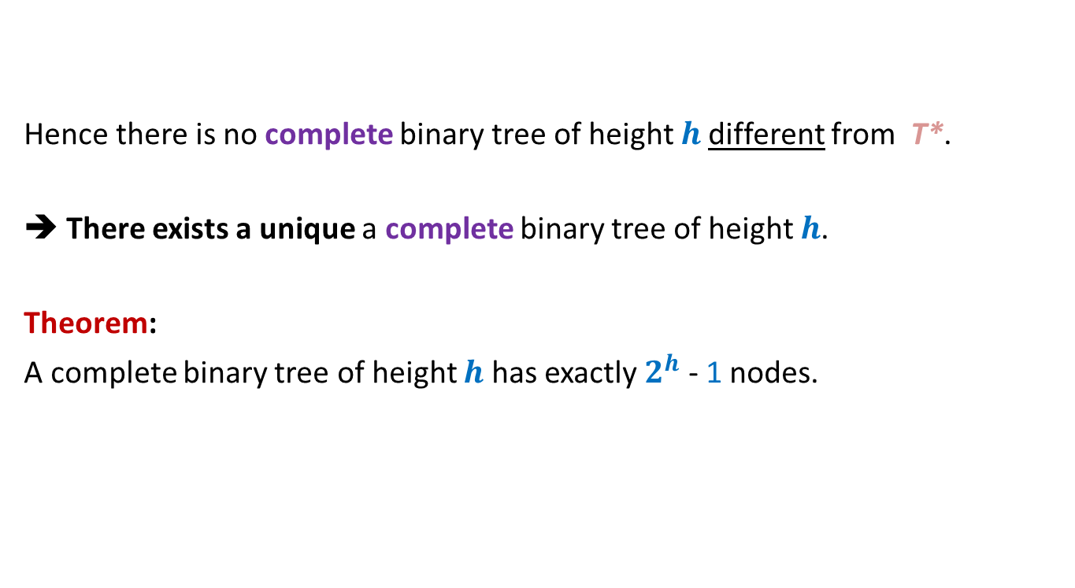
Hence there is no complete binary tree of height $h$different from T*.
➔ There exists a unique a complete binary tree of height $h$.
Theorem:
A complete binary tree of height $h$ has exactly $2^{h}$ - 1 nodes.

Slide 48
A Red Black Tree is height balanced
The final proof

Slide 49
$$T$$
$$h$$
?
$$2h−1$$

Slide 50

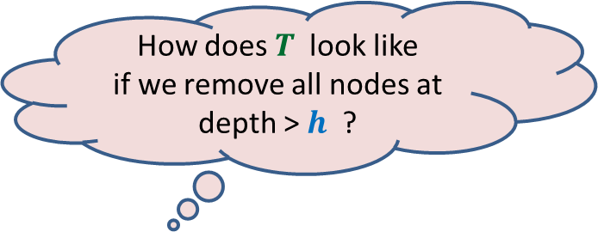

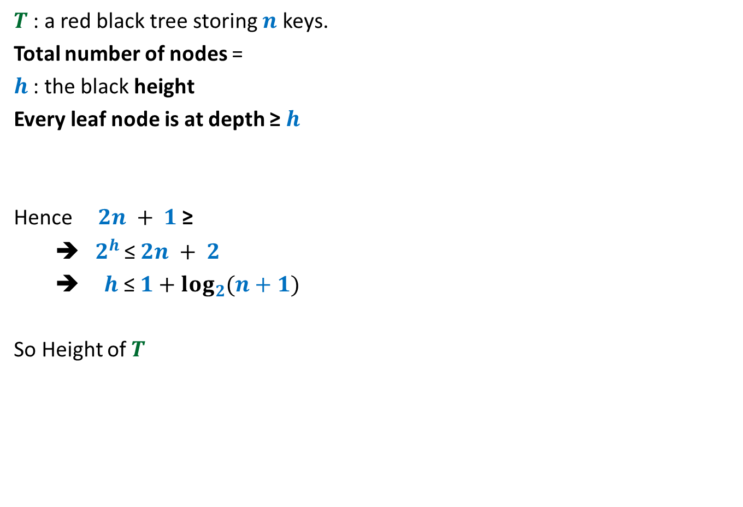



$T$ : a red black tree storing $n$ keys.
Total number of nodes =
$h$ : the black height
Every leaf node is at depth ≥ $h$
Hence $2n + 1$≥
➔${ 2}^{h}$ ≤ $2n + 2$
➔ $h$≤ $1+\log_{2}{(n+1)}$
So Height of $T$
$$2n + 1$$
How does $T$ look like
if we remove all nodes at depth > $h$ ?
$2^{h}$ $− 1$
a complete binary tree of height $h$
≤ 2$h$ - 1
≤ 2 $\log_{2}{(n+1)}$ + 1

Slide 51
Best wishes for you mid semester exam ☺

