Slide 1
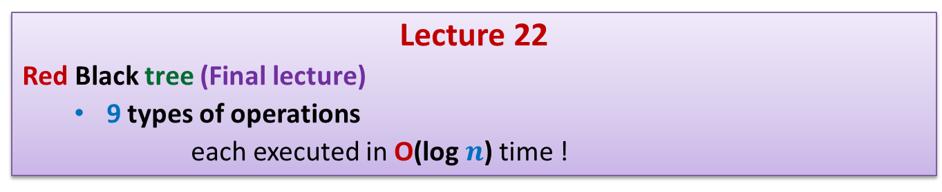
Data Structures and Algorithms (ESO207A)
Lecture 22
Red Black tree (Final lecture)
9 types of operations
each executed in O(log $n$) time !

Slide 2


Red Black tree (Height Balanced BST)
Operations you already know
Search(T,$x$)
Insert(T,$x$)
Delete(T,$x$)
Min(T)
Max(T)
Every operation in O(log $n$) time.

Slide 3
Binary Search Tree
How well have you understood ?

Slide 4
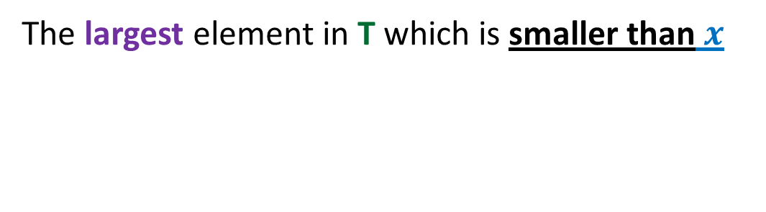

Predecessor(T,$x$)
The largest element in T which is smaller than $x$

Slide 5

Predecessor(T,$x$)
Predecessor of 25 ?
Predecessor of 28 ?
T
Predecessor of 44 ?
43
28
67
5
35
49
83
2
25
31
41
44
54
Can you figure out the algorithm for Predecessor(T,x) ?

Slide 6
Predecessor(T,$x$)
Can you figure out the algorithm for Predecessor(T,x) ?
T
43
28
67
5
35
49
83
2
25
31
41
44
54

Slide 7





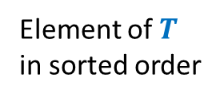


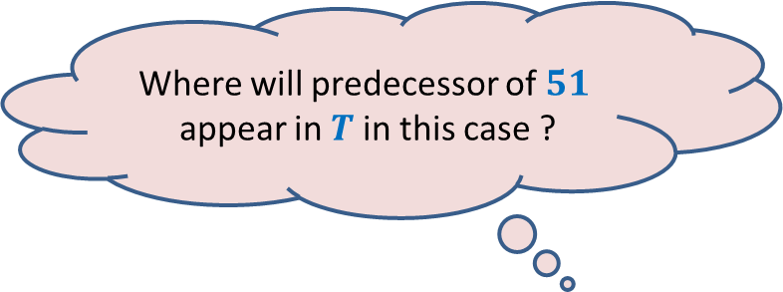
Where will predecessor of $51$
appear in $T$ in this case ?
How do the elements of $T(51)$
appear in A ?
Within $T(51)$
$$51$$
$$T$$
$$T(51)$$
Contiguously
A
$$41$$
Element of $T$
in sorted order
$$51$$

Slide 8

$$51$$
$$41$$
$$T$$
$$T(51)$$
A
$$41$$
$$51$$
Sorted

Slide 9



Where will predecessor of $51$
appear in $T$ in this case ?
Outside $T(51)$
$$51$$
$$T$$
$$T(51)$$
A
$$41$$
$$51$$
Sorted

Slide 10
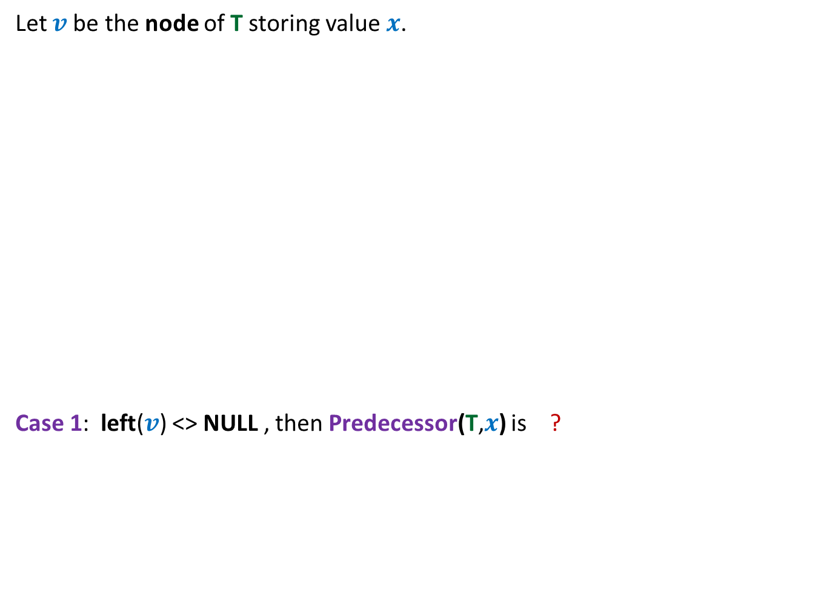



Predecessor(T,$x$)
Let $v$be the node of T storing value $x$.
Case 1: left($v$) <> NULL , then Predecessor(T,$x$) is ?
$$v$$
non-NULL
Max(left($v$))

Slide 11

Predecessor(T,$x$)
Let $v$be the node of T storing value $x$.
Case 2: left($v$) == NULL , then Predecessor(T,$x$) is ?
$$v$$

Slide 12
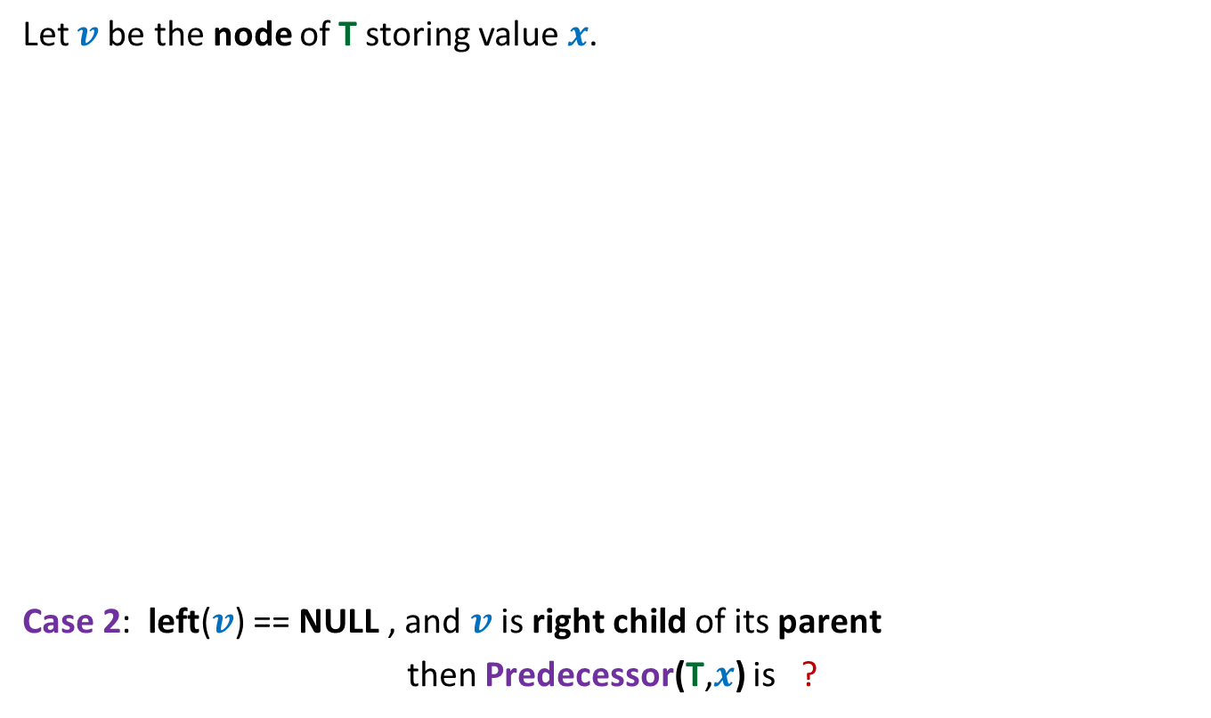

Predecessor(T,$x$)
Let $v$be the node of T storing value $x$.
Case 2: left($v$) == NULL , and $v$ is right child of its parent
then Predecessor(T,$x$) is ?
$$v$$
parent($v$)

Slide 13


Predecessor(T,$x$)
$$q$$
Let $v$be the node of T storing value $x$.
Case 3: left($v$) == NULL , and $v$ is left child of its parent
then Predecessor(T,$x$) is ?
$$v$$

Slide 14
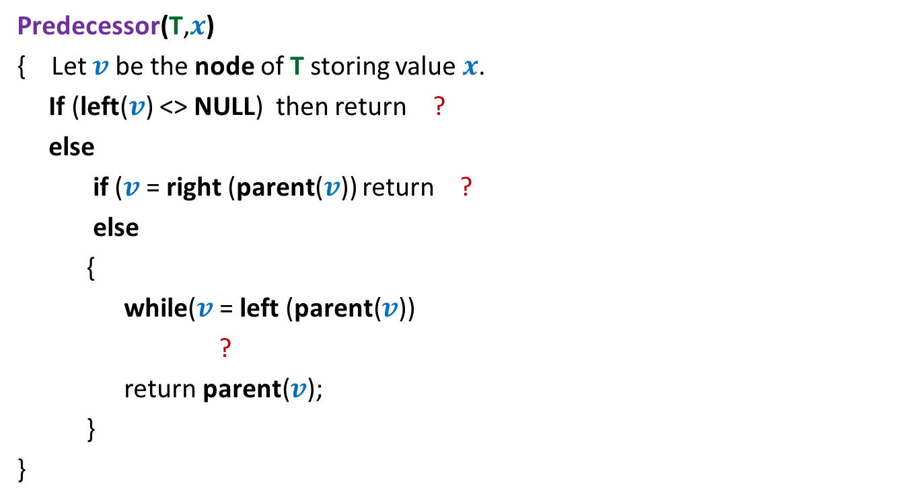



Predecessor(T,$x$)
Do you notice some redundancy in this pseudocode ?
Predecessor(T,$x$)
{ Let $v$be the node of T storing value $x$.
If (left($v$) <> NULL) then return ?
else
if ($v$= right (parent($v$)) return ?
else
{
while($v$= left (parent($v$))
?
return parent($v$);
}
}
Max(left($v$))
parent($v$)
$v$← parent($v$);

Slide 15


Predecessor(T,$x$)
Predecessor(T,$x$)
{ Let $v$be the node of T storing value $x$.
If (left($v$) <> NULL) then return ?
else
{ while($v$= left (parent($v$))
?
return parent($v$);
}
}
Max(left($v$))
$v$← parent($v$);

Slide 16

Homework
Refine the pseudocode given in the previous slide so that it seamlessly incorporates the following corner cases as well.
What if $x$ is the minimum element of $T$ ?
What if $x$ is not present in $T$ ?

Slide 17
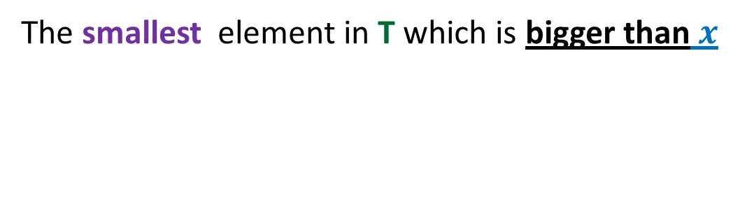

Successor(T,$x$)
The smallest element in T which is bigger than $x$
Homework

Slide 18
Red Black tree (Height Balanced BST)
Operations you already know
New operations
Search(T,x)
Insert(T,x)
Delete(T,x)
Min(T)
Max(T)
Predecessor(T,x)
Successor(T,x)
A NOTATION
T < T’ :
every element of T is smaller than every element of T’.
8. SpecialUnion(T, T’):
Given T and T’ such that T < T’,
compute T*=TUT’.
NOTE: T and T’ don’t exist after the union.
9. Split(T, x):
Split T into T’ and T’’ such that T’ < x < T’’.
Every operation in O(log n) time.

Slide 19
Red-Black Tree
How well have you understood ?

Slide 20
Insertion in a red-black tree
T
46
28
67
5
35
49
83
2
25
31
41
54
44
Color imbalance

Slide 21

A side-benefit
Let $T$ be a red black tree with color-imbalance at a node $v$.
We can remove color-imbalance in O(log $n$)time

Slide 22
SpecialUnion(T,T’)
Remember:
every element of T is smaller than every element of T’

Slide 23
A trivial algorithm that does not work
Time complexity: O(log n)
Height balance lost
<
T
T’

Slide 24
Towards an O(log n) time for SpecialUnion(T,T’) …
Can we solve some simple cases easily ?
Simplifying the problem
Solving the simpler version efficiently
Extending the solution to generic version

Slide 25
Simplifying the problem
Simplified problem:
Given two trees T, T’ of same black height
and a key x, such that T<x<T’,
transform them into a tree T*=TU{x}UT’
x
<
<
T
T’

Slide 26
Solving the simplified problem
Simplified problem:
Given two trees T, T’ of same black height
and a key x, such that T<x<T’,
transform them into a tree T*=TU{x}UT’
x
O (1) time
<
<
T
T’

Slide 27
Extending the algorithm to the generic problem
T
T’

Slide 28
Extending the algorithm to the generic problem
x
<
<
T
T’

Slide 29
Extending the algorithm to the generic problem
x
T
T’

Slide 30
Extending the algorithm to the generic problem
x
T
T’

Slide 31
Extending the algorithm to the generic problem
v
x
T
T’’

Slide 32
Extending the algorithm to the generic problem
v
x
T
T’’

Slide 33

Extending the algorithm to the generic problem
Algorithm for SpecialUnion(T,T’):
Let x be the node storing smallest element of T’.
Delete the node x from T’.
Let black height of T ≤ black height of T’
Keep following left pointer of T’ until we reach a node v such that
left(v) is black
The subtree T” rooted at Left(v) has black height same as that of T
left(x)← T;
right(x) ← T”;
Color(x)← red;
left(v)← x;
parent(x)← v;
If color(v) is red, remove the color imbalance
(like in the usual procedure of insertion in a red-black tree)
Total time : O(log $n$)

Slide 34
Split(T,x)

Slide 35

Achieving O(log n) time for Split(T,x)
Take a scissor
cut T into trees starting from x
Make use of SpecialUnion algorithm.
x
T

Slide 36
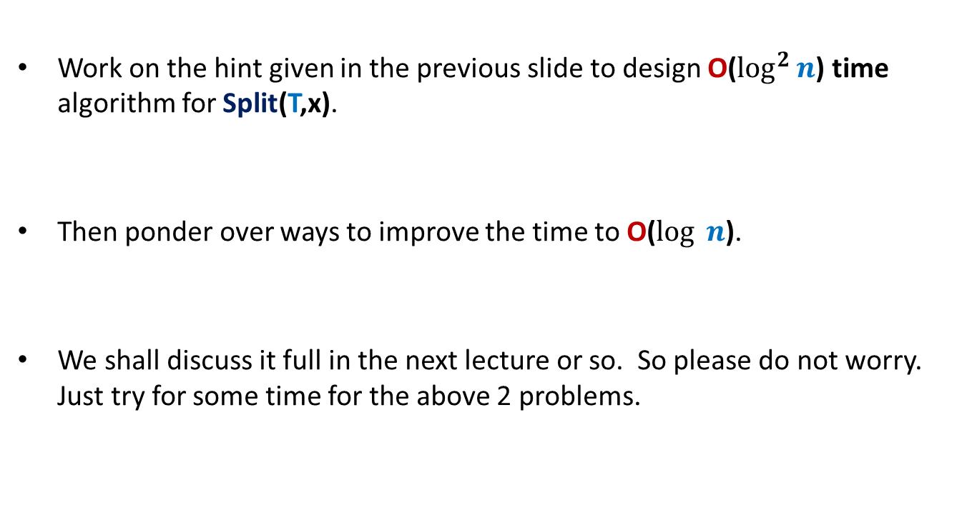
Homework
Work on the hint given in the previous slide to design O($\log^{2}⁡n$) time algorithm for Split(T,x).
Then ponder over ways to improve the time to O($log ⁡n$).
We shall discuss it full in the next lecture or so. So please do not worry. Just try for some time for the above 2 problems.

Slide 37
QuickSort

Slide 38



Partition($A$,$0$,$8$).
0 1 2 3 4 5 6 7 8
>x
$$A$$
< $x$
x

Slide 39
Partition($A$,$0$,$8$).
0 1 2 3 4 5 6 7 8
$$A$$
x

Slide 40
Partition($A$,$0$,$8$).
Write a neat pseudocode for Partition(A,i,j) that takes only O(1) extra space.
This was a homework given long ago. Do it now if you did not do it earlier.
This lies at the core of Quick Sort. We shall analyse its average time complexity in the next lecture ☺
0 1 2 3 4 5 6 7 8
$$A$$
x

Slide 41


Pseudocode for QuickSort($S$)
QuickSort($S$)
{ If (|$S$|>1)
Pick and remove an element $x$from $S$;
($S_{<x}$, $S_{>x}$)← Partition($S$,$x$);
return( Concatenate(QuickSort($S_{<x}$), $x$, QuickSort($S_{>x}$))
}

Slide 42
Analyzing average time complexity of QuickSort
Next Lecture

