Slide 1
Data Structures and Algorithms (ESO207A)
Lecture 24
Graph Traversal
Breadth First Search Traversal and its simple applications

Slide 2



Stack
A special kind of list where all operations (insertion, deletion, query)
take place at one end only, called the top.
Behavior of Stack:
Last in
top
$$a_{n}$$
$$a_{n−1}$$
$$a_{1}$$
(LIFO)
First out
Stack plays crucial role in solving many algorithmic problems.
You must remember the magical role they played in
the elegant algorithm for arithmetic expression evaluation.

Slide 3



Queue
A special kind of list based on
First in
(FIFO)
First Out
$$a_{1}$$
$$a_{2}$$
$$a_{n}$$
front
rear
We did not see any magical application of queue till now.
In today’s lecture, we shall discuss a problem which has
an elegant algorithm based on queue. Let us see
if you can figure it out at right time in this lecture ☺

Slide 4
What is Graph traversal ?

Slide 5
Graph traversal
Definition:
A vertex y is said to be reachable from x
Graph traversal from vertex x:
Starting from a given vertex x, the aim is
to visit all vertices which are reachable from x.
if there is a path from x to y.
x
z
y

Slide 6
Non-triviality of graph traversal
Avoiding loop:
How to avoid visiting a vertex multiple times ?
(keeping track of vertices already visited)
Finite number of steps :
The traversal must stop in finite number of steps.
Completeness :
We must visit all vertices reachable from the start vertex x.

Slide 7
Breadth First Search traversal
We shall introduce this traversal technique through an interesting problem.
computing distances from a vertex.

Slide 8




Notations and Observations
Observation:
If <$x$, …,$v\text{,} y$> is a path of length $k$ from $x$ to $y$,
then what is the length of the path <$x$, …,$v$> ?
Answer: $k−1$
Question: What can be the maximum length of any path in a graph ?
Answer: $n−1$
$$k$$
x
$$v$$
y
$$k−1$$

Slide 9

Notations and Observations
Question: What can be the maximum length of any path in a graph ?
Answer: $n−1$
$$k$$
x
$$v$$
y
$$k−1$$

Slide 10
Notations and Observations
Shortest Path from x to y:
Distance from x to y:
A path from x to y of least length
the length of the shortest path from x to y.
x
y

Slide 11
Shortest Paths in Undirected Graphs
Problem:
How to compute distance to all vertices reachable from x in a given undirected graph ?
x
b
w
f
u
h
v
d
g
r
y
s
c

Slide 12


Shortest Paths in Undirected Graphs
$V_{0}$ : Vertices at distance 0 from x: ??
$V_{1}$: Vertices at distance 1 from x: ??
$V_{2}$: Vertices at distance 2 from x: ??
x
b
{x}
w
f
u
{f,u,b}
h
v
d
{g,h,s,r,v,w}
g
r
y
Why ?
s
c
While reporting $V_{2}$, you have (sub)consciously used an important property of shortest paths.
Can you state this property ?

Slide 13

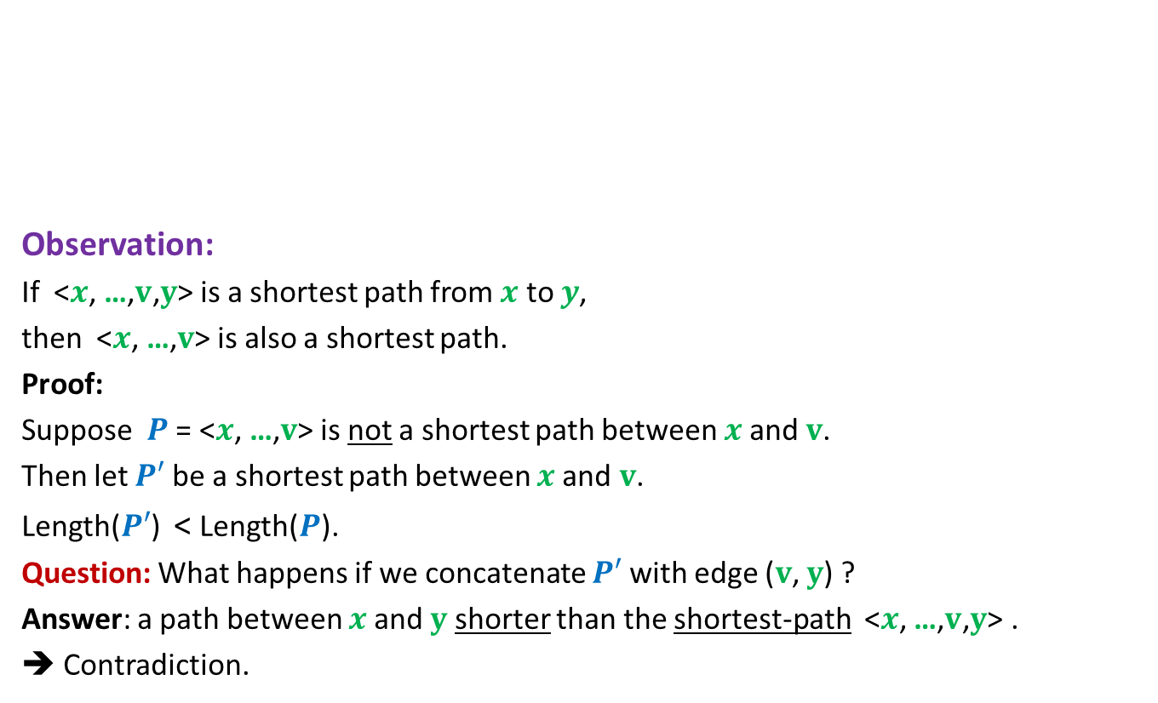


An important property of shortest paths
$$P′$$
Observation:
If <$x$, …,$v\text{,} y$> is a shortest path from $x$ to $y$,
then <$x$, …,$v$> is also a shortest path.
Proof:
Suppose $P$ = <$x$, …,$v$> is not a shortest path between $x$and $v$.
Then let $P′$ be a shortest path between $x$and $v$.
Length($P′$) < Length($P$).
Question: What happens if we concatenate $P′$ with edge ($v$, $y$) ?
Answer: a path between $x$and $y$ shorter than the shortest-path <$x$, …,$v\text{,} y$> .
➔ Contradiction.
A shortest path
between x and y
x
v
y
What can you say about $P$ ?
$$P$$

Slide 14








An important question
Question:
Let ($v$,$w$) be an edge. If Distance($x$,$v$) is $k$,
then what can be Distance($x$,$w$) ?
Answer: an element from the set {$k−1$, $k$, $k+1$} only.
$$w$$
$$w$$
$$w$$
A shortest path
between x and v
x
$$k$$
v
$$k−1$$
$$k$$
$$k+1$$
We crucially used the undirectedness of the graph in arriving at this answer. Can you spot it ?

Slide 15



Key Insight
$V_{0}$ : Vertices at distance 0 from x = {x}
$V_{1}$ : Vertices at distance 1 from x =
Neighbors of $V_{0}$
$V_{2}$ : Vertices at distance 2 from x =
Those Neighbors of $V_{1}$ which …
.
.
.
$V_{i+1}$ : Vertices at distance i+1 from x =
Those Neighbors of $V_{i}$ which …
do not belong to $V_{0}$ or $V_{1}$
do not belong to $V_{i}−1$ or $V_{i}$
This slide suggests an algorithm to compute distance to all vertices from x. Spend sometime to think of the algorithm.

Slide 16
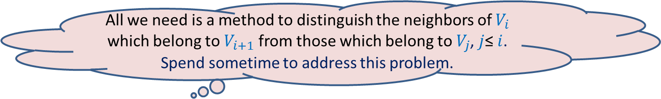

Key Insight
An incremental algorithm:
Given $V_{i}$, compute $V_{i+1}$
$V_{0}$ : Vertices at distance 0 from x = {x}
$V_{1}$ : Vertices at distance 1 from x =
Neighbors of $V_{0}$
$V_{2}$ : Vertices at distance 2 from x =
Those Neighbors of $V_{1}$ which …
.
.
.
$V_{i+1}$ : Vertices at distance i+1 from x =
Those Neighbors of $V_{i}$ which …
do not belong to $V_{0}$ or $V_{1}$
do not belong to $V_{i}−1$ or $V_{i}$
All we need is a method to distinguish the neighbors of $V_{i}$ which belong to $V_{i+1}$ from those which belong to $V_{j}$, $j$≤ $i$.
Spend sometime to address this problem.

Slide 17
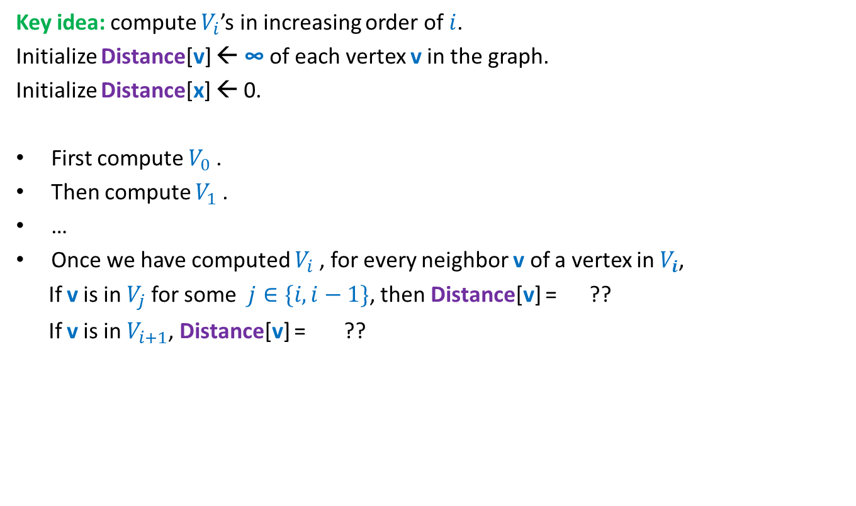

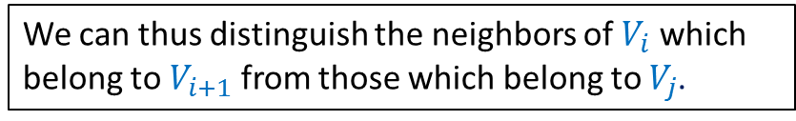

How can we compute $V_{i+1}$ ?
Key idea: compute $V_{i}$’s in increasing order of $i$.
Initialize Distance[v] ← ∞ of each vertex v in the graph.
Initialize Distance[x] ← 0.
First compute $V_{0}$.
Then compute $V_{1}$.
…
Once we have computed $V_{i}$, for every neighbor v of a vertex in $V_{i}$,
If v is in $V_{j}$for some $j∈\{i,i−1\}$, then Distance[v] = ??
If v is in $V_{i+1}$, Distance[v] = ??
a number ≤ $i$
∞
We can thus distinguish the neighbors of $V_{i}$ which belong to $V_{i+1}$ from those which belong to $V_{j}$.

Slide 18
A neat algorithm for computing distances from x
we need an algorithm which traverses/visits the vertices in
non-decreasing order of distances from x
This traversal algorithm is called BFS (breadth first search) traversal

Slide 19



Using a queue
Compute distance of vertices from x:
x
b
x
$$V_{0}$$
w
f
u
f
u
b
$$V_{1}$$
h
v
d
u
b
g
h
g
r
y
b g h s r v w
s
c
Remove x and for each neighbor of x that was unvisited, mark it visited and put it into queue.
g h s r v w
$$V_{2}$$
Remove f and for each neighbor of f that was unvisited, mark it visited and put it into queue.
Remove u and for each neighbor of u that was unvisited, mark it visited and put it into queue.
Remove b and for each neighbor of b that was unvisited, mark it visited and put it into queue.

Slide 20
BFS traversal from a vertex
BFS(G, x)
CreateEmptyQueue(Q);
Distance(x) ← 0;
Enqueue(x,Q);
While( ?? )
{ v ←Dequeue(Q);
For each neighbor w of v
{
if (Distance(w) = ∞)
{ Distance(w) ← ?? ;
?? ;
}
}
}
Not IsEmptyQueue(Q)
Distance(v) +1
Enqueue(w, Q);

Slide 21
Running time of BFS traversal
BFS(G, x)
CreateEmptyQueue(Q);
Distance(x) ← 0;
Enqueue(x,Q);
While( ?? )
{ v ←Dequeue(Q);
For each neighbor w of v
{
if (Distance(w) = ∞)
{ Distance(w) ← ?? ;
?? ;
}
}
}
Running time of BFS(x) = no. of edges in the connected component of x.
A vertex can enter queue
at most once.
Prove this claim first.
Not IsEmptyQueue(Q)
Distance(v) +1
O(deg(v))
Enqueue(w, Q);

Slide 22
Correctness of BFS traversal
Question: What do we mean by correctness of BFS traversal from vertex x ?
Answer:
All vertices reachable from x get visited.
Vertices get visited in the
At the end of the algorithm,
Distance(v) is the distance of vertex v from x.
non-decreasing order of their distances from x.
As Homework, ponder over ways to prove these assertions.
We shall discuss their proofs after the mid semester break. ☺

Slide 23
Simulating a queue
Using 1 or more stacks

Slide 24










Let us keep only one stack and keep pushing the elements into it.
You have to execute each operation on queue using
Operation(s) on 1 or more stacks only.
Enqueue($a_{1}$, Q)
Push($a_{n}$, $S_{1}$)
Push($a_{1}$, $S_{1}$)
Push($a_{2}$, $S_{1}$)
$$a_{n}$$
All operations of Queue
Enqueue($a_{2}$, Q)
$$a_{2}$$
$$a_{1}$$
Enqueue($a_{n}$, Q)
$$S_{1}$$
Dequeue(Q)
What to do now ? Notice that the element to be removed is lying at the bottom of stack.

Slide 25




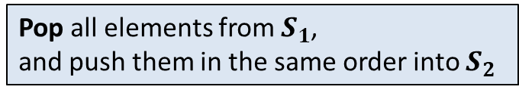




What to do now ?
Pop all elements from $S_{1}$,
and push them in the same order into $S_{2}$
Now Pop($S_{2}$)
Now Pop($S_{2}$)
Enqueue($a_{1}$, Q)
$$a_{1}$$
$$a_{2}$$
$$a_{n}$$
Enqueue($a_{2}$, Q)
$$a_{n−1}$$
$$a_{2}$$
$$a_{n}$$
$$a_{1}$$
Enqueue($a_{n}$, Q)
$$S_{2}$$
$$S_{1}$$
Dequeue(Q)
Dequeue(Q)
As Homework, ponder over ways to fill in the details
of this simulation. We shall discuss them after the
mid semester break. ☺
Enqueue($a_{n+1}$, Q)

