Slide 1
Data Structures and Algorithms (ESO207A)
Lecture 25
BFS tree
An important application of BFS traversal

Slide 2
RECAP of Last Lecture
Simulating a queue
using 1 or more stacks

Slide 3



Stack
Behavior of Stack:
Last in
top
$$a_{n}$$
$$a_{n−1}$$
$$a_{1}$$
(LIFO)
First out

Slide 4



Queue
A special kind of list based on
First in
(FIFO)
First Out
$$a_{1}$$
$$a_{2}$$
$$a_{n}$$
front
rear

Slide 5








Enqueue($a_{1}$, Q)
$$a_{n}$$
All operations of Queue
$$a_{n−1}$$
Enqueue($a_{2}$, Q)
$$a_{2}$$
$$a_{1}$$
Enqueue($a_{n}$, Q)
$$S_{1}$$
Dequeue(Q)

Slide 6







Enqueue($a_{1}$, Q)
$$a_{1}$$
$$a_{n}$$
$$a_{2}$$
$$a_{n−1}$$
Enqueue($a_{2}$, Q)
$$a_{n−1}$$
$$a_{2}$$
$$a_{n}$$
$$a_{1}$$
$$a_{n+1}$$
Enqueue($a_{n}$, Q)
$$S_{2}$$
$$S_{1}$$
Dequeue(Q)
Dequeue(Q)
Enqueue($a_{n+1}$, Q)

Slide 7
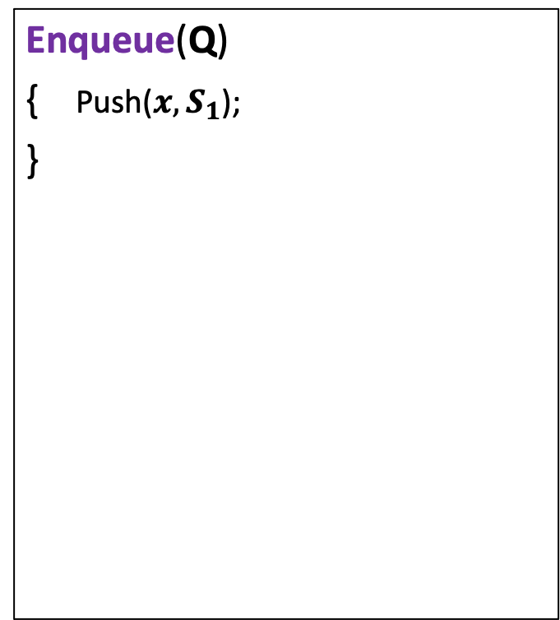
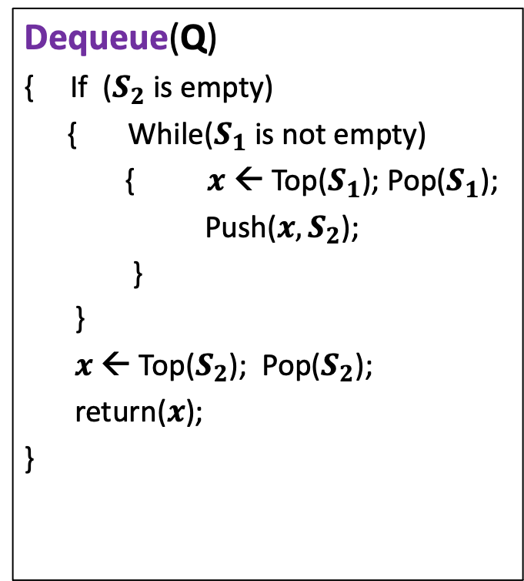
Simulating a queue
Dequeue(Q)
{ If ($S_{2}$ is empty)
{ While($S_{1}$ is not empty)
{ $x$ ← Top($S_{1}$); Pop($S_{1}$);
Push($x,S_{2}$);
}
}
$x$ ← Top($S_{2}$); Pop($S_{2}$);
return($x$);
}
Enqueue(Q)
{ Push($x,S_{1}$);
}

Slide 8
Breadth First Search traversal

Slide 9
BFS Traversal in Undirected Graphs
x
b
w
f
u
h
v
d
g
r
y
s
c

Slide 10

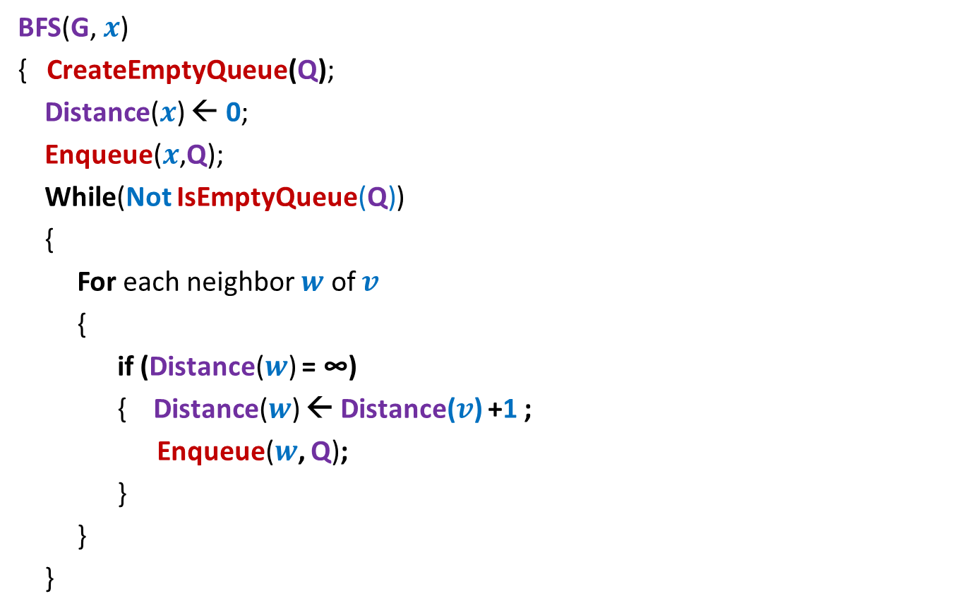





BFS traversal of G from a vertex $x$
Correctness of BFS traversal
BFS(G, $x$)
{ CreateEmptyQueue(Q);
Distance($x$) ← 0;
Enqueue($x$,Q);
While(Not IsEmptyQueue(Q))
{
For each neighbor $w$ of $v$
{
if (Distance($w$) = ∞)
{ Distance($w$) ← Distance($v$) +1 ;
Enqueue($w$, Q);
}
}
}
//Initially for each $v$, Distance($v$) ← ∞
, and Visited($v$) ← false.
Visited($x$) ← true;
$v$ ←Dequeue(Q);
Visited($w$) ← true;

Slide 11
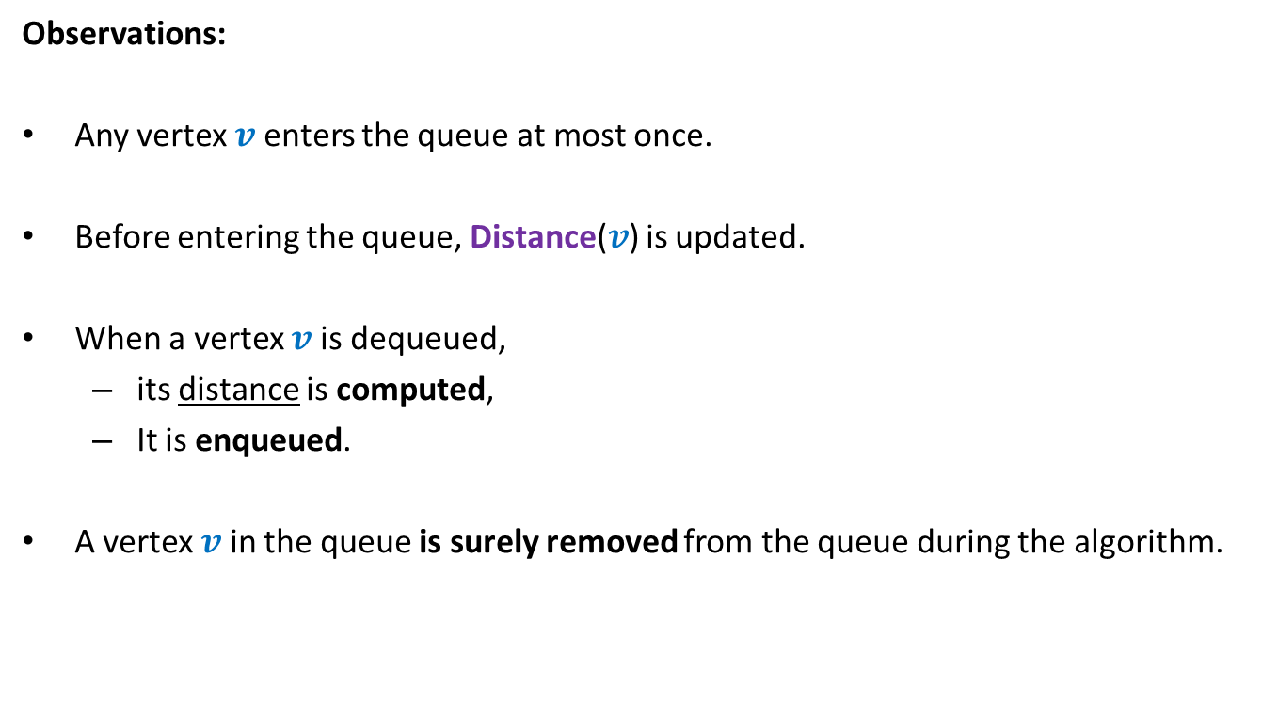


Observations about BFS($x$)
Observations:
Any vertex $v$ enters the queue at most once.
Before entering the queue, Distance($v$) is updated.
When a vertex $v$ is dequeued,
its distance is computed,
It is enqueued.
A vertex $v$ in the queue is surely removed from the queue during the algorithm.
$v$ processes all its unvisited neighbors as follows

Slide 12
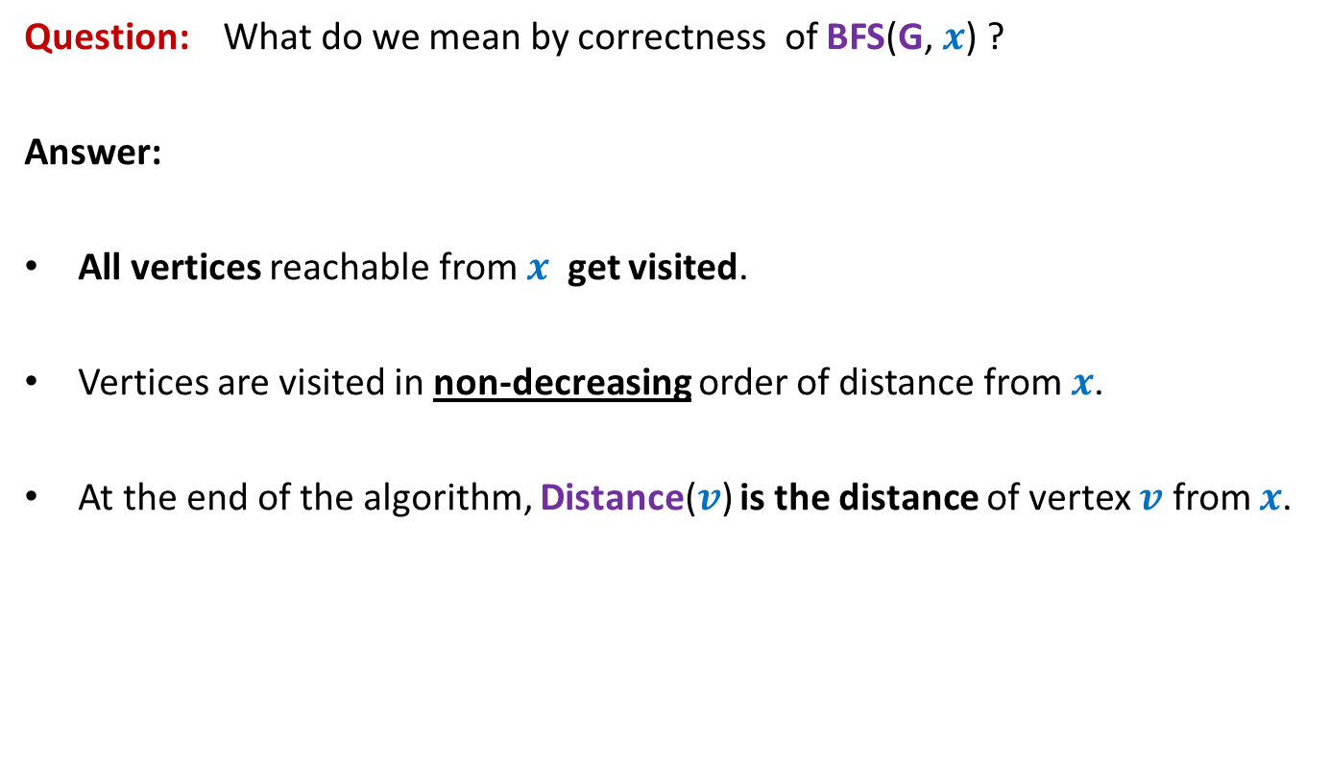
Correctness of BFS traversal
Question: What do we mean by correctness of BFS(G, $x$) ?
Answer:
All vertices reachable from $x$ get visited.
Vertices are visited in non-decreasing order of distance from $x$.
At the end of the algorithm, Distance($v$) is the distance of vertex $v$ from $x$.

Slide 13













The key idea
Partition the vertices according to their distance from $x$.
$$V_{0}$$
$$x$$
0
$$V_{1}$$
1
$$V_{2}$$
2
$w$can not have any neighbor from level $i−2$ or higher.
$$V_{i−1}$$
$$i−1$$
$$V_{i}$$
$$i$$
$$w$$
$$V_{i+1}$$
$$i+1$$

Slide 14
Homework
Based on the key ideas given shown in the previous slide, provide a formal and concise proof of correctness of the pseudocode of BFS traversal.
We shall discuss it during the optional (virtual) doubt clearing session scheduled at 4PM on 15th October. The zoom link will be emailed on or before 14th October.

Slide 15
BFS tree

Slide 16


BFS traversal gives a tree
Perform BFS traversal from $x$.
For each vertex, the neighbor that visits it for the first time is called its parent.
$$V_{0}$$
$$x$$
0
$$V_{1}$$
1
$$V_{2}$$
2
$$v$$
$$V_{i−1}$$
$$i−1$$
$$V_{i}$$
$$i$$
$$w$$
$$V_{i+1}$$
$$i+1$$

Slide 17
A nontrivial application of BFS traversal
Determining
if a graph is bipartite

Slide 18
Bipartite graph
Definition: A graph G=(V,E) is said to be bipartite
if its vertices can be partitioned into two sets A and B
such that every edge in E has one endpoint in A and another in B.
Is this graph bipartite ?
A
B
YES

Slide 19
Nontriviality in determining whether a graph is bipartite
Both are same graph but drawn in different ways. Can you see it ?
Is this graph bipartite ?
A
B
B
A
A
B
A
B
bipartite
bipartite

Slide 20
Bipartite graph
Question: Is a path bipartite ?
Answer: Yes
A B A B A B A

Slide 21
Bipartite graph
Question: Is a cycle bipartite ?
B
B
A
A
A
B
B
non-bipartite
bipartite

Slide 22
Bipartite graph
Question: Is a cycle bipartite ?
B
A
B
A
B
A
Odd length cycle
A
non-bipartite
B
A
B
A
B
A
B
A
B
A
B
Even length cycle
A
A
bipartite
B
A
B
A
B

Slide 23
Subgraph
A subgraph of a graph G=(V,E)
is a graph G’=(V’,E’) such that
V’ ⊆ V
E’ ⊆ E
Question: If G has a subgraph which is an odd cycle, is G bipartite ?
Answer: No.
∩ (V’ ⨯ V’)

Slide 24
Bipartite graph
Question: Is a tree bipartite ?
Answer: Yes
Even level vertices: A
Odd level vertices: B
0
1
2
3
4

Slide 25
An algorithm for determining if a given graph is bipartite
Assumption:
the graph is a single connected component

Slide 26

Compute a BFS tree at any vertex x.
If every nontree edge goes between two consecutive levels, what can we say ?
The graph is bipartite
$$V_{0}$$
$$x$$
0
A
B
A
B
A
B
$$V_{1}$$
1
$$V_{2}$$
2
The BFS tree is bipartite. Now place the non tree edges
$$V_{i−1}$$
$$i−1$$
$$V_{i}$$
$$i$$
$$w$$
$$V_{i+1}$$
$$i+1$$

Slide 27
Observation:
If every non-tree edge goes between two consecutive levels of BFS tree,
then the graph is bipartite.
Question:
What if there is an edge with both end points at same level ?

Slide 28


What if there is an edge
with both end points at same level ?
Keep following parent pointer from $u$and $w$ simultaneously until we reach a common ancestor. What do we get ?
Can you spot an odd length cycle here ?
$$V_{0}$$
$$x$$
0
A
B
A
B
A
B
$$V_{1}$$
1
$$V_{2}$$
2
$$V_{i−1}$$
$$i−1$$
$$V_{i}$$
$$i$$
$$u$$
$$w$$
$$V_{i+1}$$
$$i+1$$

Slide 29
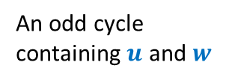
An odd cycle
containing $u$ and $w$
$$V_{0}$$
$$x$$
0
A
B
A
B
A
B
$$V_{1}$$
1
$$V_{2}$$
2
$$V_{i−1}$$
$$i−1$$
$$V_{i}$$
$$i$$
$$u$$
$$w$$
$$V_{i+1}$$
$$i+1$$

Slide 30
Observation:
If there is any non-tree edge with ?
then the graph has an odd length cycle.
Hence the graph is not bipartite.
both endpoints at the same level

Slide 31

Theorem:
There is an O($n+m$) time algorithm to determine
if a given undirected graph is bipartite.

