Slide 1
Data Structures and Algorithms (ESO207A)
Lecture 26
Average case time complexity of Algorithms
Average running time of Quick Sort

Slide 2
Overview of this lecture
Main Objective:
Analyzing average time complexity of QuickSort using recurrence.
Using mathematical induction.
Solving the recurrence exactly.
The outcome of this analysis will be quite surprising!
Extra benefits:
You will learn a standard way of using mathematical induction to bound time complexity of an algorithm. You must try to internalize it.

Slide 3


Sorting Algorithms from ESC101
Selection Sort
Bubble Sort
Insertion Sort
Let $e_{i}$ : $i$th smallest element of $A$.
0 1 2 3 4 5 6 7 8
$6 11 42 37 24 5 16 27 2$
$e_{3} e_{4} { e}_{9} e_{8 }$ $e_{6} e_{2}$ $e_{5}$ $e_{7} e_{1}$
$$15 20 49 41 29 4 23 36 3$$
0 1 2 3 4 5 6 7 8

Slide 4



Sorting Algorithms
Selection Sort
Bubble Sort
Insertion Sort
$O(n^{2})$
$O(n^{2})$
$O(n^{2})$

Slide 5
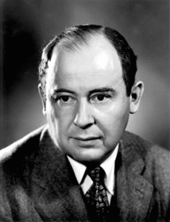

John von Neumann
Merge Sort, 1945
 | Merge Sort
Average case comparisons
Worst case comparisons
$$n\log_{2}{n}$$
$$n\log_{2}{n}$$

Slide 6
QuickSort

Slide 7

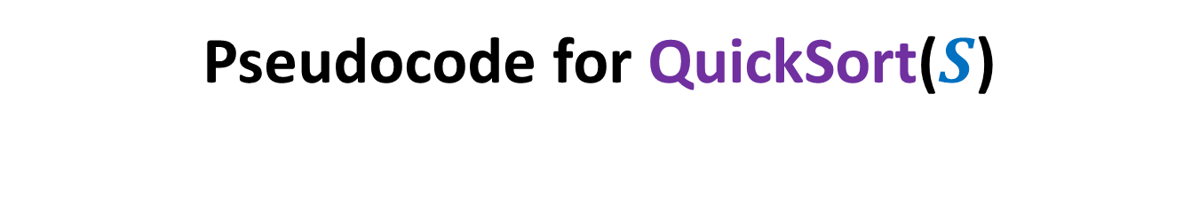
Pseudocode for QuickSort($S$)
QuickSort($S$)
{ If (|$S$|>1)
Pick and remove an element $x$from $S$;
($S_{<x}$, $S_{>x}$)← Partition($S$,$x$);
return( Concatenate(QuickSort($S_{<x}$), $x$, QuickSort($S_{>x}$))
}

Slide 8
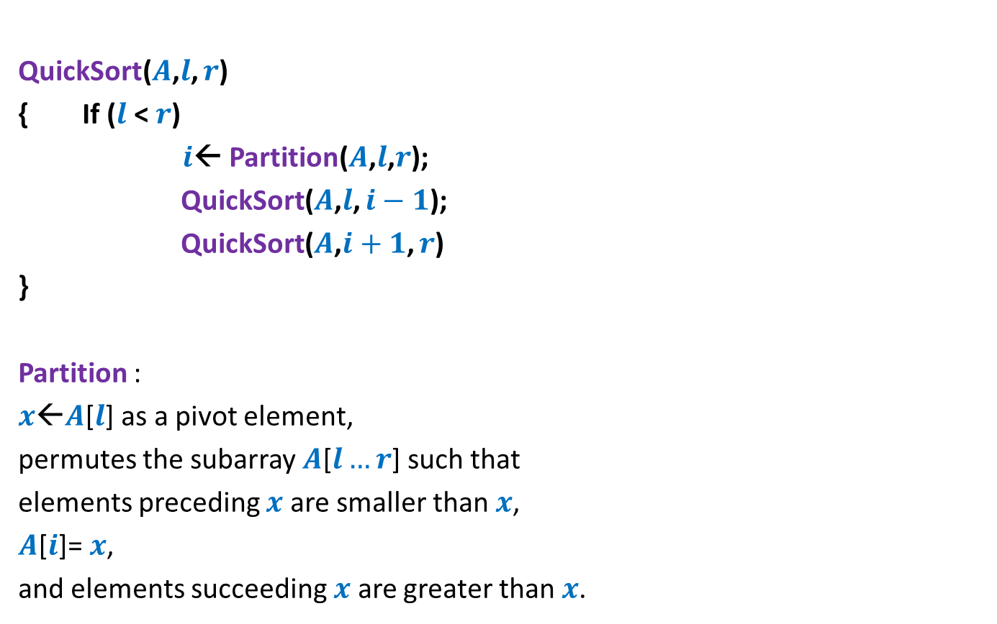
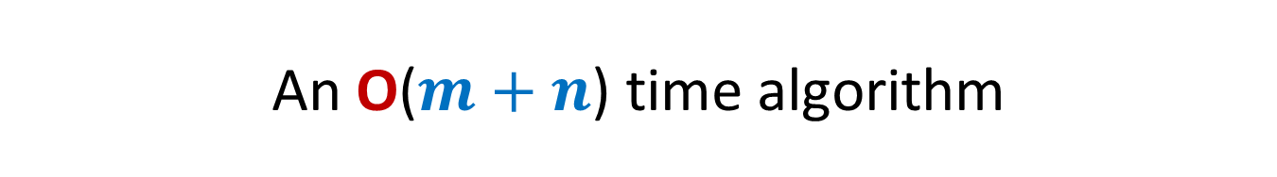
Pseudocode for QuickSort($S$) When the input $S$is stored in an array
QuickSort($A$,$l$, $r$)
{ If ($l$ < $r$)
$i$← Partition($A$,$l$,$r$);
QuickSort($A$,$l$, $i−1$);
QuickSort($A$,$i+1$, $r$)
}
Partition :
$x$←$A$[$l$] as a pivot element,
permutes the subarray $A$[$l…r$] such that
elements preceding $x$ are smaller than $x$,
$A$[$i$]= $x$,
and elements succeeding $x$ are greater than $x$.

Slide 9


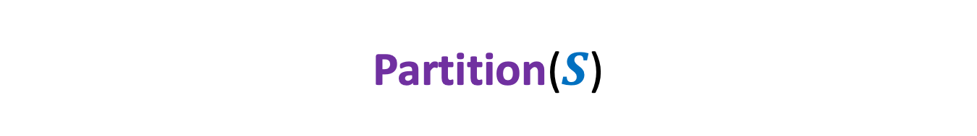


Partition($S$)
0 1 2 3 4 5 6 7 8
> $e_{i}$
$$S$$
< $e_{i}$
$$e_{i}$$

Slide 10



Partition($S$)
0 1 2 3 4 5 6 7 8
$$S$$
$$e_{i}$$
0 1 2 3 4 5 6 7 8
$$e_{i}$$
{ $e_{1}$… $e_{i−1}$}
{ $e_{i+1}$… $e_{n}$ }

Slide 11


Pseudocode for QuickSort($S$) When the input $S$is stored in an array
QuickSort($A$,$l$, $r$)
{ If ($l$ < $r$)
$i$← Partition($A$,$l$,$r$);
QuickSort($A$,$l$, $i−1$);
QuickSort($A$,$i+1$, $r$)
}
Worst case time complexity:
$O(n^{2})$

Slide 12
Analyzing average time complexity of QuickSort
Part 1
Deriving the recurrence

Slide 13
Analyzing average time complexity of QuickSort
Assumption (just for a neat analysis):
All elements are distinct.
Each recursive call selects the first element of the subarray as the pivot element.

Slide 14

Analyzing average time complexity of QuickSort
$T$($n$) : Average running time for Quick sort on input of size $n$.
$T$($n$) =
$\frac{1}{n!}\sum_{π }{Q(π)}$

Slide 15
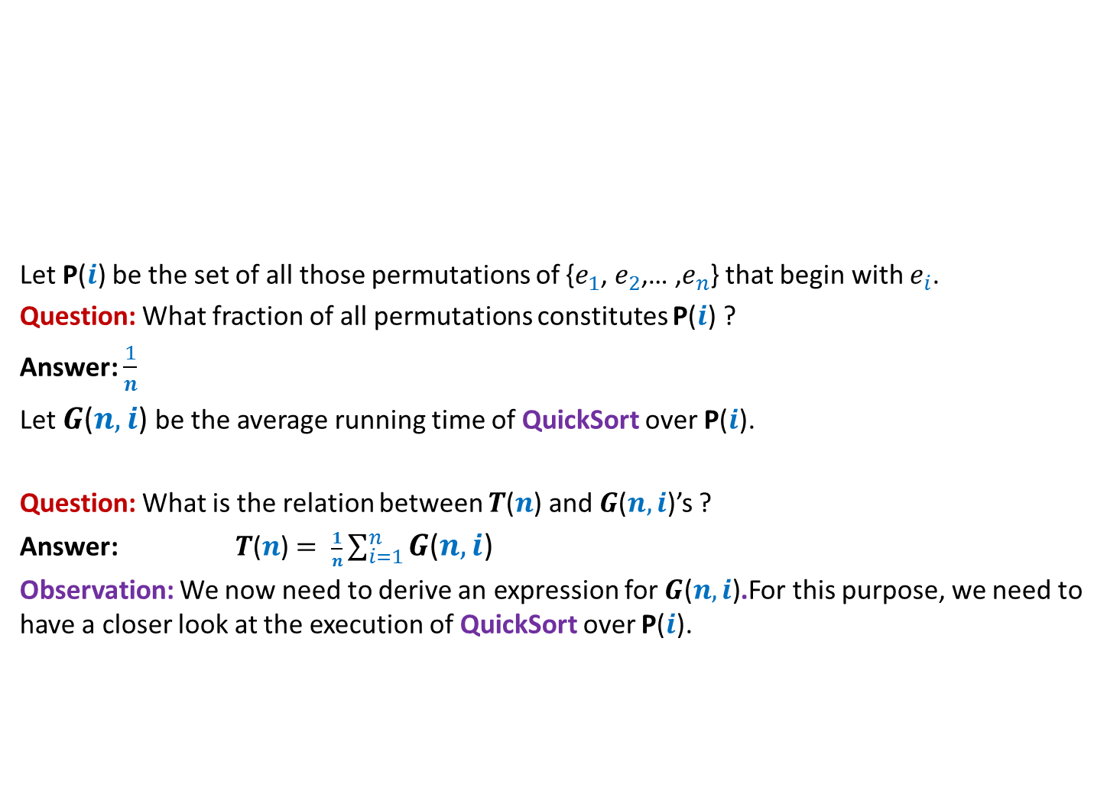




Analyzing average time complexity of QuickSort
Permutations beginning with $e_{2}$
Let P($i$) be the set of all those permutations of {$e_{1}$, $e_{2}$,… ,$e_{n}$} that begin with $e_{i}$.
Question: What fraction of all permutations constitutes P($i$) ?
Answer: $\frac{1}{n}$
Let $G$($n,i$) be the average running time of QuickSort over P($i$).
Question: What is the relation between $T$($n$) and $G$($n,i$)’s ?
Answer: $T$($n$) $= \frac{1}{n}\sum_{i=1}^{n}{G\text{(}n,i\text{)}}$
Observation: We now need to derive an expression for $G\text{(}n,i\text{)}$.For this purpose, we need to have a closer look at the execution of QuickSort over P($i$).
Permutations beginning with $e_{1}$
Permutations beginning with $e_{3}$
All $n!$permutations of {$e_{1}$, $e_{2}$,… ,$e_{n}$}

Slide 16
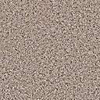
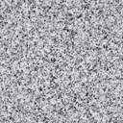

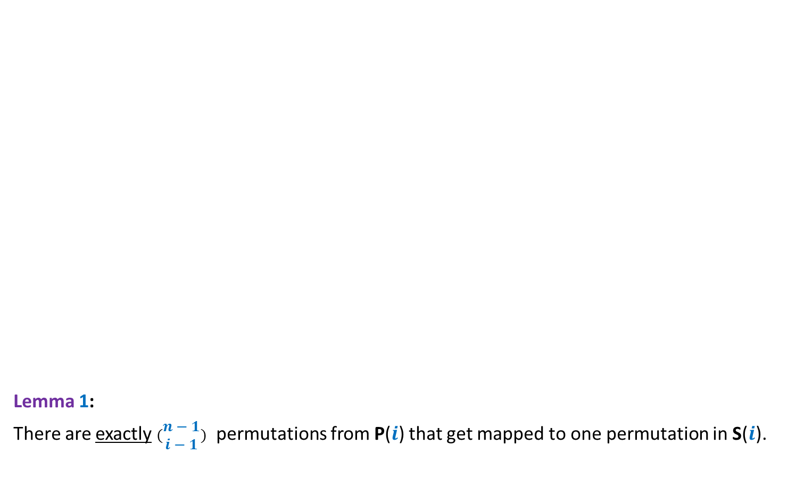


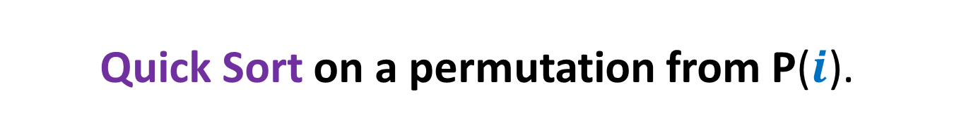







Quick Sort on a permutation from P($i$).
Lemma 1:
There are exactly $(\begin{matrix}n−1 \\ i−1\end{matrix})$ permutations from P($i$) that get mapped to one permutation in S($i$).
($n−1$)!
0 1 2 3 4 5 6 7 8
P($i$)
$$A$$
Many-to-one
mapping
$$e_{i}$$
Is it also a uniform mapping ?
0 1 2 3 4 5 6 7 8
Yes
S($i$)
($i−1$)!⨯ ($n−i$)!
$$e_{i}$$
$e_{1}$… $e_{i−1}$
$e_{i+1}$… $e_{n}$
S($i$): Permutations resulting from Partition().
Homework: Try to prove the lemma

Slide 17
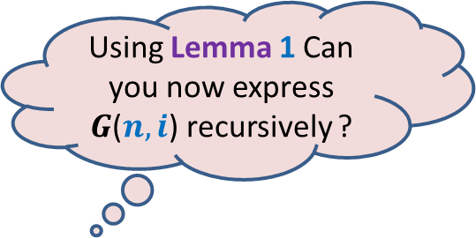
Quick Sort on a permutation from P($i$).
Lemma 1:
There are exactly $(\begin{matrix}n−1 \\ i−1\end{matrix})$ permutations from P($i$) that get mapped to one permutation in S($i$).
($n−1$)!
0 1 2 3 4 5 6 7 8
P($i$)
$$A$$
Using Lemma 1 Can you now express $G$($n,i$) recursively ?
Many-to-one
mapping
$$e_{i}$$
0 1 2 3 4 5 6 7 8
S($i$)
($i−1$)!⨯ ($n−i$)!
$$e_{i}$$
$e_{1}$… $e_{i−1}$
$e_{i+1}$… $e_{n}$

Slide 18

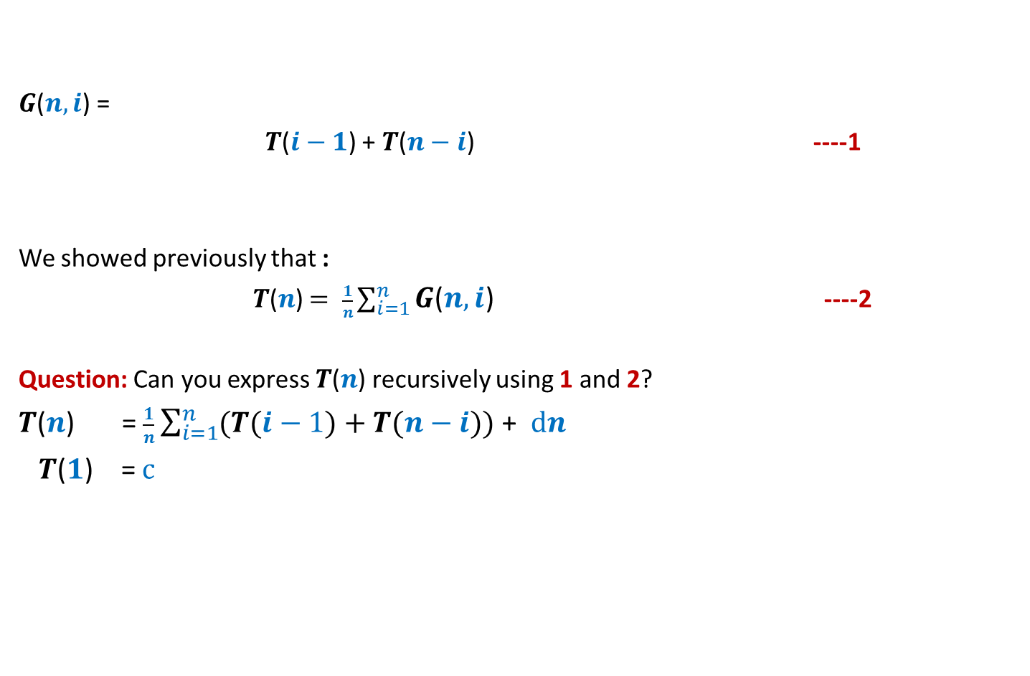
Analyzing average time complexity of QuickSort
$G$($n,i$) =
$T$($i−1$) + $T$($n−i$) ----1
We showed previously that :
$T$($n$) $= \frac{1}{n}\sum_{i=1}^{n}{G\text{(}n,i\text{)}}$ ----2
Question: Can you express $T$($n$) recursively using 1 and 2?
$T$($n$) = $\frac{1}{n}\sum_{i=1}^{n}{(T(i−1)}+T(n−i))$ + $dn$
$T$($1$) = $c$
+ $dn$

Slide 19
Analyzing average time complexity of QuickSort
Part 2
Solving the recurrence

Slide 20
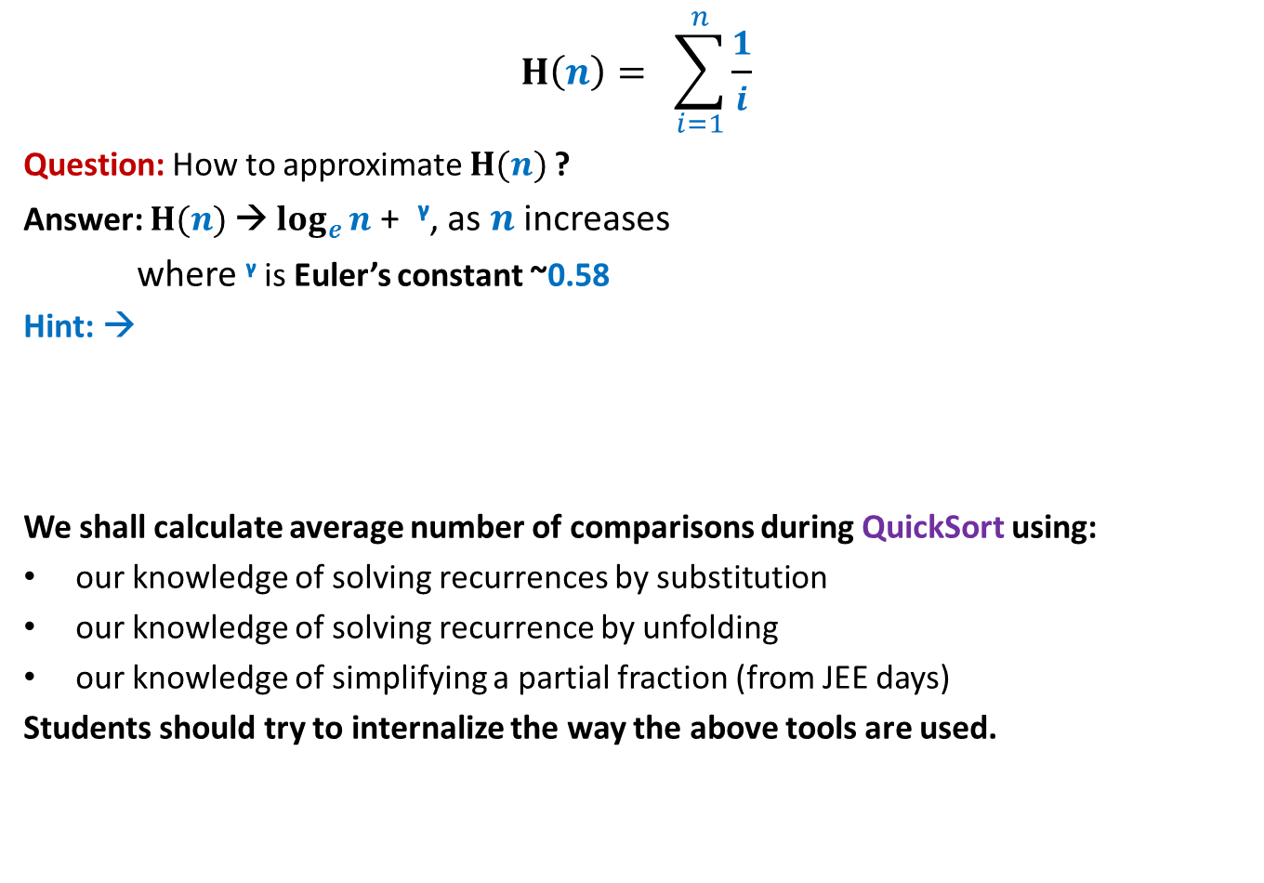
Some elementary tools
$$H\left(n\right)= \sum_{i=1}^{n}{\frac{1}{i}}$$
Question: How to approximate $H(n)$?
Answer: $H(n)$→ $\log_{e}{n}$ + ᵞ, as $n$ increases
where ᵞ is Euler’s constant ~0.58
Hint: →
We shall calculate average number of comparisons during QuickSort using:
our knowledge of solving recurrences by substitution
our knowledge of solving recurrence by unfolding
our knowledge of simplifying a partial fraction (from JEE days)
Students should try to internalize the way the above tools are used.
Look at this figure, and relate it to the curve for function f(x)= 1/x and its integration…
1
1/2
1/3
1/4
1/5
1/6

Slide 21
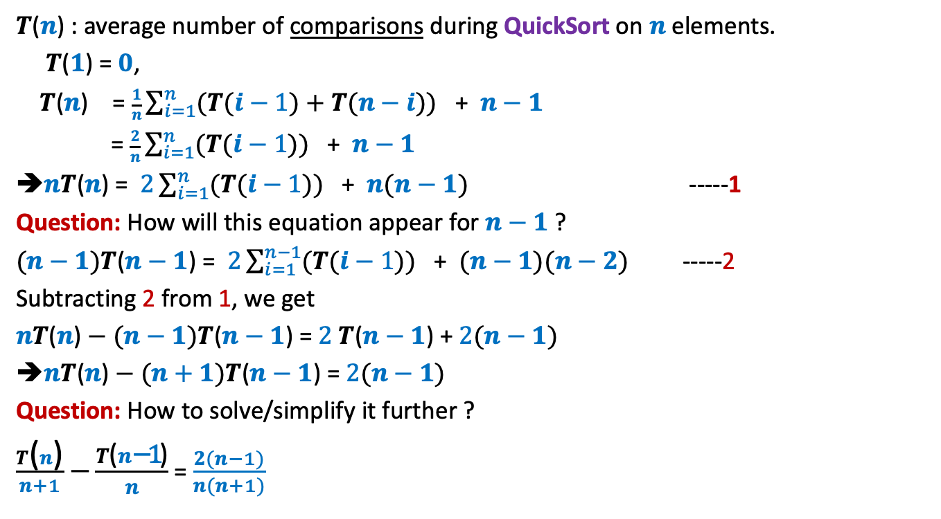
$T$($n$) : average number of comparisons during QuickSort on $n$elements.
$T$($1$) = $0$,
$T$($n$) = $\frac{1}{n}\sum_{i=1}^{n}{(T(i−1)}+T(n−i))$ + $n−1$
= $\frac{2}{n}\sum_{i=1}^{n}{(T(i−1)})$ + $n−1$
➔$nT$($n$) = $2\sum_{i=1}^{n}{(T(i−1)})$ + $n(n−1)$ -----1
Question: How will this equation appear for $n−1$ ?
$(n−1)T$($n−1$) = $2\sum_{i=1}^{n−1}{(T(i−1)})$ + $(n−1)(n−2)$ -----2
Subtracting 2 from 1, we get
$nT$($n$) $− (n−1)T$($n−1$) = $2 T$($n−1$) + $2(n−1)$
➔$nT$($n$) $− (n+1)T$($n−1$) = $2(n−1)$
Question: How to solve/simplify it further ?
$\frac{T\text{(}n\text{)}}{n+1}$ $−\frac{T\text{(}n\text{−1}\text{)}}{n}$ = $\frac{2(n−1)}{n(n+1)}$

Slide 22

$\frac{T\text{(}n\text{)}}{n+1}$ $−\frac{T\text{(}n\text{−}\text{1}\text{)}}{n}$ = $\frac{2(n−1)}{n(n+1)}$
$g(n) −g\left(n−1\right)$ = $\frac{2(n−1)}{n(n+1)}$ , where $g\left(m\right)= \frac{T\text{(}m\text{)}}{m+1}$
Question: How to simplify RHS ?
$\frac{2(n−1)}{n(n+1)}$ = $\frac{2\left(n+1\right)−4}{n(n+1)}$ =
= $\frac{2}{n}$ $−\frac{4}{n(n+1)}$
=$\frac{2}{n}$ $−\frac{4}{n}+\frac{4}{n+1}$
= $\frac{4}{n+1}$ $−\frac{2}{n}$
➔ $g(n) −g\left(n−1\right)$ = $\frac{4}{n+1}$ $−\frac{2}{n}$

Slide 23
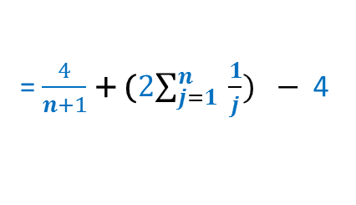
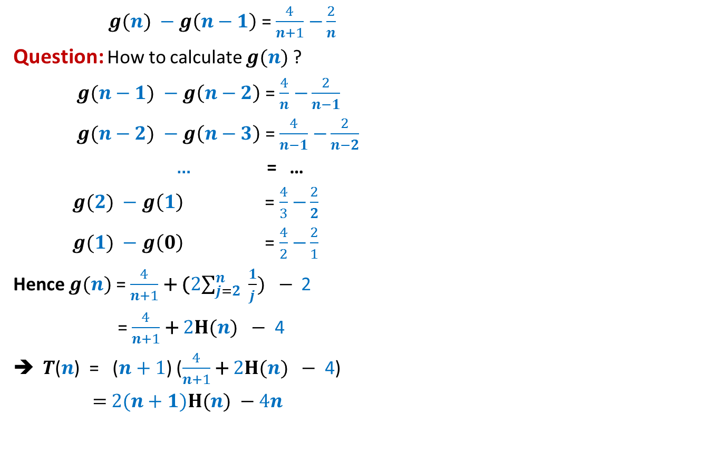
$g(n) −g\left(n−1\right)$ = $\frac{4}{n+1}$ $−\frac{2}{n}$
Question: How to calculate $g(n)$?
$g(n−1) −g\left(n−2\right)$ = $\frac{4}{n}$ $−\frac{2}{n−1}$
$g(n−2) −g\left(n−3\right)$ = $\frac{4}{n−1}$ $−\frac{2}{n−2}$
… = …
$g(2) −g\left(1\right)$ = $\frac{4}{3}$ $−\frac{2}{2}$
$g(1) −g\left(0\right)$ = $\frac{4}{2}$ $−\frac{2}{1}$
Hence $g(n)$ = $\frac{4}{n+1}$ + (2$\sum_{j=2}^{n}{ \frac{1}{j}}) −$ 2
= $\frac{4}{n+1}$ + 2$H(n) −$ 4
$T$($n$) = ($n+1$) ($\frac{4}{n+1}$ + 2$H(n) −$ 4)
= 2($n+1)H(n) −4n$
= $\frac{4}{n+1}$ + (2$\sum_{j=1}^{n}{ \frac{1}{j}}) −$ 4

Slide 24
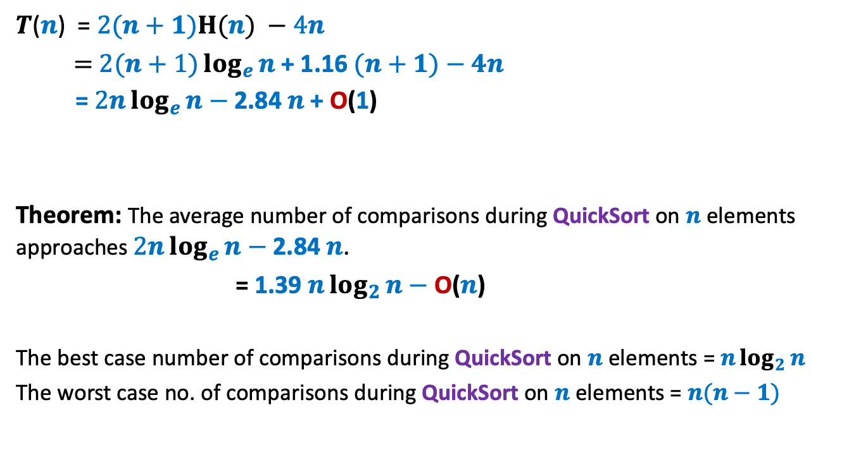
$T$($n$) = 2($n+1)H(n) −4n$
= 2$(n+1)\log_{e}{n}$+ 1.16 $(n+1)−4n$
= 2$n\log_{e}{n}−$ 2.84 $n$ + O(1)
Theorem: The average number of comparisons during QuickSort on $n$ elements approaches 2$n\log_{e}{n}−$ 2.84 $n$.
= 1.39 $n\log_{2}{n}−$ O($n$)
The best case number of comparisons during QuickSort on $n$ elements = $n\log_{2}{n}$
The worst case no. of comparisons during QuickSort on $n$ elements = $n(n−1)$

Slide 25
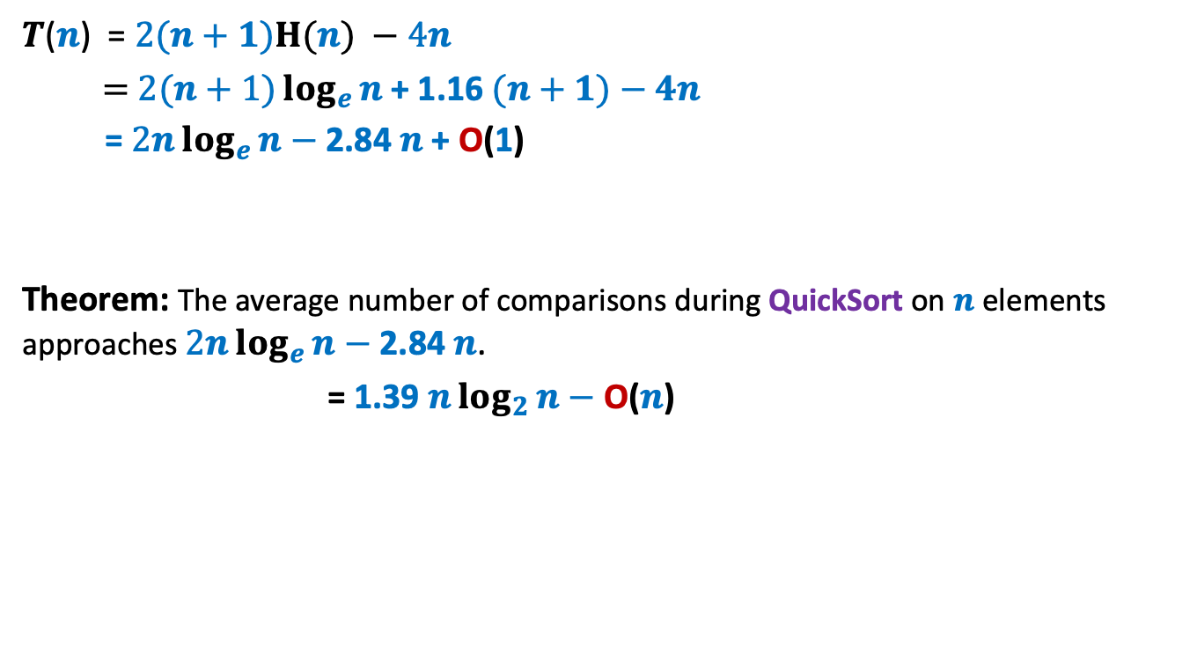
$T$($n$) = 2($n+1)H(n) −4n$
= 2$(n+1)\log_{e}{n}$+ 1.16 $(n+1)−4n$
= 2$n\log_{e}{n}−$ 2.84 $n$ + O(1)
Theorem: The average number of comparisons during QuickSort on $n$ elements approaches 2$n\log_{e}{n}−$ 2.84 $n$.
= 1.39 $n\log_{2}{n}−$ O($n$)

Slide 26
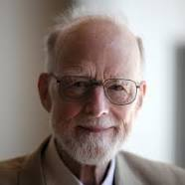




Quick sort versus Merge Sort
Find the answer on your own in the
final programming assignment ☺
John von Neumann
C. A. R. Hoare
After seeing this table,
no one would prefer Quick sort to
Merge sort. Isn’t it ?
But Quick sort is there in the library of
C, C++, Java,… Why ?
Merge Sort, 1945
Quick Sort, 1960
No. of Comparisons | Merge Sort | Quick Sort
Average case
Best case
Worst case
$$n\log_{2}{n}$$
1.39 $n\log_{2}{n}$
$$n\log_{2}{n}$$
$$n\log_{2}{n}$$
$$n\log_{2}{n}$$
$$n(n−1)$$

