Slide 1
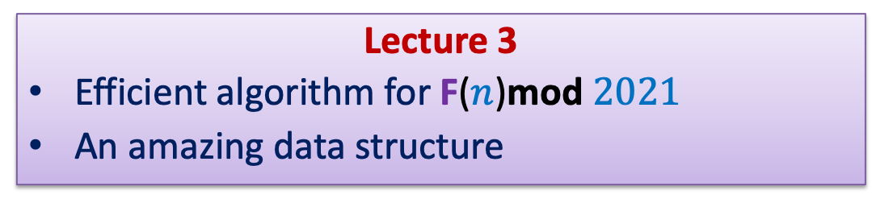
Data Structures and Algorithms (ESO207A)
Lecture 3
Efficient algorithm for F($n$)mod $2021$
An amazing data structure

Slide 2
HoMework
from the last class

Slide 3

Efficient Algorithm for F($n$)mod $2021$

Slide 4



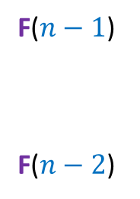
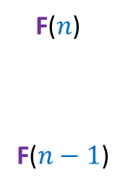
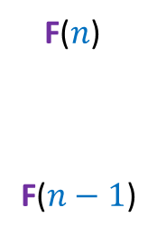
Idea 2
Let $n>1$
F($n$)
F($n−1$)
F($n−1$)
F($n−2$)
1
1 0
1
1 0
F($n−2$)
F($n−3$)
?
?
?
?
$$n−1$$
?
F($n$)
F($n−1$)
1
0
1
1 0

Slide 5
Homework from last class
Using the insight from the previous slide,
Make sincere attempt to design an efficient algorithm for Problem 2.
How many instructions will it execute in the word RAM model ?

Slide 6
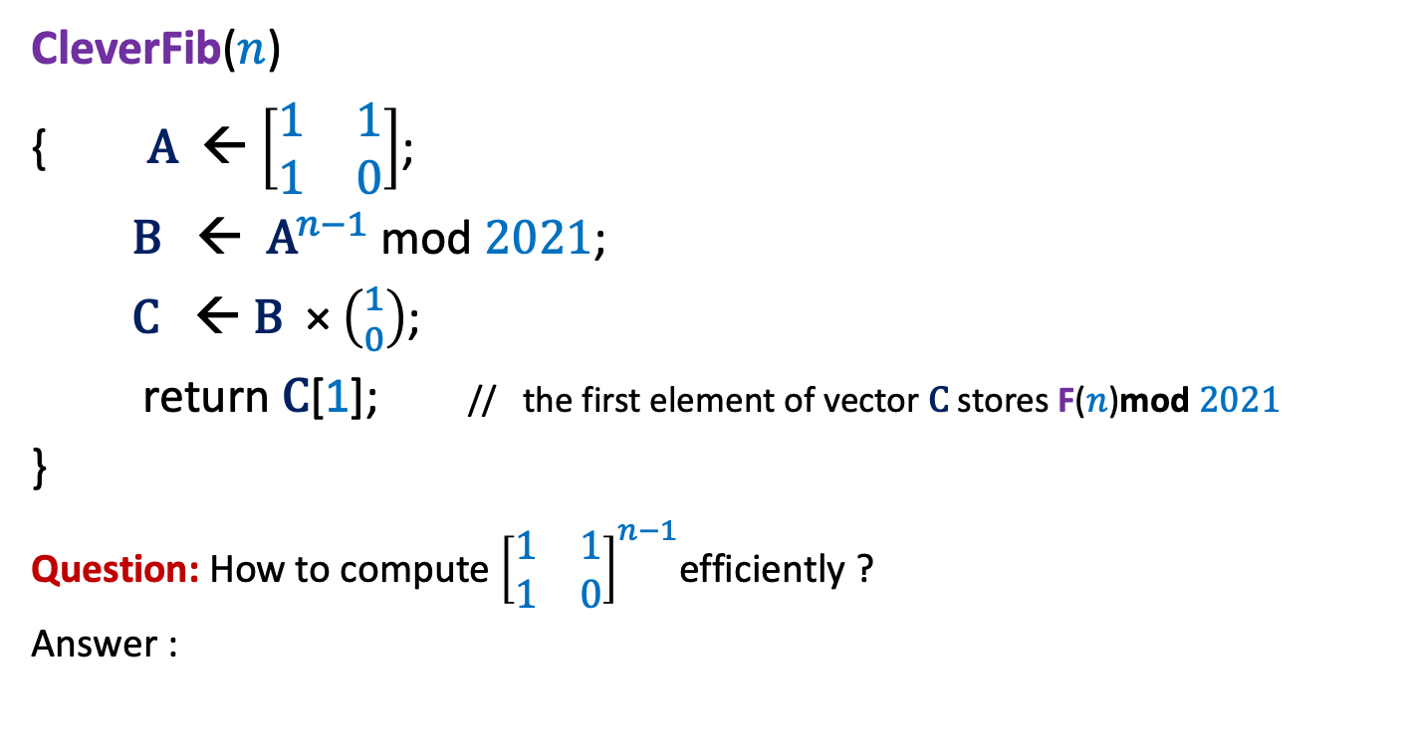


A clever algorithm for F($n$)mod $2021$
CleverFib($n$)
{ $\text{A}$← $\left[\begin{matrix}1 & 1 \\ 1 & 0\end{matrix}\right]$;
$\text{B}$ ← ${\text{A}}^{n−1}$ mod $2021$;
$\text{C}$ ← $\text{B}$ × $\left({1 \atop 0}\right)$;
return $\text{C}$[1]; // the first element of vector $\text{C}$ stores F($n$)mod $2021$
}
Question: How to compute ${\left[\begin{matrix}1 & 1 \\ 1 & 0\end{matrix}\right]}^{n−1}$efficiently ?
Answer :
4 instructions
6 instructions
Inspiration from Algorithm for $x^{n}mod 2021$

Slide 7
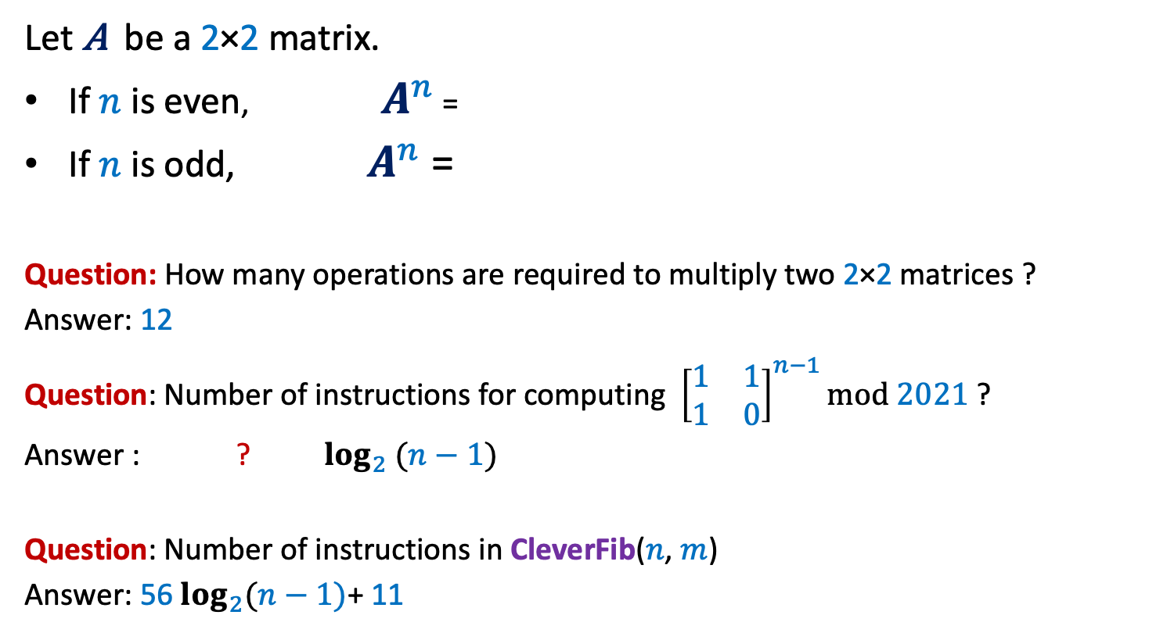

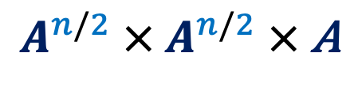
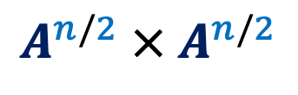
A clever algorithm for F($n$)mod $2021$
Let $\text{A}$ be a 2×2 matrix.
If $n$ is even, $A^{n}$ =
If $n$ is odd, $A^{n}$ =
Question: How many operations are required to multiply two 2×2 matrices ?
Answer: 12
Question: Number of instructions for computing ${\left[\begin{matrix}1 & 1 \\ 1 & 0\end{matrix}\right]}^{n−1}mod 2021$ ?
Answer : ? $\log_{2} (n−1)$
Question: Number of instructions in CleverFib($n$, $m$)
Answer: 56 $\log_{2}(n−1)$+ 11
$$A^{n/2} × A^{n/2}$$
$$A^{n/2} × A^{n/2} × \text{A}$$
mod $2021$?
24
56
28 + 28
4 instructions for copying the resulting matrix.

Slide 8
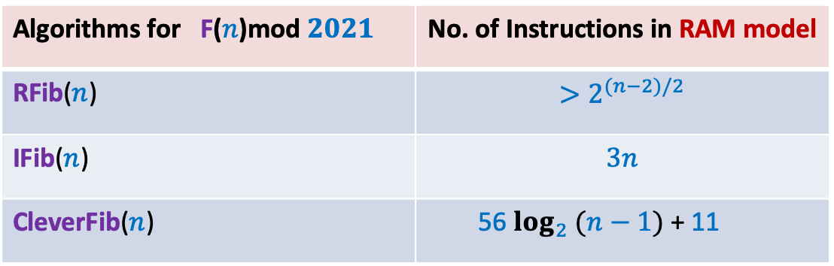
Three algorithms
Algorithms for F($n$)mod $2021$ | No. of Instructions in RAM model
RFib($n$) | $$>2^{(n−2)/2}$$
IFib($n$) | $$3n$$
CleverFib($n$) | 56 $\log_{2} (n−1)$ + 11
Assignment 1
?
Variation in the time of various operations
Architecture : 32 versus 64
Code optimization due to Compiler
Multitasking due to Operating system
Deadline: 11:55 PM on 7th August

Slide 9
The Data Structures

Slide 10


Problem 1:
Design and implement an algorithm with the following objective:
Input: an integer $n$
Output: $n!$
int
The simple code you might have written fails even for $n=21$ ☹

Slide 11

Problem 2:
HoMework
Design and implement an algorithm with the following objective:
Input: integer $m$
integer $n$
Output: $m ×n$
long long int
long long int

Slide 12
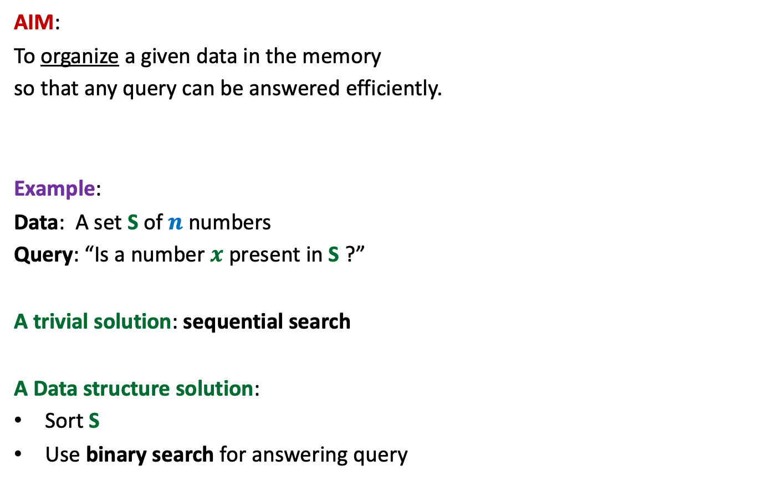
Data structures
AIM:
To organize a given data in the memory
so that any query can be answered efficiently.
Example:
Data: A set S of $n$ numbers
Query: “Is a number $x$ present in S ?”
A trivial solution: sequential search
A Data structure solution:
Sort S
Use binary search for answering query

Slide 13
Data structures
AIM:
To organize a data in the memory
so that any query can be answered efficiently.
Important assumption:
No. of queries to be answered will be …
Parameters of Efficiency
Query time
Space
Preprocessing time
many.

Slide 14
RANGE-MINIMA Problem

Slide 15






Range-Minima Problem
Given:
Query:
Range-minima($i,j$) :
Let $n$ = $1$million.
No. of queries = $10$ millions
an array A storing $n$numbers
report the smallest element from A[$i$],…,A[$j$]
Range-Minima($i,j$) = $−6$
A
$$3$$ | $$5$$ | $$1$$ | $$8$$ | $$19$$ | $$0$$ | $$−1$$ | $$30$$ | $$99$$ | $$−6$$ | $$10$$ | $$2$$ | $$40$$ | $$27$$ | $$44$$ | $$67$$
$$i=4$$
$$j=11$$

Slide 16

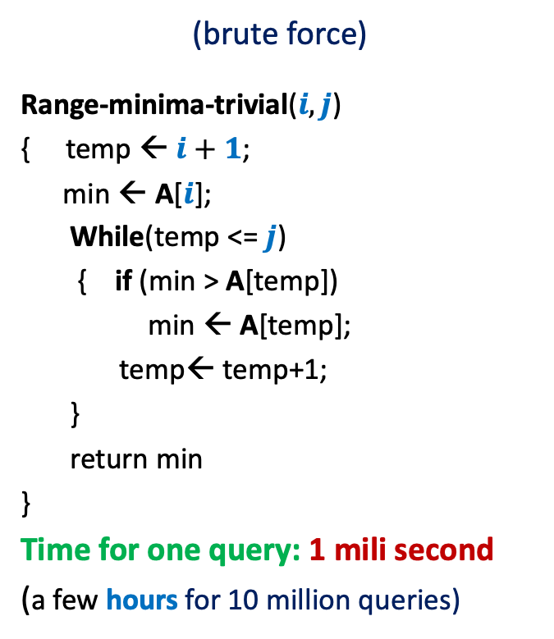


Range-Minima Problem
Solution 1
Solution 2
(brute force)
Range-minima-trivial($i,j$)
{ temp ← $i+1$;
min ← A[$i$];
While(temp <= $j$)
{ if (min > A[temp])
min ← A[temp];
temp← temp+1;
}
return min
}
Time for one query: 1 mili second
(a few hours for 10 million queries)
(store all answers)
Space : $n^{2}$
$$j$$
$$i$$
3
B
1 terabyte
Impractical

Slide 17


Range-Minima Problem
An amazing data structure:
Space: $n log n$
Query time: constant
Isn’t it amazing ?
How to achieve it ?
…Ponder over it…
1 terabyte
20 Mega bytes
Independent of $n$

Slide 18
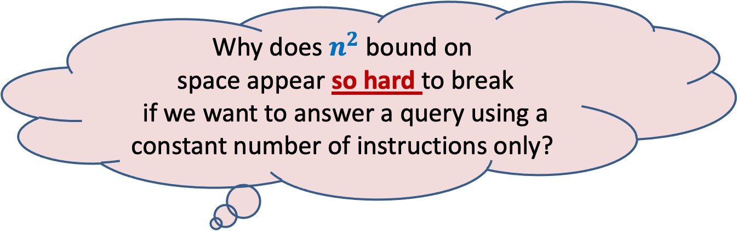
Why does $n^{2}$ bound on
space appear so hard to break
if we want to answer a query using a constant number of instructions only?
… Because of artificial hurdles

Slide 19
Artificial hurdle
If we want to answer each query in constant time,
we must store its answer explicitly.
Spend some time to find the origin of this hurdle.…

Slide 20


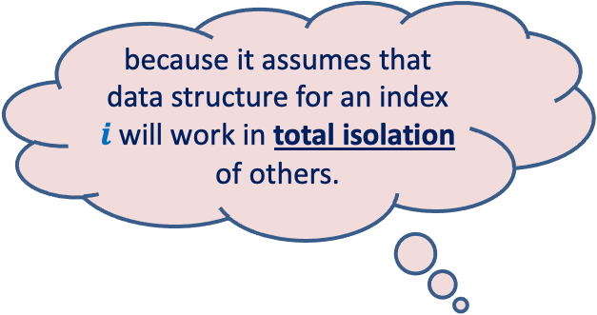

Artificial hurdle
… If we fix the first parameter $i$ for all queries, we need $n−i$ space.
➔
for all $i$, we need ${\sim n}^{2}$ space.
$$i$$
$n$-1
A
29
3.1
99
781
41.5
67.4
0
True Fact
because it assumes that data structure for an index $i$will work in total isolation of others.
A wrong inference

Slide 21

Collaboration (team effort) works in real life
Why not try collaboration for the given problem ?

Slide 22

The amazing Data Structure
An Overview:
Keep $n$ tiny data structures:
Each index $i$ stores minimum only for a few $j>i$.

Slide 23
How might collaboration work in this problem ?

Slide 24




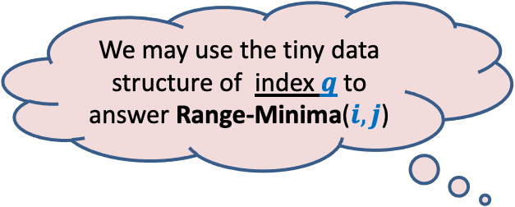




We may use the tiny data structure of index $q$ to answer Range-Minima($i,j$)
$$i$$
$$j$$
A
$$1$$
$$i$$
$$q$$
$$n$$
$i$stores answers for this range
$q$stores answers for this range

Slide 25
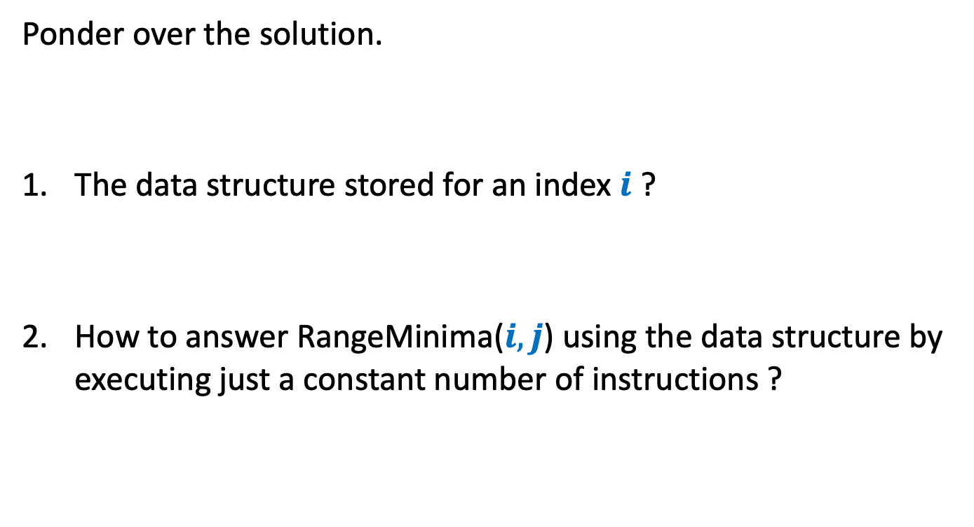
Homework
Ponder over the solution.
The data structure stored for an index $i$ ?
How to answer RangeMinima($i,j$) using the data structure by executing just a constant number of instructions ?

