Slide 1
Data Structures and Algorithms (ESO207A)
Lecture 31
Magical application of binary trees – II
Data structure for sets

Slide 2
Recap of Last Lecture

Slide 3
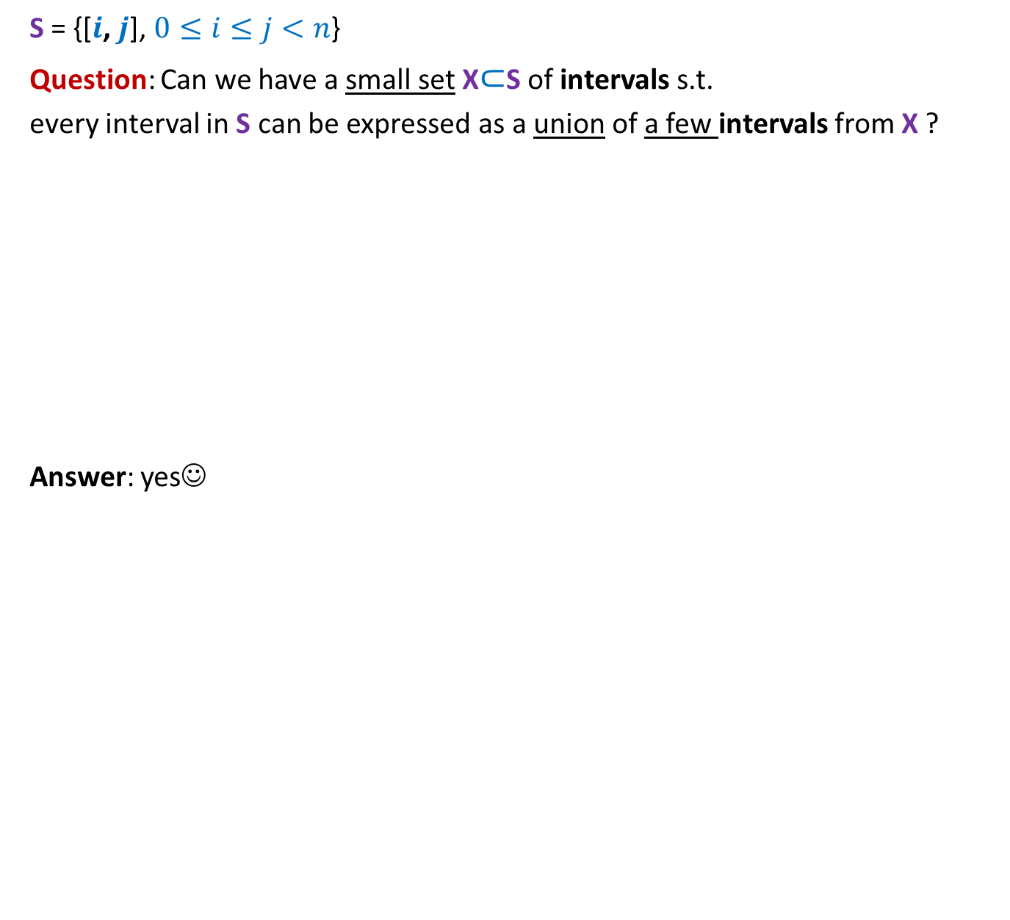
Intervals
S = {[$i$, $j$], $0≤i≤j<n$}
Question: Can we have a small set X$⊂$S of intervals s.t.
every interval in S can be expressed as a union of a few intervals from X ?
Answer: yes☺
$\left[0,0\right] \left[1,1\right] \left[2,2\right] \left[3,3\right] \left[4,4\right] \left[5,5\right] \left[6,6\right] \left[7,7\right] \left[8,8\right] \left[9,9\right] …………………………………. [15,15]$

Slide 4



Hierarchy of intervals
$$[0,15]$$
$$[0,7]$$
$$[8,15]$$
$\left[0,3\right] [4,7]$ $\left[8,11\right] [12,15]$
$\left[0,1\right] \left[2,3\right] \left[4,5\right] \left[6,7\right] \left[8,9\right] \left[10,11\right] \left[12,13\right] [14,15]$
$\left[0,0\right] \left[1,1\right] \left[2,2\right] \left[3,3\right] \left[4,4\right] \left[5,5\right] \left[6,6\right] \left[7,7\right] \left[8,8\right] \left[9,9\right] …………………………………. [15,15]$

Slide 5



Hierarchy of intervals
$$[0,15]$$
Observation: There are $2n$intervals such that
any interval [$i$, $j$] can be expressed
$$[0,7]$$
$$[8,15]$$
$\left[0,3\right] [4,7]$ $\left[8,11\right] [12,15]$
$\left[0,1\right] \left[2,3\right] \left[4,5\right] \left[6,7\right] \left[8,9\right] \left[10,11\right] \left[12,13\right] [14,15]$
$\left[0,0\right] \left[1,1\right] \left[2,2\right] \left[3,3\right] \left[4,4\right] \left[5,5\right] \left[6,6\right] \left[7,7\right] \left[8,8\right] \left[9,9\right] …………………………………. [15,15]$
as union of O(log $n$) basic intervals ☺

Slide 6
Hierarchy of intervals
$$[0,15]$$
Observation: There are $2n$intervals such that
any interval [$i$, $j$] can be expressed
$$[0,7]$$
$$[8,15]$$
$\left[0,3\right] [4,7]$ $\left[8,11\right] [12,15]$
$\left[0,1\right] \left[2,3\right] \left[4,5\right] \left[6,7\right] \left[8,9\right] \left[10,11\right] \left[12,13\right] [14,15]$
$\left[0,0\right] \left[1,1\right] \left[2,2\right] \left[3,3\right] \left[4,4\right] \left[5,5\right] \left[6,6\right] \left[7,7\right] \left[8,8\right] \left[9,9\right] …………………………………. [15,15]$
Relation to a sequence ?
as union of O(log $n$) basic intervals ☺

Slide 7
Which data structure emerges ?
$$[0,15]$$
$$[0,7]$$
$$[8,15]$$
$\left[0,3\right] [4,7]$ $\left[8,11\right] [12,15]$
$\left[0,1\right] \left[2,3\right] \left[4,5\right] \left[6,7\right] \left[8,9\right] \left[10,11\right] \left[12,13\right] [14,15]$
$\left[0,0\right] \left[1,1\right] \left[2,2\right] \left[3,3\right] \left[4,4\right] \left[5,5\right] \left[6,6\right] \left[7,7\right] \left[8,8\right] \left[9,9\right] …………………………………. [15,15]$
Sequence
${ x}_{0}$ ${ x}_{1}{ x}_{2 }x_{3}$ $x_{4}{ x}_{5}$ ${ x}_{6}$ ${ x}_{7}{ x}_{8 }x_{9}$ $x_{10}{ x}_{11}$ ${ x}_{12}$ ${ x}_{13}{ x}_{14 }x_{15}$

Slide 8
A Binary tree
$$[0,15]$$
This is called segment tree or interval tree or ? in the literature.
But we all know – what is in a name ?
$$[0,7]$$
$$[8,15]$$
$\left[0,3\right] [4,7]$ $\left[8,11\right] [12,15]$
$$\left[0,1\right] \left[2,3\right] \left[4,5\right] \left[6,7\right] \left[8,9\right] \left[10,11\right] \left[12,13\right] [14,15]$$
${ x}_{0}$ ${ x}_{1}{ x}_{2 }x_{3}$ $x_{4}{ x}_{5}$ ${ x}_{6}$ ${ x}_{7}{ x}_{8 }x_{9}$ $x_{10}{ x}_{11}$ ${ x}_{12}$ ${ x}_{13}{ x}_{14 }x_{15}$

Slide 9
Problem 2
Dynamic Range-minima

Slide 10

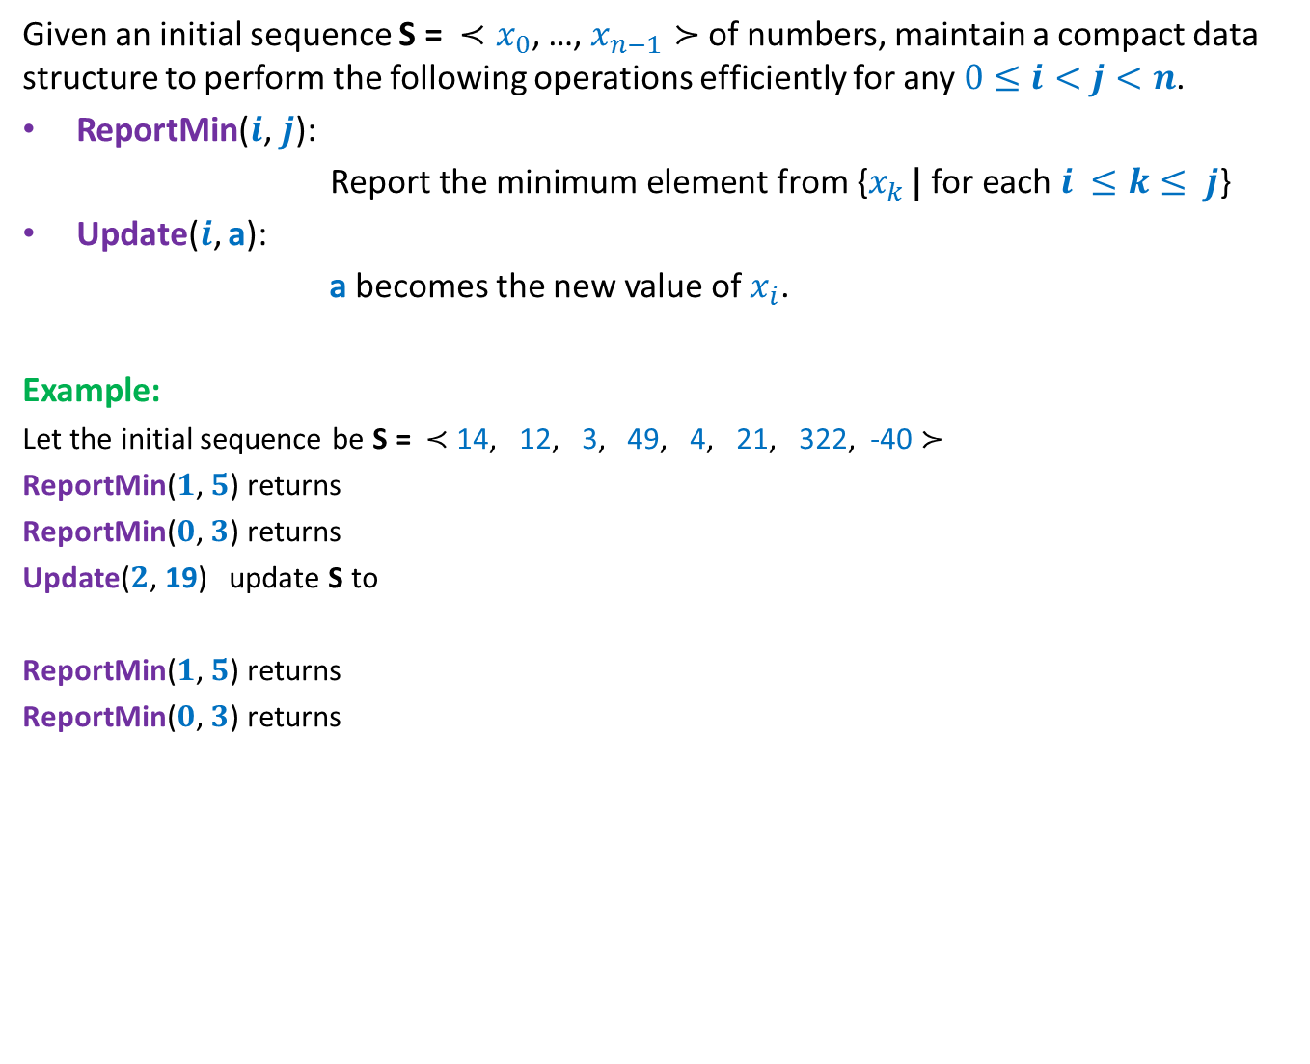
Dynamic Range Minima Problem
Given an initial sequence S = ${≺x}_{0}$, …, $x_{n−1}≻$ of numbers, maintain a compact data structure to perform the following operations efficiently for any $0≤i<j<n$.
ReportMin($i\text{,} j\text{): }$
$\text{Report} \text{the} \text{minimum} \text{element} \text{from} \text{\{}x_{k }\text{|} \text{for} \text{each} i ≤k≤ j$}
Update($i$, a):
a becomes the new value of $x_{i}$.
Example:
Let the initial sequence be S = $≺$ 14, 12, 3, 49, 4, 21, 322, -40 $≻$
ReportMin($1\text{,} 5\text{)}$ returns
ReportMin($0\text{,} 3\text{)}$ returns
Update($2$, 19) update S to
ReportMin($1\text{,} 5\text{)}$ returns
ReportMin($0\text{,} 3\text{)}$ returns
3
3
$≺$ 14, 12, 19, 49, 4, 21, 322, -40 $≻$
4
12

Slide 11
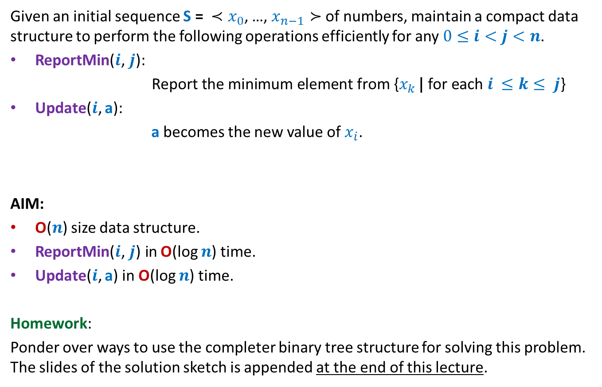
Dynamic Range Minima Problem
Given an initial sequence S = ${≺x}_{0}$, …, $x_{n−1}≻$ of numbers, maintain a compact data structure to perform the following operations efficiently for any $0≤i<j<n$.
ReportMin($i\text{,} j\text{): }$
$\text{Report} \text{the} \text{minimum} \text{element} \text{from} \text{\{}x_{k }\text{|} \text{for} \text{each} i ≤k≤ j$}
Update($i$, a):
a becomes the new value of $x_{i}$.
AIM:
O($n$) size data structure.
ReportMin($i\text{,} j\text{)} \text{in}$O(log $n$) time.
Update($i$, a) in O(log $n$) time.
Homework:
Ponder over ways to use the completer binary tree structure for solving this problem. The slides of the solution sketch is appended at the end of this lecture.

Slide 12
Rooted tree
Revisiting and extending

Slide 13
A typical rooted tree we studied
What data structure will you use ?
Definition we gave:
Every vertex, except root, has exactly one incoming edge and has a path from the root.
Examples:
Binary search trees,
BFS tree.

Slide 14
A typical rooted tree we studied
Question: what data structure can be used for representing a rooted tree ?
Answer:
Data structure 1:
Each node stores a list of its children.
To access the tree, we keep a pointer to the root node.
(there is no way to access any node (other than root) directly in this data structure)
Data structure 2: (If nodes are labeled in a contiguous range [0..n-1])
rooted tree becomes an instance of a directed graph.
So we may use adjacency list representation.
Advantage: ?
We can access each node directly.

Slide 15
Extending the definition of rooted tree
Extended Definition:
Type 1: Every vertex, except root, has exactly one incoming edge and has a path from the root.

Slide 16
Extending the definition of rooted tree
Extended Definition:
Type 1: Every vertex, except root, has exactly one incoming edge and has a path from the root.
OR
Type 2: Every vertex, except root, has exactly one outgoing edge and has a path to the root.

Slide 17
Extending the definition of rooted tree

Slide 18

Data structure for rooted tree of type 2
Adjacency lists
If nodes are labeled in a contiguous range [$0$..$n−1$],
there is even simpler and more compact data structure
Guess ??
7
23 11
1 15 6 9 13
14 12 18 2 21 5 8
16 10 20 17 19 4 3 22 0
8 23 9 8 18 13 23 13 11 14 7 6 11 1 23 14 12 6 12 12 9 8 7
Parent
7
0 1 2 3 4 5 6 7 8 9 10 11 12 13 14 15 16 17 18 19 20 21 22 23

Slide 19
Application of rooted tree of type 2
Maintaining sets

Slide 20

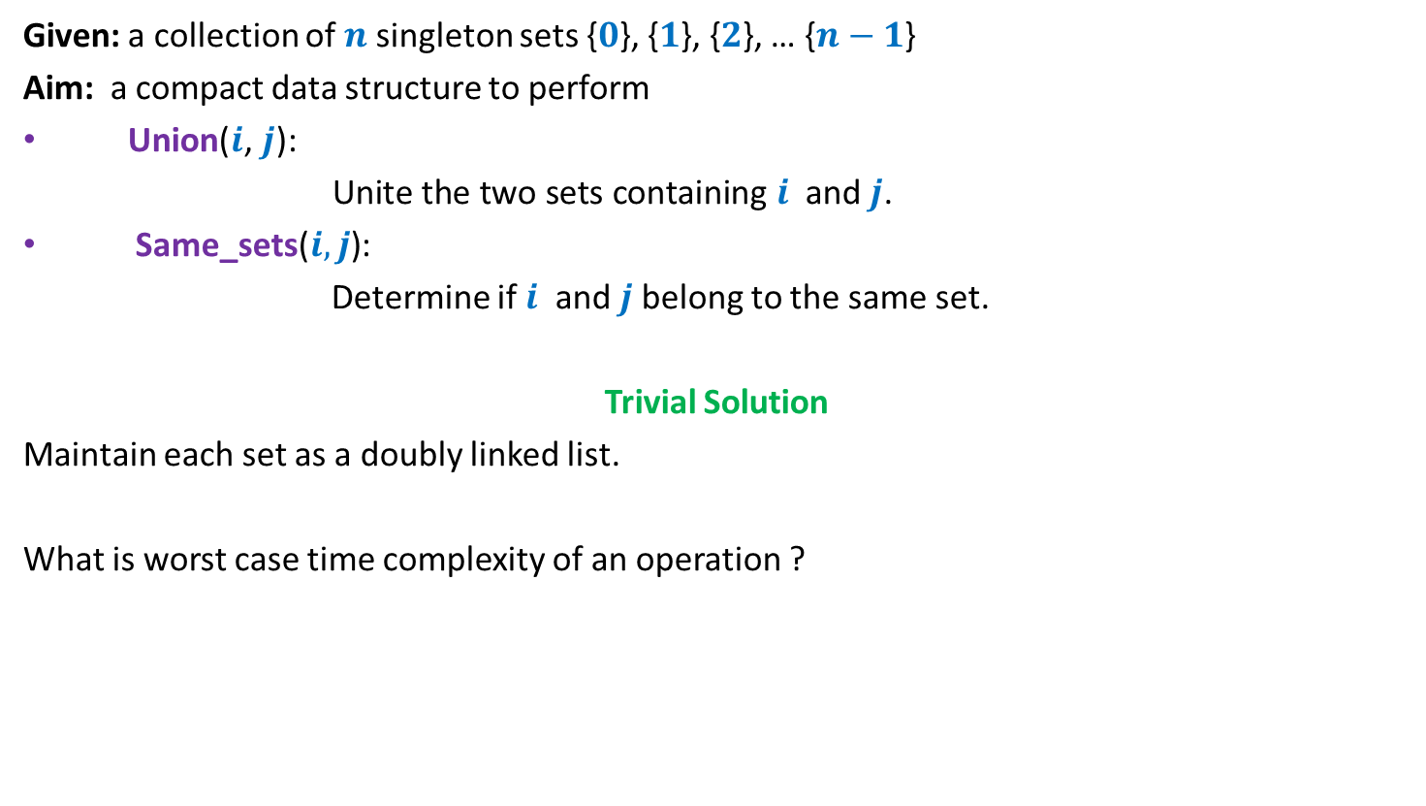
Sets under two operations
Given: a collection of $n$singleton sets {$0$}, {$1$}, {$2$}, … {$n−1$}
Aim: a compact data structure to perform
Union($i\text{,} j\text{): }$
$\text{Unite} \text{the} \text{two} \text{sets} \text{containing} i$ and $j$.
Same_sets($i,j$):
Determine if $i$ and $j$belong to the same set.
Trivial Solution
Maintain each set as a doubly linked list.
What is worst case time complexity of an operation ?
O($n$) time

Slide 21
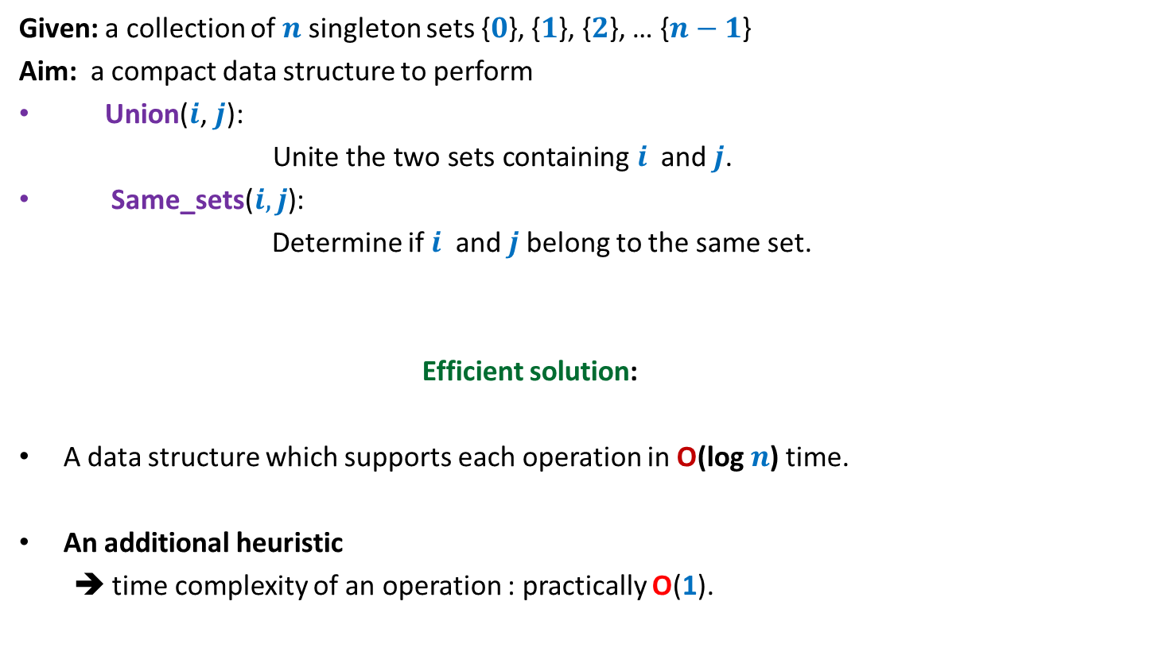
Sets under two operations
Given: a collection of $n$singleton sets {$0$}, {$1$}, {$2$}, … {$n−1$}
Aim: a compact data structure to perform
Union($i\text{,} j\text{): }$
$\text{Unite} \text{the} \text{two} \text{sets} \text{containing} i$ and $j$.
Same_sets($i,j$):
Determine if $i$ and $j$belong to the same set.
Efficient solution:
A data structure which supports each operation in O(log $n$) time.
An additional heuristic
➔ time complexity of an operation : practically O(1).

Slide 22


Data structure for sets
Maintain each set as ? .
a rooted tree
Union($i\text{,} j\text{)}$ ?
SameSet($i\text{,} j\text{)}$ ?
2
1
4
6
0
5
3
{2,4,6}
{0}
{5}
{1,3}

Slide 23

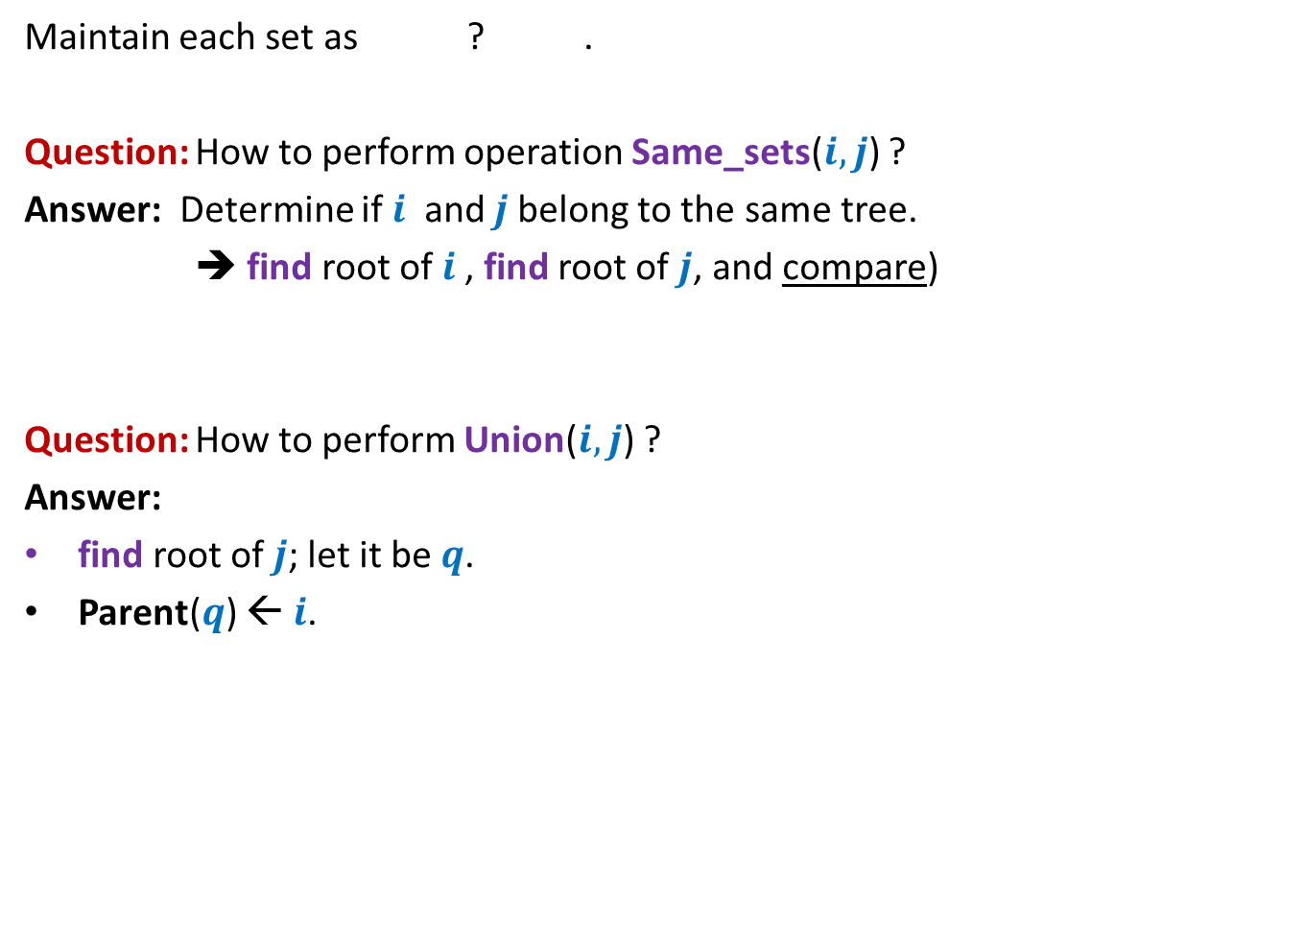



Data structure for sets
Maintain each set as ? .
Question: How to perform operation Same_sets($i,j$) ?
Answer: Determine if $i$ and $j$belong to the same tree.
➔ find root of $i$, find root of $j$, and compare)
Question: How to perform Union($i,j$) ?
Answer:
find root of $j$; let it be $q$.
Parent($q$) ← $i$.
a rooted tree
$$k$$
$$q$$
A
B
$$i$$
$j$

Slide 24
A rooted tree as a data structure for sets
Union(2,6)
0
1
2
3
4
5
6
7
8
9
10
11
Parent
0 1 2 3 4 5 6 7 8 9 10 11
0 1 2 3 4 5 6 7 8 9 10 11

Slide 25
A rooted tree as a data structure for sets
Union(9,0)
2
6
0
1
3
4
5
7
8
9
10
11
Parent
0 1 2 3 4 5 6 7 8 9 10 11
2
0 1 2 3 4 5 6 7 8 9 10 11

Slide 26
A rooted tree as a data structure for sets
Union(2,8)
2
9
6
0
1
3
4
5
7
8
10
11
Parent
0 1 2 3 4 5 6 7 8 9 10 11
9
2
0 1 2 3 4 5 6 7 8 9 10 11

Slide 27
A rooted tree as a data structure for sets
Union(6,0)
2
9
8
6
0
1
3
4
5
7
10
11
Parent
9 1 2 3 4 5 2 7 8 9 10 11
2
0 1 2 3 4 5 6 7 8 9 10 11

Slide 28
A rooted tree as a data structure for sets
2
8
6
9
0
1
3
4
5
7
10
11
Parent
9 1 2 3 4 5 2 7 8 9 10 11
2
6
0 1 2 3 4 5 6 7 8 9 10 11

Slide 29
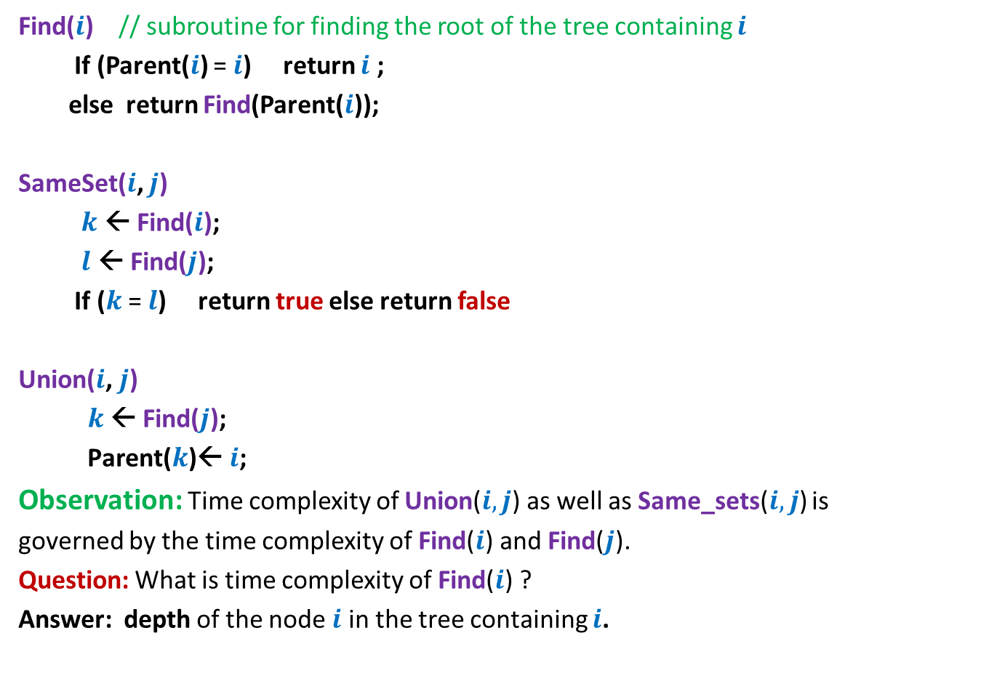
Pseudocode for Union and SameSet()
Find($i$) // subroutine for finding the root of the tree containing $i$
If (Parent($i$) = $i$) return $i$ ;
else return Find(Parent($i$));
SameSet($i$, $j$)
$k$ ← Find($i$);
$l$ ← Find($j$);
If ($k$ = $l$) return true else return false
Union($i$, $j$)
$k$ ← Find($j$);
$\text{Parent}\text{(}k\text{)}$← $i$;
Observation: Time complexity of Union($i,j$) as well as Same_sets($i,j$) is
governed by the time complexity of Find($i$) and Find($j$).
Question: What is time complexity of Find($i$) ?
Answer: depth of the node $i$ in the tree containing $i$.

Slide 30

Time complexity of Find($i$)
Union(0,1)
Union(1,2)
Union(2,3)
…
Union(9,10)
Union(10,11)
What will be the rooted tree structures after these union operations ?
0
1
2
3
4
5
6
7
8
9
10
11
Parent
0 1 2 3 4 5 6 7 8 9 10 11
0 1 2 3 4 5 6 7 8 9 10 11

Slide 31

Time complexity of Find($i$)
Union(0,1)
Union(1,2)
Union(2,3)
…
Union(9,10)
Union(10,11)
0
1
Time complexity of Find($i$) = O($n$)
2
3
10
11
Parent
0 0 1 2 3 4 5 6 7 8 9 10
0 1 2 3 4 5 6 7 8 9 10 11

Slide 32

Improving the time complexity of Find($i$)
Heuristic 1: Union by size

Slide 33

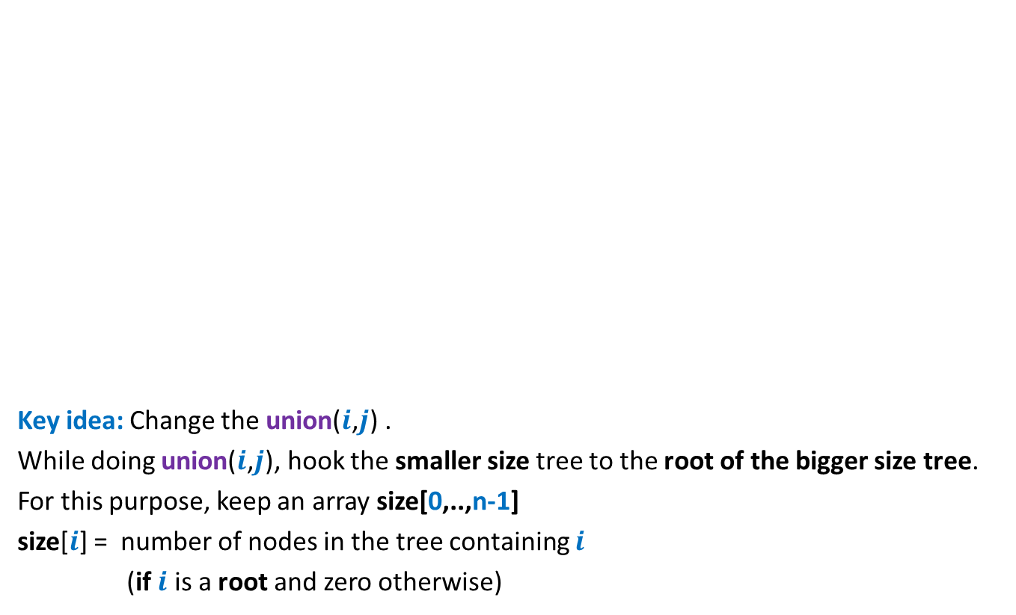



Improving the Time complexity
Key idea: Change the union($i$,$j$) .
While doing union($i$,$j$), hook the smaller size tree to the root of the bigger size tree.
For this purpose, keep an array size[0,..,n-1]
size[$i$] = number of nodes in the tree containing $i$
(if $i$ is a root and zero otherwise)
$$k$$
$$q$$
A
B
$$i$$
$j$

Slide 34
Efficient data structure for sets
0
1
2
3
4
5
6
7
8
9
10
11
Parent
0 1 2 3 4 5 6 7 8 9 10 11
0 1 2 3 4 5 6 7 8 9 10 11
size
1 1 1 1 1 1 1 1 1 1 1 1

Slide 35
Efficient data structure for sets
Union(11,0)
2
10
8
6
9
7
11
0
1
3
4
5
Parent
9 1 2 3 4 5 2 10 2 6 10 10
0 1 2 3 4 5 6 7 8 9 10 11
size
0 1 5 1 1 1 0 0 0 0 3 0

Slide 36
Efficient data structure for sets
2
10
8
6
9
7
11
0
1
3
4
5
Parent
9 1 2 3 4 5 2 10 2 6 10 10
0 1 2 3 4 5 6 7 8 9 10 11
size
0 1 5 1 1 1 0 0 0 0 3 0

Slide 37
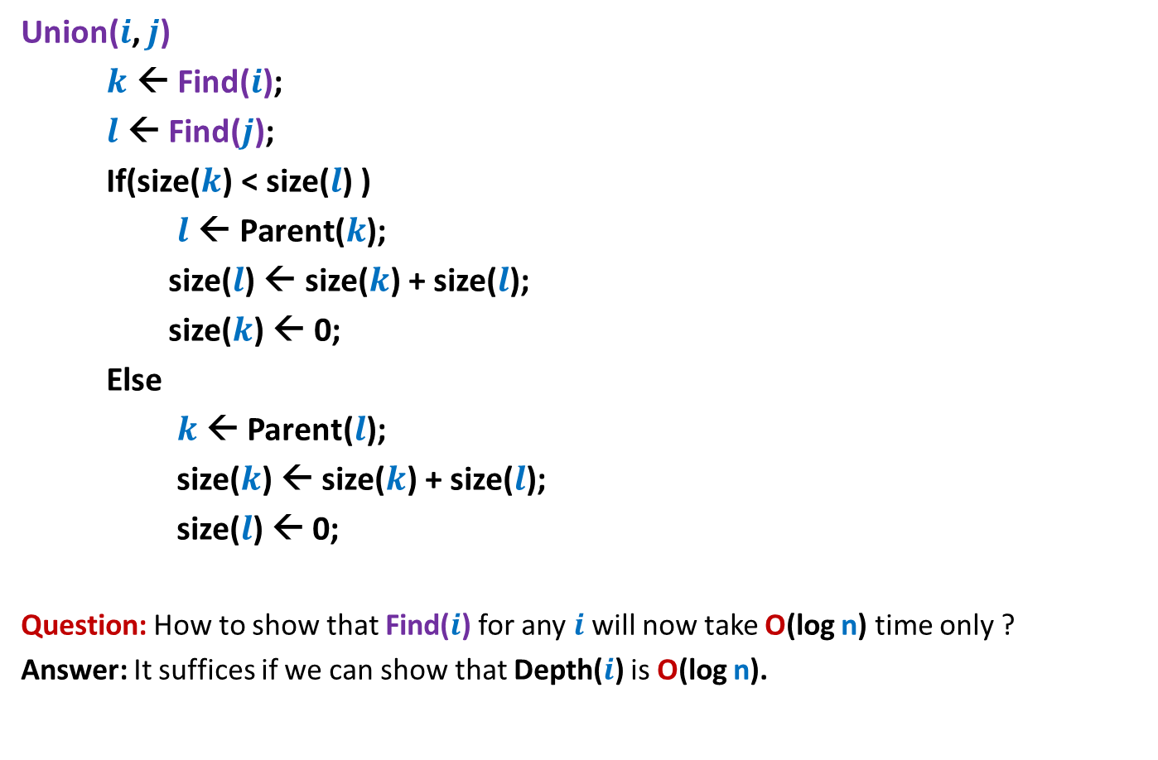
Pseudocode for modified Union
Union($i$, $j$)
$k$ ← Find($i$);
$l$ ← Find($j$);
If(size($k$) < size($l$) )
$l \text{←} \text{Parent}\text{(}k\text{);}$
size($l$) ← size($k$) + size($l$);
size($k$) ← 0;
Else
$k$ ← Parent($l$);
size($k$) ← size($k$) + size($l$);
size($l$) ← 0;
Question: How to show that Find($i$) for any $i$will now take O(log n) time only ?
Answer: It suffices if we can show that Depth($i$) is O(log n).

Slide 38
Can we infer history of a tree?
Answer: Can not be inferred with any certainty ☹.
2
8
6
Which one of these was
Added before the other ?

Slide 39
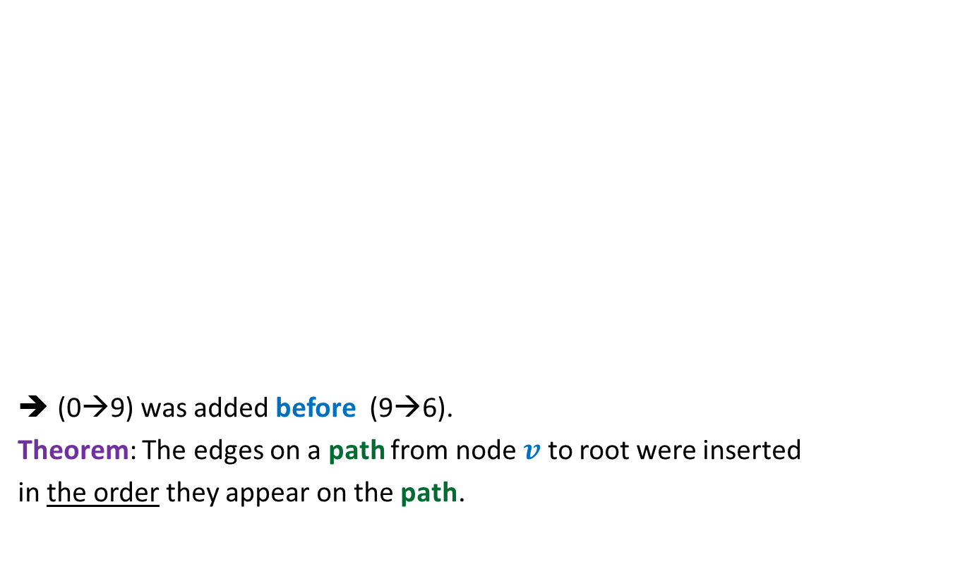
Can we infer history of a tree?
(0→9) was added before (9→6).
Theorem: The edges on a path from node $v$ to root were inserted
in the order they appear on the path.
During union, we join roots of two trees.
Which one of these was
Added before the other ?
2
8
1
9
10
6
7
0
4
11
5

Slide 40




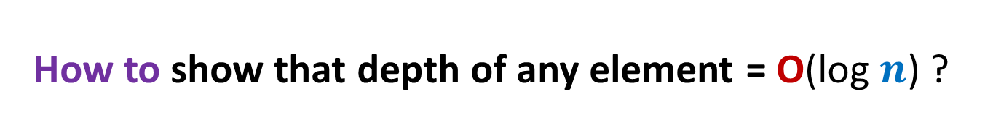






How to show that depth of any element = O(log $n$) ?
Let $e_{1},$ $e_{2}$, …, $e_{t}$ be the edges on the path from $i$ to the root.
Edges $e_{1},$ $e_{2}$, …, $e_{t}$ would have been added in the order:
$$e_{1}$$
$$e_{2}$$
…
$$e_{t}$$
$$r$$
$$e_{t}$$
A
Let us visit the history.
(how this tree came into being ? ).
$$q$$
B
$$e_{3}$$
$$k$$
$$e_{2}$$
X
$$p$$
$$e_{1}$$
Y
$$i$$
Y

Slide 41
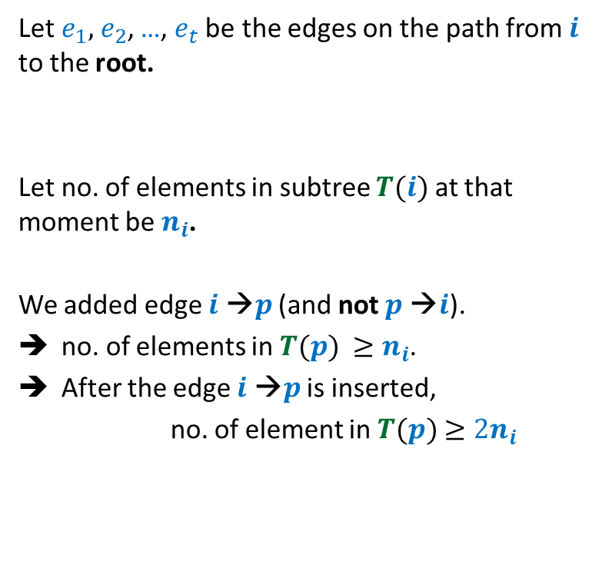
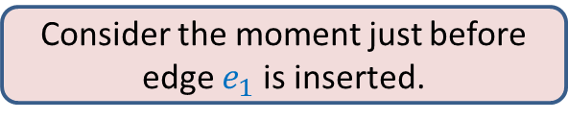

How to show that depth of any element = O(log $n$) ?
Let $e_{1},$ $e_{2}$, …, $e_{t}$ be the edges on the path from $i$ to the root.
Let no. of elements in subtree $T(i)$ at that moment be $n_{i}$.
We added edge $i$ →$p$ (and not $p$ →$i$).
no. of elements in $T(p)$ $≥n_{i}$.
After the edge $i$ →$p$ is inserted,
no. of element in $T(p)$ $≥2n_{i}$
Consider the moment just before edge $e_{1}$ is inserted.
$$p$$
$$e_{1}$$
Y
$$i$$
Z

Slide 42
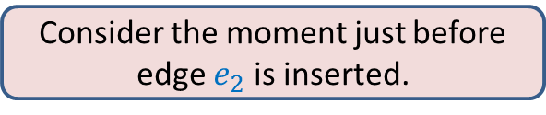
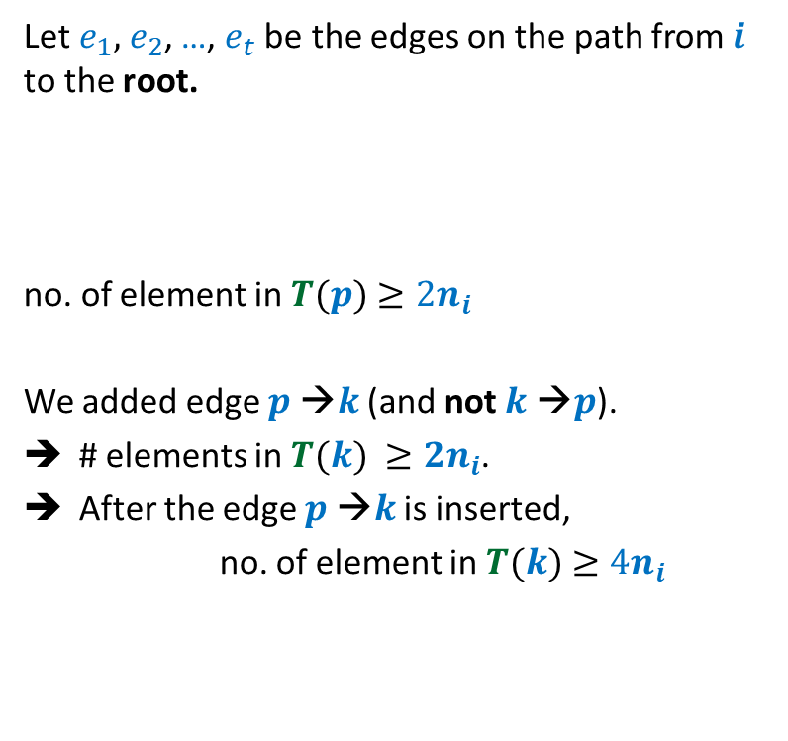
How to show that depth of any element = O(log $n$) ?
Let $e_{1},$ $e_{2}$, …, $e_{t}$ be the edges on the path from $i$ to the root.
no. of element in $T(p)$ $≥2n_{i}$
We added edge $p$ →$k$ (and not $k$ →$p$).
# elements in $T(k)$ $≥{2n}_{i}$.
After the edge $p$ →$k$ is inserted,
no. of element in $T(k)$ $≥4n_{i}$
Consider the moment just before edge $e_{2}$ is inserted.
$$k$$
$$e_{2}$$
X
$$p$$
$$e_{1}$$
Y
$$i$$
Z

Slide 43

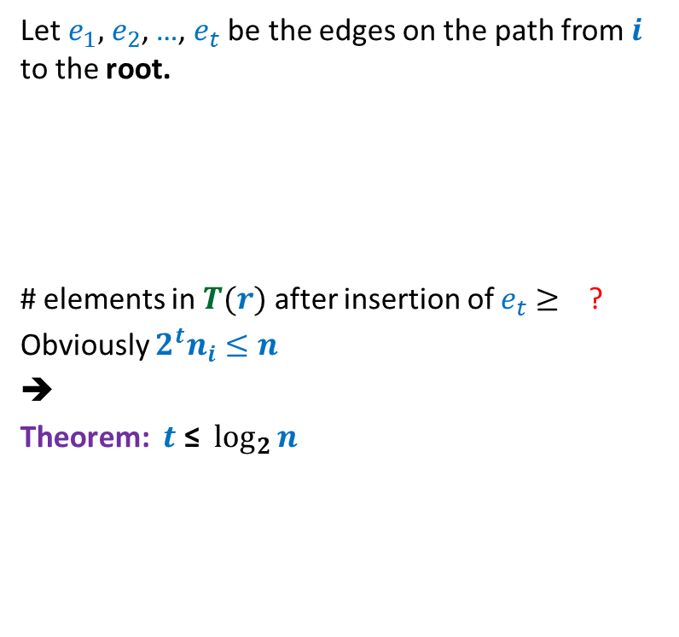




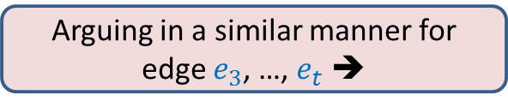

How to show that depth of any element = O(log $n$) ?
Let $e_{1},$ $e_{2}$, …, $e_{t}$ be the edges on the path from $i$ to the root.
# elements in $T(r)$ after insertion of $e_{t}$ $≥$ ?
Obviously ${2^{t}n}_{i}≤n$
➔
Theorem: $t \text{≤}$ $\log_{2}{n}$
$$r$$
$$e_{t}$$
A
$$q$$
B
Arguing in a similar manner for edge $e_{3}$, …, $e_{t}$ ➔
$$e_{3}$$
$$k$$
$${2^{t}n}_{i}$$
$$e_{2}$$
X
$$p$$
$$e_{1}$$
Y
$$i$$
Z

Slide 44
Theorem: Given a collection of n singleton sets
followed by a sequence of union and find operations,
there is a data structure based that achieves O(log n) time per operation.
Question: Can we achieve even better bounds ?
Answer: Yes.

Slide 45
A new heuristic for better time complexity
Heuristic 2: Path compression

Slide 46
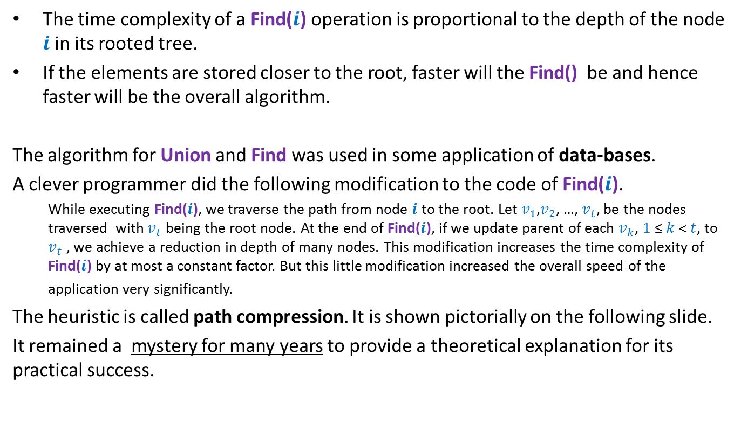
This is how this heuristic got invented
The time complexity of a Find($i$) operation is proportional to the depth of the node $i$in its rooted tree.
If the elements are stored closer to the root, faster will the Find() be and hence faster will be the overall algorithm.
The algorithm for Union and Find was used in some application of data-bases.
A clever programmer did the following modification to the code of Find($i$).
While executing Find($i$), we traverse the path from node $i$ to the root. Let $v_{1}$,$v_{2}$, …, $v_{t}$, be the nodes traversed with $v_{t}$ being the root node. At the end of Find($i$), if we update parent of each $v_{k}$, $1$≤ $k$< $t$, to $v_{t}$ , we achieve a reduction in depth of many nodes. This modification increases the time complexity of Find($i$) by at most a constant factor. But this little modification increased the overall speed of the application very significantly.
The heuristic is called path compression. It is shown pictorially on the following slide.
It remained a mystery for many years to provide a theoretical explanation for its practical success.

Slide 47
Path compression during Find(i)
v
v
S
i
q
g
S
x
x
A
B
D
H
H
g
D
q
B
i
A

Slide 48

Pseudocode for the modified Find
Find($i$)
If (Parent($i$) = $i$) return $i$ ;
else
$j$← Find(Parent($i$));
Parent($i$) ← $j$;
return $j$

Slide 49
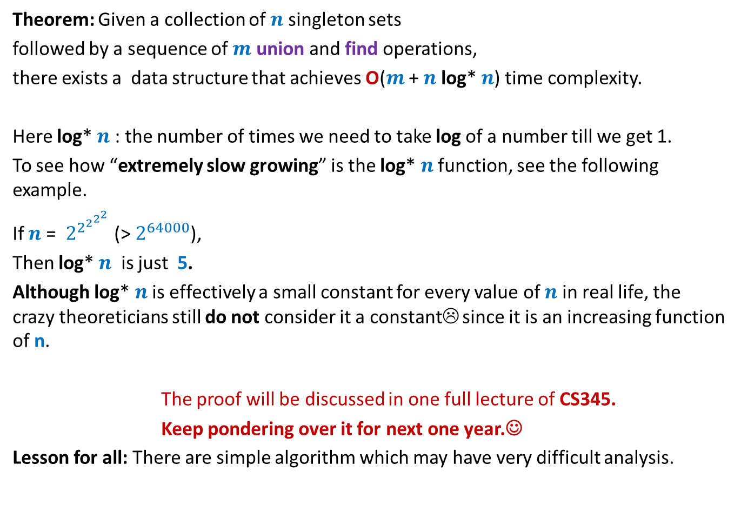
Concluding slide
Theorem: Given a collection of $n$ singleton sets
followed by a sequence of $m$ union and find operations,
there exists a data structure that achieves O($m$ + $n$ log* $n$) time complexity.
Here log* $n$ : the number of times we need to take log of a number till we get 1.
To see how “extremely slow growing” is the log* $n$ function, see the following example.
If $n$= $2^{2^{2^{2^{2}}}}$ (> $2^{64000}$),
Then log* $n$ is just 5.
Although log* $n$ is effectively a small constant for every value of $n$ in real life, the crazy theoreticians still do not consider it a constant☹ since it is an increasing function of n.
The proof will be discussed in one full lecture of CS345.
Keep pondering over it for next one year.☺
Lesson for all: There are simple algorithm which may have very difficult analysis.

Slide 50
Data Structure for
Dynamic Range minima
Attention:
First make sincere attempt to design the data structure on your ownbefore proceeding further.
It is for your own benefit only.

Slide 51
Data structure for dynamic range minima
Question: What should be stored in an internal node v ?
Answer:
minimum value stored in subtree(v).
2
4
2
4
21
8
2
4
9
21
29
25
8
2
11
Initial
sequence
4 14 9 17 23 21 29 91 37 25 8 33 2 67 11 44
${ x}_{0}$ ${ x}_{1}{ x}_{2 }x_{3}$ $x_{4}{ x}_{5}$ ${ x}_{6}$ ${ x}_{7}{ x}_{8 }x_{9}$ $x_{10}{ x}_{11}$ ${ x}_{12}$ ${ x}_{13}{ x}_{14 }x_{15}$

Slide 52
Data structure for dynamic range minima
How to do Report-Min(2,10) ?
2
4
2
4
21
8
2
4
9
21
29
25
8
2
11
Initial
sequence
4 14 9 17 23 21 29 91 37 25 8 33 2 67 11 44
${ x}_{0}$ ${ x}_{1}{ x}_{2 }x_{3}$ $x_{4}{ x}_{5}$ ${ x}_{6}$ ${ x}_{7}{ x}_{8 }x_{9}$ $x_{10}{ x}_{11}$ ${ x}_{12}$ ${ x}_{13}{ x}_{14 }x_{15}$

Slide 53
Data structure for dynamic range minima
How to do Report-Min(2,10) ?
2
4
2
4
21
8
2
4
9
21
29
25
8
2
11
Initial
sequence
4 14 9 17 23 21 29 91 37 25 8 33 2 67 11 44
${ x}_{0}$ ${ x}_{1}{ x}_{2 }x_{3}$ $x_{4}{ x}_{5}$ ${ x}_{6}$ ${ x}_{7}{ x}_{8 }x_{9}$ $x_{10}{ x}_{11}$ ${ x}_{12}$ ${ x}_{13}{ x}_{14 }x_{15}$

Slide 54



Data structure for dynamic range minima
0
Data structure: An array A of size 2n-1.
Copy the sequence S = ${≺x}_{0}$, …, $x_{n−1}≻$ into ??
Leaf node corresponding to $x_{i}$= ??
How to check if a node is left child or right child of its parent ?
(if index of the node is odd, then the node is left child, else the node is right child)
2
1 2
4
2
3 4 5 6
4
21
8
2
7 8 9 10 11 12 13 14
4
9
21
29
25
8
2
11
Initial
sequence
4 14 9 17 23 21 29 91 37 25 8 33 2 67 11 44
15 16 17 18 19 20 21 22 23 24 25 26 27 28 29 30
A[$n−1$]…A[$2n−2$]
A[($n−1)+i$]

Slide 55


Update($i,a$)
Update($i,a$)
$i$← $(n−1)+i$;
A[$i$]← $a$;
$i$ ← $\left\lfloor (i−1)/2\right\rfloor$ ;
While( ?? )
{
If($a$< A[$i$]) A[$i$]← $a$;
$i$ ← $\left\lfloor (i−1)/2\right\rfloor$ ;
}
$i$≥ 0
There is an error in the above pseudocode. Try spotting it.

Slide 56

Update($i,a$)
Update($i,a$)
$i$← $(n−1)+i$;
A[$i$]← $a$;
$i$ ← $\left\lfloor (i−1)/2\right\rfloor$ ;
While( ?? )
{
If( A[$2i+1$]< A[$2i+2$])
A[$i$]← A[$2i+1$]
else
A[$i$]← A[$2i+2$] ;
$i$ ← $\left\lfloor (i−1)/2\right\rfloor$ ;
}
$i$≥ 0
Here is the correct pseudocode.

Slide 57
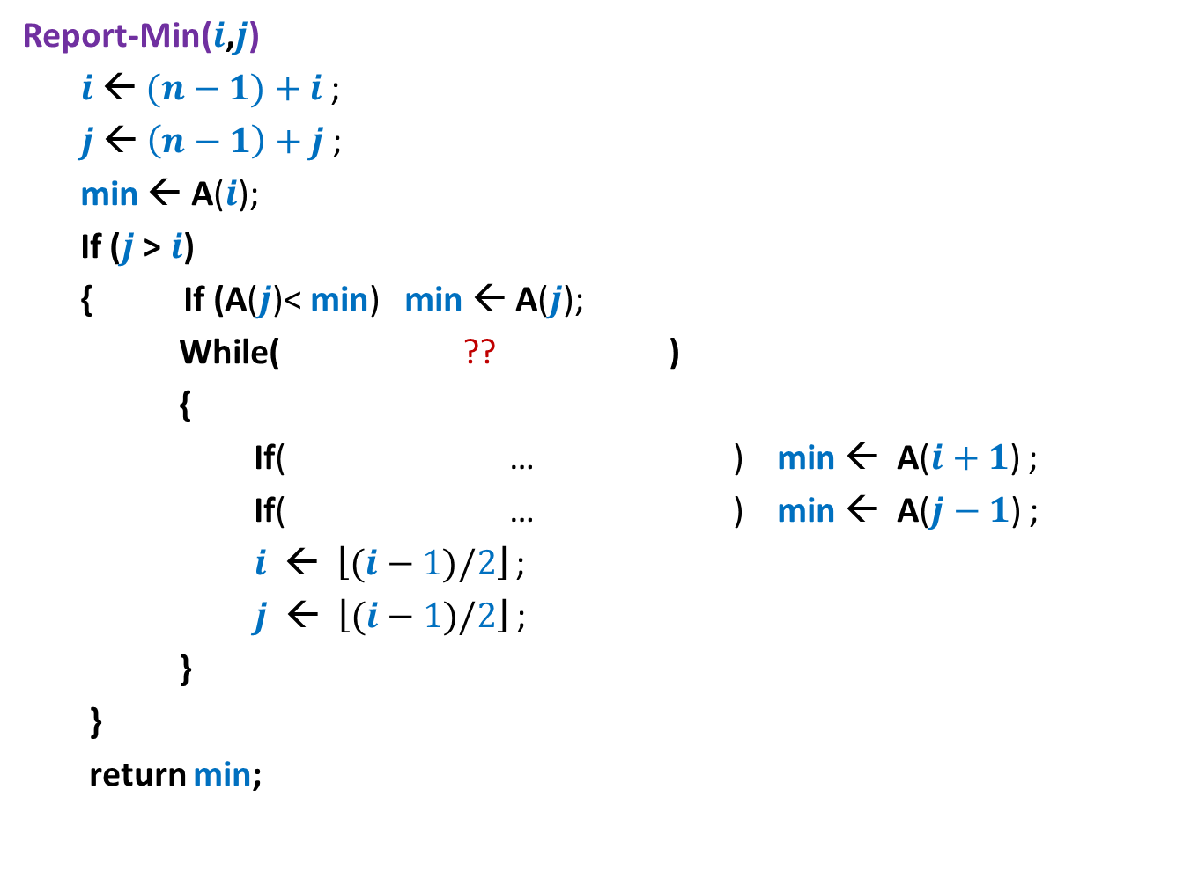




Report-Min($i$,$j$)
Report-Min($i$,$j$)
$i$← $(n−1)+i$;
$j$← $\left(n−1\right)+j$;
min ← A($i$);
If ($j$> $i$)
{ If (A($j$)< min) min ← A($j$);
While( ?? )
{
If( … ) min ← A($i+1$) ;
If( … ) min ← A($j−1$) ;
$i$ ← $\left\lfloor (i−1)/2\right\rfloor$ ;
$j$ ← $\left\lfloor (i−1)/2\right\rfloor$ ;
}
}
return min;
$\left\lfloor (i−1)/2\right\rfloor$ <> $\left\lfloor (j−1)/2\right\rfloor$
$i$%2=1 and A($i+1$)< min
$j$%2=0 and A($j−1$)< min

