Slide 1
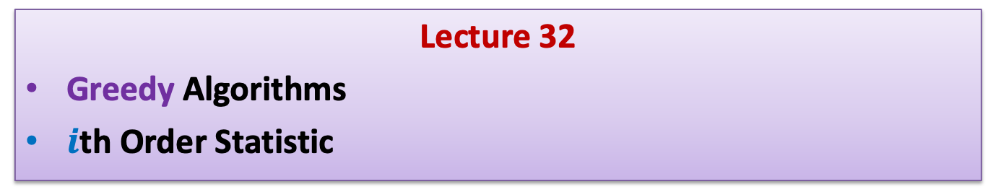
Data Structures and Algorithms (ESO207A)
Lecture 32
Greedy Algorithms
$i$th Order Statistic

Slide 2

Path to the solution of a problem
Examples
intuition/insight
Strategy
Have perseverance
Failure ☹
Better Insight ☺
No formula
But there is a systematic approach which usually works ☺
Success ☺

Slide 3
Today’s lecture will demonstrate this approach ☺
Problem : JOB Scheduling
Largest subset of non-overlapping job

Slide 4
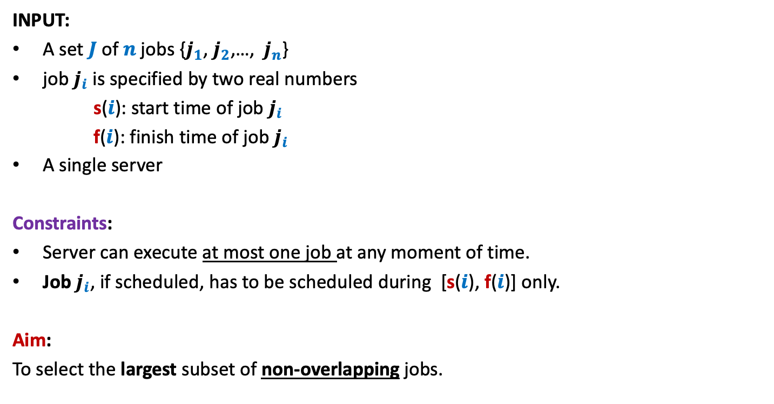
A job scheduling problem
Formal Description
INPUT:
A set $J$of $n$ jobs {$j_{1}$, $j_{2}$,…, $j_{n}$}
job $j_{i}$ is specified by two real numbers
s($i$): start time of job $j_{i}$
f($i$): finish time of job $j_{i}$
A single server
Constraints:
Server can execute at most one job at any moment of time.
Job $j_{i}$, if scheduled, has to be scheduled during [s($i$), f($i$)] only.
Aim:
To select the largest subset of non-overlapping jobs.

Slide 5

Example
INPUT: ($1$, $2$), ($1.2$, $2.8$), ($1.8$, $4.6$), ($2.1$, $3$), ($3$, $5$), ($3.3$, $4.2$), ($3.9$, $4.4$), ($4.3$, $5.4$)
job $i$ is said to be non-overlapping with job $k$if [s($i$), f($i$)] ∩[s($k$), f($k$)] = ∅
0 1 2 3 4 5 6 7
It makes sense to work with pictures than these numbers☺
Try to find solution for the above example.

Slide 6
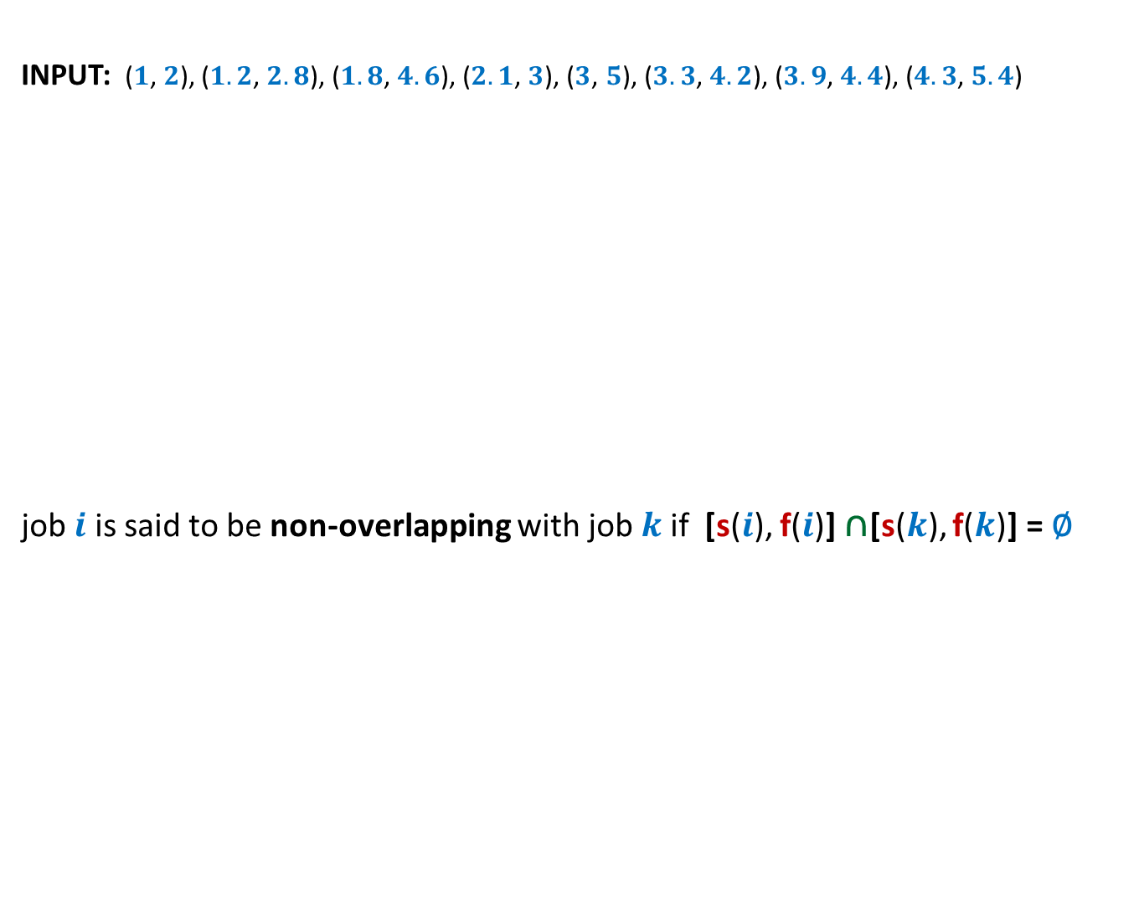
Example
INPUT: ($1$, $2$), ($1.2$, $2.8$), ($1.8$, $4.6$), ($2.1$, $3$), ($3$, $5$), ($3.3$, $4.2$), ($3.9$, $4.4$), ($4.3$, $5.4$)
job $i$ is said to be non-overlapping with job $k$if [s($i$), f($i$)] ∩[s($k$), f($k$)] = ∅
0 1 2 3 4 5 6 7
What strategy come to your mind?

Slide 7
Designing algorithm for any problem
Choose a strategy based on some intuition
Transform the strategy into an algorithm.
Try to prove
correctness
of the
algorithm
c
Try to design a
conterexample
c
Stop as soon as either of these goals is reached

Slide 8
Designing algorithm for the problem
Strategy 1: Select the earliest start time job
Intuition:
It might be better to assign jobs as early as possible so as to make optimum use of server.
0 1 2 3 4 5 6 7
When one fails to prove the correctness of this strategy, one should search for a counterexample. Can you transform the above example into a counterexample ?

Slide 9
Designing algorithm for the problem
Strategy 1: Select the earliest start time job
Intuition:
It might be better to assign jobs as early as possible so as to make optimum use of server.
0 1 2 3 4 5 6 7

Slide 10
Designing algorithm for the problem
Strategy 1: Select the earliest start time job
Intuition:
It might be better to assign jobs as early as possible so as to make optimum use of server.
0 1 2 3 4 5 6 7
Instead of getting disappointed, try to realize that this counterexample points towards some other strategy which might work.
counterexample. ☹

Slide 11
Designing algorithm for the problem
Strategy 2: Select the job with smallest duration
Intuition:
Such a job will make least use of the server
➔ this might lead to larger number of jobs to be executed
0 1 2 3 4 5 6 7
When one fails to prove the correctness of this strategy, one should search for a counterexample. Can you transform the above example into a counterexample ?

Slide 12
Designing algorithm for the problem
Strategy 2: Select the job with smallest duration
Intuition:
Such a job will make least use of the server
➔ this might lead to larger number of jobs to be executed
0 1 2 3 4 5 6 7
Instead of getting disappointed, try to realize that this counterexample points towards some other strategy which might work.
counterexample. ☹

Slide 13
Designing algorithm for the problem
Strategy 3: Select the job with smallest no. of overlaps
Intuition:
Selecting such a job will result in least number of other jobs to be discarded.
0 1 2 3 4 5 6 7
When one fails to prove the correctness of this strategy, one should search for a counterexample. Can you transform the above example into a counterexample ?

Slide 14
Designing algorithm for the problem
Strategy 4: Select the job with earliest finish time
Intuition:
Selecting such a job will free the server earliest
➔ hence more no. of jobs might get scheduled.
0 1 2 3 4 5 6 7

Slide 15
Designing algorithm for the problem
Strategy 4: Select the job with earliest finish time
Homework:
For Strategy 3 and Strategy 4,
Prove their correctness or give a counterexample.
0 1 2 3 4 5 6 7

Slide 16

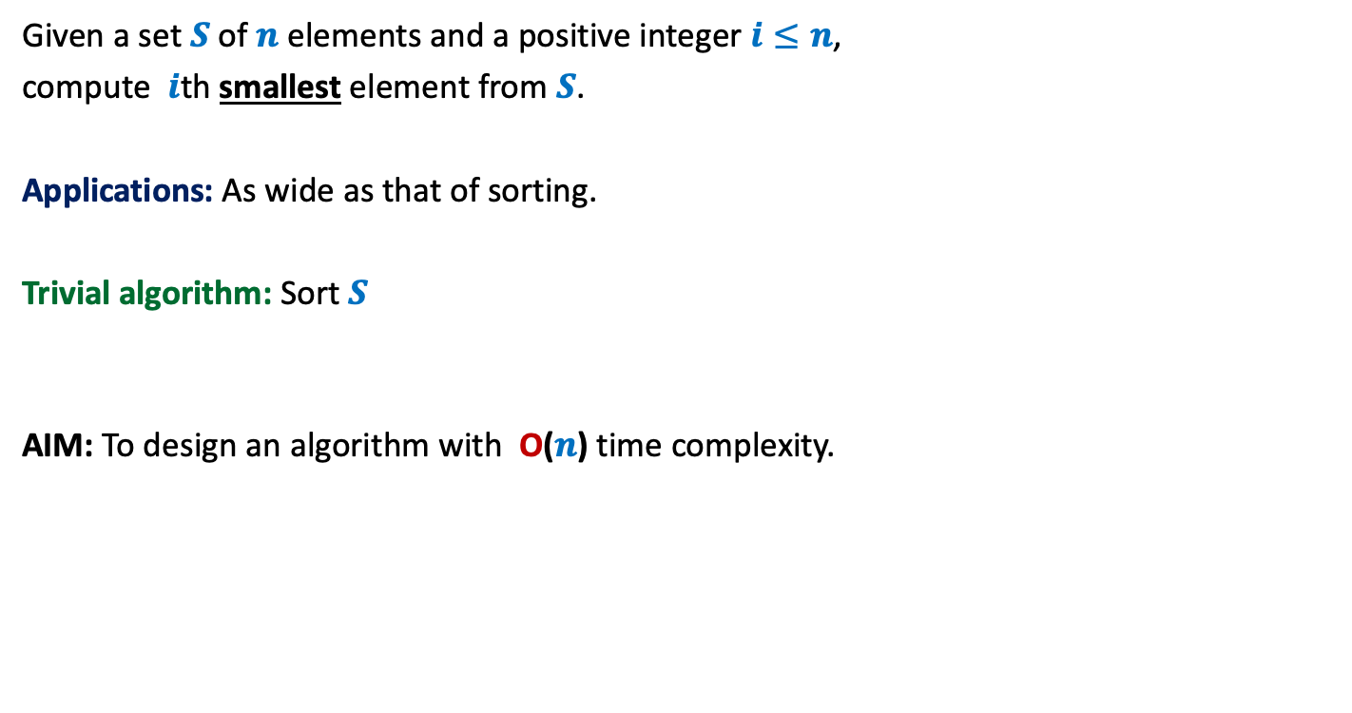

Problem definition
Given a set $S$of $n$ elements and a positive integer $i≤n$,
compute $i$th smallest element from $S$.
Applications: As wide as that of sorting.
Trivial algorithm: Sort $S$
AIM: To design an algorithm with O($n$) time complexity.
But sorting takes O(n log n) time
and appears to be an overkill
for this simple problem.
$$1945$$
$$1972$$

Slide 17
Notations
We shall now introduce some notations which will help in a neat description of the algorithm.

Slide 18
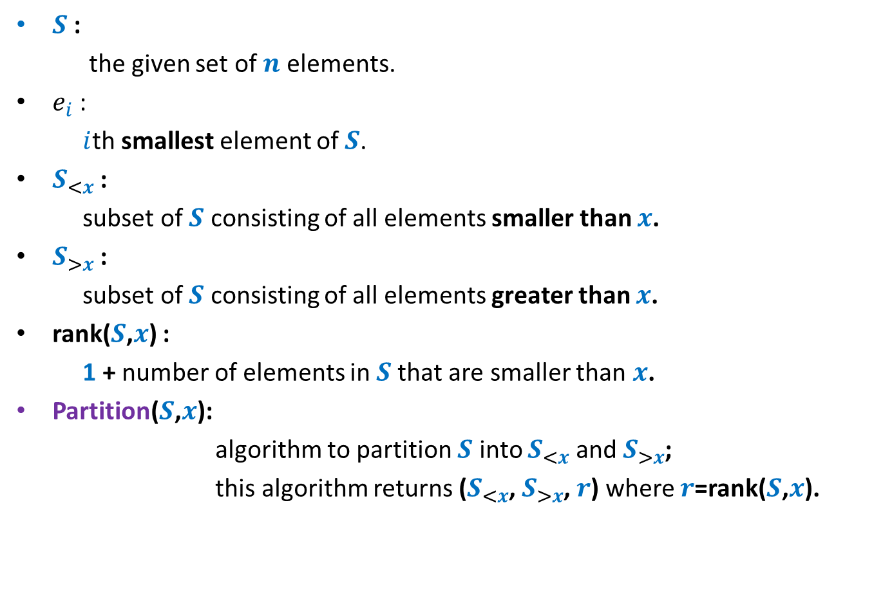
Notations
$S$ :
the given set of $n$ elements.
$e_{i}$ :
$i$th smallest element of $S$.
$S_{<x}$ :
subset of $S$ consisting of all elements smaller than $x$.
$S_{>x}$ :
subset of $S$ consisting of all elements greater than $x$.
rank($S$,$x$) :
1 + number of elements in $S$that are smaller than $x$.
Partition($S$,$x$):
algorithm to partition $S$ into $S_{<x}$ and $S_{>x}$;
this algorithm returns ($S_{<x}$, $S_{>x}$, $r$) where $r$=rank($S$,$x$).

Slide 19

Why should an O($n$) time algorithm exist ?
(inspiration from QuickSort)

Slide 20
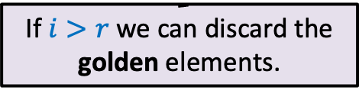





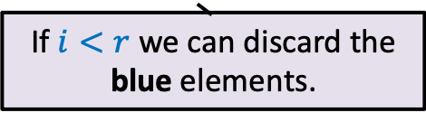
QuickSelect($S$,$i$)
0 1 2 3 4 5 6 7 8
> $e_{r}$
$$S$$
< $e_{r}$
$$e_{r}$$
If $i>r$ we can discard the golden elements.
If $i<r$ we can discard the blue elements.

Slide 21
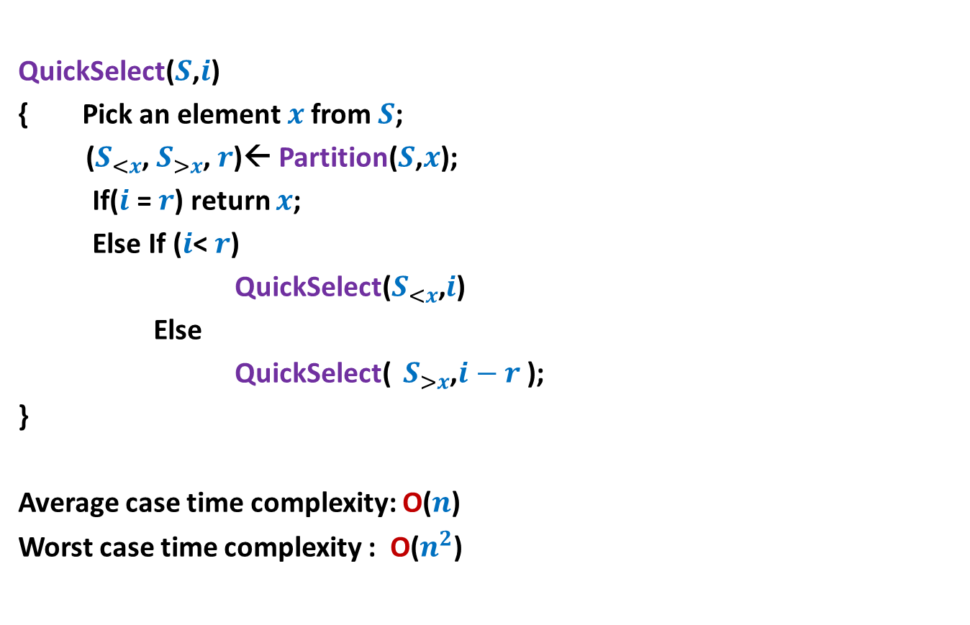
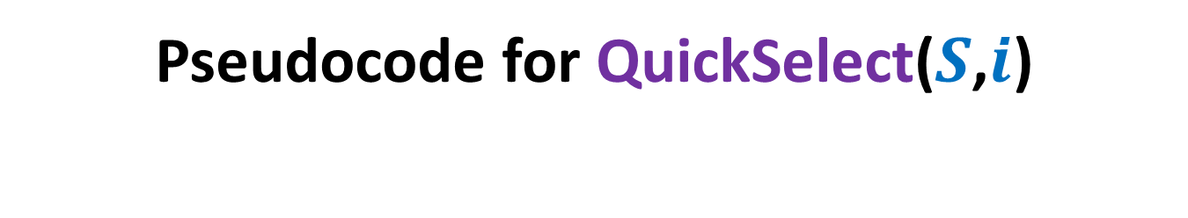
Pseudocode for QuickSelect($S$,$i$)
QuickSelect($S$,$i$)
{ Pick an element $x$from $S$;
($S_{<x}$, $S_{>x}$, $r$)← Partition($S$,$x$);
If($i$ = $r$) return $x$;
Else If ($i$< $r$)
QuickSelect($S_{<x}$,$i$)
Else
QuickSelect( $S_{>x}$,$i−r$ );
}
Average case time complexity: O($n$)
Worst case time complexity : O($n^{2}$)
Analysis is simpler than Quick Sort.

Slide 22

Towards worst case O($n$) time algorithm …

Slide 23

Key ideas
Inspiration from some recurrences.
Concept of approximate median
Learning from QuickSelect($S$,$i$)
isn’t is surprising that knowledge of recurrence
can help in the design an efficient algorithm) ☺
This is the usual trick:
When a problem appears difficult, weaken the problem and try to solve it.
This is also a natural choice.
Can we fine tune this algorithm to achieve our goal ?

Slide 24

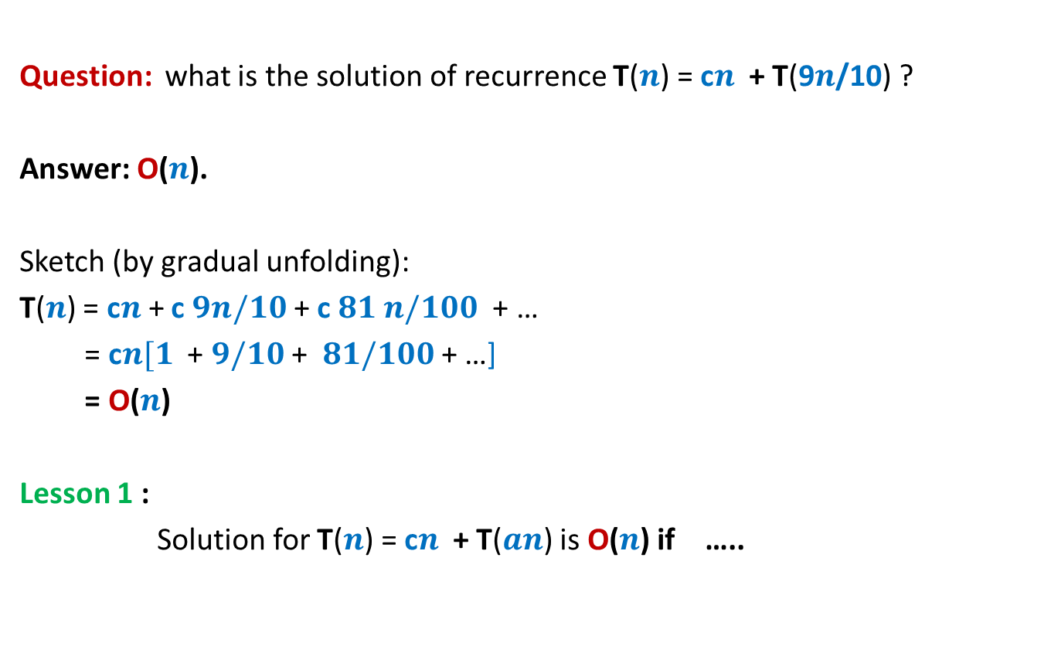
Revisiting Recurrences
Question: what is the solution of recurrence T($n$) = c$n$ + T(9$n$/10) ?
Answer: O($n$).
Sketch (by gradual unfolding):
T($n$) = c$n$+ c $9n/10$ + c $81 n/100$ + …
= c$n[1$ + $9/10$ + $81/100$ + …]
= O($n$)
Lesson 1 :
Solution for T($n$) = c$n$ + T($an$) is O($n$) if …..
$0<a<1$.

Slide 25

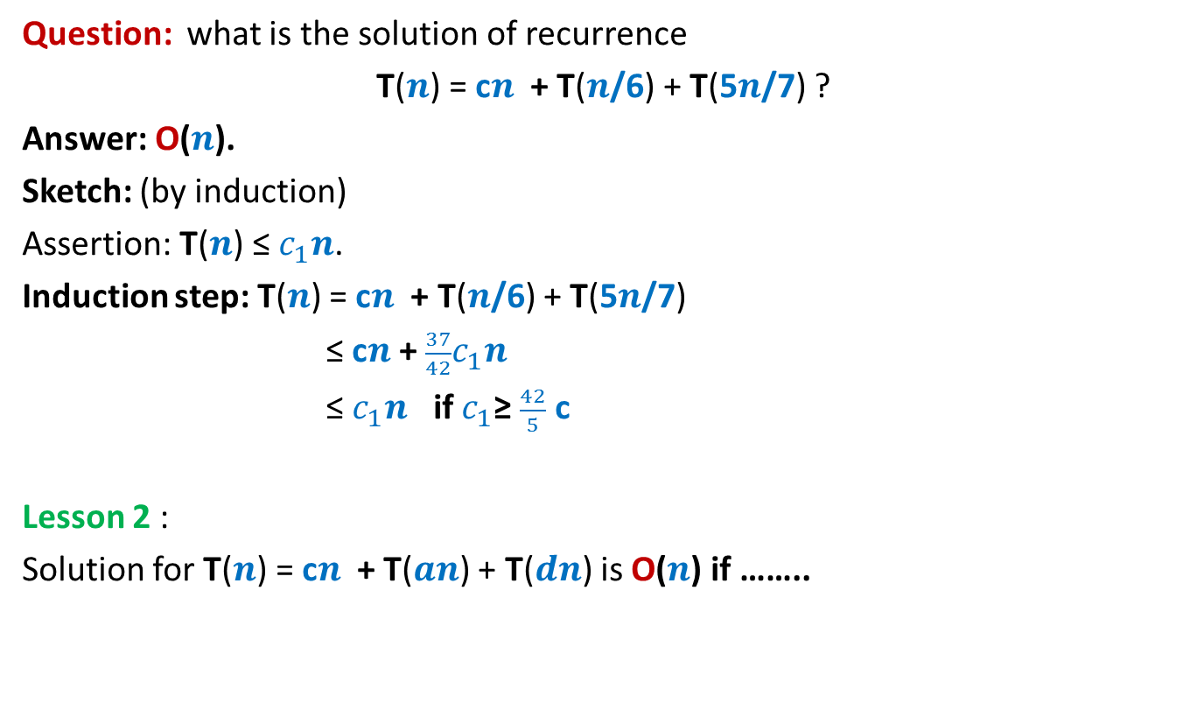
Revisiting recurrences
Question: what is the solution of recurrence
T($n$) = c$n$ + T($n$/6) + T(5$n$/7) ?
Answer: O($n$).
Sketch: (by induction)
Assertion: T($n$) ≤ $c_{1}n$.
Induction step: T($n$) = c$n$ + T($n$/6) + T(5$n$/7)
≤ c$n$ + $\frac{37}{42}c_{1}n$
≤ $c_{1}n$ if $c_{1}$≥ $\frac{42}{5}$ c
Lesson 2 :
Solution for T($n$) = c$n$ + T($an$) + T($dn$) is O($n$) if ……..
$a+d<1$.

Slide 26







Concept of approximate median
Definition: Given a constant $0<b≤1/2$,
an element $x$ ϵ $S$ is said to be $b$-approximate median of $S$
if rank($x,S$) is in the range [$bn$, ($1−b$)$n$].
$$e_{1}$$
$$e_{2}$$
$$e_{bn}$$
$$x$$
$$e_{(1−b)n}$$
$$e_{n}$$

Slide 27
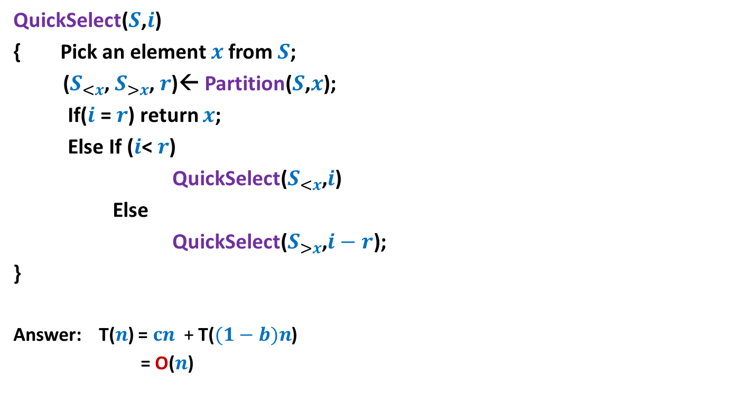



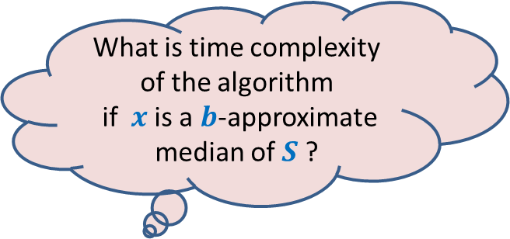
Learning from QuickSelect($S$,$i$)
QuickSelect($S$,$i$)
{ Pick an element $x$from $S$;
($S_{<x}$, $S_{>x}$, $r$)← Partition($S$,$x$);
If($i$ = $r$) return $x$;
Else If ($i$< $r$)
QuickSelect($S_{<x}$,$i$)
Else
QuickSelect($S_{>x}$,$i−r$);
}
Answer: T($n$) = $cn$ + T($(1−b)n$)
= O($n$)
O($n$)
T( $(1−b)n$)
What is time complexity of the algorithm
if $x$ is a $b$-approximate median of $S$ ?
Lesson 1

Slide 28
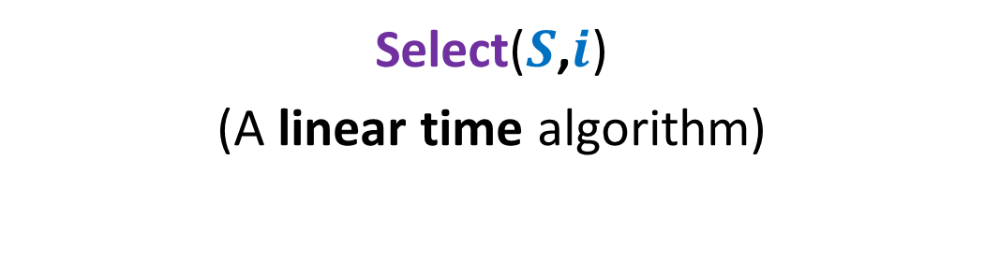
Algorithm 2
Select($S$,$i$)
(A linear time algorithm)

Slide 29

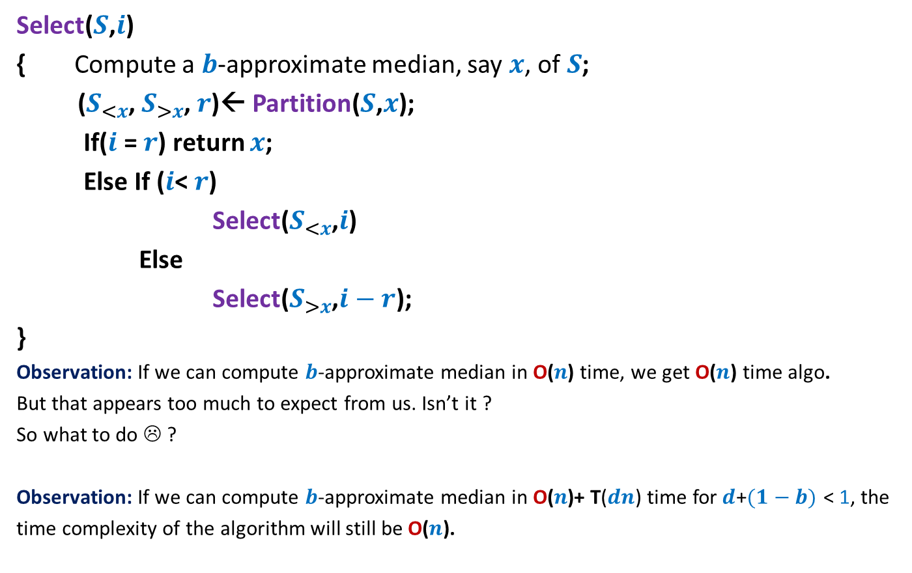


Overview of the algorithm
Select($S$,$i$)
{ Compute a $b$-approximate median, say $x$, of$S$;
($S_{<x}$, $S_{>x}$, $r$)← Partition($S$,$x$);
If($i$ = $r$) return $x$;
Else If ($i$< $r$)
Select($S_{<x}$,$i$)
Else
Select($S_{>x}$,$i−r$);
}
Observation: If we can compute $b$-approximate median in O($n\text{)}$ time, we get O($n$) time algo.
But that appears too much to expect from us. Isn’t it ?
So what to do ☹ ?
Observation: If we can compute $b$-approximate median in O($n\text{)+} \text{T}\text{(}dn\text{)}$time for$d$+$(1−b)$ < 1, the
time complexity of the algorithm will still be O($n$).
O($n\text{) +} \text{T}\text{(}dn\text{)}$
O($n$)
T( $(1−b)n$)
Hint: use Lesson 2
Spend some time on this observation to infer what it hints at.

Slide 30
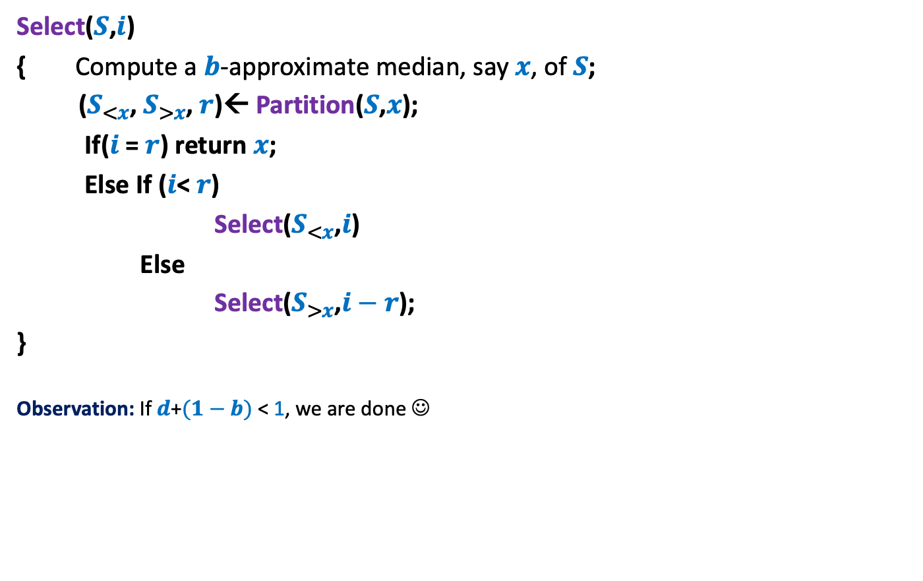
Overview of the algorithm
Select($S$,$i$)
{ Compute a $b$-approximate median, say $x$, of$S$;
($S_{<x}$, $S_{>x}$, $r$)← Partition($S$,$x$);
If($i$ = $r$) return $x$;
Else If ($i$< $r$)
Select($S_{<x}$,$i$)
Else
Select($S_{>x}$,$i−r$);
}
Observation: If $d$+$(1−b)$ < 1, we are done ☺
O($n\text{) +} \text{T}\text{(}dn\text{)}$
O($n$)
T( $(1−b)n$)
Hint: use Lesson 2

Slide 31


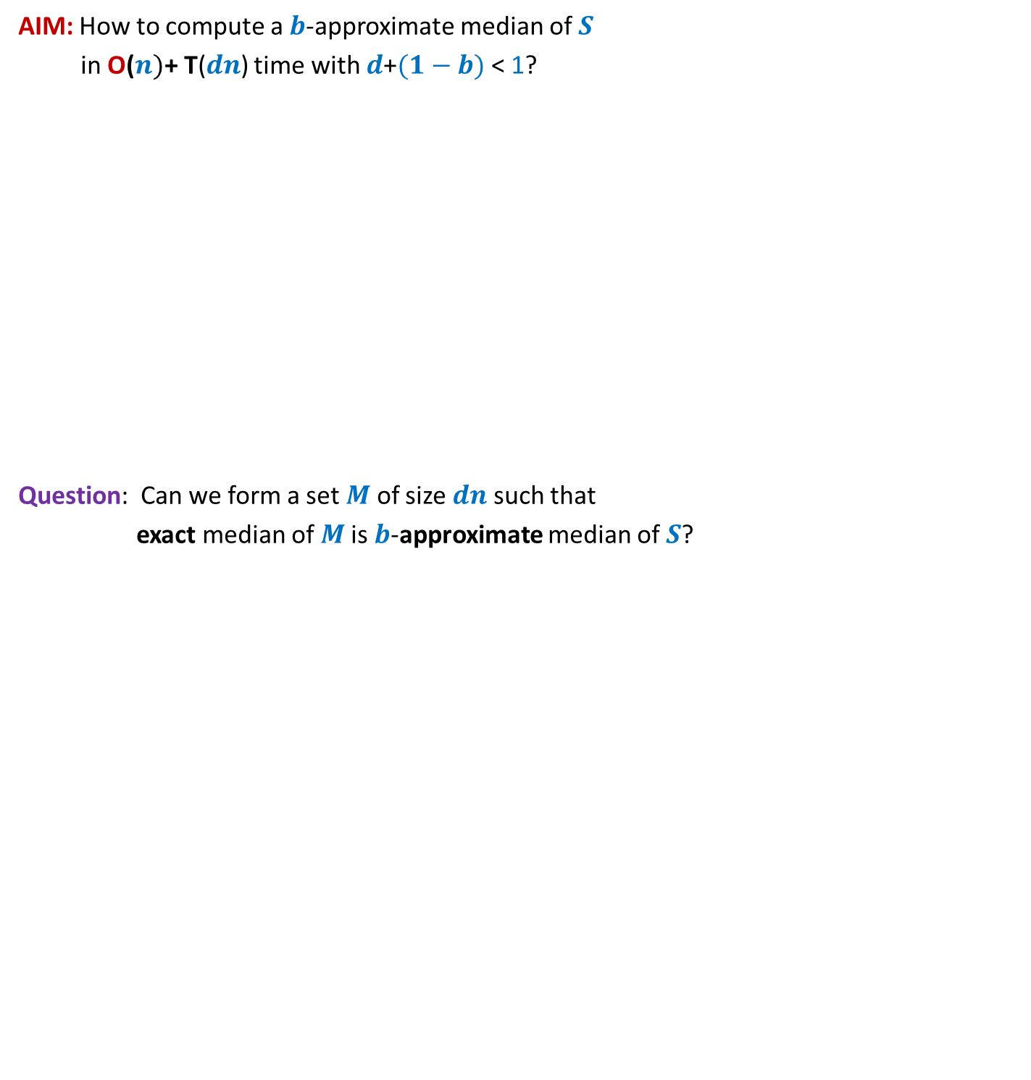


AIM: How to compute a $b$-approximate median of $S$
in O($n)\text{+} \text{T}\text{(}dn\text{)}$ time with $d$+$(1−b)$ < 1?
Question: Can we form a set $M$ of size $dn$such that
exact median of $M$is $b$-approximate median of $S$?
$$S$$
$$M$$

Slide 32
Homework
Ponder over how to achieve the aim mentioned in the previous slide.

Slide 33
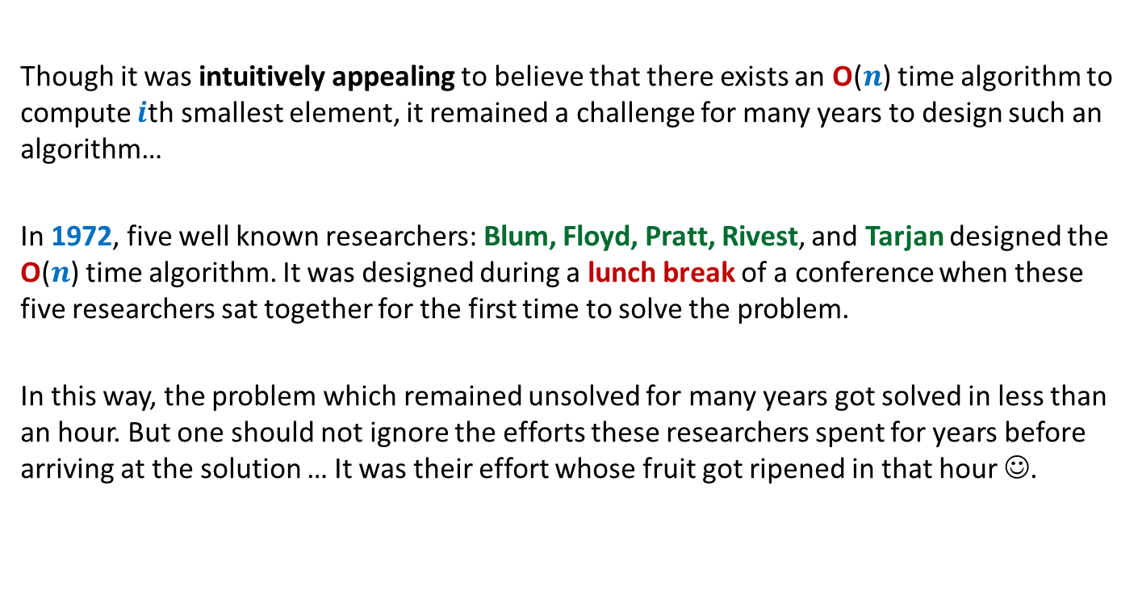
A motivational background
Though it was intuitively appealing to believe that there exists an O($n$) time algorithm to compute $i$th smallest element, it remained a challenge for many years to design such an algorithm…
In 1972, five well known researchers: Blum, Floyd, Pratt, Rivest, and Tarjan designed the O($n$) time algorithm. It was designed during a lunch break of a conference when these five researchers sat together for the first time to solve the problem.
In this way, the problem which remained unsolved for many years got solved in less than an hour. But one should not ignore the efforts these researchers spent for years before arriving at the solution … It was their effort whose fruit got ripened in that hour ☺.

