Slide 1
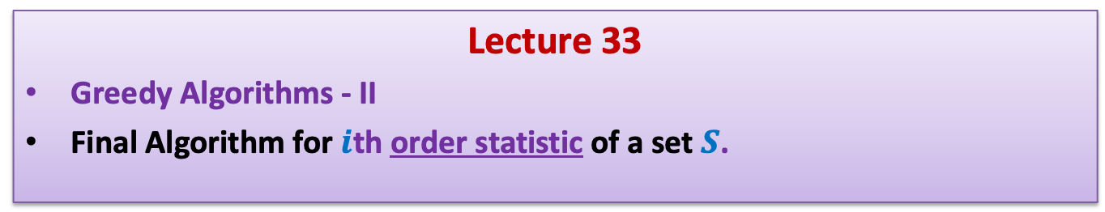
Data Structures and Algorithms (ESO207A)
Lecture 33
Greedy Algorithms - II
Final Algorithm for $i$th order statistic of a set $S$.

Slide 2
RECAP of the Previous Lecture

Slide 3
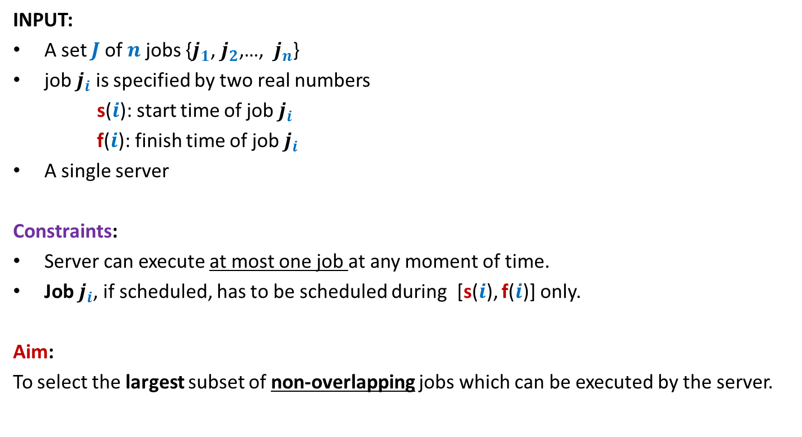
A job scheduling problem
Formal Description
INPUT:
A set $J$of $n$ jobs {$j_{1}$, $j_{2}$,…, $j_{n}$}
job $j_{i}$ is specified by two real numbers
s($i$): start time of job $j_{i}$
f($i$): finish time of job $j_{i}$
A single server
Constraints:
Server can execute at most one job at any moment of time.
Job $j_{i}$, if scheduled, has to be scheduled during [s($i$), f($i$)] only.
Aim:
To select the largest subset of non-overlapping jobs which can be executed by the server.

Slide 4
Designing algorithm for the problem
Strategy 3: Select the job with smallest no. of overlaps
Intuition:
Selecting such a job will result in least number of other jobs to be discarded.
0 1 2 3 4 5 6 7
When one fails to prove the correctness of this strategy, one should search for a counterexample. Can you transform the above example into a counterexample ?

Slide 5
Designing algorithm for the problem
Strategy 3: Select the job with smallest no. of overlaps
Intuition:
Selecting such a job will result in least number of other jobs to be discarded.
0 1 2 3 4 5 6 7
counterexample.

Slide 6
Designing algorithm for the problem
Strategy 4: Select the job with earliest finish time
Intuition:
Selecting such a job will free the server earliest
➔ hence more no. of jobs might get scheduled.
0 1 2 3 4 5 6 7

Slide 7
Designing algorithm for the problem
Strategy 4: Select the job with earliest finish time
Intuition:
Selecting such a job will free the server earliest
➔ hence more no. of jobs might get scheduled.
0 1 2 3 4 5 6 7

Slide 8
Designing algorithm for the problem
Strategy 4: Select the job with earliest finish time
Intuition:
Selecting such a job will free the server earliest
➔ hence more no. of jobs might get scheduled.
0 1 2 3 4 5 6 7

Slide 9
Designing algorithm for the problem
Strategy 4: Select the job with earliest finish time
Intuition:
Selecting such a job will free the server earliest
➔ hence more no. of jobs might get scheduled.
0 1 2 3 4 5 6 7
It is indeed a correct solution for this example. We should try to prove the correctness of the algorithm.☺But first we give a full description of the algorithm based on this strategy.

Slide 10
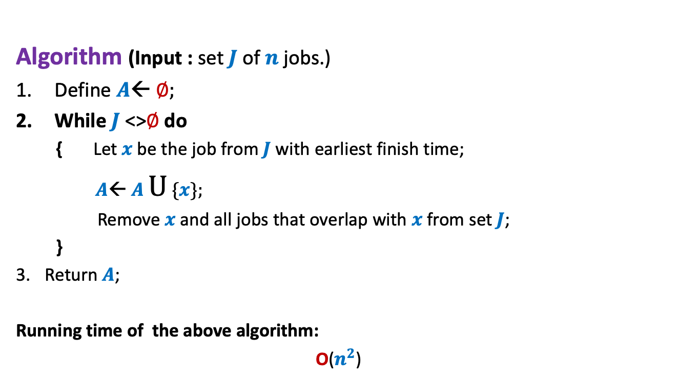
Algorithm “earliest finish time” Description
Algorithm (Input : set $J$of $n$ jobs.)
Define $A$← ∅;
While $J$<>∅ do
{ Let $x$be the job from $J$with earliest finish time;
$A$← $A$ U {$x$};
Remove $x$and all jobs that overlap with $x$from set $J$;
}
Return $A$;
Running time of the above algorithm:
O($n^{2}$)

Slide 11

Algorithm “earliest finish time” Correctness
Let $x$ be the job with earliest finish time.
Lemma1: $x$is present in the optimal solution for $J$.
Too strong a claim !
Wrong
0 1 2 3 4 5 6 7

Slide 12
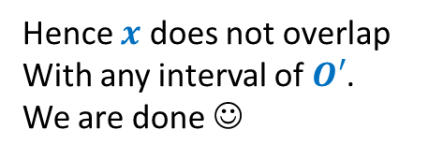






Algorithm “earliest finish time” Correctness
Let $x$ be the job with earliest finish time.
Lemma1: There exists an optimal solution for $J$in which $x$is present.
Proof: Consider any optimal solution $O$ for $J$. Let us suppose $x$∉ $O$.
Let $y$ be the job from $O$ with earliest finish time.
Let $O′$← $O\backslash \{y\}$
$O^{′}∪\{x\}$ is also an optimal solution.
Reason: $O^{′}∪\{x\}$ has no overlapping intervals. Give arguments.
➔f($x$) $≤$ f($y$)
➔f($y$) < s($z$) $∀$ $z∈$ $O′$
➔f($x$) < s($z$) $∀$ $z∈$ $O′$
$$x$$
Hence $x$ does not overlap
With any interval of $O′$.
We are done ☺
$$y$$
0 1 2 3 4 5 6 7

Slide 13

Homework
Design an O($n$log $n$) implementation of the algorithm.

Slide 14

Problem definition
Given a set $S$of $n$ elements and a positive integer $i≤n$,
compute $i$th smallest element from $S$.
AIM: To design an algorithm with O($n$) time complexity.

Slide 15



Lessons from recurrences
Lesson 1 :
Solution for T($n$) = c$n$ + T($an$) is O($n$) if …..
Lesson 2 :
Solution for T($n$) = c$n$ + T($an$) + T($dn$) is O($n$) if ……..
$0<a<1$.
$a+d<1$.

Slide 16
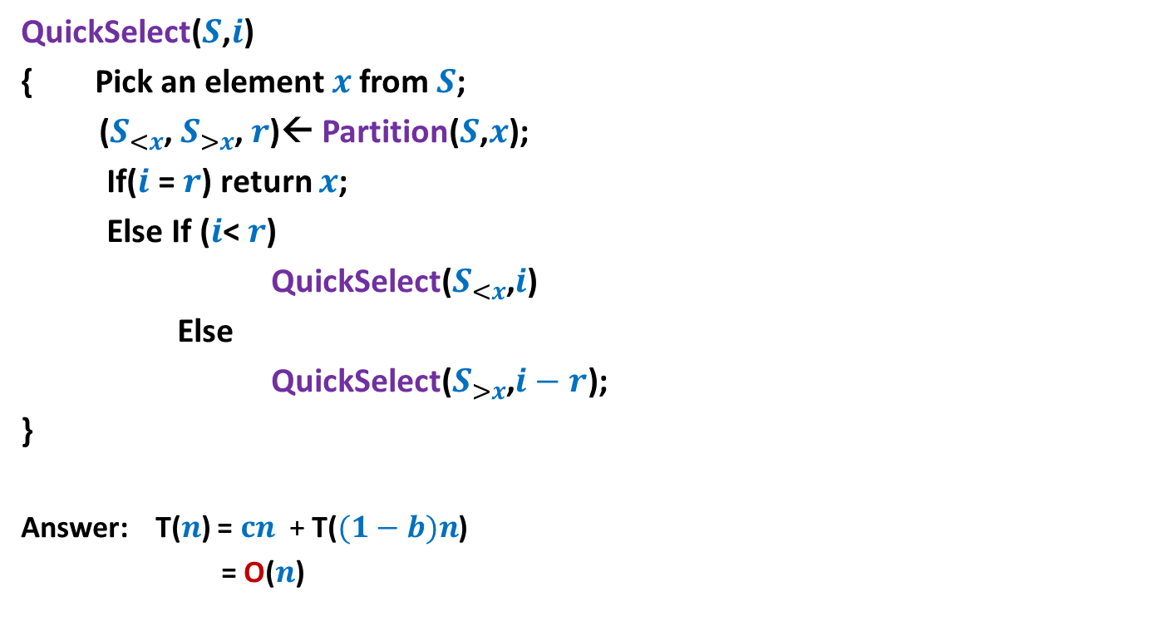



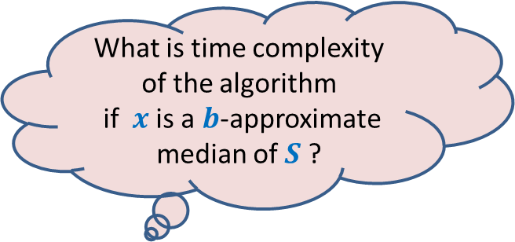
Learning from QuickSelect($S$,$i$)
QuickSelect($S$,$i$)
{ Pick an element $x$from $S$;
($S_{<x}$, $S_{>x}$, $r$)← Partition($S$,$x$);
If($i$ = $r$) return $x$;
Else If ($i$< $r$)
QuickSelect($S_{<x}$,$i$)
Else
QuickSelect($S_{>x}$,$i−r$);
}
Answer: T($n$) = $cn$ + T($(1−b)n$)
= O($n$)
O($n$)
T( $(1−b)n$)
What is time complexity of the algorithm
if $x$ is a $b$-approximate median of $S$ ?
Lesson 1

Slide 17
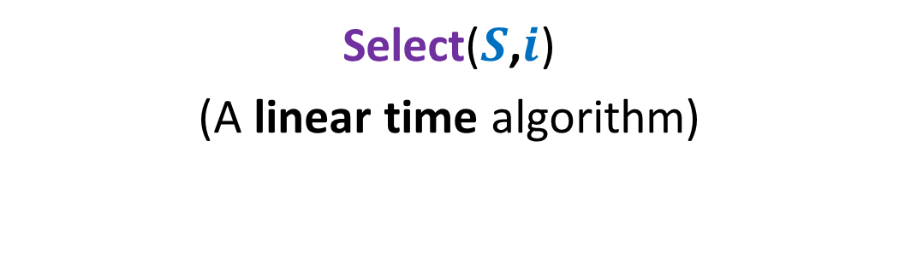
Algorithm 2
Select($S$,$i$)
(A linear time algorithm)

Slide 18

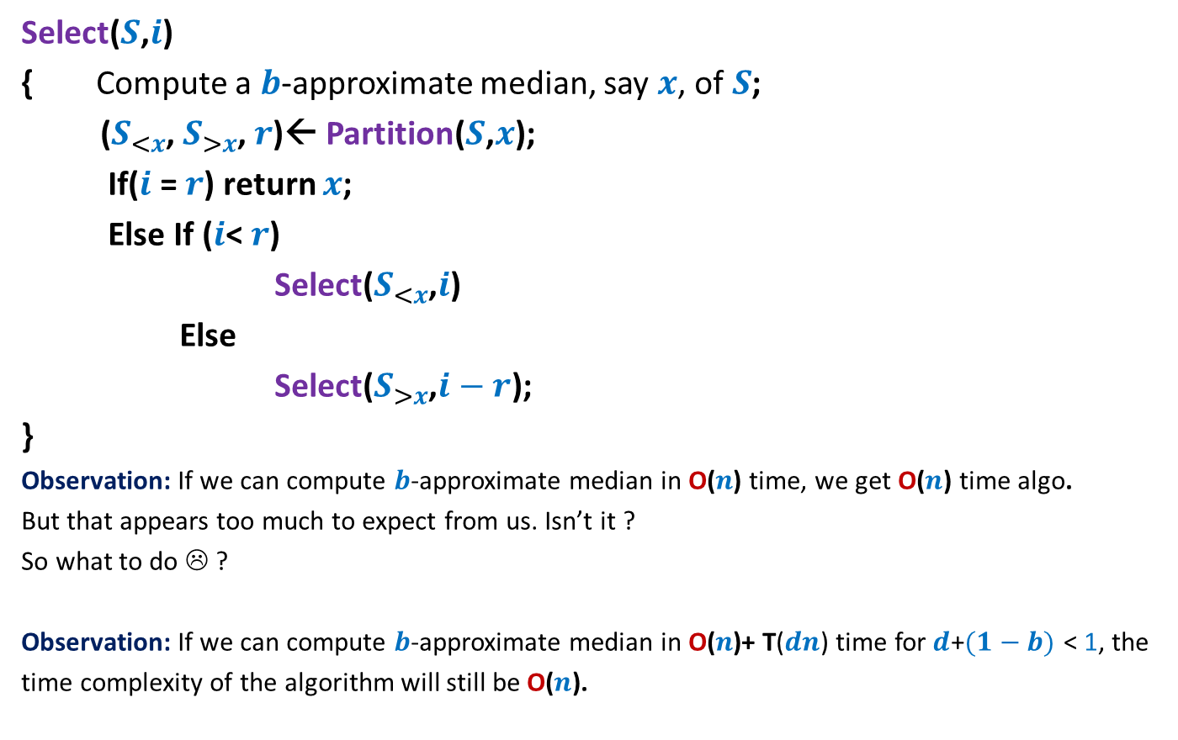


Overview of the algorithm
Select($S$,$i$)
{ Compute a $b$-approximate median, say $x$, of$S$;
($S_{<x}$, $S_{>x}$, $r$)← Partition($S$,$x$);
If($i$ = $r$) return $x$;
Else If ($i$< $r$)
Select($S_{<x}$,$i$)
Else
Select($S_{>x}$,$i−r$);
}
Observation: If we can compute $b$-approximate median in O($n\text{)}$ time, we get O($n$) time algo.
But that appears too much to expect from us. Isn’t it ?
So what to do ☹ ?
Observation: If we can compute $b$-approximate median in O($n\text{)+} \text{T}\text{(}dn\text{)}$time for$d$+$(1−b)$ < 1, the
time complexity of the algorithm will still be O($n$).
O($n\text{) +} \text{T}\text{(}dn\text{)}$
O($n$)
T( $(1−b)n$)
Hint: use Lesson 2
Spend some time on this observation to infer what it hints at.

Slide 19




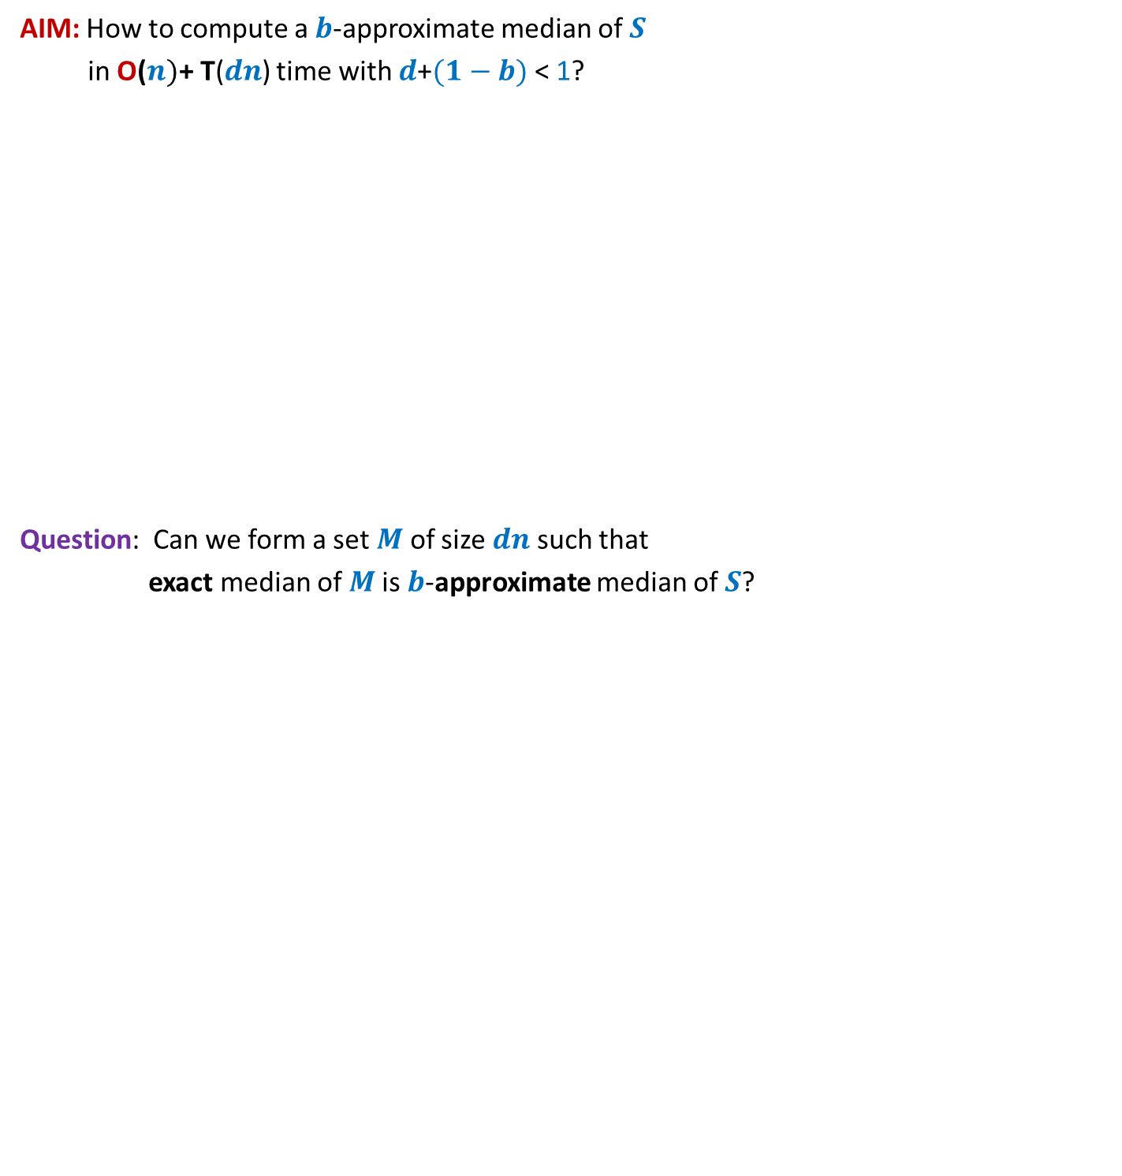




AIM: How to compute a $b$-approximate median of $S$
in O($n)\text{+} \text{T}\text{(}dn\text{)}$ time with $d$+$(1−b)$ < 1?
Question: Can we form a set $M$ of size $dn$such that
exact median of $M$is $b$-approximate median of $S$?
$$S$$
$b$-approximate median
$$n$$
O($n)$ time
$$M$$
Median
$$dn$$
Homework in the last class

Slide 20
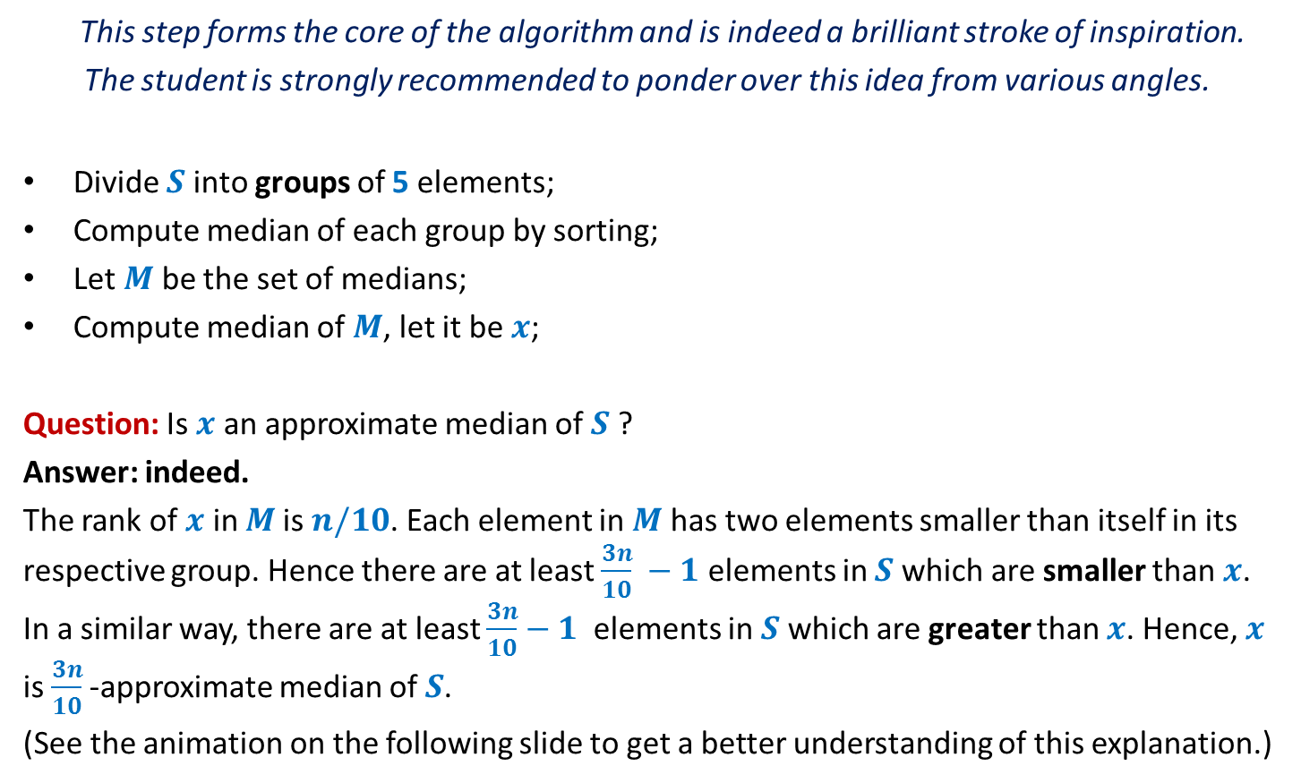



Forming the subset $M$ with desired parameters
This step forms the core of the algorithm and is indeed a brilliant stroke of inspiration.
The student is strongly recommended to ponder over this idea from various angles.
Divide $S$ into groups of 5 elements;
Compute median of each group by sorting;
Let $M$ be the set of medians;
Compute median of $M$, let it be $x$;
Question: Is $x$ an approximate median of $S$ ?
Answer: indeed.
The rank of $x$ in $M$is $n/10$. Each element in $M$ has two elements smaller than itself in its respective group. Hence there are at least $\frac{3n}{10} −1$ elements in $S$which are smaller than $x$. In a similar way, there are at least $\frac{3n}{10}−1$ elements in $S$which are greater than $x$. Hence, $x$ is $\frac{3n}{10}$-approximate median of $S$.
(See the animation on the following slide to get a better understanding of this explanation.)
O($n$)
$$\text{T}\text{(}n\text{/5}\text{)}$$

Slide 21






Forming the subset $M$
$$S$$
$$15 9 7 82 17 59 32 1 101 46 78 …$$
Divide $S$ into groups of 5 elements;
Compute median of each group by sorting;
$$M$$
$$15$$
$$46$$
1 2 … $\frac{n}{10}$ … $\frac{n}{5}$
O($n$)

Slide 22



Forming the subset $M$
$$S$$
$$15 9 7 82 17 59 32 1 101 46 78 …$$
Divide $S$ into groups of 5 elements;
Compute median of each group by sorting;
Let $M$ be the set of medians;
Let $x$be median of $M$.
Spend some time to answer this question before moving ahead.
$$M$$
$$15$$
$$46$$
$$x$$
What can we say about rank of $x$ in $S$ ?

Slide 23



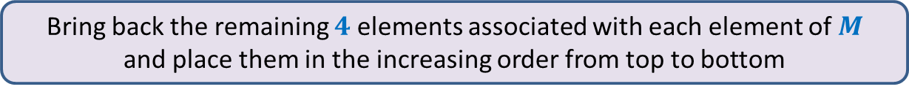




Forming the subset $M$
Bring back the remaining $4$ elements associated with each element of $M$
and place them in the increasing order from top to bottom
➔ $x$ is $\left(\frac{3n}{10}\right)−$approximate median of $S$.
Time required to form $M$ : O($n$)
Increasing order of values in $M$
Surely smaller than $x$
$$M$$
$$x$$
$$S$$
Surely greater than $x$
1 2 … $\frac{n}{10}$ … $\frac{n}{5}$

Slide 24
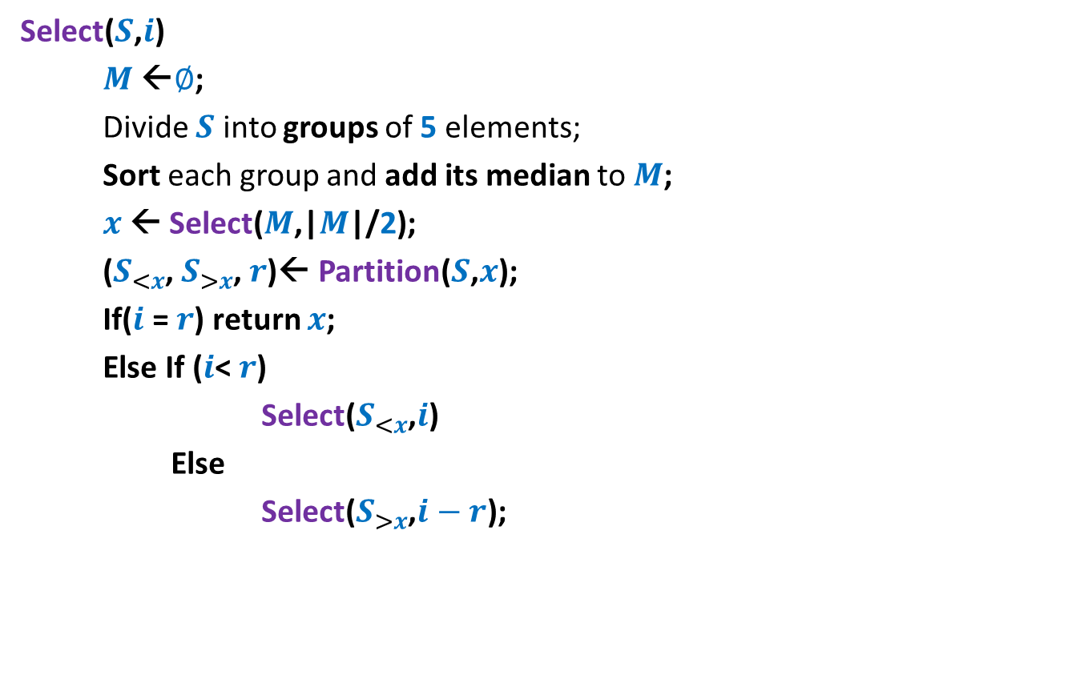

Pseudocode for Select($S$,$i$)
Select($S$,$i$)
$M$←$∅$;
Divide $S$ into groups of 5 elements;
Sort each group and add its median to $M$;
$x$← Select($M$,|$M$|/2);
($S_{<x}$, $S_{>x}$, $r$)← Partition($S$,$x$);
If($i$ = $r$) return $x$;
Else If ($i$< $r$)
Select($S_{<x}$,$i$)
Else
Select($S_{>x}$,$i−r$);
O(n)
T(n/5)
O(n)
T(7n/10)

Slide 25

Analysis
T(n) = cn + T(n/5) + T(7n/10)
= O(n) [Learning from Recurrence of type II]
Theorem: Given any $S$of n elements, we can compute ith smallest element from $S$ in O(n) worst case time.

Slide 26

Homework
What if we divide the set $S$ into groups of size
$3 ?$
$7 ?$
$4 ?$
$6 ?$

Slide 27
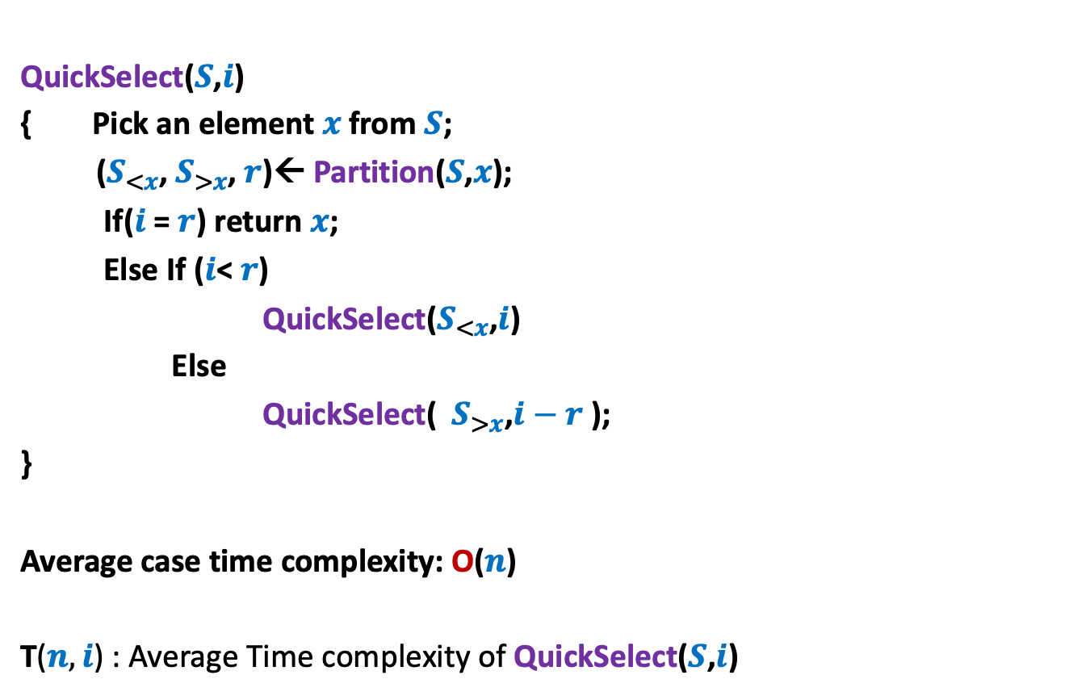
Homework from previous class
QuickSelect($S$,$i$)
{ Pick an element $x$from $S$;
($S_{<x}$, $S_{>x}$, $r$)← Partition($S$,$x$);
If($i$ = $r$) return $x$;
Else If ($i$< $r$)
QuickSelect($S_{<x}$,$i$)
Else
QuickSelect( $S_{>x}$,$i−r$ );
}
Average case time complexity: O($n$)
T($n,i$) : Average Time complexity of QuickSelect($S$,$i$)
Analysis is simpler than Quick Sort.

Slide 28
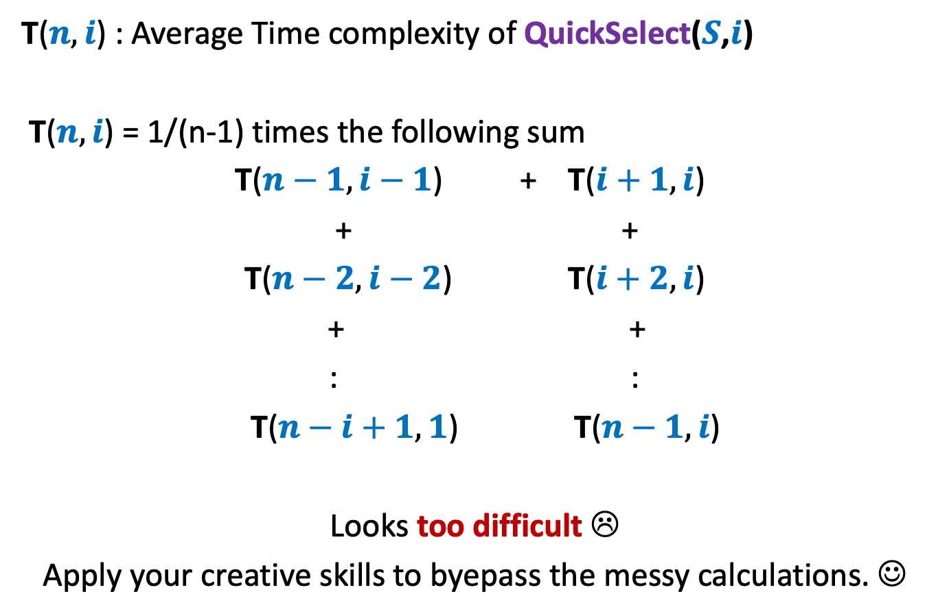
T($n,i$) : Average Time complexity of QuickSelect($S$,$i$)
T($n,i$) = 1/(n-1) times the following sum
T($n−1,i−1$) + T($i+1,i$)
+ +
T($n−2,i−2$) T($i+2,i$)
+ +
: :
T($n−i+1,1$) T($n−1,i$)
Looks too difficult ☹
Apply your creative skills to byepass the messy calculations. ☺

