Slide 1
Data Structures and Algorithms (ESO207A)
Lecture 34
Greedy Algorithms - III

Slide 2
Homework of the Previous Lecture

Slide 3
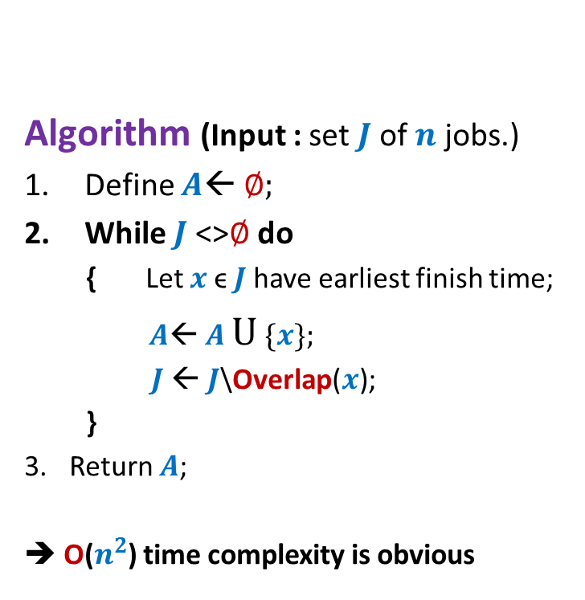

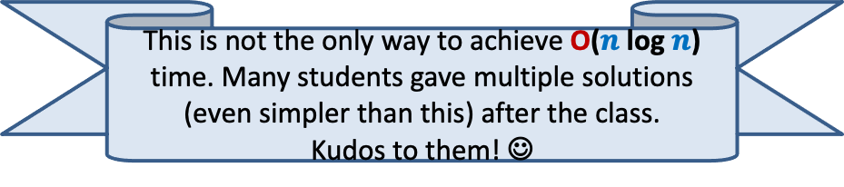
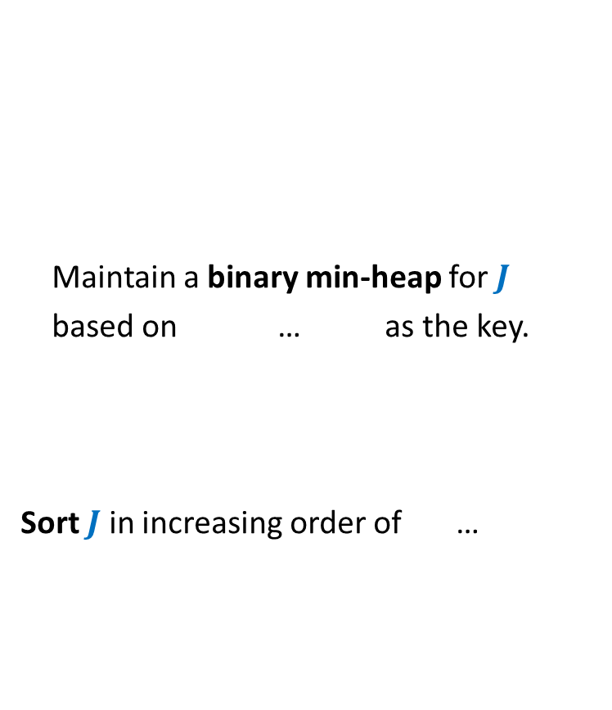
O($n$ log $n$) implementation of the Algorithm
This is not the only way to achieve O($n$ log $n$) time. Many students gave multiple solutions (even simpler than this) after the class.
Kudos to them! ☺
Algorithm (Input : set $J$of $n$ jobs.)
Define $A$← ∅;
While $J$<>∅ do
{ Let $x$ϵ $J$have earliest finish time;
$A$← $A$ U {$x$};
$J$← $J$\Overlap($x$);
}
Return $A$;
➔ O($n^{2}$) time complexity is obvious
Maintain a binary min-heap for $J$
based on … as the key.
Sort $J$ in increasing order of …
finish time
start time.

Slide 4
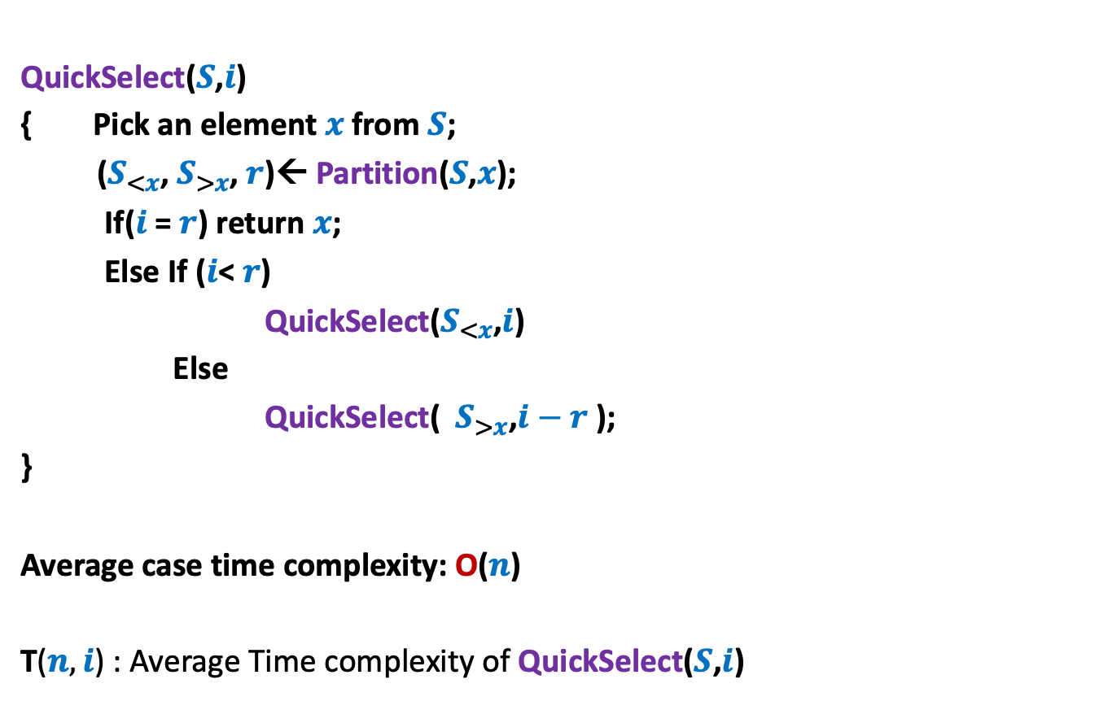
QuickSelect($S$,$i$)
{ Pick an element $x$from $S$;
($S_{<x}$, $S_{>x}$, $r$)← Partition($S$,$x$);
If($i$ = $r$) return $x$;
Else If ($i$< $r$)
QuickSelect($S_{<x}$,$i$)
Else
QuickSelect( $S_{>x}$,$i−r$ );
}
Average case time complexity: O($n$)
T($n,i$) : Average Time complexity of QuickSelect($S$,$i$)

Slide 5
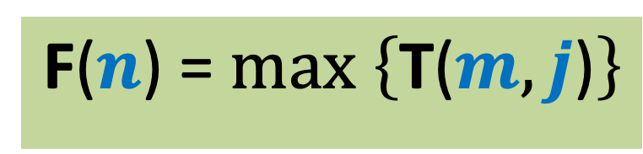
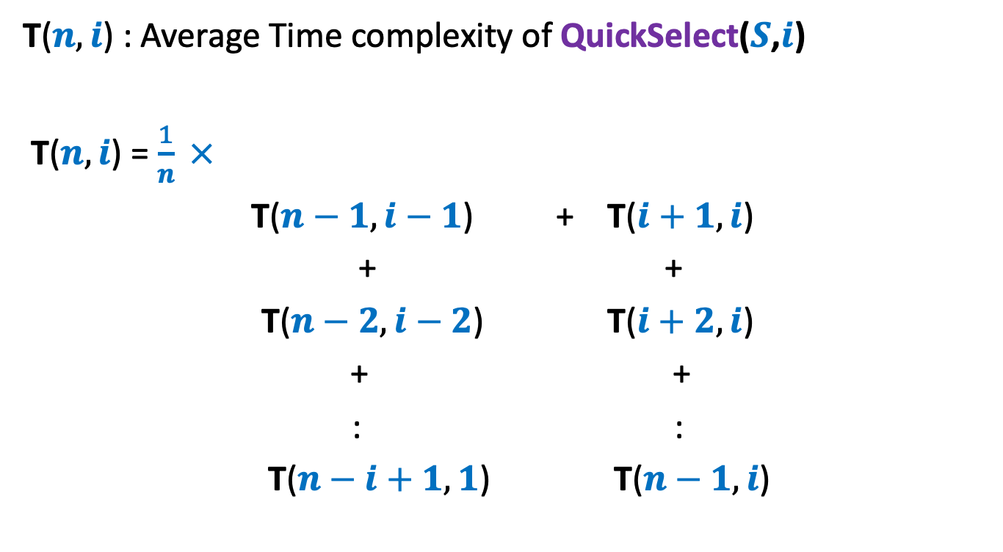

F($n$) = $max \left\{\text{T}\text{(}m,j\text{)}\right\}$
Hint
$$m≤n, j≤m$$
T($n,i$) : Average Time complexity of QuickSelect($S$,$i$)
T($n,i$) = $\frac{1}{n} ×$
T($n−1,i−1$) + T($i+1,i$)
+ +
T($n−2,i−2$) T($i+2,i$)
+ +
: :
T($n−i+1,1$) T($n−1,i$)

Slide 6
Problem 2
Mobile Tower Problem

Slide 7



Problem 2 Mobile Tower Problem
$$d$$
$$d$$
Problem statement:
There is a set $H$of $n$ houses located along a road.
We want to place mobile towers such that
Each house is covered by at least one mobile tower.
The number of mobile towers used is least possible.

Slide 8
Problem 3
Minimum Spanning Tree

Slide 9
Motivation: A road or telecommunication network
Suppose there is a collection of possible links/roads that can be laid.
But laying down each possible link/road is costly.
Aim: To lay down least number of links/roads to ensure connectivity between each pair of nodes/cities.

Slide 10
Motivation
Formal description of the problem
Input: an undirected graph G=(V,E).
Aim: compute a subgraph (V,E’), E’ ⊆ E such that
Connectivity among all V is guaranteed in the subgraph.
|E’| is minimum.
How will such a subgraph look like ?

Slide 12
Is this subgraph meeting our requirement ?
No
Yes
No

Slide 13
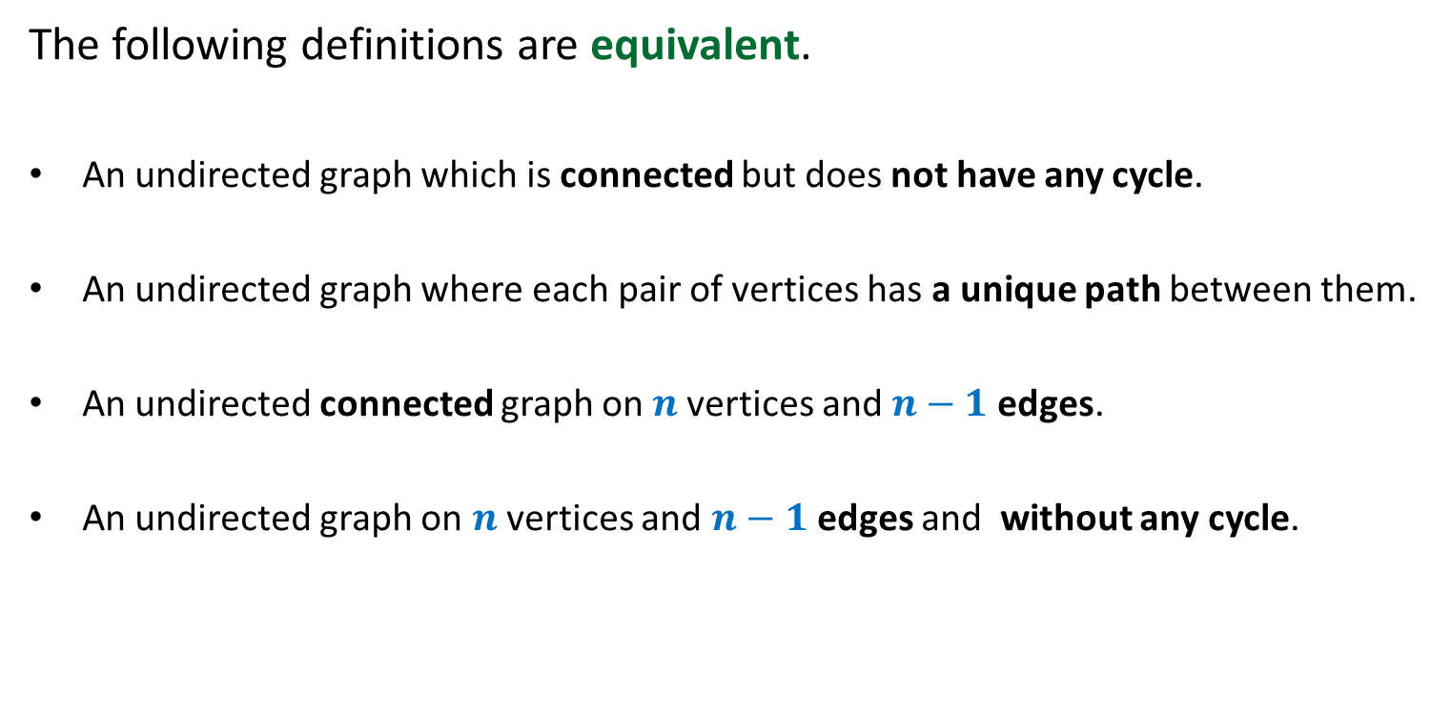
A tree
The following definitions are equivalent.
An undirected graph which is connected but does not have any cycle.
An undirected graph where each pair of vertices has a unique path between them.
An undirected connected graph on $n$vertices and $n−1$edges.
An undirected graph on $n$vertices and $n−1$edges and without any cycle.

Slide 14
A Spanning tree
Definition: For an undirected graph (V,E),
A spanning tree is a subgraph (V,E’), E’ ⊆ E which is a tree.

Slide 15
Assign each edge a weight/cost.
170
54
33
63
35
50
70
31
41
81
64
78
53
52
80
49
54
42
60
44
50
30
49
57
29
102
Adding more reality to the problem

Slide 16

Problem Description
Input: an undirected graph G=(V,E) with w: E → ℝ,
Aim: compute a spanning tree (V,E’), E’ ⊆ E such that
$\sum_{eϵ\text{E}\text{’}}{\text{w}(e)}$ is minimum.
Exponential number of spanning trees

Slide 17
A useful lesson for design of a graph algorithm
If you have a complicated algorithm for a graph problem, …
search for some graph theoretic property
to design simpler and more efficient algorithm

Slide 18
Two graph theoretic properties of MST
Cut property
Cycle property
Every algorithm till date is based on one of these properties!

Slide 19
Cut Property

Slide 20

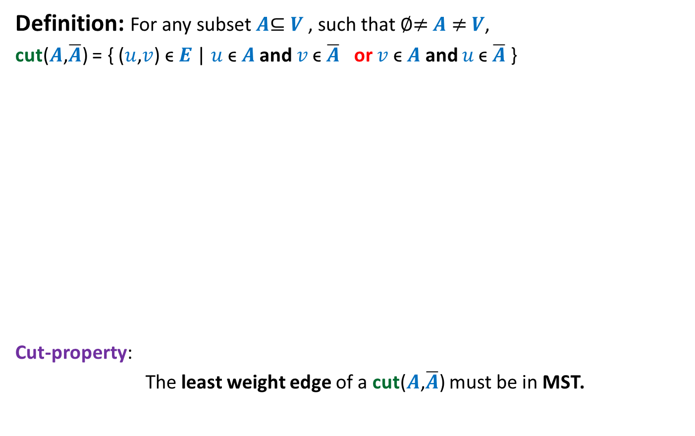
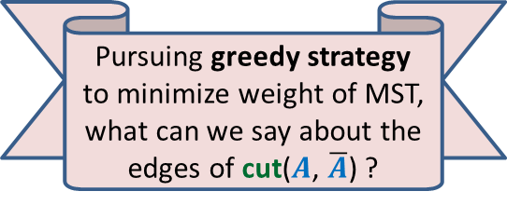


Cut Property
Definition: For any subset $A$⊆ $V$, such that ∅≠ $A$ ≠ $V$,
cut($A$,$\overline{A}$) = { ($u$,$v$) ϵ $E$ | $u \text{ϵ} A$ and $v \text{ϵ} \overline{A}$ or $v \text{ϵ} A$ and $u \text{ϵ} \overline{A}$ }
Cut-property:
The least weight edge of a cut($A$,$\overline{A}$) must be in MST.
Pursuing greedy strategy to minimize weight of MST, what can we say about the edges of cut($A$, $\overline{A}$) ?
$$A$$
cut($A$,$\overline{A}$)
$$\overline{A}$$
48
67
37
v
13
u
23

Slide 21

Proof of cut-property
$$A$$
$$\overline{A}$$
48
67
37
v
13
u
23

Slide 22







Proof of cut-property
Let $T$ be the MST, and (u,v) $∉T$.
Question: What happens if we remove (x,y) from $T$, and add (u,v) to $T$.
$$\text{ϵ} \overline{A}$$
y
x
>13
$$\text{ϵ} A$$
$$\text{ϵ} A$$
v
13
$$\text{ϵ} \overline{A}$$
$$\text{ϵ} A$$
u
$$\text{ϵ} A$$

Slide 23

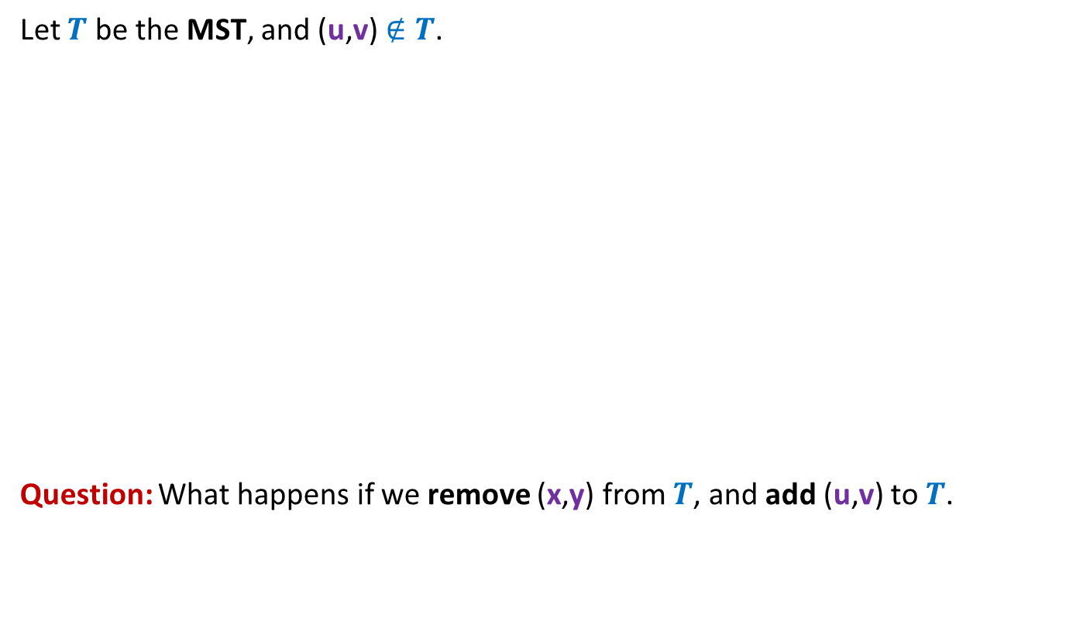
Proof of cut-property
Let $T$ be the MST, and (u,v) $∉T$.
Question: What happens if we remove (x,y) from $T$, and add (u,v) to $T$.
y
x
≥13
v
13
u
We get a spanning tree $T′$ with weight < weight($T$)
A contradiction !

Slide 24
Cycle Property

Slide 25


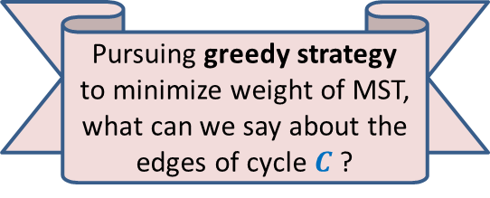
Cycle Property
c
b
31
Let $C$ be any cycle in $G$.
Cycle-property:
Maximum weight edge of any cycle $C$can not be present in MST.
17
12
f
36
a
s
26
Pursuing greedy strategy to minimize weight of MST, what can we say about the edges of cycle $C$?
24
43
19
r
u
v
$$C$$

Slide 26
Homework
Prove Cycle property of MST.
Design an algorithm for MST using Cut Property.
Design an algorithm for MST using Cycle Property.

