Slide 1
Data Structures and Algorithms (ESO207A)
Lecture 35
Greedy Algorithms – IV

Slide 2
Recap of the Previous Lecture

Slide 3

Problem Description
Input: an undirected graph $G$=($V$,$E$) with w: $E$ → ℝ,
Aim: compute a spanning tree ($V$, $E′$), $E′$ ⊆ $E$ such that $\sum_{e∈E′}{\text{w}(e)}$ is minimum.

Slide 4
Two graph theoretic properties of MST
Cut property
Cycle property
Every algorithm till date is based on one of these properties!

Slide 5

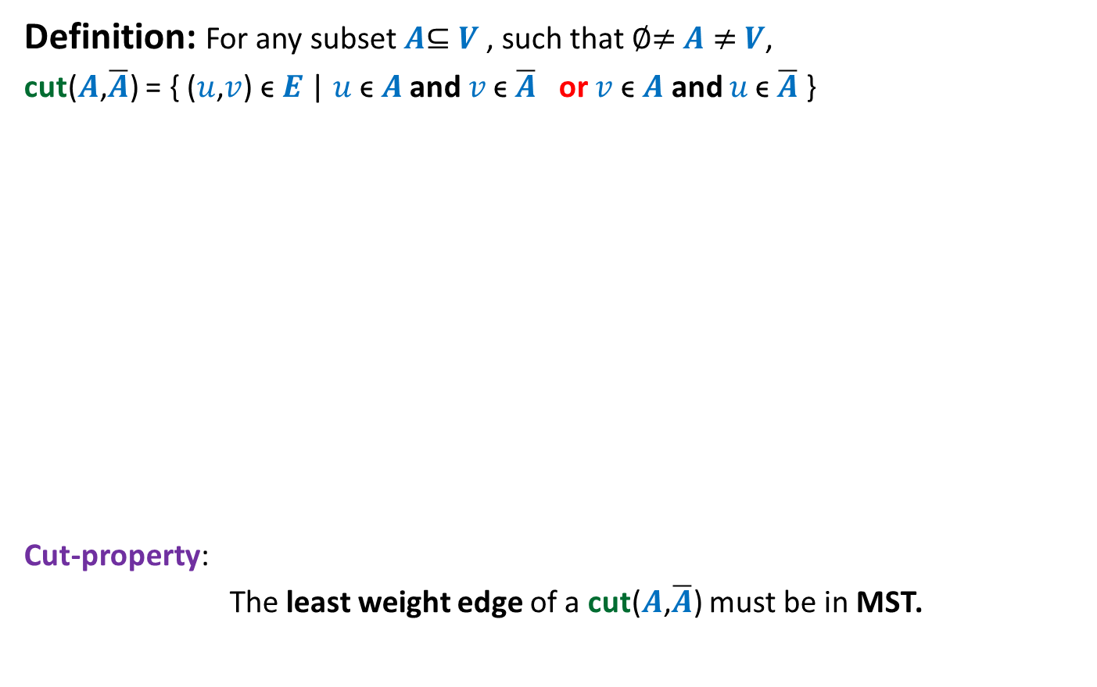


Cut Property
Definition: For any subset $A$⊆ $V$, such that ∅≠ $A$ ≠ $V$,
cut($A$,$\overline{A}$) = { ($u$,$v$) ϵ $E$ | $u \text{ϵ} A$ and $v \text{ϵ} \overline{A}$ or $v \text{ϵ} A$ and $u \text{ϵ} \overline{A}$ }
Cut-property:
The least weight edge of a cut($A$,$\overline{A}$) must be in MST.
$$A$$
cut($A$,$\overline{A}$)
$$\overline{A}$$
48
67
37
v
13
u
23

Slide 6


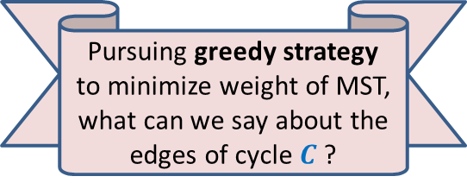
Cycle Property
c
b
31
Let $C$ be any cycle in $G$.
Cycle-property:
Maximum weight edge of any cycle $C$can not be present in MST.
17
12
f
36
a
s
26
Pursuing greedy strategy to minimize weight of MST, what can we say about the edges of cycle $C$?
24
43
19
r
u
v
$$C$$

Slide 7

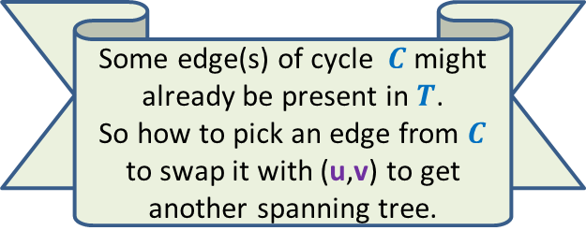


Proof of Cycle property
c
b
31
Let $T$ be the MST, and (u,v) $ϵ T$.
17
Some edge(s) of cycle $C$might already be present in $T$.
So how to pick an edge from $C$ to swap it with (u,v) to get another spanning tree.
f
We might like to replace (u,v) by some edge of cycle $C$? But how to find such an edge ?
12
36
a
s
26
24
43
19
r
u
v
$$C$$
43
u
v
$$T$$

Slide 8



Fundamental Cycles
Definition: For an undirected graph (V,E),
A spanning tree is a subgraph (V,E’), E’ ⊆ E which is a tree.
$$T$$
$n−1$ tree edges
$m−n+1$ non-tree edges

Slide 9

Fundamental Cycles
Definition: For an undirected graph (V,E),
A spanning tree is a subgraph (V,E’), E’ ⊆ E which is a tree.
Each non tree edge and $T$ define a unique cycle. Can you spot them ?
These cycles are called fundamental cycles induced by $T$.
There are total $m−n+1$ such cycles.
y
x
$$T$$
x
y
y
x

Slide 10

Fundamental Cycles
Definition: For an undirected graph (V,E),
A spanning tree is a subgraph (V,E’), E’ ⊆ E which is a tree.
Observation: Let $e$ be any non-tree edge.
Let $C$ be the fundamental cycle defined by $e$ with respect to $T$.
Swapping $e$ with any other edge of $C$ gives us another spanning tree.
y
x
$$T$$

Slide 11
Fundamental Cycles
Definition: For an undirected graph (V,E),
A spanning tree is a subgraph (V,E’), E’ ⊆ E which is a tree.
Observation: Let $e$ be any non-tree edge.
Let $C$ be the fundamental cycle defined by $e$ with respect to $T$.
Swapping $e$ with any other edge of $C$ gives us another spanning tree.
Can you use this Observation to prove Cycle Property ? Make attempts …☺
y
x
$$T$$

Slide 12
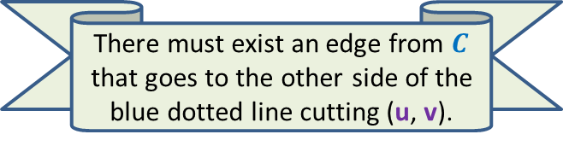


Proof of Cycle property
c
b
31
Let $T$ be the MST, and (u,v) $ϵ T$.
17
12
f
For non-tree edge (f, s), tree edge (u, v) lies in the fundamental cycle.
So we can swap them. ☺_
36
There must exist an edge from $C$ that goes to the other side of the blue dotted line cutting (u, v).
Let us traverse the cycle from u. Watch carefully how its vertices appear in $T$.
a
s
26
24
43
19
r
u
v
$$C$$
a
24
43
u
v
12
$$T$$
s
17
c
b
31
f
36

Slide 13

Proof of Cycle property
c
b
31
Let $T$ be the MST, and (u,v) $ϵ T$.
17
12
f
We get another spanning tree of weight less than that of MST. – A contradiction. ☺
36
a
s
26
24
43
19
r
u
v
$$C$$
43
u
v
$$T$$
s
f
36

Slide 14
Algorithm based on cut Property

Slide 15
How to use cut property to compute a MST ?
There are exponential number of cuts. ☹
How to efficiently choose the cuts so that each cut gives us one edge of the MST ?
170
24
33
v
63
70
35
50
70
31
41
81
64
78
53
u
42
52
80
49
54
42
60
44
43
50
30
49
57
29
102

Slide 16
How to use cut property to compute a MST ?
170
w
24
33
v
63
70
35
50
70
31
41
81
64
78
53
u
42
52
80
49
54
42
60
44
43
50
30
49
57
29
102

Slide 17
How to use cut property to compute a MST ?
170
w
24
33
v
63
70
35
50
x
31
70
41
81
64
78
53
u
42
52
80
49
54
42
60
44
43
50
30
49
57
29
102

Slide 18
How to use cut property to compute a MST ?
170
w
24
33
v
63
70
35
50
x
31
70
41
81
64
78
53
u
y
42
52
80
49
54
42
60
44
43
50
30
49
57
29
102

Slide 19
How to use cut property to compute a MST ?
170
w
24
33
v
63
70
35
50
x
31
70
41
81
64
78
53
u
y
42
52
80
49
54
42
60
44
43
50
30
49
57
29
102

Slide 20
How to use cut property to compute a MST ?
170
w
24
33
v
63
70
35
50
x
31
70
41
81
64
78
53
u
y
42
52
80
49
54
42
60
44
43
50
30
49
57
29
102

Slide 21

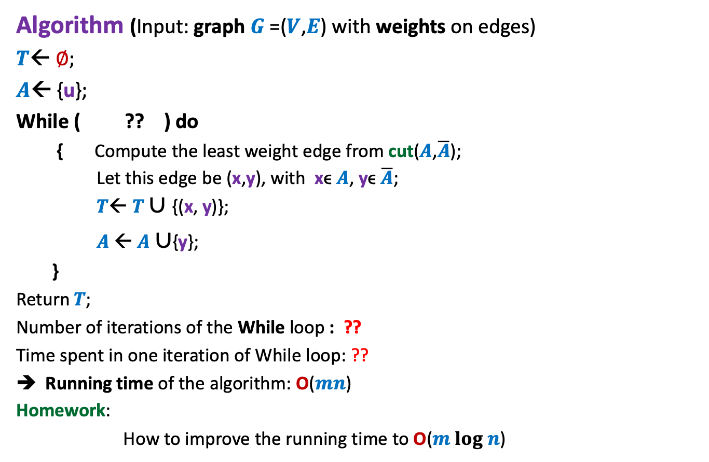


An Algorithm based on cut property
Algorithm (Input: graph $G$=($V$,$E$) with weights on edges)
$T$← ∅;
$A$← {u};
While ( ?? ) do
{ Compute the least weight edge from cut($A$,$\overline{A}$);
Let this edge be (x,y), with xϵ $A$, yϵ $\overline{A}$;
$T$← $T∪${(x, y)};
$A$← $A$ $∪${y};
}
Return$T$;
Number of iterations of the While loop : ??
Time spent in one iteration of While loop: ??
Running time of the algorithm: O($mn$)
Homework:
How to improve the running time to O($m log n$)
$A<>$ $V$
$$n−1$$
$$\text{O}\text{(}m\text{)}$$

Slide 22
Algorithm based on cycle Property

Slide 23

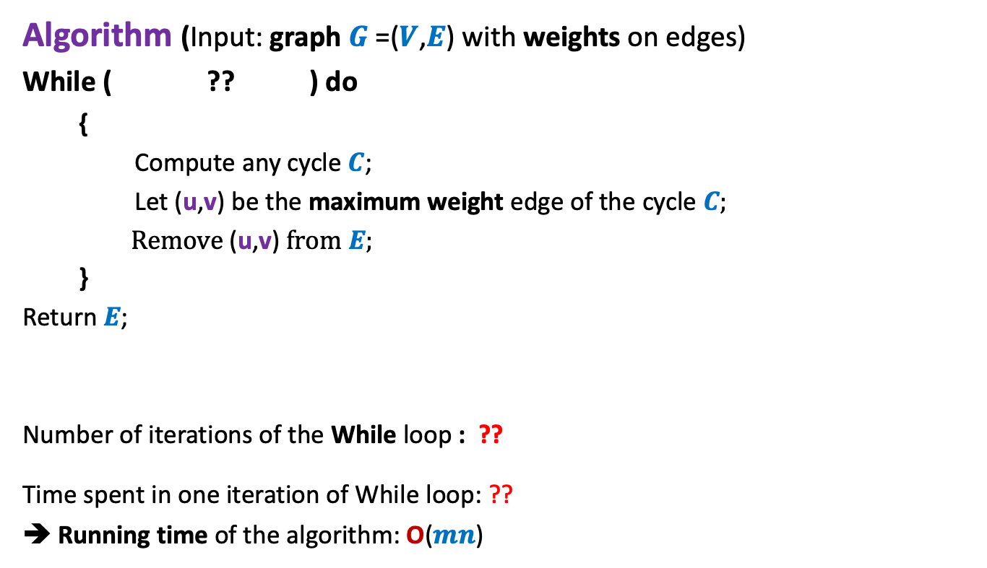


An Algorithm based on cycle property Description
Algorithm (Input: graph $G$=($V$,$E$) with weights on edges)
While ( ?? ) do
{
Compute any cycle $C$;
Let (u,v) be the maximum weight edge of the cycle $C$;
Remove (u,v) from $E$;
}
Return$E$;
Number of iterations of the While loop : ??
Time spent in one iteration of While loop: ??
➔ Running time of the algorithm: O($mn$)
$E$has any cycle
$$m−n+1$$
4th problem of Practice sheet
on BFS Traversal
$$\text{O}\text{(}n\text{)}$$

Slide 24
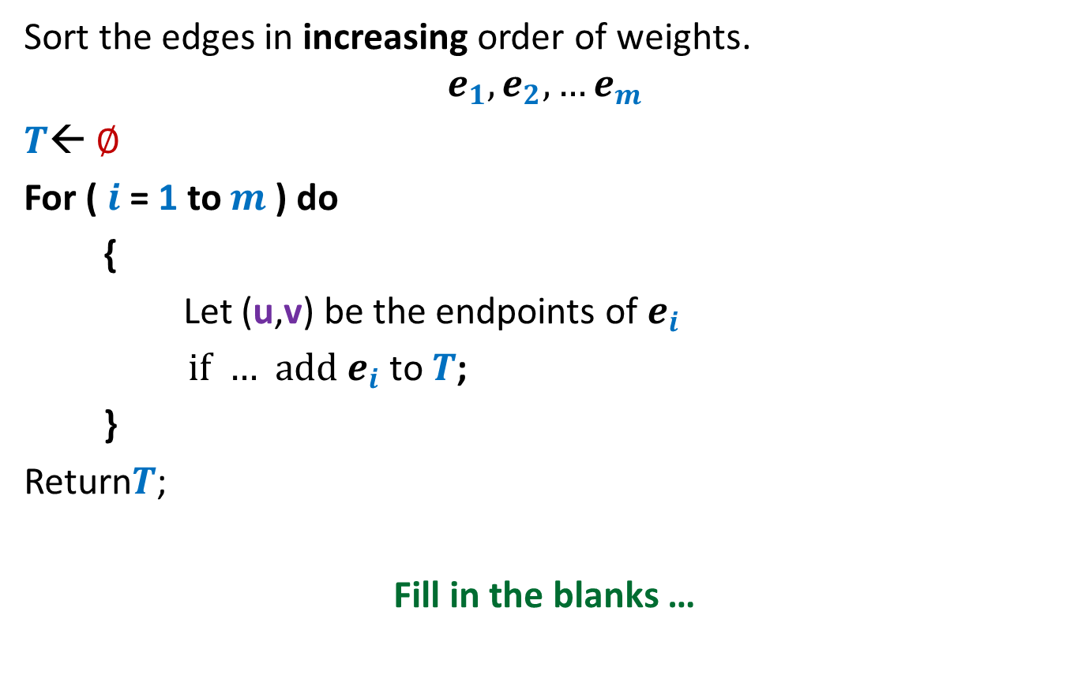
Homework
Sort the edges in increasing order of weights.
$$e_{1}, e_{2},…e_{m}$$
$T$← ∅
For ( $i$= 1 to $m$) do
{
Let (u,v) be the endpoints of $e_{i}$
if … add $e_{i}$ to $T$;
}
Return$T$;
Fill in the blanks …

