Slide 1
Data Structures and Algorithms (ESO207A)
Lecture 36
Greedy Algorithms – V

Slide 2
Recap of the Previous Lecture

Slide 3

Problem Description
Input: an undirected graph $G$=($V$,$E$) with w: $E$ → ℝ,
Aim: compute a spanning tree ($V$, $E′$), $E′$ ⊆ $E$ such that $\sum_{e∈E′}{\text{w}(e)}$ is minimum.

Slide 4
Algorithm based on cut Property

Slide 5
170
24
33
v
63
70
35
50
70
31
41
81
64
78
53
u
42
52
80
49
54
42
60
44
43
50
30
49
57
29
102

Slide 6
170
w
24
33
v
63
70
35
50
70
31
41
81
64
78
53
u
42
52
80
49
54
42
60
44
43
50
30
49
57
29
102

Slide 7
170
w
24
33
v
63
70
35
50
x
31
70
41
81
64
78
53
u
42
52
80
49
54
42
60
44
43
50
30
49
57
29
102

Slide 8
170
w
24
33
v
63
70
35
50
x
31
70
41
81
64
78
53
u
y
42
52
80
49
54
42
60
44
43
50
30
49
57
29
102

Slide 9
170
w
24
33
v
63
70
35
50
x
31
70
41
81
64
78
53
u
y
42
52
80
49
54
42
60
44
43
50
30
49
57
29
102

Slide 10
170
w
24
33
v
63
70
35
50
x
31
70
41
81
64
78
53
u
y
42
52
80
49
54
42
60
44
43
50
30
49
57
29
102

Slide 11

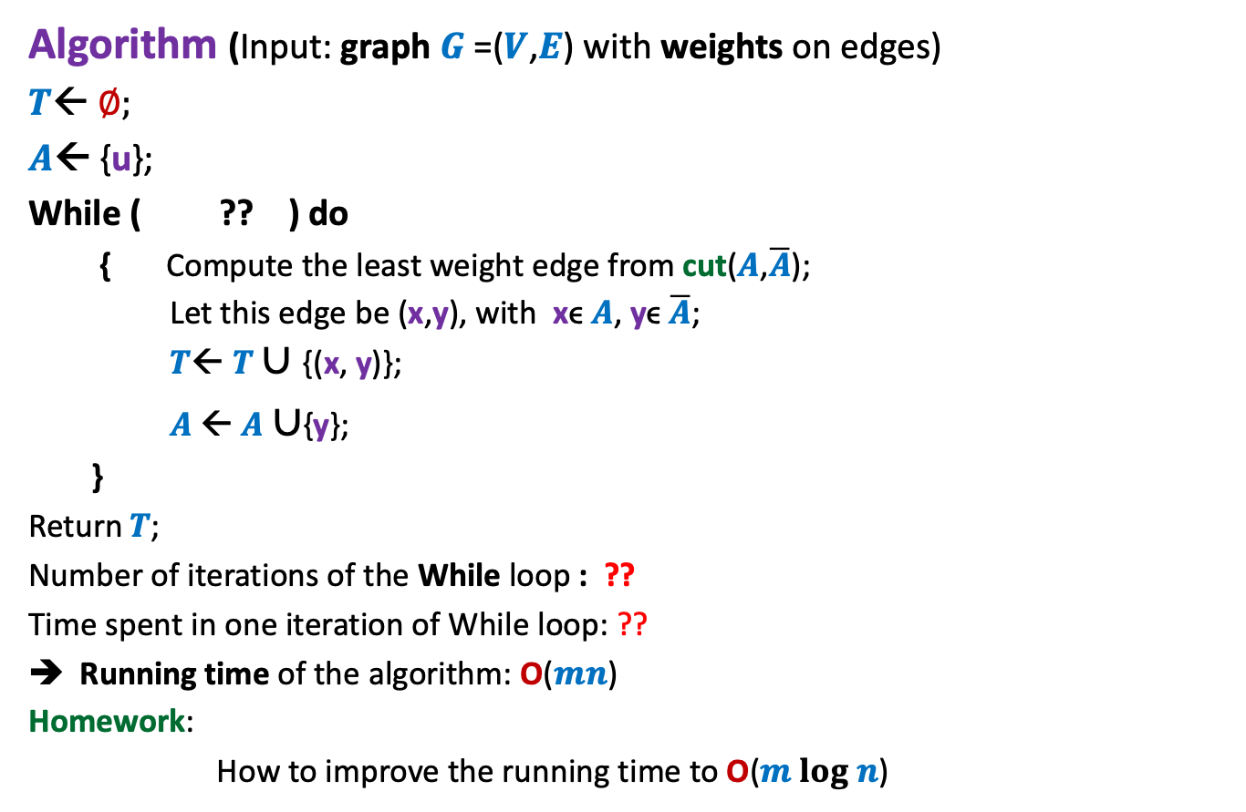


An Algorithm based on cut property
Algorithm (Input: graph $G$=($V$,$E$) with weights on edges)
$T$← ∅;
$A$← {u};
While ( ?? ) do
{ Compute the least weight edge from cut($A$,$\overline{A}$);
Let this edge be (x,y), with xϵ $A$, yϵ $\overline{A}$;
$T$← $T∪${(x, y)};
$A$← $A$ $∪${y};
}
Return$T$;
Number of iterations of the While loop : ??
Time spent in one iteration of While loop: ??
Running time of the algorithm: O($mn$)
Homework:
How to improve the running time to O($m log n$)
$A<>$ $V$
$$n−1$$
$$\text{O}\text{(}m\text{)}$$

Slide 12






$i$th iteration of the while loop
For each $x∈V \backslash A$
$$L\left(x\right)=$$
What is the next vertex to be added to MST ??
G
$$x$$
$$A$$
Weight of the least weight edge incident from $A$
= the vertex with minimum value of $L$.

Slide 13

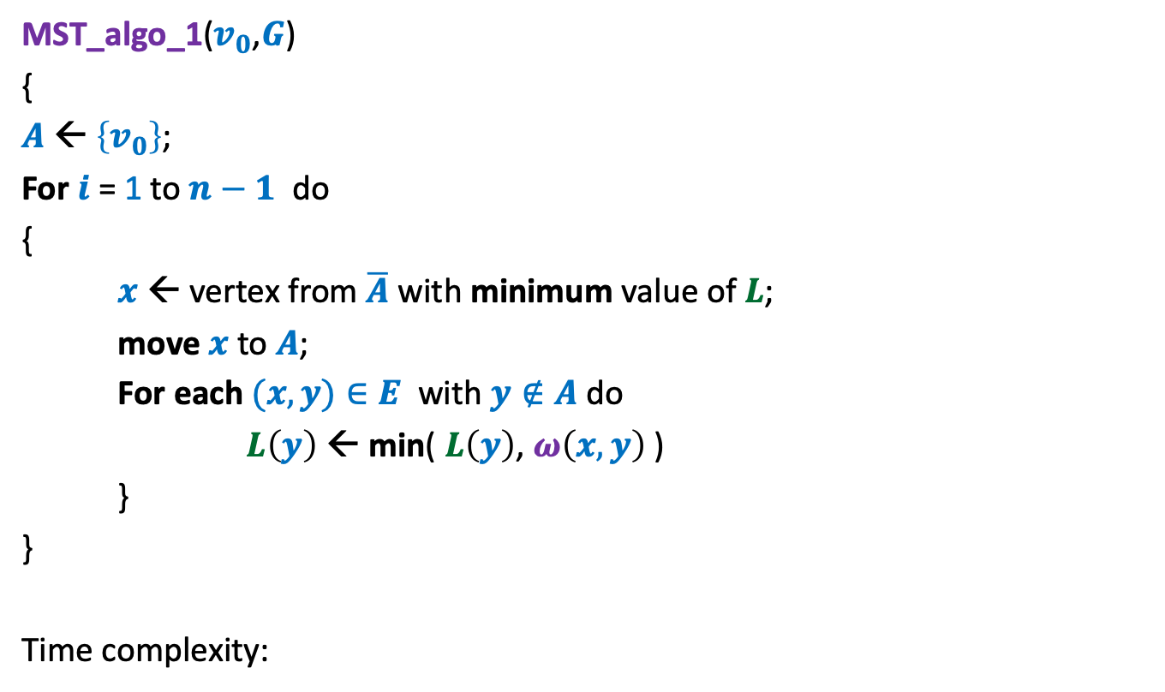



Prim’s algorithm
MST_algo_1($v_{0}$,$G$)
{
$A$← $\left\{v_{0}\right\}$;
For $i$ = 1 to $n−1$ do
{
$x$ ← vertex from $\overline{A}$ with minimum value of $L$;
move $x$ to $A$;
For each $(x,y)∈E$ with $y∉A$do
$L\left(y\right) \text{←}$ min( $L\left(y\right)$, $ω\left(x,y\right)$ )
}
}
Time complexity:
Extract_min($L$)
Decrease_Key($L,y,ω\left(x,y\right)$)
Maintain a Heap over $L$
O($(m+n) log n$)

Slide 14
Algorithm based on cycle Property

Slide 15

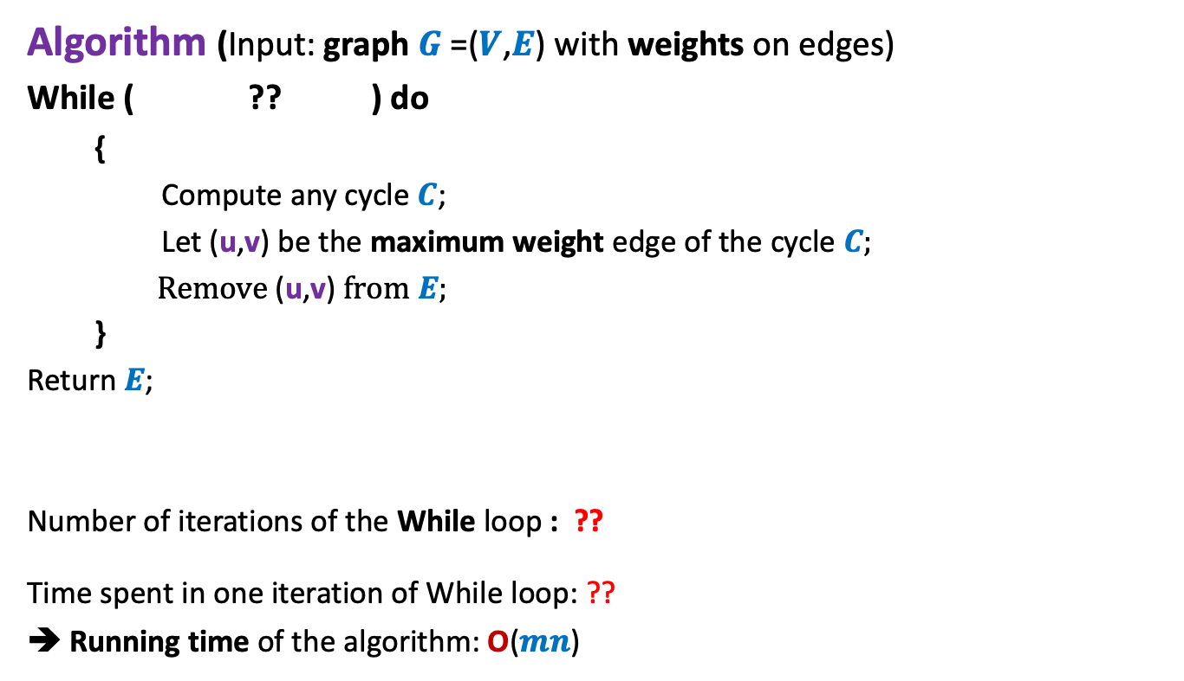


An Algorithm based on cycle property Description
Algorithm (Input: graph $G$=($V$,$E$) with weights on edges)
While ( ?? ) do
{
Compute any cycle $C$;
Let (u,v) be the maximum weight edge of the cycle $C$;
Remove (u,v) from $E$;
}
Return$E$;
Number of iterations of the While loop : ??
Time spent in one iteration of While loop: ??
➔ Running time of the algorithm: O($mn$)
$E$has any cycle
$$m−n+1$$
4th problem of Practice sheet
on BFS Traversal
$$\text{O}\text{(}n\text{)}$$

Slide 16
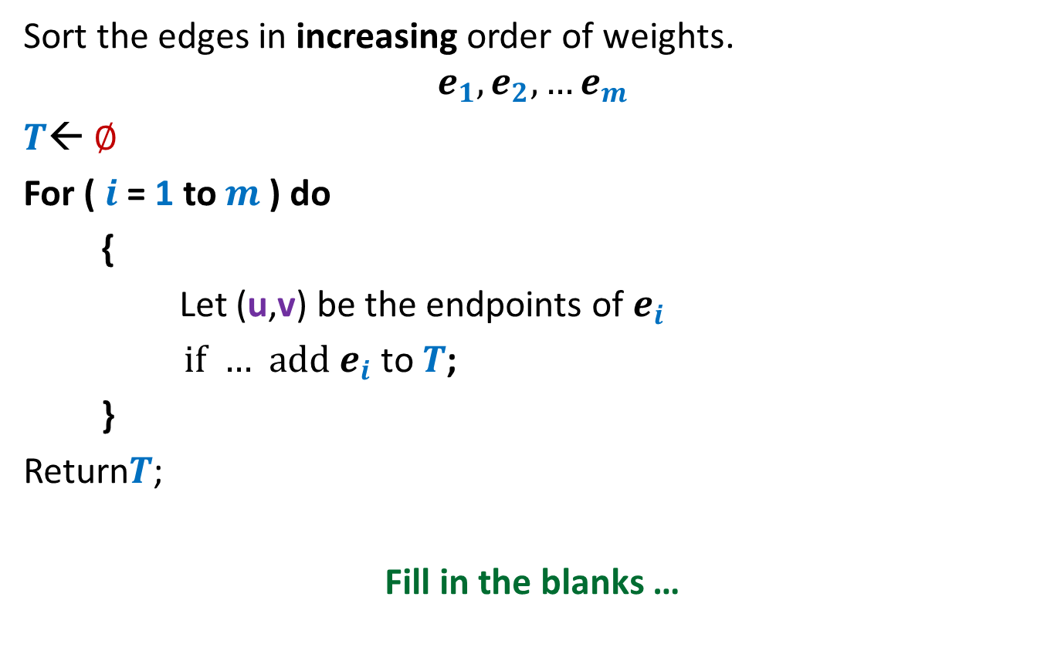
Homework
Sort the edges in increasing order of weights.
$$e_{1}, e_{2},…e_{m}$$
$T$← ∅
For ( $i$= 1 to $m$) do
{
Let (u,v) be the endpoints of $e_{i}$
if … add $e_{i}$ to $T$;
}
Return$T$;
Fill in the blanks …

Slide 17









A forest of trees
$$e_{6}$$
$$e_{2}$$
$$e_{1}$$
$$e_{7}$$
$$e_{5}$$
$$e_{9}$$
$$e_{8}$$
$$e_{4}$$
$$e_{3}$$

Slide 18
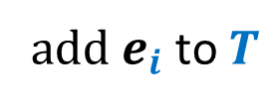

Sort the edges in increasing order of weights.
$$e_{1}, e_{2},…e_{m}$$
$T$← ∅
For ( $i$= 1 to $m$) do
{
Let (u,v) be the endpoints of $e_{i}$
if …
}
Return$T$;
u and v belong to different trees
add $e_{i}$ to $T$

Slide 19



Let (u,v) be the endpoints of $e_{i}$
Do BFS from u in $T$
$$e_{6}$$
$$e_{2}$$
$$e_{1}$$
$$e_{11}$$
$$e_{7}$$
$$e_{10}$$
$$e_{5}$$
$$e_{4}$$
$$e_{3}$$
to determine if v is reachable

Slide 20
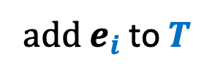
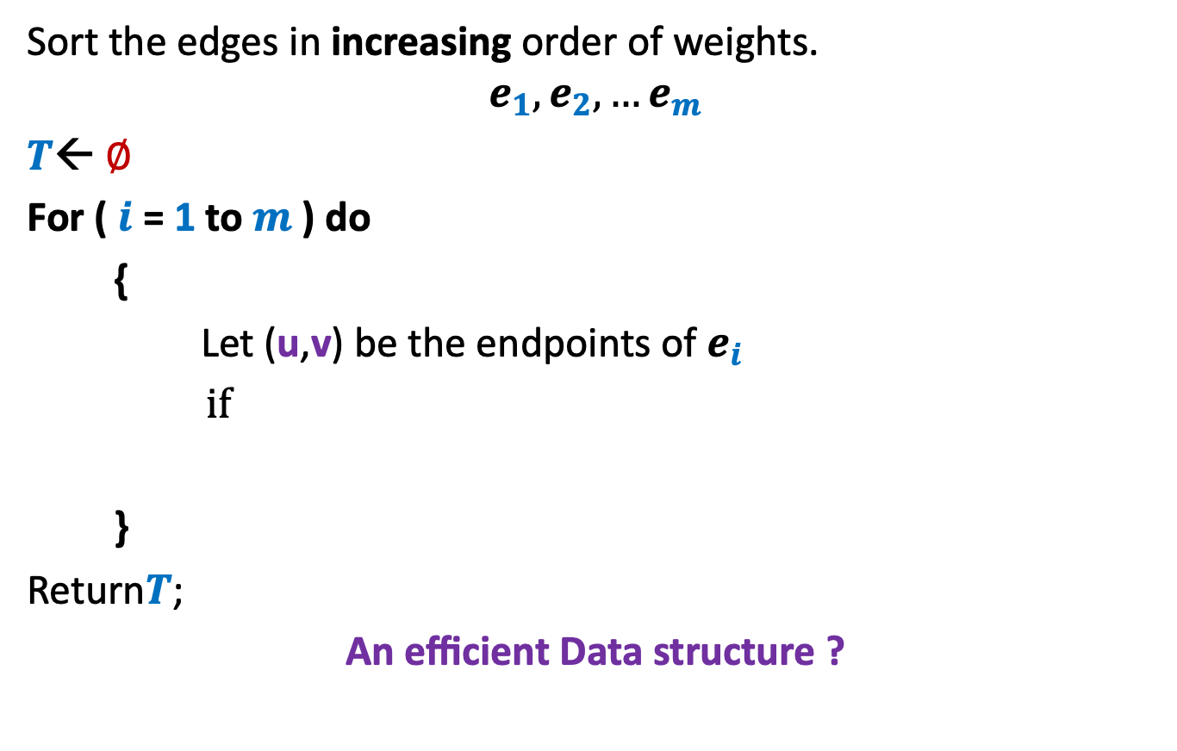
Sort the edges in increasing order of weights.
$$e_{1}, e_{2},…e_{m}$$
$T$← ∅
For ( $i$= 1 to $m$) do
{
Let (u,v) be the endpoints of $e_{i}$
if
}
Return$T$;
An efficient Data structure ?
(u and v belong to different trees)
Find(u)
add $e_{i}$ to $T$
Union()
Maintain each tree as a set

Slide 21
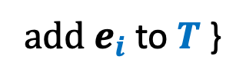
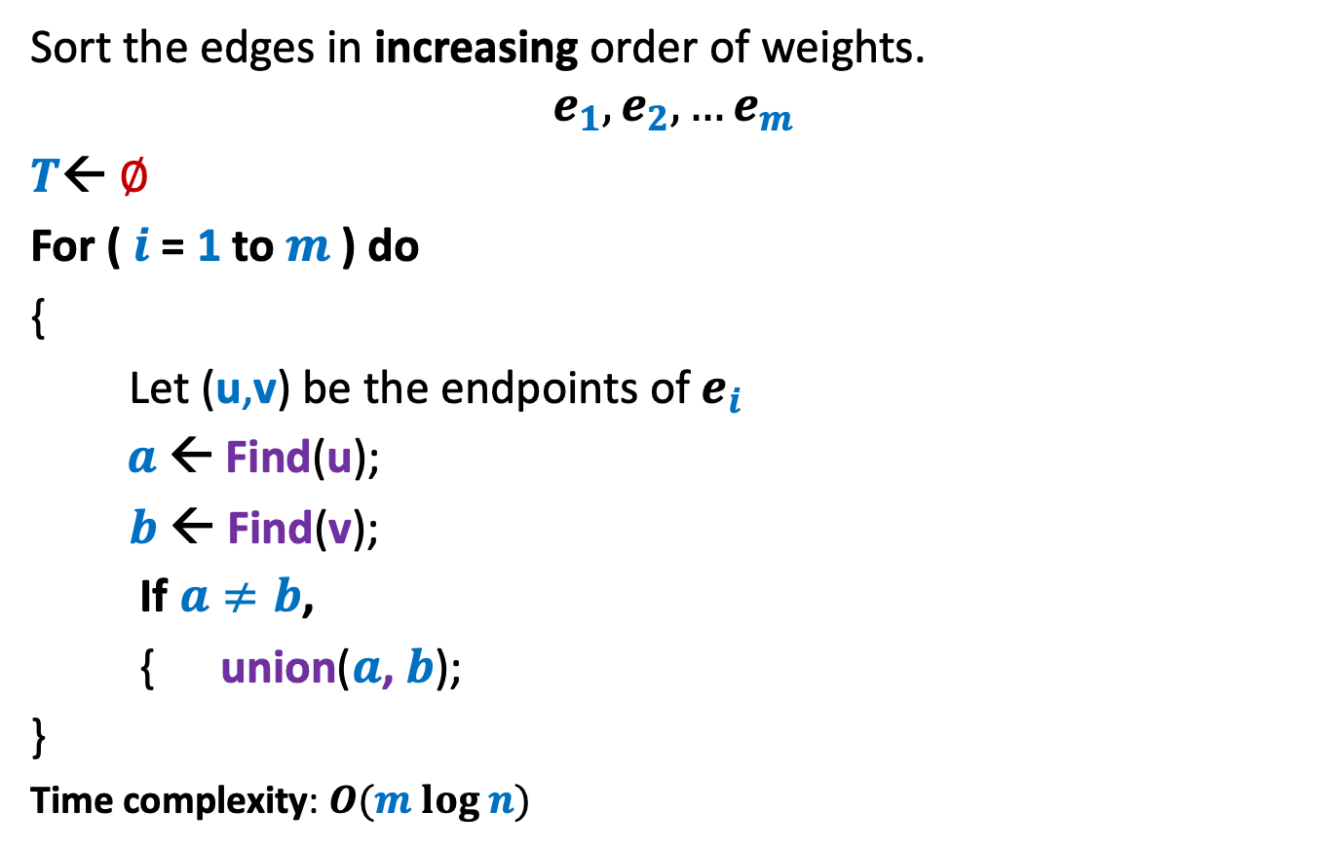
Kruskal’s Algorithm
Sort the edges in increasing order of weights.
$$e_{1}, e_{2},…e_{m}$$
$T$← ∅
For ( $i$= 1 to $m$) do
{
Let (u,v) be the endpoints of $e_{i}$
$a$ ← Find(u);
$b$ ← Find(v);
If $a≠b$,
{ union($a$, $b$);
}
Time complexity: $O(m log n)$
add $e_{i}$ to $T$ }

Slide 22
Problem 3
Mobile towers on a road

Slide 23


Mobile towers on a road
A mobile tower can cover any cell phone within radius $d$.
$$d$$
Mobile tower

Slide 24



Mobile towers on a road
$$d$$
$$d$$
Problem statement:
There are $n$ houses located along a road.
We want to place mobile towers such that
Each house is covered by at least one mobile tower.
The number of mobile towers used is least possible.

Slide 25


Mobile towers on a road
$$d$$
$$d$$
Strategy 1:
Place tower at first house,
Remove all houses covered by this tower.
Proceed to the next uncovered house …
$$d$$
$$d$$

Slide 26

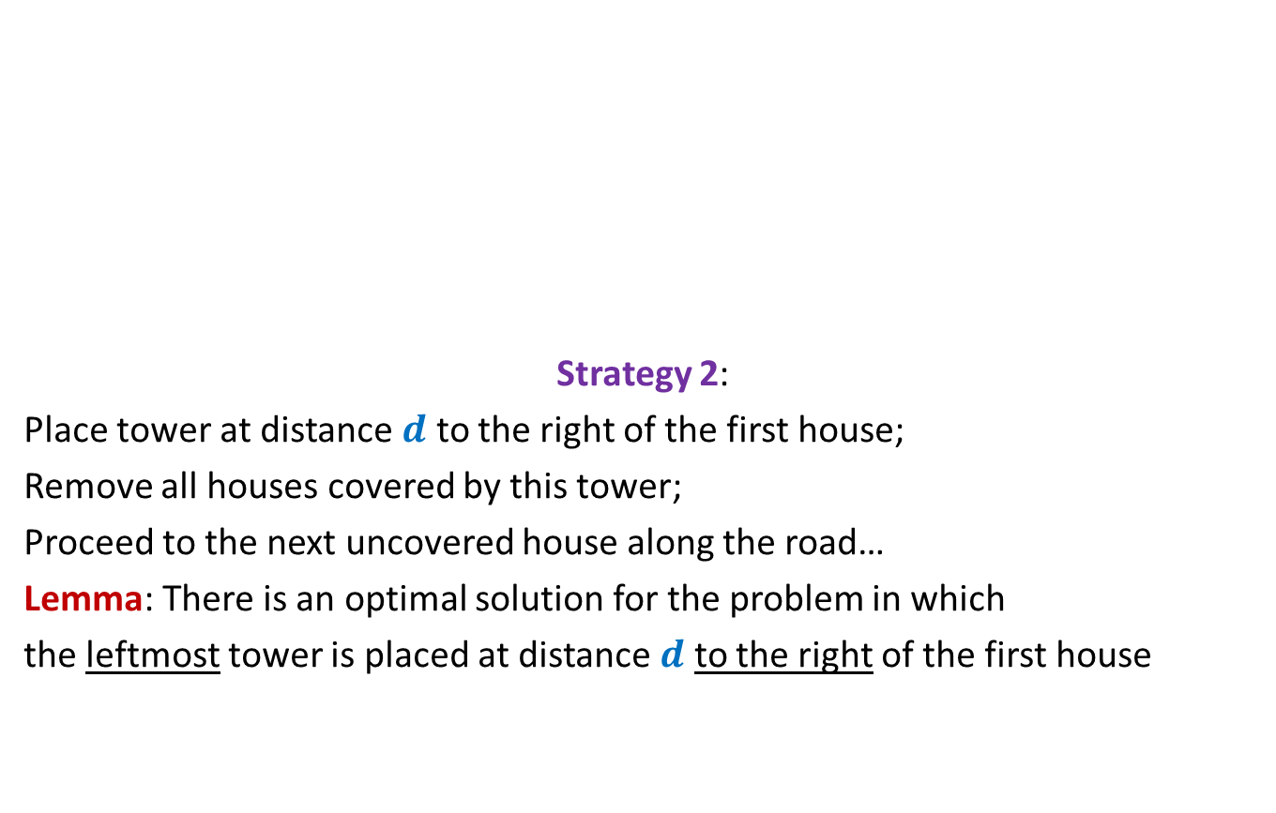

Mobile towers on a road
$$d$$
$$d$$
Strategy 2:
Place tower at distance $d$ to the right of the first house;
Remove all houses covered by this tower;
Proceed to the next uncovered house along the road…
Lemma: There is an optimal solution for the problem in which
the leftmost tower is placed at distance $d$ to the right of the first house
$$d$$
$$d$$
can we say anything about the optimal solution ?

Slide 27
Greedy Algorithms
No global perspective of the solution (unlike divide & conquer)
Local perspective of the solution
Solving the problem:
Establishing a local property of the solution
A greedy step based on the local property
Using the greedy step to reducing the given instance to smaller instance.
Homework:
Try to view the solutions of 3 problems we discussed in the above framework.

Slide 28
Integer sorting

Slide 29

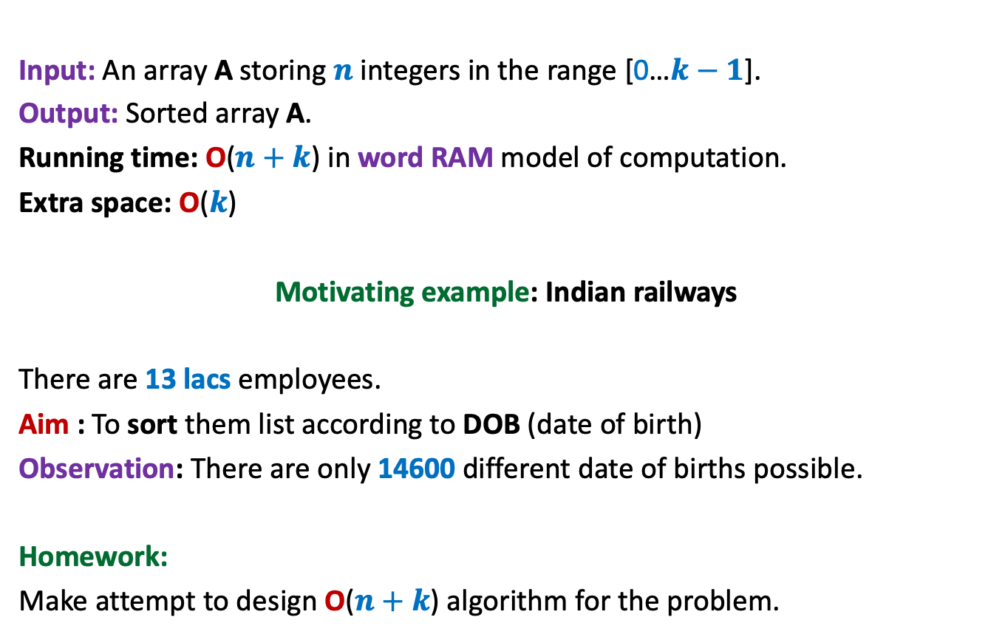
Counting sort: algorithm for sorting integers
Input: An array A storing $n$ integers in the range [0…$k−1$].
Output: Sorted array A.
Running time: O($n+k$) in word RAM model of computation.
Extra space: O($k$)
Motivating example: Indian railways
There are 13 lacs employees.
Aim : To sort them list according to DOB (date of birth)
Observation: There are only 14600 different date of births possible.
Homework:
Make attempt to design O($n+k$) algorithm for the problem.
$k$= O($n$)

