Slide 1
Data Structures and Algorithms (ESO207A)
Lecture 4
An amazing data structure for Range Minima

Slide 2
Guidance for Assignment 1
Optional session:
Time: 11:00 AM to 1:00 PM
Date: 6th August, 2022
Venue: KD 101.

Slide 3
HoMework
from the last class

Slide 4

Problem 2:
HoMework
Design and implement an algorithm with the following objective:
Input: integer $m$
integer $n$
Output: $m ×n$
long long int
long long int

Slide 5
The Data Structures

Slide 6
Data structures
AIM:
To organize a data in the memory
so that any query can be answered efficiently.
Important assumption:
No. of queries to be answered will be …
Parameters of Efficiency
Query time
Space
Preprocessing time
many.

Slide 7
RANGE-MINIMA Problem

Slide 8






Range-Minima Problem
Given:
Query:
Range-minima($i,j$) :
Let $n$ = $1$million.
No. of queries = $10$ millions
an array A storing $n$numbers
report the smallest element from A[$i$],…,A[$j$]
Range-Minima($i,j$) = $−6$
A
$$3$$ | $$5$$ | $$1$$ | $$8$$ | $$19$$ | $$0$$ | $$−1$$ | $$30$$ | $$99$$ | $$−6$$ | $$10$$ | $$2$$ | $$40$$ | $$27$$ | $$44$$ | $$67$$
$$i=4$$
$$j=11$$

Slide 9


Range-Minima Problem
An amazing data structure:
Space: $n log n$
Query time: constant
1 terabyte
20 Mega bytes
Independent of $n$

Slide 10


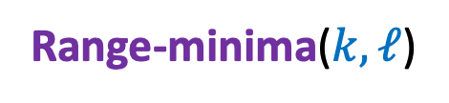

Trivial Data Structure
Range-minima($i,j$)
Range-minima($k,ℓ$)
$$0 1 2… n−1$$
$$i$$
B
$$k$$

Slide 11
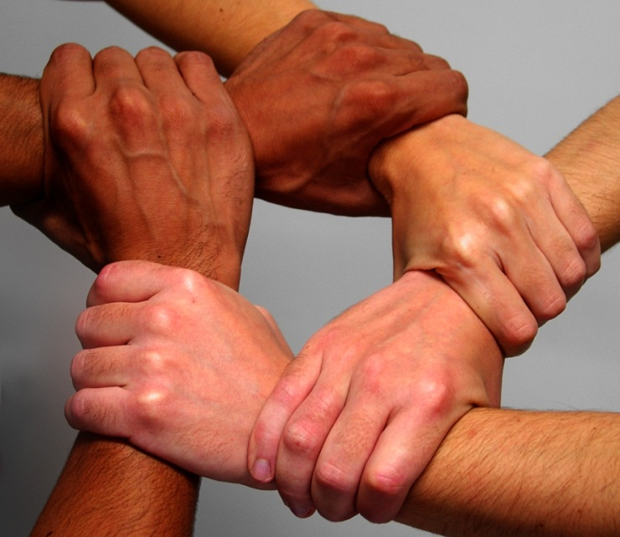
Collaboration (team effort) works in real life

Slide 12
Collaborative Data Structure
$$0 1 2… n−1$$
B

Slide 13



Collaborative Data Structure
Range-minima($i,j$)
$$0 1 2… \log_{2}{n}$$
$$i$$
C
$$q$$

Slide 14




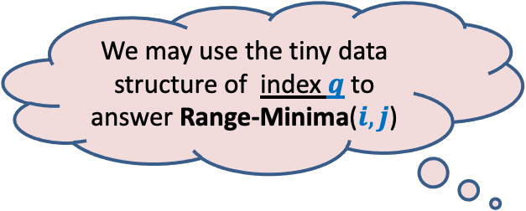




How might collaboration work ?
We may use the tiny data structure of index $q$ to answer Range-Minima($i,j$)
$$i$$
$$j$$
A
$$1$$
$$i$$
$$q$$
$$n$$
$i$stores answers for this range
$q$stores answers for this range

Slide 15
Collaborative Data Structure
Range-minima($i,j$)
$$0 1 2… \log_{2}{n}$$
$$i$$
C

Slide 16
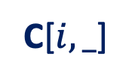



Collaborative Data Structure
$$0 1 2… \log_{2}{n}$$
C[$i,_$]
$$i$$
C[$i,k$] stores minimum of {A[$i$],…,A[$i$+$2^{k}$ ]} for each $k$ ≤ $\log_{2}{n}$
$$2^{t}$$
8
4
2
1
A
1
$$i$$
$$n$$

Slide 17





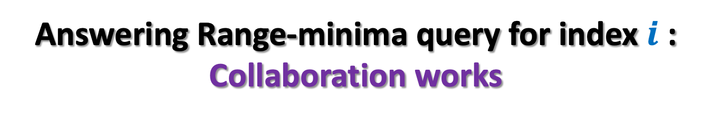

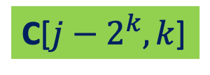



Answering Range-minima query for index $i$ : Collaboration works
$$i<j−2^{k}$$
$$2^{k}<j−i<2^{k+1}$$
But how to determine using only constant number of instructions:
Whether $j−i$ is a power of 2 ?
To compute $k$ such that $2^{k}<j−i<2^{k+1}$
To compute $2^{k}$.
$$j−2^{k}<i+2^{k}$$
$$2^{k+1}$$
$$2^{k}$$
C[$i,k$]
A
1
$$i$$
$$j$$
$$n$$
C[$j−2^{k},k$]
$${j−2}^{k}$$

Slide 18
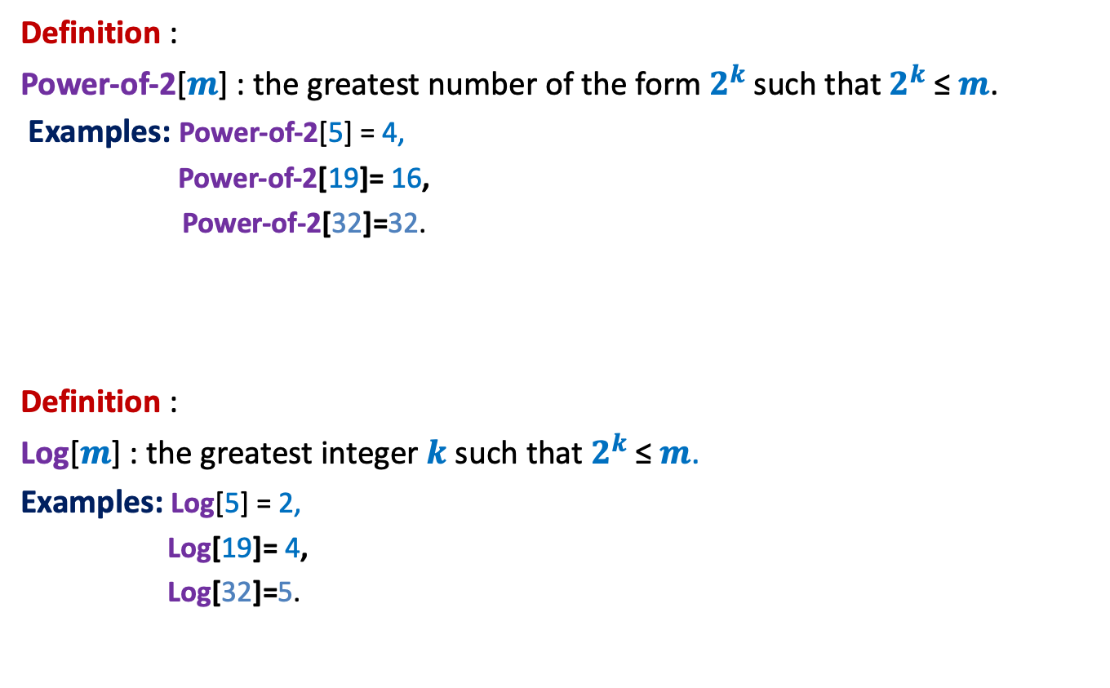
We shall use two additional arrays
Definition :
Power-of-2[$m$] : the greatest number of the form $2^{k}$such that $2^{k}$≤ $m$.
Examples: Power-of-2[5] = 4,
Power-of-2[19]= 16,
Power-of-2[32]=32.
Definition :
Log[$m$] : the greatest integer $k$ such that $2^{k}$≤ $m$.
Examples: Log[5] = 2,
Log[19]= 4,
Log[32]=5.

Slide 19
Final solution for Range Minima problem

Slide 20



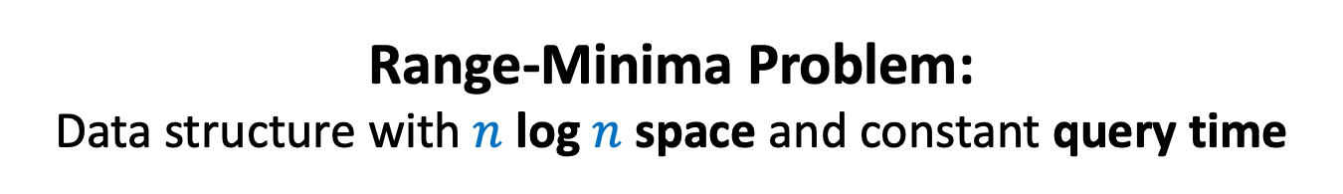



Range-Minima Problem: Data structure with $n$ log $n$ space and constant query time
Data Structure:
A
$n$ × log $n$ matrix C
Array Power-of-2[]
Array Log[]
Range-minima-($i,j$)
{ L ← $j−i$;
$t$ ← Power-of-2[L];
$k$← Log[L];
If ($t$ = L) return ??;
else return min( ?? , ?? );
}
0
1
$$log_{2} n$$
0
1
…
C
C[$i$][$k$];
C[$i$][$k$]
C[$j−t$][$k$];
$$n−1$$

Slide 21

Theorem:
There is a data structure for range-minima problem that occupies
$n$ log $n$ words in RAM and constant query time.

Slide 22
Homework
Try to design an efficient algorithm for the following subproblems.
Building array Power-of-2[] in
Building array Log[]
Build the matrix C.

