Slide 1
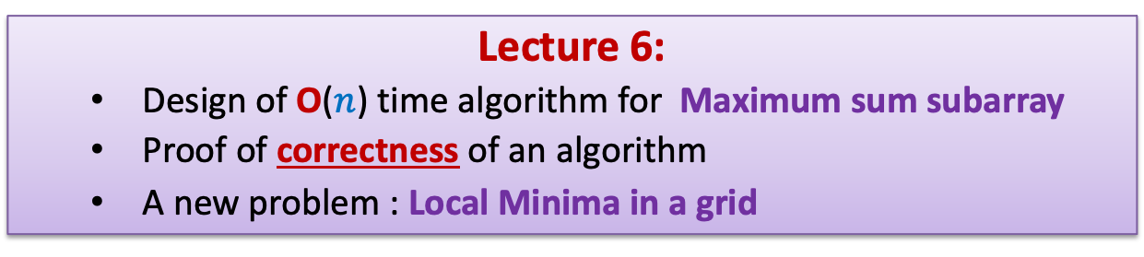
Data Structures and Algorithms (ESO207A)
Lecture 6:
Design of O($n$) time algorithm for Maximum sum subarray
Proof of correctness of an algorithm
A new problem : Local Minima in a grid

Slide 2

Max-sum subarray problem
Given an array A storing $n$ numbers,
find its subarray the sum of whose elements is maximum.
4
7
A
3 -5 3 8 2 -4 9 -6 3 -2 -8 3 -5 1 7 -9
18
-2

Slide 3

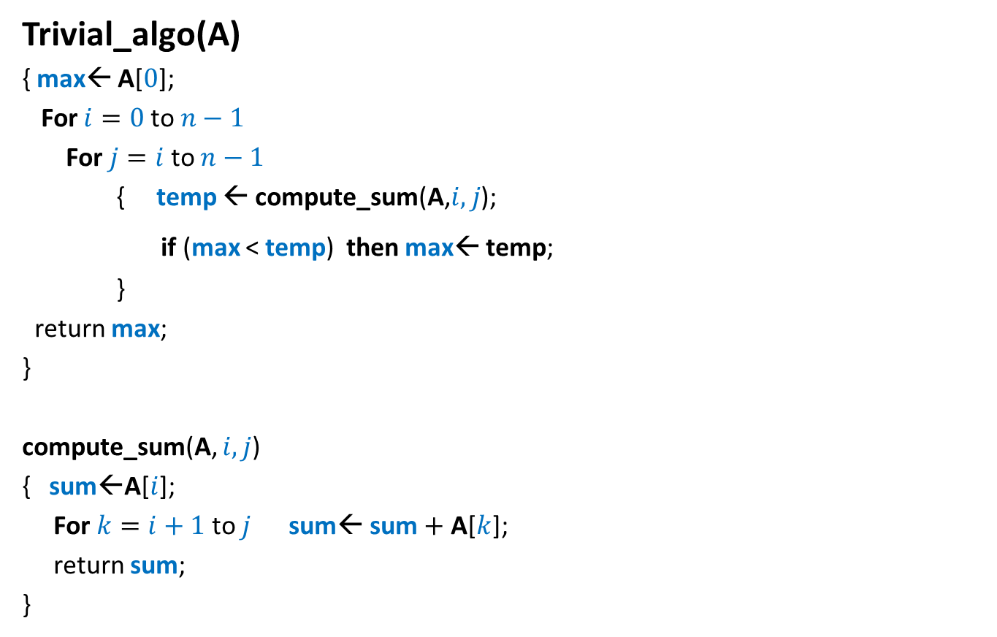
Max-sum subarray problem
A trivial algorithm
Trivial_algo(A)
{ max← A[$0$];
For $i=0$ to $n−1$
For $j=i$to $n−1$
{ temp ← compute_sum(A,$i,j$);
if (max < temp) then max← temp;
}
return max;
}
compute_sum(A, $i,j$)
{ sum←A[$i$];
For $k=i+1$ to $j$ sum← sum $+$ A[$k$];
return sum;
}
Time complexity = O($n^{3}$)

Slide 4

Designing an O($n^{2}$) time Algorithm

Slide 5








Max-sum subarray problem
A trivial algorithm
Trivial_algo(A)
{ max← A[$0$];
For $i=0$ to $n−1$
For $j=i$to $n−1$
{ temp ← compute_sum(A,$i,j$);
if (max < temp) then max← temp;
}
return max;
}
compute_sum(A, $i,j$)
{ sum←A[$i$];
For $k=i+1$ to $j$ sum← sum $+$ A[$k$];
return sum;
}
Sum[$j$] $−$ Sum[$i−1$]
$O(1)$ time
Time complexity = O($n^{2}$)
Let Sum[] be an array such that
$$=\sum_{ℓ=0}^{ℓ=k}{A[ℓ]}$$
Sum[$k$]
for all $k≥0$
Sum[$−1$] $=0$

Slide 6

Designing an O($n$) time Algorithm

Slide 7
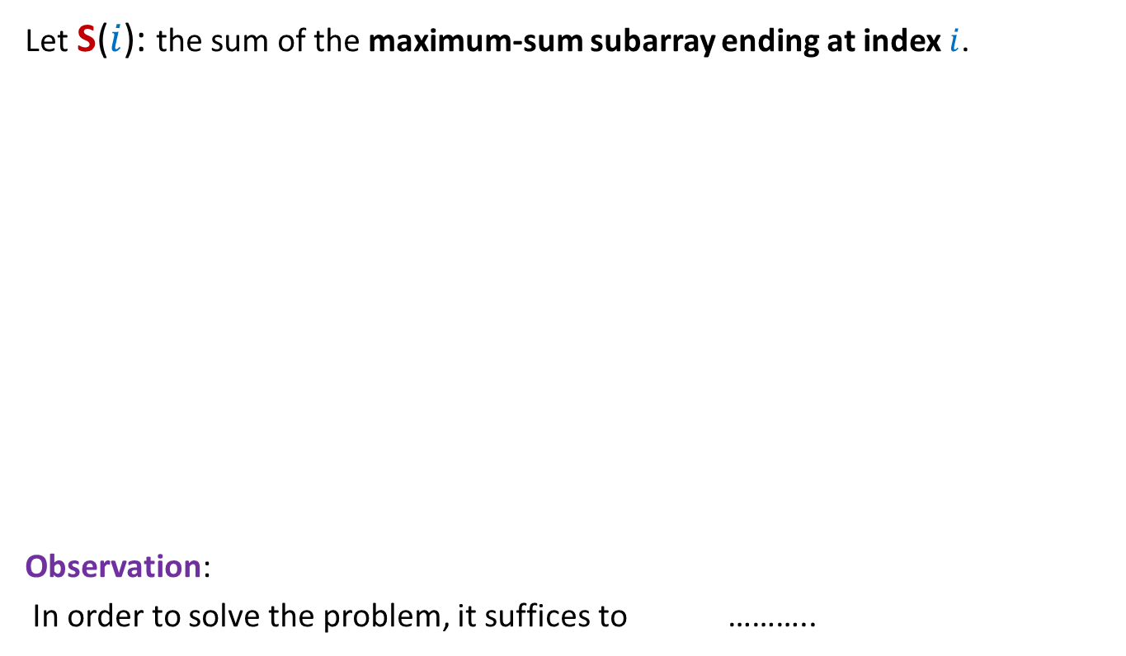




Focus on any particular index $i$
Let S($i$): the sum of the maximum-sum subarray ending at index $i$.
Observation:
In order to solve the problem, it suffices to ………..
$i$=5
A
3 -5 3 8 2 -4 8 -6 3 -2 -8 3 -5 1 7 -9
-4
-2
6
9
S($i$)=9 for $i$ = 5
4
7
compute S($i$) for each $0≤i<n$.

Slide 8
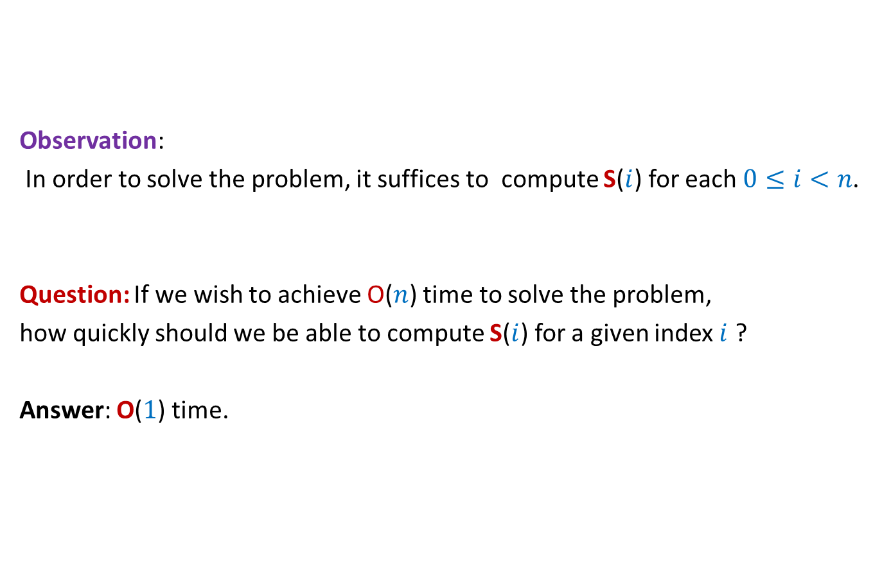
Focus on any particular index $i$
Observation:
In order to solve the problem, it suffices to compute S($i$) for each $0≤i<n$.
Question: If we wish to achieve O($n$) time to solve the problem,
how quickly should we be able to compute S($i$) for a given index $i$ ?
Answer: O($1$) time.

Slide 9



Focus on any particular index $i$
Observation:
In order to solve the problem, it suffices to compute S($i$) for each $0≤i<n$.
We should compute
S($i$) for a given index $i$
in O($1$) time.

Slide 10

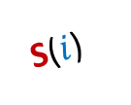
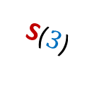


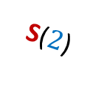

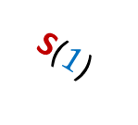
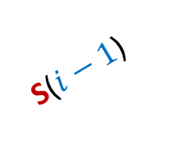


How to compute S($i$) in O($1$) time ?
S($0$)
?
S($i+1$)
S($1$)
Any relation
among them ?
S($i$)
S($2$)
?
S($3$)
S($i−1$)
S($4$)
?
What is the relation between S($i$) and S($i−1$) ?
S($5$)

Slide 11

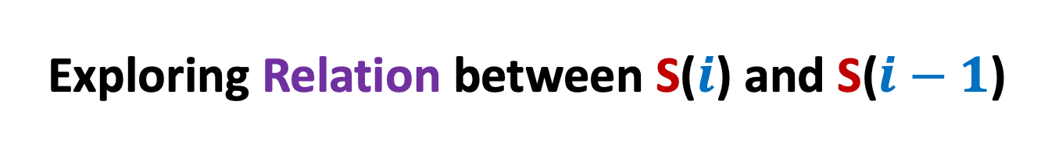
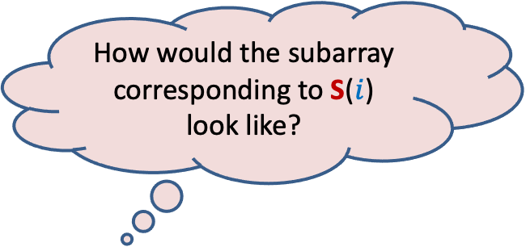


Exploring Relation between S($i$) and S($i−1$)
$$i$$
A
How would the subarray corresponding to S($i$) look like?
Subarray corresponding to S($i$)
It would be A[$i$]
only
or …

Slide 12




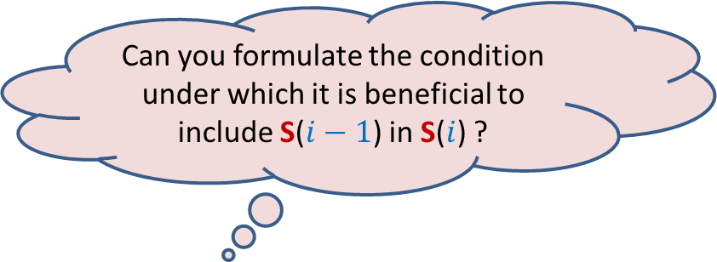
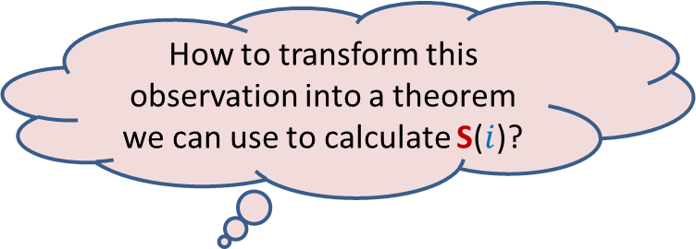
Exploring Relation between S($i$) and S($i−1$)
Subarray corresponding to S($i−1$)
Observation 1:
If subarray corresponding to S($i$) has more than 1 elements, then
?
$$i$$
Give reason.
A
Can you formulate the condition under which it is beneficial to include S($i−1$) in S($i$) ?
How to transform this observation into a theorem we can use to calculate S($i$)?
Subarray corresponding to S($i$)
When S(𝑖−1) $> 0$☺
S($i$) $=$ S($i−1$) + A[$i$]
It would be A[$i$]
and a few elements preceding it.

Slide 13


Exploring Relation between S($i$) and S($i−1$)
Subarray corresponding to S($i−1$)
Theorem 1:
If S($i−1$) > 0 then
else S($i$) = A[$i$]
$$i$$
A
Subarray corresponding to S($i$)
S($i$) = S($i−1$) + A[$i$]

Slide 14
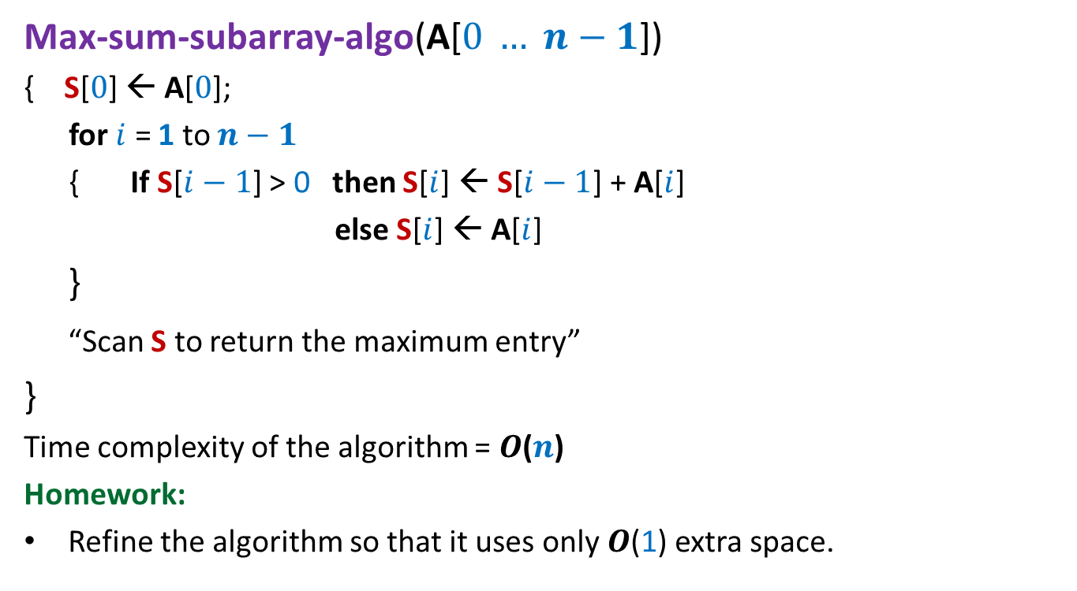

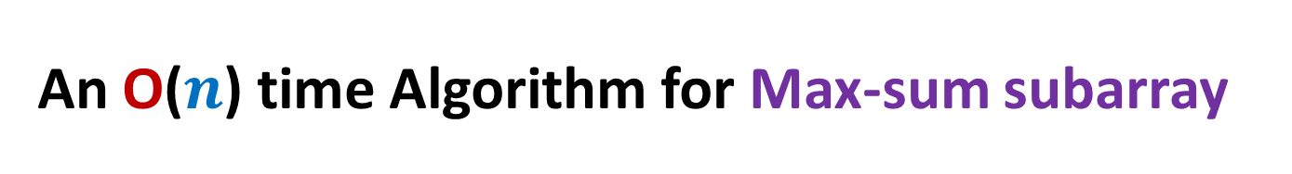



An O($n$) time Algorithm for Max-sum subarray
Max-sum-subarray-algo(A[$0 … n−1$])
{ S[$0$] ← A[$0$];
for $i$ = 1 to $n−1$
{ If S[$i−1$] > 0 then S[$i$] ← S[$i−1$] + A[$i$]
else S[$i$] ← A[$i$]
}
“Scan S to return the maximum entry”
}
Time complexity of the algorithm = $O$($n$)
Homework:
Refine the algorithm so that it uses only $O$(1) extra space.
$O$($1$) time
$n−1$repetitions
$O$($1$) time
$O$($n$) time

Slide 15

An O($n$) time Algorithm for Max-sum subarray
Max-sum-subarray-algo(A[$0 … n−1$])
{ S[$0$] ← A[$0$]
for $i$ = 1 to $n−1$
{ If S[$i−1$] > 0 then S[$i$] ← S[$i−1$] + A[$i$]
else S[$i$] ← A[$i$]
}
“Scan S to return the maximum entry”
}
What is the proof of correctness of the algorithm ?

Slide 16
What does correctness of an algorithm mean ?
For every possible valid input,
the algorithm must output correct answer.

Slide 17
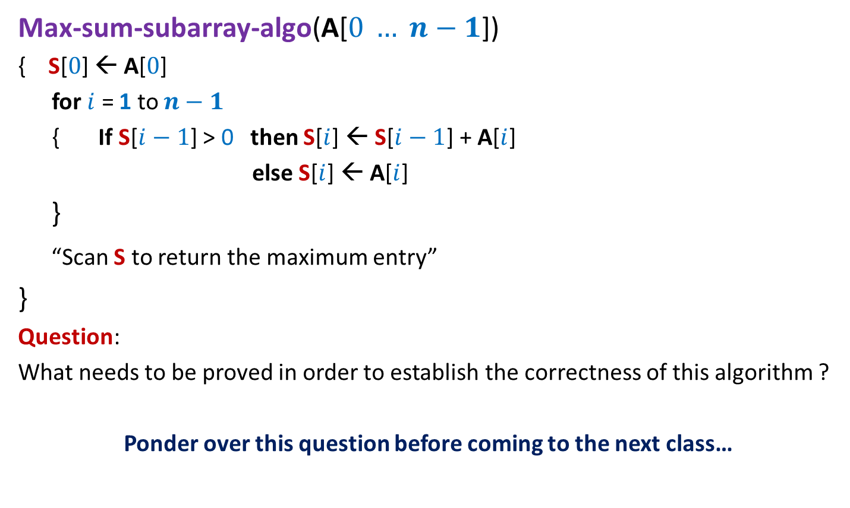
An O($n$) time Algorithm for Max-sum subarray
Max-sum-subarray-algo(A[$0 … n−1$])
{ S[$0$] ← A[$0$]
for $i$ = 1 to $n−1$
{ If S[$i−1$] > 0 then S[$i$] ← S[$i−1$] + A[$i$]
else S[$i$] ← A[$i$]
}
“Scan S to return the maximum entry”
}
Question:
What needs to be proved in order to establish the correctness of this algorithm ?
Ponder over this question before coming to the next class…

Slide 18
new Problem:
Local minima in a GRID

Slide 19



Local minima in a GRID
Definition: Given a $n$× $n$ grid storing distinct numbers,
an entry is local minima if it is smaller than each of its neighbors.
$$j$$
Does a local minima exist always ?
31
$$i$$
5
3
10
3
99
Yes. After all, global minima is also a local minima.

Slide 20


Local minima in a GRID
Problem: Given a $n$× $n$ grid storing distinct numbers, output any local
minima in $O$($n$) time.
$$j$$
31
$$i$$
5
3
10
3
99

Slide 21
Using common sense principles
There are some simple but very fundamental principles
which are not restricted/confined to a specific stream of science/philosophy.
These principles, which we usually learn as common sense,
can be used in so many diverse areas of human life.
For the current problem of local minima,
we shall use two such simple principles.
This should convince you that designing algorithm does not require any thing magical ☺!

Slide 22
Two simple principles
Respect every new idea
Principle of simplification
even if it does not solve a problem finally.
If you find a problem difficult,
Try to solve its simpler version, and then …
Try to extend this solution to the original (difficult) version.

Slide 23


A new approach
Repeat : if current entry is not local minima, explore the neighbor storing smaller value.
$$j$$
$$i$$

Slide 24
A new approach
Explore()
{ Let c be any entry to start with;
While(c is not a local minima)
{
c ← a neighbor of c storing smaller value
}
return c;
}
Question: What is the proof of correctness of Explore ?
Answer:
➔It suffices if we can prove that While loop eventually terminates.
➔Indeed, the loop terminates since we never visit a cell twice.

Slide 25
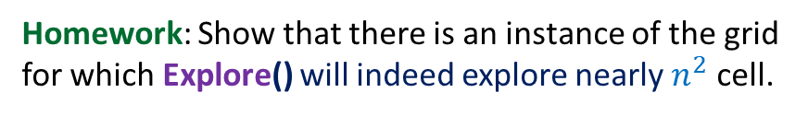

A new approach
Explore()
{ Let c be any entry to start with;
While(c is not a local minima)
{
c ← a neighbor of c storing smaller value
}
return c;
}
Time complexity : ?
How to apply this principle ?
$O$($n^{2}$)
First principle:
Do not discard Explore()
Second principle:
Simplify the problem
Homework: Show that there is an instance of the grid
for which Explore() will indeed explore nearly $n^{2}$ cell.

Slide 26
Local minima in a GRID
How to simplify the problem ?

Slide 27
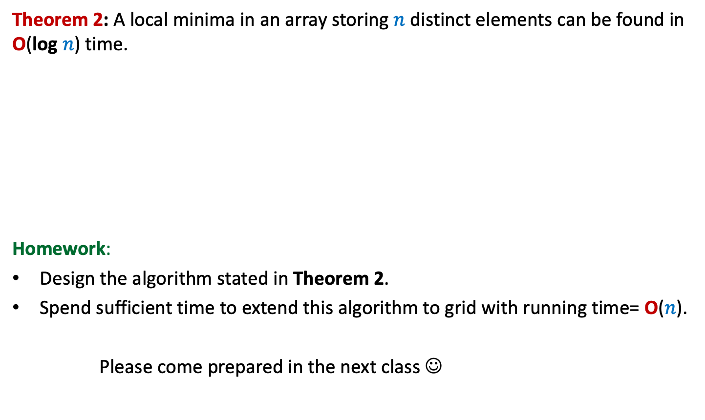
Local minima in a GRID
an ARRAY
Theorem 2: A local minima in an array storing $n$ distinct elements can be found in O(log $n$) time.
Homework:
Design the algorithm stated in Theorem 2.
Spend sufficient time to extend this algorithm to grid with running time= O($n$).
Please come prepared in the next class ☺

