Slide 1

Data Structures and Algorithms (ESO207A)
Lecture 8
Proof of Correctness.
Design of O($n$) time algorithm for Local Minima in a grid

Slide 2
RECAp from last lecture

Slide 3




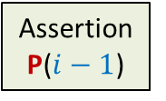
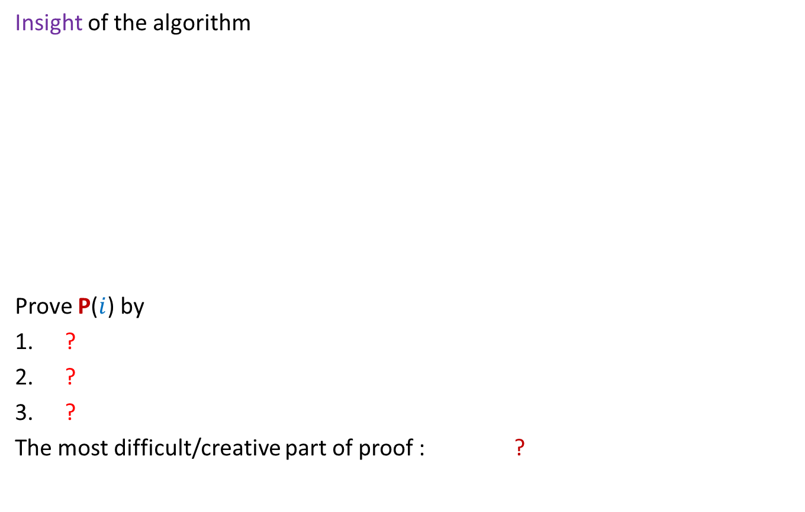

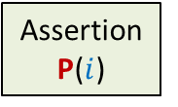





Proof of correctness
For an iterative algorithm
Insight of the algorithm
Prove P($i$) by
?
?
?
The most difficult/creative part of proof : ?
Theorem
Assertion
P($i−1$)
Assertion
P($i$)
Start
of Loop
$$i−1$$
$$i$$
Iterations
$$1$$
$$2$$
$$3$$
$$4$$
What would you expect at the end of $i$th iteration ?
Assuming P($i−1$)
Theorem
Proof by induction
Body of the Loop
To come up with the right assertion P($i$)

Slide 4
Example Maximum sum subarray

Slide 5

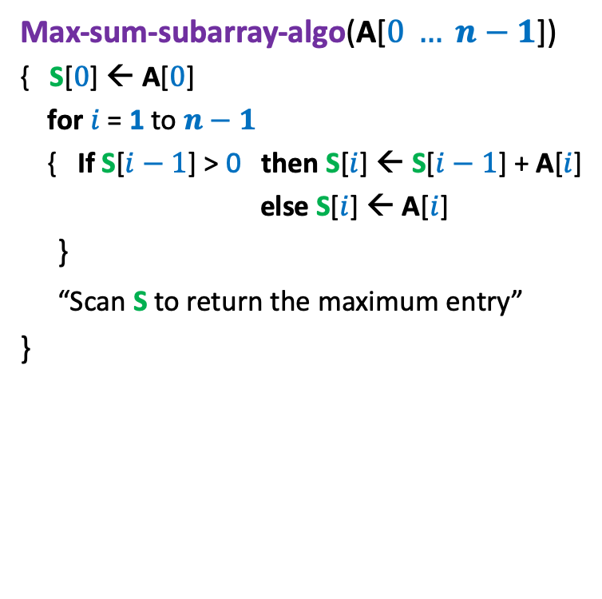

An O($n$) time Algorithm for Max-sum subarray
Max-sum-subarray-algo(A[$0 … n−1$])
{ S[$0$] ← A[$0$]
for $i$ = 1 to $n−1$
{ If S[$i−1$] > 0 then S[$i$] ← S[$i−1$] + A[$i$]
else S[$i$] ← A[$i$]
}
“Scan S to return the maximum entry”
}
Let S($i$): the sum of the maximum-sum subarray ending at index $i$.
Theorem 1 :
If S($i−1$) > 0 then S($i$) = S($i−1$) + A[$i$]
else S($i$) = A[$i$]

Slide 6







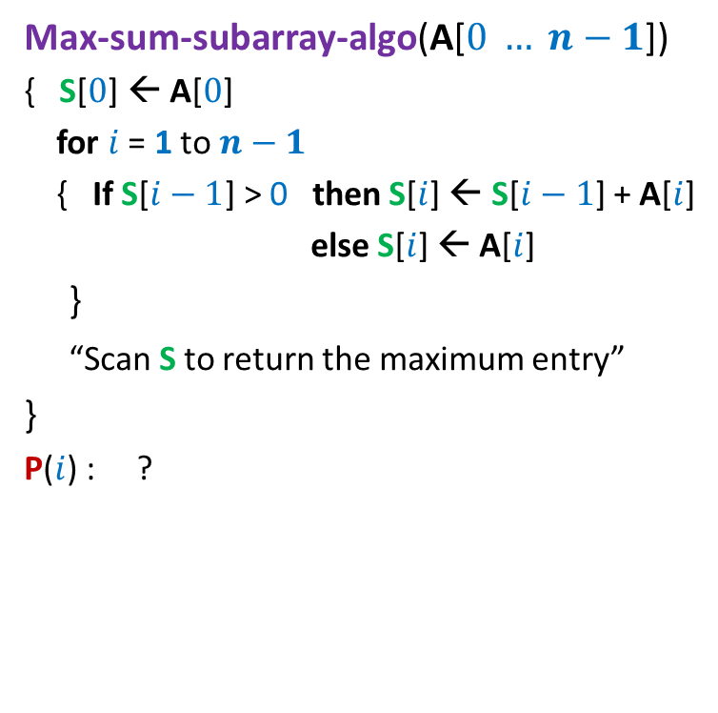

An O($n$) time Algorithm for Max-sum subarray
P($i$) holds for each $0≤i≤n−1$
Max-sum-subarray-algo(A[$0 … n−1$])
{ S[$0$] ← A[$0$]
for $i$ = 1 to $n−1$
{ If S[$i−1$] > 0 then S[$i$] ← S[$i−1$] + A[$i$]
else S[$i$] ← A[$i$]
}
“Scan S to return the maximum entry”
}
P($i$) : ?
Let Opt($i$): the sum of the maximum-sum subarray ending at index $i$.
Theorem 1 :
If Opt($i−1$) > 0 then Opt($i$) = Opt($i−1$) + A[$i$]
else Opt($i$) = A[$i$]
S[$i$] = Opt($i$)
Assume P($i−1$) holds.
P($0$) holds.
S[$i−1$] = Opt($i−1$)
P($i$) holds.
How to show that P($i$) holds ?

Slide 7
Example Local minima in an array

Slide 8




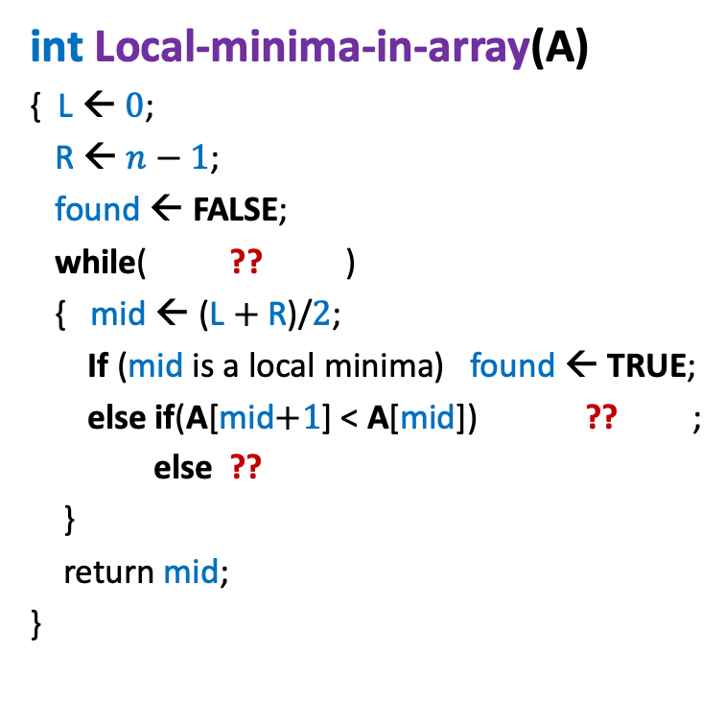






Algorithm for Local minima in an array
P($i$) holds for $i$th iteration, if executed
int Local-minima-in-array(A)
{ L ← $0$;
R ← $n−1$;
found ← FALSE;
while( ?? )
{ mid ← (L $+$R)/$2$;
If (mid is a local minima) found ← TRUE;
else if(A[mid$+1$] < A[mid]) ?? ;
else ??
}
return mid;
}
P($i$) :
L $≤$ R
There is a local minima among A[L],...,A[R].
A[L] < A[L$−1$]
A[R] < A[R$+1$]
not found
L← mid$+1$
R← mid$−$1;
A
Assume P($i−1$) holds.
P($0$) holds.
L $=$ R
L
R

Slide 9



Algorithm for Local minima in an array
P($i$) holds for $i$th iteration, if executed.
int Local-minima-in-array(A)
{ L ← $0$;
R ← $n−1$;
found ← FALSE;
while( ?? )
{ mid ← (L $+$R)/$2$;
If (mid is a local minima) found ← TRUE;
else if(A[mid$+1$] < A[mid]) ?? ;
else ??
}
return mid;
}
P($i$) :
L $≤$ R
A[L] < A[L$−1$]
A[R] < A[R$+1$]
not found
L← mid$+1$
R← mid$−$1;
A
Assume P($i−1$) holds.
P($i$) holds.
L $=$ R
L
R
L $<$ R

Slide 10

Algorithm for Local minima in an array
P($i$) holds for $i$th iteration, if executed.
int Local-minima-in-array(A)
{ L ← $0$;
R ← $n−1$;
found ← FALSE;
while( ?? )
{ mid ← (L $+$R)/$2$;
If (mid is a local minima) found ← TRUE;
else if(A[mid$+1$] < A[mid]) ?? ;
else ??
}
return mid;
}
P($i$) :
L $≤$ R
A[L] < A[L$−1$]
A[R] < A[R$+1$]
not found
L← mid$+1$
R← mid$−$1;
A
Assume P($i−1$) holds.
P($i$) holds.
L $<$ R
L
mid
R

Slide 11
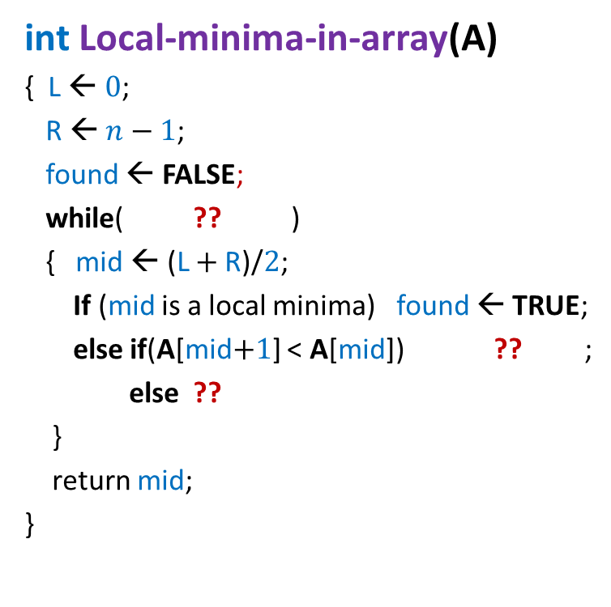

Algorithm for Local minima in an array
P($i$) holds for $i$th iteration, if executed.
int Local-minima-in-array(A)
{ L ← $0$;
R ← $n−1$;
found ← FALSE;
while( ?? )
{ mid ← (L $+$R)/$2$;
If (mid is a local minima) found ← TRUE;
else if(A[mid$+1$] < A[mid]) ?? ;
else ??
}
return mid;
}
P($i$) :
L $≤$ R
A[L] < A[L$−1$]
A[R] < A[R$+1$]
not found
L← mid$+1$
R← mid$−$1;
A
Assume P($i−1$) holds.
L $<$ R
L
mid
R

Slide 12

Algorithm for Local minima in an array
P($i$) holds for $i$th iteration, if executed.
int Local-minima-in-array(A)
{ L ← $0$;
R ← $n−1$;
found ← FALSE;
while( ?? )
{ mid ← (L $+$R)/$2$;
If (mid is a local minima) found ← TRUE;
else if(A[mid$+1$] < A[mid]) ?? ;
else ??
}
return mid;
}
P($i$) :
L $≤$ R
A[L] < A[L$−1$]
A[R] < A[R$+1$]
not found
L← mid$+1$
R← mid$−$1
A
Assume P($i−1$) holds.
P($i$) holds.
L $<$ R
mid
L
R

Slide 13
Algorithm for Local minima in an array
P($i$) holds for $i$th iteration, if executed.
int Local-minima-in-array(A)
{ L ← $0$;
R ← $n−1$;
found ← FALSE;
while( ?? )
{ mid ← (L $+$R)/$2$;
If (mid is a local minima) found ← TRUE;
else if(A[mid$+1$] < A[mid]) ?? ;
else ??
}
return mid;
}
P($i$) :
L $≤$ R
A[L] < A[L$−1$]
A[R] < A[R$+1$]
not found
L← mid$+1$
R← mid$−$1
A
Assume P($i−1$) holds.
L $<$ R
L
mid
R

Slide 14
Algorithm for Local minima in an array
P($i$) holds for $i$th iteration, if executed
int Local-minima-in-array(A)
{ L ← $0$;
R ← $n−1$;
found ← FALSE;
while( ?? )
{ mid ← (L $+$R)/$2$;
If (mid is a local minima) found ← TRUE;
else if(A[mid$+1$] < A[mid]) ?? ;
else ??
}
return mid;
}
P($i$) :
L $≤$ R
A[L] < A[L$−1$]
A[R] < A[R$+1$]
not found
L← mid$+1$
R← mid$−$1
A
Assume P($i−1$) holds.
P($i$) holds.
L $<$ R
L
R
mid

Slide 15



Algorithm for Local minima in an array
P($i$) holds for each $0≤i≤n−1$
P($i$) holds for $i$th iteration, if executed
int Local-minima-in-array(A)
{ L ← $0$;
R ← $n−1$;
found ← FALSE;
while( ?? )
{ mid ← (L $+$R)/$2$;
If (mid is a local minima) found ← TRUE;
else if(A[mid$+1$] < A[mid]) ?? ;
else ??
}
return mid;
}
P($i$) :
Question 1:
What happens during an iteration
that begins with L $=$ R.
Answer:
Local Minima is found ☺
L $≤$ R
A[L] < A[L$−1$]
A[R] < A[R$+1$]
not found
L← mid$+1$
R← mid$−$1

Slide 16
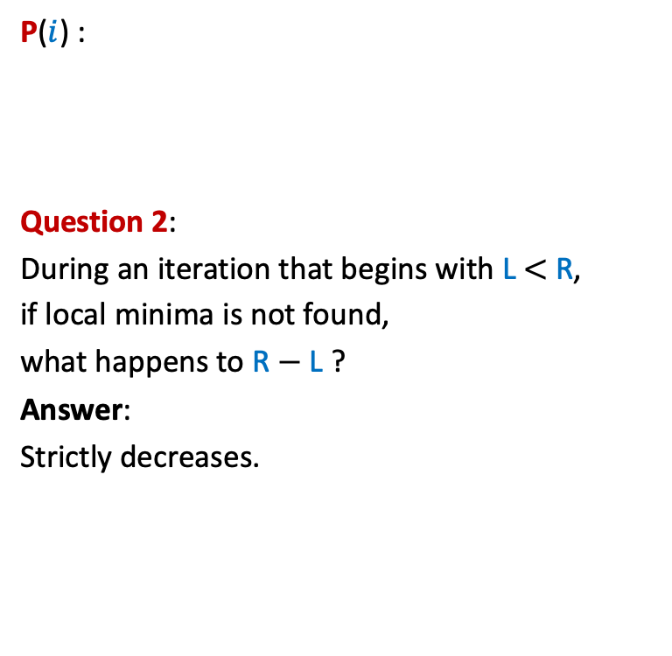
Algorithm for Local minima in an array
P($i$) holds for $i$th iteration, if executed
int Local-minima-in-array(A)
{ L ← $0$;
R ← $n−1$;
found ← FALSE;
while( ?? )
{ mid ← (L $+$R)/$2$;
If (mid is a local minima) found ← TRUE;
else if(A[mid$+1$] < A[mid]) ?? ;
else ??
}
return mid;
}
P($i$) :
Question 2:
During an iteration that begins with L $<$ R,
if local minima is not found,
what happens to R $−$ L ?
Answer:
Strictly decreases.
L $≤$ R
A[L] < A[L$−1$]
A[R] < A[R$+1$]
not found
L← mid$+1$
R← mid$−$1
Algorithm is correct.

Slide 17

Local minima in an array (Proof of correctness)
Theorem: A local minima in an array storing $n$ distinct elements
can be found in O(log $n$) time.

Slide 18

Local minima in a GRID
in O($n$log $n$) time

Slide 19




Local minima in a grid (extending the solution from 1-D to 2-D)
Under what circumstances even this smallest element is not a local minima ?
A local minima exists
in this region. Why ?
Search for a local minima in the column M[$∗$, $mid$]
What if there is no local minima in the entire column.
Explore() from M[$i$, $mid+1$]
$$mid$$
Smallest element
of the column
$$i$$
9
7

Slide 20

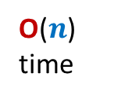
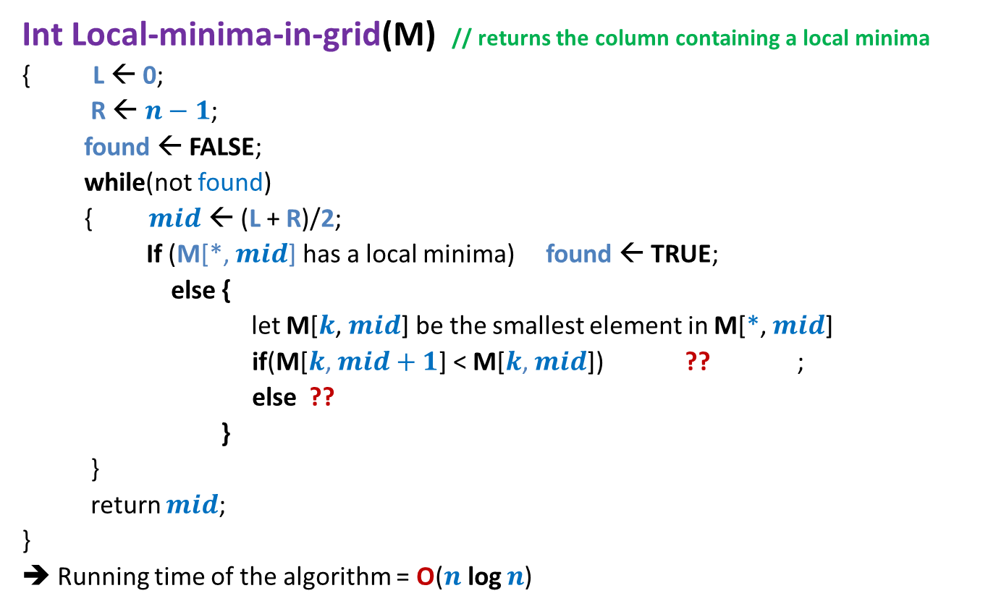



Local minima in a grid
Int Local-minima-in-grid(M) // returns the column containing a local minima
{ L ← 0;
R ← $n−1$;
found ← FALSE;
while(not found)
{ $mid$ ← (L + R)/2;
If (M[*, $mid$] has a local minima) found ← TRUE;
else {
let M[$k$, $mid$] be the smallest element in M[*, $mid$]
if(M[$k$, $mid+1$] < M[$k$, $mid$]) ?? ;
else ??
}
}
return $mid$;
}
➔ Running time of the algorithm = O($n$log $n$)
O($n$) time
O($n$) time
O($n$)
time
L← $mid+1$
R← $mid−1$
Proof of correctness ?
Homework

Slide 21


Local minima in a grid
Theorem: A local minima in an $n$×$n$ grid storing distinct elements can be found in O($n$ log $n$) time.
How to improve it to O($n$) ?

Slide 22
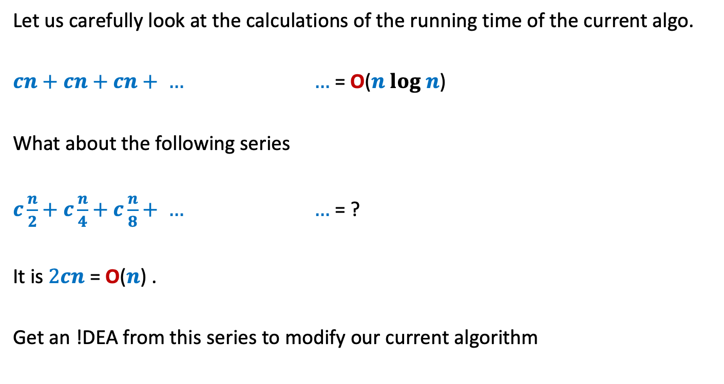

Local minima in a grid in O($n$) time
Let us carefully look at the calculations of the running time of the current algo.
$cn+cn+cn+ … …$ = O($n log n$)
What about the following series
$c\frac{n}{2}+c\frac{n}{4}+c\frac{n}{8}+ … …$ = ?
It is $2cn$ = O($n$) .
Get an !DEA from this series to modify our current algorithm
(log $n$terms)
(log $n$terms)

Slide 23
Local minima in a grid in O($n$) time
Bisect alternatively along rows and column
Try on your own.
We shall revisit it towards the end of the course.

Slide 24
Quiz 1
Date: 20th August, 2022
Time: 9:00 AM to 10:45 AM
Details of seating plan will be posted today.

