Slide 1
Self Transforming Quadruped Robot
Group 14
Design Practicum 2019
Members:
Mentors:
Dr. Arnav Bhavsar Dr. Rajneesh Sharma
Vikas Verma Siddharth Gupta Suraj Kumar Divyanshu Kumavat Sachin Ranjalkar Aditya Nautiyal

Slide 2
Concept
A quadruped robot has four limbs and all are used for locomotion.
Our project aims to build a self transforming quadruped robot that will be able to traverse different kinds of terrains and paths by transforming into a different shape more suited to traverse that specific path.
The robot will transform into a suitable form depending on the path.

Slide 3
Design
The quadruped robot has the following design features:
Servo motors (high torque) used to control the limbs.
Arduino Mega as the main control unit of the robot.
Bluetooth Module to send and receive command signals.
Gyroscopic sensor to stabilize the movement and transformations of the robot.
Ultrasonic sensor to sense the obstacles in its path.
Servo motor controller to connect the servo motors.
LM2596 dc to dc buck converter for step down power.

Slide 4
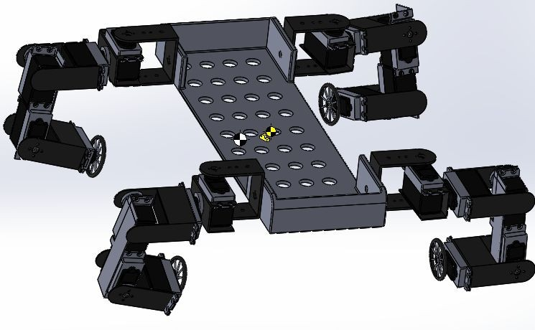
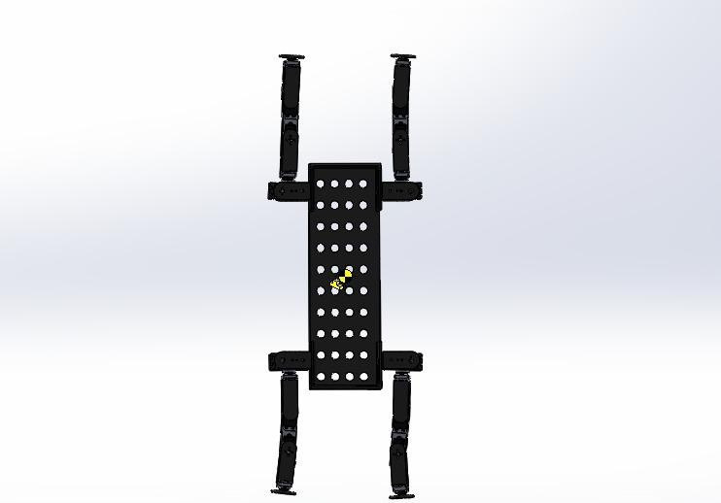
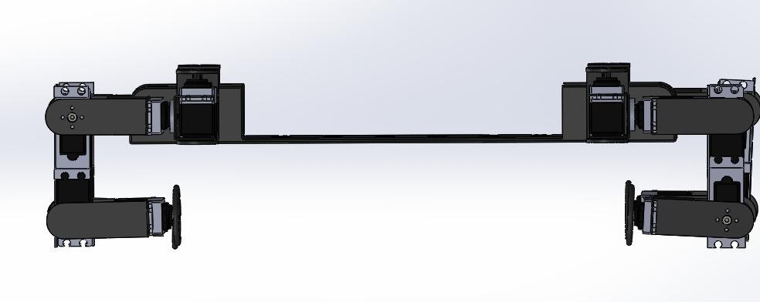
Design
Isometric View
Top View
Side View

Slide 5
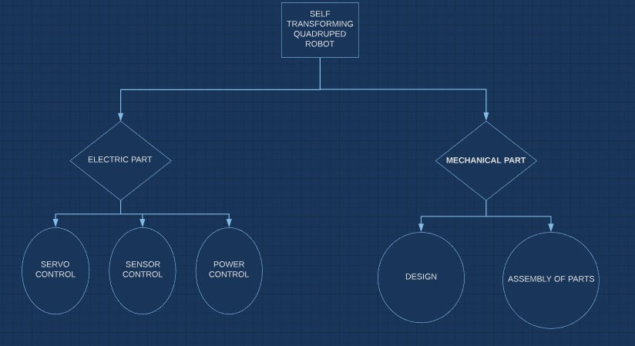
Strategy

Slide 6
Progress Proportion
Tasks completed
Order of Components.
SolidWorks Model of the robot.
Assembling of one leg of the robot.
Tasks have to be done
Assembling of the all hardware parts.
Coding for arduino, to control servo motors.
Assembling of all the components.
Testing and Debugging

Slide 7
Timeline
Most of the parts for the project have been delivered.
The assembling of all the hardware components will be completed by third week of April.
Following two weeks will be the coding phase.
The estimated time for complete construction of the working model is by the first week of May.
Testing and debugging will follow in the second and third weeks of May.

