Slide 1
IOT Project
Project Topic : Real Time air pollution Monitoring system which will update info on a Web dashboard or Android app.

Slide 2


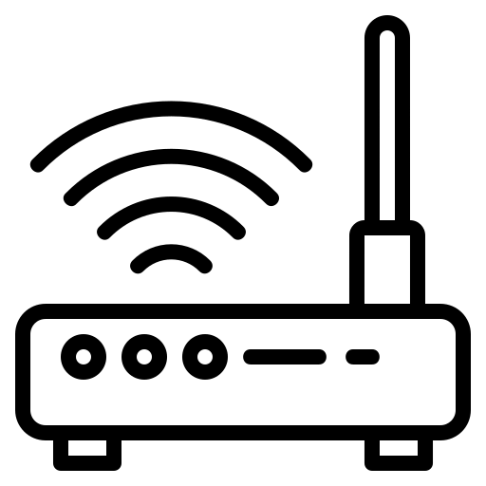

ARCHITECTURE
Cloud
Proteus (Simulation Environment )
Hardware
DHT11
MQ135
MQ7
ESP-32
Arduino Uno R3
Serial Communication
16x2 Display
OLED
Display

Slide 3
Working
Gas data is collected by MQ-135(For Particulate Matter) and MQ-9 for (CO) using Arduino UNO in proteus Simulation Environment.
Using Serial communication between Arduino in proteus and Esp-32(Hardware) gas data is transferred from Arduino to Esp-32.
In Esp-32 by using DHT-11 sensor temperature and humidity is collected and set to along with gas data using MQTT protocol via a WIFI link to router.
On Cloud there is a graphical dashboard which displays the sent data on any Device.

Slide 4
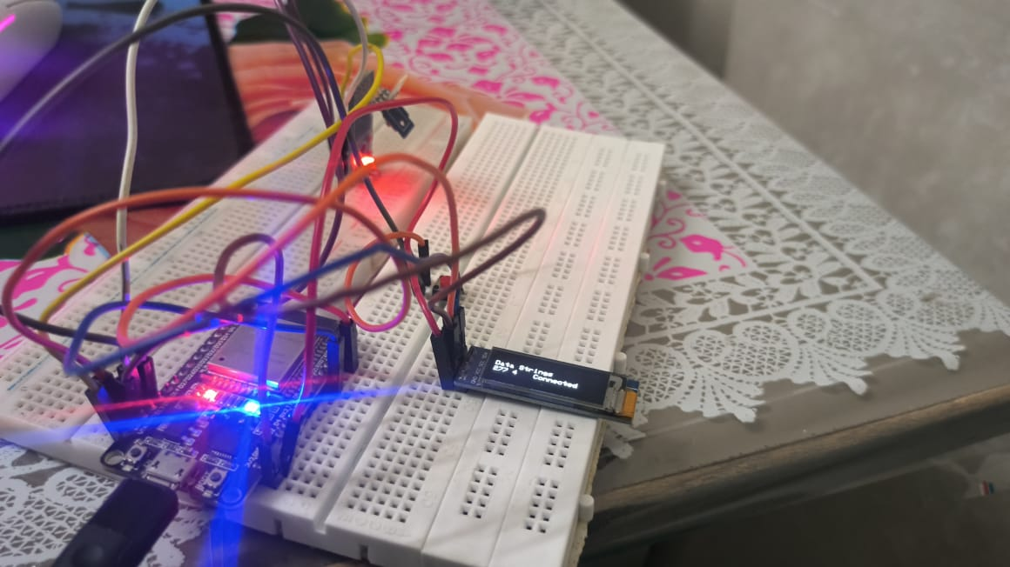
Hardware Requirements
Esp 32
DHT 11 Temperature Sensor
Push Button
128x32 OLED display
Bread Boards
Jumber Wires

Slide 5
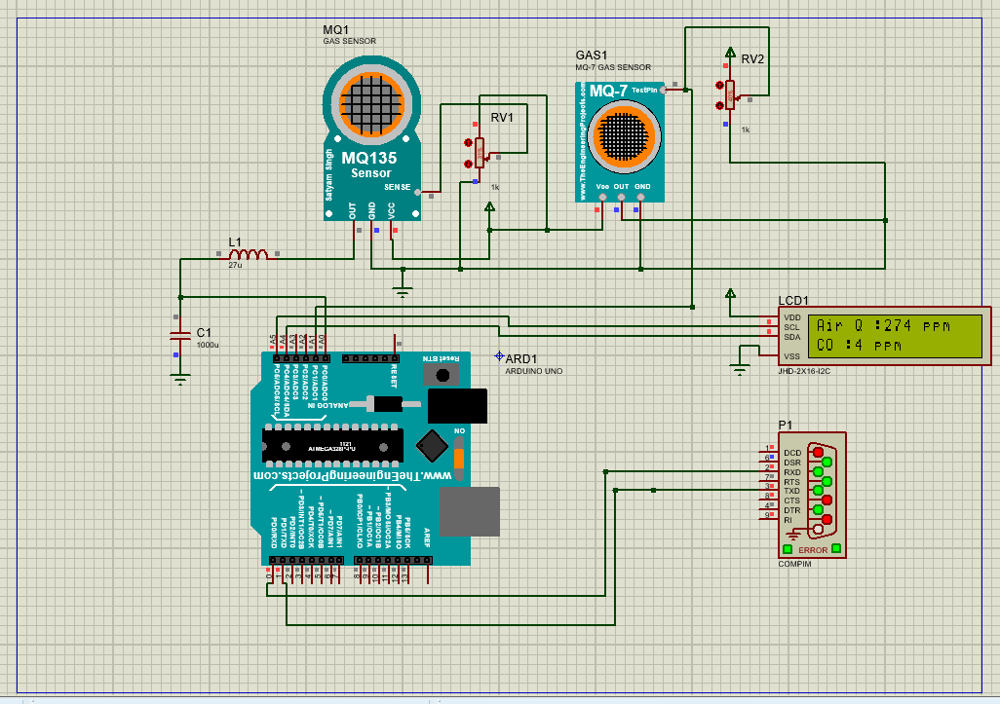
Software Requirements
Proteus
Arduino Library for proteus
MQ gas sensor Library for proteus

Slide 6
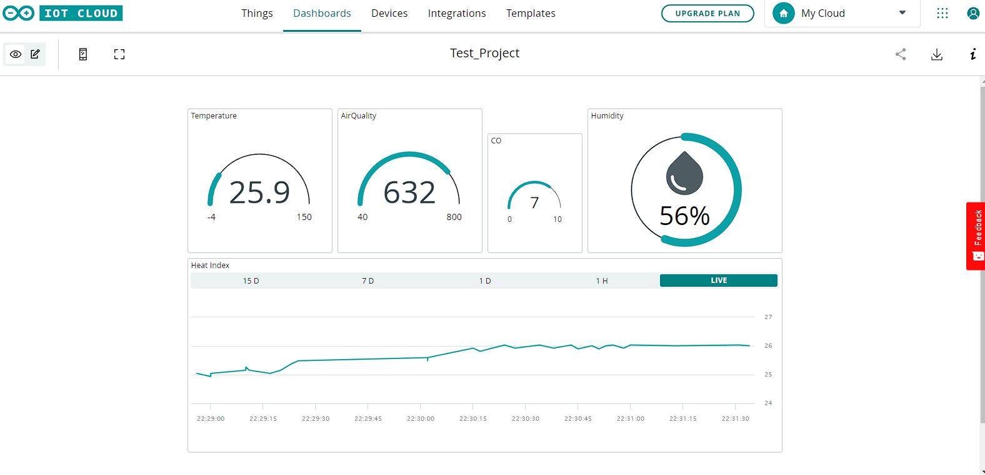
Dashboard

