Slide 1
BLUESTOCK FINTECH
Mutual Fund Analytics Platform
Capstone Project — End-to-End Data Engineering, ETL & Interactive Dashboard
40
64K+
32,778
10
Fund Schemes
NAV Records
Transactions
Fund Houses
Prepared by: Divyanshu Rai | Duration: 7 Days, June 2026 | Data: AMFI India, mfapi.in, NSE/BSE

Slide 2
Problem Statement & Objectives
Why does this platform need to exist?
The Gaps We're Solving
8 Project Objectives
Data fragmentation — NAV, AUM, SIP data in different formats across AMFI, NSE, BSE
No unified risk-adjusted comparison across 1,900+ schemes
Retail investors can't tell if their fund beats the benchmark
AMCs lack visibility into demographic SIP behaviour
Monthly reports are static PDFs — no self-service analytics
O1 — Automated ETL pipeline
O2 — 7-table star schema SQLite DB
O3 — EDA with 15+ charts
O4 — Sharpe, Alpha, Beta, VaR metrics
O5 — 4-page Power BI dashboard
O6 — Investor demographic analysis
O7 — Benchmark comparison (Nifty 50/100)
O8 — Professional report & presentation
Bluestock Fintech | Mutual Fund Analytics Capstone | June 2026 • 2/12

Slide 3
Data Sources & Dataset Overview
10 datasets | 87,000+ rows | All public sources
# | File | Size | Description
01 | fund_master.csv | 40 rows | 40 scheme master with expense ratio, risk grade
02 | nav_history.csv | 46,000 rows | Daily NAV Jan 2022 – May 2026 (mfapi.in)
03 | aum_by_fund_house.csv | 90 rows | Quarterly AUM for 10 fund houses
04 | monthly_sip_inflows.csv | 48 rows | SIP inflow, accounts, AUM — AMFI Monthly Notes
05 | category_inflows.csv | 144 rows | Net inflows by category FY 2024-25
07 | scheme_performance.csv | 40 rows | Pre-computed Sharpe, Alpha, Beta, Drawdown
08 | investor_transactions.csv | 32,778 rows | SIP/Lumpsum/Redemption for 5,000 investors
09 | portfolio_holdings.csv | 322 rows | Top equity holdings, sector weights Dec 2025
10 | benchmark_indices.csv | 8,050 rows | Nifty 50, Nifty 100, BSE SmallCap, CRISIL
Bluestock Fintech | Mutual Fund Analytics Capstone | June 2026 • 3/12

Slide 4
ETL Pipeline & System Architecture
5-layer data engineering design
EXTRACT
AMFI Daily NAV, mfapi.in REST API, NSE Bhavcopy, pre-packaged CSVs
TRANSFORM
Python/Pandas — parse dates, forward-fill holidays, validate, deduplicate
LOAD
SQLite star schema — 7 tables, indexed on amfi_code + date
ANALYSE
Jupyter — CAGR, Sharpe, Sortino, Alpha, Beta, VaR, CVaR, HHI, cohorts
VISUALISE
Power BI — 4 interactive pages, slicers, drill-through, KPI cards
Bluestock Fintech | Mutual Fund Analytics Capstone | June 2026 • 4/12

Slide 5
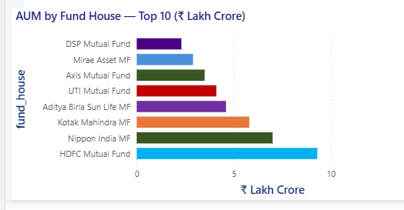
EDA Highlights — Industry & AUM
Macro view of the Indian MF industry
Rs. 62.74L Cr
Rs. 31,002 Cr
26.12 Cr
9.35 Cr
Industry AUM Dec 2025
Monthly SIP Inflow
Total Folios
Active SIP Accounts
Key Findings
AUM grew 2.1x from Rs.29.5L Cr (Jan 2022) to Rs.62.7L Cr (Dec 2025)
SBI MF leads with Rs.12.5L Cr, ICICI at Rs.10.74L Cr, HDFC at Rs.9.3L Cr
SIP inflows grew 169% — Rs.11,517 Cr (Jan 2022) to Rs.31,002 Cr (Dec 2025)
Industry folios doubled: 13.26 Cr → 26.12 Cr in under 4 years
Bluestock Fintech | Mutual Fund Analytics Capstone | June 2026 • 5/12

Slide 6
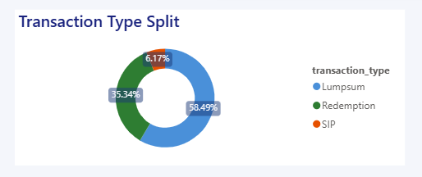
EDA Highlights — Investor Analytics
Who is investing, how much, and from where?
SIP = 60.2% of transactions | Lumpsum = 24.7% | Redemption = 15.2% | Age 36-45 invests most on average — peak earning years
Top states: Maharashtra, Delhi, Gujarat | 92% investors KYC verified | T30 cities dominate SIP value
Bluestock Fintech | Mutual Fund Analytics Capstone | June 2026 • 6/12

Slide 7
Fund Performance Metrics
CAGR, Sharpe, Sortino, Alpha, Beta for all 40 schemes
Methodology
Top 5 — Composite Scorecard
CAGR = (NAV_end / NAV_start) ^ (1/n) - 1
Sharpe = (Rp - Rf) / Std(Rp) × √252 | Rf = 6.5%
Sortino = uses only downside std deviation
Alpha/Beta = OLS regression on Nifty 100 daily returns
Max Drawdown = min(NAV / running_max - 1)
#1 Mirae Asset Large Cap — Regular 85.9
#2 HDFC Top 100 — Regular 81.2
#3 SBI Bluechip — Regular 79.8
#4 ICICI Pru Bluechip — Regular 77.4
#5 Axis Bluechip — Regular 74.1
7.68
+30.3%
-2.39%
85.9
Highest Sharpe
(ICICI Liquid)
Highest Alpha
(SBI Small Cap)
Worst VaR 95%
(ABSL Small Cap)
Top Scorecard
(Mirae Large Cap)
Bluestock Fintech | Mutual Fund Analytics Capstone | June 2026 • 7/12

Slide 8
Benchmark Comparison & Risk Metrics
Top 5 funds vs Nifty 50 & Nifty 100 — 3 year window
Benchmark Tracking Error (vs Nifty 100)
All top 5 equity funds show positive Alpha vs Nifty 100
SBI Small Cap: highest alpha at +30.3% annualised
Tracking error ranges from 8% to 24% (equity funds)
Liquid funds: near-zero tracking vs CRISIL Liquid index
VaR Insight
Small Cap funds: lose up to 2.39% on a bad day (1-in-20)
Liquid funds: effectively zero daily VaR
Industry avg VaR: -0.82% daily ≈ -13% annualised
Bluestock Fintech | Mutual Fund Analytics Capstone | June 2026 • 8/12

Slide 9
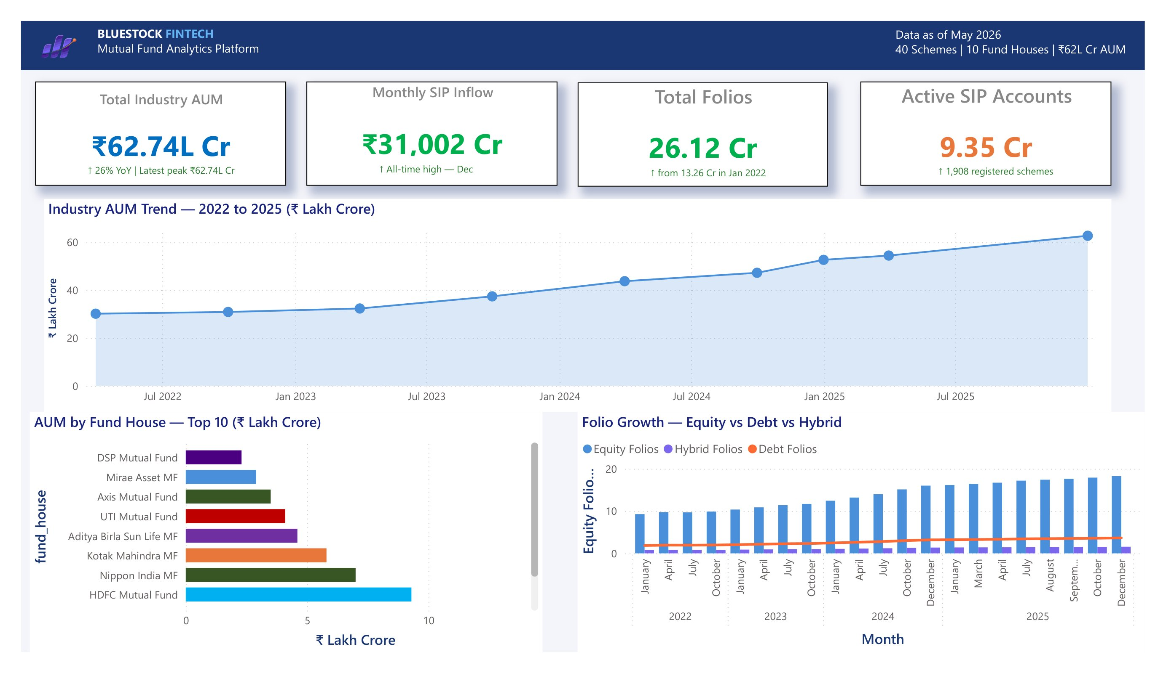
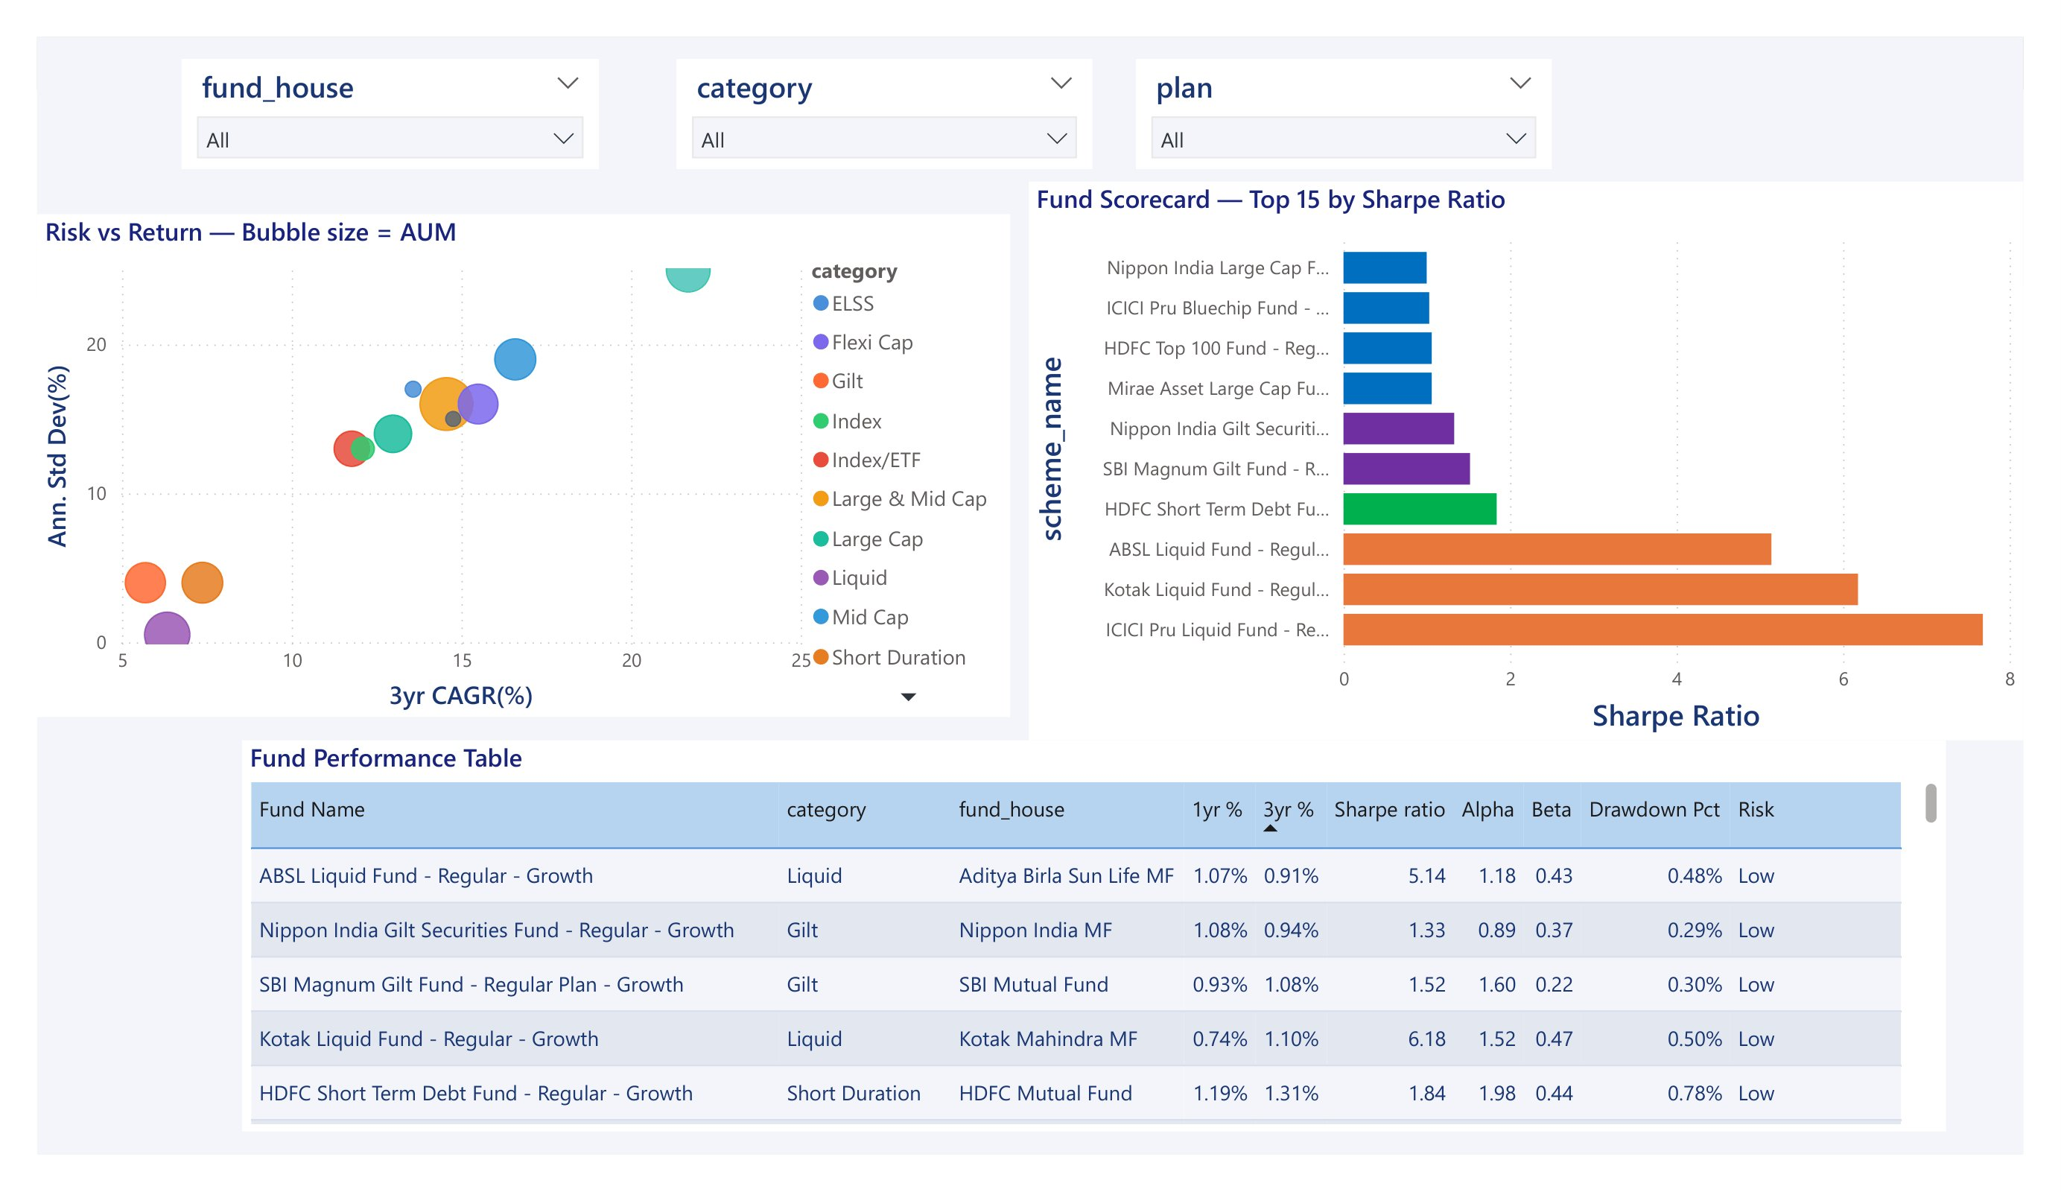
Dashboard — Page 1 & 2: Industry & Performance
Power BI | 4 interactive pages with slicers and drill-through
Page 1 — Industry Overview
Page 2 — Fund Performance
Bluestock Fintech | Mutual Fund Analytics Capstone | June 2026 • 9/12

Slide 10
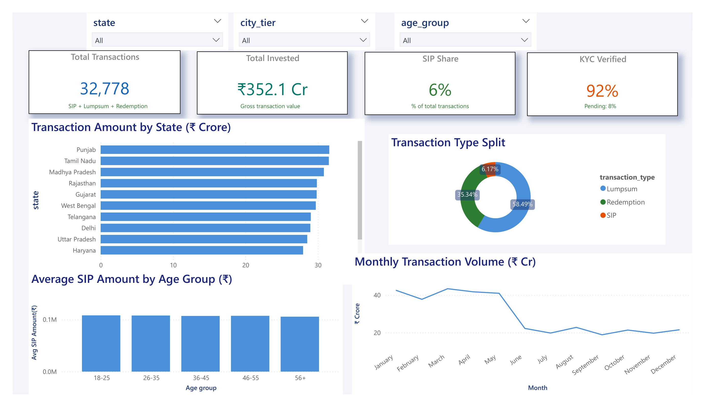
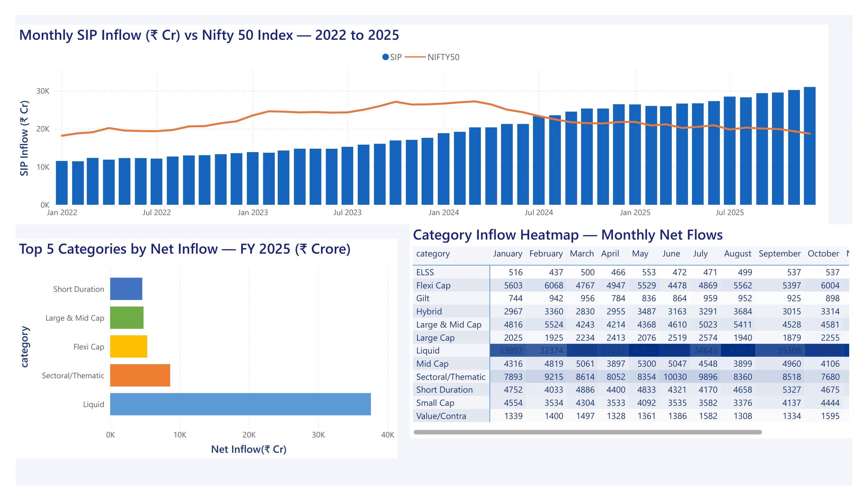
Dashboard — Page 3 & 4: Investor & SIP Trends
Demographics, geography, SIP inflow vs market movement
Page 3 — Investor Analytics
Page 4 — SIP & Market Trends
Bluestock Fintech | Mutual Fund Analytics Capstone | June 2026 • 10/12

Slide 11
Key Findings & Recommendations
What the data tells us — and what to do about it
1. Best Fund
4. Risk Reality
Mirae Asset Large Cap — Regular scores 85.9/100 on the composite scorecard (30% CAGR + 25% Sharpe + 20% Alpha + 15% Expense + 10% Drawdown)
Small Cap funds lose up to 2.39% on a bad day. Liquid funds: effectively zero daily VaR. Category selection matters more than fund selection
2. Alpha Leaders
5. Newer Investors
SBI Small Cap generates +30.3% annualised Alpha vs Nifty 100 — fund manager significantly outperforms market
Cohort 2025 investors put in Rs.13,505 avg SIP vs Rs.10,997 for 2024 cohort — 23% higher ticket size from newer entrants
3. SIP Growth
6. Recommendation
Monthly SIP inflows grew 169% in under 4 years — India's retail investment culture is deepening rapidly
Deploy ETL as daily cron at 8 PM IST, expand from 40 to 200+ schemes, migrate to PostgreSQL for production
Bluestock Fintech | Mutual Fund Analytics Capstone | June 2026 • 11/12

Slide 12
Thank You
Bluestock Fintech | Mutual Fund Analytics Platform
10
64K+
8
4
7
Datasets Ingested
NAV Data Points
Risk Metrics
Dashboard Pages
Days to Build
GitHub Repository available on request | Data: AMFI India, NSE, mfapi.in | Educational purposes only
Prepared by: Divyanshu Rai | Bluestock Fintech Internship | June 2026

