Slide 1

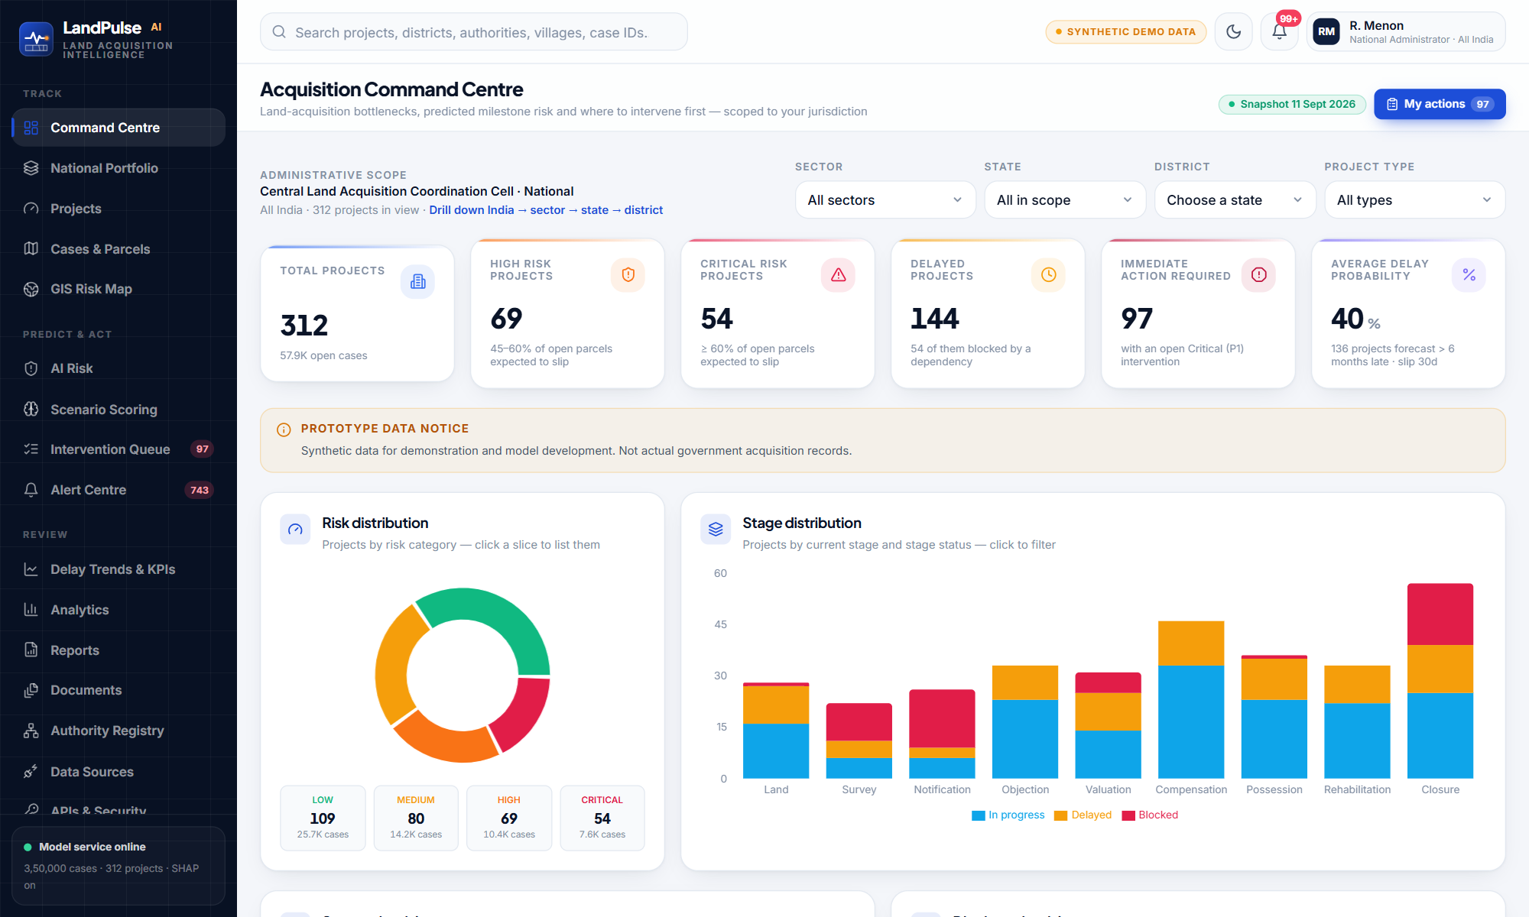
SMART INDIA HACKATHON 2026 · TEAM ROOTSTACK
LandPulse AI
Predict Delays. Enable Action.
An AI-powered predictive analytics and decision-support platform that identifies land acquisition projects at risk of delay — before the delay happens — explains why, and routes corrective action to the right office.
Prototype on a 3.5 lakh-case synthetic corpus built on real Indian geography and land acquisition law
Notes:
Opening: LandPulse AI by Team RootStack. One sentence: we predict which land acquisition projects will be delayed, explain why, and tell the right officer what to do about it. Be upfront that the prototype runs on synthetic data.

Slide 2








AGENDA
What this presentation covers
01 The problem
02 Our solution
Why acquisition delays matter and what SIH asks for
Architecture, scope and technology choices
03 Data & machine learning
04 Decision support
Corpus, model, risk score, stage forecast, explainability
Recommendations, interventions, alerts, scenario scoring
05 Dashboards & GIS
06 Learning, integration, security
Command centre, trends, analytics, maps, drill-down
Continuous learning, APIs, roles and audit
07 SIH compliance & validation
08 Impact & roadmap
Requirement-by-requirement matrix and tests
Limitations, benefits and the path to deployment
LandPulse AI · RootStack · SIH 2026
2

Slide 3

01
The problem
Land acquisition is the most time-sensitive phase of infrastructure delivery — and delays are discovered only after they happen.
LandPulse AI · RootStack · SIH 2026
3

Slide 4








BACKGROUND FROM THE SIH PROBLEM STATEMENT
Why land acquisition gets delayed
Prolonged administrative approvals
Legal disputes
Delayed compensation disbursement
Incomplete documentation
Files wait for sanctions and clearances across offices
Title suits, objections and references on compensation
Awards declared but money not reaching owners
Record-of-rights gaps, pending mutation and verification
Pending notifications
Land ownership conflicts
Rehabilitation & resettlement
Inter-departmental coordination
Statutory notifications not yet published
Joint, fragmented and disputed holdings
Entitlements and sites not ready for displaced families
Revenue, forest, utilities and agencies waiting on each other
Consequence: idle construction packages, cost escalation and delayed public benefit. Today most monitoring is reactive — a delay becomes visible only after a deadline has passed.
LandPulse AI · RootStack · SIH 2026
4
Notes:
Walk through the eight causes named in the SIH background. Each one is modelled or tracked somewhere in LandPulse AI — say where as you go.

Slide 5


DESCRIPTION OF THE STUDY, DECODED
What the SIH statement asks for
AN AI-POWERED PREDICTIVE ANALYTICS SYSTEM THAT…
The gap
Identifies at-risk projects by analysing historical and real-time project data
Learns patterns from completed and ongoing cases using machine learning
Uses 10 parameters: project type, land area, affected families, compensation, approval timelines, legal disputes, possession, R&R, stakeholder responsiveness, historical performance
Scores every project and predicts delay probability at different lifecycle stages
Explains the key contributing factors and recommends mitigating actions
Offers dashboards to monitor high-risk projects and district/state trends, and prioritise interventions
Keeps learning as new project data arrives
There is no intelligent mechanism that identifies projects likely to be delayed before the delay occurs. Monitoring is reactive reporting.
The expected shift
From reactive reporting to predictive decision-making: fewer delays, optimised public expenditure, faster infrastructure.
LandPulse AI · RootStack · SIH 2026
5
Notes:
Summarise the ask in plain words. Then point out the core gap: no intelligent mechanism to identify projects likely to be delayed before it happens.

Slide 6
WHAT LANDPULSE AI COVERS IN THIS PROTOTYPE — AND WHAT IT DOES NOT
Scope of Study
Dimension | In scope (implemented) | Out of scope / future
Geography | National hierarchy: all 28 States + 8 UTs, ministries, zones, divisions, districts. Corpus spans 25 States, 265 districts | Village cadastral maps; live LGD codes
Project types | 11 types: National Highway, Expressway, Railway, Metro, Urban, Industrial, Irrigation, Power Transmission, Renewable, Pipeline, Airport | Ports, coal, defence (registered, no data yet)
Legal frameworks | RFCTLARR 2013, NH Act 1956, Railways Act 1989, PMP Act 1962, Electricity Act RoW, KIAD Act, MID Act | Legal advice; state rule-book variations beyond configured profiles
Lifecycle | 9 stages: identification → survey → notification → objections → valuation → compensation → possession → R&R → closure | Construction-phase monitoring
Unit of analysis | Parcel-level case (3.5 lakh) → project (312) → district → State → nation | Individual landowner profiling
Parameters | All 10 SIH parameters + department dependencies, approvals pending, coordination | Social-media / news sentiment
Predictions | Delay probability per case and project, stage-wise forecast, expected slip days, P(miss target) | Cost-overrun prediction
Decision support | Drivers (TreeSHAP), recommendations with predicted impact, interventions, alerts, escalation | Automatic action without a human
Data | Synthetic corpus on real boundaries and statutes; user entries, CSV and API ingestion | Real government records (need MoU and access)
Users | 10 roles from National Administrator to Field Verification Officer, scoped by position | Citizen / landowner portal
LandPulse AI · RootStack · SIH 2026
6
Notes:
Read the table top-down. Stress the last two columns: we are explicit about what is out of scope for a hackathon prototype.

Slide 7

02
Our solution
One platform that predicts, explains, recommends, alerts and learns — for every level of government from national to district.
LandPulse AI · RootStack · SIH 2026
7

Slide 8




FROM PROJECT DATA TO OFFICER ACTION
LandPulse AI at a glance
Project data
ML prediction
Risk & forecast
Explain
Recommend
Alert & act
Learn
Parcel cases, stages, approvals, compensation, legal, R&R, dependencies
Gradient-boosted model: P(milestone slips > 30 days)
Risk score, band, stage-wise probability, P(miss target)
Exact TreeSHAP drivers for every case and project
Owned actions ranked by predicted risk reduction
Interventions, scheduled alerts, escalation, audit
New outcomes → monitor → gated retrain → registry
3,50,000
312
25 / 265
0.834
27
211
parcel-level acquisition cases
projects across 11 types
States / districts in the corpus
test ROC-AUC (synthetic data)
screens, from command centre to audit
automated end-to-end tests passing
Every figure on every screen is labelled with its provenance: synthetic demo data, user-entered, or model-generated.
LandPulse AI · RootStack · SIH 2026
8
Notes:
This is the whole story in one line. Each box is a real module; later slides show each one.

Slide 9
HOW THE PIECES CONNECT
System architecture
Officers (web app)
LandPulse AI API
Project service
Scoring
Data stores
React 18 · TypeScript · Vite · Tailwind · Recharts · custom SVG GIS · 27 screens
Node.js, zero runtime dependencies
• Password auth, hashed expiring sessions
• Role permissions + position jurisdiction
• CORS allowlist, security headers
• OpenAPI 3 contract
• Scheduler: alert scans, auto-retrain
corpus + edits + additions
exported trees + exact TreeSHAP
• Columnar case store (43 MB, 3.5 lakh rows)
• Runtime state + documents
• Hash-chained audit log
• Model registry & archived versions
Stage forecast
Rules & impact
Monte Carlo, 2,000 runs
owned actions, model what-if
External systems
Workflow
Notifications
Offline ML pipeline
State LA case systems, portals, government databases via REST API v1 + API keys · webhooks
interventions, alerts, escalation
in-app · email/SMS outbox · webhook
Generator → ml/train.py (LR, GBM, RF, gate, refit, SHAP, export) → build-store → hot reload
Analytics
Learning
trends, KPIs, drill-down, GIS
outcomes, monitoring, drift, registry
Government sources (future)
Data integration layer
DILRMP · eCourts · PFMS · PARIVESH · LGD
9 provider contracts (land records, registration, courts, compensation, notifications, project status, clearances, GIS, admin units) · synthetic adapters today
LandPulse AI · RootStack · SIH 2026
9
Notes:
Left to right: people and systems come in through the web app or the API; services do the work; stores hold data; the offline pipeline builds and retrains the model.

Slide 10
WHAT A SOLUTION OF THIS KIND NEEDS, AND WHAT WE BUILT
Suggested component-wise technology
Component | Suggested technology | LandPulse AI implementation | Production path
User interface & dashboards | React / Angular, charting library | React 18, TypeScript, Vite, Tailwind CSS, Recharts, Lucide | Same; accessibility audit, Hindi & regional languages
GIS visualisation | Leaflet / OpenLayers, PostGIS, Bhuvan | Custom SVG GIS on Survey of India-aligned boundaries (INDIAN-SHAPEFILES), choropleth, clustering | Bhuvan / PM Gati Shakti layers, PostGIS
Backend & APIs | Node.js / Django / FastAPI, REST | Node.js HTTP API (zero runtime deps), REST + OpenAPI 3 v1, API keys, webhooks | API gateway, containerised services
Machine learning | scikit-learn, XGBoost, LightGBM | scikit-learn HistGradientBoosting (+ logistic regression, random forest baselines); trees exported and scored in the API | Same model family; per-state calibration on real data
Explainable AI | SHAP, LIME | TreeSHAP (Python shap) on all cases + exact TreeSHAP port in the API for new records | Same
Data processing | pandas, NumPy, Spark | pandas, NumPy; columnar binary case store | Spark / Airflow at national volume
Database | PostgreSQL / PostGIS | Columnar store + JSON runtime state (prototype) | PostgreSQL + PostGIS with row-level security
Alerts & notifications | Email / SMS gateway, push | Scheduler, in-app centre, email & SMS outbox adapters, webhooks, escalation | NIC email / SMS gateway
Continuous learning (MLOps) | MLflow, Airflow | Outcome ingestion, prospective monitoring, PSI drift, champion–challenger gate, registry, rollback | MLflow tracking, scheduled pipelines
Security & identity | OAuth2 / SSO, RBAC, audit | scrypt passwords, lockout, hashed expiring sessions, 10 roles + jurisdiction, API scopes, SHA-256 hash-chained audit | Government SSO with MFA, TLS, SIEM
Integration | ESB / API gateway | 9 provider contracts with swappable adapters (synthetic today) | DILRMP, NGDRS, eCourts/NJDG, PFMS, PARIVESH, LGD
Deployment & testing | Docker, Kubernetes, CI | Single Node process; 211 end-to-end tests, 56 data checks, 16 live consistency checks | NIC cloud / MeghRaj, CI/CD
LandPulse AI · RootStack · SIH 2026
10
Notes:
For each component: the typical technology choice, what LandPulse AI actually uses, and the production path.

Slide 11

03
Data & machine learning
How the data is built, how the model learns, and how a prediction becomes a risk score, a stage forecast and an explanation.
LandPulse AI · RootStack · SIH 2026
11

Slide 12
SYNTHETIC CORPUS ON REAL FOUNDATIONS
The data we use — and what is real
3,50,000
312
25
Real
Synthetic
parcel-level cases (60 columns)
projects, 11 project types
States in the corpus
State, district and taluk names
Administrative boundaries (Survey of India depiction)
Statutory frameworks and stage sequence
Authority and dependency structure (configured from statute)
Case coordinates fall inside real district polygons
Every project, parcel, owner, date and amount
Delay outcomes (from a documented formula)
District & authority historical delay rates
Project names describe the kind of work only
Seeded — byte-identical on every run
265
2,92,077
57,923
districts (real polygons)
cases with a known outcome
open cases scored live
Data quality realism
Missing values injected (1–4% in 7 fields), right-censored recent outcomes, uneven state and type mix, parcels progressing ahead of their project, residual case backlogs in completed stages. A per-case data-quality score is shown wherever a case appears.
LandPulse AI · RootStack · SIH 2026
12
Notes:
Be explicit: no government acquisition records were available, so we generated a realistic corpus. Geography and law are real; cases and outcomes are synthetic.

Slide 13

WHY OUR ACCURACY IS NOT A REAL-WORLD CLAIM
How delay outcomes are generated — stated openly
Latent delay propensity (scripts/generate-dataset.mjs)
What this means
z = gain × ( 2.0·schedule slack + 0.9·unpaid compensation
+ 0.75·legal cases + 0.8·inactivity + 0.65·documentation gap
+ 0.6·pending department actions + 0.55·approval delay
+ district / authority / stage history + interactions
+ hidden noise ) + intercept
delayed ~ Bernoulli( sigmoid(z) ) · target positive rate ≈ 36%
The weights encode commonly cited delay causes; they are our assumptions
A hidden noise term means no single field decides the outcome (AUC ceiling ≈ 0.84)
The model re-learns this structure: metrics prove the pipeline, not real-world accuracy
Outcomes of open cases are withheld and released later to demonstrate learning
With real data, the same pipeline re-fits and re-validates on authorised historical acquisition records — per State and per project type — before any figure is used for decisions.
LandPulse AI · RootStack · SIH 2026
13
Notes:
Judges will ask this. Show the formula, say it is ours, and explain what the metrics do and do not prove.

Slide 14
EVERY PARAMETER IS AN INPUT THE MODEL ACTUALLY USES
The 10 SIH parameters in the model
SIH parameter | Model inputs (feature columns) | Status
Project type | project_type (11 types) + type-specific dependency network and rule thresholds | Implemented
Land area | land_area_ha (parcel), log area, project_land_requirement_ha | Implemented
Number of affected families | affected_families, log families, rehabilitation_cases | Implemented
Compensation status | compensation_status, completion %, days pending, unpaid share | Implemented
Approval timelines | approval_status, approval_delay_days, department_response_days, pending department actions | Implemented
Legal disputes | legal_dispute, legal_case_count, dispute_complexity | Implemented
Possession status | possession_status (Not initiated → Complete) | Implemented
Rehabilitation progress | rr_required, rr_progress_percentage, rr_status, R&R pending share | Implemented
Stakeholder responsiveness | stakeholder_responsiveness (Low / Moderate / High) | Partial — coarse rating
Historical performance | stage, district and authority historical delay rates | Partial — synthetic rates
Plus: documentation completeness, verification, inactivity, schedule pressure, ownership complexity, dependency count and coordination — 83 engineered features in total. State, authority and coordinates are deliberately not features, so a State or district the model has never seen is scored on its signals, not mis-mapped.
LandPulse AI · RootStack · SIH 2026
14
Notes:
Go row by row. Note the two that are weaker: stakeholder responsiveness is a three-level rating, and historical performance rates are synthetic constants in the corpus.

Slide 15



TRAIN HONESTLY, COMPARE, GATE, PUBLISH
The machine learning pipeline
1 · Time-aware split
2 · Compare models
3 · Threshold
4 · Gate
5 · Refit & export
6 · Explain & publish
Train 2,04,453 (to 2026-06-08) · validate 43,812 · test 43,812 (to 2026-09-11)
Logistic regression baseline, histogram gradient boosting, random forest
Operating threshold 0.3337 chosen on validation (best F1)
Challenger vs serving champion on the same latest window
Refit on all labelled rows; trees exported, parity 0 vs scikit-learn
TreeSHAP for every case, registry entry, store rebuild, hot reload
Target variable
Leakage and overfitting controls
next_milestone_delayed = 1 when a case's current-stage milestone slips by more than 30 days. Trained only on cases whose outcome is already knowable (36.1% delayed). A second regressor predicts slip days given a delay: expected slip = P(delay) × slip days.
Outcomes and actual slip days are never features
Chronological split, no shuffling; imputation fitted on training window only
Early stopping, minimum leaf size, L2 regularisation
Metrics reported per project type and per stage
LandPulse AI · RootStack · SIH 2026
15
Notes:
Explain the time-aware split: we train on the past and test on the future, never shuffling. Then the gate and refit. Then export, so the API uses the real model.

Slide 16
TEST WINDOW — SYNTHETIC DATA
Model performance on held-out future data
Metric (deployed) | Value | Meaning
ROC-AUC | 0.834 | A delayed case outranks an on-time case 83% of the time
PR-AUC | 0.716 | Test positive rate 31%; a random ranking would score about that
Precision | 0.610 | Of flagged cases, this share really slips
Recall | 0.707 | Of cases that slip, this share is caught
F1 | 0.655 | Balance of precision and recall
Brier | 0.146 | Probability error; calibration bins agree within ~2 points
Slip MAE | 55.45 d | vs 58.31 d median baseline (censored)
Gradient boosting is only modestly ahead of logistic regression because the synthetic outcome formula is close to linear. On real data, where interactions are richer, the gap is expected to be larger — and must be re-measured.
Operating threshold 0.3337. Split: train to 2026-06-08, test 2026-07-24 → 2026-09-11.
LandPulse AI · RootStack · SIH 2026
16
Notes:
Read the numbers slowly: ROC-AUC, precision and recall at the operating threshold. Then the caveat: this measures how well the pipeline learns the synthetic structure.

Slide 17
CASE-LEVEL AND PROJECT-LEVEL RISK
From probability to risk score and category
Case risk = P(this parcel's milestone slips > 30 days) × 100
Low
Medium
High
Critical
30
55
78
Used for cases, the parcel map and single-milestone forecasts.
Project risk = expected share of open current-stage parcels that slip
Low
Medium
High
Critical
30
45
60
Mean of the case probabilities, so it sits in a narrower range and gets its own cut-offs.
Also produced for every project: expected slip days (30 days on average) and the probability of missing the sanctioned target, with P50 / P80 completion dates — 136 projects have a median forecast more than 6 months beyond target.
LandPulse AI · RootStack · SIH 2026
17
Notes:
Two levels: one parcel's probability, and a project's expected share of parcels that slip. Each has its own cut-offs, published in the model card.

Slide 18
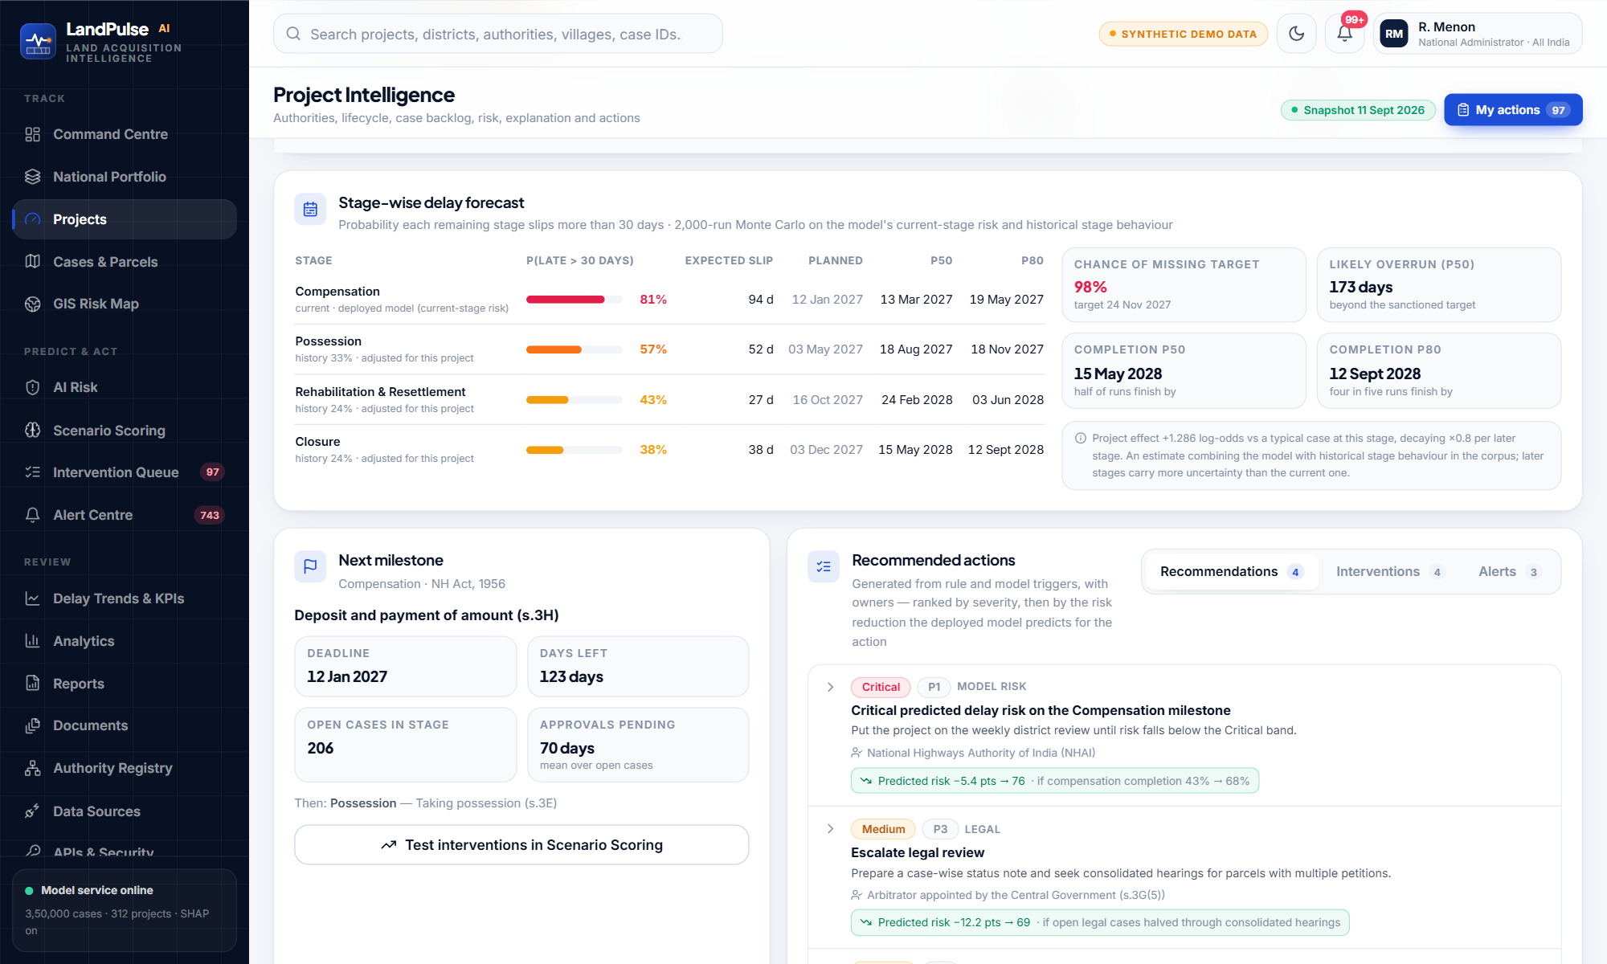
STAGE-WISE FORECAST
Delay probability at every stage of the lifecycle
Current stage: the deployed model's risk for open parcels
Later stages: observed stage delay rate, shifted by this project's risk relative to a typical case, decaying ×0.8 per stage
Monte Carlo: 2,000 seeded runs draw late / on time and slip days per stage from the observed distributions
Outputs: P(late) per stage, expected slip, P50 / P80 dates, P(miss target)
Example · NH-424 Bypass — Alirajpur
Risk 81 (Critical) at Compensation. Chance of missing the 2027-11-24 target: 98%. P50 completion 2028-05-15, P80 2028-09-12.
LandPulse AI · RootStack · SIH 2026
18
Notes:
The model scores the current stage; for the stages not yet reached we combine that risk with each stage's observed history, carried forward with a decay, and simulate 2,000 futures.

Slide 19
TREESHAP ON THE DEPLOYED MODEL
Explainable AI: why is this project at risk?
How it works
Per case: exact TreeSHAP for all 3,50,000 cases (top 6 stored), in log-odds
Per project: risk-increasing contributions summed over open cases, grouped into operational factors
New records: the API runs exact TreeSHAP on the exported trees — matches the SHAP library to 1e-7
Global: mean |SHAP| and permutation importance in the model card
Caveat shown everywhere: a contribution explains the prediction; it is not proof of cause
Case LAC-848274 (Compensation, risk 99%): Legal disputes +1.53 · Pending department actions +0.75 · Approval delay +0.62 · Documentation & verification +0.49 log-odds.
LandPulse AI · RootStack · SIH 2026
19
Notes:
SHAP splits each prediction into a base value plus one contribution per factor; they add up exactly. We show the factors, not the encodings, and always say that contribution is not cause.

Slide 20
WHERE RISK COMES FROM, NATIONALLY
Key delay drivers across the portfolio
SIH driver → model factor groups
Pending approvals
Approval delay · Pending department actions · Administrative response
Compensation delays
Compensation (completion, days pending, status)
Legal disputes
Legal disputes · Ownership complexity
Incomplete documentation
Documentation & verification · Inactivity
Rehabilitation status
Rehabilitation & resettlement · Affected families
Administrative bottlenecks
Inter-department coordination · Authority dependencies · history
LandPulse AI · RootStack · SIH 2026
20
Notes:
Portfolio view of the same SHAP attributions. These map directly to the drivers the SIH statement names: approvals, compensation, legal, documentation, R&R, administrative bottlenecks.

Slide 21

04
Decision support
Turning a prediction into an owned, tracked, escalated action — and testing interventions before committing to them.
LandPulse AI · RootStack · SIH 2026
21

Slide 22
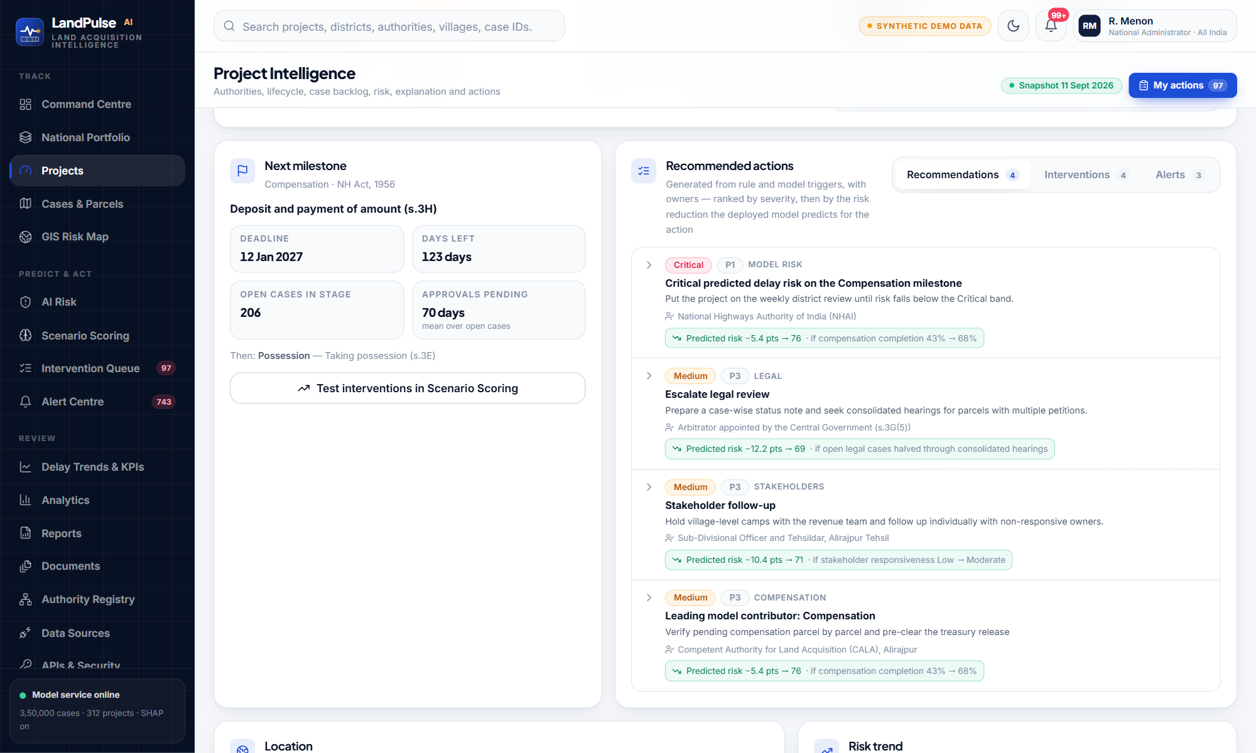
WHAT SHOULD BE DONE, BY WHOM, AND HOW MUCH IT HELPS
Predictive recommendations with predicted impact
Triggers: 20+ rules on model risk, blocked or delayed stages, compensation, legal load, documentation, approvals, dependencies, coordination, R&R, stakeholders, possession
Owner: resolved from the project's own dependency network — e.g. SLAO Mandya vs ADM (LA) Kanpur Nagar
Model driver → action: the leading SHAP driver of a High/Critical project becomes an intervention
Predicted impact: each action is applied to the project inputs and re-scored with the deployed model
Type-aware: 5 documented threshold overrides by framework and project type
−11.3 pts · Document completeness 63% → 85%, records verified
−9.1 pts · Open legal cases halved through consolidated hearings
−6.2 pts · Pending department actions halved, coordination score +10
−11.6 pts · Document completeness 65% → 85%, records verified
LandPulse AI · RootStack · SIH 2026
22
Notes:
Rules decide what applies and who owns it; the model predicts how much each action reduces risk; the list is ranked by severity then impact.

Slide 23
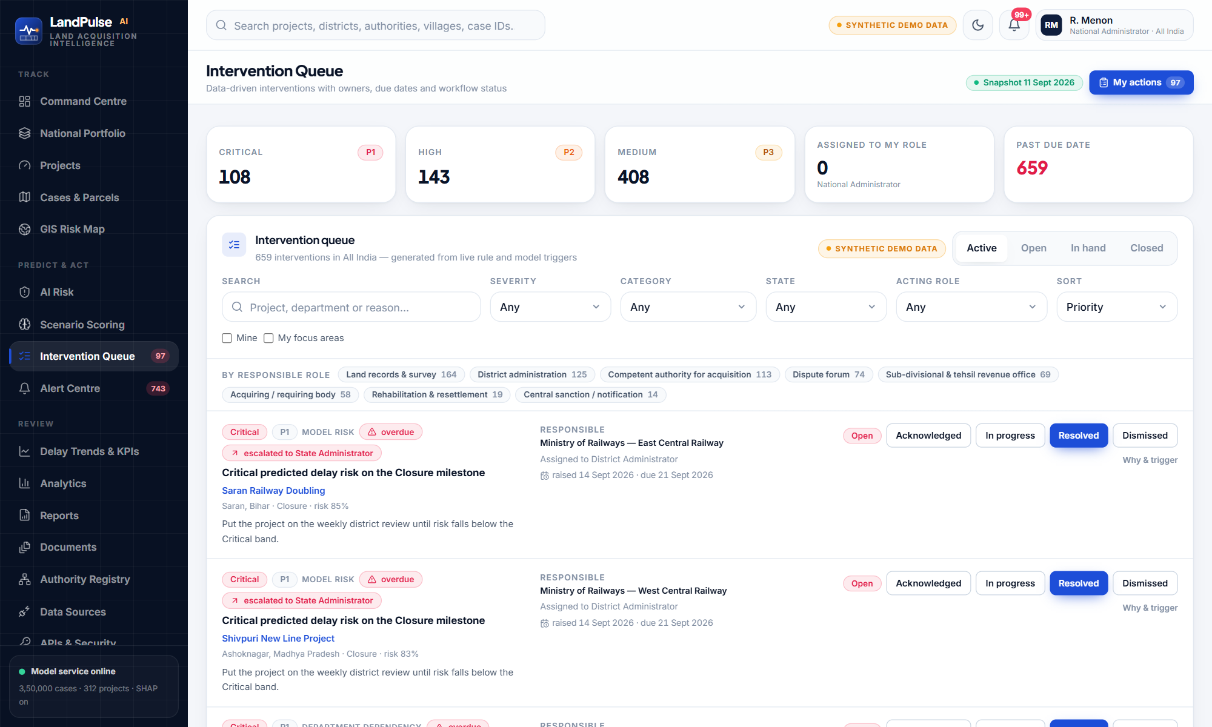
OWNED, DUE-DATED, AUDITED WORKFLOW
Intervention queue: from recommendation to resolution
OPEN
ACKNOWLEDGED
IN PROGRESS
RESOLVED
Due in 7 / 14 / 30 days by severity
Resolve or dismiss needs a note
Overdue items escalate automatically one level up
Every change: user, role, before, after — in the audit chain
LandPulse AI · RootStack · SIH 2026
23
Notes:
Every Medium-or-higher recommendation becomes an intervention with an owner role, a due date by severity, and a status that only the owner or a supervisor can change.

Slide 24
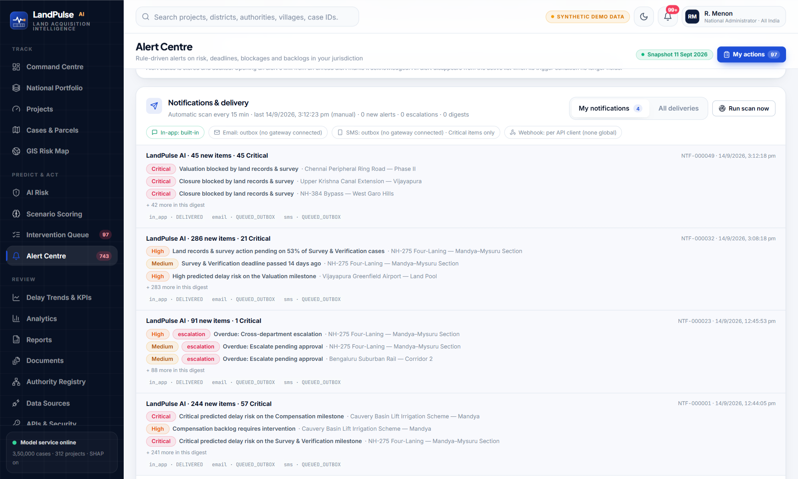





NOBODY HAS TO REMEMBER TO CHECK
Automated alerts, escalation and notifications
In-app
Bell, alert centre, “My notifications” — delivered
Email
Digest per officer — recorded in outbox (gateway not connected)
SMS
Critical items only, 160 characters — outbox
Webhook
Real HTTP POST to systems registered with an API key
Escalation
Overdue → supervising role (e.g. LAO → District Administrator → State)
LandPulse AI · RootStack · SIH 2026
24
Notes:
A scheduler scans every project every 15 minutes. New alerts and overdue escalations are grouped into one digest per officer and delivered on each channel. Be honest: email and SMS are recorded in an outbox — no gateway is connected.

Slide 25
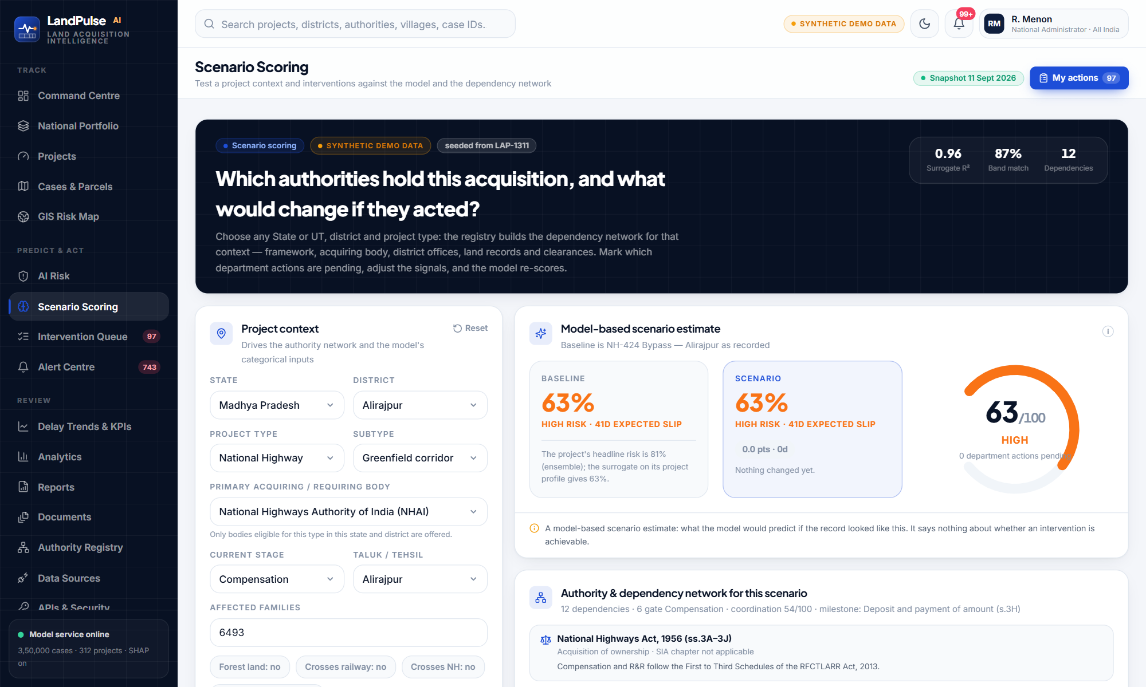
WHAT-IF ON THE DEPLOYED MODEL
Scenario scoring: test an intervention before committing
Context drives the dependency network: an irrigation project never gets aviation clearances
Ineligible acquiring bodies are rejected by the API
Every slider change re-scored by the deployed ensemble, with exact TreeSHAP
Effect of clearing one pending department action measured by re-scoring
Baseline vs scenario: change in risk, slip days and dependencies
Seed from any real project in your jurisdiction
LandPulse AI · RootStack · SIH 2026
25
Notes:
Pick State, district, project type and stage; the registry builds the correct authority network; toggle pending department actions and signals; the deployed model re-scores instantly with drivers and recommendations.

Slide 26

05
Dashboards & GIS
Interactive views for policymakers and administrators — from the national portfolio to a single parcel.
LandPulse AI · RootStack · SIH 2026
26

Slide 27
DELAY PROBABILITY, RISK CATEGORIES, TIMELINE — SCOPED TO YOUR JURISDICTION
Command Centre dashboard
KPIs: 312 projects · 69 High · 54 Critical · 144 delayed · 97 need immediate action
Delay probability: average 40%; 136 projects forecast > 6 months late
Risk categorisation: project and case distributions
Stage distribution with in-progress / delayed / blocked
State and district risk, project-type risk, delay drivers, department bottlenecks
Timeline: stage status and forecast overrun buckets
Delay trend: observed history then model forecast
LandPulse AI · RootStack · SIH 2026
27
Notes:
Everything filters by sector, State, district and project type; every chart clicks through to the project list.

Slide 28
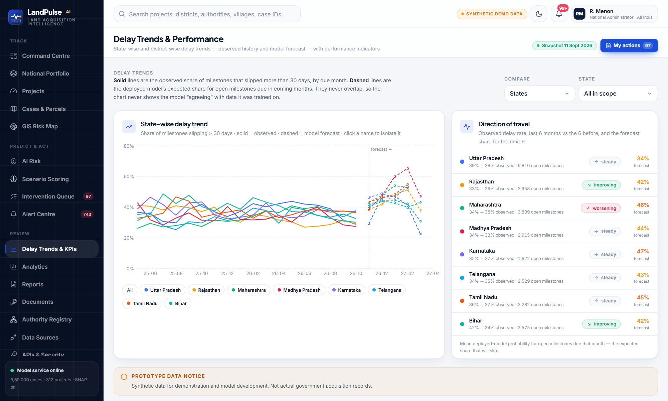
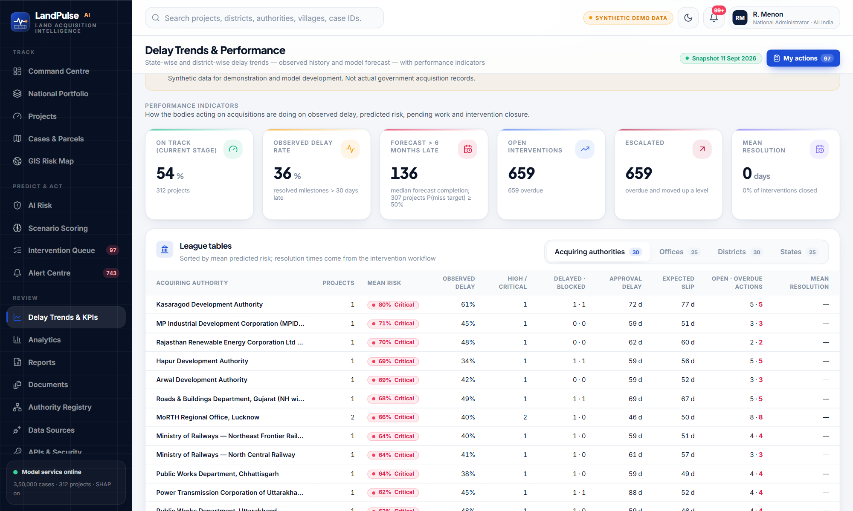
DELAY TRENDS, PERFORMANCE INDICATORS
District & State delay trends and KPIs
Compare States, or the districts of one State · direction of travel (last 6 vs previous 6 months) · forecast share for the next 6 months
League tables for acquiring authorities, offices, districts and States: observed delay, mean risk, approvals pending, expected slip, open / overdue actions, mean resolution time
Now: 54% of projects on track · observed delay rate 36% · 136 forecast > 6 months late · 659 overdue and escalated after the demo clock moved 60 days · resolution times fill in as officers close items
LandPulse AI · RootStack · SIH 2026
28
Notes:
Solid = observed share of milestones slipping > 30 days by due month; dashed = model forecast for open milestones. They never overlap, so the chart never shows the model agreeing with its own training data.

Slide 29
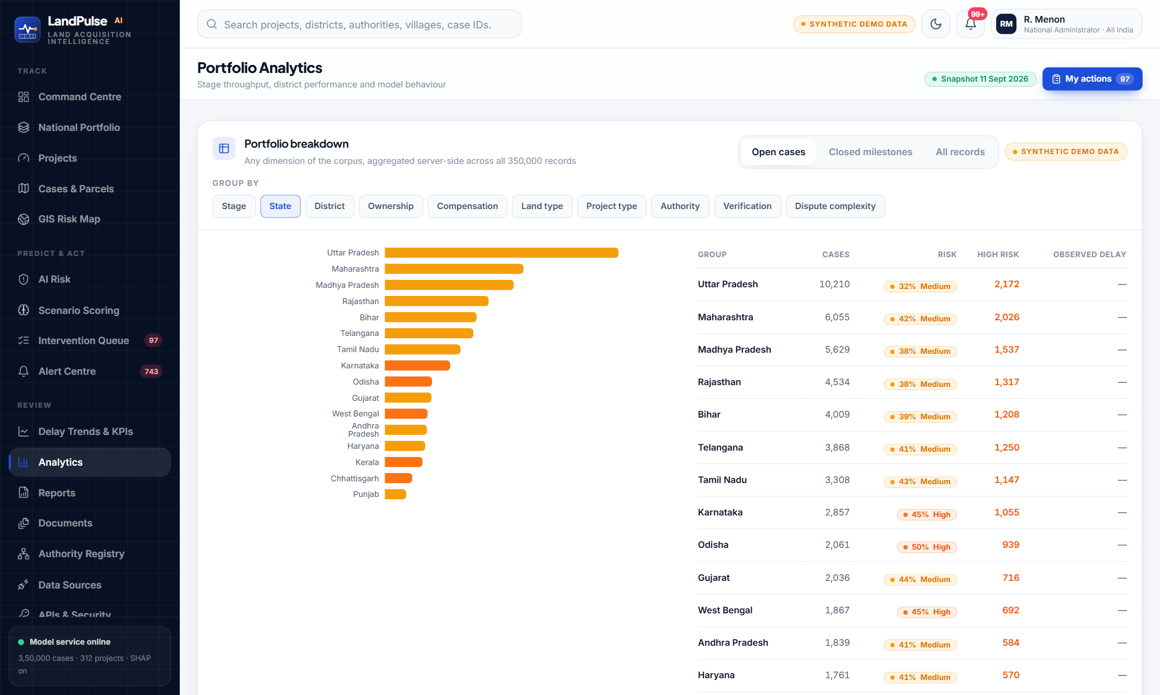
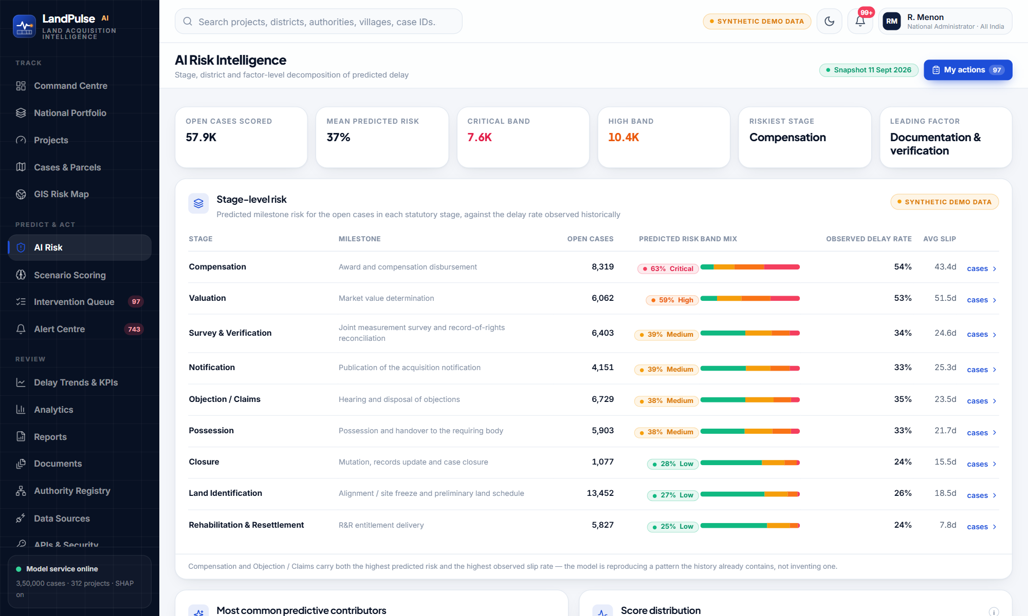
SLICE THE PORTFOLIO ANY WAY
Comparative analytics and AI risk intelligence
Portfolio Analytics — 10 comparison dimensions, case-level
AI Risk — stage, district and factor decomposition
Reports: MIS review packs with project and case CSV exports (scoped, audited)
Data & Model: corpus composition, data quality, model card, calibration, feature importance
LandPulse AI · RootStack · SIH 2026
29
Notes:
Analytics compares stages, States, districts, ownership, compensation, land type, project type, authority, verification and dispute complexity. AI Risk decomposes predicted delay by stage, district and factor.

Slide 30
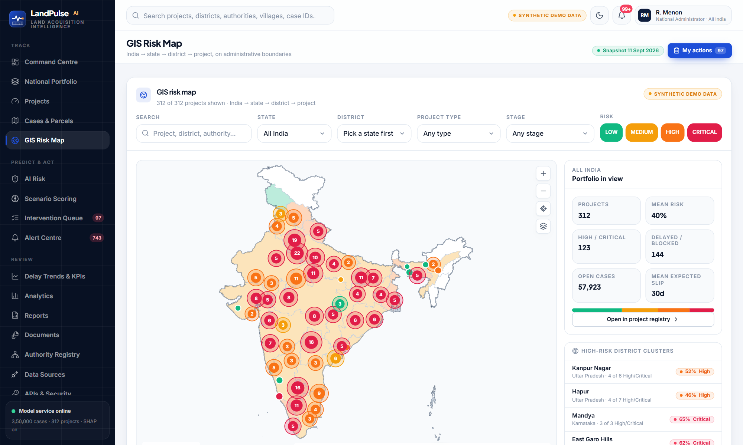
INDIA → STATE → DISTRICT → PROJECT, ON REAL BOUNDARIES
GIS-enabled visualisation of high-risk projects
National outline, State and district layers (Survey of India depiction, LGD / Census codes)
Choropleth by mean project risk; click a State to load its districts
Project markers clustered at low zoom; popups link to the project page
Filters: risk band, State, district, type, stage, search
High-risk district clusters listed beside the map
Same risk figures as every other screen
Future: Bhuvan / PM Gati Shakti base layers, parcel polygons, forest overlays
LandPulse AI · RootStack · SIH 2026
30
Notes:
Real boundaries; project and parcel points are synthetic locations inside real districts, and the legend says so.

Slide 31
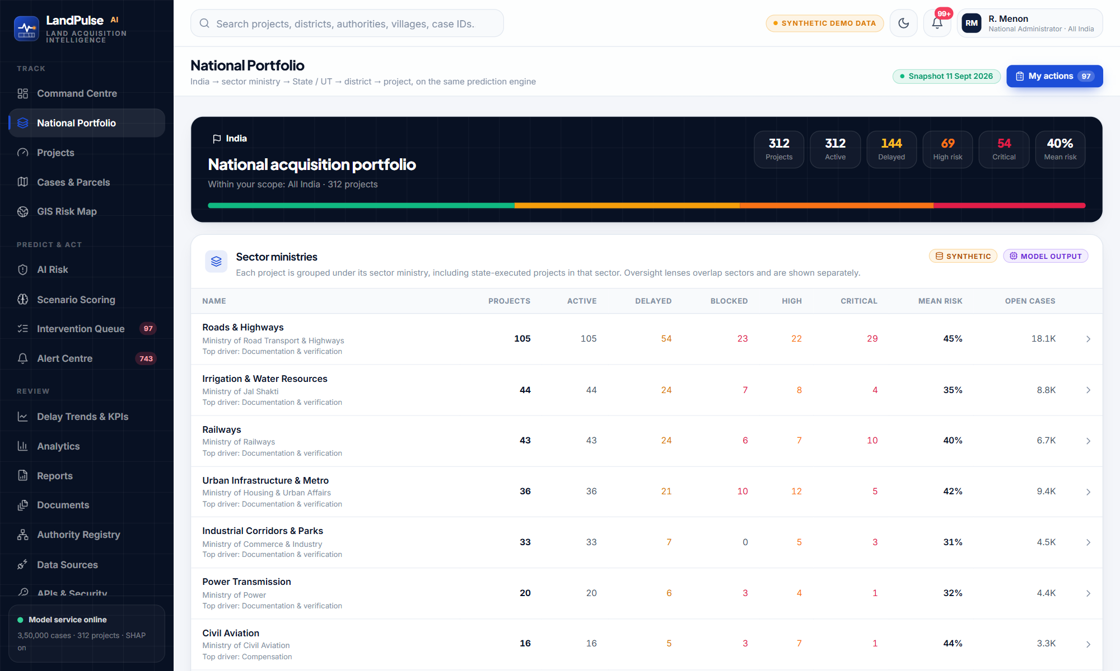
WORKS ACROSS INDIA, NOT JUST ONE STATE
National portfolio drill-down and position-based scope
India → sector ministry → State / UT → district → project
All 28 States + 8 UTs with their governments and departments
14 central ministries and central organisations (NHAI, DFCCIL, POWERGRID, AAI…)
Hierarchy templates: ministry with zones, organisation with regions, state department with divisions
Portfolio matchers: sector types, frameworks (DoLR), named authorities, clearances (MoEFCC)
Enforced by the API on every read, export and API key
LandPulse AI · RootStack · SIH 2026
31
Notes:
The position — organisation plus units — decides jurisdiction; the role decides permissions. MoRTH sees roads nationally; a District Magistrate sees only the district.

Slide 32
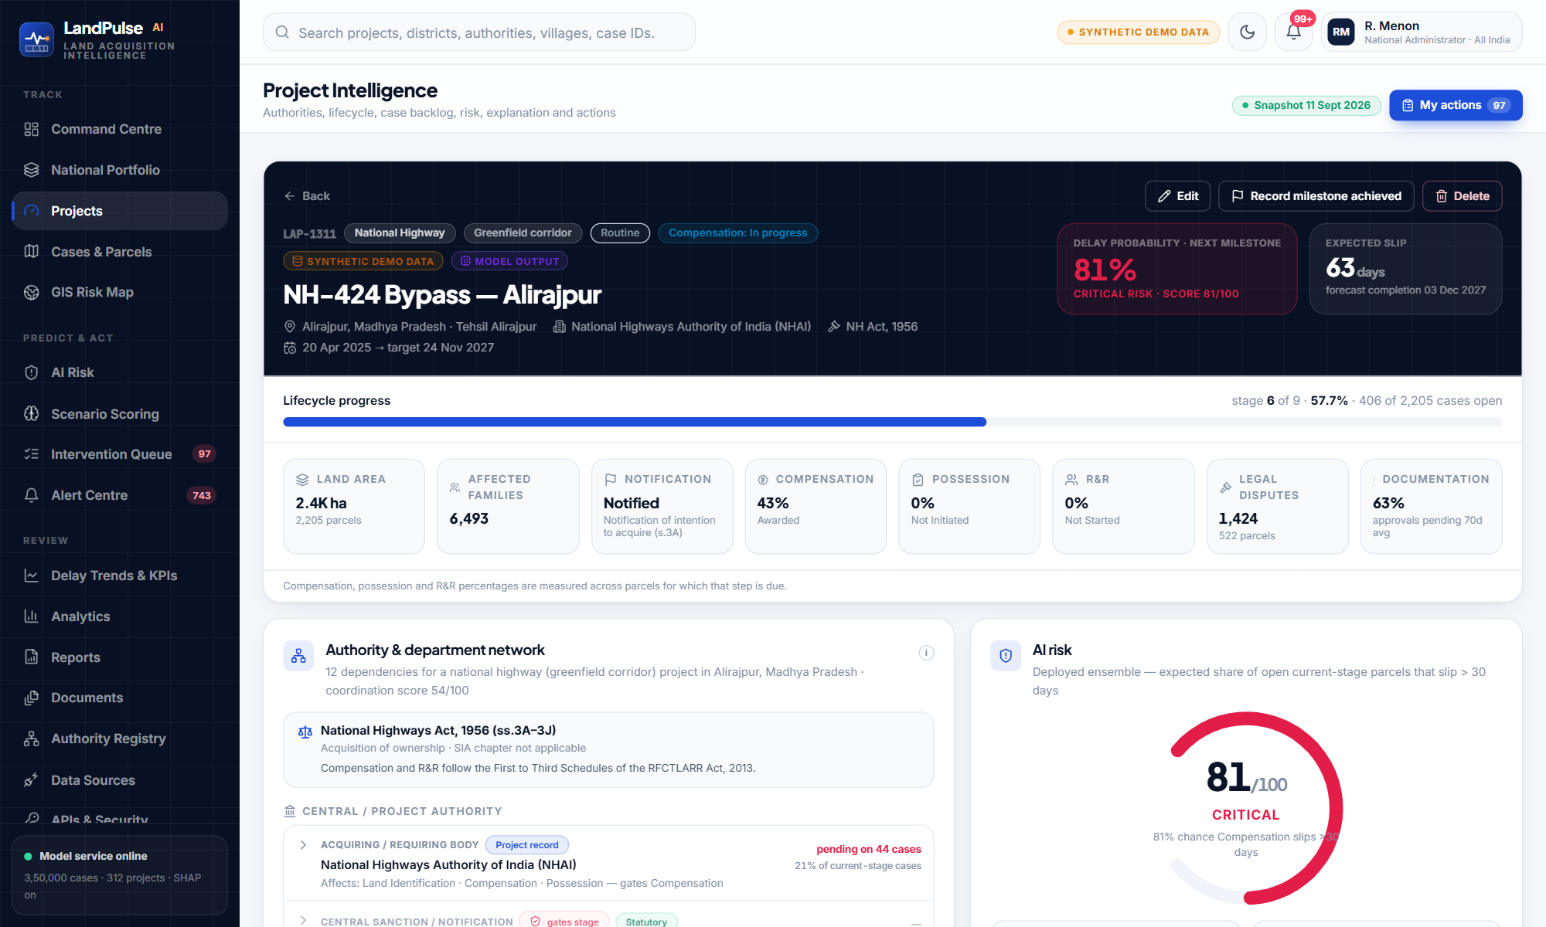
EVERYTHING ABOUT ONE PROJECT IN ONE PLACE
Project intelligence page
Overview and statutory framework
Authority & dependency network with pending actions
AI risk gauge with the basis of the figure
TreeSHAP delay drivers
Land-acquisition issue profile (19 issues, type-aware)
Stage timeline: stage status ≠ case backlog
Stage-wise forecast, next milestone
Recommendations, interventions, alerts
Location map, risk trend, riskiest cases, documents, audit history
Edit, record milestone achieved, test in Scenario Scoring
LandPulse AI · RootStack · SIH 2026
32
Notes:
Walk down the page: overview, authority network, AI risk, drivers, issue profile, stage timeline, stage forecast, recommendations, interventions, alerts, GIS, cases, documents, audit.

Slide 33
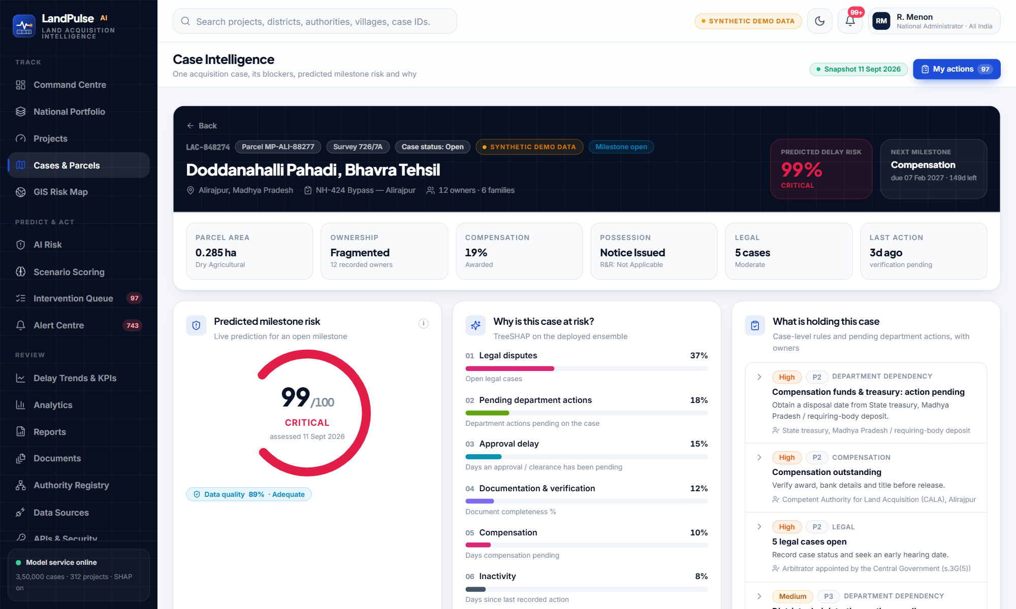
DOWN TO THE PARCEL
Cases, parcels, documents and outcome recording
Case registry with server-side filters and exports
Predicted milestone risk and exact TreeSHAP drivers
What is holding this case: pending department actions with owners
Case status workflow (under review, escalated, on hold)
Record milestone outcome — stored with the prediction made before it
Document repository: upload by type and stage, versions, reviewer approval
Integration view: land records, courts, compensation, GIS — each with provenance
LandPulse AI · RootStack · SIH 2026
33
Notes:
3.5 lakh parcel cases, each with its prediction, drivers, pending department actions, case rules, documents and audit. Officers record what actually happened, which feeds learning.

Slide 34
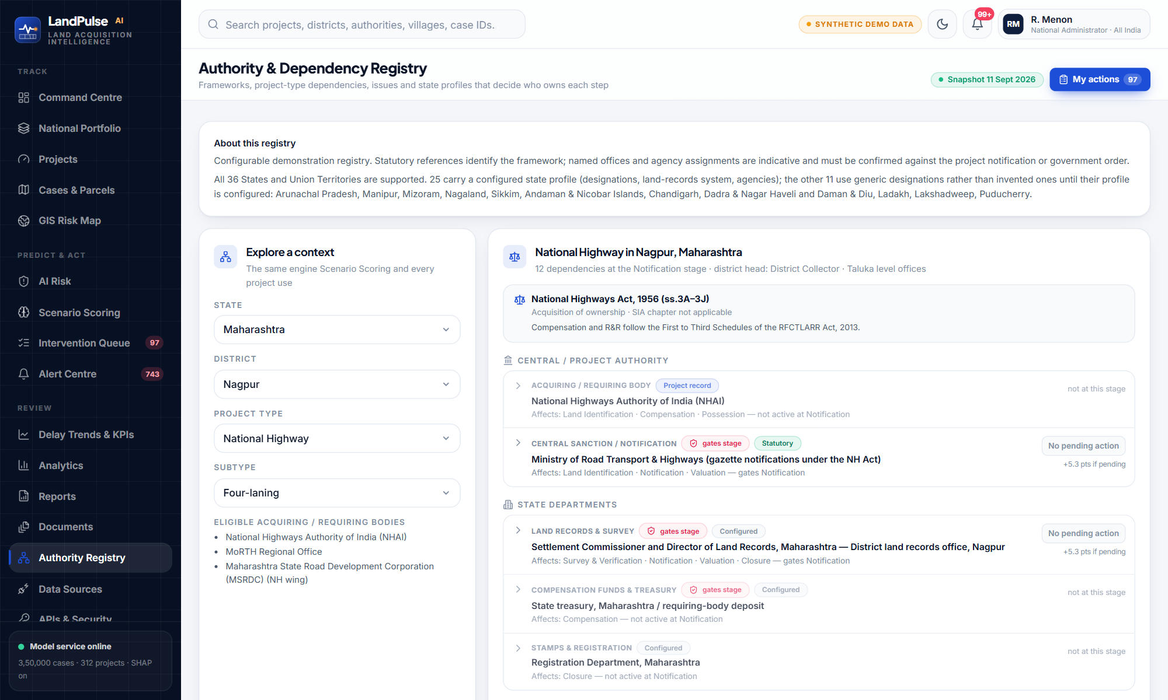
ONLY THE DEPENDENCIES THAT APPLY
Project-type intelligence: the authority & dependency registry
7 statutory frameworks decide milestones, dispute forum and SIA applicability
Declarative dependency rules: always, linear, flag:forestLand, subtype, mode:ownership
Irrelevant bodies never appear: aviation only on airports — checked by a live consistency test
State profiles: Deputy Commissioner vs District Magistrate, Taluk vs Tehsil, land-records systems
19-issue taxonomy: issues that cannot arise for a type are excluded with a reason
Rule thresholds overridden per framework and project type, each with its rationale
LandPulse AI · RootStack · SIH 2026
34
Notes:
Which authorities an acquisition depends on is declarative configuration: framework by type and subtype, eligible acquiring bodies by type, State and district, and flags for forest land and crossings.

Slide 35

06
Learning, integration & security
A model that improves with new outcomes, APIs that existing systems can use, and access that is scoped and audited.
LandPulse AI · RootStack · SIH 2026
35

Slide 36




NEW DATA → BETTER MODEL, ONLY IF IT REALLY IS BETTER
Continuous model learning — demonstrated end to end
New outcomes
Monitor
Drift
Retrain
Gate
Registry
Officer entry · CSV · API · simulation release
Score predictions made before the outcome was known
PSI per signal vs the training window
Manual or automatic past an outcome threshold
Challenger vs champion on the same latest window
Versions, gate reasons, archived artefacts, rollback
54,331
0.837
2,92,077
2
outcomes released by +60 days on the simulation clock
live ROC-AUC of the serving model on outcomes it had not seen
labelled rows in the retrained model (was 2,37,746)
model versions in the registry
Gate decision (real)
Challenger PR-AUC 0.7155 vs champion 0.7204; Brier 0.1462 vs 0.1449. Within tolerance — promoted.
LandPulse AI · RootStack · SIH 2026
36
Notes:
This is a real run from our demo: advancing the simulation clock released withheld outcomes; the model was monitored on them, retrained with them, compared against the champion and promoted.

Slide 37
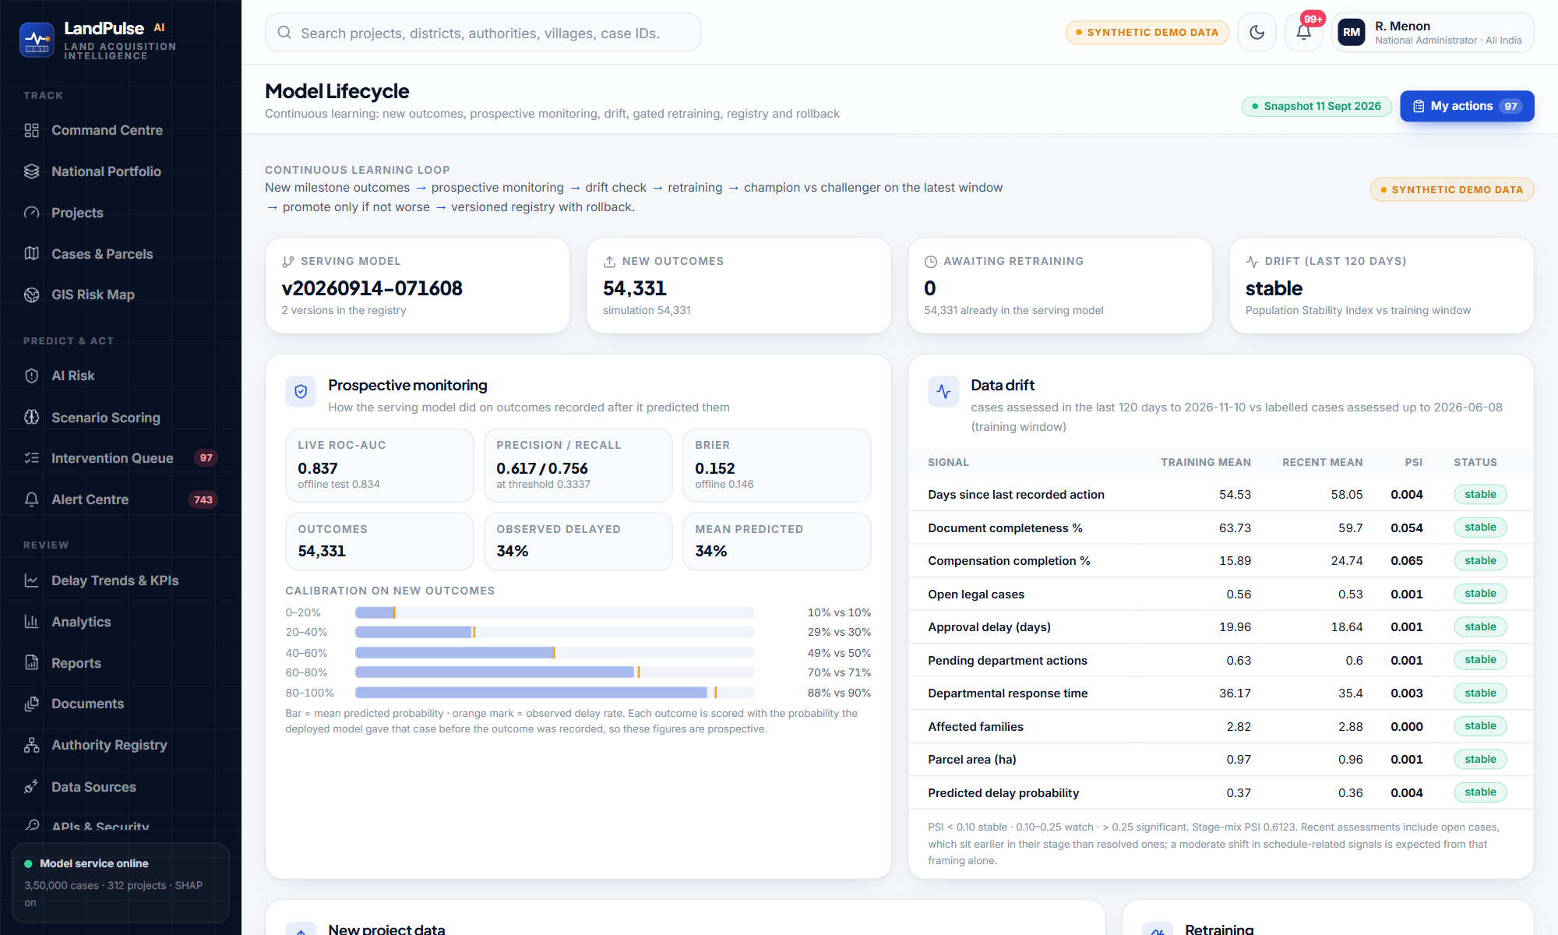
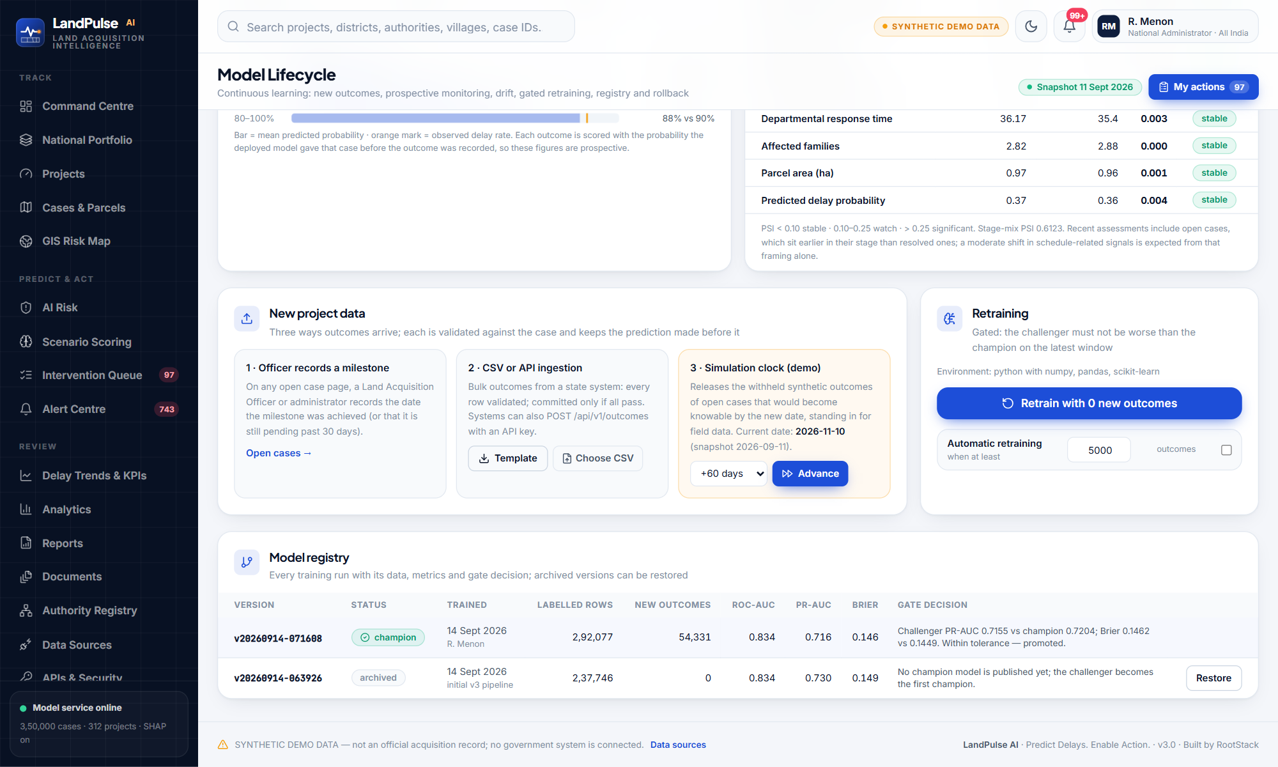
WHERE ADMINISTRATORS RUN CONTINUOUS LEARNING
Model Lifecycle screen
Monitoring, drift and new data
Retraining and the model registry
Outcomes keep the prediction made before them, so live metrics are prospective
A rejected challenger leaves the champion serving; the reason is recorded
Rollback restores an archived version without retraining
LandPulse AI · RootStack · SIH 2026
37
Notes:
Prospective monitoring and calibration on new outcomes, drift table, three ways to add data, gated retraining and automatic retraining settings, and the registry with one-click restore.

Slide 38
INTEGRATION-READY — HONESTLY NOT INTEGRATED
Integration with land acquisition systems and government databases
Provider contract | Future official source | Today
Land records | State record-of-rights systems digitised under the Digital India Lan… | Integration-ready — synthetic adapter
Registration & encumbrance | National Generic Document Registration System (NGDRS) and state regi… | Integration-ready — synthetic adapter
Court & dispute records | eCourts Services / National Judicial Data Grid (NJDG) | Integration-ready — synthetic adapter
Compensation & payments | Public Financial Management System (PFMS) | Integration-ready — synthetic adapter
Acquisition notifications | e-Gazette of India and State Gazettes | Integration-ready — synthetic adapter
Project progress | PM Gati Shakti National Master Plan | Integration-ready — synthetic adapter
Forest & environment clearances | PARIVESH (MoEFCC clearance portal) | Integration-ready — synthetic adapter
GIS & geospatial | PM Gati Shakti National Master Plan layers | Integration-ready — synthetic adapter
Administrative units | Local Government Directory (LGD) | Integration-ready — synthetic adapter
Integration API v1
GET /v1/projects
GET /v1/projects/{id}/risk
PATCH /v1/projects/{id}
POST /v1/projects
POST /v1/score
POST /v1/outcomes
GET /v1/alerts
GET /v1/openapi.json
X-API-Key, hashed, shown once
Scopes + jurisdiction + rate limit per key
Status pushes re-score instantly
Webhooks deliver alerts to the system
LandPulse AI · RootStack · SIH 2026
38
Notes:
Two directions. Outbound: existing systems call our API v1 with scoped keys. Inbound: government sources plug into provider contracts. No government system is connected in this prototype.

Slide 39
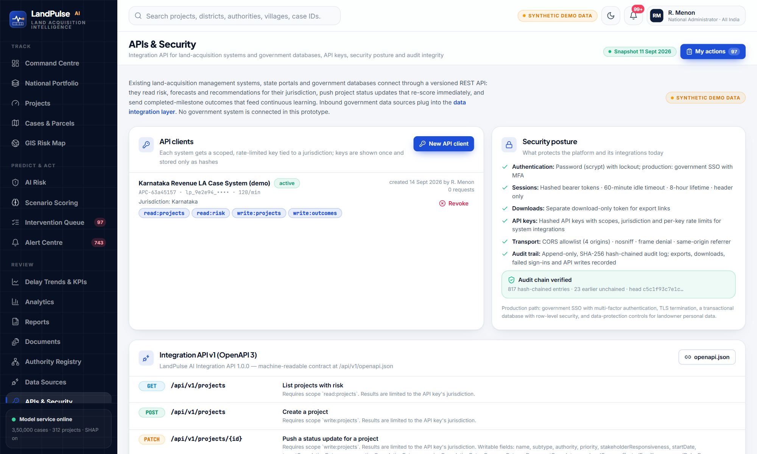
ISSUE KEYS, READ THE CONTRACT, VERIFY THE AUDIT CHAIN
APIs & Security screen
Create an API client: name, scopes, rate limit, optional webhook — key shown once
Revoke instantly; revoked keys are refused
Security posture stated plainly, including what production adds
Audit chain verification: every entry carries the SHA-256 of the previous one
Data Sources screen: provenance modes and every provider contract
LandPulse AI · RootStack · SIH 2026
39
Notes:
Administrators create scoped API clients; the page shows the OpenAPI endpoints, the security posture and whether the audit hash chain verifies.

Slide 40




WHO CAN DO WHAT, WHERE — AND A RECORD OF IT
Secure, role-based access with comprehensive audit trails
Role | Typical scope | Can
National Administrator | All India | Everything incl. retraining, API keys, deletion
Ministry / Organisation Nodal Officer | Sector nationally, zone or State | Assign & update interventions, review, audit
State Administrator | State | Create/edit projects, CSV, API keys, notifications
District Administrator | District | Edit, advance stages, assign, record outcomes
Land Acquisition Officer | District | Advance stages, cases, awards, record outcomes
Project Implementing Agency | Own authority's projects | Update interventions, survey documents
Legal Officer | State / district | Legal interventions and documents
Revenue / Land Records Officer | District | Documentation, land records, reviews
Field Verification Officer | District | Field interventions, possession, R&R documents
Policy Viewer | Any tier | Read-only analytics and reports
Authentication
scrypt passwords, 5-attempt lockout; SSO + MFA in production
Sessions
256-bit hashed tokens, 60-min idle, 8-hour lifetime, header only
API protection
Jurisdiction on every read, CORS allowlist, security headers, rate limits
Audit
SHA-256 hash chain · 816 chained entries verify · failed sign-ins, exports, downloads, API writes
LandPulse AI · RootStack · SIH 2026
40
Notes:
Ten roles, each normally held at certain tiers. Scope from position, permissions from role, both enforced server-side. Audit is append-only and tamper-evident.

Slide 41
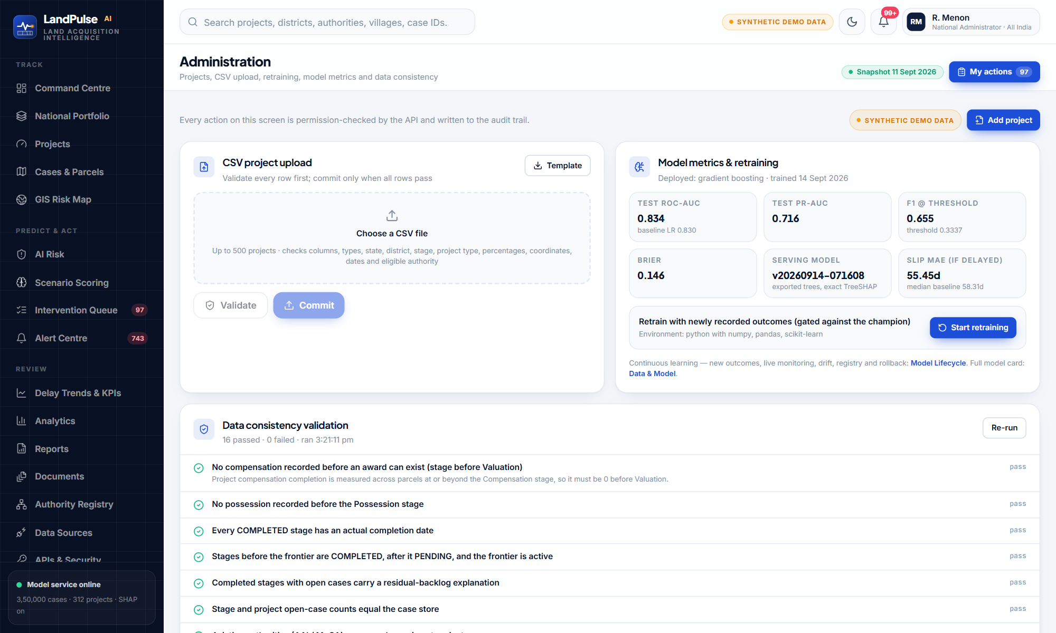
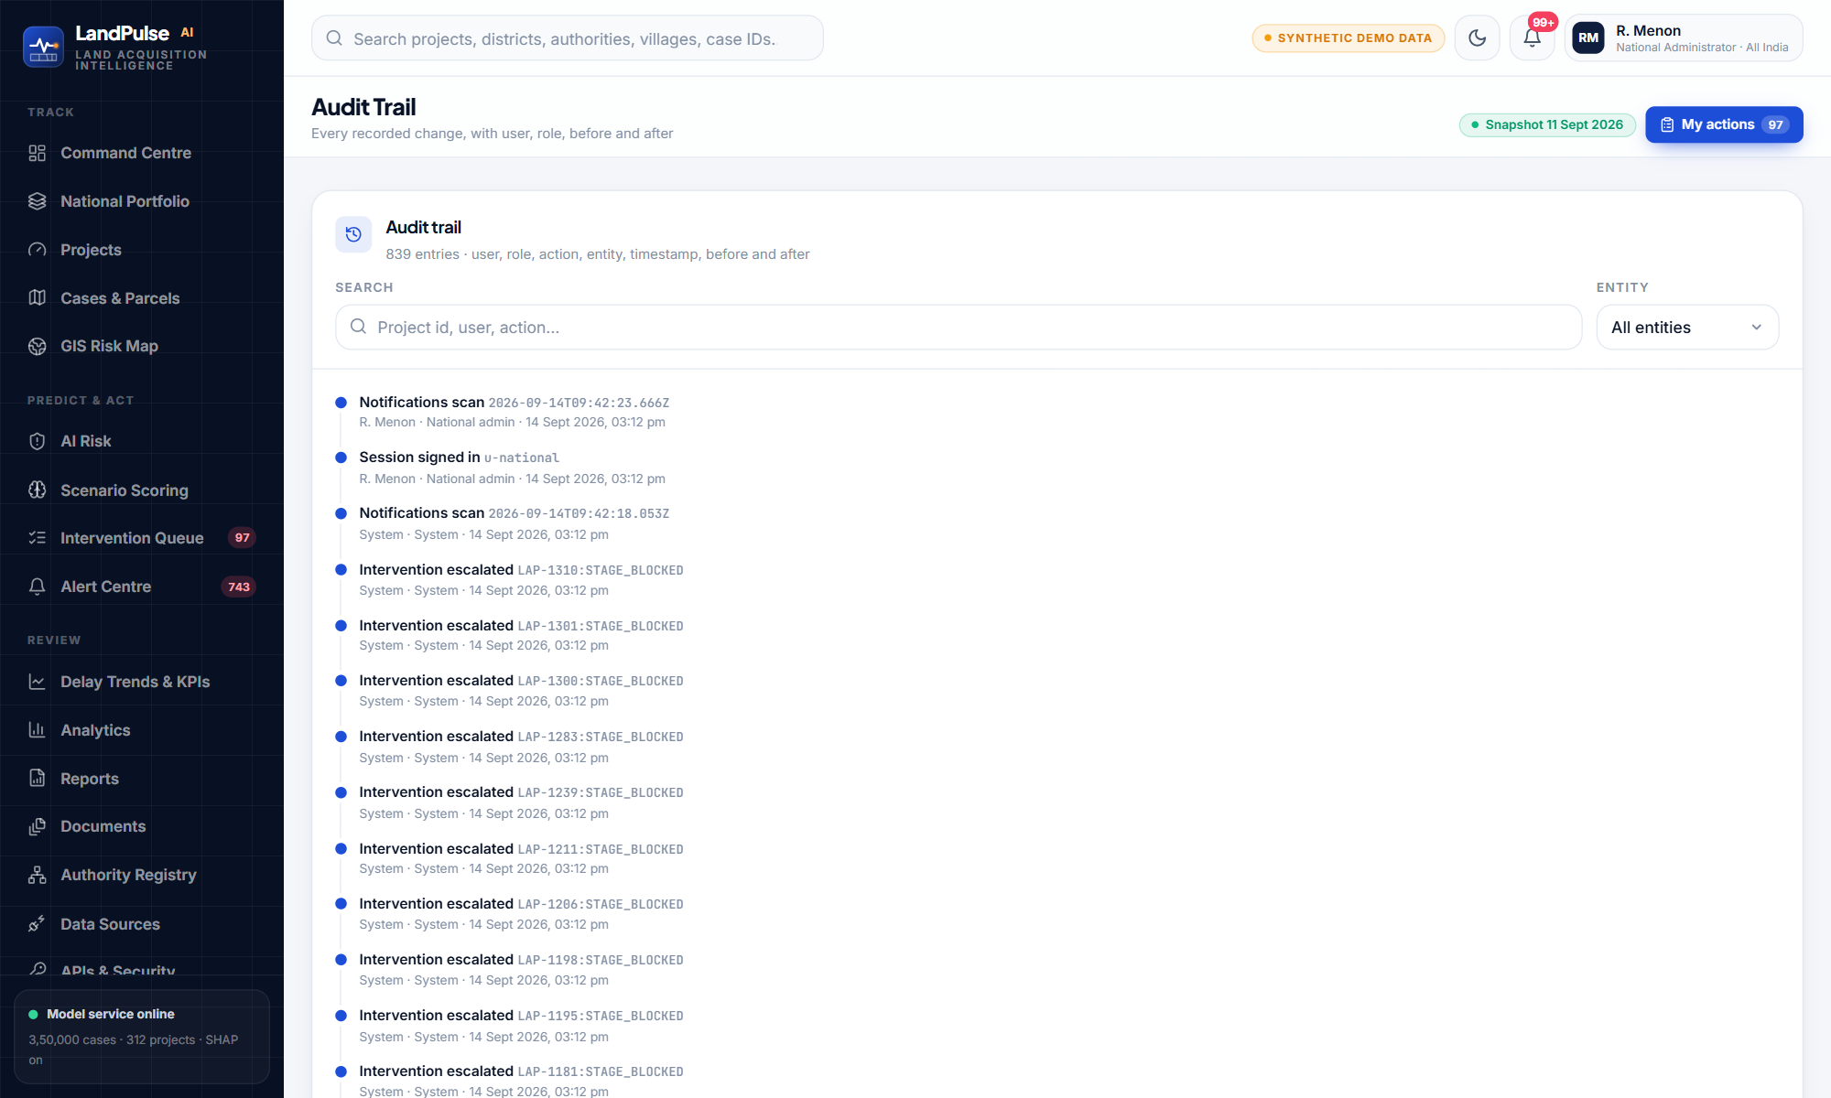
OPERATING THE PLATFORM
Administration and audit trail
Administration — CSV validation, retraining, consistency checks
Audit trail — user, role, action, before and after
CSV rows validated field by field with readable errors; committed only when all pass
Consistency checks prove that dashboard, registry, GIS, workflow and store agree
LandPulse AI · RootStack · SIH 2026
41
Notes:
Administration: add projects, validated CSV upload, retraining, model metrics, 16 live data-consistency checks, restore deleted projects. Audit: every change searchable with before and after.

Slide 42

07
SIH compliance & validation
Every requirement in the problem statement, mapped to what exists — with the gaps stated.
LandPulse AI · RootStack · SIH 2026
42

Slide 43
EXPECTED SOLUTION, ITEMS 1–6
SIH requirement matrix (1 of 2)
SIH requirement | How LandPulse AI delivers it | Status
1. AI/ML predictive models for forecasting delays | Gradient boosting vs LR and RF, time-aware split, test ROC-AUC 0.834; exported trees serve every prediction | Implemented — synthetic data
2. Automated identification of high-delay projects | Project bands (Critical ≥ 60% of open parcels expected to slip); Critical/High raise alerts and interventions automatically | Implemented
3. Project-wise risk scoring & prioritisation | Risk score, band, expected slip, P(miss target); queue ranked by severity and risk | Implemented
4. Key delay drivers | TreeSHAP factor groups: approvals, compensation, legal, documentation, R&R, administrative bottlenecks | Implemented
5. Explainable AI techniques | Exact TreeSHAP per case and per new record; global SHAP and permutation importance; cause caveat | Implemented
6a. Dashboard: delay probability | Per case, project, State; KPI tiles; stage-wise probabilities | Implemented
6b. Dashboard: risk categorisation | Case and project band distributions, filters, drill-through | Implemented
6c. District- and State-wise delay trends | Observed trend by due month + model forecast, States or districts, direction of travel | Implemented
6d. Timeline analysis | Stage status timeline, forecast overrun, P50/P80 completion per stage | Implemented
6e. Performance indicators | League tables: authorities, offices, districts, States; resolution time, overdue, escalated | Implemented
6f. Comparative analytics | 10-dimension analytics, AI risk decomposition, MIS reports | Implemented
LandPulse AI · RootStack · SIH 2026
43
Notes:
Green means implemented and demonstrable today on synthetic data. Amber means partial; we say what is missing.

Slide 44
EXPECTED SOLUTION ITEMS 7–12 AND THE STUDY DESCRIPTION
SIH requirement matrix (2 of 2)
SIH requirement | How LandPulse AI delivers it | Status
7. GIS-enabled visualisation of high-risk projects | India → State → district → project on real boundaries, risk choropleth, clustering, filters | Implemented — synthetic locations
8. Automated alerts & notifications | Scheduled scans, in-app delivery, escalation of overdue items, webhooks; email/SMS rendered to outbox | Partial — no SMS/email gateway
9. Predictive recommendations | Owned actions ranked by risk reduction predicted by the deployed model | Implemented
10. Continuous model learning | Outcome ingestion, prospective monitoring, drift, gated retraining, registry, rollback — run with 54,331 outcomes | Implemented — simulated new data
11. APIs for integration with LA systems & databases | REST API v1 + OpenAPI, scoped keys, webhooks; 9 provider contracts | Integration-ready — none connected
12. Secure role-based access & audit trails | 10 roles + jurisdiction, hashed sessions, lockout, API scopes, SHA-256 hash-chained audit | Implemented — SSO in production
Analyse historical and real-time project data | Synthetic history; status updates via UI, CSV and API re-score immediately | Simulated — no real records
Learn from completed and ongoing cases | Trains on resolved milestones, scores open ones | Implemented
10 listed parameters | 8 fully represented; responsiveness coarse, historical rates synthetic | Partial
Delay probability at different lifecycle stages | Current stage from the model; later stages via Monte Carlo on stage history | Implemented
Prioritise interventions (policymakers) | Intervention queue, immediate-action KPI, league tables | Implemented
LandPulse AI · RootStack · SIH 2026
44
Notes:
The two honest ambers: alert delivery gateways and real-time government data. Everything else is implemented and tested.

Slide 45
VERIFICATION, NOT JUST A DEMO
How we know it works
211
56
16
end-to-end functional tests against an isolated API (roles, CRUD, security, learning, APIs)
corpus, model, registry, store and deliverable checks
live data-consistency checks on the Administration screen
0.0
1e-7
Byte-identical
max probability difference: exported trees vs scikit-learn
max TreeSHAP difference: API port vs the SHAP library
corpus on every regeneration (seeded)
Examples of what the tests prove: a Mandya DC cannot open a UP project · an irrigation scenario never shows aviation · wrong passwords lock a profile · a revoked API key is refused · outcomes cannot be recorded twice · the audit chain verifies.
LandPulse AI · RootStack · SIH 2026
45
Notes:
We test the platform the way a user uses it, check the data and model artefacts, and prove that the exported model is identical to the trained one.

Slide 46
HONEST LIMITATIONS
What is not real yet — stated plainly
Synthetic data
No government system connected
All cases and outcomes are generated; accuracy is not a real-world claim.
Integration contracts and API are ready; adapters are synthetic.
Next: Pilot with one State under an MoU; re-fit and re-validate per State and type
Next: Connect LGD and one land-records system first
Alert gateways
Identity
Email and SMS are rendered to an outbox, not sent.
Demo password sign-in; no government SSO.
Next: NIC email/SMS gateway adapter
Next: SSO with MFA; keep role and position model
Stage order
Storage & scale
One statutory sequence for all frameworks (e.g. RFCTLARR s.38 ties possession to R&R).
Single process, file-based state.
Next: Framework-specific stage ordering
Next: PostgreSQL + PostGIS, containerised services
LandPulse AI · RootStack · SIH 2026
46
Notes:
Say these before a judge asks. Each has a concrete next step.

Slide 47




WHO BENEFITS AND HOW
Impact: from reactive reporting to predictive governance
Policymakers & ministries
Outcomes we aim for
See which States, sectors and authorities are slipping, and the forecast, before targets are missed
Delays flagged weeks before a deadline, not after
Clear ownership of every bottleneck
Interventions chosen by predicted benefit
Fewer idle construction packages and cost escalations
A model that improves as outcomes are recorded
State administrators
Prioritise districts and cross-department escalations using league tables and trends
District officers & LAOs
A ranked, owned to-do list with the reason, the owner and the predicted benefit of each action
Project implementing agencies
Know land-availability risk per stage and the probability of missing construction dates
Affected families
Compensation and R&R backlogs surface early instead of after a milestone fails
LandPulse AI · RootStack · SIH 2026
47
Notes:
Tie each role to one concrete benefit. Close with the national outcome: fewer delays, better use of public money, faster infrastructure.

Slide 48



WHAT HAPPENS AFTER THE HACKATHON
Roadmap to deployment
Phase 1 · 0–3 months
Phase 2 · 3–6 months
Phase 3 · 6–12 months
Phase 4 · 12+ months
Pilot data
Connect & secure
Scale
National rollout
MoU with one State revenue department
Map real fields to the feature contract
Re-fit, validate per project type, calibrate bands
Government SSO with MFA
LGD + land-records adapters
NIC email / SMS gateway
PostgreSQL + PostGIS, containers on NIC cloud
eCourts, PFMS, PARIVESH adapters
MLflow tracking, scheduled retraining
Multi-State onboarding
Bhuvan / PM Gati Shakti layers
Hindi & regional languages, fairness audits per State
LandPulse AI · RootStack · SIH 2026
48
Notes:
A realistic sequence: real data first, then identity and gateways, then scale.

Slide 49
WHAT WE WILL SHOW THE JUDGES
Live demo flow (7 minutes)
1
Sign in
2
Command Centre
Password, National Administrator; show position-based scope
KPIs, risk categories, delay trend; click a Critical project
3
Project intelligence
4
Scenario Scoring
Risk, TreeSHAP drivers, stage forecast, recommendations with impact
Clear pending approvals; watch risk fall
5
Queue & alerts
6
Trends & GIS
Acknowledge an intervention; notifications and escalation
District trends, league tables, map drill-down
7
Model Lifecycle
8
APIs & Security
Released outcomes, live AUC, gate decision, registry
Issue a key, call /v1/projects/{id}/risk, verify audit chain
LandPulse AI · RootStack · SIH 2026
49
Notes:
Rehearse this exact path. Use the National Administrator, then switch to the Mandya District Commissioner to show scoping.

Slide 50

LandPulse AI
Predict Delays. Enable Action.
Predicts which land acquisition projects will slip, explains why, recommends what to do and who should do it — and learns from every recorded outcome.
Thank you · Questions welcome
Team RootStack · Smart India Hackathon 2026 · Prototype on synthetic data
LandPulse AI · RootStack · SIH 2026
50

