Slide 1
SKYTRAX BRITISH AIRWAYS REVIEW ANALYSIS

Slide 2
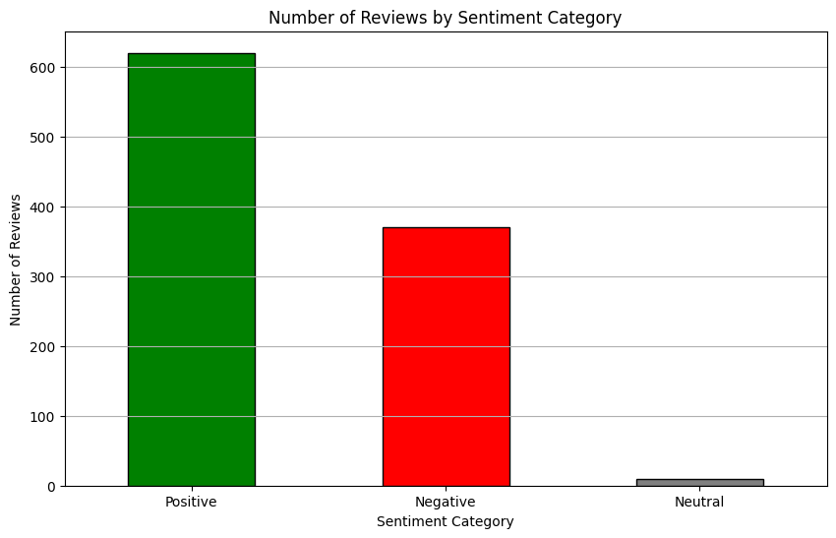
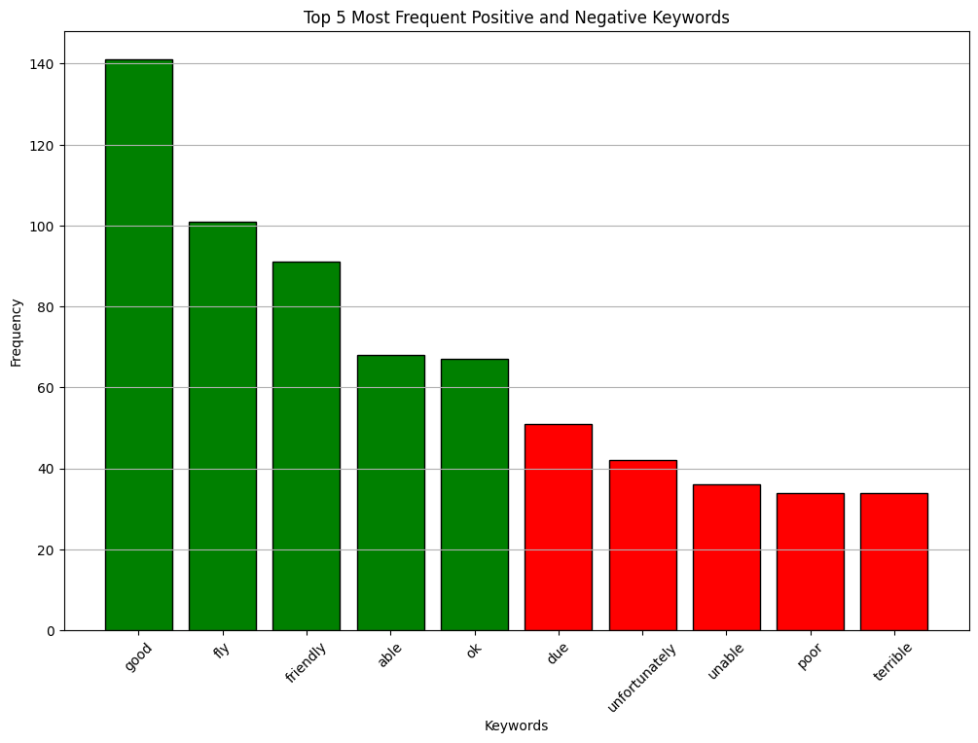
Results
Sentiment & polarity
The following chart displays the sentiment observed from 1,000 reviews.
Frequent Keywords
The following chart presents the top 5 most frequently occurring positive and negative keywords.
POSITIVE
62%
NEUTRAL​​
1%​​
NEGATIVE​
37%​

