Slide 1
BRITISH AIRWAYS HOLIDAY PREDICTION

Slide 2
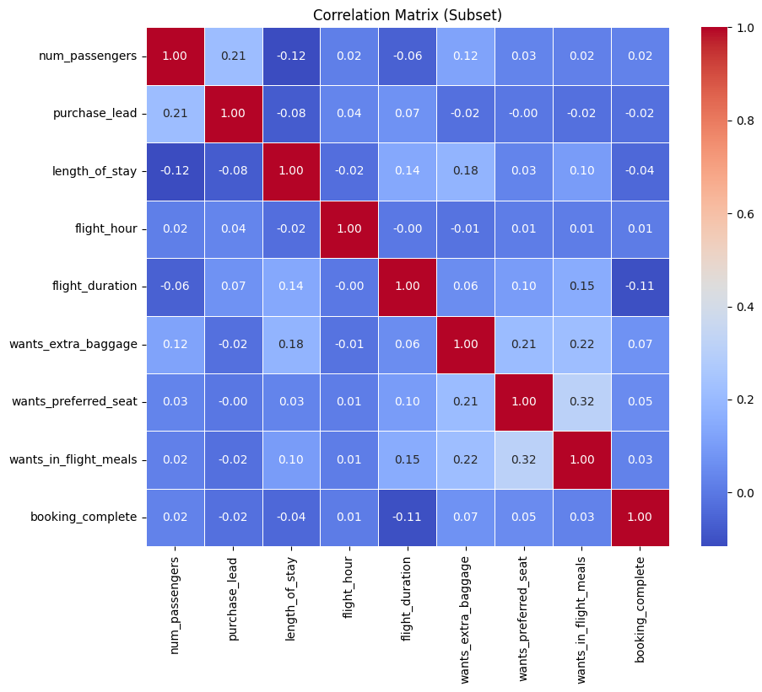
Results
Correlation analysis
The following chart displays the correlation of the features with the target feature.
Correlation analysis
The following chart displays the correlation of the features with the target feature.
Model Evaluation
A random forest classifier was used to predict if a customer would buy a holiday.
The model had an accuaracy of 0.85.
K fold cross validation
A 5 fold cross validation was done and resulted in a mean accuracy of 0.75 with standard deviation of 0.1

