Slide 1

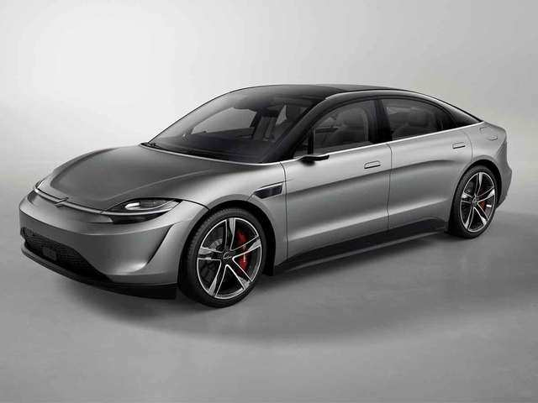
CAR PRICE PREDICTION
MINI PROJECT BY:
Divyanshu Mishra (1900540100068)
SUBMITTED TO:
Dr. Diwakar Yagyasen
(Assistant Professor)

Slide 2
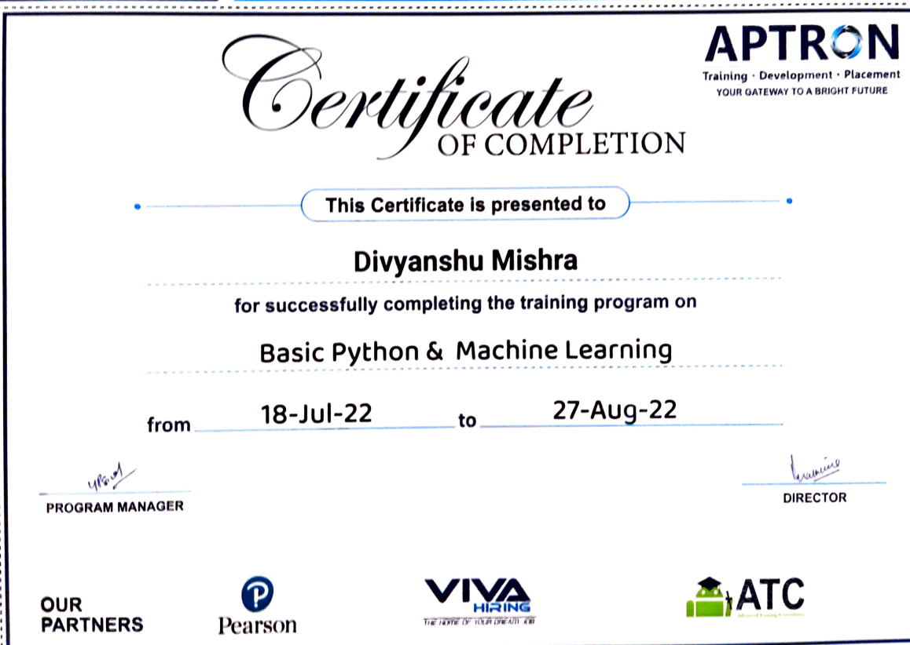

Slide 3
TABLE OF CONTENTS
1) INTRODUCTION
2) AIM AND OBJECTIVE
3) PROBLEM STATEMENT
4) LITERATURE REVIEW
5) METHODOLOGY
6) SCOPE
7) HARDWARE & SOFTWARE REQUIREMENTS
8) RESULT
9) CONCLUSION
10) REFERENCES

Slide 4
INTRODUCTION
Car price prediction is somehow interesting and popular problem. As per information that was gotten from the Agency , 921.456 vehicles were registered in 2014 from which 84% of them are cars for personal usage .
This number is increased by 2.7% since 2013 and it is likely that this trend will continue, and the number of cars will increase in future. This adds additional significance to the problem of the car price prediction.
Accurate car price prediction involves expert knowledge, because price usually depends on many distinctive features and factors.
Typically, most significant ones are brand and model, year, horsepower and mileage. The fuel type used in the car as well as fuel consumption per mile highly affect price of a car due to a frequent changes in the price of a fuel.

Slide 5
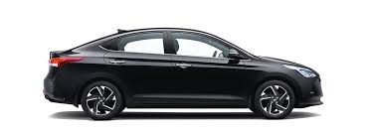
AIM & OBJECTIVE
This project aims to develop an application which will predict the Car prices for various data using machine learning model.
The user will get the predicted values and with that he can decide which car to buy.
In the current day scenario car is very important in day today travel and almost everyone’s needs it.
But there are also many people who wants to buy a car but they can not buy because of financial issue so car price prediction can help them to find a used car according to their data and what they can afford.
The proposed system can help save money of several customers by providing them the information of car price according to their uses.

Slide 6
PROBLEM STATEMENT
Car Price Predictor is used to Predict the price of the car , that we have to sell the car, in our project we have to select the company then model , Year of purchase , Type of Fuel ,How much km that the car has travelled.
It will help the people to predict the price of the car , easy to sell it.
We have to create a user-friendly model where:
A traveller should be able to access the module to get the future price prediction of individual cars.
The prediction will help a traveller to decide a specific car as per his/her budget.

Slide 7
LITERATURE REVIEW
RESEARCH PAPER/ SOURCES | DESCRIPTION
Author-(Eneis Gegic, Becir Isakovic, Dino Keco) | A car price prediction has been a high interest research area, as it requires noticeable effort and knowledge of the field expert. Considerable number of distinct attributes are examined for there liable and accurate prediction. To build a model for predicting the price of used cars in Bosnia and Herzegovina, we applied three machine learning techniques (Artificial Neural Network, Support Vector Machine and Random Forest).
Author-(Pattabirman Venkatasubbu,Mukkesh Ganesh) | The production of cars has been steadily increasing in the past decade, with over 70 million passenger cars being produced in the year 2016. This has given rise to the used car market, which on its own has become a booming industry.

Slide 8
RESEARCH PAPER/ SOURCES | DESCRIPTION
Author-(Kanwal noor,Sadaqat Jan) | This paper presents a vehicle price prediction system by using the supervised machine learning technique. The research uses multiple linear regression as the machine learning prediction method which offered 98% prediction precision. Using multiple linear regression, there are multiple independent variables but one and only one dependent variable whose actual and predicted values are compared to find precision of results.
Author- (Sameerchand Pudaruth) | In this paper, we investigate the application of supervised machine learning techniques to predict the price of used cars in Mauritius. The predictions are based on historical data collected from daily newspapers. Different techniques like multiple linear regression analysis, k-nearest neighbours, naïve bayes and decision trees have been used to make the predictions.

Slide 9
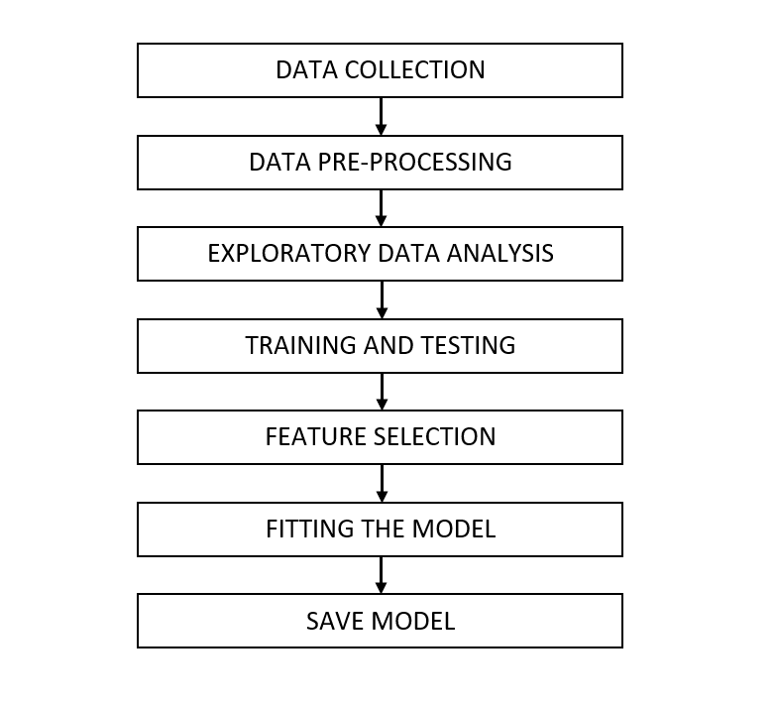

METHODOLOGY

Slide 10
SCOPE
As we can see the car is important in are day to day life ,are scope of project is to predict the price of old cars depends upon its condition(km travelled ,fuel type etc )
It predict the price of the car based on data it have been learn ,Not always it predict perfect sometimes little difference is there in actual price and predict price
Many times Dealer cheats the customer sell them with high price ,Its main Focus is to help both individual and Dealer they can buy or sell as better price

Slide 11




HARDWARE & SOFTWARE REQUIREMENTS
HARDWARE USED :
1.6 GHz or faster processor
Minimum 1 GB of RAM
Minimum 400 MB of free disk space
SOFTWARE USED :
Python, Jupyter Notebook, HTML, CSS, , Flask

Slide 12
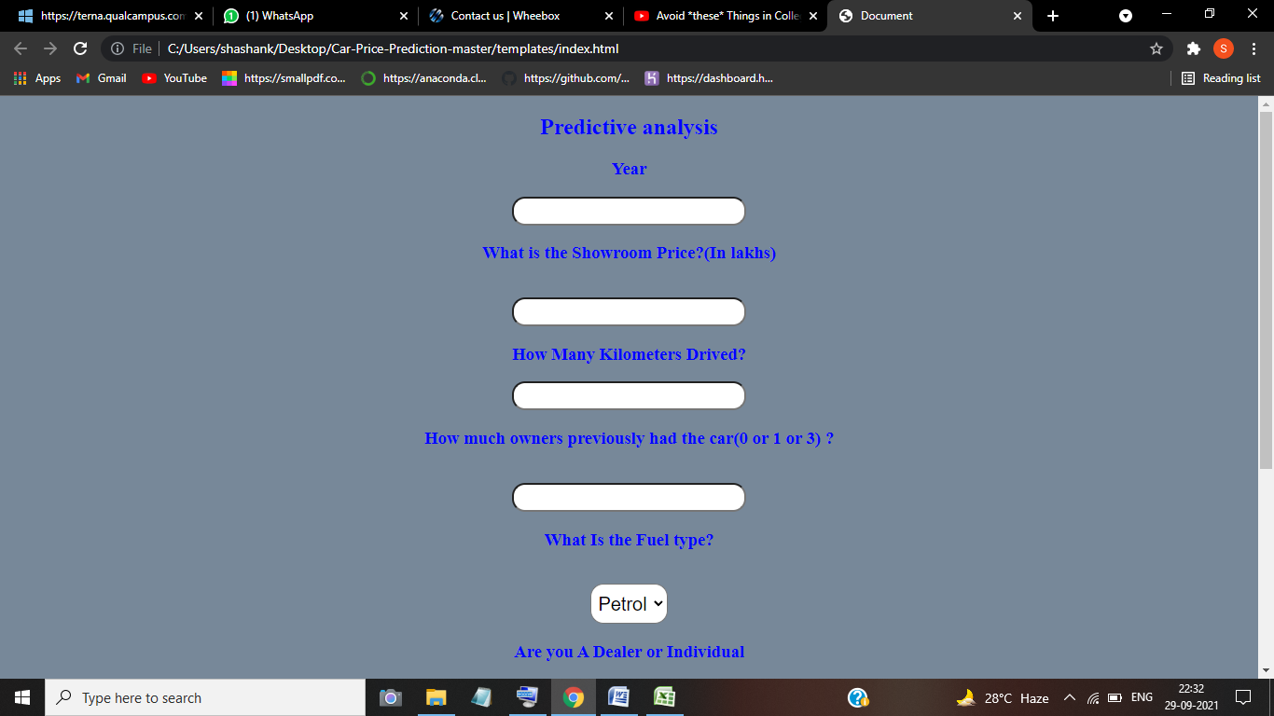
RESULT

Slide 13
CONCLUSION
Our Project CAR PRICES PREDICTION system help the Dealer and customer regarding the car rates. The requirements of the system have been gathered from the rates recorded in the past.
Following are the benefits of the proposed system:
Making it convenient for the users(Dealer and customer )to select good cars at their budget prices.
Reducing time in prediction of prices.
It will reduce the complexity of the manual system.
In conclusion, from proper analysis and assessment of the designed system it can be safely concluded that the system is an simple and usable.

Slide 14

REFERENCES
1)https://www.temjournal.com/content/81/TEMJournalFebruary2019_113_118.pdf
2)https://www.ijeat.org/wp-content/uploads/papers/v9i1s3/A10421291S319.pdf
3)https://www.ijcaonline.org/archives/volume167/number9/noor-2017-ijca-914373.pdf
4)http://ripublication.com/irph/ijict_spl/ijictv4n7spl_17.pdf
5) https://youtu.be/p_tpQSY1aTs
6)https://www.irjet.net/archives/V8/i4/IRJET-V8I4278.pdf

