Slide 1
HardFork
FORGE
Mohd Anas
+916265692813
Gauhar Ayub Khan +918949320519
Syed Kamran Ahmed
+919973214649
Arifa Nafees
+918279603198

Slide 2
Description of the Project
Problem Statement
Approach to the Solution
Counterfeiting and selling of goods/products
We are proposing a decentralized app so that the consumers don't have to rely on the word of mouth of the seller but the product itself.
Relevance to the Theme
Techstack Involved
Portis Challenge
Solidity, React, Web3.js, Truffle, Portis, Matic

Slide 3
Details of Technology Stack
Solidity
Programming Language used for creating smart contracts for ethereum blockchain.
React.js
Framework for developing responsive UI
Web3.js
Library which provides abstraction from json RPC and hex data.
Truffle
Framework for compilation and deployment of smart contracts..
Portis
Non-custodial wallet for performing transactions on blockchain.
Matic Network is a blockchain scalability platform which provides cheap and instant transaction
Matic

Slide 4
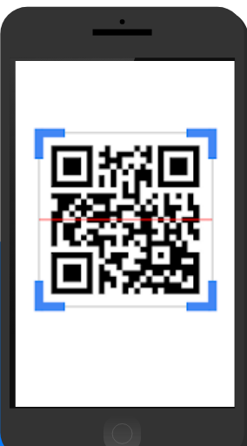
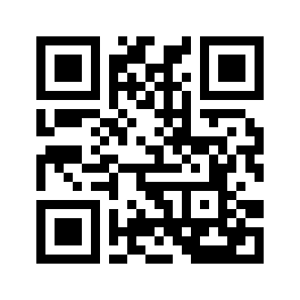

Description of the Solution
Owner
Seller
Consumer
Visible key to get details
Owner Adds the new Product
Sells products to consumers or other registered sellers
Hidden key mark as sold
If a seller buys 5 products then he will be able to sell only 5 not more than that (in case it creates copy)
Product having two keys, one visible one hidden
Hidden key can only be scanned once

Slide 5
Novelty of the Solution
A supply chain based solution to tackle the problem of product counterfeiting
Existing solution can help in checking the authenticity of the product only after the customer has bought the product.
Our system is completely decentralized so there is no need to trust the word of mouth of the seller but the product itself.
Counterfeits result in major financial losses, not only to manufacturers, but they also reduce the general welfare due to missed tax revenue.
In the case of pharmaceutical and food products, the implications are not just monetary but related to health hazards as well.

Slide 6
Growth Plan of the Product
50%
Initially we will target pharmaceutical and farming sector, however there is no limitation of sector
Checkpoint 1
75%
Future work, with the integration of GSN consumers will not have to pay for gas, making our dapp very accessible
Checkpoint 2
100%
In the year 2022 when eth2 will arrive there will be no need to use matic because of cheap and fast transactions and low gas price
Checkpoint 3

Slide 7
Business Aspects of the Hack
01
Market Impact
Our project targets the market of counterfeit products, which estimated to be of 1.8 trillion dollars
Any Consumer can use our product, any sector can use it to provide integrity to their product and prevent the counterfeiting of their product
Target Consumers
02
03
Financial Sustainability
Our app is like make once and use everywhere for different purposes. Any organization can integrate their supply chain management into our web app.
Any organization can use our project by just printing two qr codes for each product and attaching them to every product. They have to pay nominal transaction fee of blockchain.
04
Product > Project

Slide 8
Social Impact
Recently one man was caught for creating fake plasma for covid patients.
However, 5 patients lost their lives already, till the time he was caught.
Such incidents can be stopped using our product.
Every year lakhs of crops are destroyed.
Prime reasons are fake fertilizers, illegal pesticides and adulterated seeds.
These things cannot be judged by merely looking.
Save Precious Lives
Improve Lives of Farmers

Slide 9
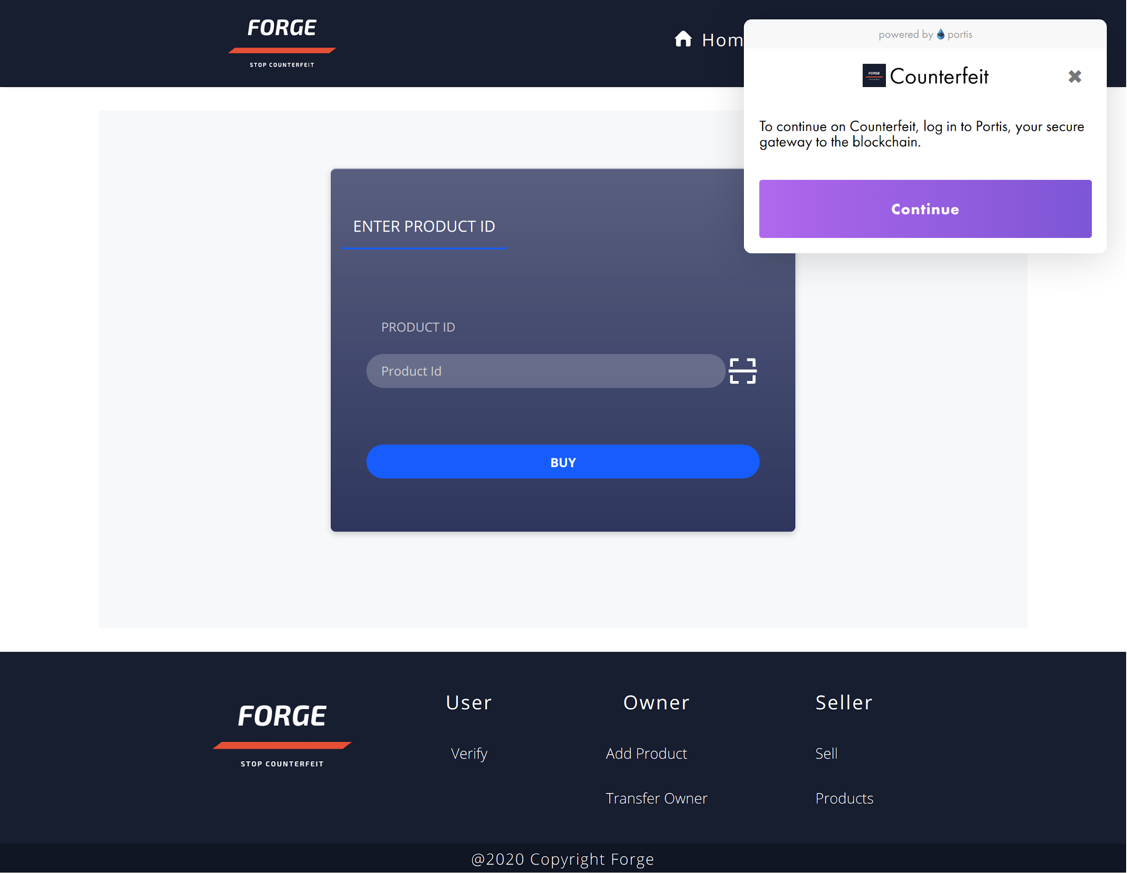
Working Prototype

Slide 10
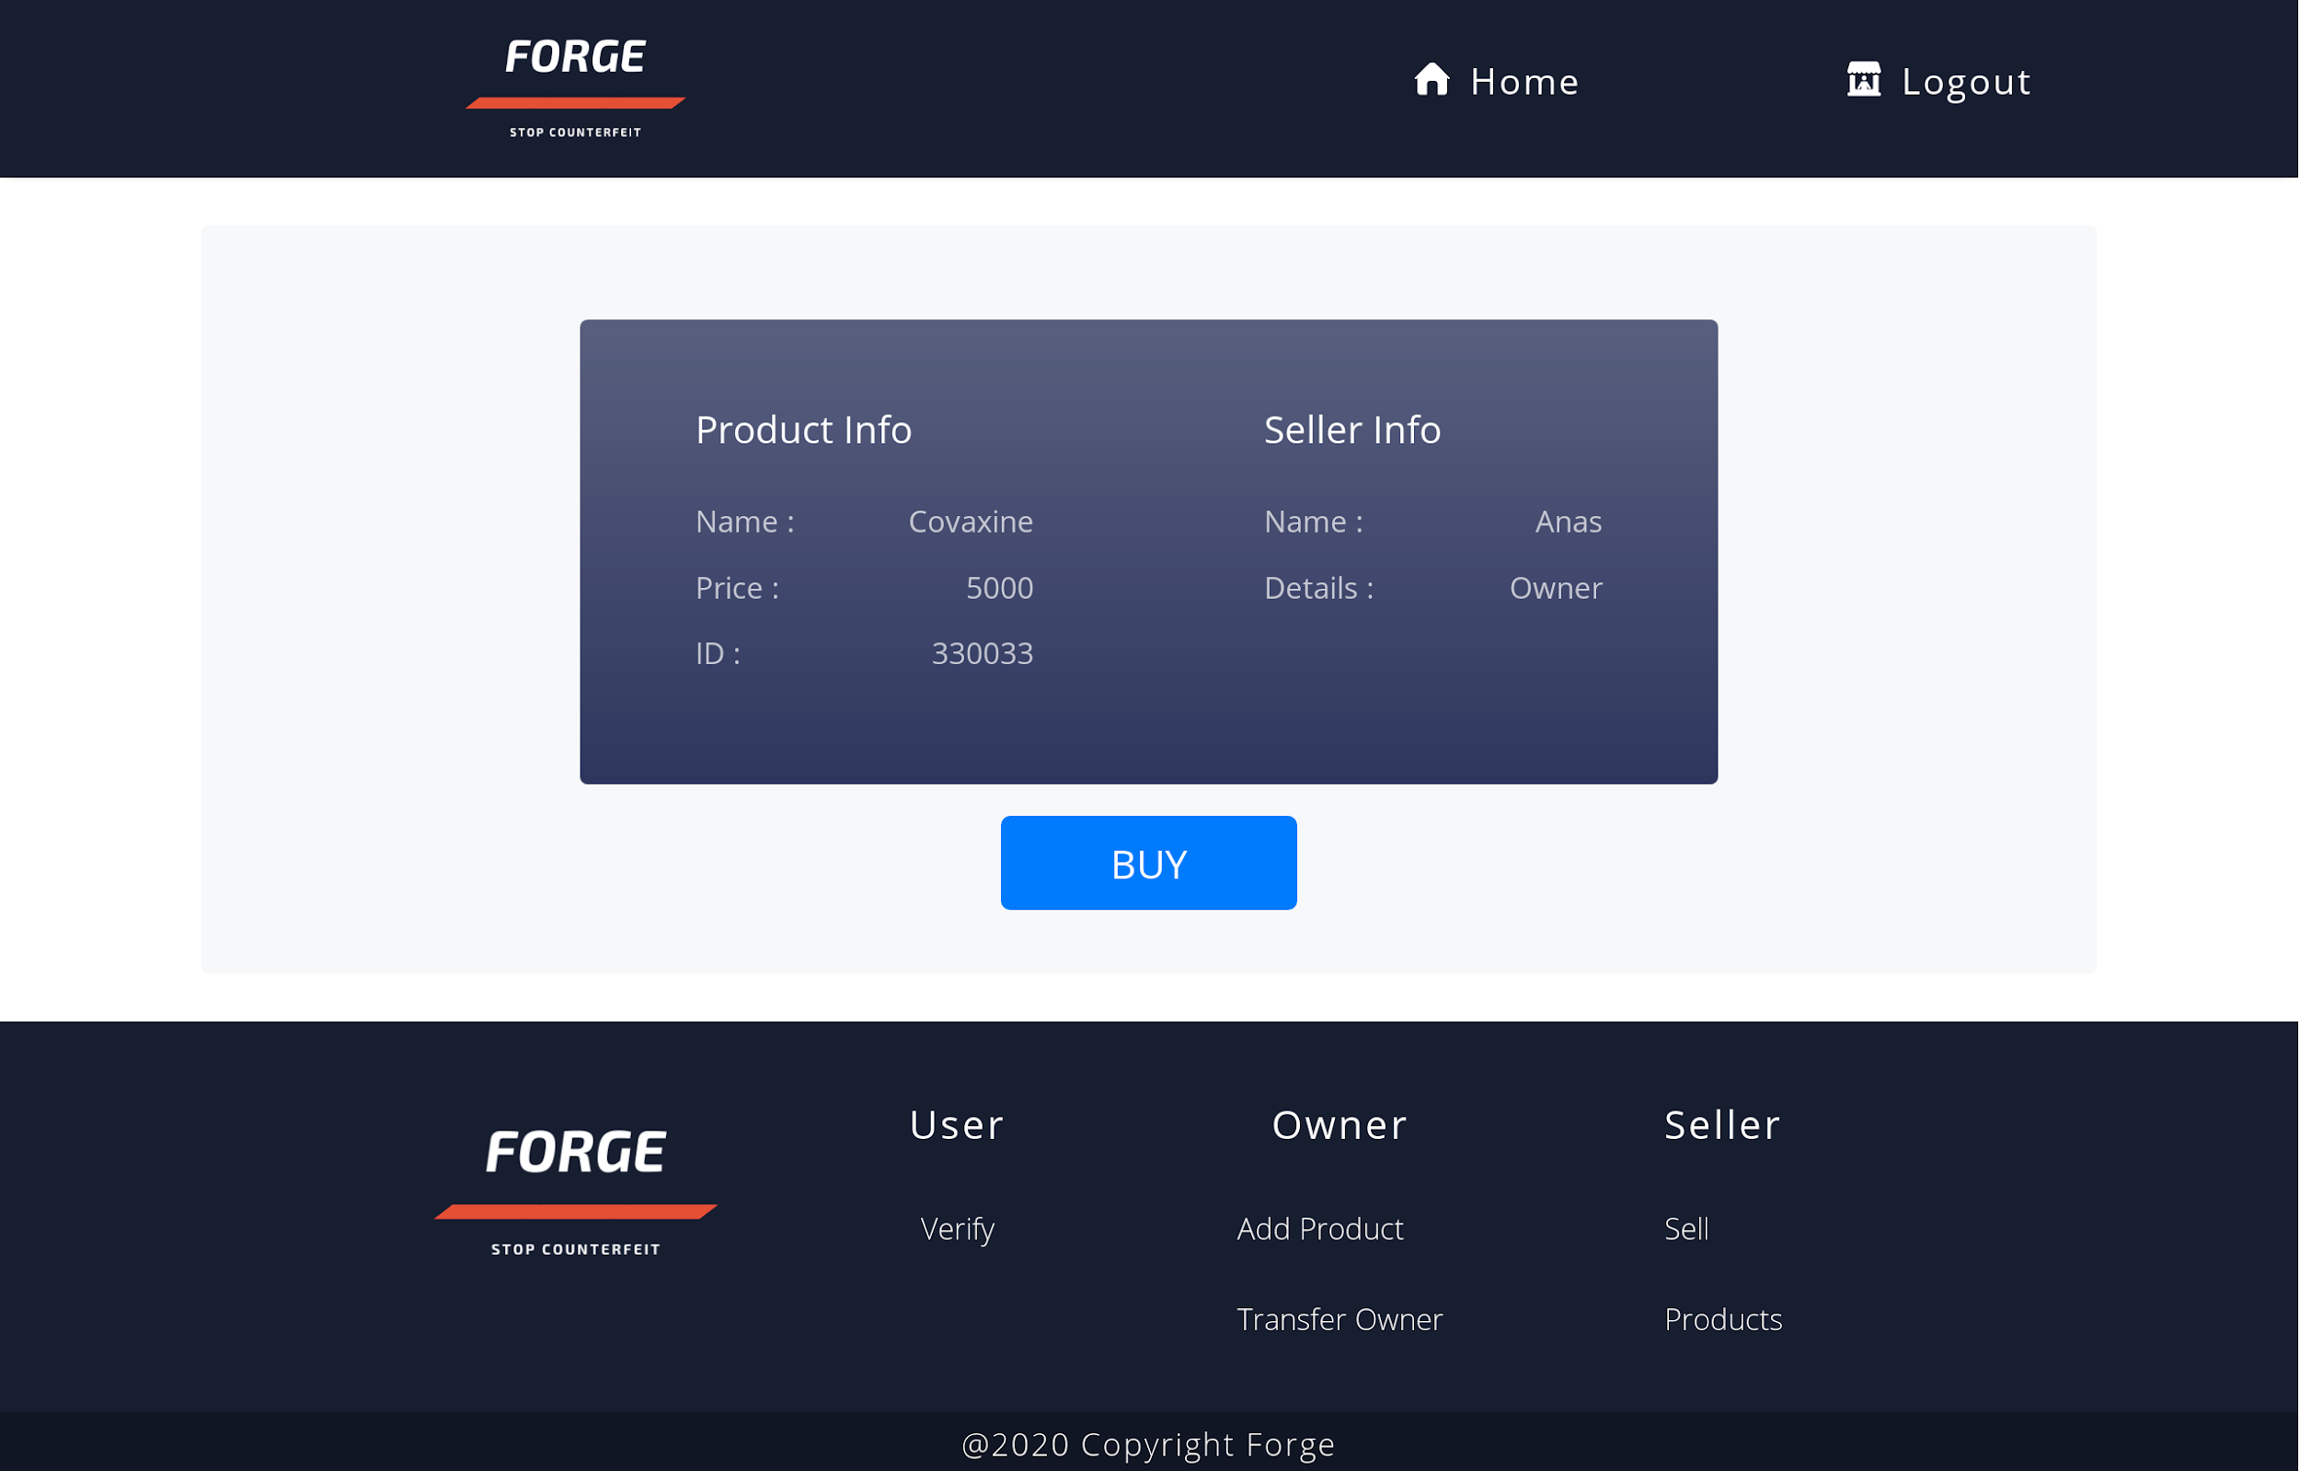

Slide 11
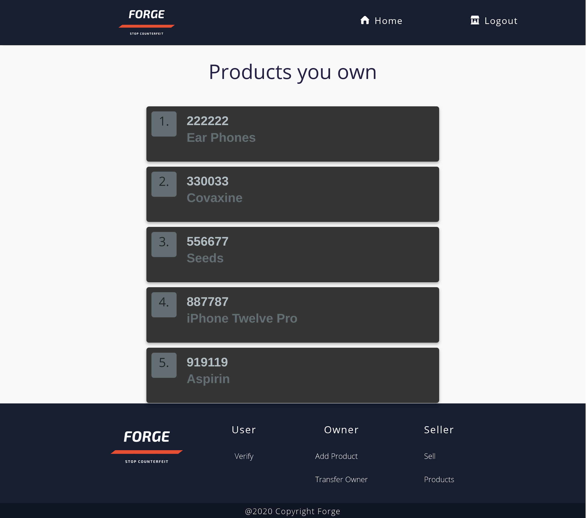

Slide 12
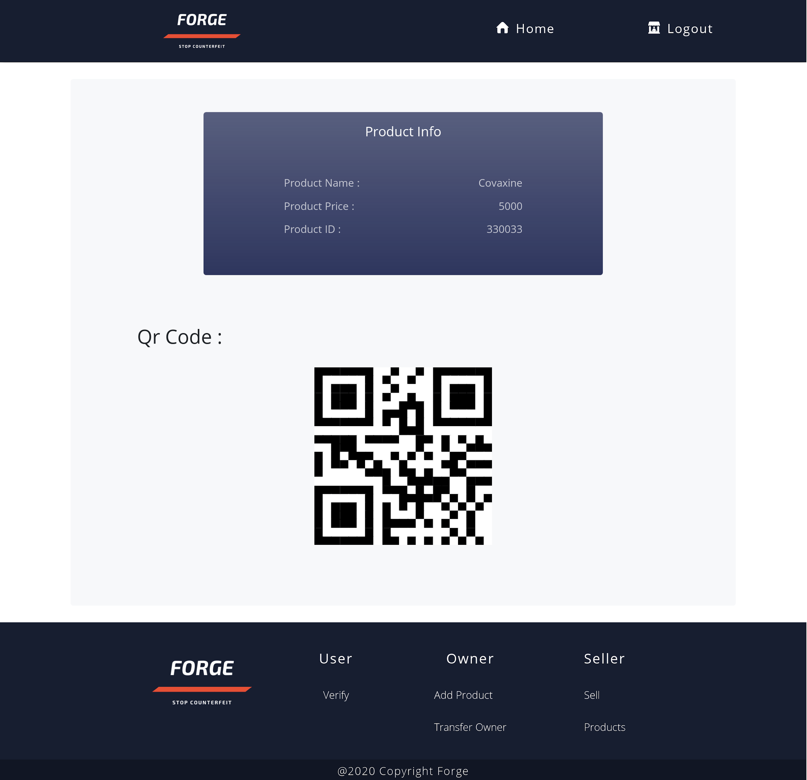

Slide 13
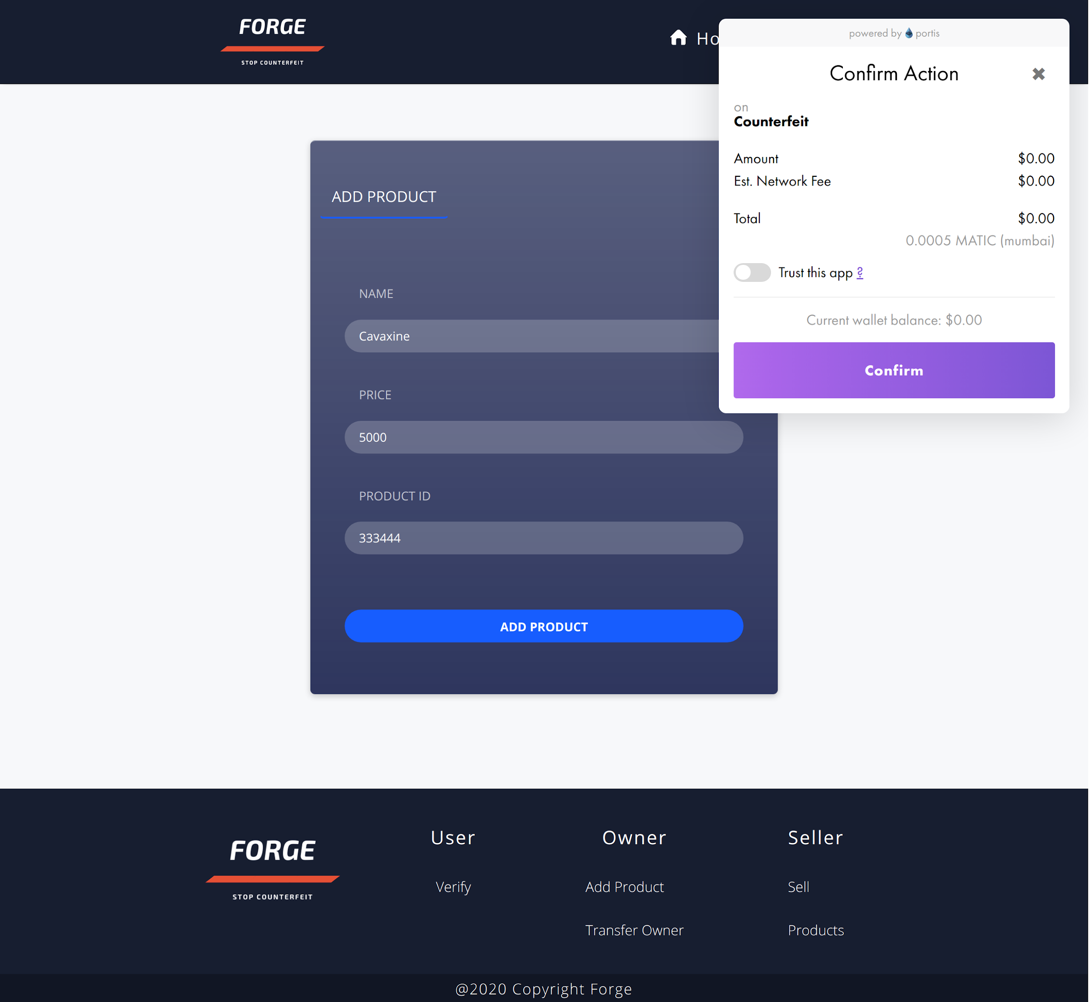
Price of 1 matic = 0.05$
Avg. Transaction cost = 0.0005$ Matic
Price/Txn =0.05*0.0005$

Slide 14
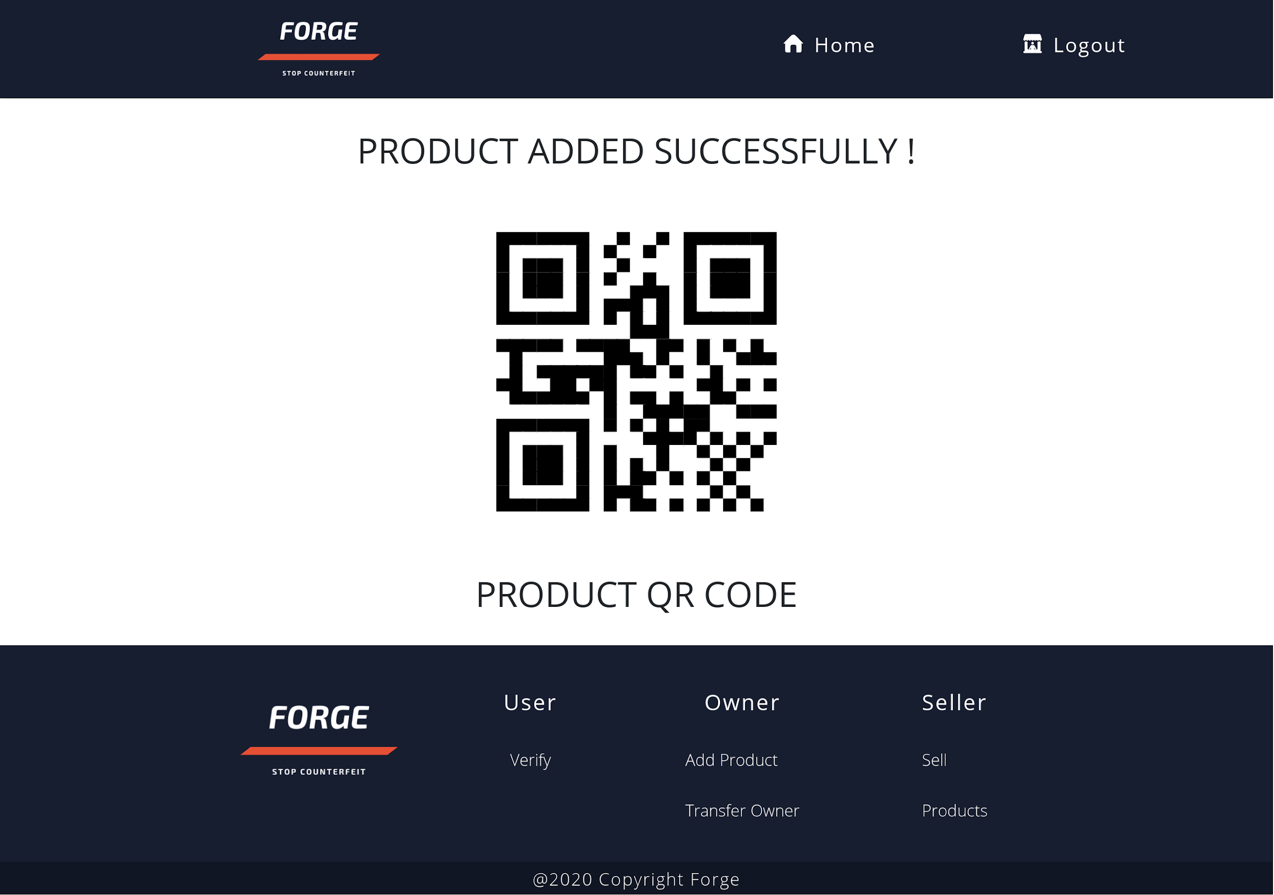

Slide 15
Learning Curve
These are the main things that we learnt
04
01
Decentralization
03
We learnt about decentralized networks and blockchain by studying about Ethereum.
02
Solidity
02
Solidity is used to create smart contracts on ethereum, we learnt this so we can create our own decentralize app
01
03
React
We created the frontend of our app using React
04
Teamwork
By coming together for a project, we have enhanced our skills of teamwork

Slide 16
About Team
01
02
Mohd Anas
Gauhar Ayub Khan
Team Leader, Full stack and blockchain developer
Full Stack and blockchain developer
03
04
Syed Kamran Ahmed
Arifa Nafees
Full stack developer
Frontend and react developer

