Slide 1
HardFork
FORGE
Mohd Anas
+916265692813
Gauhar Ayub Khan +918949320519
Syed Kamran Ahmed
+919973214649
Arifa Nafees
+918279603198

Slide 2
Description of the Project
Problem Statement
Approach to the Solution
Counterfeiting and selling of goods/products
We are proposing a decentralized app so that the consumers don't have to rely on the word of mouth of the seller but the product itself.
Relevance to the Theme
Techstack Involved
Portis Challenge
Solidity, React, Web3.js, Truffle, Portis, Matic, Infura

Slide 3
Details of Technology Stack
Solidity
Programming Language used for creating smart contracts for ethereum blockchain.
React.js
Framework for developing responsive UI
Web3.js
Library which provides abstraction from json RPC and hex data.
Truffle
Framework for compilation and deployment of smart contracts..
Portis
Non-custodial wallet for performing transactions on blockchain.
Matic Network is a blockchain scalability platform which provides cheap and instant transaction
Matic

Slide 4
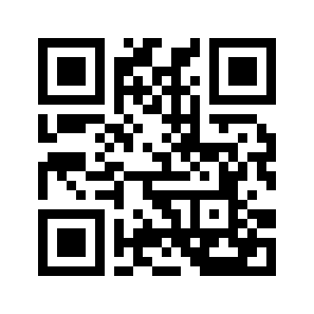

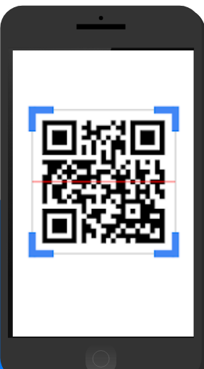
Description of the Solution
Owner
Seller
Consumer
Sell
Buy
Only owner can add the new product
Sells products to consumers or other registered sellers
Visible key to get details
Hidden key mark as sold
If a seller buys 5 products then he will be able to sell only 5 not more than that (in case it creates copy) making other copies useless
Product having two keys, one visible one hidden.
All keys will be unique
Hidden key can only be scanned once

Slide 5
Novelty of the Solution
A supply chain based solution to tackle the problem of product counterfeiting
Existing solution can help in checking the authenticity of the product only after the customer has bought the product.
Our system is completely decentralized so there is no need to trust the word of mouth of the seller but the product itself.
Counterfeits result in major financial losses, not only to manufacturers, but they also reduce the general welfare due to missed tax revenue.
In the case of pharmaceutical and food products, the implications are not just monetary but related to health hazards as well.

Slide 6
Growth Plan of the Product
50%
Initially we will target pharmaceutical and farming sector, however there is no limitation of sector
Checkpoint 1
75%
Future work, with the integration of GSN consumers will not have to pay for gas, making our dapp very accessible
Checkpoint 2
100%
In the year 2022 when eth2 will arrive there will be no need to use matic because of cheap and fast transactions and low gas price
Checkpoint 3

Slide 7
Business Aspects of the Hack
01
Market Impact
Our project targets the market of counterfeit products, which estimated to be of 1.8 trillion dollars
Any Consumer can use our product, any sector can use it to provide integrity to their product and prevent the counterfeiting of their product
Target Consumers
02
03
Financial Sustainability
Our app is like make once and use everywhere for different purposes. Any organization can integrate their supply chain management into our web app.
Any organization can use our project by just printing two qr codes for each product and attaching them to every product. They have to pay nominal transaction fee of blockchain.
04
Product > Project

Slide 8
Social Impact
Recently one man was caught for creating fake plasma for covid patients.
However, 5 patients lost their lives already, till the time he was caught.
Such incidents can be stopped using our product.
Every year lakhs of crops are destroyed.
Prime reasons are fake fertilizers, illegal pesticides and adulterated seeds.
These things cannot be judged by merely looking.
Save Precious Lives
Improve Lives of Farmers

Slide 9
Progress
Integrated GSN
We have integrated GSN, now consumer do not have to pay transaction fees, instead owner can pay their fees
Matic, Portis and GSN together makes our project very accessible and easy to adapt for a normal user.
Hash of secret key
Owner will add the 32 bytes KECCAK256 hash of secret key to the blockchain.
When customer will call the buyProduct method the secret key will be hashed on the blockchain and will be matched against the stored hash
Completed the functionality and UI improvements

Slide 10
Progress
Completed the project
Planned methods like buyProduct, RegisterSeller were implemented
Now the project provides a 100% effective way to check the authenticity and prevent the selling of counterfeit products
Proper Error Messages
Whenever a product which is already sold is again being scanned by the consumer, the message indicating product as sold is rendered
If product key never existed then again a proper message is displayed according to that

Slide 11
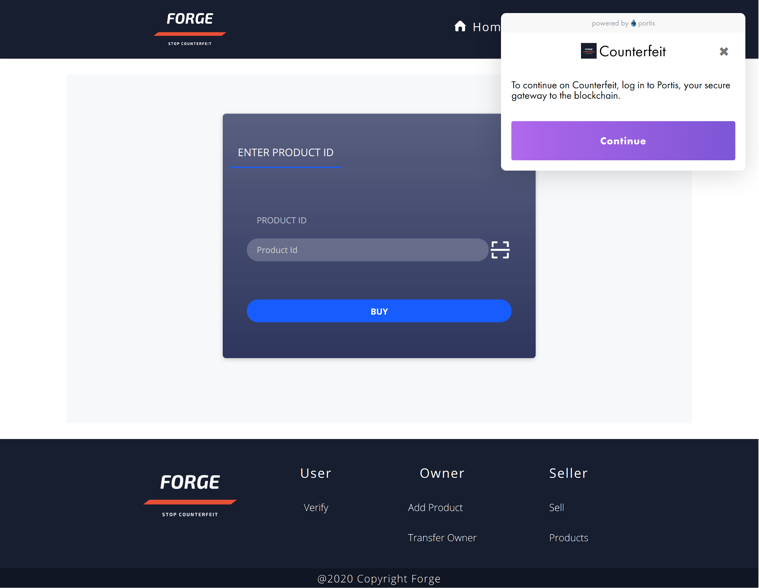
Home
Dashboard
Verify Product Form
Video Url : https://bit.ly/3aVeWdt

Slide 12
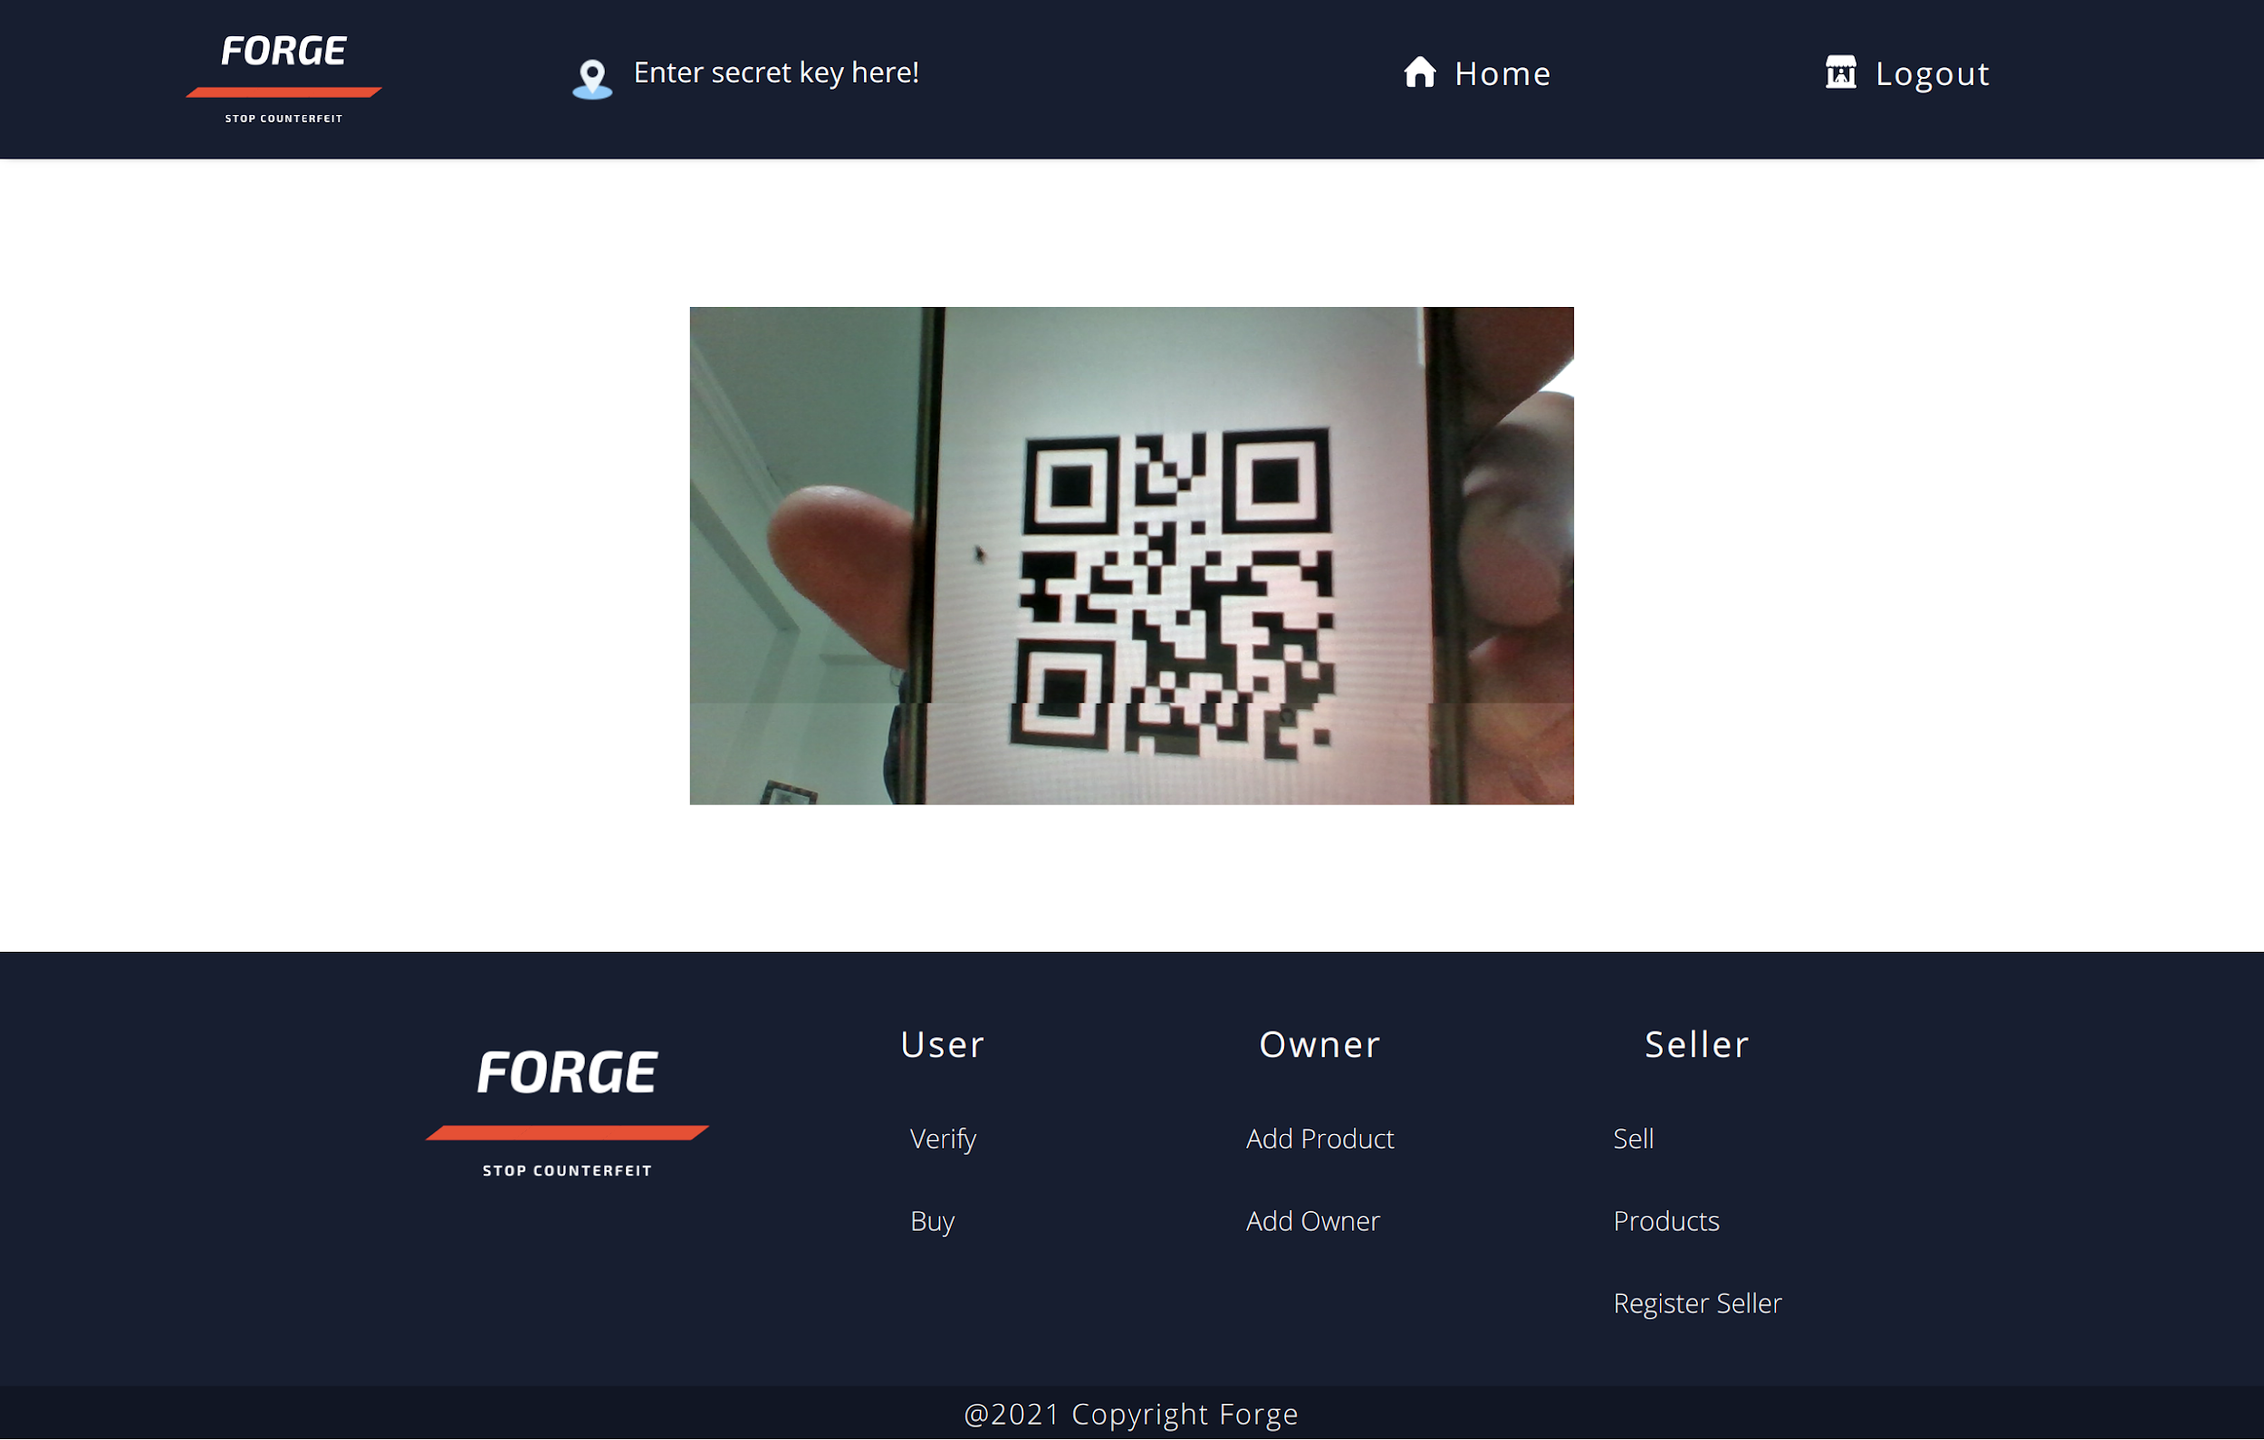

Slide 13
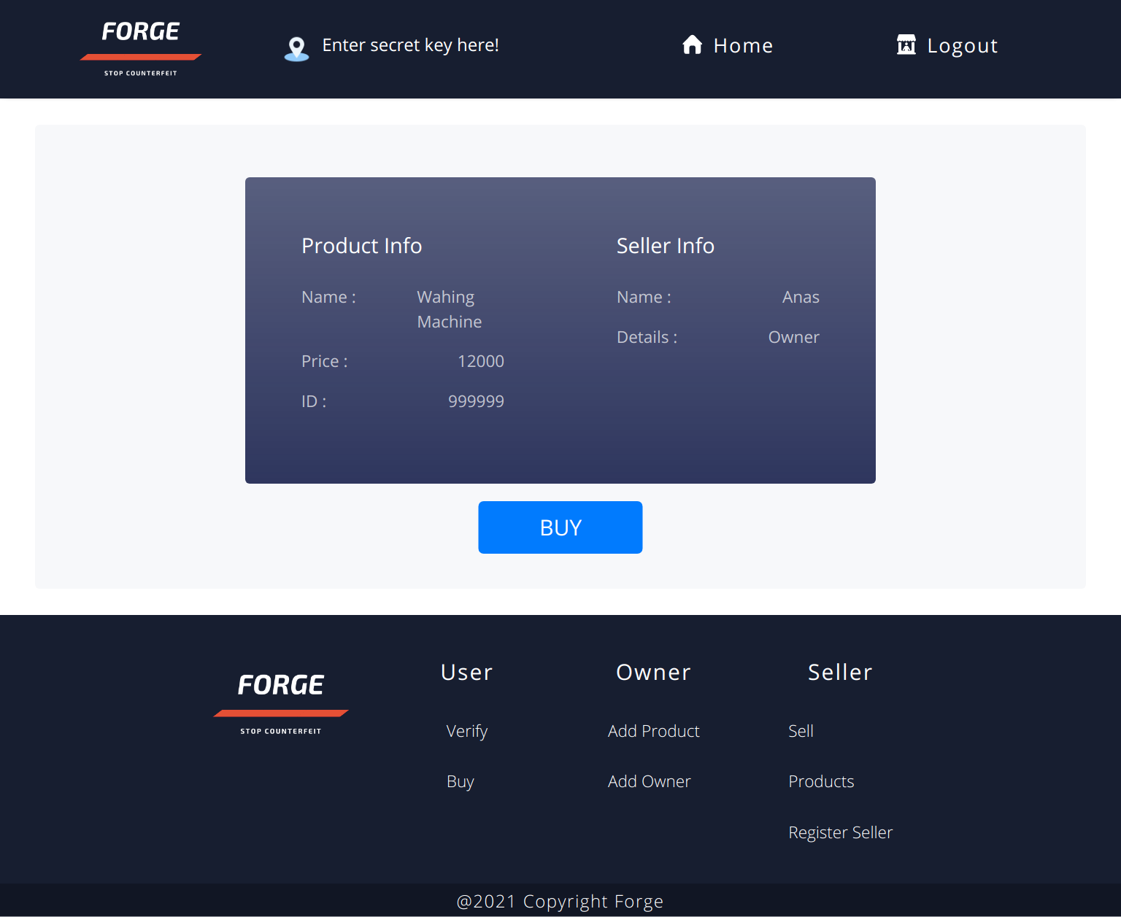
Product Info and Seller Info after scanning the product

Slide 14
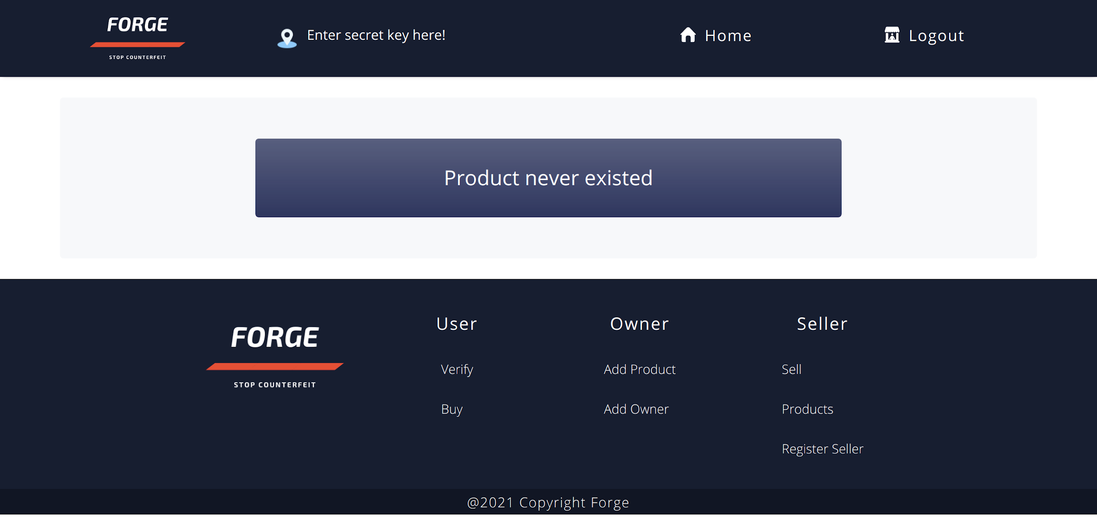

Slide 15
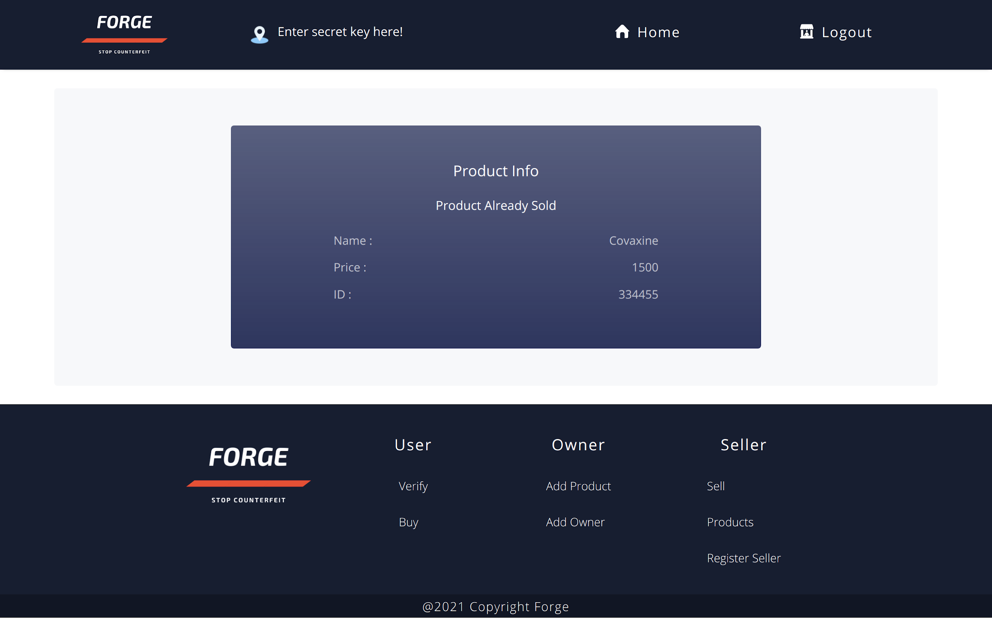

Slide 16
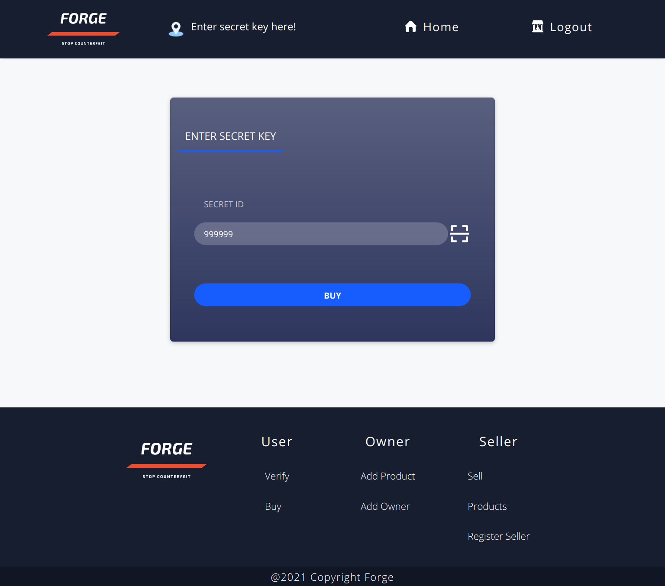
Enter Secret Key to purchase the product

Slide 17
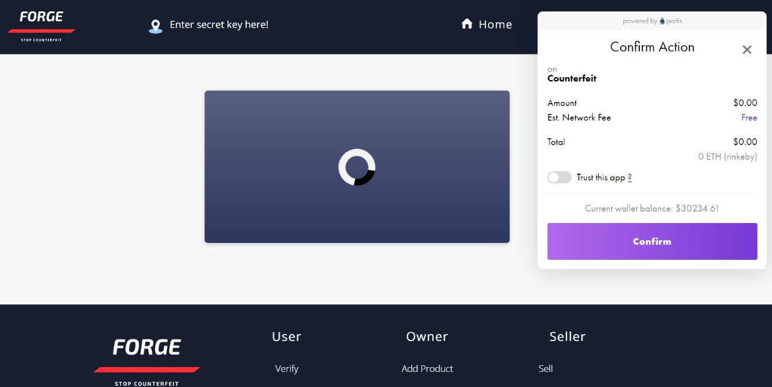
Transaction Depicting GSN, so that user do NOT have to pay transactional gas fees

Slide 18
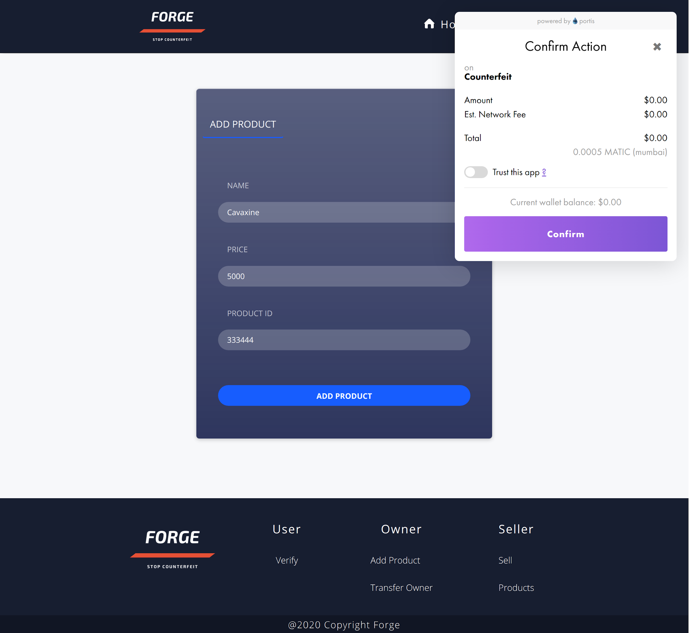
Add Product Form
Only the account with “owner” privileges can add product to the chain.
Price of 1 matic = 0.05$
Avg. Transaction cost = 0.0005$ Matic
Price/Txn =0.05*0.0005$

Slide 19
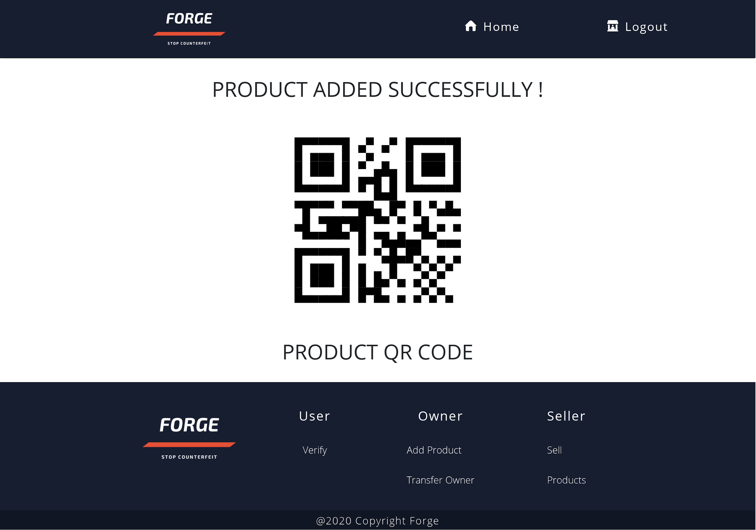
Success Message after addition of product.
Qr code embedding the product ID.

Slide 20
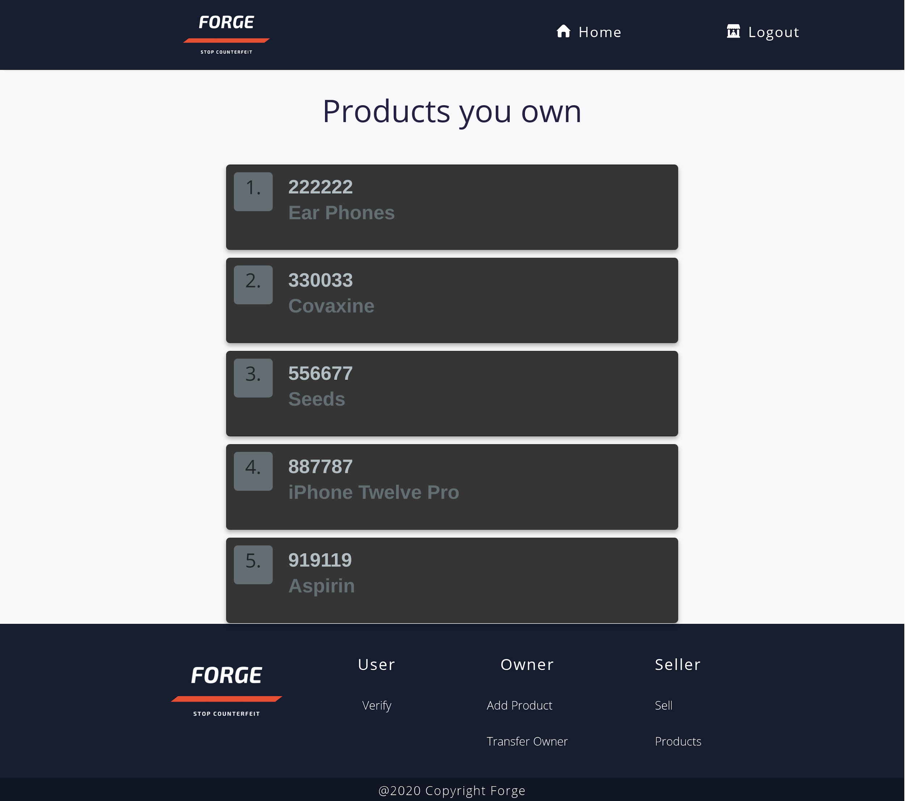
Product List showing all the products owned by seller/owner
Clicking on any product will give its details and a qr code embedding product Id.

Slide 21
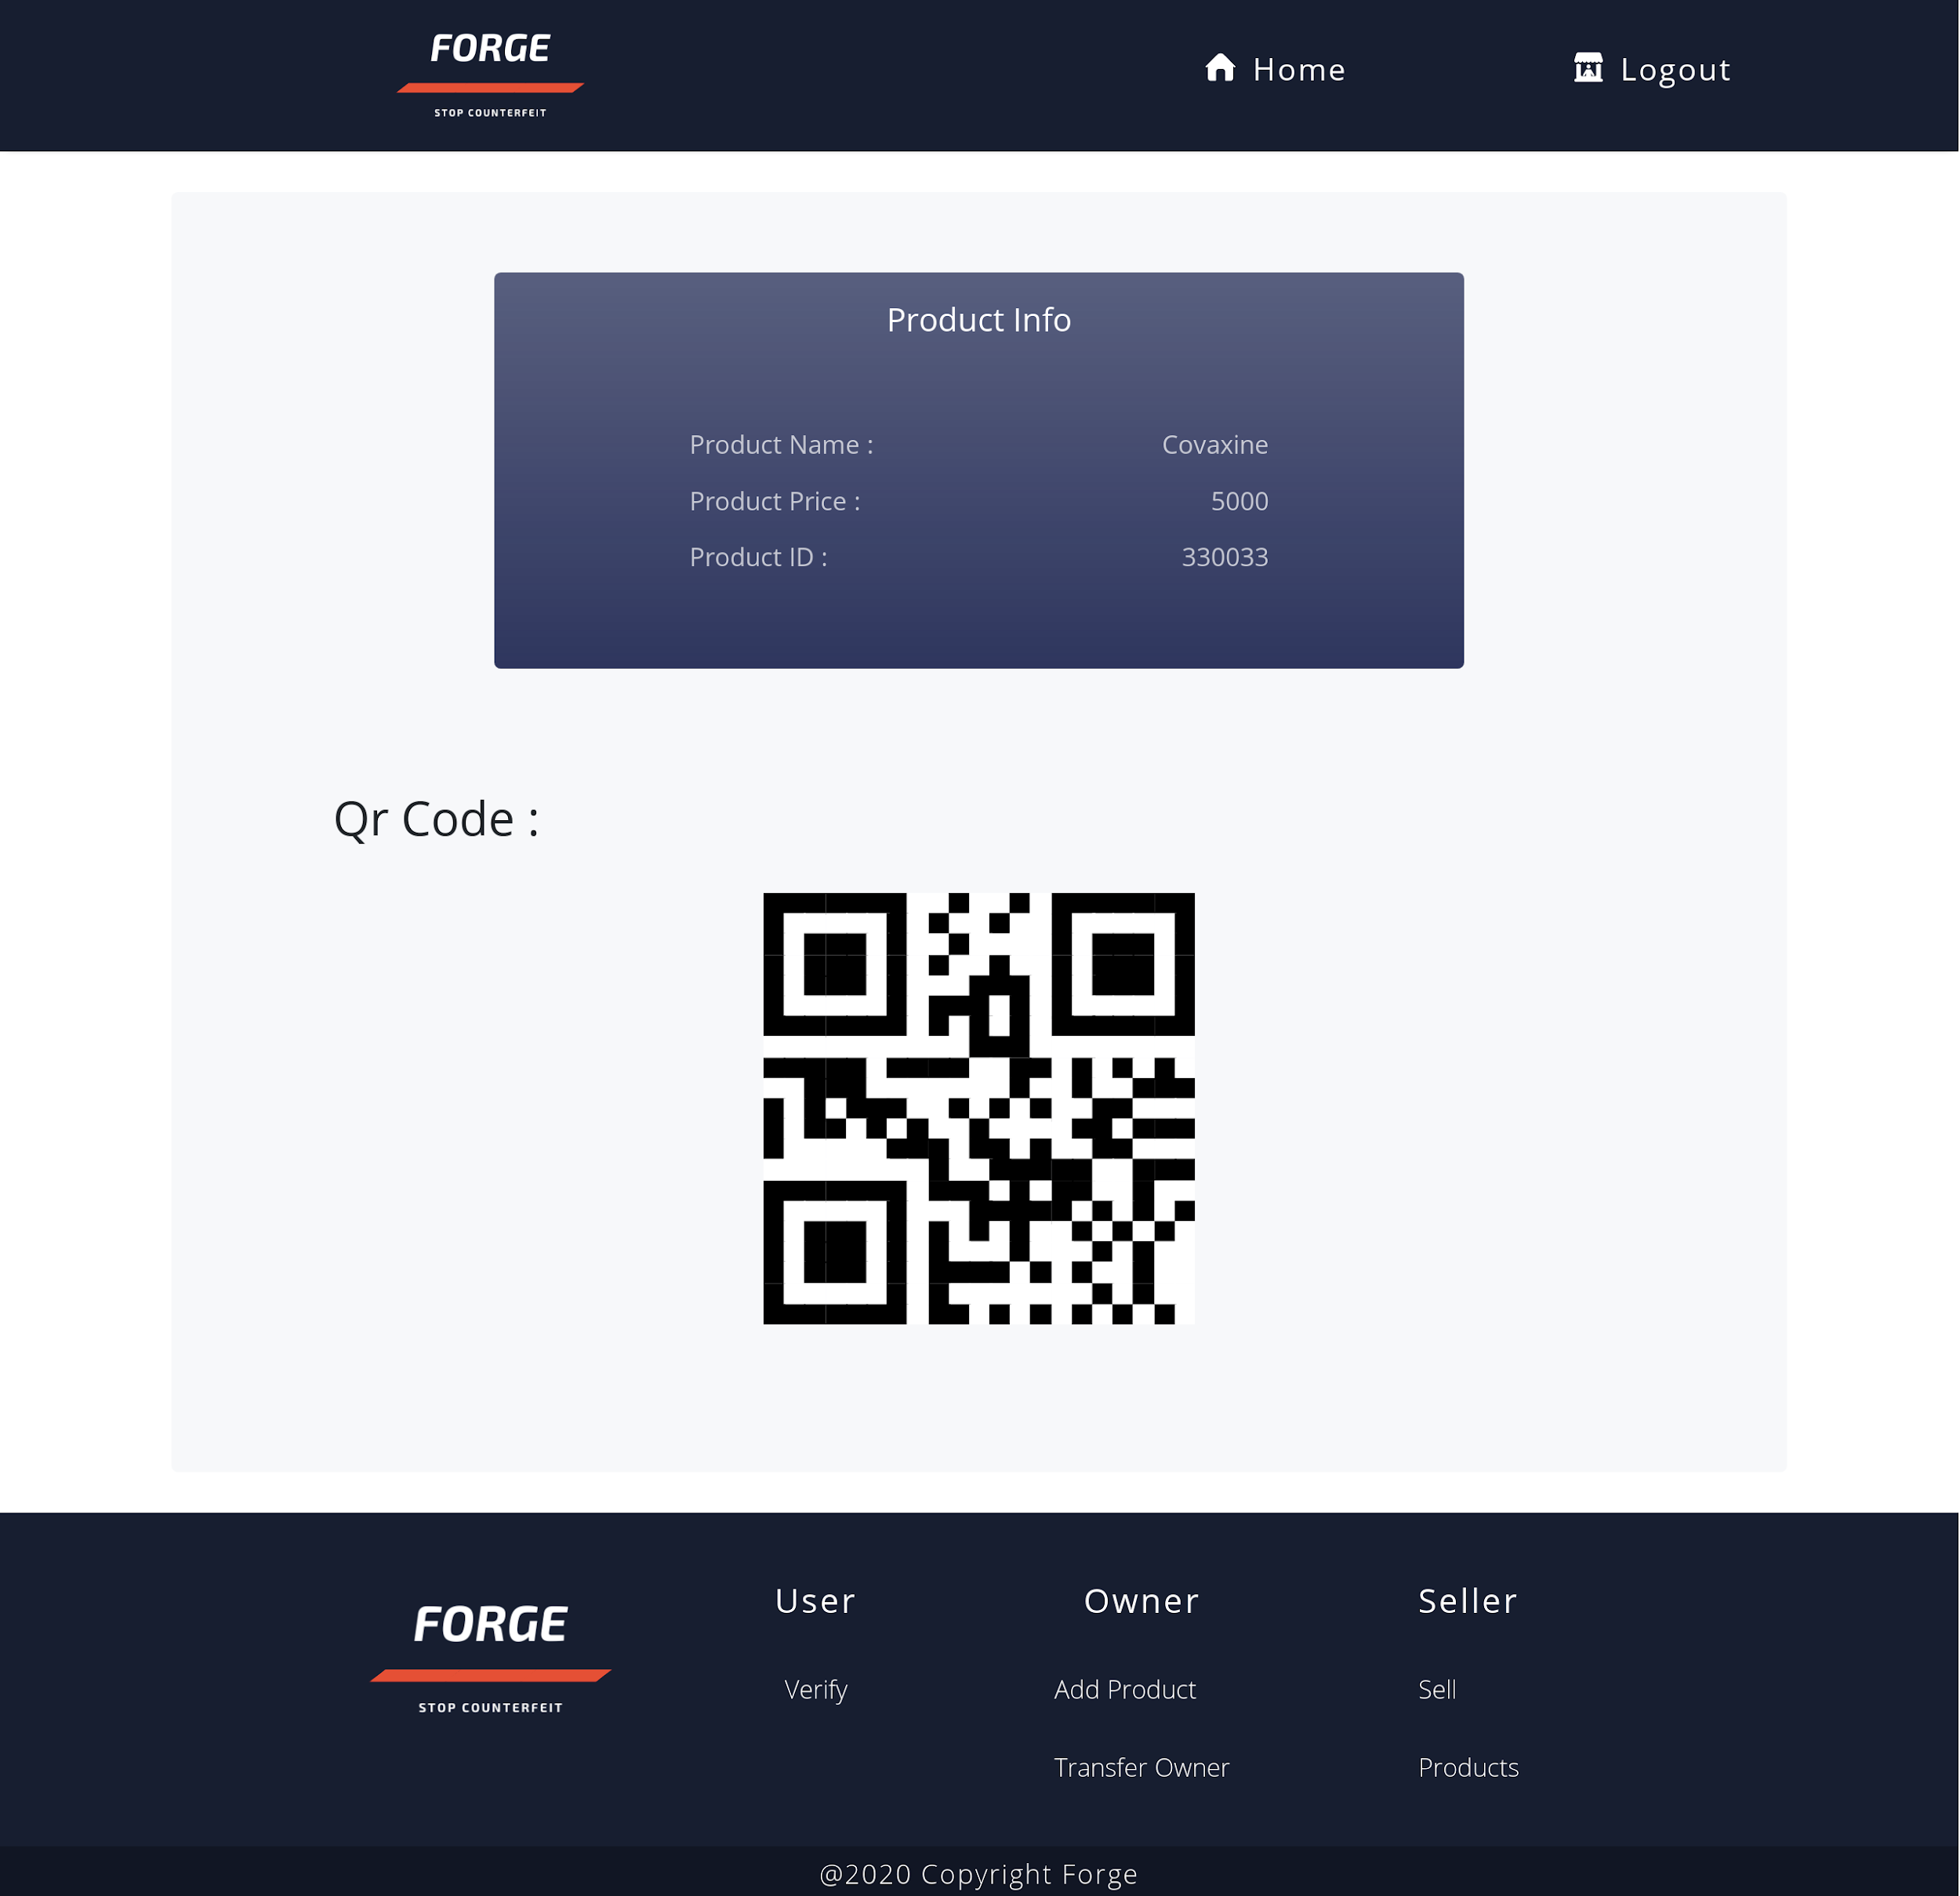
Product Info Page displayed after clicking on product list item.

Slide 22
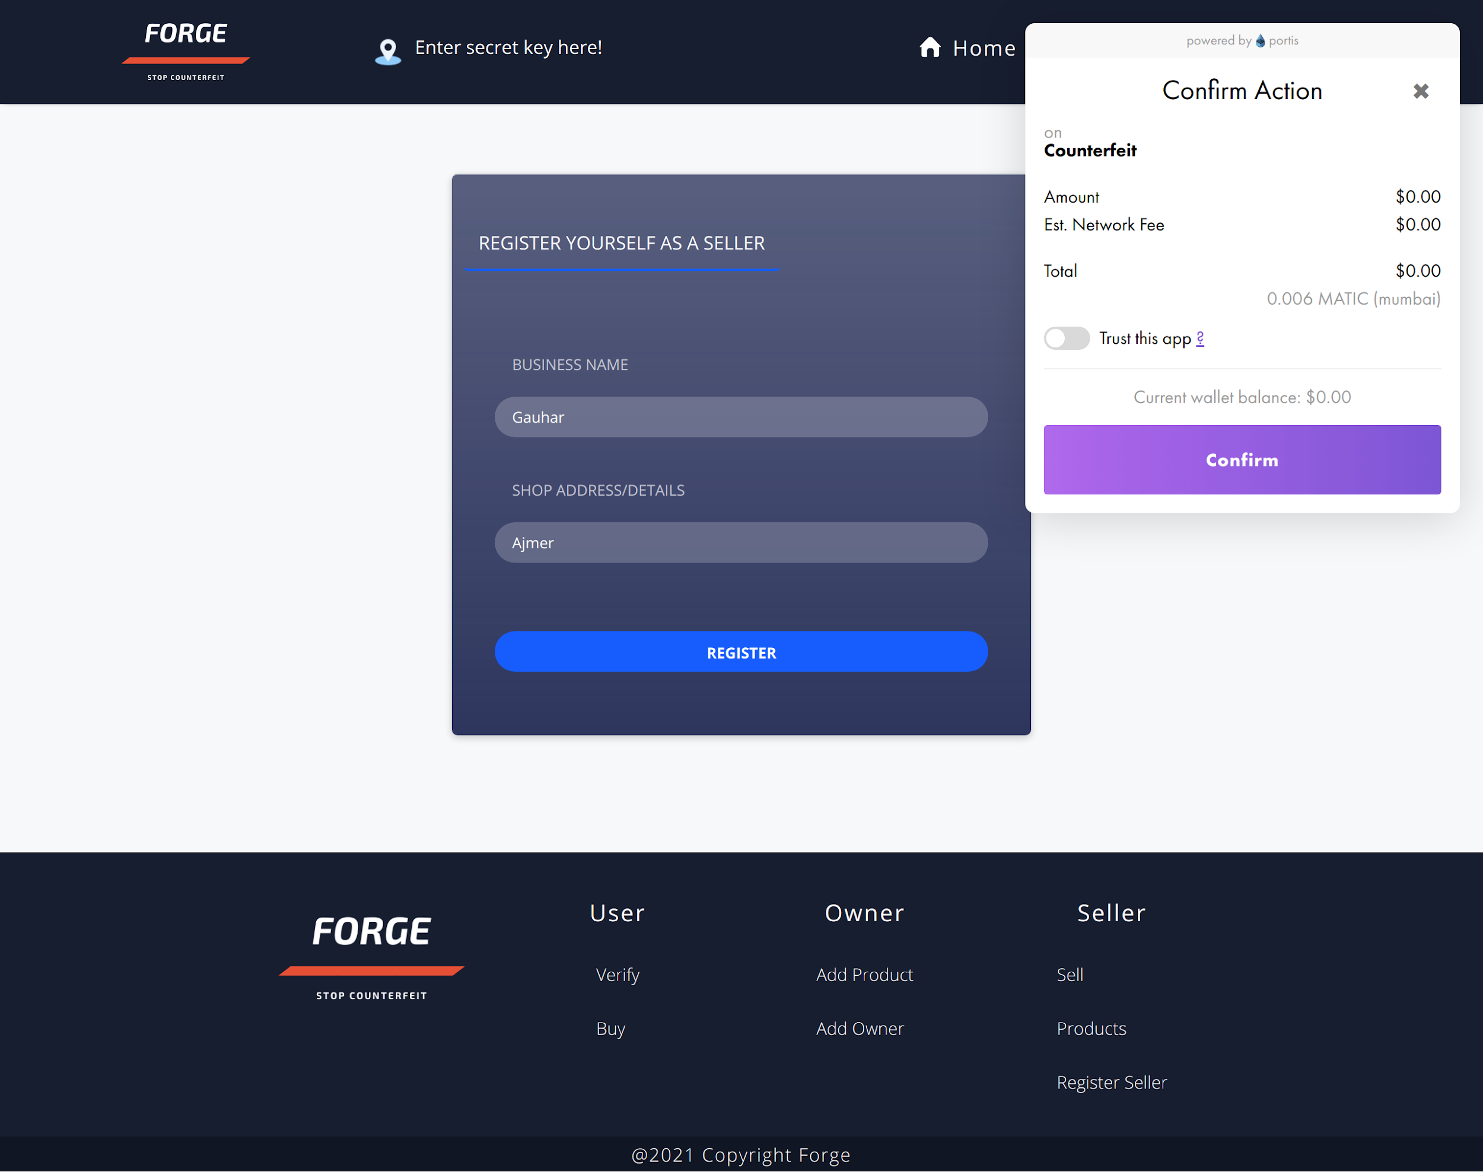
Register Seller Form
Any Consumer can register as a seller and then can sell products to other sellers

Slide 23
Learning Curve
These are the main things that we learnt
04
01
Decentralization
03
We learnt about decentralized networks and blockchain by studying about Ethereum.
02
Solidity
02
Solidity is used to create smart contracts on ethereum, we learnt this so we can create our own decentralize app
01
03
React
We created the frontend of our app using React
04
Teamwork
By coming together for a project, we have enhanced our skills of teamwork

Slide 24
About Team
01
02
Mohd Anas
Gauhar Ayub Khan
Team Leader, Full stack and blockchain developer
Full Stack and blockchain developer
03
04
Syed Kamran Ahmed
Arifa Nafees
Full stack developer
Frontend and react developer

