Slide 1
Introduction to Statistics

Slide 2

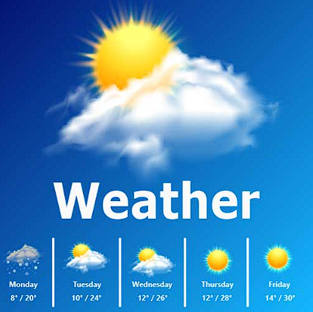
Statistics
Statistics is the study of how to collect, organize, analyze and interpret numerical information and data.
Or
40
Statistics is the science of extracting information from the data.
Examples:-
35%
1. Average marks of the class?
2. Tomorrow's weather?

Slide 3
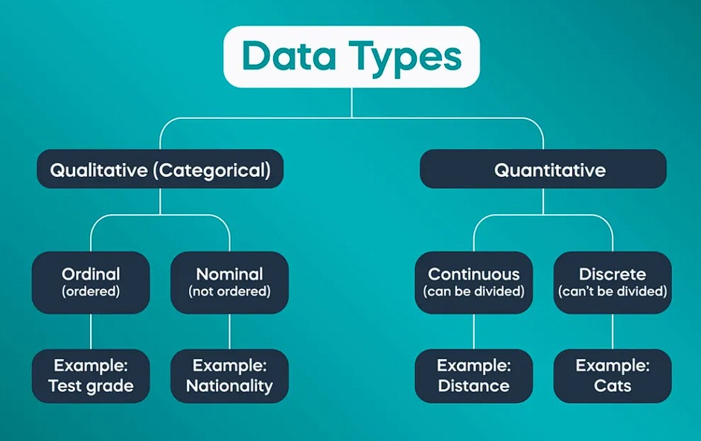
Types of Variables
50%
30%
80%
Types of Variables or Data
100%
Note: Continuous and discrete are also called ratio and interval respectively.

Slide 4
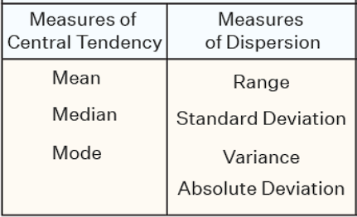
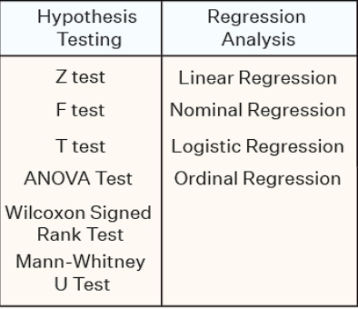
Types of Statistics
Descriptive
Inferential
Summary Statistics
Drawing conclusion of a population based samples.
50%
30%
80%
100%

Slide 5
Introduction to Descriptive Statistics
Central tendencies of the data
Spread of the data
1. Central tendencies of the data:-
1. Mode
Frequently occurring value.
Example:
Q1. 2,3,6,7,8,9,7,2,4,7,7 find mode.
Frequently occurring value = 7.
Therefore mode = 7.
Note: It is generally used for categorical variables and Data can have multiple modes.

Slide 6
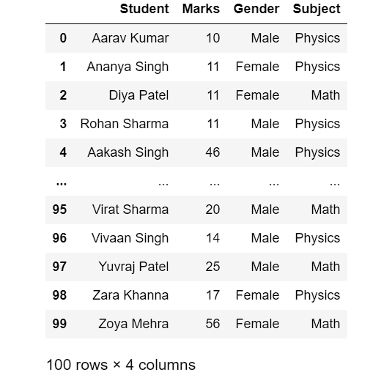
Introduction to Descriptive Statistics
To find Mode(using pandas):-
Dataset(Sample):-

Slide 7
Introduction to Descriptive Statistics
To find Mode(using pandas):-
Q1. What is the favorite subject of the students in class?
Import necessary libraries.
import pandas as pd
2. import dataset.
df = pd.read_csv('Students.csv’)
3. Final step.
mode_data = df['Subject'].mode()
print(mode_data)
Answer = Physics

Slide 8
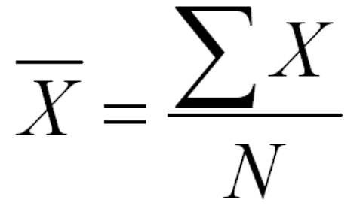

Introduction to Descriptive Statistics
2. Mean
Often called as average.
Mean formula:-
Where,
= sum of quantities
And N = number of quantities.
Example:
Q1. 2,3,6,7,8,9,7,2,4,7,7 find mean.
Mean = (2+3+6+7+8+9+7+2+4+7+7) / 11
Answer = 5.63

Slide 9
Introduction to Descriptive Statistics
To find Mean(using pandas):-
Q1. How well the class is performing?
Import necessary libraries.
import pandas as pd
2. import dataset.
df = pd.read_csv('Students.csv’)
3. Final step.
mean_data = df[‘Marks’].mean()
print(mean_data)
Therefore answer = 53.26

Slide 10
Outliers
Any value which falls outside the normal data range.
Example:
Q1. 2,3,6,7,8,9,7,2,4,7,150 find outlier.
Outlier = 150
Reasons for Outliers in the data:
Typos – Outliers during data collection. For example adding an extra zero by mistake.
Measurement error – Outliers in data due to measurement operator being faulty.
For example the weighing machine not working properly.
3. Intentional error – These are errors which are induced by people intentionally. For example teens might claim they’ve had a smaller amount of alcohol than they actually have.
4. Legit Outliers – These are values which are not actually errors but are in the data due to legitimate reasons. For example a CEOs salary might actually be very high as compared to other employees.

Slide 11
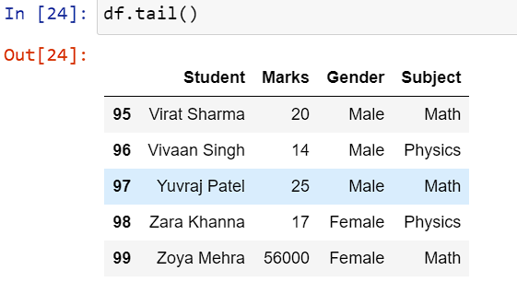
Outliers
Let's add an outlier to the data and observe the impact it has.
we can see that Zoya's mark is an outlier because marks are usually given out of 100.
Let's examine how the outlier affects our data –
Mean (before Outlier) = 53.26
Mean (after Outlier) = 612.7
Mode (before outlier) = 11
Mode (after Outlier) = 11

Slide 12
Outliers
Conclusion:
1. Mode is not significantly affected by the addition of a few new values, and is therefore considered robust.
However, Mode only shows the most frequently occurring value, so it may not accurately represent the data.
2. We can see that a single observation can significantly influence the mean, making it an unreliable metric.
How to summarize data when we have outliers?
To address the problem caused by outliers, we can introduce a new statistical measure called the median.

Slide 13
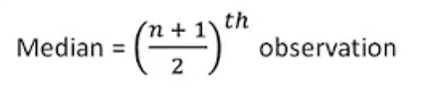
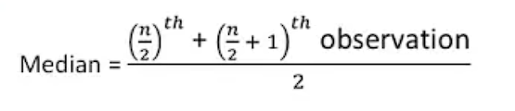
Introduction to Descriptive Statistics
3. Median
The Median is the middle value in a dataset when it is ordered.
Median formula (for an odd number of observations):-
Where, n = number of values
Median formula (for an even number of observations):-

Slide 14
Introduction to Descriptive Statistics
Example:-
Q1. 2,8,4,4,9,2,8,2,6. Find median.
- first arrange the data series in ascending or descending order.
i.e. 2,2,2,4,4,6,8,8,9
Here, we have odd numbers, so we can use the formula (n+1)/2.= 9 +1/2 = 5th element.
Answer = 4.
To find Median (using pandas):-
Import necessary libraries.
import pandas as pd

Slide 15
Introduction to Descriptive Statistics
2. import dataset.
df = pd.read_csv('Students.csv’)
3. Final step.
median_data = df[‘Marks’].median()
or
median_data = df['Marks'].quantile(0.5)
print(median_data)
Answer = 49.5

