Slide 1
PulseMind AI – Android Health Application
Innovative AI technology enhancing personal health monitoring
DiVYANSHU RATTI (100366564)
RACHHPAL SIDHU (100443829)
Nikita Gupta (100432739)
Notes:
AI-generated content may be incorrect. ---

Slide 2
Project Overview
Notes:
PulseMind AI: Smart Healthcare Companion

Slide 3
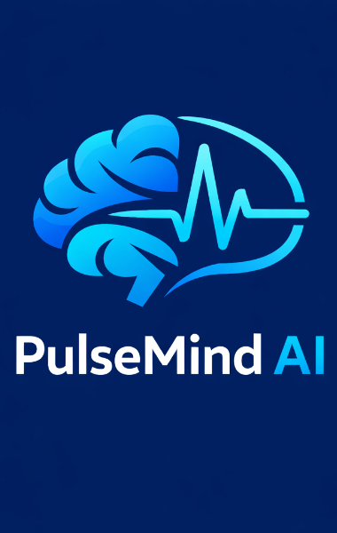
PulseMind AI: Smart Healthcare Companion
AI-Powered Health Assistance
PulseMind AI integrates artificial intelligence to provide timely symptom checking and health guidance for users.
User-Centered Design
The app features a clean, minimalistic interface with intuitive navigation to enhance user experience and accessibility.
Addressing Common Health Issues
PulseMind AI helps users manage challenges like finding clinics, tracking medications, and understanding medical reports.
Academic Project Development
Developed by a three-member team, the app balances technical completeness with practical usability for classroom and real-world use.
Notes:
--- PulseMind AI is a modern Android-based healthcare application designed to make essential health services more accessible, intelligent, and responsive for everyday users. The core idea behind PulseMind AI is to combine artificial intelligence with practical mobile features to support users in managing their health more efficiently. The app positions itself as a smart companion rather than a replacement for doctors, offering timely assistance, guidance, and emergency support when it matters most. Its slogan, “Because your health matters,” reflects a strong focus on user well-being and reliability. At its foundation, PulseMind AI addresses common problems faced by users such as difficulty understanding symptoms, delays in finding nearby clinics, forgetting medications, and handling medical reports. By integrating AI-powered symptom checking using Grok AI, the app allows users to input symptoms and receive preliminary insights that can guide their next steps. This reduces uncertainty and encourages informed decision-making without overwhelming users with medical jargon. The app is developed as part of an academic Android project by a three-member team: Divyanshu Ratti, Nikita Gupta, and Rachhpal Sohi. Each member contributed to designing, implementing, and testing different components of the application, ensuring both technical completeness and usability. The project emphasizes clarity, simplicity, and real-world relevance, making it suitable for classroom demonstration as well as practical evaluation. From a design perspective, PulseMind AI follows a clean and minimal visual style, using a light background and dark blue accent color to ensure readability and a professional appearance. The interface prioritizes spacing, alignment, and intuitive navigation so that users can quickly understand and access features. Overall, this project demonstrates how AI, mobile technologies, and thoughtful design can come together to create a meaningful healthcare solution that is simple to use, easy to present, and aligned with modern Android development practices. Image source: Uploaded

Slide 4
Application Purpose and Features
Notes:
Core Features and Functional Scope

Slide 5
Core Features and Functional Scope
Integrated Healthcare Platform
PulseMind AI offers a unified app for managing symptoms, emergencies, medications, and reports efficiently.
AI-Powered Symptom Checker
Grok AI analyzes symptoms to give preliminary health insights, aiding early understanding without replacing doctors.
Emergency SOS Feature
Quick SOS alerts share location and emergency messages to enable rapid help in urgent situations.
Nearby Clinics and Medication Support
Locator powered by maps APIs helps find nearby clinics and pharmacies; medication reminders boost adherence.
Notes:
The primary purpose of PulseMind AI is to provide users with a single, integrated platform for essential healthcare-related tasks. Instead of relying on multiple apps or manual processes, users can manage symptoms, emergencies, medications, and reports within one streamlined Android application. The feature set has been carefully selected to balance usefulness with simplicity, ensuring the app remains easy to navigate and present. One of the key features is the AI-powered symptom checker, which uses Grok AI to analyze user-input symptoms and provide preliminary health insights. This feature helps users better understand what their symptoms might indicate and whether further medical attention may be needed. While it does not replace professional diagnosis, it serves as a helpful first step and educational tool. Another critical component is the Emergency SOS feature. With a simple action, users can trigger an SOS alert that shares their location and sends emergency messages. This functionality is particularly valuable in urgent situations where quick communication can make a significant difference. The integration of location services enhances the reliability of this feature. PulseMind AI also includes a nearby clinics and pharmacy locator powered by Google Maps APIs. This allows users to quickly find healthcare facilities around them, saving time during both routine and emergency situations. Medication reminders ensure that users follow prescribed schedules, reducing missed doses and improving adherence. Additionally, the report scanner enables users to capture and store health reports using the device camera, making medical documentation more organized and accessible. Together, these features define the functional scope of PulseMind AI. They focus on real-world health needs, leverage modern APIs, and are implemented in a way that prioritizes clarity, speed, and user confidence.

Slide 6
Technical Architecture
Notes:
System Architecture Overview

Slide 7
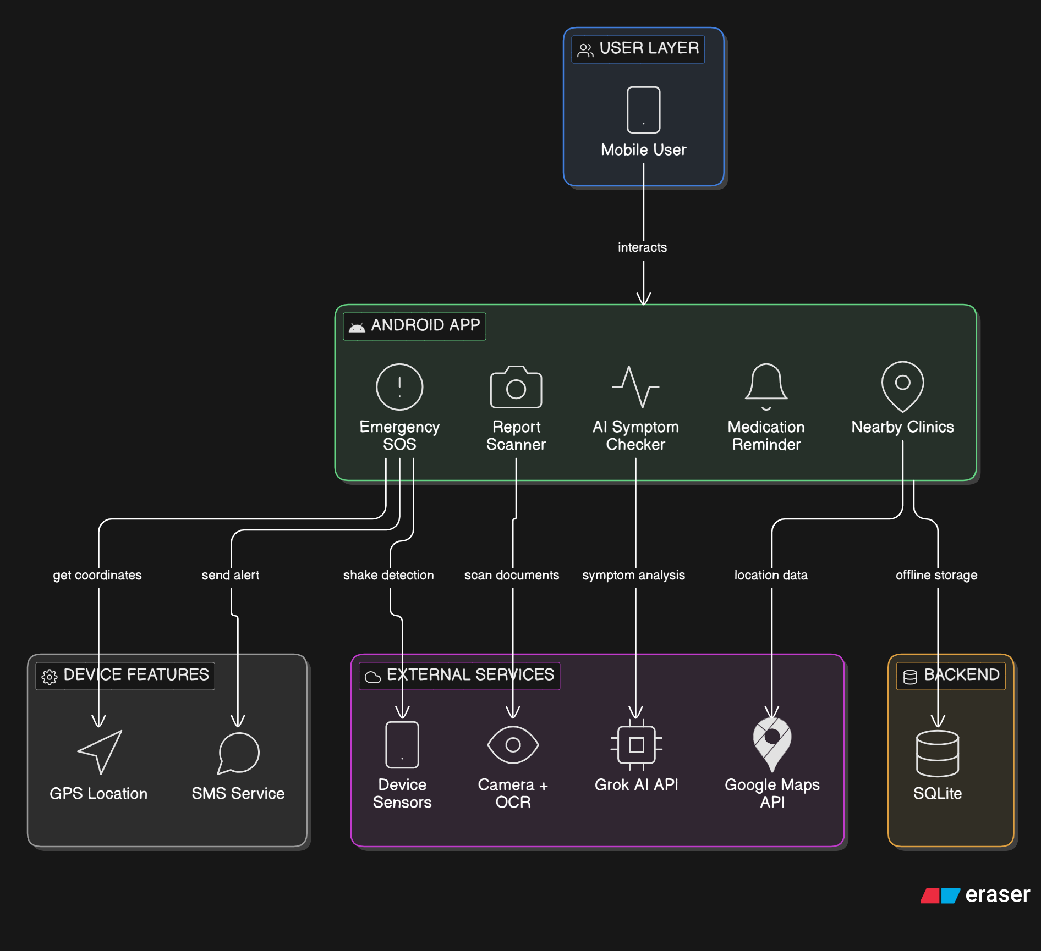
System Architecture Overview
Core Android Application
The Android app built with Kotlin and XML manages user interactions and local data efficiently within Android Studio.
SQLite Database Services
SQLite manages all application data locally, enabling secure, lightweight, and offline data storage directly within the Android device without reliance on cloud services.
AI and Location APIs
Grok AI API processes user symptom data for intelligent responses; Google Maps API offers real-time location services.
Notes:
The system architecture of PulseMind AI is designed to support smooth communication between the Android application and various backend and third-party services. At the center of the architecture is the Android app itself, developed using Kotlin and XML within Android Studio. This client-side application handles user interactions, UI rendering, and local data management while delegating complex processing and storage tasks to external services. Firebase plays a crucial role in the backend architecture. Firebase Authentication is used to manage secure user login and access control, ensuring that personal health-related data remains protected. Firestore and SQLite are used for structured data storage, allowing both cloud-based synchronization and local offline access when required. This hybrid approach improves reliability and user experience. For intelligent features, the app communicates with the Grok AI API. User-entered symptom data is sent securely to the AI service, which processes the input and returns meaningful responses to the app. Similarly, Google Maps APIs are integrated to provide real-time location-based services such as nearby clinics and pharmacies. Additional system components include SMS services for emergency alerts, device sensors for location tracking, and camera access for scanning health reports. All these components are coordinated through well-defined API interactions. In simple terms, the Android app communicates with APIs and Firebase services to deliver a responsive, secure, and feature-rich healthcare experience. This architecture supports scalability, modular development, and easy future enhancements.

Slide 8
Development and Technologies
Notes:
Implementation Tools and APIs

Slide 9
Implementation Tools and APIs
Android Development Environment
Android Studio and Kotlin provide a modern, safe, and concise development platform with XML for responsive UI layouts.
Date Storage
SQLite manage local data storage efficiently.
AI and Location APIs
Grok AI API powers symptom checking, while Google Maps API enables location-based discovery of clinics and pharmacies.
Additional Android Features
SMS, device sensors, and camera functionality enhance emergency communication, location tracking, and medical report scanning.
Notes:
The implementation of PulseMind AI relies on a modern Android development stack combined with reliable cloud and API services. Android Studio was used as the primary development environment, with Kotlin serving as the main programming language due to its safety features, concise syntax, and official support by Google. XML was used for UI layouts to maintain precise control over alignment, spacing, and responsiveness. Firebase Authentication was integrated to handle secure user sign-in and account management. This ensures that only authorized users can access sensitive features such as health data, reports, and SOS settings. For data storage, a combination of Firestore and SQLite was used. Firestore supports cloud-based storage and synchronization, while SQLite allows fast local data access and offline functionality. Artificial intelligence capabilities were implemented using the Grok AI API. This integration enables the symptom checker feature by sending user data to the AI service and receiving analyzed results. Location-based services were powered by the Google Maps API, allowing accurate discovery of nearby clinics and pharmacies. Additional Android system features were also utilized. SMS services enable emergency communication, device sensors provide location data, and the camera is used for scanning and saving medical reports. By combining these technologies, PulseMind AI demonstrates a comprehensive and practical implementation that aligns well with real-world Android application development standards.

Slide 10
User Interface Screens
Notes:
Login and Main Dashboard Screens

Slide 11
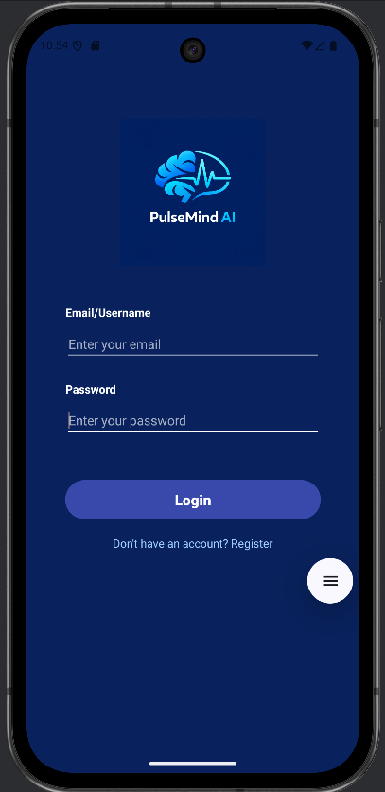
Login and Main Dashboard Screens
Login Screen Design
The login screen features a clean, focused layout with minimal input fields and clear labels to ensure quick and secure access.
Dashboard Layout
The main dashboard organizes key features like symptom checking and medication reminders with balanced spacing and easy navigation.
Visual Hierarchy and Usability
Effective use of alignment, contrast, and consistent colors enhances readability and prioritizes important actions.
Notes:
--- The login and main dashboard screens form the first impression of PulseMind AI and are designed with simplicity and clarity in mind. The login screen provides a clean and focused interface that allows users to securely access the application using Firebase Authentication. Minimal input fields, clear labels, and proper spacing help reduce cognitive load and make the process quick and intuitive. Once logged in, users are directed to the main dashboard, which serves as the central hub of the application. The dashboard presents key features such as symptom checking, SOS, nearby clinics, medication reminders, and report scanning in a well-organized layout. Icons and sections are evenly spaced to ensure visual balance and easy navigation. The design avoids overcrowding by limiting on-screen elements and using clear visual hierarchy. Important actions are emphasized, while secondary options remain accessible without distraction. The consistent use of a light background and dark blue accent color improves readability and maintains a professional look. From a usability standpoint, these screens demonstrate effective application of UI principles such as alignment, contrast, and consistency. For presentation purposes, the side-by-side display of the login and dashboard screens clearly shows the transition from authentication to core functionality, helping viewers quickly understand how users interact with the app from the very beginning. Image source: Uploaded

Slide 12
AI and Emergency Features
Notes:
AI Assistance and SOS Functionality

Slide 13
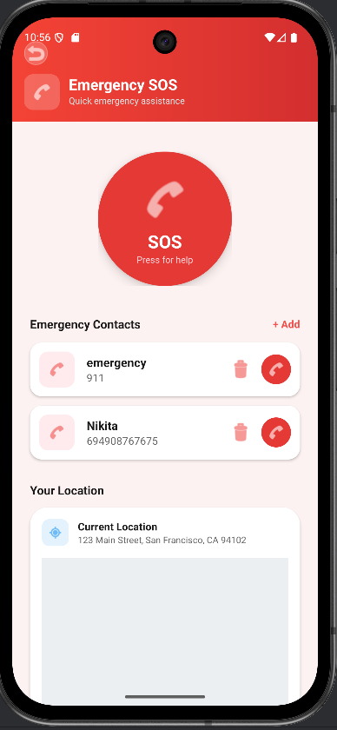
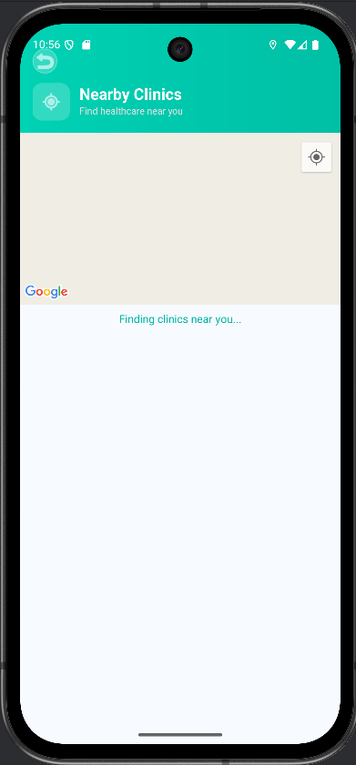
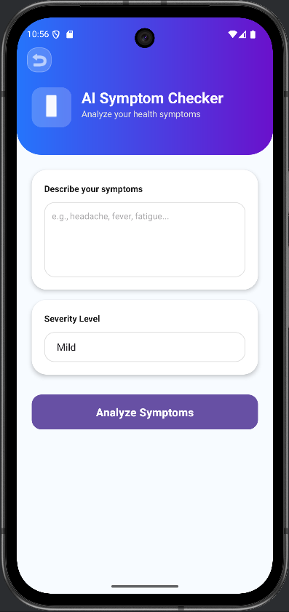
AI Assistance and SOS Functionality
AI Symptom Checker
The AI assistance screen enables users to input symptoms and receive clear, informative health guidance.
Nearby Clinics and Pharmacy
Google Maps integration shows nearby healthcare facilities based on user’s current location for quick access.
Emergency SOS Alert
The SOS screen allows users to quickly send emergency alerts with location data to predefined contacts.
Notes:
--- The AI and SOS features represent the most impactful and safety-focused aspects of PulseMind AI. The AI assistance screen allows users to interact with the symptom checker powered by Grok AI. Users can input symptoms in a simple, guided manner and receive informative responses that help them understand possible health concerns. The interface is intentionally minimal to keep the focus on user input and AI feedback. Complementing the AI feature is the nearby clinics and pharmacy functionality, which uses Google Maps integration to display healthcare facilities based on the user’s current location. This feature reduces the time and effort required to find medical help, especially in unfamiliar areas or urgent situations. The SOS screen is designed for speed and reliability. With a clear and prominent layout, users can quickly trigger an emergency alert. Once activated, the app sends SMS messages and location data to predefined contacts or services. The screen avoids unnecessary elements to prevent confusion during high-stress situations. Together, these features highlight how PulseMind AI combines intelligence with emergency preparedness. They demonstrate thoughtful design, practical use of APIs, and a strong focus on user safety, making them essential components to showcase in both academic and real-world evaluations. Image source: Uploaded

Slide 14
Health Management Tools
Notes:
Medication Reminders and Report Scanner

Slide 15
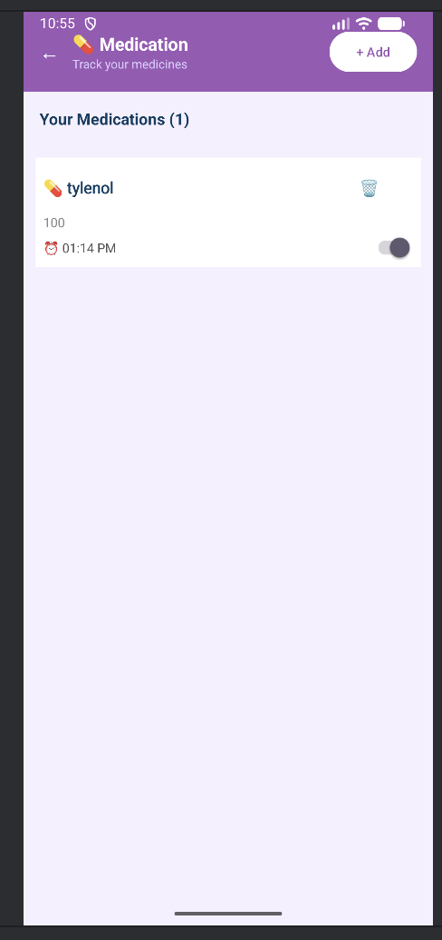
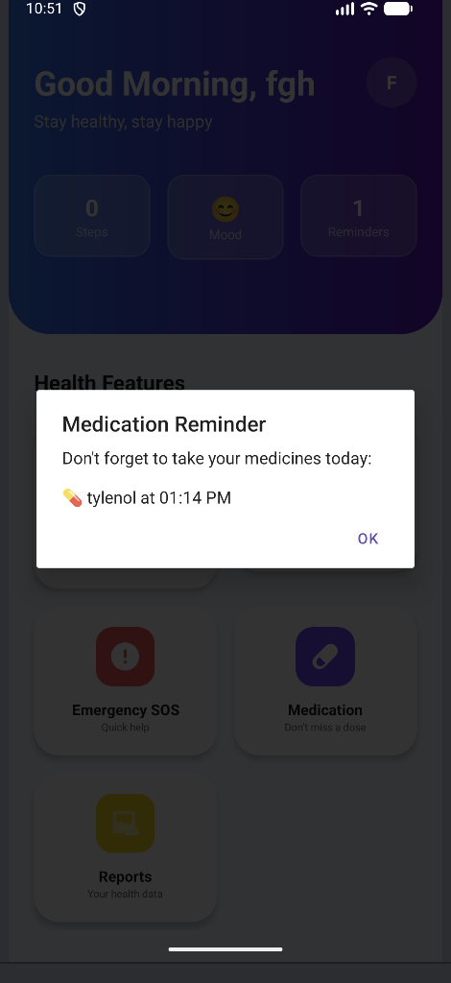
Medication Reminders
Medication Reminder Features
Allows setting clear, simple reminders to maintain consistent medication routines easily and effectively.
User-Friendly Interface Design
Prioritizes readability and ease of use, ensuring accessibility for all users including those less tech-savvy.
Comprehensive Health Support
Features demonstrate app’s role as a health companion beyond emergencies by supporting everyday health needs.
Notes:
--- The medication reminder and report scanner features focus on long-term health management and organization. The medication screen allows users to set reminders for prescribed medicines, helping them maintain consistent treatment routines. Clear labels, simple scheduling options, and uncluttered design ensure that users can manage medications without confusion. The report scanner feature uses the device camera to capture medical documents such as prescriptions, test results, or reports. Once scanned, these documents can be stored and accessed later within the app. This reduces the risk of losing important paperwork and makes it easier to share information during doctor visits. Both features are designed with practicality in mind. The interfaces prioritize readability and ease of use, especially for users who may not be highly tech-savvy. Visual consistency with the rest of the app ensures a smooth user experience. From a presentation perspective, showing these screens side by side clearly communicates the app’s ability to support ongoing healthcare needs. They demonstrate how PulseMind AI goes beyond emergency and AI features to provide everyday value, reinforcing its role as a comprehensive health companion. Image source: Uploaded

Slide 16
Quality Assurance
Notes:
Testing and Validation

Slide 17
Testing and Validation
Emulator-Based Testing
Android emulator testing simulated multiple devices and screen sizes to ensure compatibility and resolve layout issues early.
Core Feature Validation
Individual testing verified AI symptom checker, location services, medication reminders, and report scanner functionality.
API Integration Testing
Testing ensured smooth data flow and error handling for Grok AI, Google Maps, SMS, and SOS features.
Stable User Experience
Systematic validation confirmed app stability and reliability, reinforcing good software development standards.
Notes:
Testing was an essential phase in the development of PulseMind AI to ensure stability, reliability, and correct functionality. The application was tested extensively using the Android emulator to simulate different devices and screen sizes. This helped identify and resolve layout issues, performance concerns, and compatibility problems early in the development process. Each core feature was individually tested to confirm expected behavior. The AI symptom checker was validated to ensure proper API communication and accurate display of responses. Location-based services were tested to verify correct detection of nearby clinics and pharmacies. Medication reminders were checked for timely notifications, and the report scanner was tested for image capture and storage reliability. API integrations, including Firebase services, Grok AI, Google Maps, and SMS functionality, were tested to ensure smooth data flow and error handling. Special attention was given to the SOS feature, verifying that emergency messages and location data were sent correctly. Overall, testing confirmed that the app functions as intended and provides a stable user experience. This systematic validation process strengthens confidence in the project and demonstrates adherence to good software development practices suitable for academic evaluation.

Slide 18
Project Summary
Notes:
Conclusion and Future Scope

Slide 19
Conclusion and Future Scope
Unified Healthcare Platform
PulseMind AI integrates symptom analysis, emergency support, location, medication, and reports into one easy platform.
User-Centered Design
The app features a clean, simple interface designed for ease of use and effective presentation in classrooms.
Future Enhancements
Future improvements include wearable integration, advanced AI for better symptom analysis, and telehealth consultation features.
Project Significance
PulseMind AI demonstrates a balanced Android app combining design, functionality, and technical depth with real user impact.
Notes:
PulseMind AI successfully demonstrates how modern Android development, cloud services, and artificial intelligence can be combined to create a practical healthcare application. The project improves access to essential health tools by bringing symptom analysis, emergency support, location services, medication management, and report organization into a single, easy-to-use platform. The application is intentionally designed to be simple, fast, and useful. Its clean interface, consistent spacing, and minimal content make it easy to present in a classroom setting while still showcasing meaningful technical depth. Each feature addresses a real user need, reinforcing the relevance of the project beyond academic requirements. Looking ahead, there are several opportunities for future enhancement. Integration with wearable devices could enable real-time health monitoring. More advanced AI models could improve symptom analysis accuracy and personalization. Telehealth features such as in-app consultations could further expand the app’s usefulness. In conclusion, PulseMind AI reflects a well-rounded Android app project that balances design, functionality, and technology. It highlights the team’s ability to plan, implement, test, and present a professional-grade application focused on user health and safety.

