Slide 1

School of Computer Science and Engineering
Department of Computer Science and Engineering
Hand&Brain
Submitted By:
Divyanshu Saini
23FE10CSE00278
Supervised By:
Dr Ankit Shrivastava
Hand&Brain — Personalized Stock Trading Assistant | Divyanshu Saini
1

Slide 2


Table of Contents
    Introduction
    Literature Review
    Problem Statement
    Objectives
    Proposed Methodology
    Result
    References
Hand&Brain — Personalized Stock Trading Assistant | Divyanshu Saini
2

Slide 3


Introduction - The Challenge
Challenges
🔹Benefits Of The Solution
Generic Approaches:
    Most retail investors use generic tools that lack personal context.
    These tools often ignore individual risk assessment.
    Limited Actionability:
    Existing models primarily focus on predicting price movements.
    They often fail to provide personalized, actionable trading advice.
    This results in a lack of customized trading decisions.
    Personalization Gap:
    Current systems overlook user-specific factors like investment capital.
    They disregard individual risk tolerance.
    The investment horizon of the user is also frequently ignored
Generic Approaches
Limited Actionability
Personalization Gap
🔹Potential Impact on Target Audience
    Our Aim: To design and develop Hand&Brain, a personalized stock trading assistant.
    Core Idea: Merge the predictive power of deep learning models with user-specific financial profiles.
    The Goal: Deliver actionable, customized, and risk-aware trading recommendations.
Hand&Brain — Personalized Stock Trading Assistant | Divyanshu Saini
3

Slide 4


Literature Review
Model | Strength | Reported Accuracy | Remarks
LSTM | Sequential Learning | ~89% | Good for time series
CNN-LSTM | Combines Spatial & Temporal Features | ~92% | Best with RSI, MACD indicators
Transformer | Long-term Forecasting | ~95% | High potential, but complex
🔹Literature Review: Existing Models
    Machine Learning: SVM, Random Forest, and XGBoost are effective for feature-driven classification tasks.
    Deep Learning: Models like LSTM, CNN, and Transformers excel at sequential data and time-series forecasting.
    🔹Conclusion: The CNN-LSTM model offers the best balance of accuracy, interpretability, and computational efficiency for this task.
You can see the full paper here
https://www.overleaf.com/read/gybcknjhhrjx#5fa0de
Hand&Brain — Personalized Stock Trading Assistant | Divyanshu Saini
4

Slide 5

Problem Statement
Current stock prediction tools fail to provide personalized, risk-aware investment recommendations that are aligned with an individual investor's financial profile and goals.
Hand&Brain — Personalized Stock Trading Assistant | Divyanshu Saini
5

Slide 6

Objectives
Project Objectives:-
    To analyze and compare various ML/DL models for stock market forecasting.
    To develop a CNN-LSTM-based prediction model using technical indicators (RSI, MACD).
    To design a data pipeline for fetching and preprocessing live stock data from APIs.
    To predict next-month stock trends using 6 months of historical data.
    To lay the groundwork for personalized recommendations based on user risk and capital.
Hand&Brain — Personalized Stock Trading Assistant | Divyanshu Saini
6

Slide 7

Proposed Methodology
Data Collection
    Data Collection: Fetch live stock data for Indian markets (.NS, .BO) using yfinance and Alpha Vantage APIs.
    Data Preprocessing: Clean data, handle missing values, and normalize prices.
    Generate technical indicators: RSI, MACD, Moving Averages, Bollinger Bands.
    Model Training & Prediction: Implement a CNN-LSTM model for time-series prediction.
    Input: 6 months of historical data (price, volume, indicators).
    Output: Next-month price movement forecast.
    Evaluation: Measure performance using metrics like RMSE, MAE, and Accuracy.
Data Preprocessing
Feature Engineering
Model Training (CNN-LSTM)
Prediction
Evaluation
Hand&Brain — Personalized Stock Trading Assistant | Divyanshu Saini
7

Slide 8
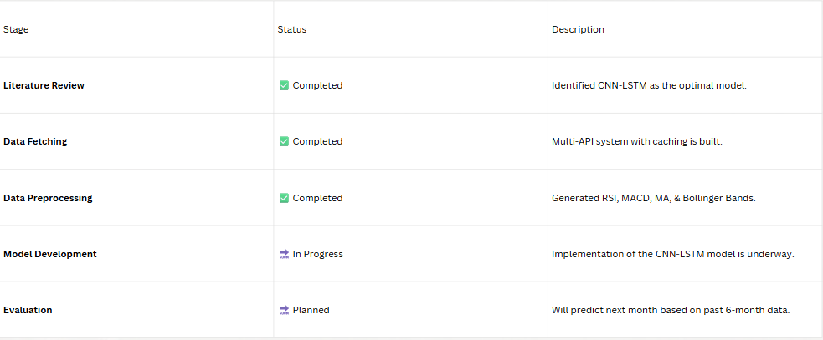
Current Status
Hand&Brain — Personalized Stock Trading Assistant | Divyanshu Saini
8

Slide 9
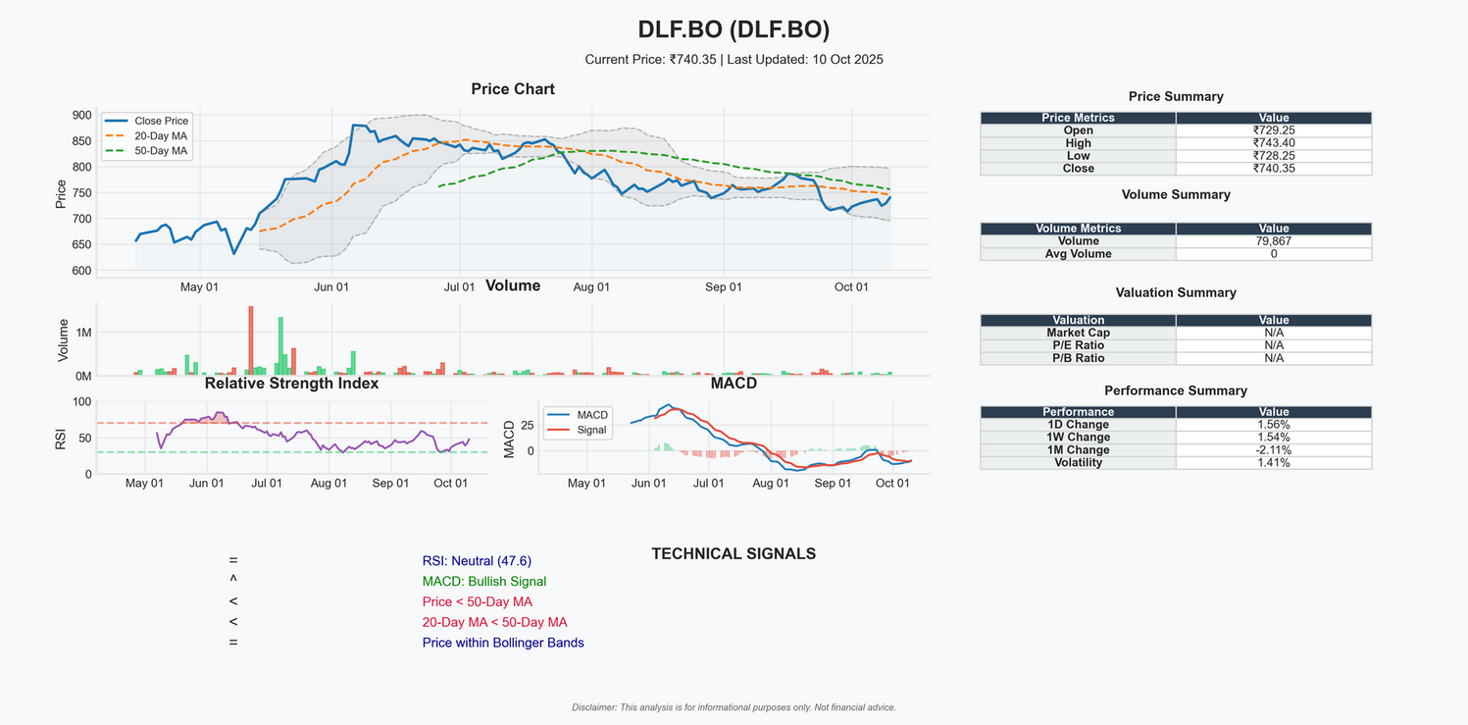

Expected Result
    Model Accuracy: Achieve a predictive accuracy of approximately 92% with the CNN-LSTM model.
    Error Metrics: Target a low Root Mean Square Error (RMSE) of around 0.15.
    Practical Outcome: A reliable forecasting tool for short- to medium-term trades.
*Actual image of the result of the code (Fetches Data)
Github Link
https://github.com/DivyanshuSaini2112/Hand-Brain-AI-Stock-Assistant
Hand&Brain — Personalized Stock Trading Assistant | Divyanshu Saini
9

Slide 10

References
    Fischer, T., & Krauss, C. (2018). Deep learning with LSTM networks for stock return prediction. European Journal of Operational Research.
    Saini, A. (2025). A Comparative Review of Machine Learning and Deep Learning Models for Stock Market Price and Trend Prediction. [Journal/Conference Name].
    Yahoo Finance API Documentation. Retrieved from https://python-yahoofinance.readthedocs.io/en/latest/api.html
    Zhang, Y. et al. (2023). Deep Learning Models for Stock Price Prediction. Journal of Finance and Data Science.
    Alpha Vantage API Documentation.
Hand&Brain — Personalized Stock Trading Assistant | Divyanshu Saini
10

Slide 11
Thank You
Hand&Brain — Personalized Stock Trading Assistant | Divyanshu Saini
11

