Slide 1

INVEST IN BLUE GOLD

Slide 2
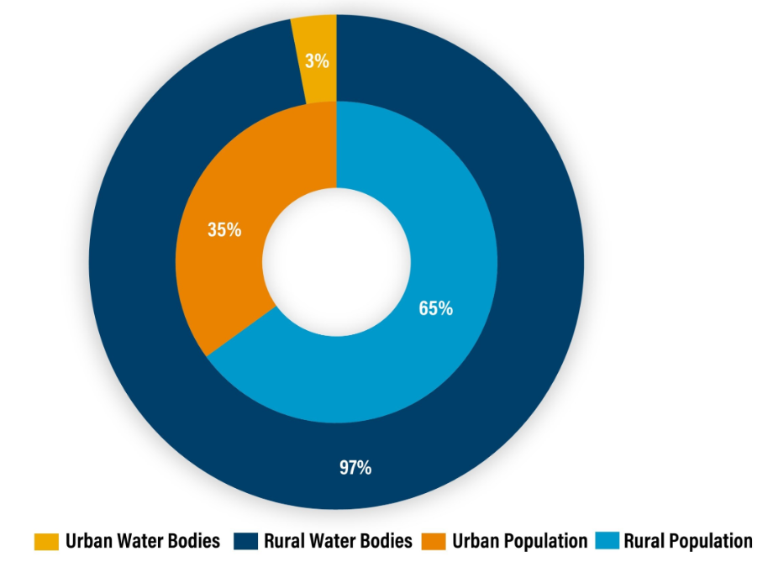
India is facing its worst water crisis ever, with nearly 600 million people facing high to extreme water stress. The situation has worsened to the point where India ranked 120 out of 122 countries in the water quality index (NITI Aayog 2019).
The average annual water availability per person is expected to decrease from 1,486 cubic meters in 2021 to 1,367 cubic meters by 2031. According to the Water Resources Ministry, levels below 1,700 cubic meters indicate water stress, while 1,000 cubic meters mark the point of water scarcity.
About 70 percent of India’s surface water is polluted. The main causes of this pollution include wastewater from various sources, intensive farming, industrial activities, infrastructure development, and untreated runoff from urban areas.
Source: 1, 2, 3, 4

Slide 3
Key Trends
Indian Government's water centric initiatives
The Central Pollution Control Board (CPCB) estimates that India generates approximately 72,368 million liters per day (MLD) of wastewater, of which only 20 to 30% receives treatment.
NITI Aayog, plans to tackle the challenge by building desalination plants along India's 7,800-km coastline. Running on solar or ocean-drawn power, the floating plants will also be energy-efficient.
Recycle and Reuse: Five states in India - Tamil Nadu, Karnataka, Maharashtra, Haryana and Gujarat - have come up with a state-level reuse policy, aiming at 70% reuse of treated wastewater by 2030.
Water net neutrality: It will enable industries to offset their water consumption by purchasing credits to be invested in water efficiency efforts and extended clean water availability (similar to a carbon credit/offset programs)
Emerging Industries/Ultra Pure water: Some new industries like - Semiconductor, Green Hydrogen, Pharma, stringent norms in Food & Beverage - is creating a market for ultra pure water.
Soucre: 1, 2, 3, 4, 5

Slide 4
Sector wise projected water demand in India
Units in bcm (billion cubic meters)
Sector | 2010 |  | 2025 |  | 2050
Irrigation | 543 | 557 | 561 | 611 | 628 | 807
Drinking Water | 42 | 43 | 55 | 62 | 90 | 111
Industry | 37 | 37 | 67 | 67 | 81 | 81
Energy | 18 | 19 | 31 | 33 | 63 | 70
Other | 54 | 54 | 70 | 70 | 111 | 111
Total | 694 | 710 | 784 | 843 | 973 | 1180
Source: click here

Slide 5
WATER CAPEX IN INDIA
In Budget FY24 earmarked 1.07 lakh crore towards water and related infrastructure under six different schemes, an increase from 383,525 crore In FY23 and 91,567 crore in FY22.
Tap water to every rural household (Jal Jeevan Mission) ₹70,000 crore
Drip irrigation (Pradhan Mantri Krishi Sinchai Yojana) ₹10,787 crore
Groundwater management (Atal Bhujal Yojana) ₹1,000 crore
₹1,06,727 crore Centre’s outlay for water schemes FY24
Rejuvenation of water bodies/ sewage treatment (AMRUT 2.0& Swachh Bharat Mission)
₹21,000 crore
Cleaning river Ganga (Namami Gange) ₹3,940 crore
Source: click here

Slide 6
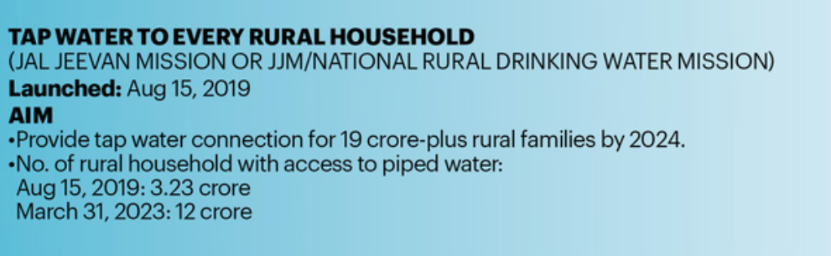
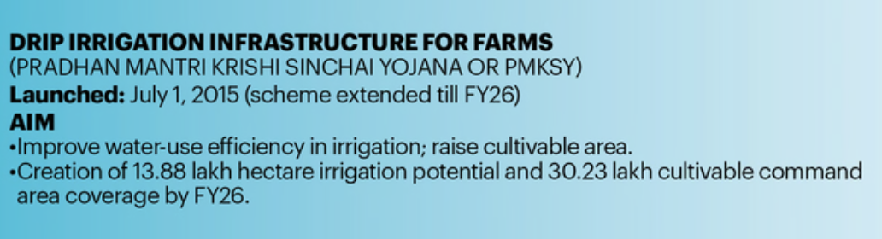
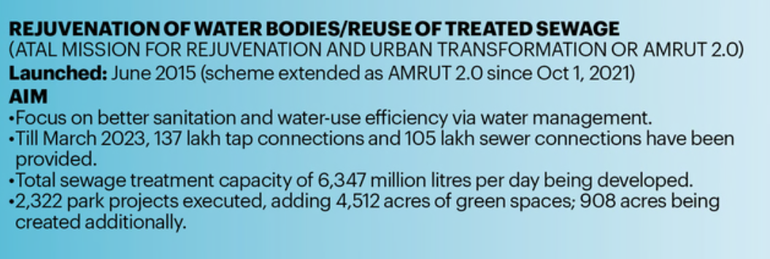
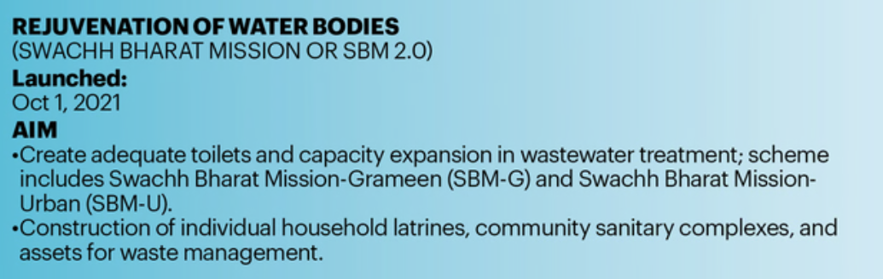
Government Schemes
Source: click here

Slide 7
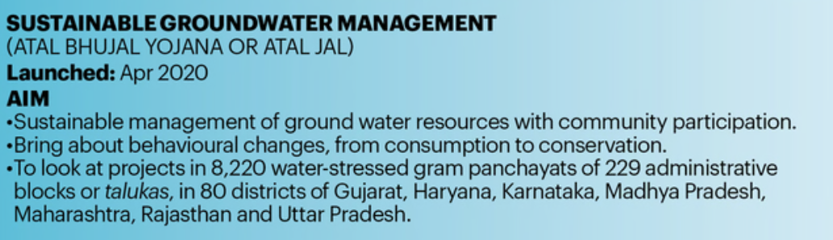
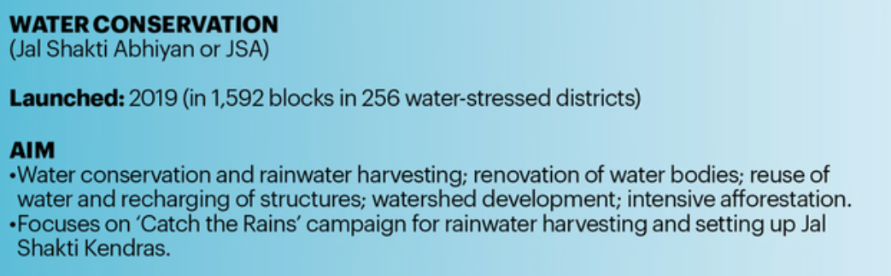
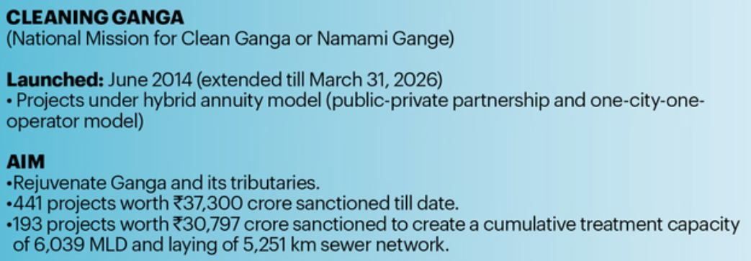
Government Schemes
Source: click here

Slide 8



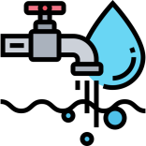










WATER RISKS & RELATED IMPLICATIONS
570 BCM Expected water demand – supply gap of up by 2030 in Agriculture sector
Virtual water export adds to the problem – export 37 lac tonnes of Basmati rice alone costed india 10 trillion liters of water in 2014 - 15
5 of the world’s largest cities under water stress present in india. Delhi ranks second on the list
Industries expected to draw 3X water compared to their actual consumption by 2030
Shutdowns possible as states prioritize irrigation and household needs and fail to provide water to industries
Water-intensive industries such as Food & Beverages, Textile and paper & paper products likely to be worst affected
40% of India's thermal power plant located in water scare regions
70% of India's thermal power plant expected to face high water stress by 2030
30% of Indian land is degraded or faces desertification
Water erosion largest cause of desertification and is responsible for 11% of total desertification
Cost of land degradation estimated at 2.1% of India's 2014-2015 GDP
Source: click here

Slide 9
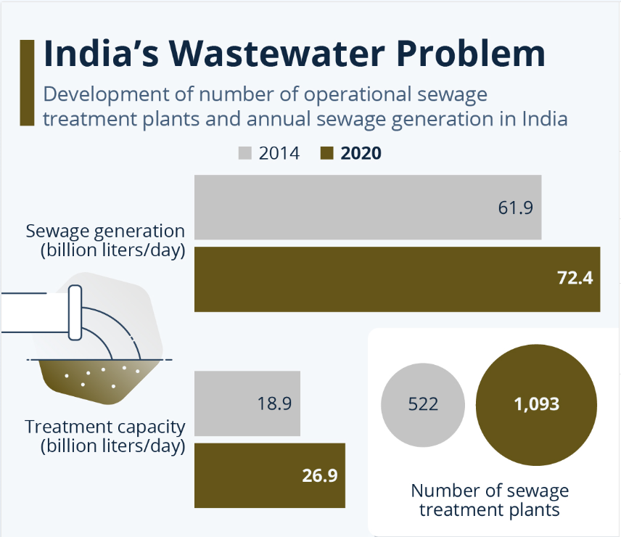
India’s Wastewater Problem
Sewage treatment plants (STPs) in India are able to treat a little more than a third of the sewage generated per day, according to the latest report of the Central Pollution Control Board (CPCB).
India generated 72,368 MLD (million liters per day) whereas the installed capacity of STPs was 31,841 MLD (43.9%), according to the report.
Of this installed capacity, developed and operationalized capacity was 26,869 MLD (84%). Of the total operationalized capacity, 20,235 MLD (75%) was the actual utilized capacity.
In other words, out of total 72,368 MLD sewage generated every day, only 20,235 MLD is treated which is just 28%.
Source: click here

Slide 10
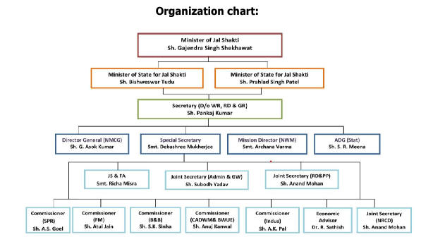
Hierarchical Chart
Source: click here

Slide 11
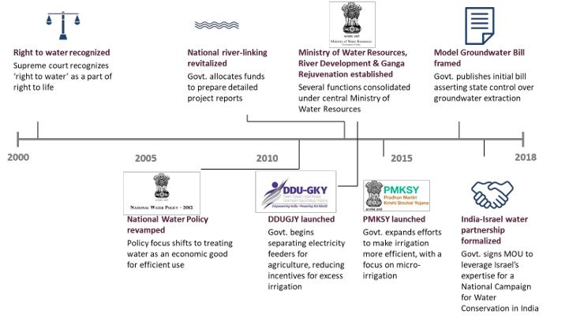
Water policy timeline in india (non exhaustive)
Source: click here

Slide 12
Global Investments in water sector
Investing in water-related stocks, including companies focused on water treatment, engineering, filtration, environmental controls, and utility services, allows investors to diversify their portfolios and tap into a sector with promising growth potential. This approach not only aligns with sustainable investing principles but also aims for long-term value creation. Recent performance data shows that water-related mutual funds and ETFs have delivered impressive average returns of 45.7% over the past year, outpacing the S&P 500 Index, which recorded returns of 40.3%.
Listing of equity thematic water-related funds and their sustainable investing approach
Fund Name | MF/ETF | Active/Passive | Geographic Mandate | Explicit Sustainable Investing Approach
Calvert Global Water C | MF | P | G | ESG Integration Mixed
Virtus AllianzGI Water Class C | MF | A | G | ESG Integration-Mixed (1)
Calvert Global Water A | MF | P | G | ESG Integration Mixed
Virtus AllianzGI Water Class A | MF | A | G | ESG Integration-Mixed (1)
KBI Global Investors Aquarius Instl | MF | A | G | ESG Integration
Fidelity® Water Sustainability | MF | A | G | None
Calvert Global Water I | MF | P | G | ESG Integration-Mixed
Virtus AllianzGI Water Class P | MF | A | G | ESG Integration-Mixed (1)
Virtus AllianzGI Water Inst Class | MF | A | G | ESG Integration-Mixed (1)
Invesco Global Water ETF | ETF | P | G | None
Invesco Water Resources ETF* | ETF | P | US Listed | None
Invesco S&P Global Water ETF | ETF | P | G | None
Source : Click here

Slide 13
Listing of equity thematic water-related funds, expenses, AUM and performance records
Fund Name | MF/ETF | Expense Ratio (%) | Assets ($millions) | 1-Month Return (%) | 12-M Return (%) | 3-YR Return (%) | 5-YR Return (%)
Calvert Global Water C | MF | 1.99 | 42.6 | 1.43 | 45.71 | 12.94 | 11.41
Virtus AllianzGI Water Class C | MF | 1.97 | 70 | 2 | 40.68 | 15.94 | 11.95
Calvert Global Water A | MF | 1.24 | 239.5 | 1.49 | 46.82 | 13.78 | 12.25
Virtus AllianzGI Water Class A | MF | 1.22 | 270.7 | 2.08 | 41.72 | 16.81 | 12.79
KBI Global Investors Aquarius Instl | MF | 1.1 | 175.5 | 2.59 | 52.8
Fidelity® Water Sustainability | MF | 1 | 55.5 | 1.71 | 40.2
Calvert Global Water I | MF | 0.99 | 266.9 | 1.52 | 47.17 | 14.09 | 12.59
Virtus AllianzGI Water Class P | MF | 0.94 | 318.7 | 2.12 | 42.22 | 17.14 | 13.1
Virtus AllianzGI Water Inst Class | MF | 0.93 | 293.7 | 2.12 | 42.19 | 17.15 | 13.11
Invesco Global Water ETF | ETF | 0.75 | 281 | 3.15 | 39.19 | 17.2 | 14.18
Invesco Water Resources ETF* | ETF | 0.6 | 1661.4 | 1.71 | 45.11 | 20.92 | 18.51
Invesco S&P Global Water ETF | ETF | 0.57 | 944.3 | 2.92 | 46.25 | 18.21 | 14.6
First Trust Water ETF | ETF | 0.54 | 996.3 | 1.28 | 50.41 | 20.79 | 19.74
Global X Clean Water ETF* | ETF | 0.5 | 3.2 | 2.58
Ecofin Global Water ESG* | ETF | 0.4 | 42.6 | 2.58 | 47.8 | 17.95
Source : Click here

Slide 14
India's water sector
The Indian water market is valued at approximately $14 billion and is projected to expand at a compound annual growth rate (CAGR) of 6.1%, reaching around $19.8 billion by 2030. Of this total, about 75% is used for agriculture, 7% for drinking water, 4% for industrial purposes, and 9% for energy production.
Growth rate of water sector and its segments (across 2025-30)
Sectors/segment | Estimated size currently | Estimated growth rate
Capital Goods/EPC Companies | $2.3 billion | 9.5%
Ductile Pipes Market | $4.2 billion | 7.5%
Wastewater Treatment Market | $2.3 billion | 6.2%
Overall Water Market | $14 billion | 6.1%
Water Chemical Market | $1.6 billion | 5.4%
India's water sector presents significant investment opportunities, primarily categorized into four key areas: Ductile Iron Pipes, Engineering, Procurement, and Construction (EPC) services, Water Treatment solutions, and Capital Goods/Equipment. These sectors play a crucial role in addressing the country's growing water challenges and improving infrastructure, making them attractive for investors looking to engage in this vital market. Each category offers unique potential for growth and innovation, contributing to the overall development of sustainable water management in India.
Source : click here

Slide 15
Water investment opportunities
Ductile Iron Pipes
EPC services
Water Treatment solutions
Capital Goods/Equipment

Slide 16
Few Listed companies which will benefit
EPC plays and Water Treatment
Capital Goods/ Equipment
Ductile Iron Pipes
Jindal Saw Ltd.
Electrosteel Castings Ltd.
Welspun Corp Ltd
Jai Balaji Industries Ltd.
VA Tech Wabag Ltd.
EMS Ltd.
Ion Exchange Ltd.
NCC Ltd.
ITD Cementation Ltd.
Larsen & Toubro Ltd.
Gayatri Projects Ltd.
Simplex Infrastructures Ltd.
Jash Engineering Ltd.
KSB Ltd.
WPIL Ltd.
Thermax Ltd.
Kirloskar Brothers Ltd.
Wilo Mather and Platt Pvt. Ltd.
V-Guard Industries Ltd.

Slide 17
Recommended area to invest
Investing in the Engineering, Procurement, and Construction (EPC) sector, particularly within the water industry, presents a compelling opportunity for several reasons. The EPC business plays a critical role in the development of essential infrastructure, and its significance is amplified in a country like India, where water management is increasingly vital due to rapid urbanization and population growth.
Key Reasons to Invest in EPC Water Sector
Growing Demand for Water Infrastructure: With India facing challenges such as water scarcity and pollution, there is an urgent need for efficient water supply and wastewater management systems. EPC companies are at the forefront of designing and implementing these projects, making them essential players in addressing the country's water crisis.
Government Initiatives: The Indian government has launched numerous initiatives aimed at improving water infrastructure, such as the Namami Gange program and various urban development schemes. These initiatives promise significant funding and support for EPC projects, ensuring a robust pipeline of opportunities.
Technological Advancements: The EPC sector is embracing innovative technologies such as smart water management systems, advanced treatment solutions, and automation. Investing in companies that leverage these technologies not only enhances efficiency but also aligns with sustainability goals, attracting more investments.
Long-term Contracts and Revenue Stability: EPC projects typically involve long-term contracts with guaranteed revenue streams. This stability can provide a cushion against market volatility, making EPC companies more resilient during economic downturns.
Diversification Potential: Investing in EPC firms allows for diversification within the water sector. These companies often engage in a range of projects—from water treatment plants to pipeline construction—reducing reliance on any single segment.
Environmental and Social Impact: The EPC sector is integral to creating sustainable water solutions that positively impact communities. By investing in these companies, you're not just seeking financial returns; you're also contributing to environmental stewardship and social well-being.
Attractive Growth Prospects: With projections indicating substantial growth in the water sector, particularly in developing economies like India, EPC companies are well-positioned to capitalize on this upward trajectory. Their ability to secure new projects can lead to significant revenue growth and enhanced shareholder value.

Slide 18
Major players in the EPC business
Companies | Market cap in ₹ crore | Revenue in ₹ crore | % of total revenue from water | ROE | 3-year price CAGR | P/E
L&T Technology Services | 47,533 | 8,679 | NA | 25.8% | 19.3% | 37.0x
K E C International | 20,473 | 19,914 | NA | 8.8% | 23.5% | 55.7x
Kalpataru Projects International | 20,202 | 19,626 | 16.0% | 10.4% | 42.6% | 36.4x
NCC | 18,098 | 20,845 | 21.0% | 11.4% | 50.1% | 24.3x
Triveni Engineering | 7,704 | 5,220 | 3.0% | 14.2% | 34.6% | 18.0x
Va Tech Wabag | 6,209 | 2,849 | 100.0% | 14.5% | 52.2% | 23.1x
Patel Engineering | 5,257 | 4,544 | 74.0% | 7.3% | 64.3% | 21.7x
EMS | 2,491 | 700 | 100.0% | 24.8% | NA* | 16.1x
Jash Engineering | 2,879 | 516 | 68.0% | 22.6% | 79.8% | 38.6x
Average | 14,538 | 9,210 | 54.6% | 15.5% | 45.8% | 30.1x
Units are Listed on Sept 23; as on 31st May, 2024
Source : click here

Slide 19
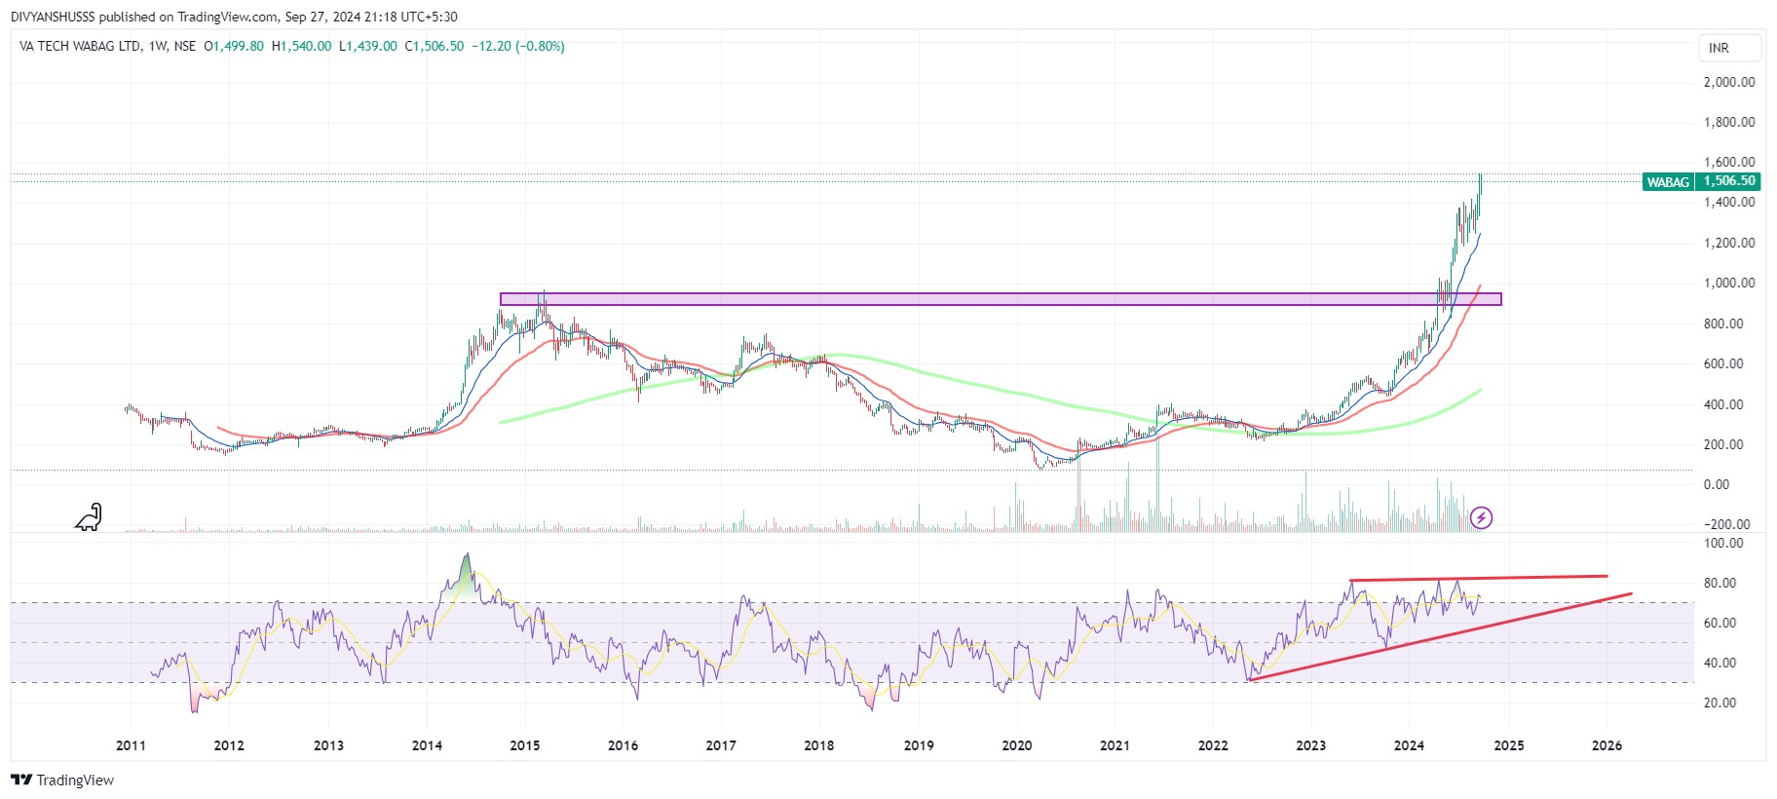
Stocks in which I Invest as per the theme
VA Tech Wabag Ltd
Technical Analysis
Technically it’s looking good at weekly time frame
creating price action (HH,HH)
Above from all moving average (20,50,200)
Recently broke it’s previous seller zone
Consolidation of volume at higher level
RSI is above 70 which is good
Source : Trading view, Stock edge, screener

Slide 20
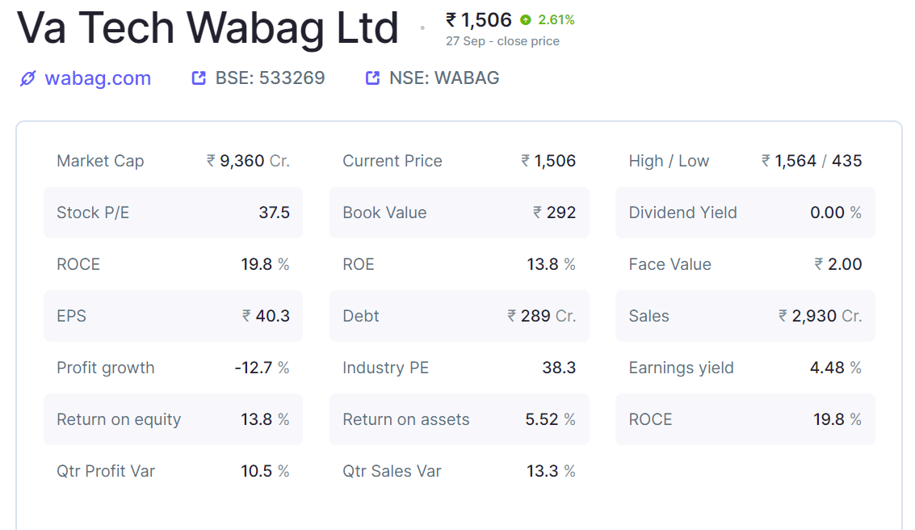
Va Tech Wabag Ltd is engaged in the business of water treatment field. Its principal activities include design, supply, installation, construction and operational management of drinking water, waste water treatment, industrial water treatment and desalination plants.
The company offers solutions for drinking water treatment, industrial water & wastewater treatment, desalination of sea & brackish water, sludge treatment, recycling, etc. It has a presence across the entire value chain of water solutions including design, procurement, construction, installation, commissioning, and operations & maintenance (O&M).
company has executed 6,500+ municipal and industrial projects across 25+ countries benefiting 88+ million people.
The company is ranked the third largest private water operator in the world and among the Top 5 Global Desalination players by Global Water Intelligence, UK.
As of FY24, the company's order book stands at Rs. ~11,400 Cr (56% EPC and 44% O&M), growing from Rs. ~10,100 Cr in FY22. 89% of orders come from municipal projects, and the remaining 11% are from industrial projects. India accounts for 67% of the order book, followed by ROW (33%).
Key Clients Municipal- CIDCO, BUIDCO, Delhi Jal Board, Dhaka Wasa, Uttar Pradesh Jal Nigam etc. Industrial- Reliance, ONGC, Petronas, Indian Oil, NMDC, Pepsico, etc.
Fundamental Analysis
Company having good order book
Ratios are looking good (profit growth is in negative but this is only a turbulence in these kind of capital intense business
Company having debt but it can be ignored if we compare with sales
Company having experience to handle big projects (like Namami Gange Programme etc)
If government took any decision regarding water treatment so, they are the key player standing in the line.
Company has delivered good profit growth of 21.3% CAGR over last 5 years
Source : Trading view, Stock edge, screener

Slide 21
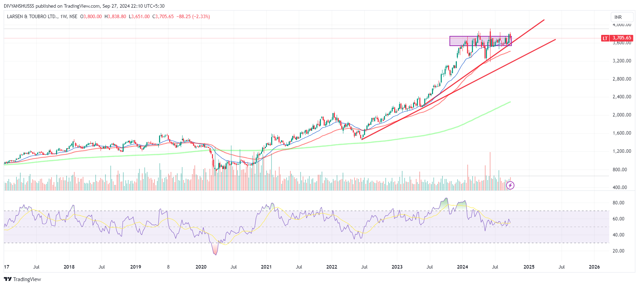
Larsen & Toubro Ltd
Technical Analysis
Technically it’s looking good at weekly time frame
creating price action (HH,HL)
Above from all moving average (20,50,200)
Consolidation of price at higher level
RSI is in between 50 to 70 which is good
Stock is ready for good up move
Source : Trading view, Stock edge, screener

Slide 22
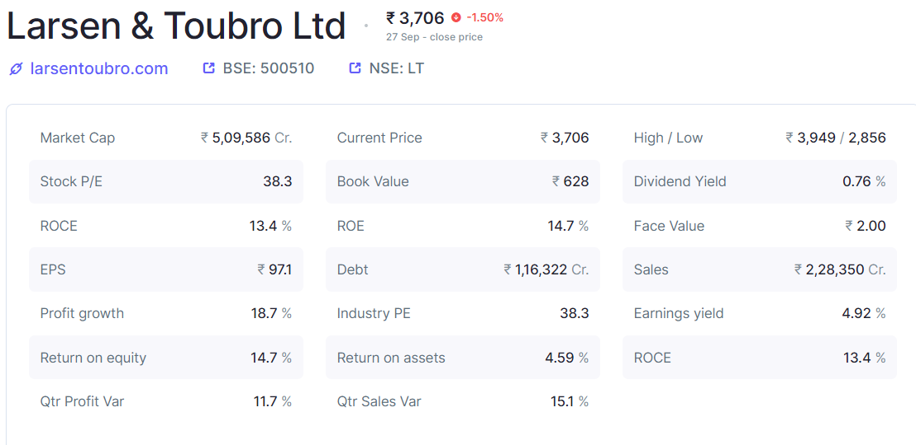
Fundamental Analysis
Larsen & Toubro Ltd is a multinational conglomerate which is primarily engaged in providing engineering, procurement and construction (EPC) solutions in key sectors such as Infrastructure, Hydrocarbon, Power, Process Industries and Defence, Information Technology and Financial Services in domestic and international markets.
Company is diversified in various segment their revenue is also diversified Infrastructure Segment (51% of revenues), Hydrocarbon Segment (13% of revenues), ower Segment (3% of revenues), Defence Engineering Segment (7% of revenues), Heavy Engineering Segment (2% of revenues), Others (4% of revenues)
Their order book is good As of FY23, company has a record-high order book of ~Rs 4 trillion, with Rs 2 trillion+ Order Inflow in FY23 (19% higher vs FY22). Out of these, 62% is Domestic, 16% from USA & Europe, 19% from middle east and 3% from ROW.
Company has been maintaining a healthy dividend payout of 34.6%
Company's working capital requirements have reduced from 55.8 days to 30.6 days
Company having good order book
Ratios are looking good
Company having debt but it can be ignored if we compare with sales
Their delivery of and trading volume is good
Company has diversified business so, they maintained consistency in growth
Their return on equity is good
If government took any decision regarding water treatment so, they are the key player standing in the line.
Source : Trading view, Stock edge, screener

Slide 23
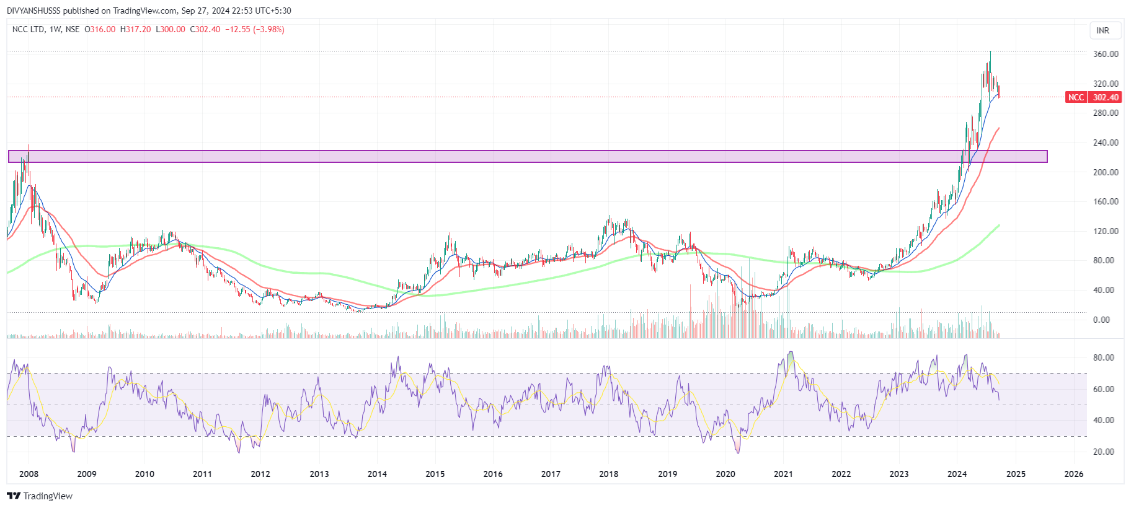
NCC LTD.
Technical Analysis
Technically it’s looking good at weekly time frame
creating price action (HH,HL)
Above from all moving average (20,50,200)
Consolidation of price at higher level
At higher level stock is giving pullback
RSI is in between 50 to 70 which is good
Stock has recently given breakout to its previous strong seller zone
Stock is ready for good up move
Source : Trading view, Stock edge, screener

Slide 24
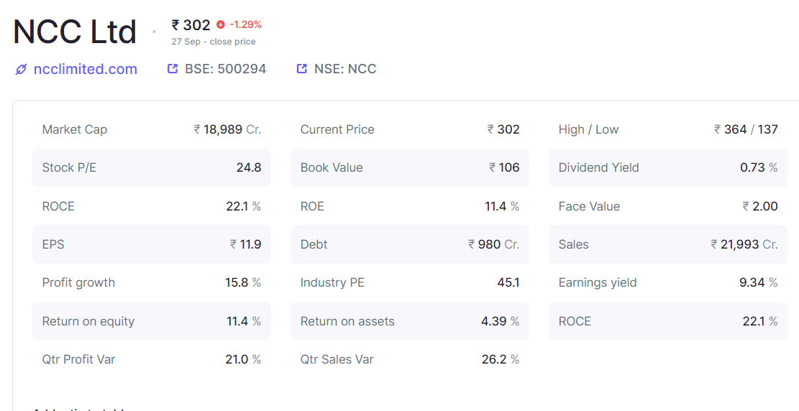
Fundamental Analysis
NCC does construction of roads, buildings, irrigation, water and environment, electrical, metals, mining and railways. It also has interests in road and energy projects through its 62.1% owned subsidiary NCC Infrastructure Holdings Limited and in real estate through its 80% owned subsidiary NCC Urban Infrastructure. Company has presence in the Middle East through its subsidiaries in Muscat and Dubai. In FY24, company entered the new segment of Smart Meters and bagged three projects worth Rs 8080 crore. They have started field trial of Smart Meters for Bihar and are planning to start field trials for Maharashtra next month.
Company has diversed business with various segments Building & Housing, Roads- Highways, Water & Environment, Electrical, Irrigation, Mining, Railways, Others
Their clients are Airports Authority of India (New Delhi), Bangalore Metro Rail Corporation, Reserve Bank of India, Nagpur Metro Rail Corporation Ltd., Ministry of Transport & Communication - Govt. of Oman, National Highways Authority of India (NHAI) and others.
Their order As of FY24, their order book is Rs. 57,536 crs. The order book is split as :
Buildings(39%), Transportation (17%), Water & Railways (12%), Electrical (T&D)(20%), Mining (1%) and Others (10%). Most orders are from Maharashtra (32%), UP (22%). Order inflow for FY24 was Rs. 27,283 crs.
Company having good order book
Ratios are looking good
Company having debt but it can be ignored if we compare with sales
Their delivery of and trading volume is good
Company has diversified business so, they maintained consistency in growth
Their return on equity is good
If government took any decision regarding water treatment so, they are the key player standing in the line.
Source : Trading view, Stock edge, screener

Slide 25
THANK YOU

