Slide 1
GENERATIVE AI
Foundations of
Generative AI
Unit 1
Deep Learning · Transformers · LLMs · GANs · VAEs · Diffusion Models · Platform Tools
VIT College | Corporate Training Program

Slide 2
Unit 1 — At a Glance
Ch 1
Foundation Models & Gen AI Platforms
Ch 2
Generative AI Essentials
Deep learning & neural networks
Foundation models & LLMs
Transformer architecture
IBM Granite & watsonx.ai
Hugging Face ecosystem
Responsible AI basics
Lab: Text, image & code generation
Discriminative vs. Generative AI
GANs — generator & discriminator
Variational Autoencoders (VAEs)
Diffusion models for images
Text generation techniques
Audio & video generation
Real-world tools: ChatGPT, DALL·E
Lab: Text & image generation hands-on
9 Hours Total

Slide 3

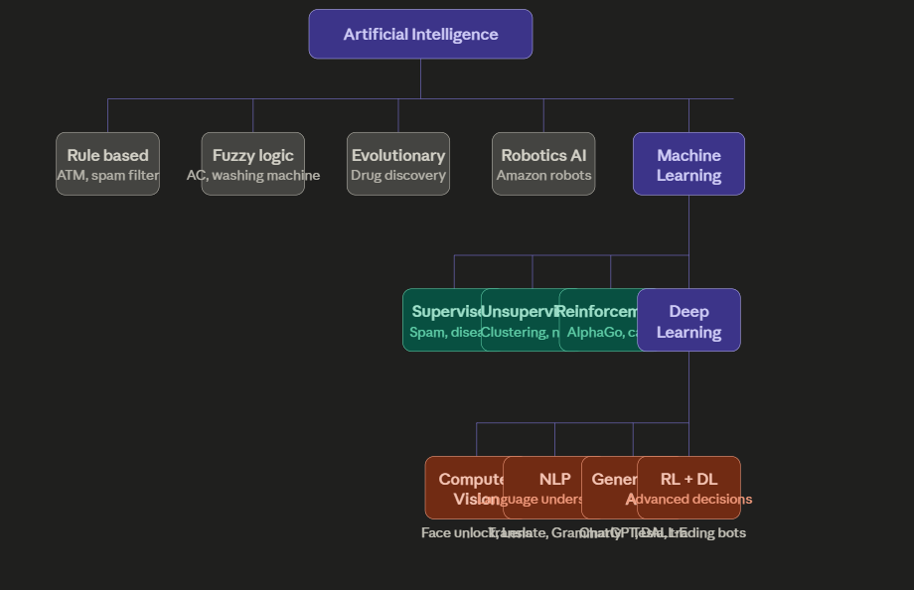
Introduction to AI

Slide 4
CH 1 · CONCEPT
Deep Learning Fundamentals & Neural Networks
Deep Learning: A subset of machine learning that uses multi-layered neural networks to learn patterns from large amounts of data — enabling machines to perform tasks that require human-like intelligence.
Neuron (Node)
Layers
Backpropagation
Basic unit that receives inputs, applies a weight, adds bias, and passes output through an activation function (e.g., ReLU, Sigmoid).
Input Layer → Hidden Layers → Output Layer. Deep networks have many hidden layers enabling complex feature learning.
Algorithm that adjusts weights by computing gradients of the loss function. Enables the network to 'learn' from errors.

Slide 5
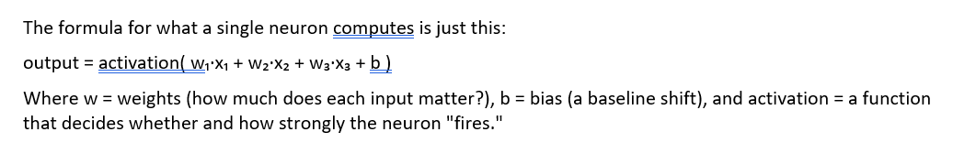
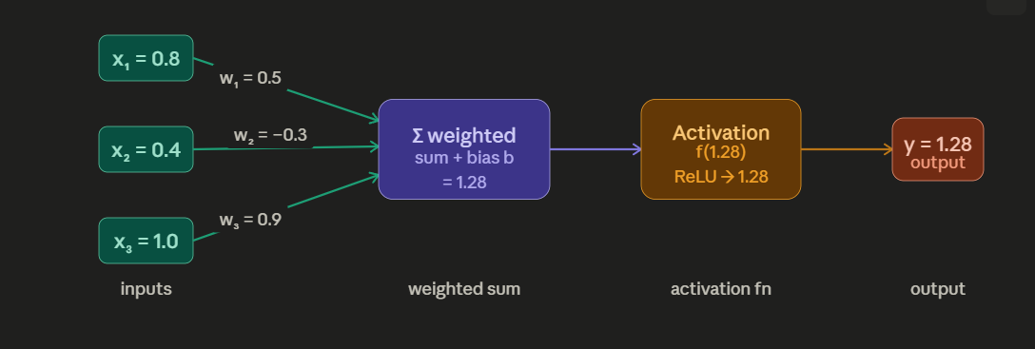
Neural Network

Slide 6
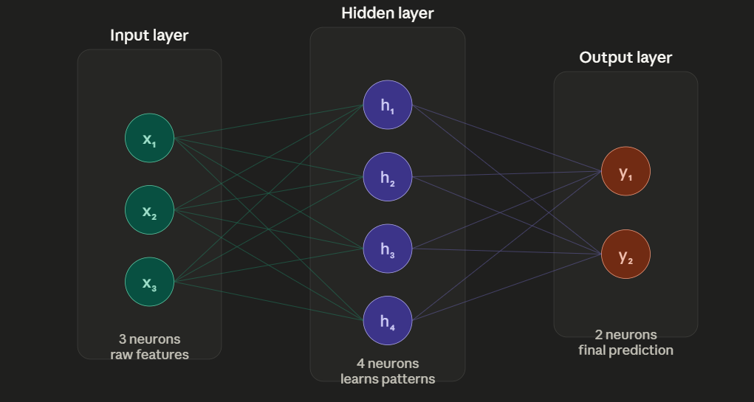
Layers: From One Neuron to a Network

Slide 7
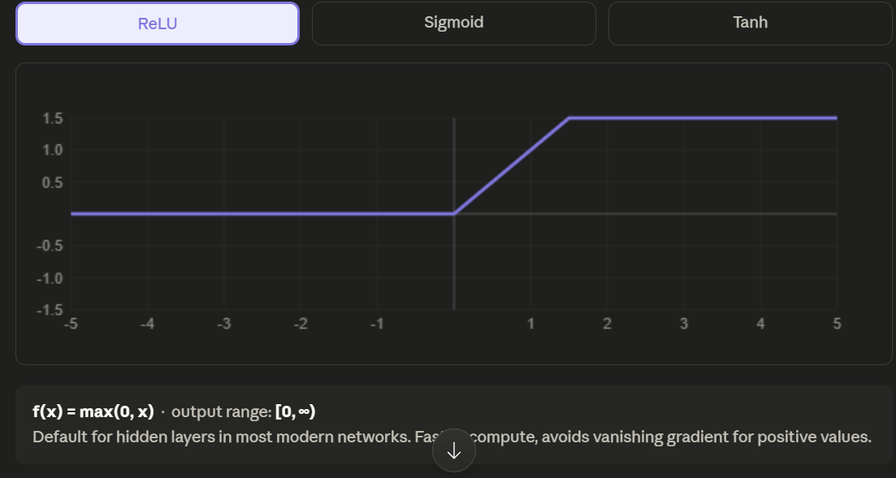
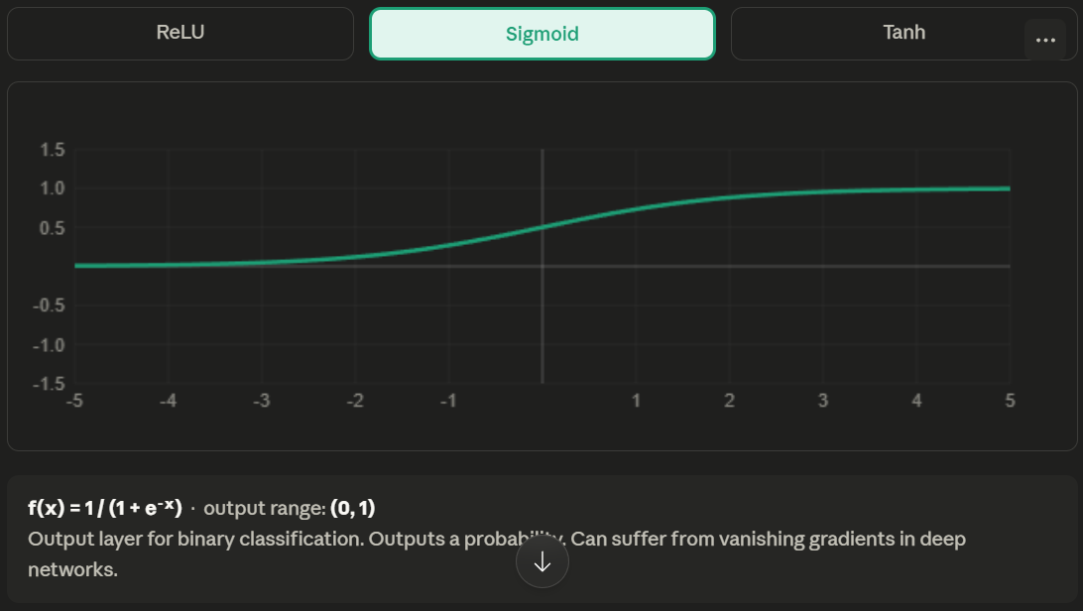
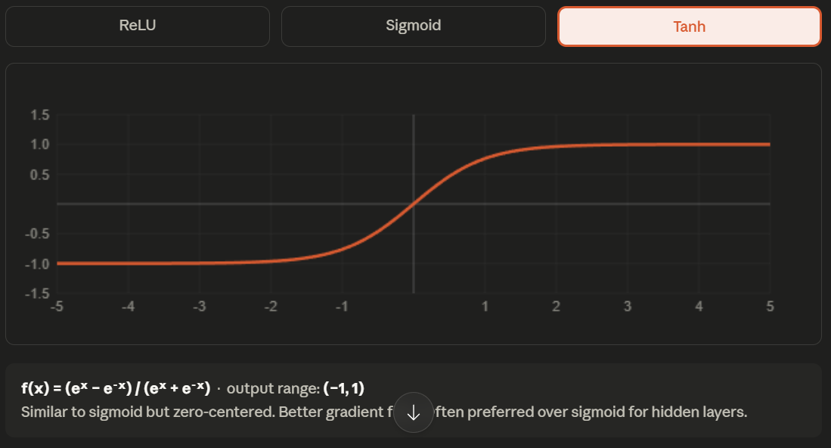
Activation Functions

Slide 8

CH 1 · CONCEPT
What Are Foundation Models?
Foundation Model: A large AI model trained on broad, diverse data at massive scale that can be adapted (fine-tuned) for a wide range of downstream tasks without training from scratch.
Key Characteristics
Examples
Trained on internet-scale data (TB–PB)
Billions to trillions of parameters
Self-supervised / unsupervised learning
Task-agnostic until fine-tuned
Emergent capabilities at scale
One model → many applications
GPT-4 / ChatGPT — Text generation, code, reasoning
IBM Granite — Enterprise AI, code, multi-modal
BERT / RoBERTa — Understanding, classification
DALL·E / Stable Diffusion — Image generation
Whisper — Speech-to-text transcription
Pre-training → Foundation Model → Fine-tuning → Specialized Application

Slide 9
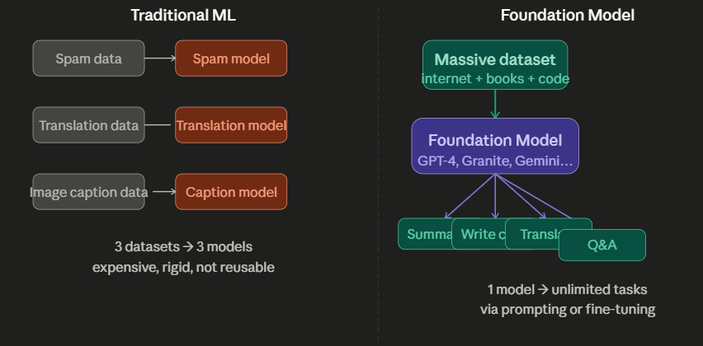

Slide 10
Pre-training vs Fine-tuning vs Prompting
Method | Description
Pre-training | Train from scratch on massive data. Expensive ($millions). Done by AI labs (OpenAI, IBM, Google).
Fine-tuning | Continue training on task-specific labeled data. Modifies model weights. Examples: sentiment analysis, medical Q&A.
Prompt Engineering | Use the base model as-is by crafting input prompts. No weight modification. Cheapest and fastest approach. Most practical for end-users.
RLHF | Reinforcement Learning from Human Feedback — align model outputs with human preferences. Used by ChatGPT, Claude.

Slide 11

CH 1 · CONCEPT
Transformer Architecture
Transformer: Introduced in 'Attention Is All You Need' (2017). Uses self-attention mechanisms to process sequences in parallel, revolutionizing NLP and beyond.
🔍 Self-Attention
📥 Encoder
📤 Decoder
Each token 'attends' to all other tokens in the sequence, computing relevance scores. Captures long-range dependencies that RNNs missed.
Processes input sequence and creates rich contextual representations. Used in models like BERT for understanding tasks.
Generates output tokens one at a time using cross-attention on encoder output. Used in GPT-style models for generation.
Multi-Head Attention: Runs multiple attention operations in parallel, each focusing on different aspects (syntax, semantics, coreference).
Positional Encoding: Since attention has no sequence order, positions are encoded using sine/cosine functions injected into embeddings.

Slide 12
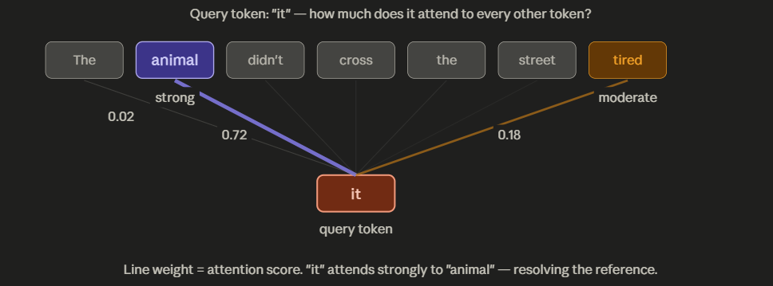
Self-Attention

Slide 13
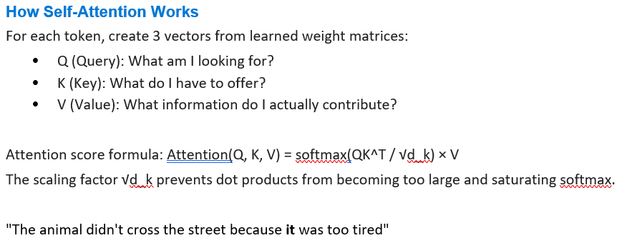
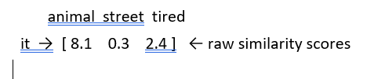
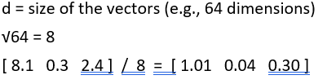
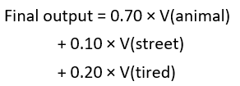
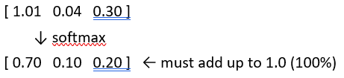
Self-Attention – Formula with example
Step 1 — QKᵀ (Q multiplied by K transpose)
Step 2 — / √d (divide by square root of d)
Step 3 — softmax(...) (convert scores to percentages)
Step 4 — · V (multiply by Values)

Slide 14
Encoder-Only vs Decoder-Only vs Encoder-Decoder
Architecture Type | Description & Use Cases
Encoder-Only (BERT) | Reads full sequence bidirectionally. Best for: classification, NER, sentiment, QA
Decoder-Only (GPT) | Auto-regressive: predicts next token. Best for: text generation, code generation, chat
Encoder-Decoder (T5, BART) | Encoder reads input, decoder generates output. Best for: translation, summarization, Q&A

Slide 15

CH 1 · CONCEPT
Large Language Models (LLMs)
LLM: A type of foundation model trained on massive text corpora using the Transformer architecture. Learns language patterns, reasoning, and world knowledge through next-token prediction.
✍️ Text Generation
❓ Question Answering
💻 Code Generation
Write articles, emails, stories, summaries
Answer factual and reasoning questions
Write, debug, explain code in any language
🌍 Translation
📝 Summarization
🧠 Reasoning
Translate between 100+ languages
Condense long documents to key points
Solve math, logic, and multi-step problems
Notable LLMs: GPT-4 · Claude · Gemini · LLaMA · Mistral · IBM Granite · Falcon

Slide 16

CH 1 · TOOL / PLATFORM
IBM Granite & watsonx.ai Platform
IBM Granite Foundation Models
IBM watsonx.ai — Platform Overview
Enterprise-focused open-source LLMs
Trained on diverse, curated datasets
Models: Granite 3.x (1B–34B params)
Tasks: text, code, instruct, multi-modal
Available on IBM watsonx.ai & Hugging Face
Built-in transparency & governance
Granite Code: specialized for software dev
All-in-one enterprise AI studio
Access to 100+ foundation models
Built-in Prompt Lab for experimentation
Model tuning with few labeled examples
AutoAI for automated model building
Production-grade deployment pipelines
Governance via IBM OpenScale / AI Factsheets
🔗 Access: watsonx.ai | cloud.ibm.com/watsonx

Slide 17

CH 1 · TOOL / PLATFORM
Hugging Face Ecosystem
Hugging Face: The 'GitHub of AI' — open platform for sharing and running ML models, datasets, and apps. Central hub for the open-source AI community.
🤗 Model Hub
📚 Datasets
500,000+ pre-trained models. Filter by task (text-gen, image-class), language, license. Download or run via API.
80,000+ datasets for training and benchmarking. Direct integration with training pipelines via datasets library.
🚀 Spaces
🔧 Transformers Library
Host interactive ML demos using Gradio or Streamlit. One-click deployment on HF infrastructure.
Python library for loading, fine-tuning, and deploying 100+ architectures with a unified API. pip install transformers
Quick Access: huggingface.co | pip install transformers datasets

Slide 18

CH 1 · ETHICS / GOVERNANCE
Responsible AI & Governance Basics
⚖️ Fairness
🔍 Explainability
🛡️ Robustness
AI systems must not discriminate. Regular bias audits across demographic groups.
AI decisions must be interpretable. Use SHAP, LIME, or attention visualization.
Reliable under adversarial inputs. Tested for edge cases and distribution shift.
📋 Transparency
🔒 Privacy
🏛️ Governance
Document training data, model architecture, and known limitations openly.
Use differential privacy, federated learning. Never expose PII in outputs.
Establish AI policies, human oversight, audit trails, and incident response.
IBM AI Ethics | EU AI Act | NIST AI Risk Management Framework

Slide 19
The 6 Pillars of Responsible AI
Pillar | Description
Fairness | AI must not discriminate based on race, gender, age, or other protected characteristics. Regular bias audits required.
Explainability | AI decisions should be interpretable. Humans must be able to understand why a model made a decision.
Robustness | Models should perform reliably under adversarial conditions, distribution shifts, and edge cases.
Transparency | Document training data, model architecture, known limitations, and failure modes.
Privacy | Protect user data. Use techniques like differential privacy, federated learning, and data anonymization.
Accountability | Clear ownership of AI systems. Audit trails. Human oversight. Incident response procedures.

Slide 20
The 6 Pillars of Responsible AI
Common AI Harms to Know
Bias & Discrimination: Historical data encodes societal bias → model perpetuates it
Hallucination: Model generates confident but false information
Privacy Leakage: Model memorizes and reproduces training data (PII)
Toxic Output: Offensive, harmful, or dangerous content generation
Deepfakes: Synthetic media used for disinformation or fraud
Over-reliance: Humans defer too much to AI without critical evaluation

Slide 21
Key Regulations to Know
Regulation/Framework | Key Points
EU AI Act (2024) | World's first comprehensive AI law. Classifies AI systems by risk: Unacceptable, High, Limited, Minimal. High-risk AI needs conformity assessment.
GDPR (Europe) | Data protection. Right to explanation of automated decisions. Affects AI training and deployment.
NIST AI RMF | US framework for AI risk management. Four functions: GOVERN, MAP, MEASURE, MANAGE.
IBM AI Ethics Policy | 5 pillars (Explainability, Fairness, etc.). AI Factsheets for model documentation.

Slide 22

CH 1 · LAB
Lab: Text, Image & Code Generation
Using IBM Granite via watsonx.ai & Hugging Face
01
Text Generation
02
Code Generation
03
Image Generation
Login to watsonx.ai Prompt Lab
Select Granite 13B Chat model
Prompt: 'Write a summary of AI in healthcare'
Experiment with temperature settings
Use Granite Code model
Prompt: 'Write Python code to sort a list'
Ask for explanation of the code
Try: 'Debug this Python function: ...'
Open Hugging Face Spaces
Find a Stable Diffusion space
Prompt: 'A futuristic city at sunset'
Compare prompts with/without style keywords
🎯 Deliverable: Screenshot + 3-line reflection on what you generated and why it works

Slide 23

CH 2 · CONCEPT
Discriminative vs. Generative AI
Discriminative AI
Generative AI
Learns decision boundary between classes
Answers: 'Which class does this belong to?'
Models P(y|x) — conditional probability
Examples: SVM, Logistic Regression, BERT
Use cases: spam filter, image classifier
Generally simpler, requires less data
Learns the full data distribution
Answers: 'How can I create new data?'
Models P(x) or P(x,y) — joint probability
Examples: GPT, GAN, VAE, Diffusion
Use cases: image gen, text writing, music
Requires massive data, compute power
VS
💡 Key Insight: Discriminative models classify existing data; Generative models CREATE new data

Slide 24
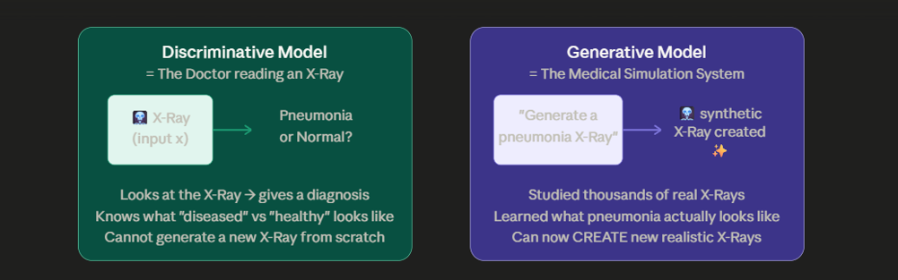
Discriminative vs. Generative AI

Slide 25
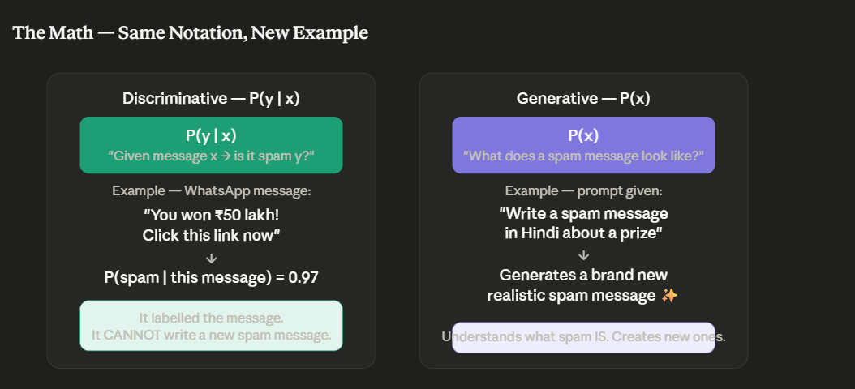
Discriminative vs. Generative AI

Slide 26
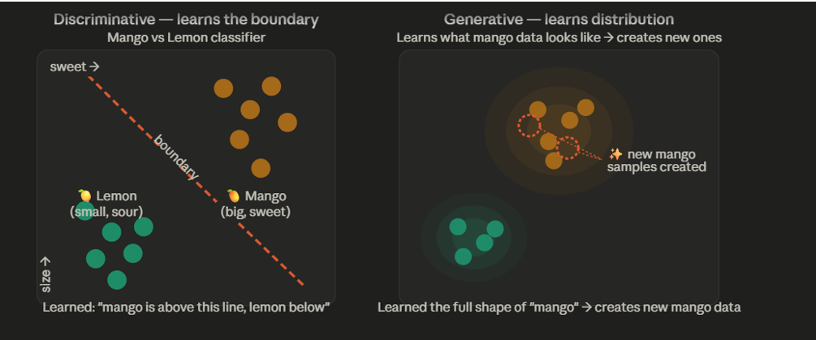
Discriminative vs. Generative AI

Slide 27

CH 2 · CONCEPT
GANs — Generative Adversarial Networks
GAN: Proposed by Ian Goodfellow (2014). Two neural networks — Generator and Discriminator — compete in a minimax game to produce increasingly realistic synthetic data.
🎨 Generator (G)
🔍 Discriminator (D)
Result
• Takes random noise vector (z) as input
• Outputs synthetic data (fake images)
• Goal: fool the Discriminator
• Never sees real data directly
• Learns to mimic real data distribution
• Takes real OR fake data as input
• Outputs probability: Real or Fake?
• Goal: correctly classify all inputs
• Trains on both real and generated data
• Gets better at detecting fakes
Photorealistic
Images
Deepfakes
Data
Augment.
Art & Style
Transfer
→
GAN Types: DCGAN · StyleGAN · CycleGAN · Conditional GAN · Pix2Pix · BigGAN

Slide 28
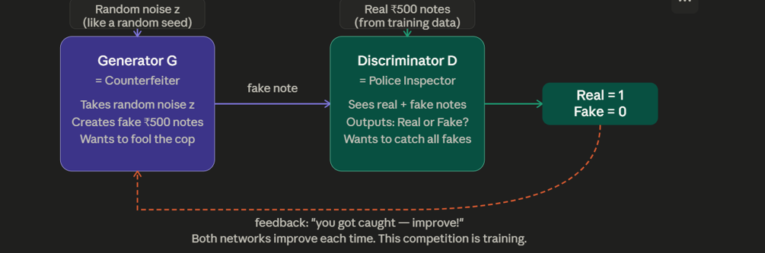
GANs — Generative Adversarial Networks

Slide 29
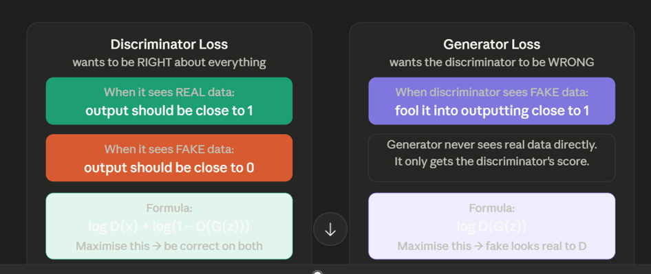
GANs — Generative Adversarial Networks

Slide 30

CH 2 · CONCEPT
Variational Autoencoders (VAEs)
VAE: A generative model that learns a compressed probabilistic latent space representation of data. Encodes data into a distribution (not a single point) and samples from it to generate new variations.
Input
Data
Encoder
Latent
Space
Decoder
Generated
Output
→
→
→
→
x (image,
text, etc.)
Compresses
to latent z
μ & σ
(mean, std)
Reconstructs
from z
x̂ (new
variation)
Latent Space Interpolation
Controlled Generation
Anomaly Detection
Smoothly morph between two generated outputs by walking through the latent space.
Edit specific attributes by manipulating dimensions of the latent vector z.
High reconstruction error signals anomaly — used in fraud detection, medical imaging.
VAE vs GAN: VAEs → smooth latent space, stable training | GANs → sharper outputs, harder to train

Slide 31
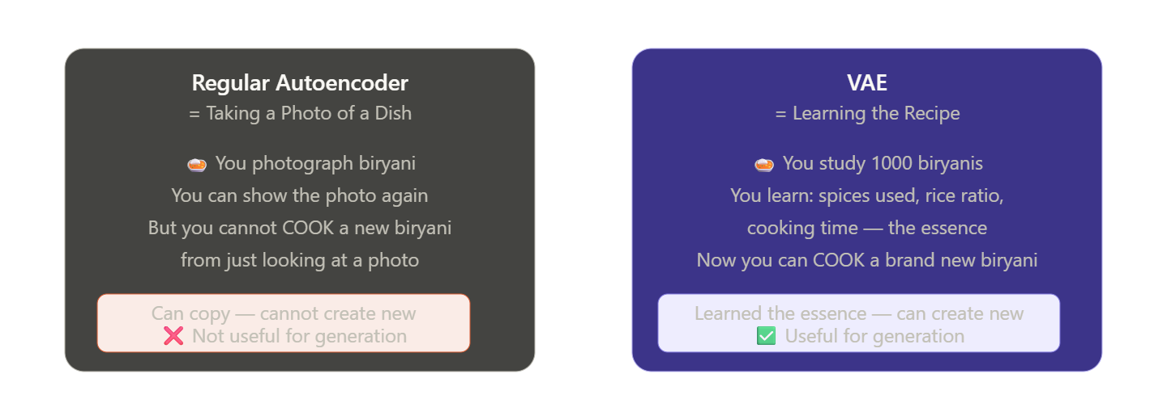
Variational Autoencoders (VAEs)

Slide 32
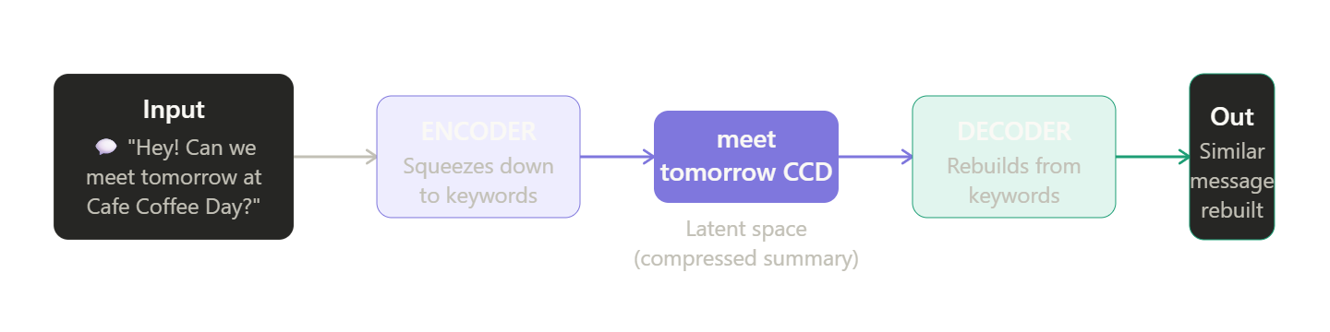
What is an Autoencoder — In One Sentence

Slide 33
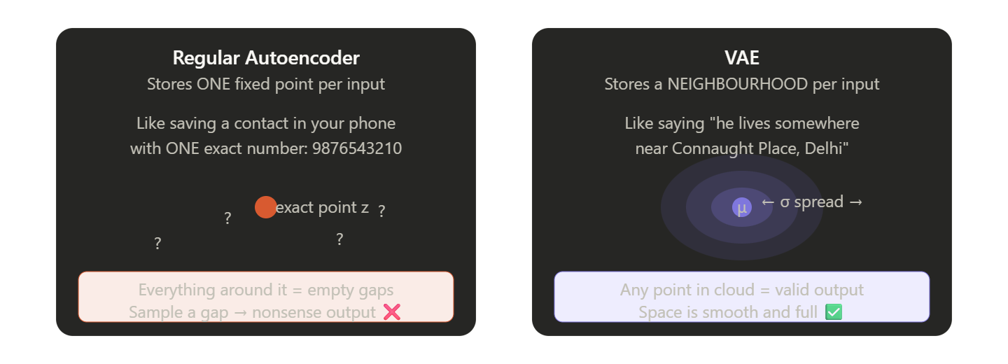
Regular AE vs VAE

Slide 34
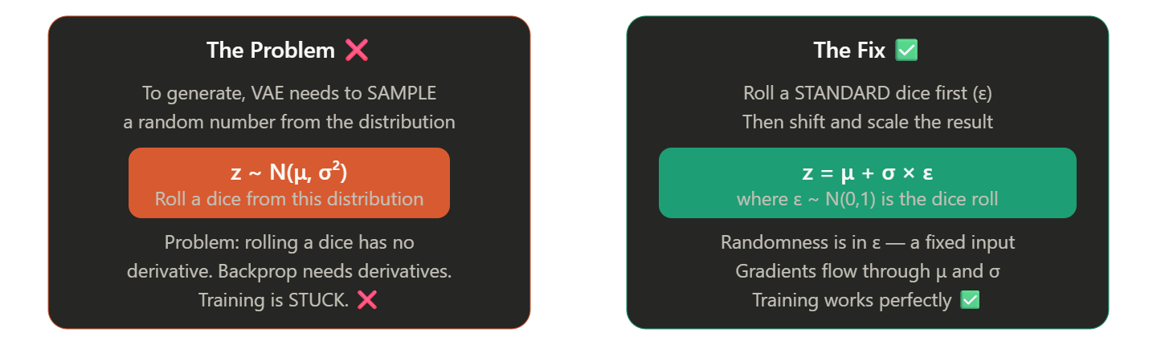
The Reparameterization Trick

Slide 35
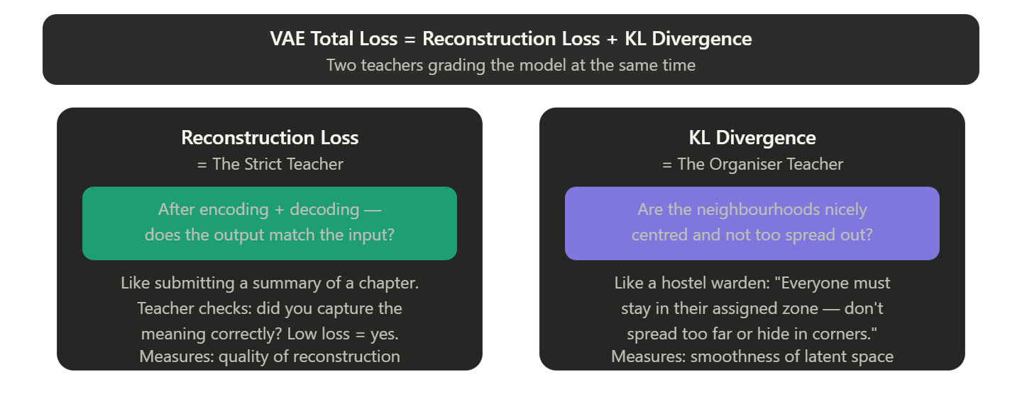
The Loss Function

Slide 36
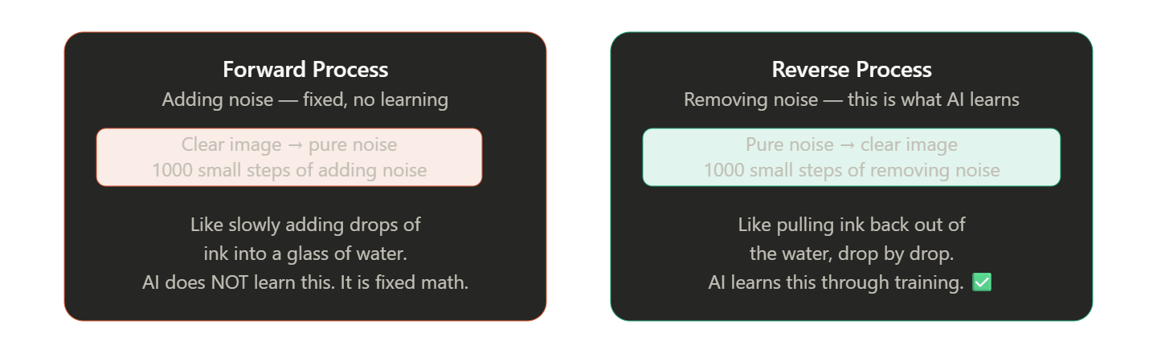
Two Processes — Simple Table

Slide 37
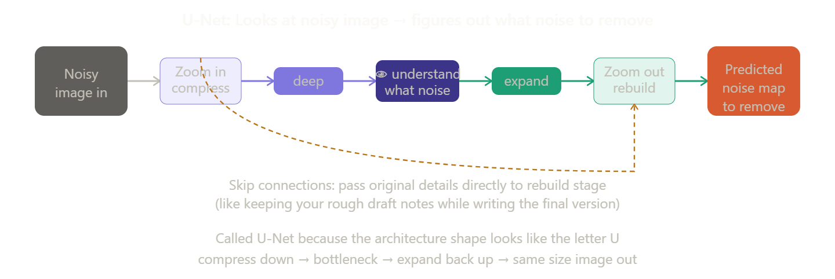
U-Net

Slide 38

CH 2 · CONCEPT
Diffusion Models for Image Generation
Diffusion Model: Learns to generate data by reversing a gradual noise-adding process. State-of-the-art for image generation — powers DALL·E 3, Stable Diffusion, and Midjourney.
Forward Process (Noising)
Reverse Process (Denoising)
• Start with a real image
• Gradually add Gaussian noise over T steps
• After ~1000 steps: pure random noise
• This is the 'training signal'
• Markov chain: each step depends only on previous
• No neural network needed in forward pass
• Start with random Gaussian noise
• Neural network predicts noise at each step
• Iteratively remove noise over T steps
• Guided by text prompt (CLIP embeddings)
• Result: photorealistic image from text
• U-Net architecture is typically used
Key Models: DALL·E 3 · Stable Diffusion · Midjourney · Imagen · Firefly

Slide 39

CH 2 · CONCEPT
Text Generation — Sampling, Temperature, Top-k/p
Temperature (T)
Top-k Sampling
Top-p (Nucleus) Sampling
Controls randomness of predictions.
• T = 0.0 → deterministic (always picks most likely token)
• T = 1.0 → default sampling
• T > 1.0 → more creative but less coherent
• T < 0.5 → more focused and conservative
Use low T for factual tasks, high T for creative writing.
At each step, only consider the top k most probable tokens.
• k = 1 → greedy (always picks most likely)
• k = 50 → balanced diversity
• k = 0 → disabled (use all tokens)
Prevents extremely unlikely tokens from being selected.
Pick from smallest set of tokens whose cumulative probability ≥ p.
• p = 0.9 → top 90% of probability mass
• Adapts dynamically to the distribution shape
• Often combined with temperature
More flexible than top-k for diverse outputs.
Typical defaults: temperature=0.7, top_p=0.95, top_k=50 | Always combine for best results

Slide 40


CH 2 · CONCEPT
Audio & Video Generation Capabilities
Audio Generation
Video Generation
▸ Text-to-Speech (TTS): ElevenLabs, Google WaveNet — natural voices
▸ Text-to-Video: Sora (OpenAI), Runway Gen-3 — cinematic from text
▸ Music Generation: MusicLM, Suno, Udio — full songs from text prompts
▸ Image Animation: Animate still photos — lip sync, facial expressions
▸ Speech Recognition: Whisper (OpenAI) — multilingual transcription
▸ Video Editing: Remove objects, change scenes using prompts
▸ Voice Cloning: Replicate a voice with just seconds of audio
▸ Deepfake Detection: Models that detect synthetically generated faces
▸ Sound FX Generation: AudioGen — create sound effects from descriptions
▸ Avatar Creation: HeyGen — AI video avatars for presentations
⚠️ Ethical Use: Always disclose AI-generated audio/video. Misuse = deepfakes, misinformation.

Slide 41

CH 2 · TOOL / PLATFORM
Real-World Gen AI Tools
ChatGPT
DALL·E 3
Midjourney
OpenAI · Text
OpenAI · Image
Midjourney Inc. · Image
Conversational AI. Excels at writing, coding, analysis, Q&A. GPT-4o supports multi-modal.
Text-to-image model. Integrated in ChatGPT. Photorealistic and artistic styles.
Premium image generation via Discord. Known for artistic, painterly aesthetics.
Stable Diffusion
Claude
Gemini
Stability AI · Image
Anthropic · Text
Google · Multi-modal
Open-source image generation. Run locally or via API. Highly customizable with LoRA.
Long context, nuanced reasoning. Excels at documents, coding, and safe responses.
Integrated with Google Workspace. Handles text, image, audio, video natively.
Access these tools → Try them in labs → Compare outputs → Discuss limitations

Slide 42

CH 2 · LAB + SUMMARY
Lab 2 & Unit 1 Summary
Lab: Text & Image Generation Hands-on
Unit 1 — Key Takeaways
Generate creative text with ChatGPT (change temperature)
Create 4 images with DALL·E or Stable Diffusion — same prompt, different styles
Use Hugging Face text-gen pipeline in Python
Compare outputs from 2 different models
Document: prompt used, output, quality rating
Deep learning + Transformers power modern AI
Foundation models = train once, use everywhere
GANs, VAEs, Diffusion = 3 generative paradigms
LLMs excel at language; multi-modal models expand to images/audio
Responsible AI is not optional — it's built-in
watsonx.ai + Hugging Face are your practical labs
Coming Up — Unit 2: Prompt Engineering
Zero-shot · Few-shot · Chain-of-Thought · Tree-of-Thought · Persona Prompting · IBM watsonx Prompt Lab
"The quality of the prompt determines the quality of the output."

