Slide 1
PROMPT ENGINEERING
Prompt
Engineering
Unit 2 · Chapters 9 & 10 · 10 Hours
Prompt Anatomy · Zero/Few-shot · CoT · ToT · Persona · Output Formatting · watsonx Prompt Lab
VIT College | Corporate Training Program

Slide 2
CH 9 · CONCEPT
What Is a Prompt?
Prompt: The input you give to a generative AI model — instructions, context, examples, and format specs — that fully shape the output. Same model, better prompt = dramatically better results.
Why Prompt Engineering Is the Most Important Skill
💰 Zero extra cost
⚡ Immediately usable
🔁 Transfers everywhere
📈 Compounds over time
Same API, same model — just a better prompt. No training required.
Use it today in ChatGPT, Claude, watsonx.ai — no setup needed.
What works on GPT-4 works on Granite, Claude, Gemini.
Each new technique improves every future prompt you write.
Before vs After Prompt Engineering
❌ Before: "Summarise this text."
→ Generic output. Wrong length. Missing key points.
✅ After: "Summarise in 3 bullets, action verbs, max 15 words each, audience: C-suite."
→ Precisely what you needed.

Slide 3
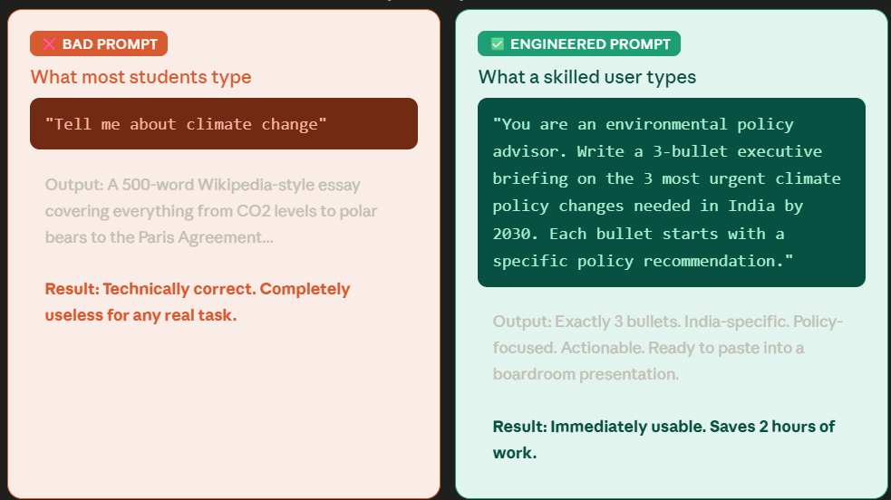
CH 9 · CONCEPT

Slide 4
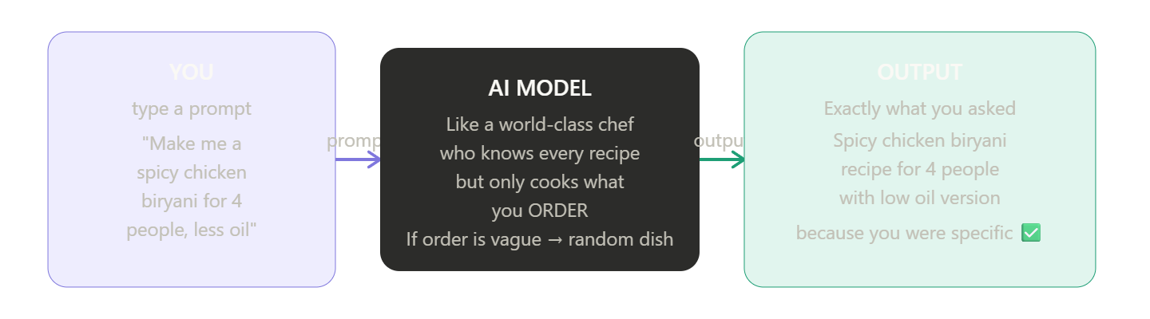
CH 9 · CONCEPT

Slide 5
CH 9 · CONCEPT
The 4-Part Anatomy of a Prompt
01
Instruction
02
Context
What task to perform. Use imperative verbs.
Background the model needs: role, audience, domain.
'Summarise', 'Write', 'Classify', 'Compare', 'Debug'
'You are a senior analyst. Audience: board of directors.'
03
Input Data
04
Output Indicator
The actual content to work on.
Format, length, tone, structure of the response.
'Article: [paste]. Code: [paste]. Dataset: [paste]'
'Format: JSON. Length: 3 bullets. Tone: formal.'
Not all 4 parts are always needed — the more complete your prompt, the more precise the output

Slide 6
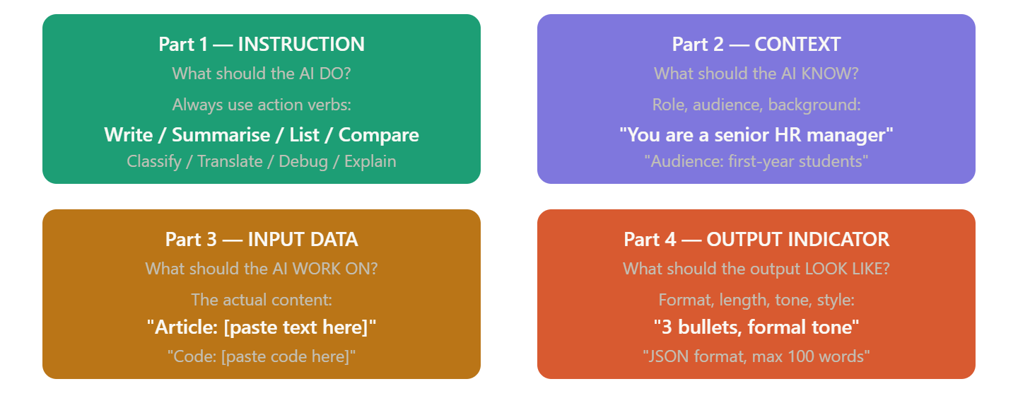
4-Part Anatomy of a Prompt

Slide 7
CH 9 · CONCEPT
Best Practices & Common Pitfalls
✅ DO
❌ DON'T
Be specific — format, length, tone, audience every time
Use positive language — say what TO do, not just what NOT to
Provide examples inside the prompt (few-shot)
Assign a role: 'You are a senior data analyst...'
Break complex tasks into smaller steps
Iterate — treat prompting as a loop, not one-shot
Vague: 'Tell me about AI' — model has no direction
Overloaded: asking for 10 things at once
Assuming context: model doesn't know your project
No output format: unpredictable structure every time
Accepting first output without refinement
Ignoring temperature — wrong setting destroys quality
💡 Lab: Trainer shows 5 badly-written prompts. Students rewrite in pairs. Compare before vs after outputs.

Slide 8
CH 9 · CONCEPT
Zero-shot, One-shot & Few-shot Prompting
Zero-Shot
One-Shot
Few-Shot
No examples
One example
2–5 examples
Relies on model training. Works for simple, well-known tasks.
One worked example calibrates format and reasoning style.
Multiple examples lock in consistent pattern. Best accuracy.
Classify: 'Broke on day 2.'
Output: POSITIVE/NEGATIVE/NEUTRAL
'Amazing!' → POSITIVE
'Broke on day 2.'
Output:
'Amazing!' → POSITIVE
'Broken' → NEGATIVE
'Okay' → NEUTRAL
'Best ever.' →
When: Simple, well-known tasks
When: Format matters, new task type
When: Complex, domain-specific tasks
Rule: Start zero-shot → if quality is low → add examples one at a time until output quality meets your bar

Slide 9
CH 9 · CONCEPT
Chain-of-Thought & Tree-of-Thought Prompting
Chain-of-Thought (CoT)
Tree-of-Thought (ToT)
Forces step-by-step reasoning before the answer
Improves accuracy on math, logic, multi-step tasks
Zero-shot trigger: 'Let's think step by step.'
Explores multiple reasoning branches simultaneously
Model backtracks bad paths, picks the best solution
Best for: planning, strategy, creative problem-solving
Example:
ToT Prompt Template:
Q: Train goes 60 km/h for 2h then
80 km/h for 1.5h. Total distance?
Let's think step by step:
Step 1: 60 × 2 = 120 km
Step 2: 80 × 1.5 = 120 km
Total = 120 + 120 = 240 km
"Imagine 3 experts solving this.
Each writes one reasoning step.
If any expert is wrong they leave.
Repeat until one expert reaches
the final answer. Question: [...]"
CoT = one chain of reasoning — linear step-by-step path to the answer
ToT = a tree of reasoning chains — multiple branches, best path wins

Slide 10
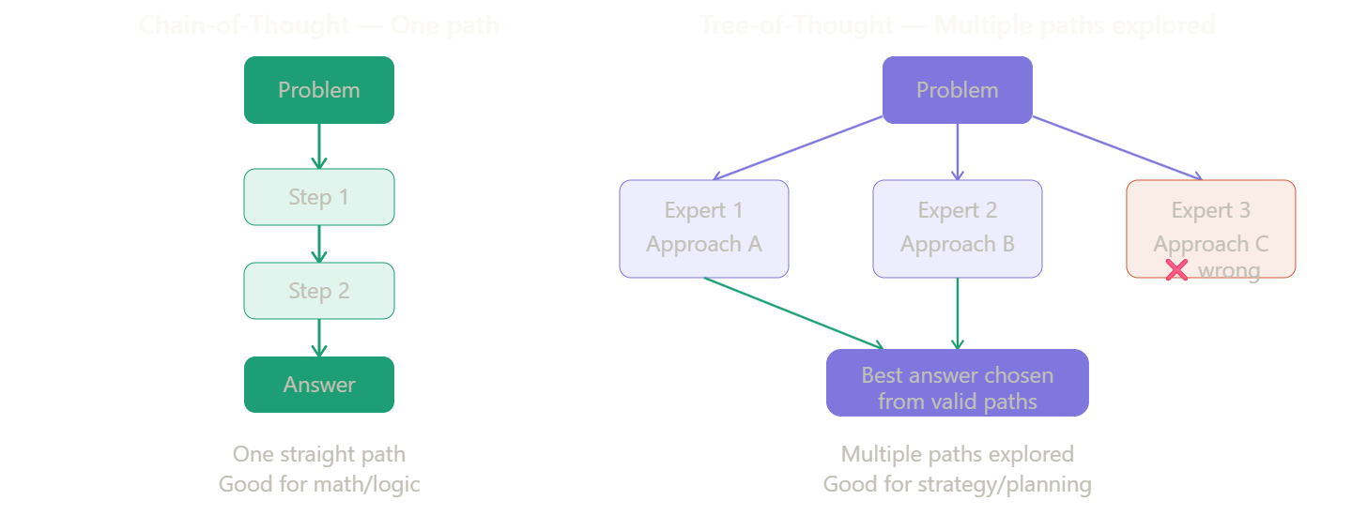
Chain-of-Thought & Tree-of-Thought Prompting

Slide 11
CH 10 · CONCEPT
Persona-Based & Interview-Style Prompting
Persona Prompting: Assigning a role changes everything — vocabulary, depth, tone, and assumptions all shift to match the assigned persona. Same question, different persona = completely different answer.
Same Question. 4 Personas. 4 Completely Different Answers.
'You are a senior cybersecurity engineer'
→ Technical, precise, mentions CVEs and mitigations
'You are a 10-year-old explaining AI to friends'
→ Simple words, analogies, no jargon at all
'You are a sceptical investigative journalist'
→ Questions assumptions, asks for evidence
'You are a Socratic tutor — never give answers'
→ Guides thinking with questions only
Interview-Style Prompting
Definition: The model asks YOU questions before generating output. Instead of front-loading all context, the model interviews you first — building richer understanding.
Trigger: "Before writing my CV, ask me all the questions you need. Do NOT generate anything yet."

Slide 12
CH 10 · CONCEPT
Output Structure, Format & Verbosity Control
If you don't specify output format, the model picks one. Specify the format and it obeys — every single time.
JSON
Markdown Table
Output ONLY valid JSON. No explanation. Schema: {name, role, salary}
Return a Markdown table. Columns: Tool | Category | Cost | Best For
{"name":"Priya","role":"Engineer","salary":85000}
| Tool | Category | Cost | Best For |
Python Code
Verbosity Control
Output only Python code. No markdown. No explanation. Just runnable code.
Explain in: (a) 1 sentence, (b) 1 paragraph, (c) 5 bullet points
def get_active(data):
return [d for d in data if d['status']=='active']
Forces model to try multiple densities — compare which suits your audience

Slide 13
CH 10 · CONCEPT
Advanced Prompting Patterns
Self-Consistency
Prompt Chaining
Run CoT 5× with temp > 0. Take majority vote. Reduces hallucination on complex reasoning.
Output of Prompt N becomes input of Prompt N+1. Each prompt does one job well.
Best for: math, logic, factual QA
Research → Draft → Edit → Format
Negative Prompting
Role + Constraint
Tell model what NOT to do, NOT to include, what style to AVOID.
Combine persona with strict output constraints — most powerful production pattern.
'No jargon. No passive voice. No examples.'
'Tax accountant. Bullets only. Max 5. India law.'
RAG-Ready Prompting
Iterative Refinement
Structure prompts to use retrieved context. Foundation for enterprise AI chatbots.
Generate → Evaluate → Identify weakness → Add constraint → Repeat.
Context: [retrieved]
Answer ONLY from context above:
Start simple. Add one constraint per iteration.

Slide 14
CH 10 · PROJECT + SUMMARY
Real-World Prompt Project & Unit 2 Summary
Real-World Prompt Project (Day 10)
Unit 2 — Key Takeaways
Choose a real domain (HR, Finance, Healthcare...)
Build a complete 4-part prompt pipeline
Present in 2 min: prompt + output + v1 vs final
Peer review: class votes best prompt per category
Submit: prompt text + 3 versions + output screenshot
Prompt = Instruction + Context + Input Data + Output Indicator
Zero-shot → Few-shot → CoT → ToT: escalate as needed
Persona + Format constraint = most powerful combo
Same model, better prompt = completely different quality
watsonx Prompt Lab: compare, version, export to code
Prompt engineering is a skill — iterate, don't settle for v1
Coming Up — Unit 3: Gen AI for Data Professionals
Days 11–17 · Data Analysts · Data Engineers · Data Scientists
NL-to-SQL · Visualisation · ETL Automation · Data Augmentation · AutoML · Microsoft Copilot
"The quality of your prompt determines the quality of your output — every single time."

