Slide 1
IBM CAREER EDUCATION · VIT COLLEGE · CORPORATE TRAINING
Generative AI
for Software Development
Day 15 · Applications · SDLC · LLMs · NLP · Tools · Tokens & Cost Estimation
Duration: 3 Hours Mode: Theory + Demo + Live Cost Calculation

Slide 2
TODAY'S ROADMAP
Session Agenda
01
05
Gen AI in Software Development
NLP and Its Significance
Core concept + 8 key applications across the dev lifecycle
Components, tools, use cases, and ethical considerations
02
8 Future Trends
06
Popular Gen AI Dev Tools
Efficiency, Collaboration, NLP, Low-Code, XAI, Ethics & more
GitHub Copilot, watsonx, CodeWhisperer, Mintlify & more
03
Gen AI Across the SDLC
07
Tokens & Cost Estimation
How AI enhances all 6 phases — Requirements to Maintenance
What tokens are, pricing models, and live cost calculation
04
Large Language Models (LLMs)
Generative AI for Software Development · Day 15
2
What they are, popular models, role in development, limitations

Slide 3
SECTION 1 · CORE CONCEPT
Generative AI in Software Development
📘 CORE CONCEPT
Generative AI produces new content — code, images, text, documentation — that resembles existing data. In software development, it acts as a co-pilot: reading every line of code ever written, suggesting the next line, spotting errors, writing documentation, and generating tests — while YOU focus on architecture and business logic.
1. Architecture &
Design
2. Automation of
Repetitive Tasks
3. Code
Optimisation
4. Bug Detection &
Troubleshooting
Creates architectural diagrams, software designs, and synthetic data
Streamlines repetitive tasks and manual processes — boilerplate, scripts, pipelines
Identifies performance bottlenecks, suggests memory and speed improvements
Detects bugs and vulnerabilities from past patterns — proactive, not reactive
5. Enhancing User
Experience
6. Creativity
Augmentation
7. Code
Refactoring
8. Smart
Documentation
NLP analyses user feedback, understands sentiment, improves usability
GANs create innovative UI/UX designs and generate realistic test data
Restructures code, renames variables, removes duplicates, applies design patterns
Analyses code and comments to auto-generate descriptive documentation
Generative AI for Software Development · Day 15
3

Slide 4
SECTION 2 · 8 KEY TRENDS
Future Trends of AI in Software Development
Efficiency
Enhancement
Generative
Collaboration
New Application
Domains
Enhanced NLP
AI automates data generation, design, and code scaffolding — faster development cycles
Human expertise + machine ideas = novel software solutions neither could create alone
Gen AI expands into materials science, drug discovery, legal tech — beyond traditional software
Code through voice or plain-language text — coding for non-technical professionals
Low-Code /
No-Code
Explainable AI
(XAI)
Intelligent
Assistants
Ethical AI
Development
Graphical AI-driven interfaces democratise software creation — domain experts build their own tools
AI decisions become auditable and understandable — essential for regulated industries
AI supports the ENTIRE SDLC — real-time help in coding, debugging, and documentation
Fairness, transparency, privacy, accountability — professional obligations, not optional extras
Generative AI for Software Development · Day 15
4
💡 DISCUSSION
If Low-Code/No-Code becomes powerful enough, do we still need software engineers? (Answer: YES — architecture, security, validation, edge cases, and ethics still need expert human judgement.)

Slide 5
SECTION 3 · 6 PHASES
Gen AI Across the SDLC — Overview
📘 THE 6-PHASE SDLC
The Software Development Lifecycle: Requirements Gathering → Design → Development → Testing → Deployment → Maintenance. Generative AI enhances EVERY phase — automating tasks, improving quality, and accelerating timelines.
Phase 1
Requirements
Phase 2
Design
Phase 3
Development
Phase 4
Testing
Phase 5
Deployment
Phase 6
Maintenance
AI + NLP extracts and validates requirements from user inputs automatically. ML detects hidden patterns. AI flags inconsistencies early.
AI analyses historical data to recommend optimal architectures. Identifies proven design patterns. Optimises for performance and scalability.
ML models generate code from prompts. AI supports code completion, refactoring, and static analysis. Finds bugs before they compile.
AI auto-generates test cases. ML predicts high-risk code areas. Intelligent regression testing adapts to codebase changes.
AI automates deployments for consistency. Monitors performance in real-time. Auto-detects issues and alerts teams instantly.
AI analyses logs to predict failures before they occur. Suggests optimisations. Recommends bug fixes from historical patterns.
→
→
→
→
→
Generative AI for Software Development · Day 15
5

Slide 6
SECTION 3 · DEEP DIVE
Advanced AI Applications in the SDLC
AI in
Requirements Analysis
AI in
Intelligent Design
AI-Assisted
Code Generation
AI in
Automated Testing
AI in DevOps
& CI/CD
NLP interprets natural-language inputs — making documentation more accurate. AI validates requirements against rules for clarity and consistency.
Processes data from successful past projects to suggest scalable, optimised architectures. AI-driven tools propose solutions based on system goals.
ML models produce syntactically correct, context-aware code. Support: code prediction, snippet generation, auto-completion, static analysis.
Auto-generates and executes test cases. Defect prediction preempts bugs. Targeted regression testing assesses impact of recent changes.
Automated decision-making in build, test, and deploy. Intelligent release management forecasts performance impact. Handles scheduling, resource allocation, and monitoring.
Generative AI for Software Development · Day 15
6

Slide 7
SECTION 4 · WHAT THEY ARE & HOW THEY WORK
Large Language Models (LLMs)
📘 WHAT IS AN LLM?
Large Language Models are advanced AI models trained on massive datasets — books, articles, websites, code repositories. They recognise language patterns, generate coherent text, and perform NLP tasks: text generation, translation, summarisation, sentiment analysis, and Q&A.
Analogy: An LLM has 'read' everything ever written. It doesn't look things up — it pattern-matches from everything it learned, then COMPOSES a new answer for you.
POPULAR LARGE LANGUAGE MODELS
GPT-4
Gemini / LaMDA
LLaMA 2
Claude
Granite
By: OpenAI
Powers ChatGPT, Microsoft Copilot, and Bing Chat
By: Google
Powers Google Bard / Gemini conversational AI
By: Meta (Open-source)
Used for custom fine-tuning by developers worldwide
By: Anthropic
Known for long context and safety-focused design
By: IBM
Enterprise LLM powering IBM watsonx.ai
ROLES IN SOFTWARE DEVELOPMENT
✨ Code Generation
& Auto-Completion
Generate code from prompts, reduce boilerplate, accelerate coding
✨ Automated Bug
Detection & Fixing
Analyse code for syntactic and semantic errors, provide fix suggestions
✨ NL Programming
Interfaces
Write code in plain English — 'Sort this list by date descending'
✨ Access to
Expert Knowledge
Contextual programming insights — like a senior dev available 24/7
Generative AI for Software Development · Day 15
7

Slide 8
SECTION 4 · STRENGTHS AND WATCH-OUTS
LLM Capabilities & Limitations
CAPABILITIES
Code Templates
& Snippets
Auto Documentation
& Comments
Automated Testing
& QA
Collaborative
Coding
Generate reusable code structures — saving hours of repetitive setup work
Automatically generate function docs and comments from existing code
Create test cases, validate outputs — 40–60% less manual testing effort
Real-time pair programming assistance — junior devs get senior-level feedback instantly
LIMITATIONS
Bias
Security
& Privacy
Complex
Scenarios
Over-Reliance
Risk
LLMs reflect biases in training data — outputs may favour certain languages, styles, or approaches. Audit regularly.
NEVER paste API keys, customer data, or proprietary code into a public LLM. Use private/on-premises deployments.
LLMs struggle with highly intricate, domain-specific code. They are NOT substitutes for deep programming expertise.
LLM output can look correct but fail under edge cases. Always treat it as a first draft — test thoroughly.
Generative AI for Software Development · Day 15
8

Slide 9
SECTION 5 · CONCEPTS & USE CASES
Natural Language Processing (NLP)
📘 WHAT IS NLP?
NLP is the branch of AI that enables computers to understand, interpret, and generate human language — combining linguistics, computer science, and machine learning. It powers chatbots, translation, sentiment analysis, text summarisation, and information extraction.
KEY NLP COMPONENTS
NLP USE CASES
Morphology
Study of word structures — 'running' = 'run' + '-ing'
Sentiment Analysis
Syntax
How words combine to form correct sentences — subject-verb-object
Detects positive/negative/neutral emotions in text — customer feedback, reviews, social media
Named Entity
Recognition (NER)
Semantics
The meaning conveyed — 'bank' means different things in different contexts
Identifies people, organisations, locations — for info retrieval and content tagging
Text Classification
Tokenization
Splitting text into smaller units — 'Hello World' → ['Hello', 'World']
Categorises text automatically — spam vs. not spam, topic labelling
Machine Translation
Stemming
Reducing words to their root — 'running' → 'run'
Converts text between languages — seq-to-seq models with attention mechanisms
Chatbots
Understand user inputs and respond meaningfully — intent recognition and dialogue flow
Generative AI for Software Development · Day 15
9

Slide 10
SECTION 6 · TOOL LANDSCAPE
Popular Gen AI Tools for Software Development
GitHub Copilot · Code Generation
ChatGPT / GPT-4 · General LLM
Real-time code suggestions, function completion, boilerplate — in VS Code, JetBrains & more
Code generation, architecture advice, debugging, documentation — in plain English
Amazon CodeWhisperer · Code Generation
Tabnine · Code Completion
AWS-optimised suggestions + built-in security scanning — for Lambda, DynamoDB, S3
AI trained on YOUR codebase — follows your team's exact coding standards and patterns
IBM watsonx Code · Enterprise Code
Replit Ghostwriter · Code Generation
Mainframe modernisation, COBOL-to-Java transformation, enterprise governance
In-browser AI coding — generation, explanation, debugging in any language
DeepCode / Snyk · Security Scanning
Mintlify · Documentation
AI-powered vulnerability detection — catches security issues before they reach production
Auto-generates developer docs from code — keeps documentation up-to-date automatically
Generative AI for Software Development · Day 15
10

Slide 11
SECTION 7 · CORE CONCEPT
Tokens in Generative AI — What They Are
📘 WHAT IS A TOKEN?
Tokens are the fundamental fragments the API breaks text into before processing. They are NOT exactly words — they can be parts of words, trailing spaces, or punctuation. The API shares a token budget between your prompt AND the model's response — exceed the limit and the response gets cut off.
OPENAI TOKEN GUIDELINES
OPENAI MODEL PRICING
1 token
≈ 4 characters in English
≈ ¾ of a word
Model | Version | Input /1K | Output /1K
GPT-4 | gpt-4 | $0.03 | $0.06
GPT-4 | gpt-4-32k | $0.06 | $0.12
GPT-3.5-Turbo | gpt-3.5-turbo | $0.0010 | $0.0020
DALL-E 3 Std | 1024×1024 image | $0.040 / img | —
DALL-E 3 HD | 1024×1024 image | $0.080 / img | —
Code Interpreter | Code Interpreter | $0.03 / session | —
100 tokens
≈ 75 words
Roughly one short paragraph
1–2 sentences
≈ 30 tokens
Quick conversational exchange
1 paragraph
≈ 100 tokens
Standard paragraph of prose
1,500 words
≈ 2,048 tokens
About 2 pages of text
1,000 tokens
≈ 750 words
Standard API billing unit
Generative AI for Software Development · Day 15
11
⚠ Prices as of writing — check openai.com/pricing for current rates

Slide 12
SECTION 7 · CALCULATE BEFORE YOU BUILD
Token Cost Estimation — Live Worked Example
💬 EXAMPLE PROMPT
Prompt: "Can you provide a brief overview of the benefits of exercise?"
Model: GPT-4 · Input price: $0.03/1K tokens · Output price: $0.06/1K tokens
1
Count words in prompt
"Can you provide a brief overview of the benefits of exercise?"
9 words
2
Convert words to tokens
9 words ÷ 0.75 words/token
≈ 12 tokens
3
Calculate prompt cost
(12 ÷ 1000) × $0.03
= $0.00036
4
Count output tokens
500 word output ÷ 0.75
≈ 667 tokens
5
Calculate output cost
(667 ÷ 1000) × $0.06
= $0.04002
6
Total cost per call
$0.00036 + $0.04002
= $0.04038
Generative AI for Software Development · Day 15
12
📊 SCALE: 1,000 calls/day
$0.04038 × 1,000 = $40.38/day · $40.38 × 30 = $1,211.40/month
💡 KEY LESSON
Using GPT-4 when GPT-3.5-Turbo would suffice costs 30× more. Model selection = cost engineering.

Slide 13
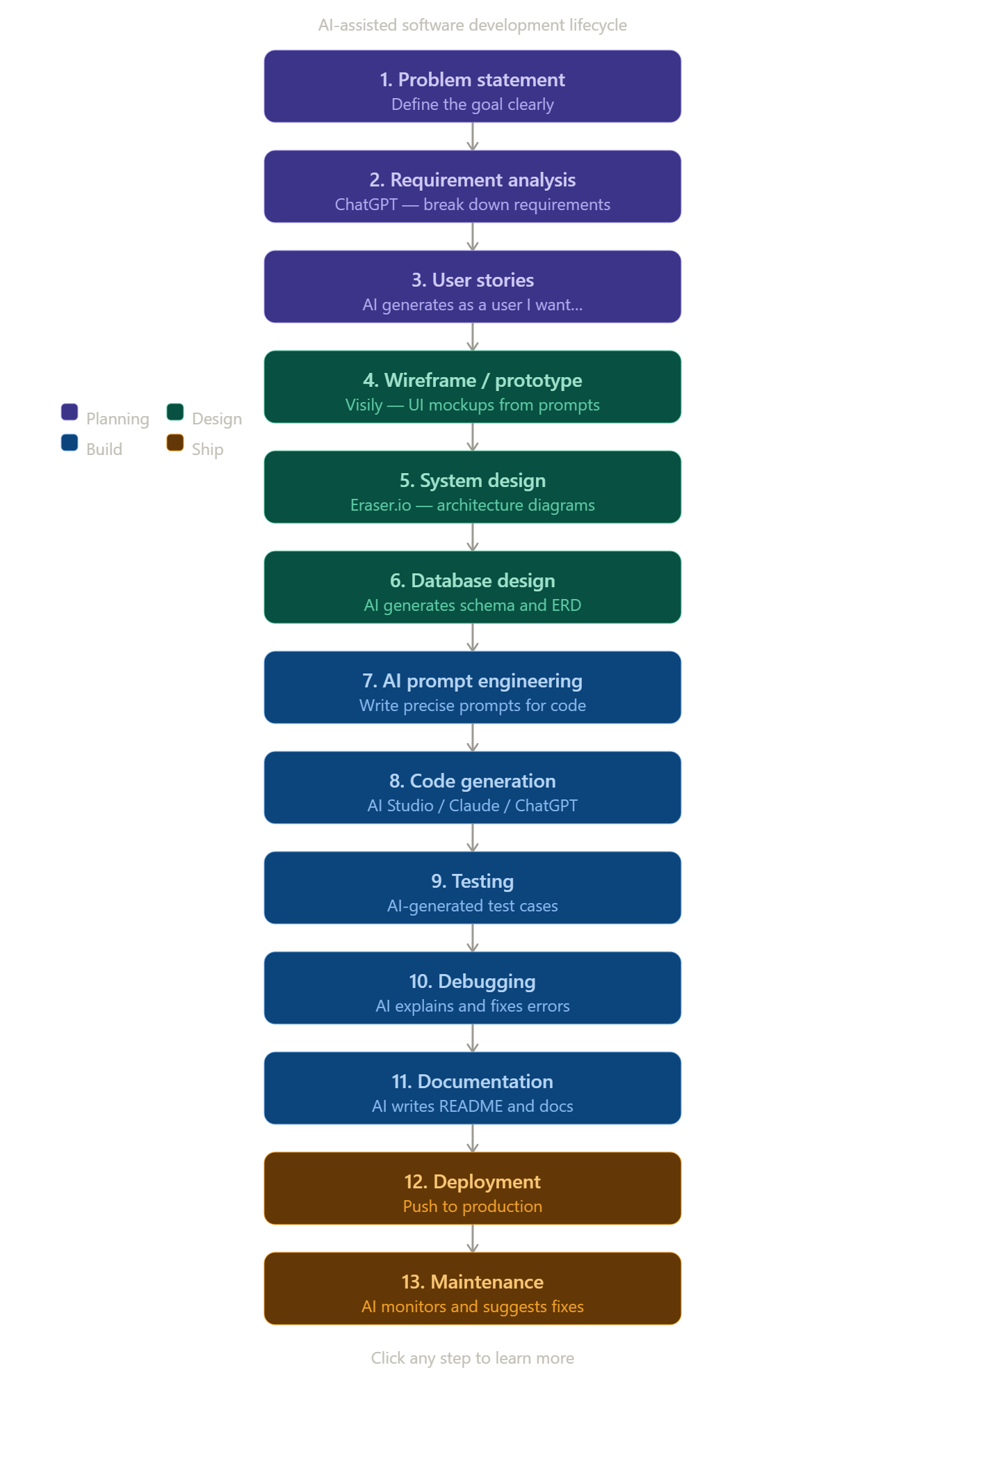

Slide 14
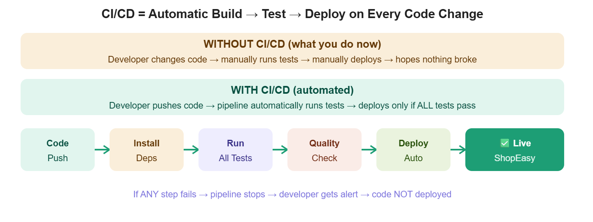

Slide 15
KEY TAKEAWAYS
1. Gen AI has 8 core applications in software development — from architecture and code generation to bug detection, refactoring, and smart documentation.
2. 8 future trends will reshape the field: efficiency, collaboration, new domains, enhanced NLP, low-code/no-code, XAI, intelligent assistants, and ethical AI.
3. Gen AI enhances ALL 6 SDLC phases — automating requirements analysis, design, code generation, testing, deployment, and maintenance.
4. LLMs (GPT-4, Gemini, Claude, LLaMA, Granite) power code generation, bug detection, NL programming, and expert knowledge access — with mandatory human oversight.
5. NLP enables sentiment analysis, NER, text classification, translation, and chatbots — with ethics around privacy, bias, fairness, and accountability.
6. Tokens are the currency of AI APIs: 1 token ≈ 4 chars ≈ ¾ word. Model selection and token cost estimation are critical professional skills.
Thank You
Day 15 · Generative AI for Software Development · IBM Career Education · VIT College · Adroit ACE

Slide 16
DAY 17

Slide 17
IBM CAREER EDUCATION · VIT COLLEGE · CORPORATE TRAINING
The Security
Implications of
Generative AI
Day 17 · Benefits, Risks, LLM Threats, Analytics, Incident Response

Slide 18
WHAT WE'LL COVER
Session Topics
01
Conventional AI vs Generative AI
06
Cybersecurity Analytics
How generative AI differs and why it matters for cybersecurity
15 types of analytics and the StreamCraft case study
02
Cybersecurity Applications
07
Content Filtering & Threats
7 tasks where Gen AI is transforming threat detection and response
Protecting against threats targeting AI models themselves
03
The Future of Cybersecurity
08
NLP-Based Attacks
Passkeys, deepfakes, and combating AI hallucinations
Prompt injection, data leakage, sandboxing, code execution
04
LLM Risks & Bias
09
AI-Enhanced Defense
Core security risks and 9 types of bias in language models
EDR, SIEM, and the real cost of a data breach
05
Security Risks of Gen AI Tools
10
Incident Response & Forensics
Privacy, data quality, and transparency concerns
6-phase IR process and Gen AI-powered playbooks
The Security Implications of Generative AI · Day 17
2

Slide 19
TOPIC 1
Conventional AI vs Generative AI
Conventional AI
Generative AI
Predictive and task-specific. Operates on static, predefined rules and historical data. Good at structured, rule-based tasks.
Creative and original. Adaptive, continuously improving, and capable of open-ended, imaginative problem-solving and human-like comprehension.
5 BENEFITS OF GENERATIVE AI IN CYBERSECURITY
Adaptability to Novel Threats
Automated Playbook Creation
Continuous Monitoring
Reduced Response Time
Enhanced Threat Creativity
Generates solutions for previously unseen risks
Builds and refines incident response strategies
Evaluates and improves security protocols over time
Speeds up detection, analysis, and response
Spots subtle anomalies conventional AI misses
The Security Implications of Generative AI · Day 17
3

Slide 20
TOPIC 2
Gen AI Applications Across Cybersecurity Tasks
Threat Intelligence & Forecasting
Incident Response Planning
Dynamic Threat Hunting
Predicts future attacks from historical threat patterns
Simulates cyberattacks to train response teams
Continuously scans for suspicious behaviour
Automated Security Alerts
Vulnerability Assessment
User Behaviour Analytics
Generates accurate, real-time threat alerts
Simulates attacks to prioritise patching
Detects insider threats via behaviour deviation
Policy & Compliance Management
Keeps security policies aligned with regulations
The Security Implications of Generative AI · Day 17
4

Slide 21
TOPIC 3
The Future of Cybersecurity
Gen AI + Cybersecurity Symbiosis
Passwords to Passkeys
Each field strengthens the other — AI improves defense, cybersecurity drives more robust AI models
FIDO-standard passkeys eliminate passwords, reducing phishing and credential-theft risk
Deepfake Threats
Combating Hallucinations
Shift focus from detecting fakes to verification systems independent of content authenticity
RAG (Retrieval-Augmented Generation) grounds AI answers in real data to reduce false outputs
The Security Implications of Generative AI · Day 17
5

Slide 22
TOPIC 4
LLM Risks
8 CORE SECURITY & PRIVACY RISKS OF LLMS
Data Leakage
Prompt Injection
Inadequate Sandboxing
Hallucinations
SSRF Attacks
DDoS Attacks
Data Poisoning
Copyright Violations
9 TYPES OF BIAS IN LLMS
Machine Bias
Availability Bias
Confirmation Bias
Selection Bias
Group Attribution Bias
Contextual Bias
Linguistic Bias
Anchoring Bias
Automation Bias
The Security Implications of Generative AI · Day 17
6

Slide 23
TOPIC 5
Security Risks of Using Generative AI Tools
Privacy Concerns
Quality of Training Data
Lack of Transparency
Models may unintentionally retain and reproduce sensitive personal data from training
Biased, incomplete, or inaccurate training data leads to unreliable or insecure outputs
'Black box' decision-making makes it hard to validate AI content or trace reasoning
The Security Implications of Generative AI · Day 17
7

Slide 24
TOPIC 6
Cybersecurity Analytics Using Generative AI
15 TYPES OF CYBERSECURITY ANALYTICS
Descriptive
Diagnostic
Predictive
Prescriptive
Behavioural
Threat Intelligence
Cyber Risk
SIEM
UEBA
Network Traffic
Network Security
EDR
Cloud Security
IoT Security
Incident Response
CASE STUDY: STREAMCRAFT
A streaming platform used Generative AI (GPTs, GANs, XAI) across data ingestion, feature engineering, and deployment to break through the recommendation 'filter bubble' and boost content discovery.
+25%
+30%
-15%
Engagement Time
Genre Discovery
Churn
The Security Implications of Generative AI · Day 17
8

Slide 25
TOPIC 7
Content Filtering, Monitoring & Threats on Gen AI Models
5 ROLES OF GEN AI IN CONTENT FILTERING
5 THREATS ON GEN AI MODELS
Anomaly Detection
Adversarial Attacks
Phishing Detection
Data Poisoning
Content Analysis
Incomplete Training Data
Behavioural Analysis
Privacy Breaches
Dynamic Policy Adaptation
Bias in Outputs
Together, content filtering and threat awareness protect the confidentiality, integrity, and availability of organisational data — and ensure AI models themselves remain trustworthy and secure.
The Security Implications of Generative AI · Day 17
9

Slide 26
TOPIC 8
Guarding Against NLP-Based Attacks
Prompt Injection
Data Leakage
Inadequate Sandboxing
Unauthorized Code Execution
Crafted inputs bypass filters or access sensitive info
Outputs may reveal confidential or memorised data
Lack of isolation allows unintended system access
Malicious input triggers unsafe operations
Each vulnerability has specific, learnable prevention strategies — input sanitisation, sandboxing, access control, and continuous monitoring.
The Security Implications of Generative AI · Day 17
10

Slide 27
TOPIC 9
AI-Enhanced Defense & The Cost of a Data Breach
EDR (Endpoint Detection & Response)
SIEM (Security Information & Event Management)
AI-driven monitoring of individual devices in real time to quickly detect and respond to threats
Centralises and correlates security data across systems for fast incident detection
$4.45M
277 days
$1.76M
82%
Average breach cost (2023)
Avg. detection delay
Saved by extensive AI users
Breaches involving cloud data
5 RECOMMENDATIONS TO REDUCE RISK
Preventive Measures
Leverage AI & Automation
Secure Hybrid Cloud
Address Vulnerabilities
Protect the Attack Surface
The Security Implications of Generative AI · Day 17
11

Slide 28
TOPIC 10
Incident Response — 6 Phases
1
2
3
4
5
6
Preparation
Identification
Containment
Eradication
Recovery
Lessons Learned
Build the IR team and plan
→
Detect and classify the incident
→
Isolate affected systems
→
Remove the root cause
→
Restore systems to normal
→
Improve for next time
GEN AI SUPPORTS IR THROUGH:
Anomaly Detection
Automated Triage
Forensic Analysis
Playbook Creation
Report Summarisation
The Security Implications of Generative AI · Day 17
12

Slide 29
TOPICS COVERED TODAY
1. Conventional AI vs Generative AI, and 5 cybersecurity benefits
2. Gen AI applications across 7 cybersecurity tasks
3. The future: passkeys, deepfakes, and combating hallucinations
4. LLM risks and 9 types of bias
5. Security risks of using Gen AI tools
6. Cybersecurity analytics and the StreamCraft case study
7. Content filtering, monitoring, and threats on Gen AI models
8. NLP-based attacks and prevention strategies
9. AI-enhanced defense tools and the cost of a data breach
10. Incident response (6 phases) and forensic analysis
Thank You
The Security Implications of Generative AI · Day 17 · IBM Career Education · VIT College · Adroit ACE

Slide 30
DAY 18

Slide 31
IBM CAREER EDUCATION · VIT COLLEGE · CORPORATE TRAINING
Generative AI for
Vulnerability Management,
SIEM, UEBA & SOAR
Day 18 · Threat Detection, IBM QRadar, Responsible AI, Incident Response

Slide 32
WHAT WE'LL COVER
Session Topics
01
Vulnerability Management
06
ChatGPT with QRadar/SIEM Tools
4 key steps and how AI transforms each one
Threat Investigator, Unified Analyst Experience
02
Threat Intelligence & Incident Response
07
SIEM + SOAR + UEBA Integration
Natural language search and contextual remediation
25 use cases of Gen AI in cybersecurity operations
03
Advanced Threat Detection in SIEM
08
Decoding UEBA
How ML strengthens detection and cuts false positives
6 advantages and 4 limitations of Gen AI anomaly detection
04
Gen AI + SIEM + IBM QRadar/EDR
09
SOAR in Cybersecurity
Real-time monitoring, automated investigation
Components, benefits, and Gen AI's transformative role
05
Responsible Generative AI
10
Securing the Future
IBM's 5 Pillars for data professionals
Issues, concerns, and ethical considerations
Generative AI for VM, SIEM, UEBA & SOAR · Day 18
2

Slide 33
TOPIC 1
Understanding Vulnerability Management
What Is It?
A continuous process of identifying, classifying, mitigating, and monitoring vulnerabilities in software, networks, and systems.
1. Identification
2. Categorisation
3. Remediation
4. Continuous Monitoring
Scanning tools detect vulnerabilities
Organises by severity and exploitability
Patching, updating, reconfiguring systems
Ongoing scans and threat intelligence feeds
HOW AI TRANSFORMS IT
Automation & Efficiency
Intelligent Prioritisation
Continuous Monitoring
Predictive Analytics
Adaptive Learning
Generative AI for VM, SIEM, UEBA & SOAR · Day 18
3

Slide 34
TOPIC 2
AI's Role in Threat Intelligence & Incident Response
Advanced Threat Detection
Real-Time Response
Proactive Defense
Analyses logs and traffic to identify hidden patterns and anomalies
Automates alerts and mitigations for immediate containment
Forecasts and prepares for future vulnerabilities
Natural Language Search
Contextual Remediation
Analysts query systems conversationally — 'What are the top risks on S3?' — instead of learning complex tool-specific interfaces or query languages. Saves time and increases data accessibility across roles.
Gen AI recommends or executes temporary mitigations until full fixes are deployed, supports secure delegation of actions, and reduces manual coordination across teams.
Generative AI for VM, SIEM, UEBA & SOAR · Day 18
4

Slide 35
TOPIC 3
Advanced Threat Detection Using Gen AI in SIEM
EVOLVING THREATS
HOW ML STRENGTHENS SIEM
Zero-Day Exploits
Analyses Vast Amounts of Data
Advanced Persistent Threats (APTs)
Detects Patterns & Anomalies
Polymorphic Malware
Adapts to Emerging Threats
Mitigating False Positives
Predictive Analytics & Behavioural Analysis
ML establishes behavioural baselines from historical data — distinguishing normal from abnormal activity so analysts focus on genuine incidents, not alert fatigue.
Forecasts potential threats from trends, integrates external threat intelligence, and detects deviations from learned user/system behaviour baselines.
Generative AI for VM, SIEM, UEBA & SOAR · Day 18
5

Slide 36
TOPIC 4
Generative AI + SIEM + IBM QRadar & EDR
Why Integrate Gen AI with SIEM?
Automates complex tasks, enhances detection of sophisticated threats (insider risks, zero-days), and proactively defends by continuously learning from past data.
IBM QRADAR SIEM
IBM EDR
Real-time event monitoring
Monitors endpoint activities continuously
Threat detection & correlation across sources
Behavioural analytics for insider threats
Streamlined incident response
Automated incident response via playbooks
Cloud-native: merges XDR, SOAR, log management
Works with UEBA for holistic visibility
Generative AI for VM, SIEM, UEBA & SOAR · Day 18
6

Slide 37
TOPIC 5
Responsible Generative AI for Data Professionals
E
F
R
T
P
Explainability
Fairness
Robustness
Transparency
Privacy
Justifies decisions clearly
No bias against any group
Reliable on new data
Discloses how AI is built/used
Protects personal data
Why It Matters
Legal & regulatory compliance, positive social impact, and long-term viability of AI technologies all depend on responsible AI practices — transparency, inclusivity, continuous monitoring, and human oversight.
Generative AI for VM, SIEM, UEBA & SOAR · Day 18
7

Slide 38
TOPIC 6
ChatGPT with QRadar / SIEM Tools
QRadar Suite Overview
A unified, AI-enhanced platform combining SIEM, EDR/XDR, SOAR, and Security Log Management — originally Q1 Labs, acquired by IBM in 2011.
Unified Analyst Experience (UAX)
Automated Investigation
Flexible Purchase Options
Security & Compliance
Consolidated interface across SIEM, SOAR, EDR/XDR, and log management
'Threat Investigator' AI tool — 900+ integrations, MITRE ATT&CK & SIGMA support
Individual components or full suite, hosted on AWS / IBM Cloud
Automated daily compliance checks and security management
Generative AI for VM, SIEM, UEBA & SOAR · Day 18
8

Slide 39
TOPIC 7
Optimising Cybersecurity: SIEM + SOAR + UEBA
Core Components Working Together
Generative AI strengthens threat detection, automates routine tasks, and provides deeper insights into user and entity behaviour across all three systems.
A FEW OF THE 25 USE CASES
Real-Time Threat Detection
Anomaly Detection
Automated Incident Response
Insider Threat Detection
Automated Phishing Detection
Cloud Security Management
Incident Forensics
Data Loss Prevention
Threat Hunting Automation
Compliance Monitoring
...and 15 more, spanning malware classification, network traffic analysis, incident visualisation, and security orchestration.
Generative AI for VM, SIEM, UEBA & SOAR · Day 18
9

Slide 40
TOPIC 8
Decoding UEBA Using Generative AI
What Is UEBA?
User and Entity Behavior Analytics — monitors behaviour of users and devices to detect deviations from normal patterns, used in cybersecurity, fraud detection, and system monitoring.
6 ADVANTAGES
4 LIMITATIONS
Reduced Dependency on Labelled Data
Bias & False Positives/Negatives
Automatic Discovery of Unknown Anomalies
Interpretability Challenges (Black Box)
In-Depth Data Analysis
Dependency on Data Quality/Quantity
Scalability
Real-Time Detection
Complexity & Resource Requirements
Predictive Insights
Example: Polymer
Scans prompts/content for sensitive data, applies automatic remediation, supports audits and compliance, and provides real-time alerts.
Generative AI for VM, SIEM, UEBA & SOAR · Day 18
10

Slide 41
TOPIC 9
SOAR in Cybersecurity
Security Orchestration
Automation
Response
Coordinates workflows across tools and teams
Eliminates repetitive manual processes
Decisive, automated actions to remediate
5 KEY BENEFITS
Efficiency
Consistency
Visibility
Scalability
Collaboration
Generative AI's Role in SOAR
Adapts to novel threats · Builds dynamic response playbooks · Automates threat intelligence analysis · Improves incident triage · Enhances log analysis (NLP) · Summarises alerts · Enables adversarial simulation testing · Delivers cost-effective risk management.
Generative AI for VM, SIEM, UEBA & SOAR · Day 18
11

Slide 42
TOPIC 10
Securing the Future: Issues, Concerns & Ethics
Business Risks
Weaponization
Security Oversight Failures
Security by Design
Insecure AI adoption → data breaches, financial damage (e.g. Bard demo error)
71% believe nation-states may weaponize generative AI in cyberattacks
Hackers bypass AI safety restrictions; platforms face impersonation attacks
Verify training data, address bias, encrypt data, conduct regular audits
KEY ETHICAL CHALLENGES
5 BEST PRACTICES
Bias and Unfairness
Ethical Guidelines
Lack of Transparency
Transparency & Explainability
Continuous Monitoring
Privacy Violations
Respect Privacy
Security Vulnerabilities
Human Oversight + Automation
Generative AI for VM, SIEM, UEBA & SOAR · Day 18
12

Slide 43
TOPICS COVERED TODAY
1. Vulnerability management — 4 steps and how AI transforms each one
2. AI's role in threat intelligence and incident response
3. Advanced threat detection using Gen AI in SIEM
4. Integrating Gen AI into SIEM, IBM QRadar, and IBM EDR
5. Responsible Generative AI — IBM's 5 Pillars
6. ChatGPT with QRadar/SIEM tools
7. Optimising cybersecurity: SIEM + SOAR + UEBA (25 use cases)
8. Decoding UEBA using Generative AI
9. SOAR in cybersecurity
10. Securing the future: issues, concerns, and ethical considerations
Thank You
Generative AI for VM, SIEM, UEBA & SOAR · Day 18 · IBM Career Education · VIT College · Adroit ACE

