Slide 1

QUIZ GAME
RNS INSTITUTE OF TECHNOLOGY
BENGALURU - 98
DEPARTMENT OF INFORMATION SCIENCE & ENGINEERING
Presentation on Internship
Divyanshu Kumar
USN: 1RN18IS042
ENMAZ Engineering Services Pvt. Ltd.
Internal Guide
Mrs. Shreedevi Suresh
Asst. Prof, Dept of ISE, RNSIT
External Guide
Mr. Akshay DR
Co Founder &CEO,Enmaz Engineering Services pvt. Ltd, Bangalore

Slide 2
AGENDA
Abstract
About the Company
Introduction
Literature Survey
Requirements
System Design
Detailed Design
Implementation
Testing
Conclusion and Future Enhancements
References
Q & A

Slide 3
ABSTRACT
The Quiz Game is an a mobile application developed using flutter.
With the input of your name, the Game starts.
consists of number of questions that user has to answer.
Score is evaluated based on the total correct answers given.

Slide 4
About the Company
Enmaz has a simple yet robust solution that helps any Industry / Factory digitize their work floor in no time. The products offered will help in remote monitoring, controlling and also analyzing any machine parameter or process
Reliable Hardware : Time tested, high quality, designed, developed and manufactured in India. 18 months of replacement warranty.
Innovative Software : Easy to use, highly scalable and cloud-based IoT platform. Dynamic dashboard, Reports, Remote control, Email & SMS alerts.

Slide 5
INTRODUCTION
Quiz Game is a mobile application in which students can learn through their mobile.
It’s a fun way to learn. The instructor will set new questions and students appear for the test. The students will know their score at the end of the test.
As the user interface is attractive so the students will have fun while studying. As a result it will help the students to score better.

Slide 6
LITERATURE SURVEY
A learning environment is any environment in which students become totally involved in the learning process.
Since the mobile devices support the anytime, anywhere learning, m-learning can faster the growth of the learning.
Mobile learning provides the freedom from learning environments, learning devices and learning content format and rather emphasize on the constructivist learning process and cognitive development among learners.
With the use of mart mobile devices with wireless networks enables mobility and mobile learning, allowing teaching and learning to extend to spaces beyond the traditional classroom.

Slide 7
Requirements
Hardware Requirements
CPU: Pentium processor and above
RAM: 4 GB
HDD: 40 GB
Software Requirements
Operating System: Windows 8 and above
Editor: Visual Studio Code
IDE: VS Code
Front-end Language: Dart
Minimum Android Version : Froyo (API Level 8)

Slide 8
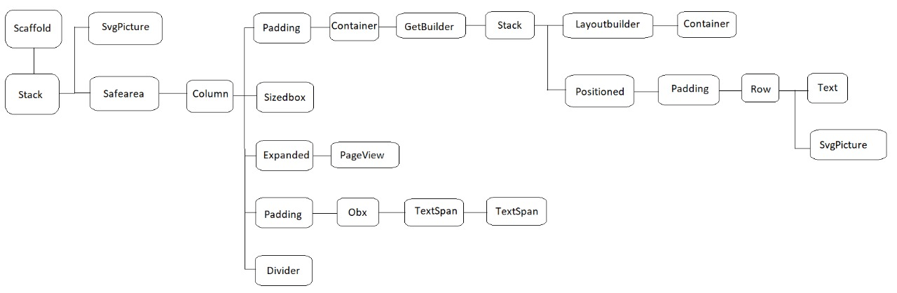
System Design
Quiz Page for Welcome page

Slide 9
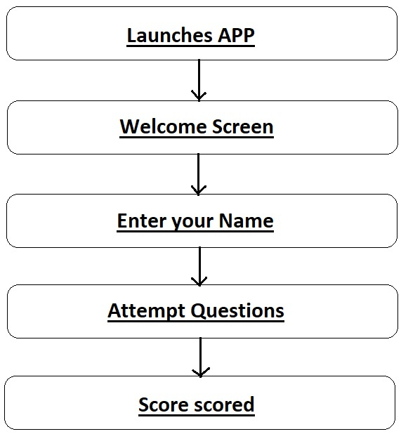
Schema Design

Slide 10
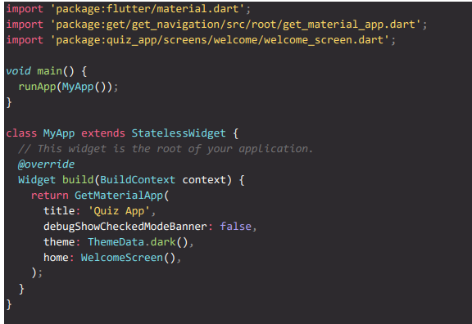
Implementation / Coding

Slide 11
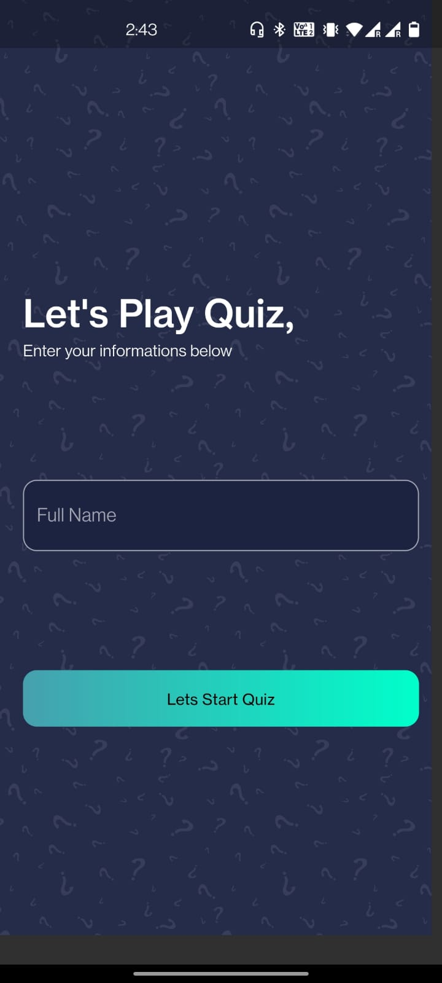
Result

Slide 12
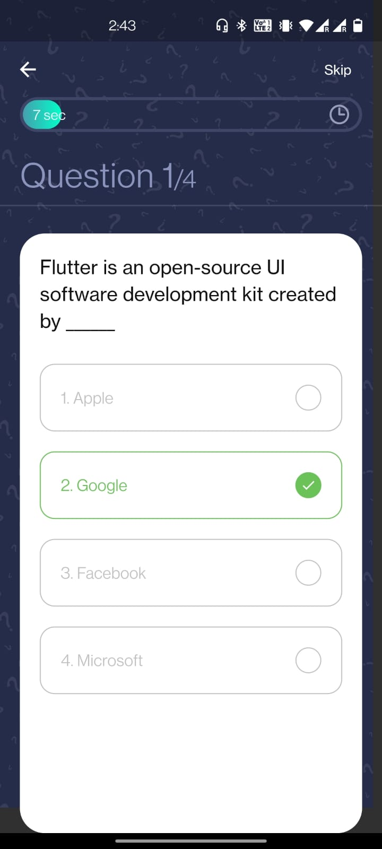
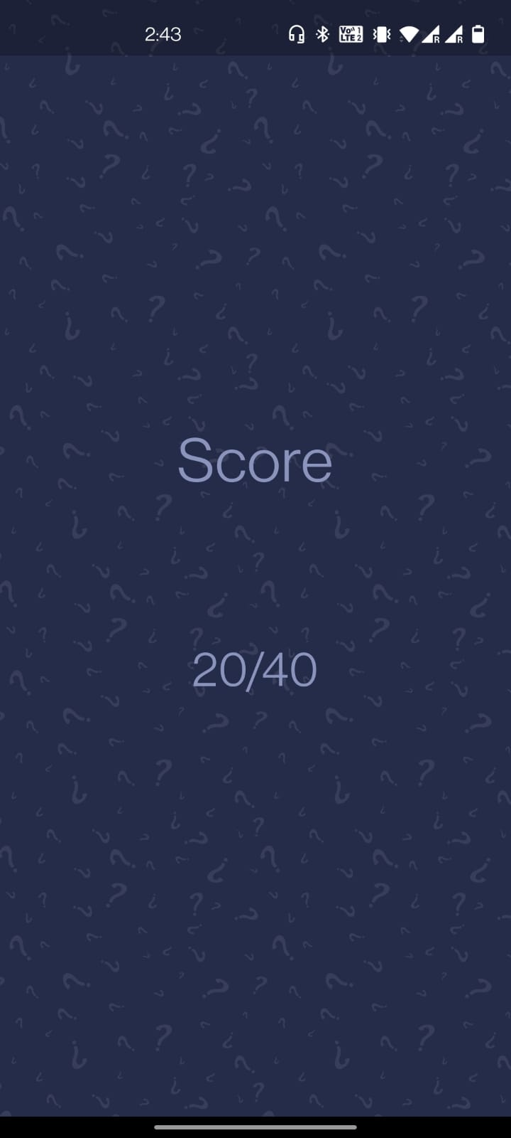

Slide 13
Testing
Testing is a process of executing a program with the interest of finding an error. Levels Of Testing
Unit Testing
Integration Testing
Validation Testing
Output Testing
User Acceptance Testing

Slide 14
CONCLUSIONS
This quiz application provides facility to play quiz anywhere and anytime.
It save time since user does need to wait for result.
Administrator has a privilege to put as much as question in any category given in application.
User can register, put their name and give the test with his/her specific id, and can see the results as well.

Slide 15
Future Enhancements
We can try and deploy it on the internet so that people can access it online also.
We can try to add different sections of the quiz as per user requirement.
We can also let different user can access the app simultaneously with their unique id.

Slide 16
REFERENCES
[1] SQL Tutorial-java point
[2] Guru99.com
[3] C#- Geeks for geeks

Slide 17
THANK YOU

