Slide 1

AMCAT DATA ANALYSIS

Slide 2
About me
Background ? (B-tech or M-tech) : B-tech
Why you want to learn Data Science : Career Growth
Any work experience : 1.5+ years , Data Analyst , TCS - Hyderabad
Share your linkedin and github profile urls : https://github.com/Divyapoojitha?tab=repositories

Slide 3
Objective : Perform Exploratory Data Analysis (EDA) on the data-set given , considering “ Salary ” as a target variable . The dataset was released by Aspiring Minds from the Aspiring Mind Employment Outcome 2015 (AMEO).
Processes Involved :
Loaded entire dataset and checked for null values which are found 0 in this case and outliers were also found but were not disturbed much as nothing seemed unreasonable
Used fuzzywuzzy .. levenshtein distance technique on some categorical columns to reduce the redundancy . Also used neutral casing techniques on some categorical columns
Post preprocessing data in required way for the ease of Analysis performed EDA on the same .
Performed Univariate and Bivariate analysis on columns in most cases with respect to target “ Salary “ and mentioned relevant observations from each plot
Checked on Research questions given and provided relevant clarification and explanation
Provided conclusion with respect to all analysis provided
In this report , some important plots and observations are being presented from the EDA done on AMCAT data .

Slide 4
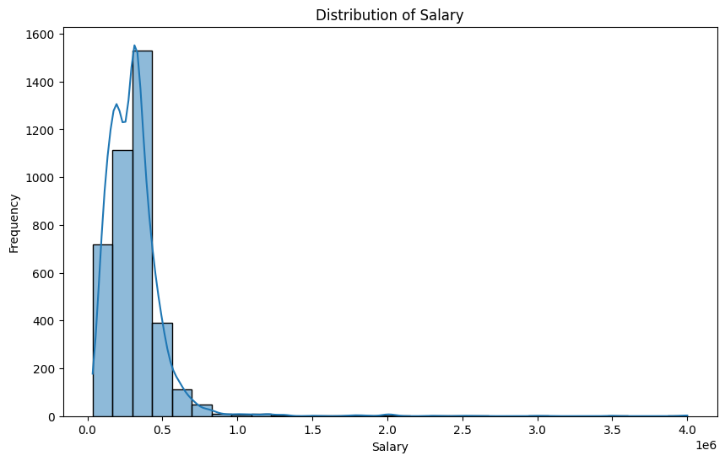
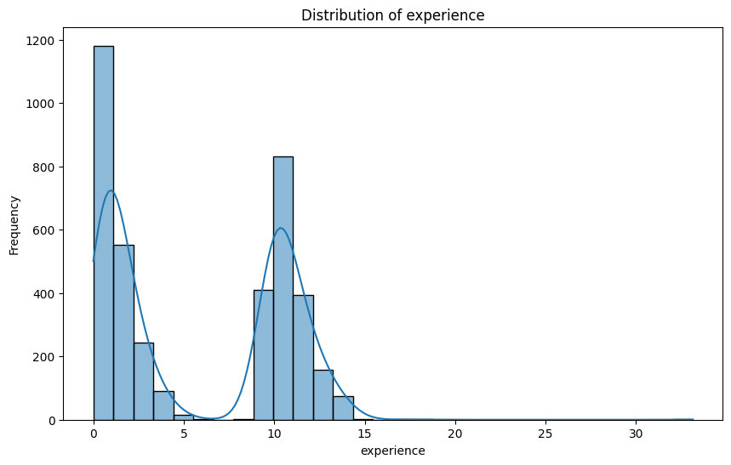

Slide 5
In univariate Numerical plots -- plots were plotted for salary , 10percentage , 12percentage and all section marks distributions individually out of which marks section columns has -1 that indicates that the student/person have not opted for that particular section . Out of above plots some general observations are :
Salary column has got more number of observations in 35,000 to 50,000 with maximum salary at 40,00,000 and minimum at 35,000
10percentage , 12percentage in these columns there are no unreasonable outliers like more than 100%
( A small assumption ) In collegeGPA column there are only some values that are actually provided in 10 GPA scale but many others GPAs are filled in percentage format so these GPA values can also be converted to percentages to be on same scale with other values .(This is performed below)
English , Logical , Quant , conscientiousness , agreeableness , extraversion , neuroticism , openess_to_experience .... these sections are mostly common for everyone
Domain , ComputerProgramming , ElectronicsAndSemicon , ComputerScience , MechanicalEngg , ElectricalEngg , TelecomEngg , CivilEngg .... In these sections '-1' indicated that the student/person have not opted for that particular section .
experience column plot can be seen with an outlier at around 33 which is also max and min of 0 . There are more number of people with experience around 3 to 10 .

Slide 6
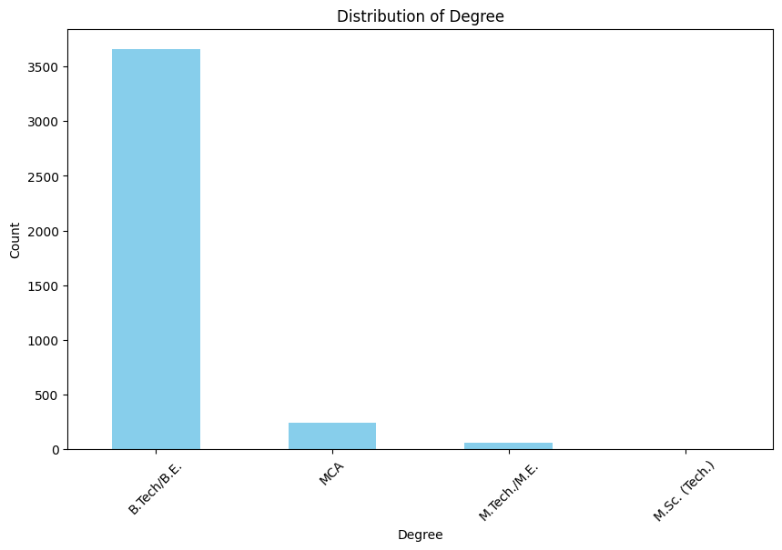
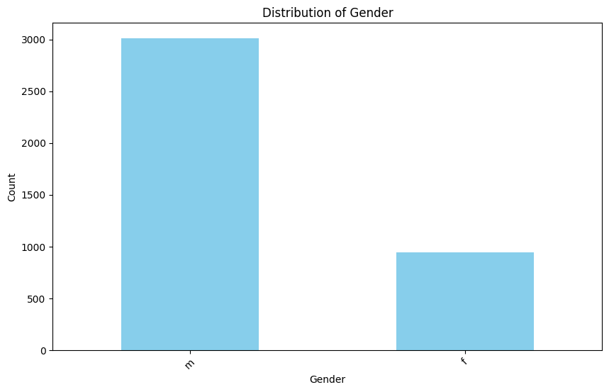

Slide 7
Univariate plots were plotted for categorical columns which are having less number of classes in it to make the plots understandable . For those columns unique elements and their value counts were also shown in between plots. Out of this some observations are :
There are more male (3009) candidates than female (949) candidates
CollegeTier '2' count ( 3662) is more than '1' count ( 296)
Degree .. most people are from B.Tech/B.E. (3663)
Specialization .... top preferred specializations are 'computers', 'electronics','information technology'
CollegeCityTier -- 0 count is more than 1 count
CollegeState -- top 4 CollegeStates from where people appeared for the exam are Uttar Pradesh > Karnataka > Tamil Nadu > Telangana
Many other observations can be seen

Slide 8
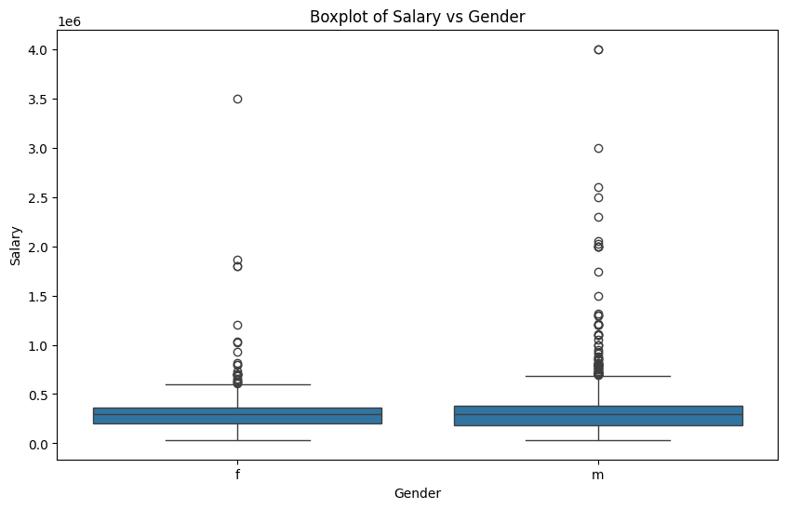

Slide 9
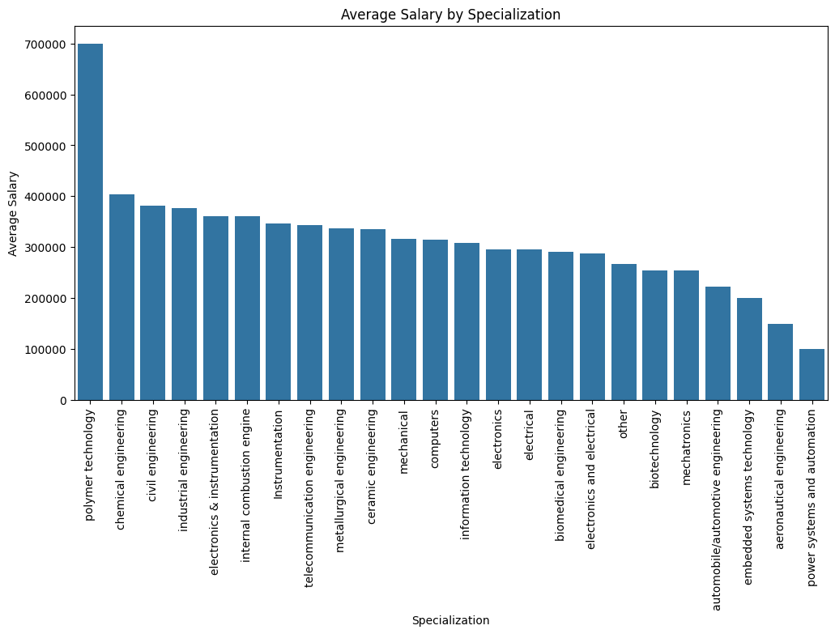

Slide 10
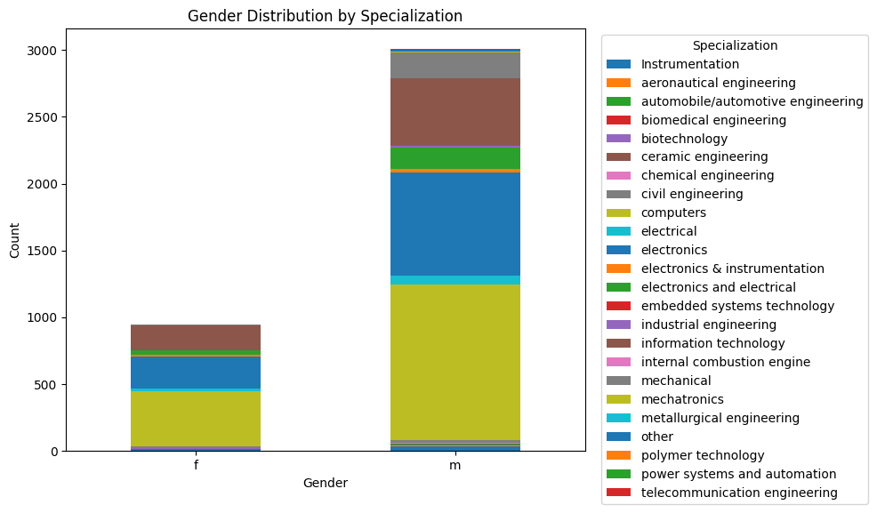

Slide 11
Research Questions :
1. Times of India article dated Jan 18, 2019 states that “After doing your Computer Science Engineering if you take up jobs as a Programming Analyst, Software Engineer, Hardware Engineer and Associate Engineer you can earn up to 2.5-3 lakhs as a fresh graduate.” Test this claim with the data given to you
…….. As checked through t-test it can be seen that with 95% confidence level salary of a fresh graduate [ Graduation Year : 2014 to 2016 ] with above jobs can earn between (281201.5757635358, 337998.4242364642) which is in the range claimed by " Times of India ". Therefore we failed to reject null hypothesis made by **Times of India**
2.Is there a relationship between gender and specialization? (i.e. Does the preference of Specialisation depend on the Gender?)
………. The chi-square statistic is approximately 83.38 and the p-value is approximately 0.0000000089238 . Since the p-value is less than the typical significance level of 0.05, we reject the null hypothesis and conclude that there is a significant relationship between 'Gender' and 'Specialization'.

Slide 12
Conclusion :
Observations were mentioned after each relevant plot . Major observations made are :
The target column Salary did not have any significant relation with any other column
Salaries ranges are almost same in both male and female irrespective of gender
Highest salary is observed in a person with polymer technology specialization where there is only one person in it
Research questions were solved and observed were mentioned above
Many relevant plots and observations were mentioned in .ipynb file of AMCAT EDA
All remaining columns does not show significant contribution towards target salary

Slide 13

THANK YOU

