Slide 1
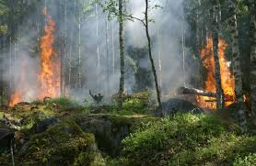
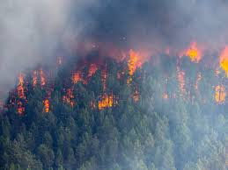
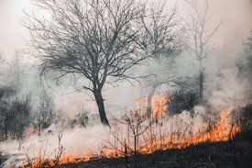
Spatial Temporal Analysis and Fire Precision Support System for Detection, Classification and Acreage Estimation

Slide 2


Bhaskaracharya National Institute for Space Applications & Geo-informatics
Ministry of Electronics and Information Technology, Govt. of India.
Gandhinagar
Sanket Gondaliya. Smit Gondaliya.
Divya Prajapati. Jayesh Patel.
Group ID No.: 24SH1 Group ID No.: 24SH1
Guided By: External Guide:
Dr. Srimanta Mandal Dr. Yagnesh Vyas
Guide & Associate Professor Project Director
DAIICT, Gandhinagar. BISAG- N, Gandhinagar.

Slide 3
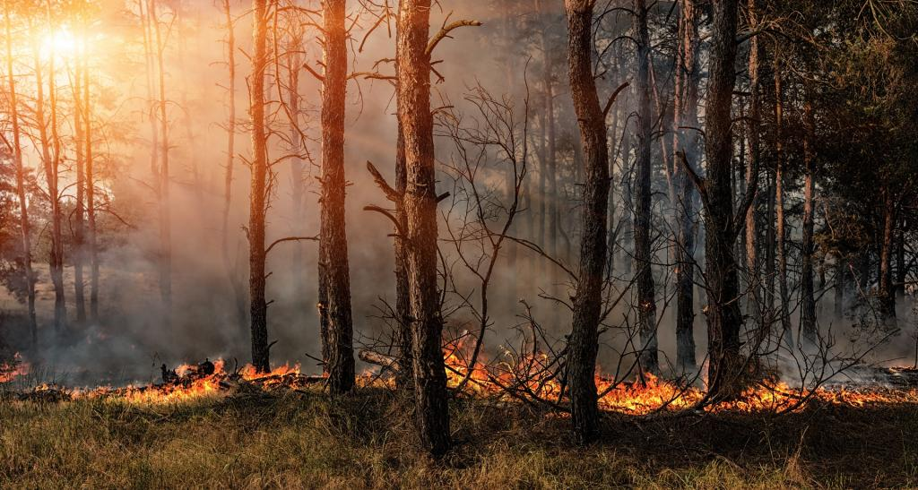
Contents
Introduction
Problem statement
Objective
Technologies used
Data explanation
Methodology
Results
Conclusion, Limitations & Future Work

Slide 4
Introduction
Forests are vital to our planet. They provide us with oxygen, clean water, and habitat for wildlife. They also regulate the climate and help to prevent soil erosion. Forests are a treasure that we should protect.
A forest fire is an uncontrolled blaze that burns through a forest ecosystem. These fires can be devastating, causing ecological damage, threatening wildlife, and endangering human settlements.
We propose a system using Sentinel satellite imagery and NDVI to detect forest fires and analyze historical fire patterns (2019-2023) for high-risk months.
Our research will develop the Fire Pattern Recognition and Severity System (FPSS) to improve fire detection, classification, and burned area estimation. This will allow for predictive modeling and more proactive fire management strategies.
This project equips forest authorities with improved tools and knowledge for faster response times and reduced environmental damage from forest fires.

Slide 5
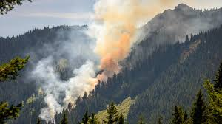
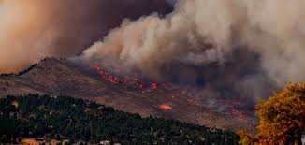
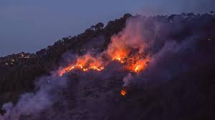
Problem statement
Climate change and human actions are driving more intense forest fires. We need better detection and management to protect ecosystems, wildlife, and communities.

Slide 6
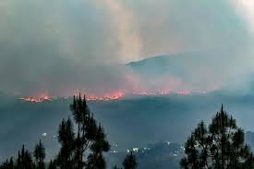
Objective
Implement a fire detection and analysis system using Sentinel satellite imagery and NDVI masks.
Assess vegetation health for pre- and post-fire scenarios to estimate burned areas.
Conduct a comprehensive temporal analysis (2019-2023) focusing on high-risk months to understand fire patterns and trends.
Design a Fire Precision Support System for improved fire detection, classification, and acreage estimation.
Equip Forest management authorities with a robust tool for proactive fire management, enhancing prevention, response, and overall effectiveness.

Slide 7
Technologies Used
1
Quantum geographic information systems (QGIS)
2
Google Looker Studio
QGIS is a versatile and user-friendly desktop GIS software, available for free as an open-source platform. QGIS supports both raster and vector layers, making it suitable for a wide range of spatial data analysis tasks.
Google Looker Studio excels in the realm of data visualization, providing an extensive suite of tools and features designed to transform raw data into visually compelling insights.
3
Google Earth Engine(GEE )
4
Python
Google Earth Engine is a cloud-based platform developed by Google that enables users to analyze and process large-scale geospatial datasets using Google's infrastructure. It provides access to an extensive archive of satellite imagery and other geospatial datasets
Python is a versatile and powerful programming language widely used for data analysis, machine learning, and automation. Its extensive libraries and frameworks make it an ideal choice for developing data-driven applications and conducting complex analyses.

Slide 8
Data Explanation
Study Area:
Forest Region (2019-2023): We analyzed high-resolution satellite imagery (Sentinel-2) to assess wildfire impacts on vegetation health using pre- and post-fire comparisons. (Latitude 19.5°N, Longitude 83.3°E)
Overview of Sentinel 2
Feature | Description
Temporal Resolution | Revisiting time: 5 days (with both Sentinel-2A & 2B), effectively 10 days at most locations
Spatial Resolution | 10 meters for bands B2, B3, B4, B8. 20 meters for band B8A. 60 meters for bands B1, B9, B10, B11, B12.
Spectral Resolution | 13 bands (visible, NIR, SWIR)
Derived data | NDVI

Slide 9
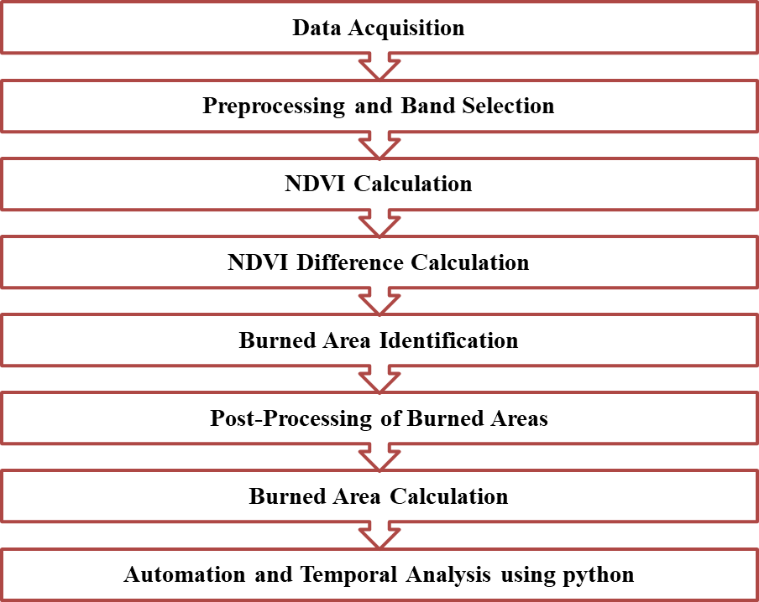
Methodology

Slide 10
Results
Early Fire Detection
Improved fire detection accuracy and timeliness, allowing for faster response times.
Fire Severity Estimation
Accurate estimation of fire intensity and spread, enabling efficient resource allocation and firefighting strategies.
Fire Acreage Estimation
Precise calculation of the area burned by fire, providing valuable information for post-fire recovery and management.
Risk Assessment
Identification of high-risk areas prone to fire ignition and spread, enabling proactive fire prevention measures.

Slide 11
Conclusion, Limitations & Future Work
Conclusion
Limitations
Future Work
The study used Sentinel satellite images and NDVI to identify fire scars in forests over 5 years. Healthy and fire-damaged areas were distinguished by analyzing the way light reflects off them . A threshold NDVI value acted like a fire severity line, separating healthy pixels from burned ones.
The effectiveness of the system heavily relies on the quality and availability of spatial and temporal data. Limited access to high-resolution data can impact the accuracy of fire detection and classification. Real-time processing of large spatial datasets requires significant computational resources.
Future efforts for the Spatial Temporal Analysis and Fire Precision Support System should focus on improving data collection methods and sensor technology. This would allow the system to gather information with greater resolution and more frequently.

Slide 12


