Slide 1
AI Pipeline for
Object Detection
And
Image Analysis
Created By : Divyaprem
E-Mail-ID : vdivyaprem@gmail.com

Slide 2
What is the need?
Building an AI pipeline that detects objects and text within an image is essential for automating image analysis, enabling efficient extraction of relevant information. This capability is valuable in various applications, such as document processing, automated inventory management, visual search, and enhancing accessibility by converting images into structured data.
It helps streamline workflows, reduces manual effort, and improves accuracy in interpreting and analyzing visual content.

Slide 3
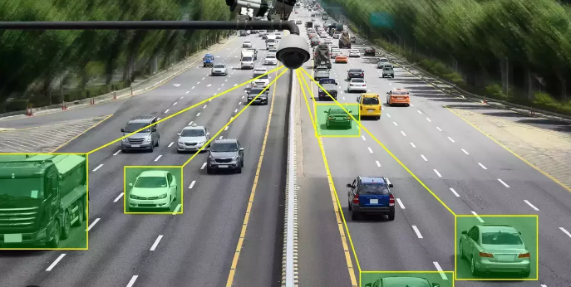
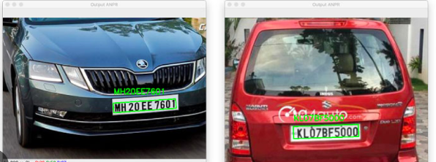
Common Application in real world?
Vehicle and number plate detection enhances security and traffic management by automating identification, monitoring violations, and managing parking.
It increases efficiency, reduces errors, and enables real-time analysis, making it vital for modern transportation systems and law enforcement.

