Slide 1
Employee Data Analysis using Excel
STUDENT NAME: Divya Priya.D
REGISTER NO: 312210906, 1D654F4984555DC98EF4E7F449312661
DEPARTMENT: B.COM Commerce
COLLEGE: Bhaktavatsalam Memorial College For Women

Slide 2
PROJECT TITLE
Employee Salary Analysis using Excel

Slide 3


AGENDA
Problem Statement
Project Overview
End Users
Our Solution and Proposition
Dataset Description
Modelling Approach
Results and Discussion
Conclusion
3/21/2024 Annual Review

Slide 4

PROBLEM STATEMENT
The organization needs a thorough analysis of employee salaries to identify disparities, optimize compensation, and ensure fairness across different roles and FTE levels. The goal is to use Excel to categorize and assess salary data, uncover trends, and provide insights for better salary management.

Slide 5

PROJECT OVERVIEW
This project uses Excel to analyze employee salaries, focusing on how they are distributed across roles and work levels. The goal is to identify trends and inconsistencies, providing insights for fair and competitive compensation. The analysis will help inform better salary decisions and improve overall pay equity.

Slide 6
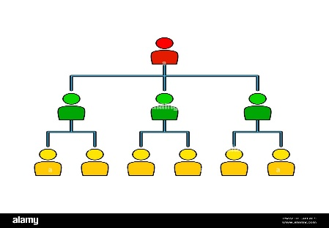

WHO ARE THE END USERS?
HR Professionals: Person reviewing salary reports and making adjustments.
Management: Executive or manager analyzing data charts and making strategic decisions.
Finance Teams: Financial analyst working on budget spreadsheets and forecasts
Employees: Employees benefiting from improved salary practices
Recruiters: Recruiter using salary
benchmarks to make job offers.

Slide 7

OUR SOLUTION AND ITS VALUE PROPOSITION
1. Conditional Formatting - Highlighted salaries greater than 80,000 and less than 80,000 in different colors.
2. Formula- Created a formula to categorize salaries into different levels such as High, Medium and Low
3. Pivot Table- Summarized salary data to show key insights like averages and distributions.
4. Graph- Used charts and graphs to visually represent salary data and trends.

Slide 8
Dataset Description
Employee- Edunet
10- Features
8- Features
Emp id- Alphanumeric
Name- Text
Gender- Text
Department- Text
Salary- Decimal
FTE- Decimal
Employee type- Text
Salary level- Text

Slide 9

THE "WOW" IN OUR SOLUTION
Salary level =IF(G2 >= 0.8, "High", IF(G2 >= 0.5, "Medium", "Low"))
3/21/2024 Annual Review
9

Slide 10
MODELLING
Data Collection- Downloaded the employee dataset from Edunet.
Data Preparation- Cleaned the data to remove any errors or inconsistencies.
- Highlighted the eight selected features (Employee ID, Name, Gender, Department, Salary, FTE, Employee Type, and Salary Level) with a yellow fill for better visibility.
- Applied conditional formatting to highlight salaries above 80,000 and below 80,000.
3. Salary Categorization - Created formulas to categorize salaries into levels (e.g., Low, Medium, High) based on predefined thresholds.
Analysis with Pivot Tables - Developed pivot tables to summarize salary data by department, gender, FTE, and other categories.
- Used slicers in pivot tables to easily filter and explore the data by different categories.
5. Visualization - Created bar graphs in a new Excel sheet to visually represent salary distributions and comparisons across different categories.
10

Slide 11
RESULTS
11

Slide 12
conclusion
The employee salary analysis using Excel revealed important patterns in the organization’s pay structure. By organizing and categorizing the data, we identified differences in salaries across departments, roles, and FTE levels. Pivot tables and bar graphs made it easy to see these trends and pinpoint areas that need attention. This analysis helps ensure that compensation is fair and competitive, aiding better decision-making for HR and management.

