Slide 1
SECURE data hiding in image using steganography
CAPSTONE PROJECT
Presented By: Divyarajsinh Thakor
Student Name : Divyarajsinh Thakor
College Name & Department : National Forensics Sciences University, M.Sc. DFIS

Slide 2
OUTLINE
Problem Statement
Technology used
Wow factor
End users
Result
Conclusion
Git-hub Link
Future scope

Slide 3
Problem Statement
In today’s digital world, secure communication is crucial. This project addresses the need to hide messages inside images using steganography, ensuring confidentiality and security.

Slide 4
Technology used
Python Version 3 or later
OpenCV
Tkinter
Numpy
PIL (Pillow)
Cryptographic Hashing (SHA-256)
Visual Studio (IDE)
RAM 2 GB (Minimum requirement)
Processor any modern dual-core processor
Storage at least 100 MB of free disk space

Slide 5
Wow factors
Uses LSB (Least Significant Bit) technique for steganography
Password protected message encoding/decoding
Simple GUI for ease of use
Secure message retrieval only with the correct key

Slide 6
End users
Journalists and whistle-blowers
Cybersecurity professionals
Privacy conscious individuals
Government agencies
Secret communication in corporate sectors

Slide 7
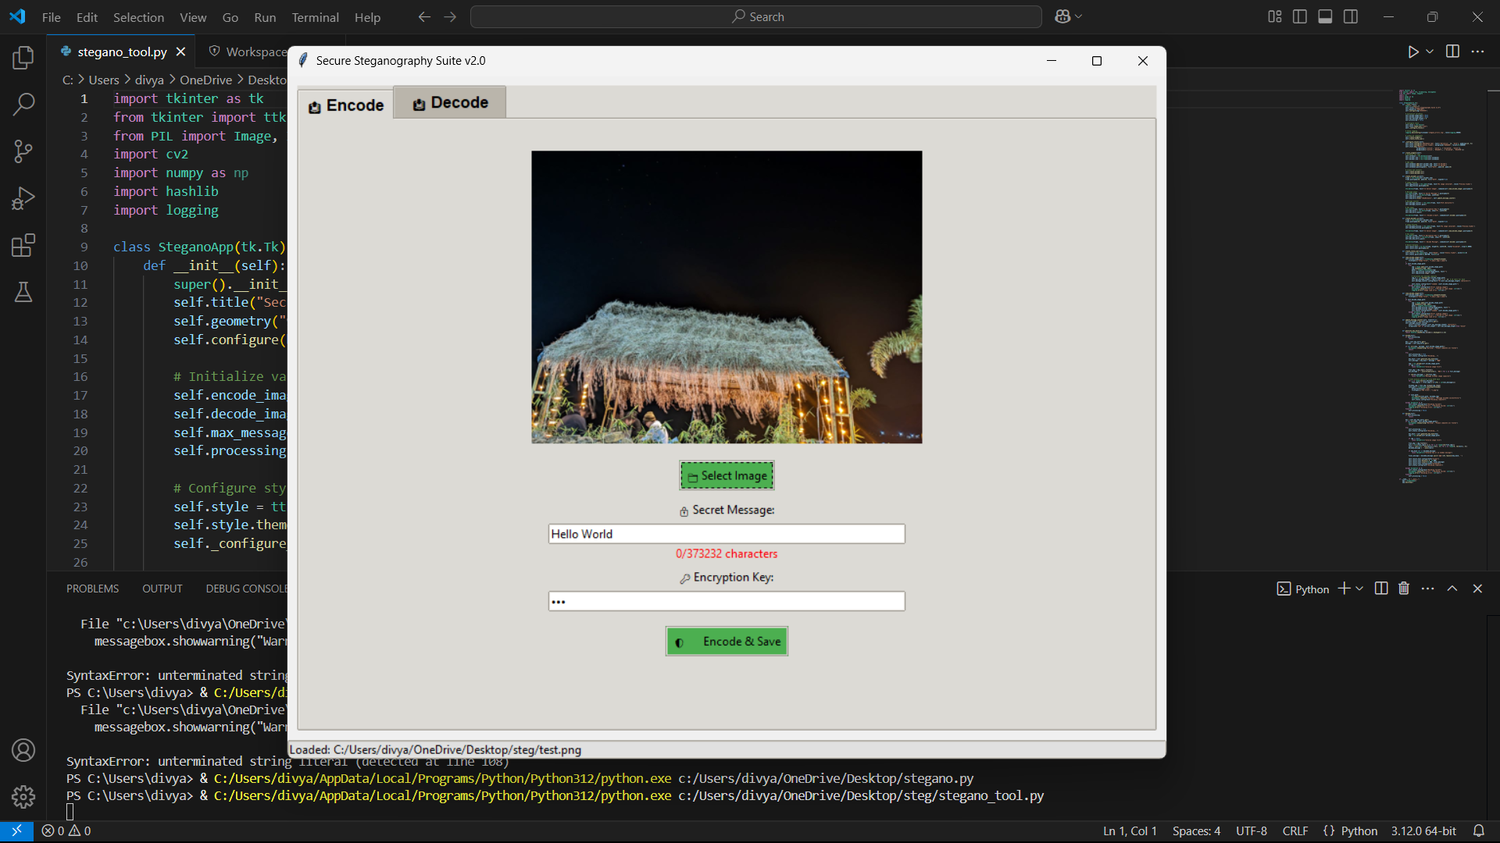
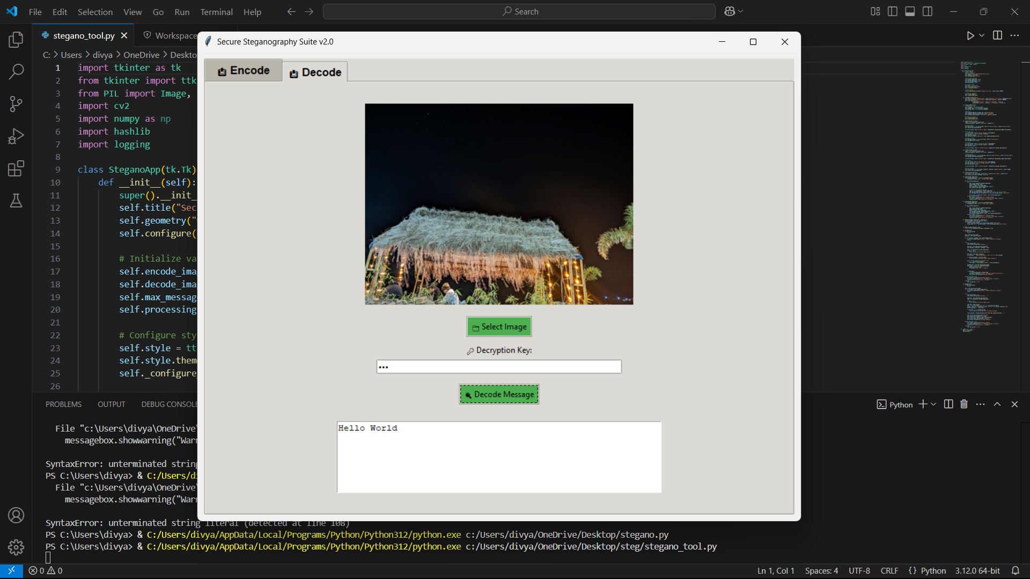
Results
The tool successfully hides and retrieves messages inside images using a user-provided key. The encoded image retains its original appearance while securely storing the message.

Slide 8
Conclusion
This project provides a simple yet effective way to ensure secure communication by embedding messages within images. It offers ease of use with a GUI and strong encryption with a secret key.

Slide 9
GitHub Link
https://github.com/DivyarajThakor/Steganography-.git

Slide 10
Future scope(optional)
Support for multiple file formats (GIF, BMP, etc.)
Improved encryption algorithm
Mobile and web-based versions

Slide 11
THANK YOU

