Slide 1


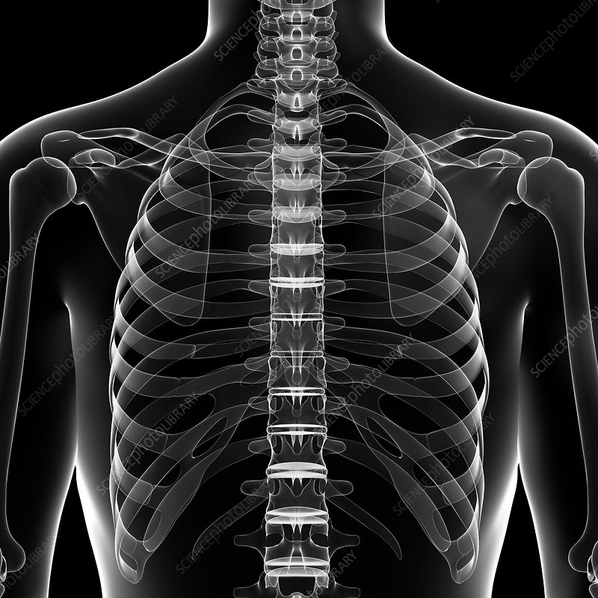

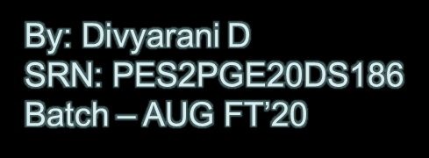

Automatic Report Generation
From Chest X-rays

Slide 2


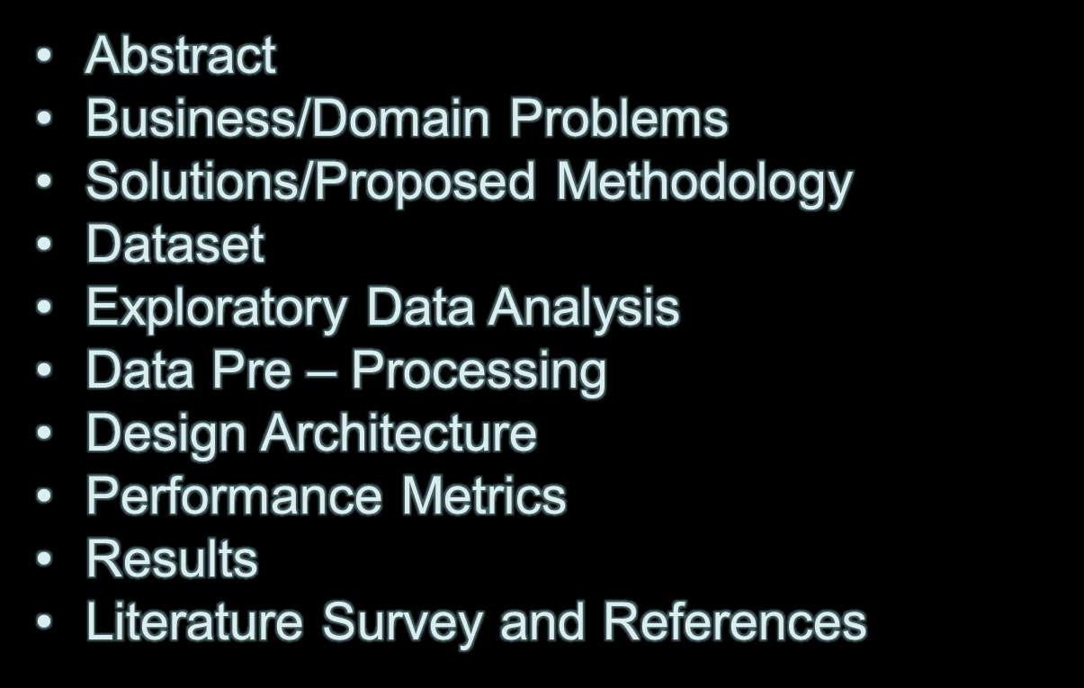
Contents

Slide 3

Abstract
Undoubtedly, the computer vision playing a significant role in healthcare domain. The recent researches also have shown potential towards automatic radiology report generation that reduces the time consumption in radiographs evaluation and report writing that requires prowess radiologists. The radiology report generation remains a challenging task in regards to understand and connect to the convoluted medical visual details with meticulous natural language explanations in spite of a successful application of deep learning techniques on image classification and image captioning tasks. The proposed system deals with this challenge and implements image captioning problem for “Indiana University Chest X-Ray” dataset containing chest X-rays along with radiology reports with the help of the state of the art deep learning architecture, however this model extracts features from the X-Ray images using a pre-trained model (CheXnet) and pass it to LSTM network. A word level attention model would be used to enrich the decoder and extract medical concepts from the x-ray images. Thus the model is built to solve the problem statement of this project.

Slide 4
Business Problems
Manual analysis of X-ray images or CT – scans
Expensive - Expertise Radiologist
Time consumption to write full - text report
Delayed in treatment - Crowded hospitals
Human error in case of urgency
Loss of patients in case of Radiologist absence

Slide 5
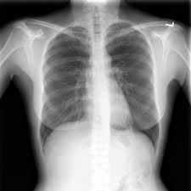
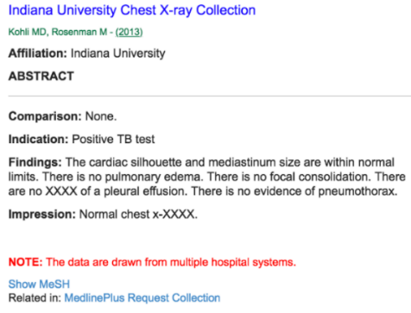
Dataset
Dataset Name: Indiana University Chest X-Ray dataset
Size: - 7471 Images
- 3955 Reports
- Each report has maximum 5 images
Features: image_name, image_caption, comparison, indication, impression
Target variable: findings
Sample image: Sample Report:

Slide 6
Exploratory Data Analysis
Exploratory Data Analysis:
Reports and Images
Reports 3.5K directly map to 3.5K patients
X-Ray images 7.5K. Each patient has 1 or more than 1 X-Ray
Each Report maps to mandatorily 1 Frontal and/or more than 1 Lateral images
Not all patients have lateral X-Ray images
Key Attributes
Findings, Impressions, Indications
Found reports with missing Findings
Found blank reports
Data Quality
Special characters
Numerical values in the data
Inconsistent sentence formation
Found XXXX

Slide 7
Data Pre - Processing
Pre - Processing:
Extract
Used BeautifulSoup to extract required data from XML
Used impressions where findings data are unavailable
Removed blank reports
Transform
Removed Punctuations, special characters
Removed XXXX
Removed blanks
Removed special characters except period (.) and special strings like '<BR>', '&gt;]', '[&lt;', '?'
Converted to lowercase
Loading
Word vocab generation using Tokenization
Add tokens (<start> and <end>) for each paragraph

Slide 8
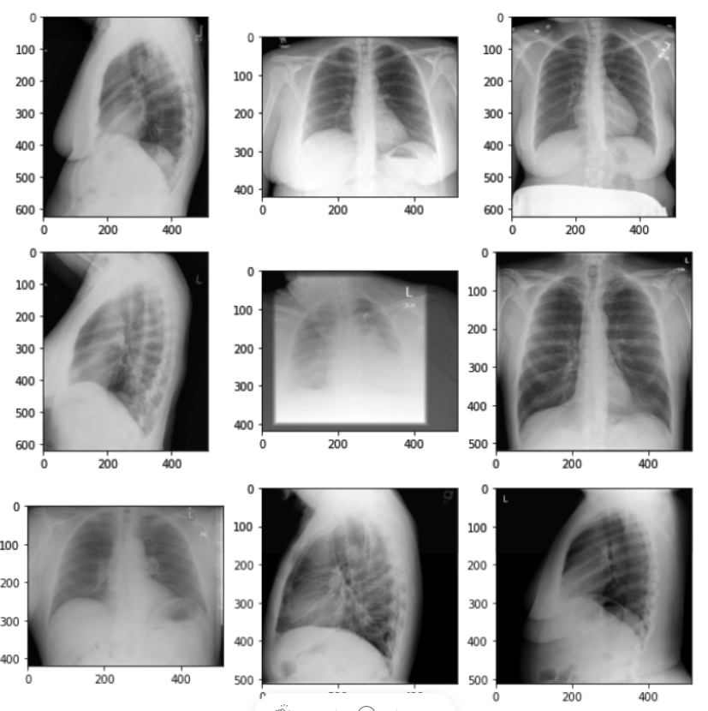
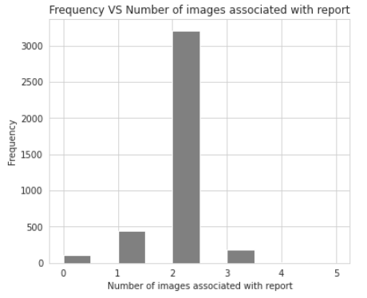
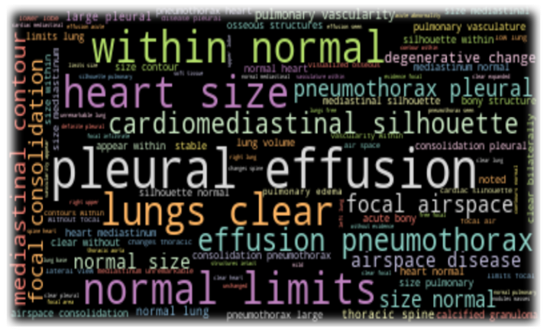
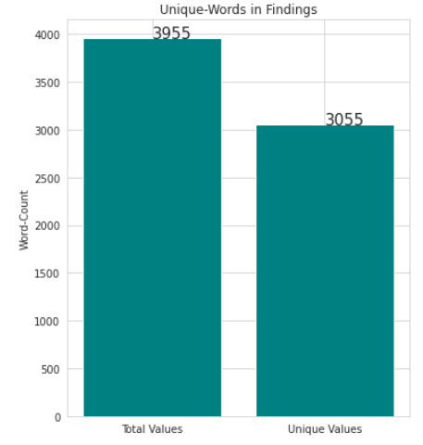

Slide 9
Structured Data
1. if I have 5 images then total 4 data points created
  1st image + 5th image
  2nd image + 5th image
  3rd image + 5th image
  4th image + 5th image
2. If I have 4 images then total 3 data points created
  1st image + 4th image
  2nd image + 4th image
  3rd image + 4th image
3. If I have 3 images then total 2 data points created
  1st image + 3rd image
  2nd image + 3rd image
4. If I have 2 images then it is according to our requirement
5. At last, If i have 1 image,I just replicate it and make it 2.

Slide 10
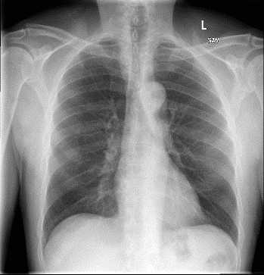
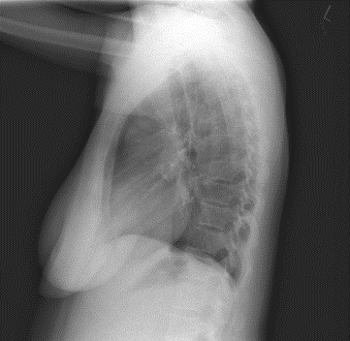
Proposed Methodology
Deep Learning Technologies used to solve the business problem:
figure: High Level Architecture
Report
CheXNet
[ Feature Extractor ]
Findings: The heart is normal in size. The mediastinum is unremarkable. The lungs are clear
Encoder
Decoder

Slide 11
Design Architecture
CheXNet
[ Pre – trained Denset 121 layered model]
a₁
a₂
.
.
.
a₁₀₂₄
Figure: CNN Architecture

Slide 12

Design Architecture Contd.,
CheXNet
[ Pre – trained model]
Image features
(2048)
Dense
512 units
Concatenate
(Context + Embeddings)
Dense
(units = vocab size)
Hidden state
Embedding layer
300 Dimensions
LSTM
(i/p length, units)
Dimensional
LSTM output
Tokenized Text
Figure: LSTM Architecture

Slide 13
Performance Metrics
The performance metrics used to evaluate the effectiveness of the system proposed in this thesis is – BLEU score
BLEU stands for Bilingual Evaluation Understudy Score
This metric is commonly used in the field of Image Captioning
They enable to assess the quality of the generated reports by comparing N-gram’s occurrence with the ground truth
BLEU scoring is a unique method for this that uses modified n-gram precision. “An n-gram is a sequence of words occurring within a given window where n represents the window size”
A perfect match results in a score of 1.0, whereas a perfect mismatch results in a score of 0.0.

Slide 14
Performance Metrics contd.,
The score was developed for evaluating the predictions made by automatic machine translation systems.
It is not perfect, but does offer 5 compelling benefits:s
It is quick and inexpensive to calculate.
It is easy to understand.
It is language independent.
It correlates highly with human evaluation.
It has been widely adopted.

Slide 15
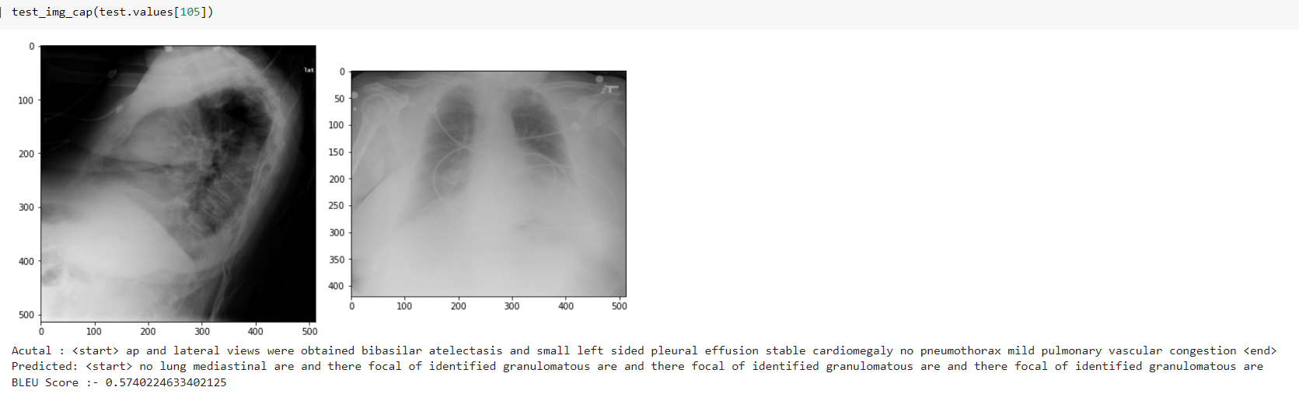

Results

Slide 16
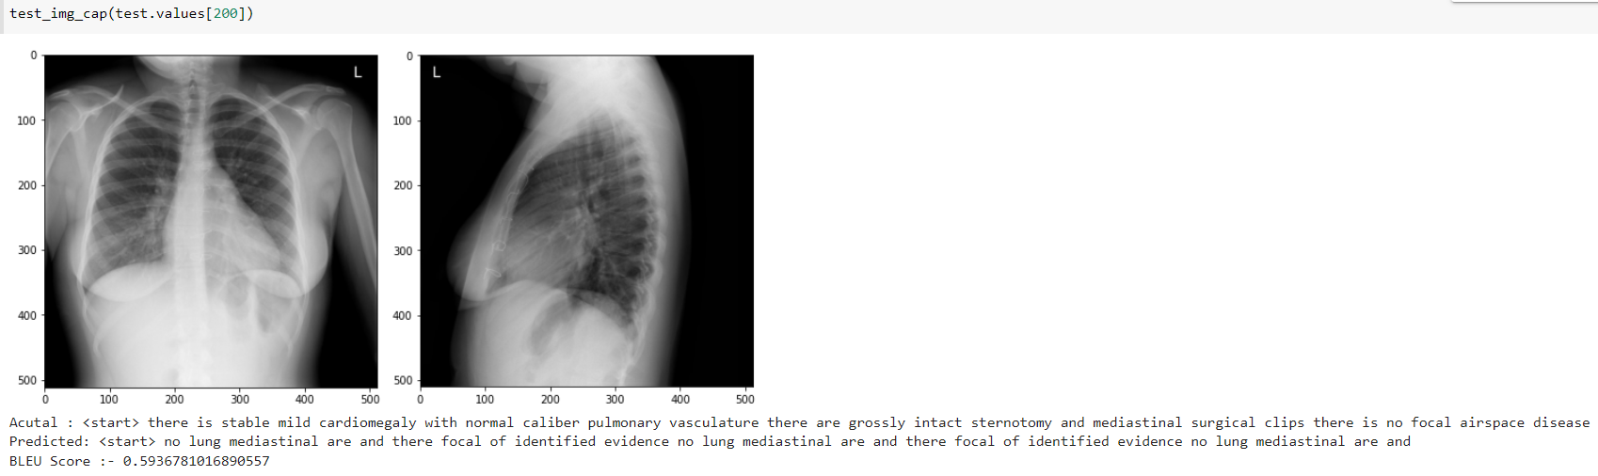

Results Contd.,

Slide 17
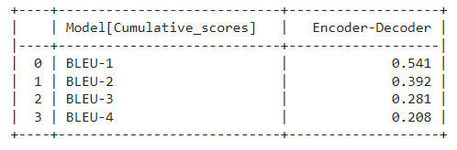
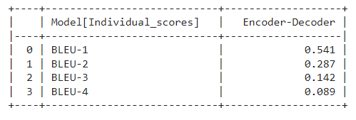
Results Contd.,

Slide 18
Results Contd.,
Model | BLEU - 1 | BLEU - 2 | BLEU - 3 | BLEU - 4
Proposed Model | 0.541 | 0.392 | 0.281 | 0.208
Automatic Generation of Chest X-ray Reports Using a Transformer-based Deep Learning Model | 0.479 | 0.359 | 0.219 | 0.160
Learning to Generate Clinically Coherent Chest X-Ray Reports | 0.420 | 0.272 | 0.193 | 0.146
Baselines for Chest X-Ray Report Generation | 0.305 | 0.201 | 0.137 | 0.092

Slide 19
Paper - 1
Year of Publication | Title & Authors | Methodology/Techniques Used | Dataset name and size | Results / Accuracy | Conclusion/Future enhancement | Takeaway for Research work
2021 | Automatic Generation of Chest X-ray Reports Using a Transformer-based Deep Learning Model Authors: Ayoub Benali Amjoud Mustapha Amrouch | Feature Extraction: DenseNet-121 CNN, Encoder and Decoder: Vanilla transformer | Indiana University Chest x-rays Size: 7470 chest x-ray images and 3955 medical reports | BLEU – 0.479 | The proposed model allows the generation of long and detailed medical reports. Future research will investigate the application of other methods and the implementation of weakly supervised learning to overcome the need for image labelling. | DenseNet - 121 is the preferred pre-trained model for feature extraction, because it does not need a great number of parameters, which means we do not spend a significant time learning redundant feature maps.

Slide 20
Paper - 2
Year of Publication | Title & Authors | Methodology/Techniques Used | Dataset name and size | Results / Accuracy | Conclusion/Future enhancement | Takeaway for Research work
2020 | Learning to Generate Clinically Coherent Chest X-Ray Reports Authors: Justin Lovelace Bobak Mortazavi | CheXpert LSTM | MIMIC-CXR dataset. Size: 227,835 chest x-ray images and 377,110 reports | BLEU – 0.415 | The clinical coherence of model is still insufficient for clinical practice. More work must be conducted in the future to continue improving the clinical coherence of automated report generation to enable adoption of such methods | Clinical Coherence is important and critical to attain

Slide 21
Paper - 3
Year of Publication | Title & Authors | Methodology/Techniques Used | Dataset name and size | Results / Accuracy | Conclusion/Future enhancement | Takeaway for Research work
2020 | Baselines for Chest X-Ray Report Generation Authors: William Boag Tzu-Ming Harry Hsu Matthew McDermott Gabriela Berner Emily Alsentzer Peter Szolovits | Image Captioning, Medical Text generation | MIMIC-CXR dataset. Size: 473,057 chest x-ray images and 206,563 reports | BLEU – 0.305 | Beam search is critical for strong text realism | Standard NLG metrics are ill-equipped to measure the quality of clinical text. The over- reliance on n-gram overlap caused these metrics to favour irrelevant-but-fluent reports over correct-but-ungrammatical ones.

Slide 22
References
Paper 1:
https://ieeexplore.ieee.org/document/9626725
Paper 2:
https://www.semanticscholar.org/paper/Baselines-for-Chest-X-Ray-Report-Generation-Boag-Alsentzer/28af66148c1728fc1cd9775242cecf6c6fc7f3c3
Paper 3:
https://www.semanticscholar.org/paper/Learning-to-Generate-Clinically-Coherent-Chest-Lovelace-Mortazavi/a554243e6806ac419ffdb19c354686f77ef2b848

Slide 23
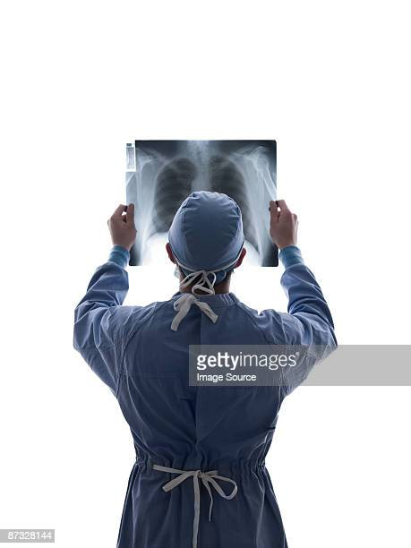
Thank You

