Slide 1
Innovation

Slide 2
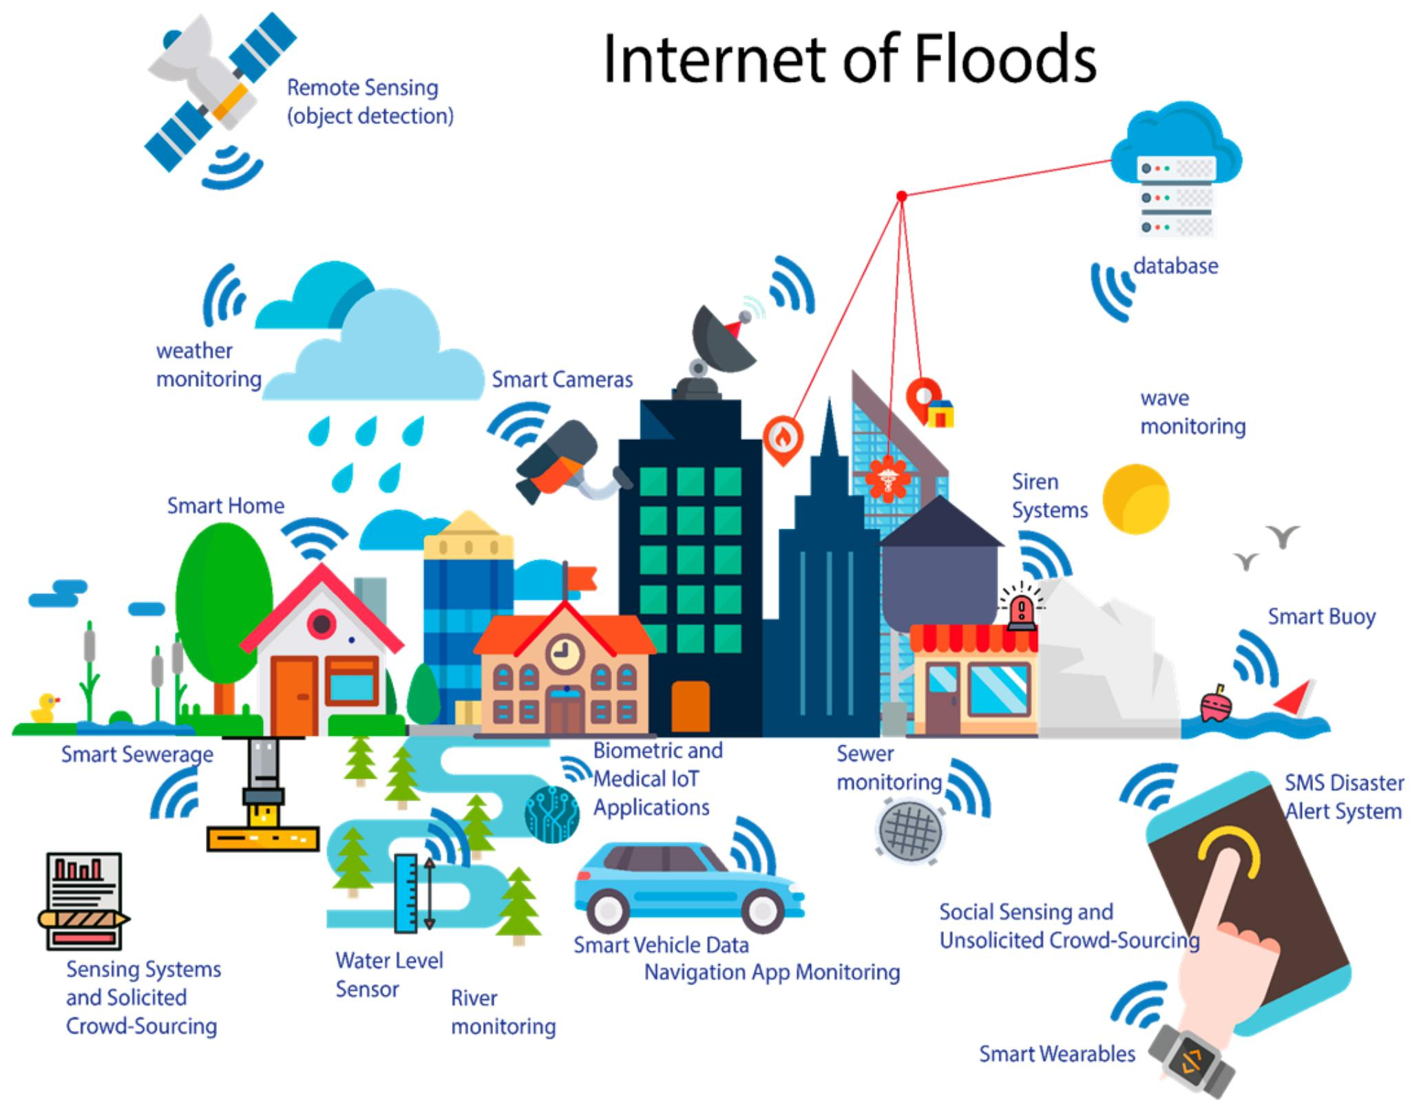
Innovation for flood monitoring and early warning system
Abstract
Introduction
Block diagram
Conclusion

Slide 3
Abstract
Water plays an important role in our day to day life in various fields.introduction of new methods to solve the water related issues includes adaptive management, remote sensing with the new concepts such as water security, global integration of information,etc . Recently we can see increasing ammount of dam damage or failure due to aging, earthquakes occurrence and unusual changes in weather. For this reason,dam safety is gaining more importance than ever before in terms of disaster management at a national level. Therefore,the government is trying to come uh with an array of legal actions to secure consistent dam safety .other dam management organizations are also taking various institutional and technical measures for the same purpose.

Slide 4
When it comes to dam safety issue.There is hardly a set of rules for how and when water can be released and what should be the standard operating procedure in case sudden release is required. This project purpose an IOT based dam management system.ln this,four ultrasonic sensors namely, temperature sensor, humidity sensor water levels sensor and rain sensor are used to monitor the state of dam. Node MCU is used to interface all the sensors and send the data to the cloud .Machine learning algorithms is designed to control the operation of doors of dam via a servo motor
KEYWORDS : Flood detection,IOT , python. Embedded C Node MCU,DNN

Slide 5
Introduction
An IOT based dam management system is being developed in this project to avoid floods Occuring due to to improper of operating and closing of doors of dam .An attempt to make a system to sense the temperature, humidity,water level and rain presence is made, depending on which the opening door percentage will be decided.
Servo motor used to control the opening and closing of doors of dam .Node MCU is an open source IOT platform,whose firmware is developed for ESP8266 wifi chip. This used to interface the ultrasonic sensors the data form these sensors is sent on cloud for for decision making stage that is designed using machine learning algorithm using python. The output of machine learning algorithm will be sent se back to back node MCU which will decide how much extent the doors of the dam should be opened.

Slide 6
Block diagram
The guidelines of the central water commission on dam safety say thatan emergency food warning system should be in place for downstream areas and technical instruments should be invented and property of people downstream besides identifying vulnerable points and setting up signboard, hooters,sirens and mobile vans equipped with public address system. For detecting change in humidity and temperature the system has a DHT11 digital temperature humidity sensor. It is an advanced sensor module with consist of resistive humidity and temperature detection components. The water level is always under observation by a float sensor, which works by opening and closing circuits as water levels rise and fall . It normally rest in the closed position, meaning the circuit is incomplete and no electricity is passing through the wires yet .

Slide 7
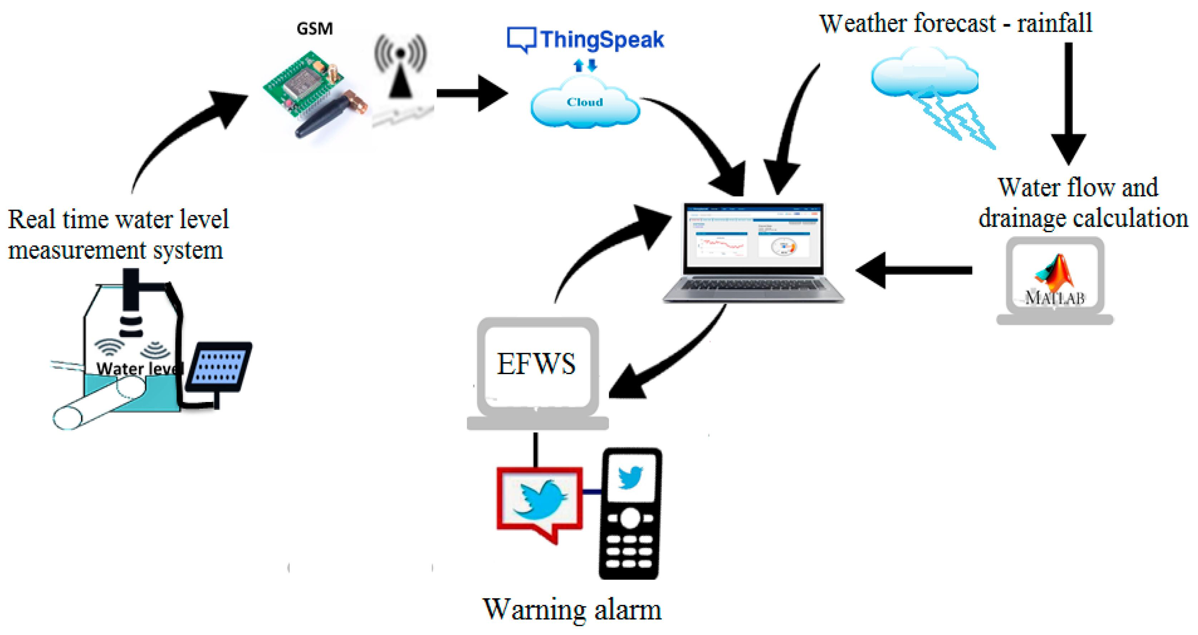
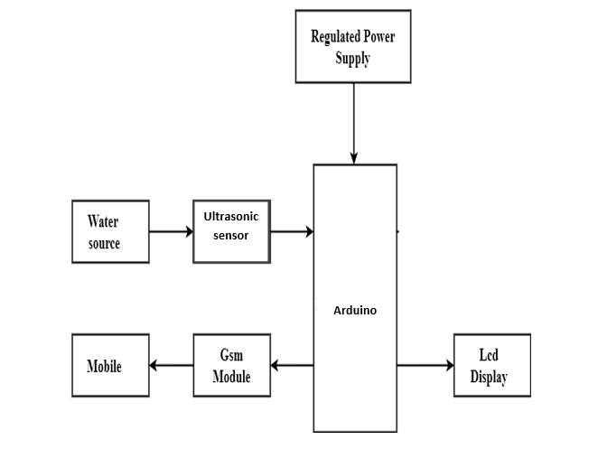
Once the water level drops below a predetermined point ,the circuit completes itself and sends electricity through the completed circuit to trigger an alarm ⏰.

Slide 8
Conclusion
It has been observed that wireless sensor network based environment monitoring systems are low cost , small size and early reliable.But these system cannot be used for large area because each node is usually energized by energy limited battery.This paper performed survay of various environmental and flood disaster detection & monitoring systems and different communication technologies which help to improve upon the effective flood detection and flood warning problem.So in the water future these system with highly reliable sensor and effective IOT cloud platform will critically be used for large scale environment monitoring and disaster prevention .

