Slide 1
ANALYSIS ON TERRORISM
K.DIVYA VANI

Slide 2
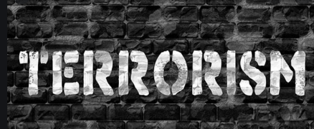

Slide 3

Terrorism is the systematic use of terror. Common definition of terrorism refer only to those violent acts which are intended to create fear.

Slide 4
WHY TO ANALYSE TERRORISM DATASET?
To gather information from the pattern of attacks happening around to help and to reduce terrorism attacks
WHAT TO ANALYSE?
The source dataset to analyse contains records of terrorist activities that happened around the world from 1970 to 2017.
The dataset contains 11 columns namely Year, Month, Day, Country, Region, City, Attack_type, killed, Group, Target_type, Weapon_type

Slide 5



Tools used:
Talend : It is used to clean data and loading of
data.
HDFS: It is used as the main storage file system
Hive: It is used to run all the queries that are used
to analyse the data.

Slide 6
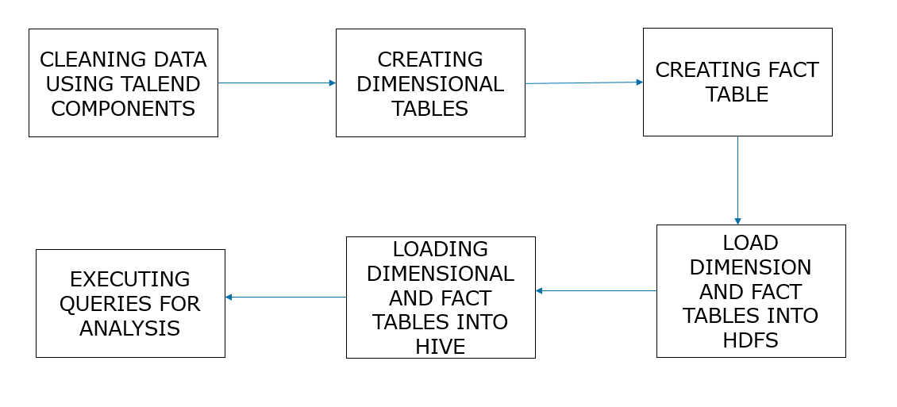
FLOW CHART:

Slide 7
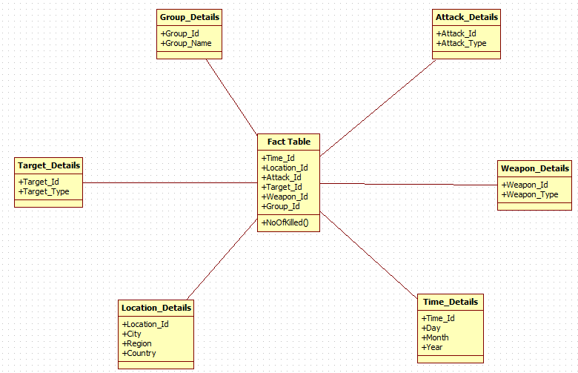
DATA MODEL:

Slide 8
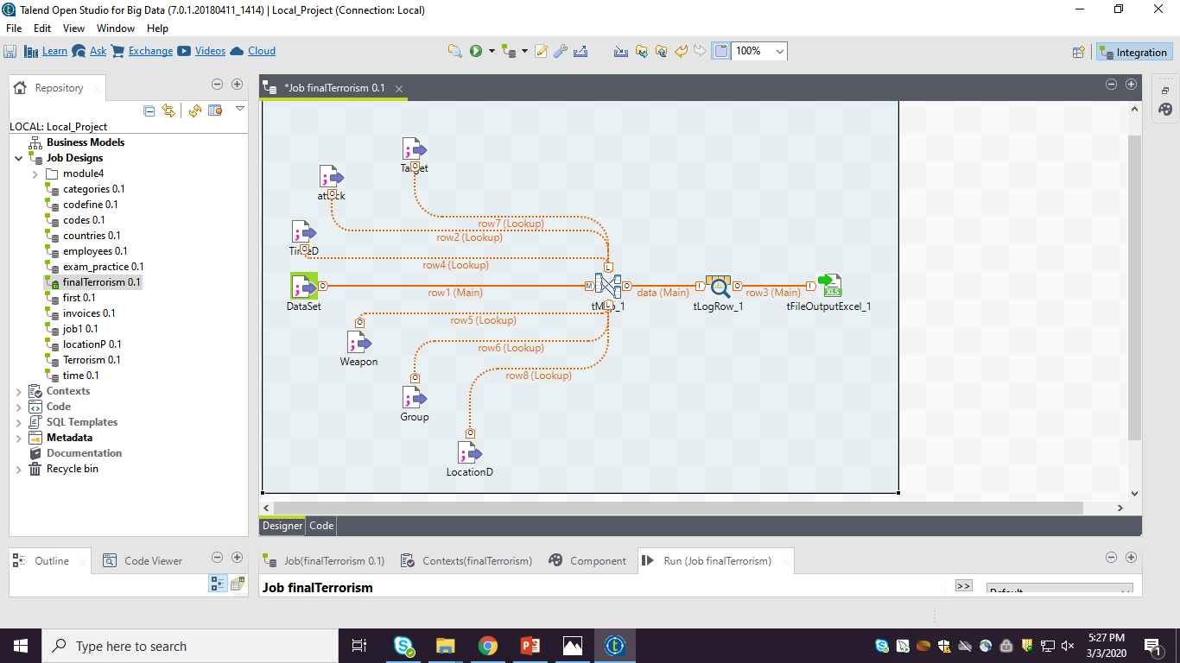
Creating fact table:

Slide 9
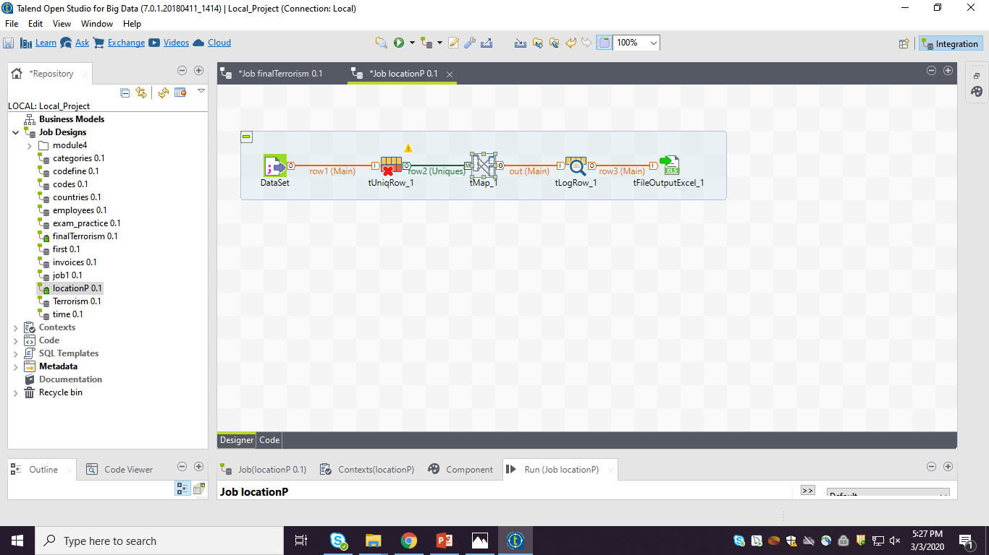
Creating dimension tables:

Slide 10
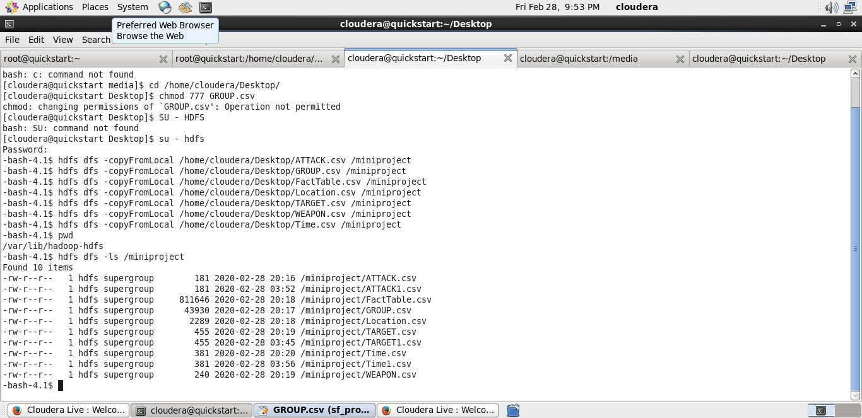
Loading data into HDFS:

Slide 11
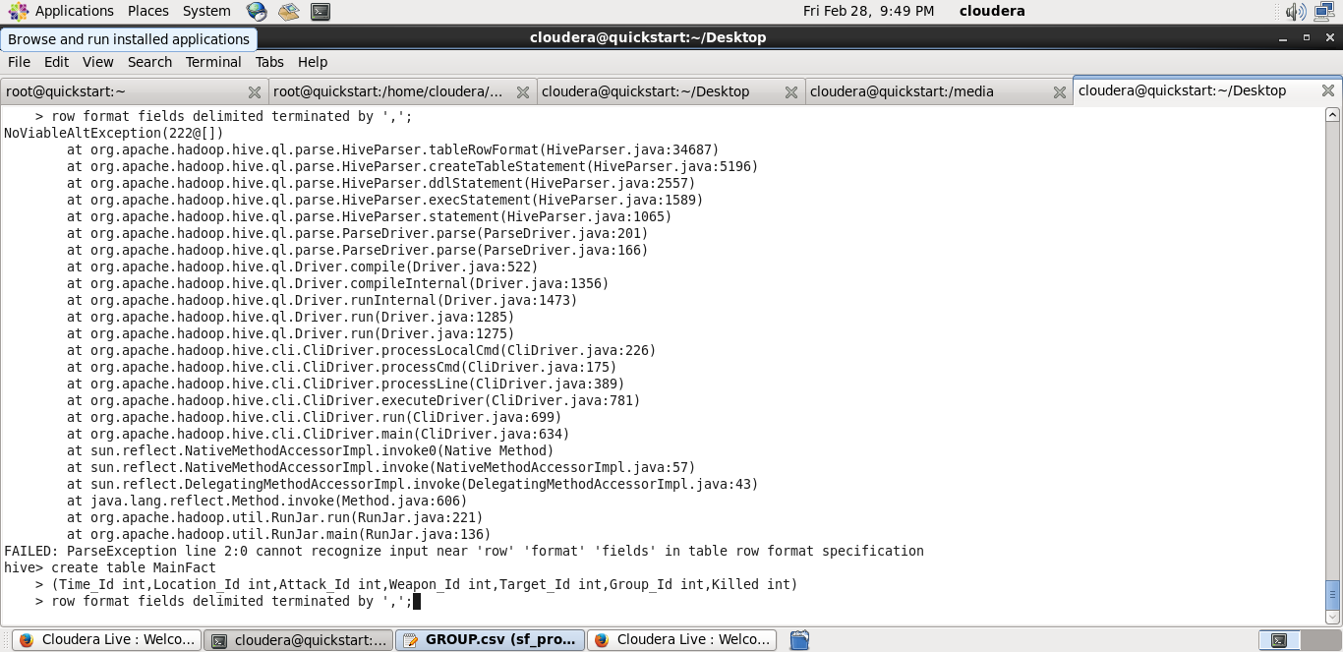
Creating fact table in hive:

Slide 12
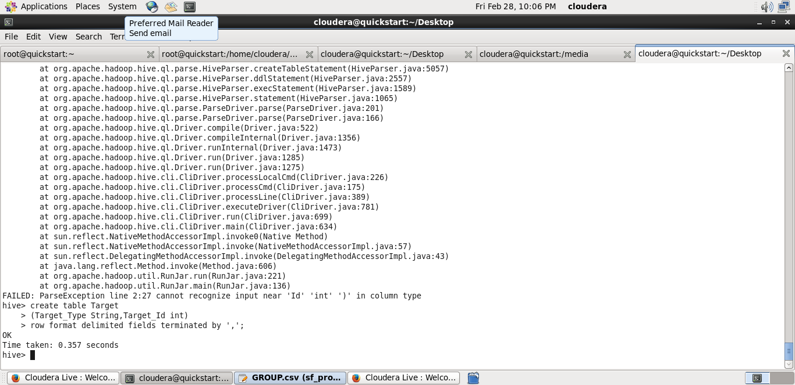
Creating dimension table in hive:

Slide 13
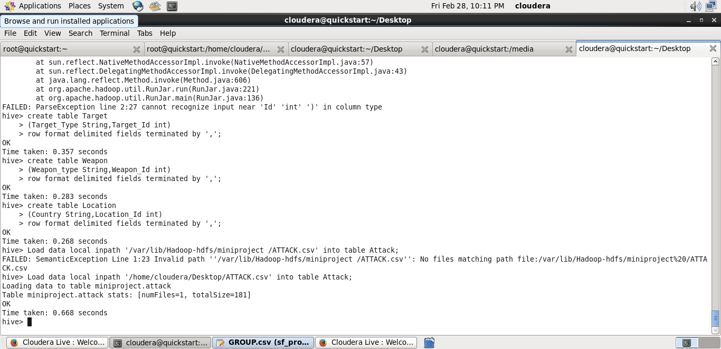
Loading data into hive:

Slide 14
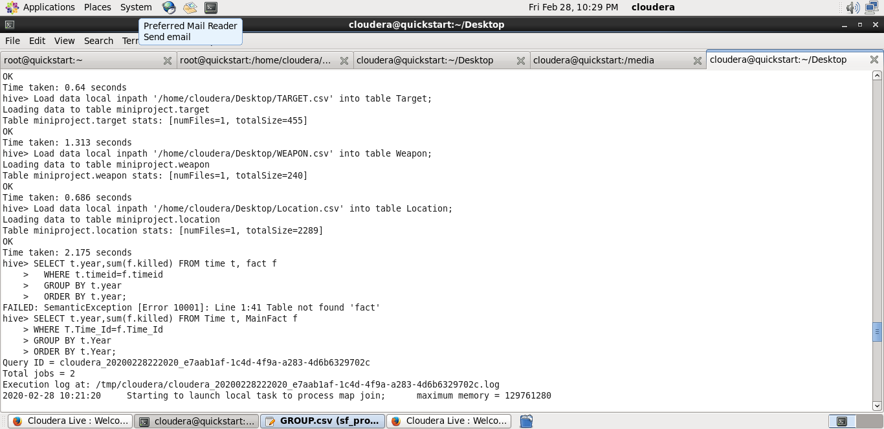
Year-wise death frequency caused by terrorism:

Slide 15
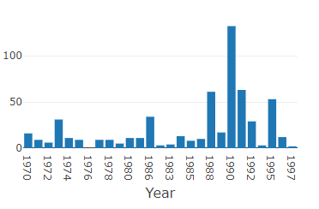
Graphs represents the people killed in different years in terrorist activities:

Slide 16
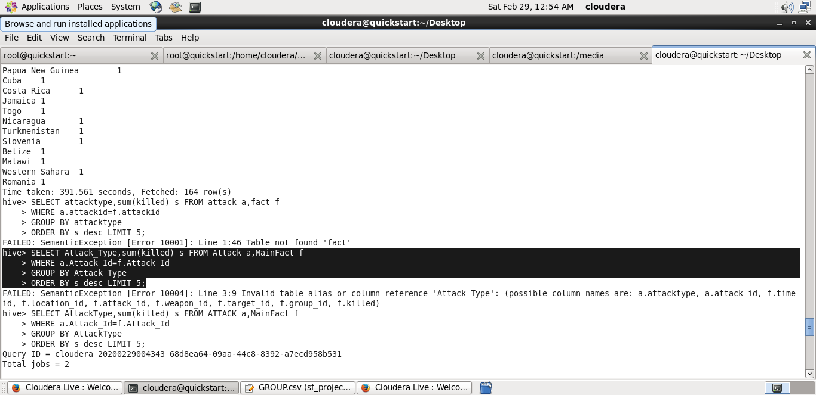
Attack type death frequency caused by terrorism:

Slide 17
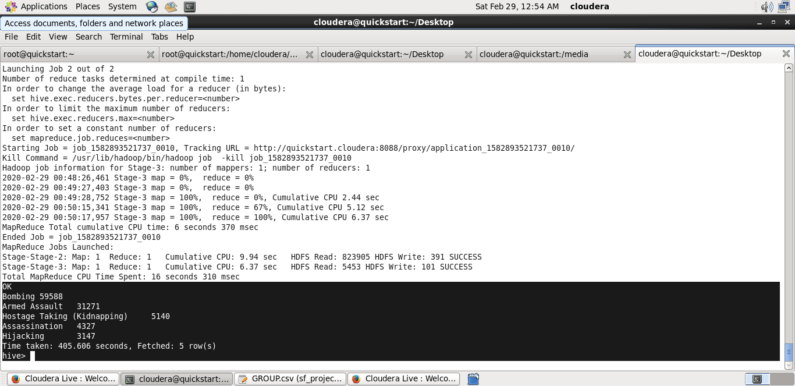
Query Output:

Slide 18
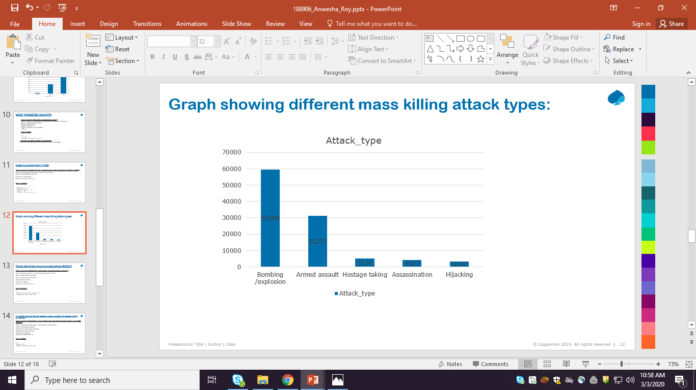
Graphs represents the people killed in different attack types in terrorist activities:

Slide 19
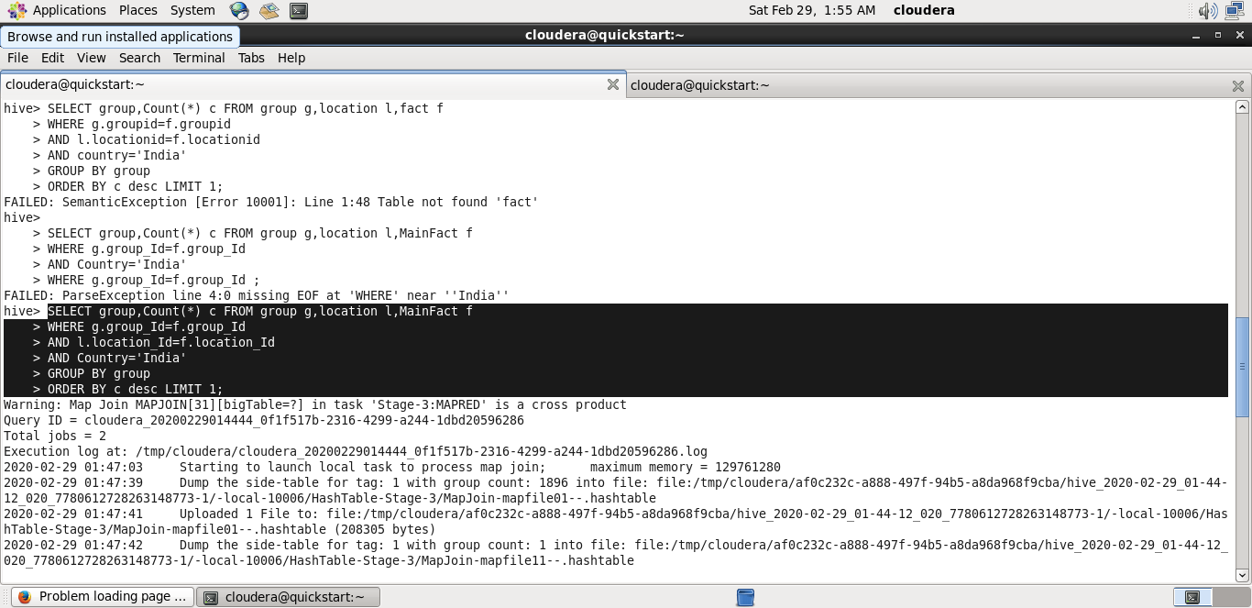
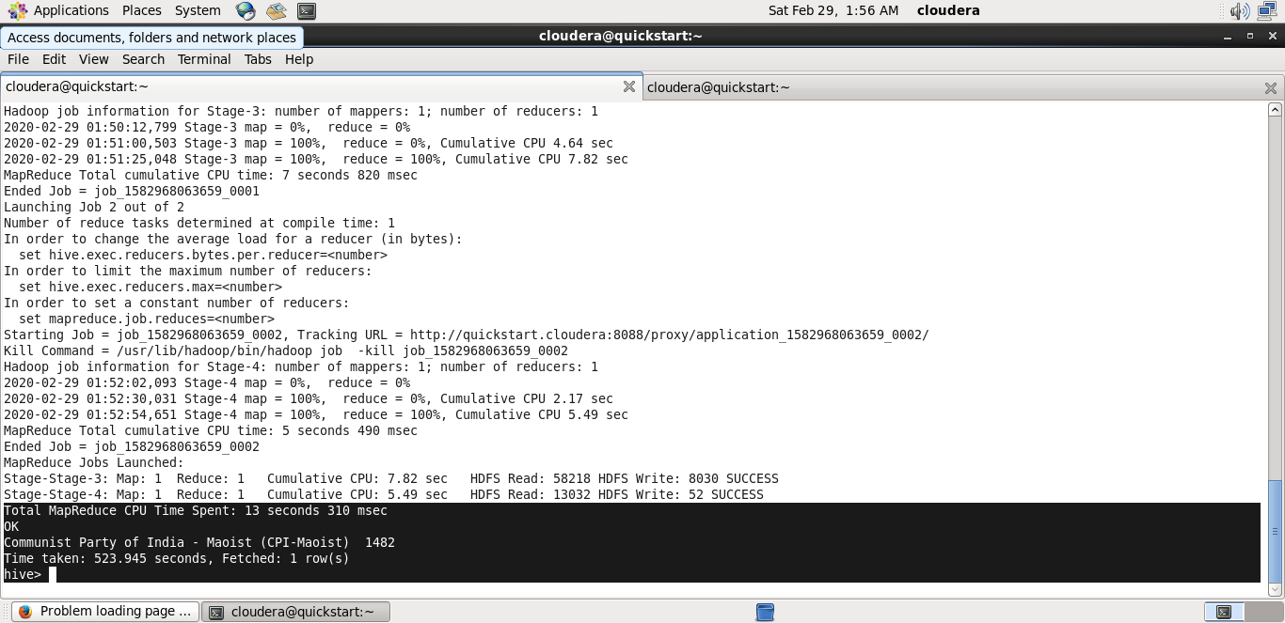
Country-wise death frequency caused by terrorism:

Slide 20
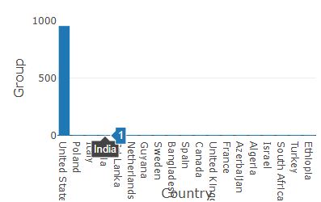
Graphs represents the number of groups in india in terrorist activities:

Slide 21
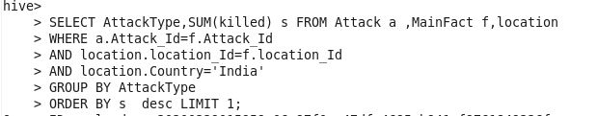
Attack type-wise death Frequency caused by terrorism:

Slide 22
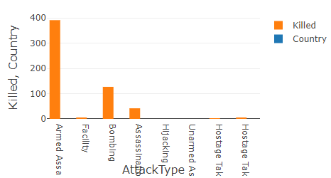
Graphs represents the people killed in different attack type in terrorist activities:

Slide 23

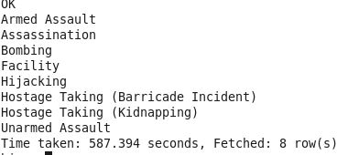
Distinct Attack Types:

Slide 24
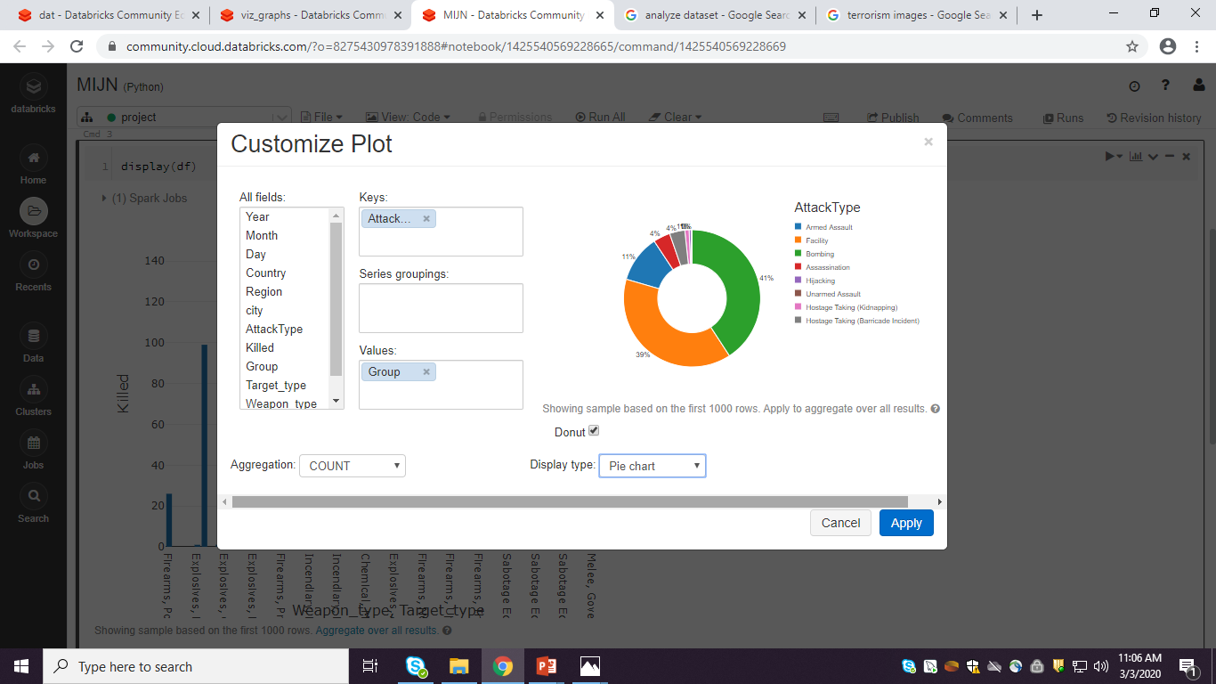
Graphs represents the different group attacktypes in terrorist activities:

Slide 25


