Slide 1


Slide 2

What is US Cancer Statistics?
The United States Cancer Statistics are the official government statistics on cancer.
The statistics provide information on newly diagnosed cancer cases and cancer deaths for the whole U.S. population.

Slide 3
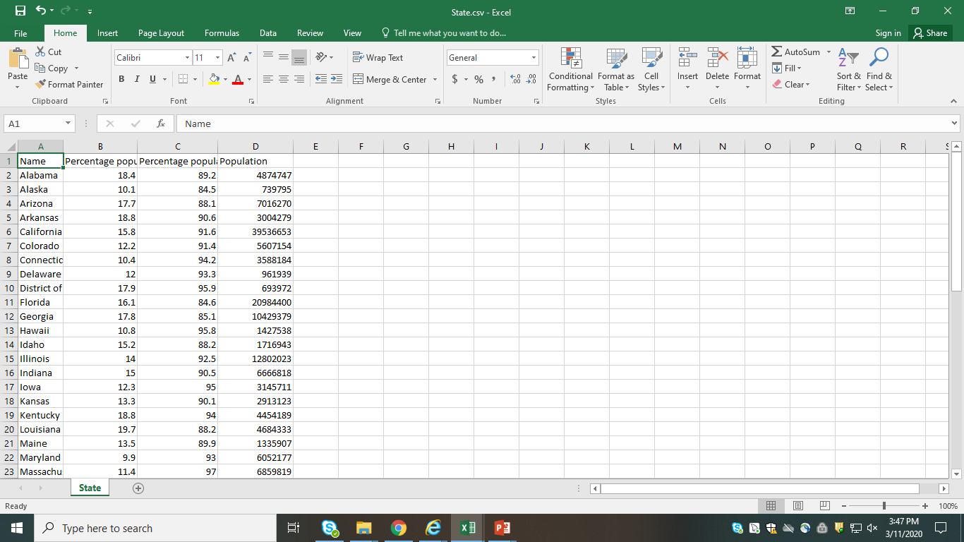
Why to analyze dataset?
Data analysis starts with questions, not data or a technique
Data analysis is important to understand problems facing and to explore data in meaningful ways.
Analyzing the dataset and making patterns from the data gives us the solution to get out of the problem.

Slide 4
Data Analysis in US Cancer Statistics:
The given source dataset contains the records of the cancer affected people in different states of US.
The cancer dataset depicts the cancer position and its category.
The cancer occurance includes the US state names and race names with affected people count.
The state dataset has the state name with the population below poverty , population insured and total population in that particular state.

Slide 5




Tools Used:
Talend : It is used to clean data and loading of data.
HDFS: It is used as the main storage file system
Hive: It is used to run all the queries
Databricks: It is used for visualization of data.

Slide 6
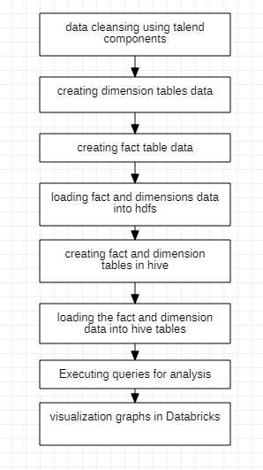
Work Flow:

Slide 7
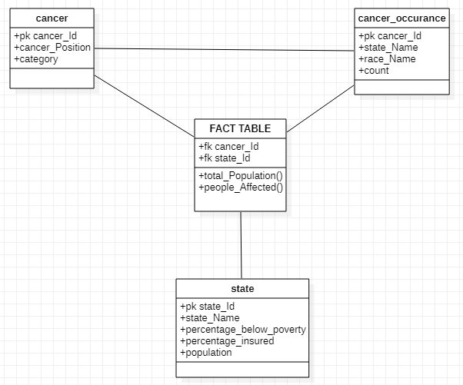
Data Model:

Slide 8
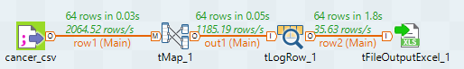
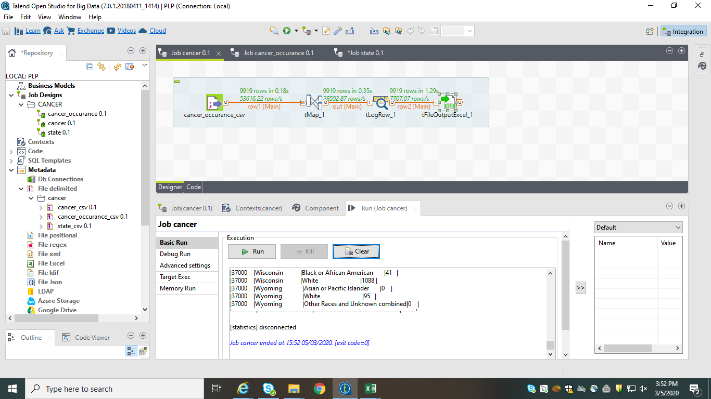
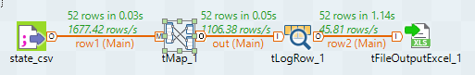
Creating Dimension table data:

Slide 9
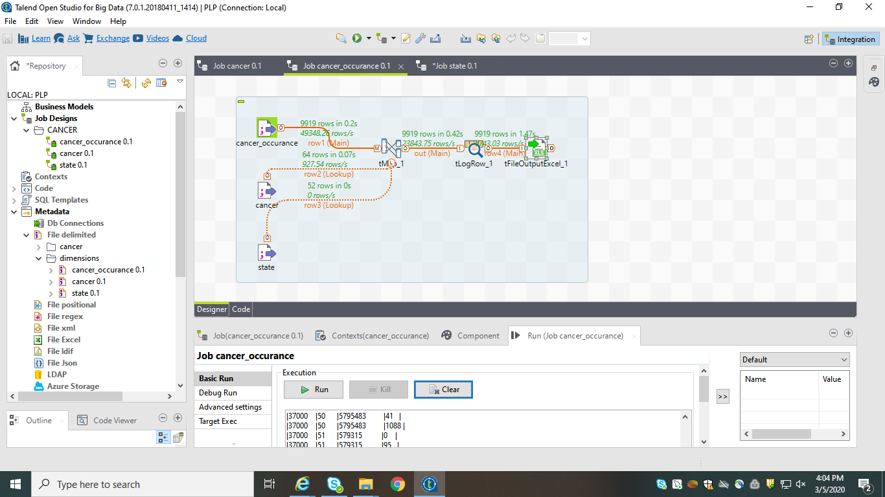
Creating Fact table data:

Slide 10
Loading data into HDFS:

Slide 11
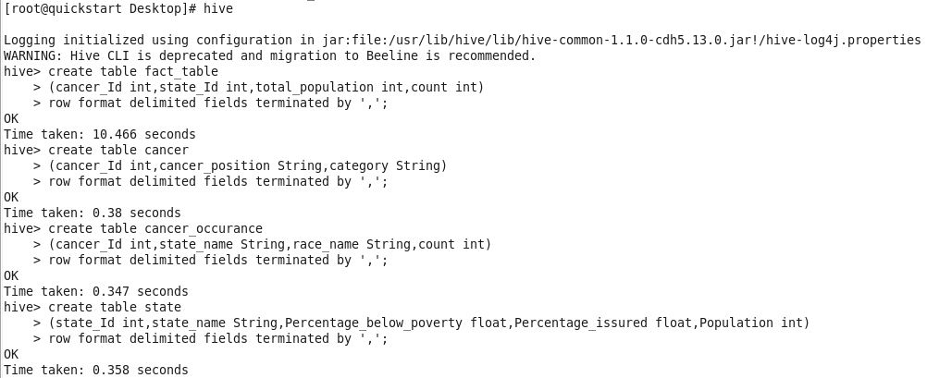
Creating fact and dimension tables in hive:

Slide 12
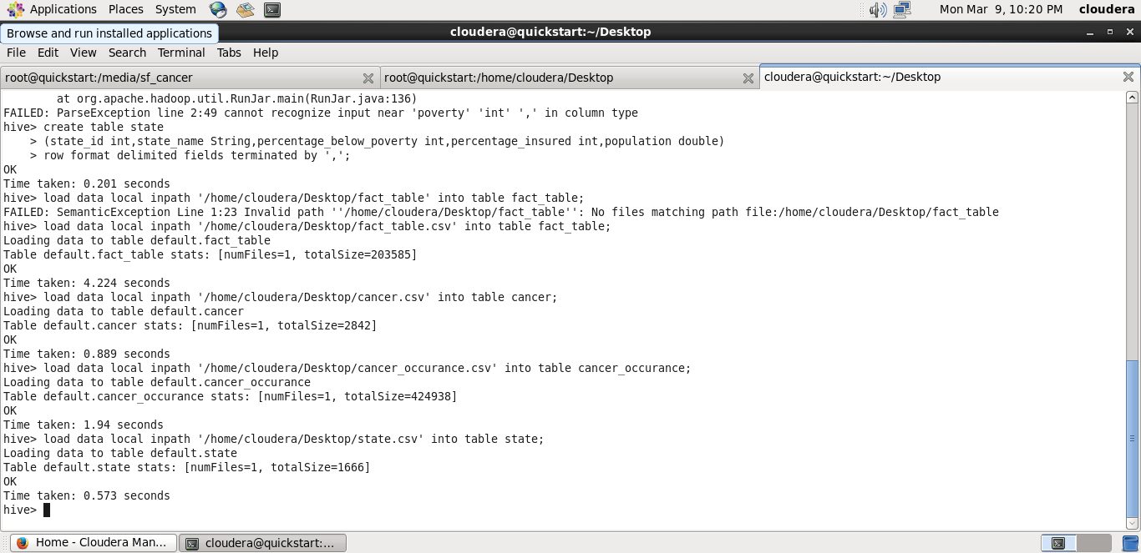
Loading data into tables:

Slide 13
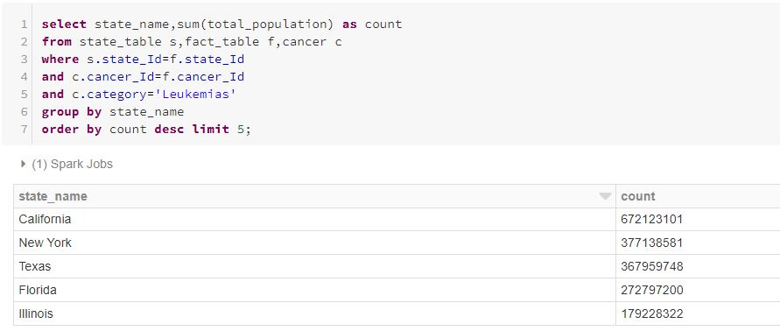
State-wise people effected with ‘Leukemias’:

Slide 14
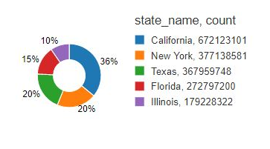
Below graph depicts the state-wise ‘Leukemias’ effected people :

Slide 15
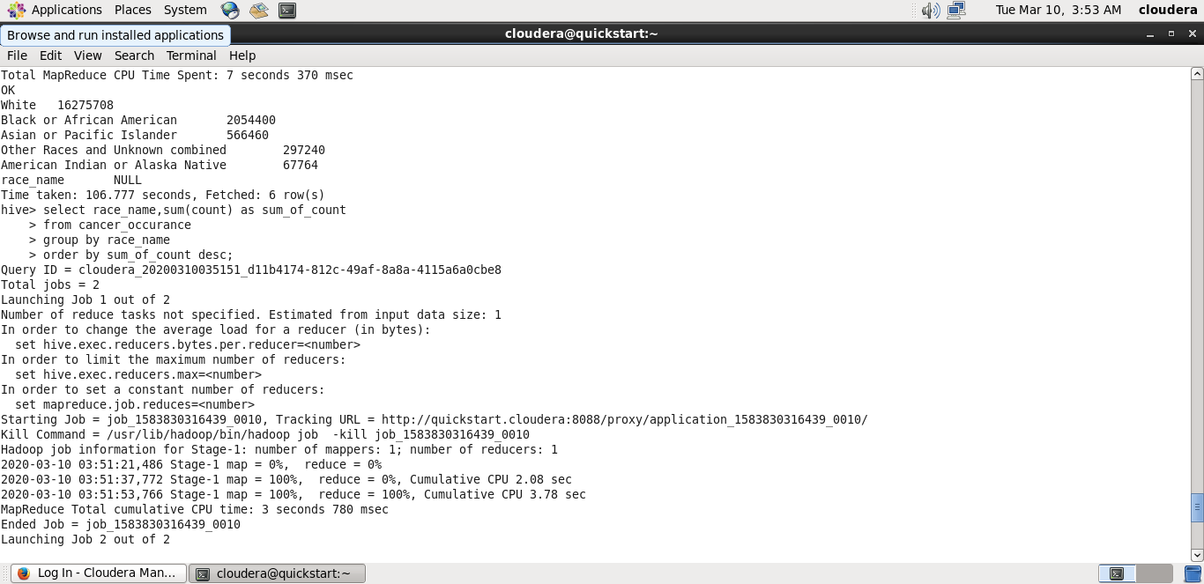
Race-wise effected people count:

Slide 16
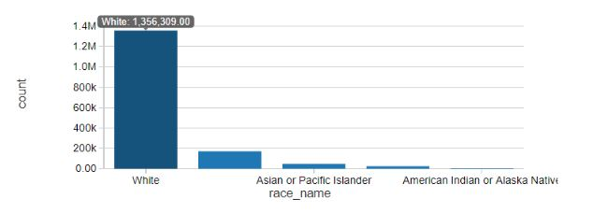
Below graph depicts the race-wise effected people :

Slide 17
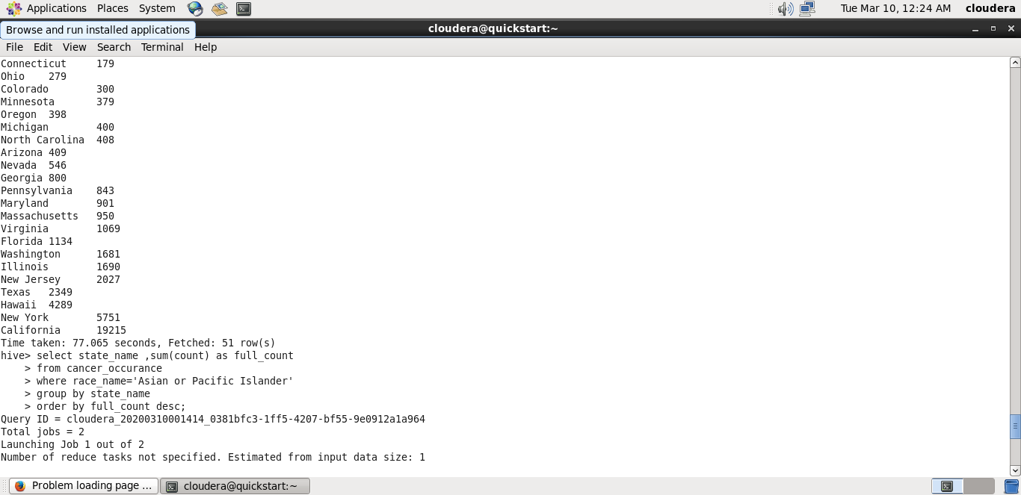
In which state is the number of affected Asian and Pacific Islander the highest:

Slide 18
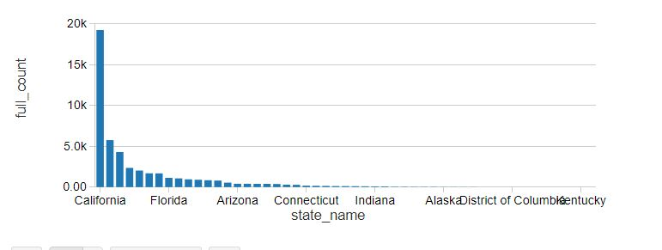
Below graph depicts the highest state effected with race name ‘Asian and Pacific Islander’ :

Slide 19
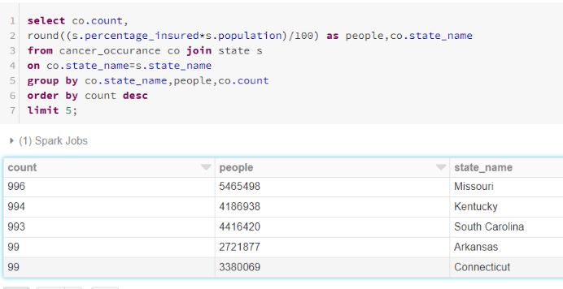
Number of people insured but have cancer:

Slide 20
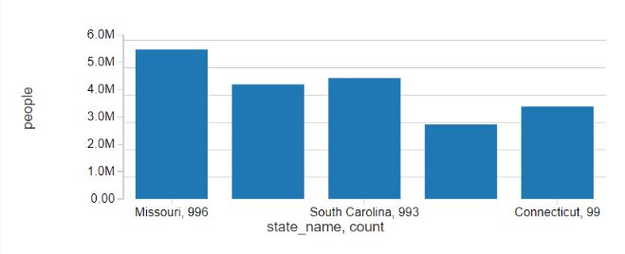
Below graph depicts the number of people insured but have cancer:

Slide 21
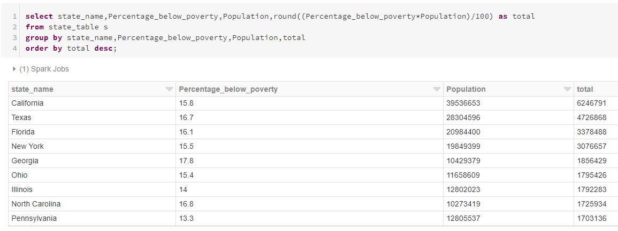
Total number of people that lie below poverty level in each state:

Slide 22
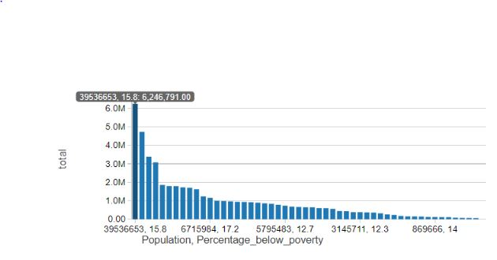
Below graph depicts total number of people that lie below poverty level in each state:

Slide 23
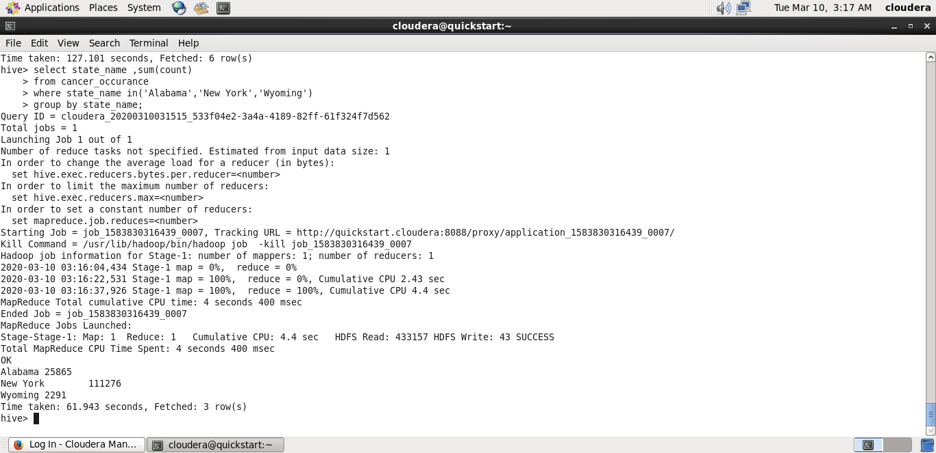
Statistics of Alabama, New York and Wyoming:

Slide 24
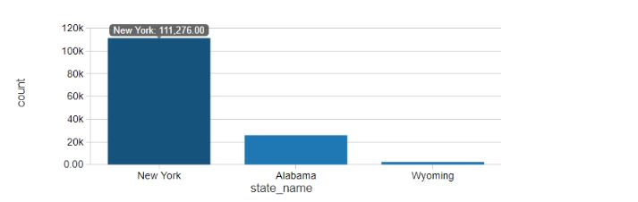
Below graph depicts statistics of Alabama, New York and Wyoming:

Slide 25
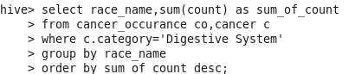
Highest count in a particular race which has been affected with cancer in Digestive category:

Slide 26
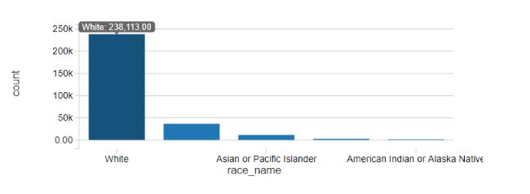
Below graph depicts highest count in a particular race which has been affected with cancer in Digestive category:

Slide 27
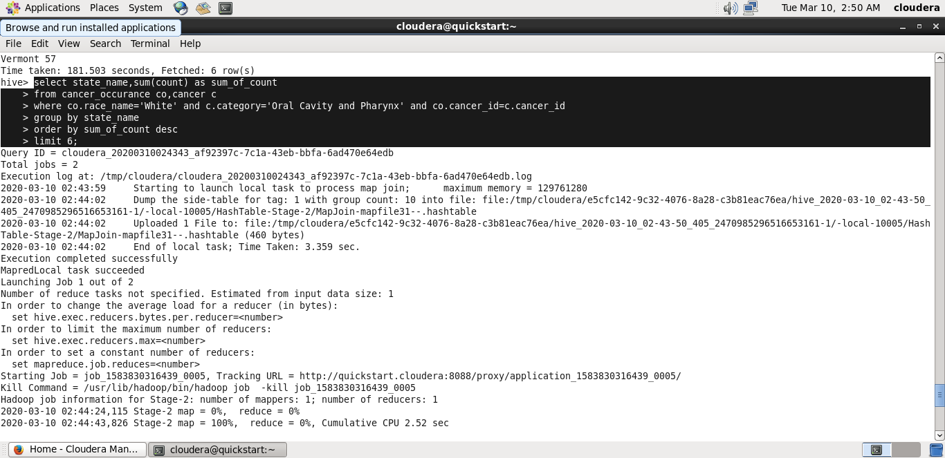
Top 6 States having highest number of white people affected with Oral cavity and Pharynx Cancer:

Slide 28
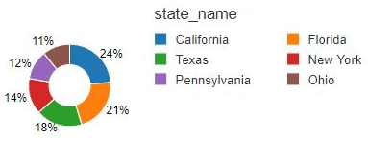
Below graph depicts top 6 States having highest number of white people affected with Oral cavity and Pharynx Cancer:

Slide 29
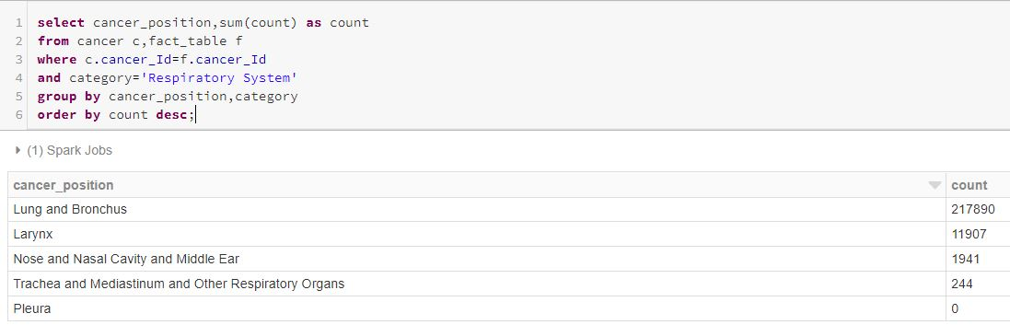
Number of people affected with cancer in Respiratory system:

Slide 30
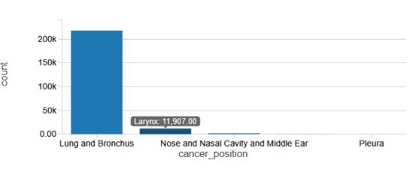
Below graph depicts number of people affected with cancer in Respiratory system:

Slide 31
OBSERVATIONS:
The dataset is provided with special characters which can’t be analyzed. These special characters are removed and replaced with the correct and effective information using “tReplace” component in talend.
The dataset is provided with no unique values. The unique are created using “tUniqueRow” and “tMap” components in talend.

Slide 32
From the executed results:
The most effected state in US with “Leukemias” cancer is California.
US State with “White” race has recorded highest number of cancer patients.
“California” has recorded highest state effected with race name ‘Asian and Pacific Islander’.
“Missouri” has the highest number of people insured but have cancer.
Number of people who lie below poverty level in California state are 6246791.

Slide 33
https://databricks-prod-cloudfront.cloud.databricks.com/public/4027ec902e239c93eaaa8714f173bcfc/3257433757019581/3158166722032146/7841027515614145/latest.html

Slide 34


Slide 35


