Slide 1
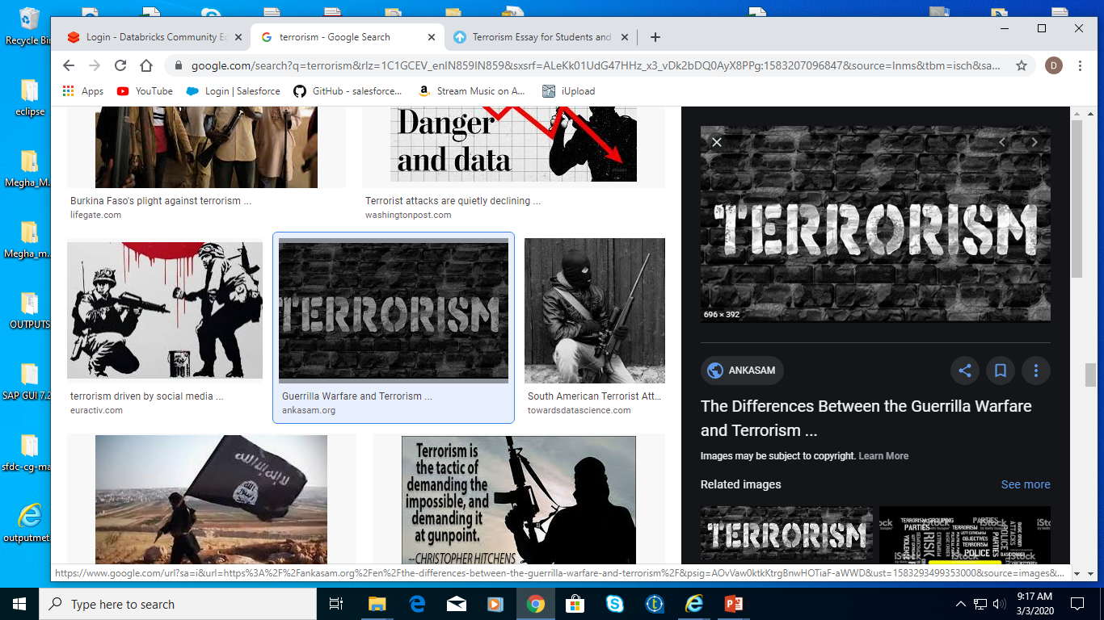

Slide 2

Terrorism is the systematic use of terror. Common definition of terrorism refer only to those violent acts which are intended to create fear.

Slide 3
WHY TO ANALYSE TERRORISM DATASET?
To gather information from the pattern of attacks happening around to help reduce terrorism attacks
WHAT TO ANALYSE?
The source dataset to analyse contains records of terrorist activities that happened around the world from 1970 to 2017.
The source dataset to analyse contains records of terrorist activities that happened around the world from 1970 to 2017.
The dataset contains 11 columns namely Year, Month, Day, Country, Region, City, Attack_type, killed, Group, Target_type, Weapon_type

Slide 4
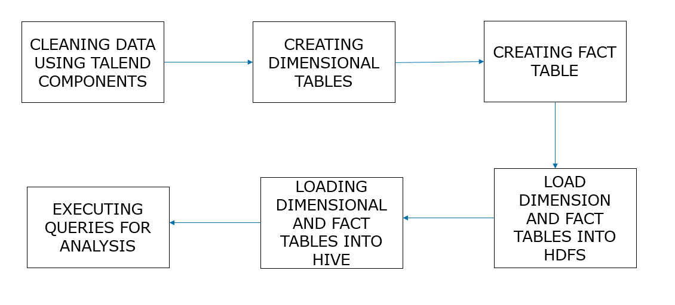

Slide 5
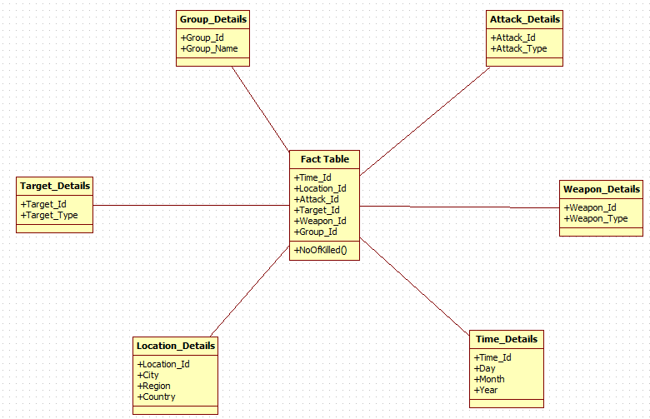
DATA MODEL:

Slide 6
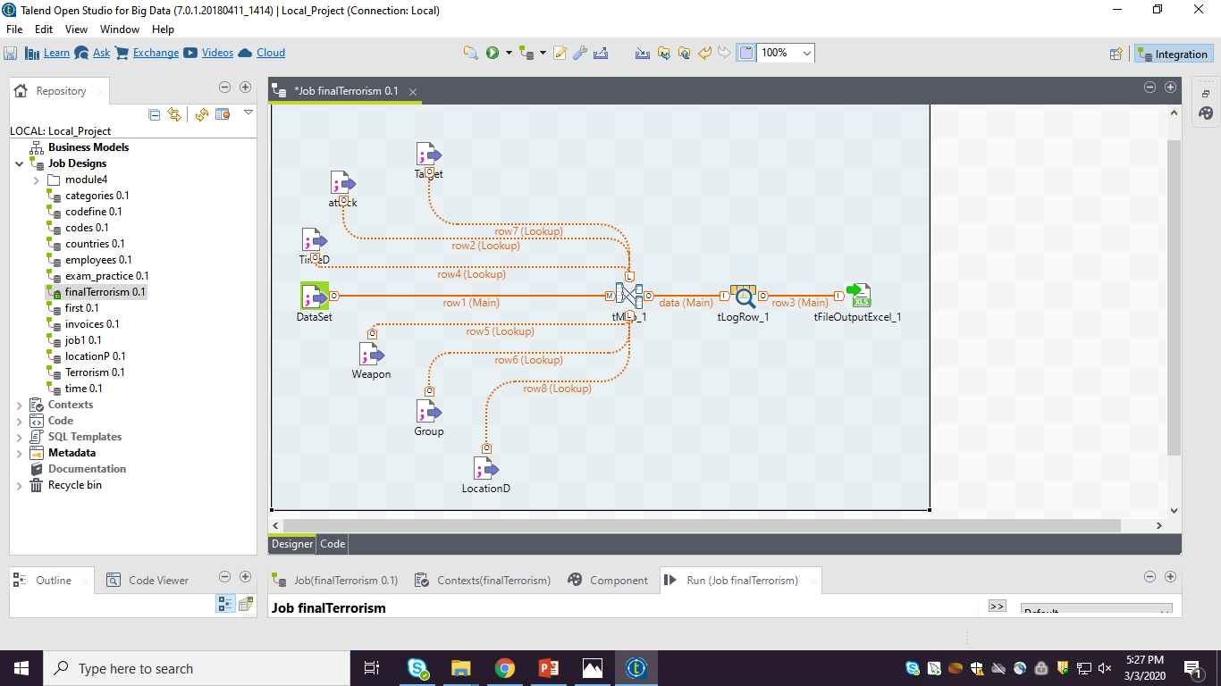
CREATING FACT TABLE:

Slide 7
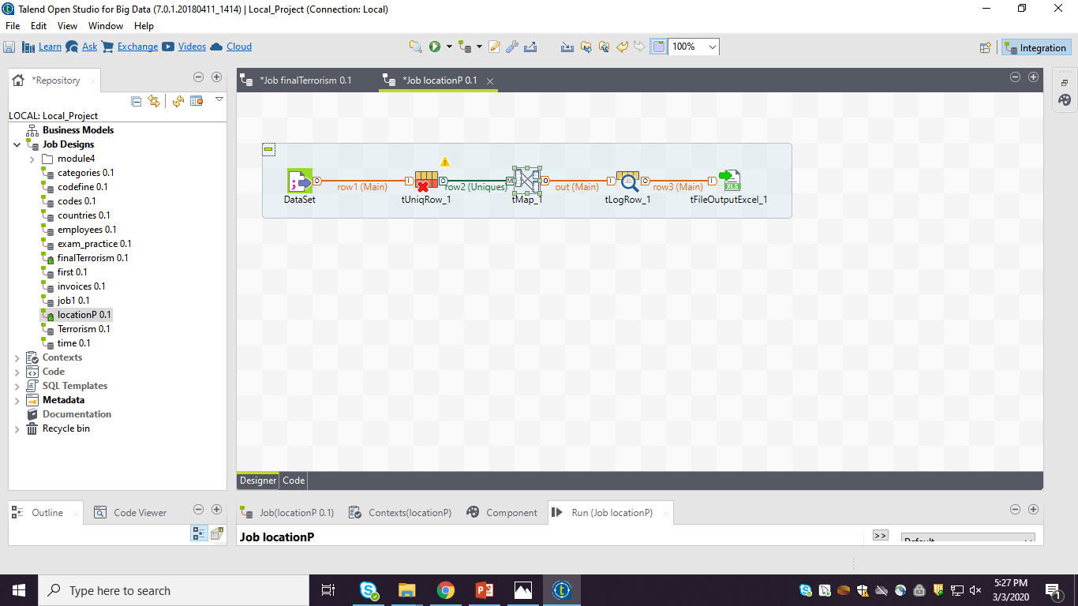
CREATING DIMENSION TABLES:

Slide 8
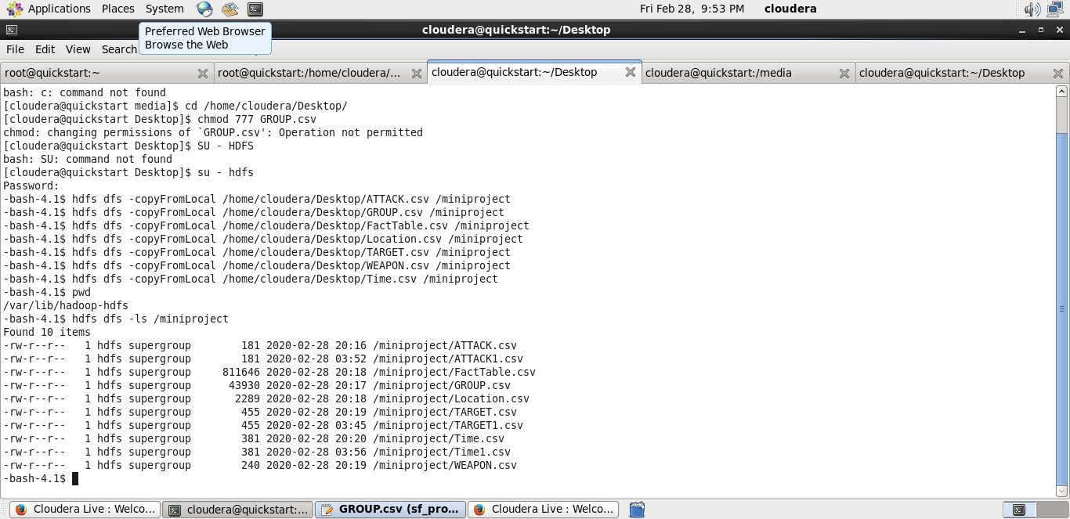
LOADING DATA INTO HDFS:

Slide 9
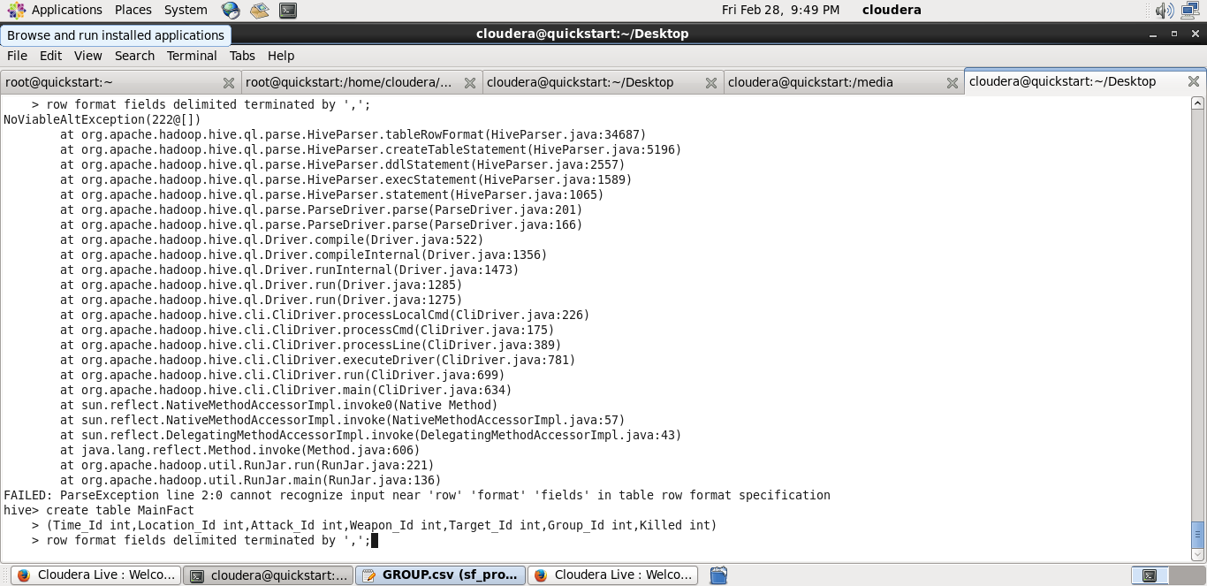
CREATING FACT TABLE IN HIVE:

Slide 10
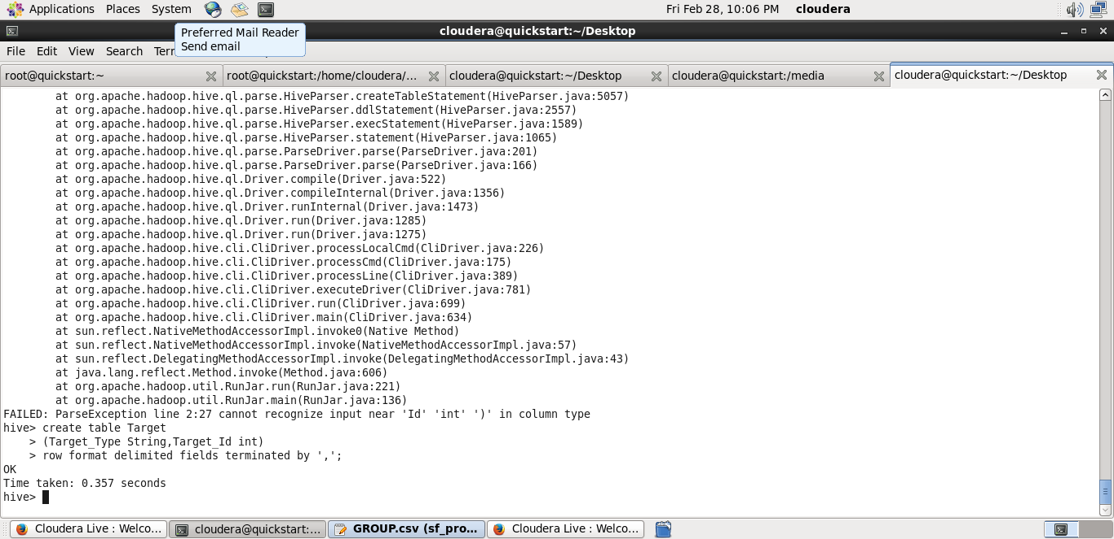
CREATING DIMENSION TABLE IN HIVE

Slide 11
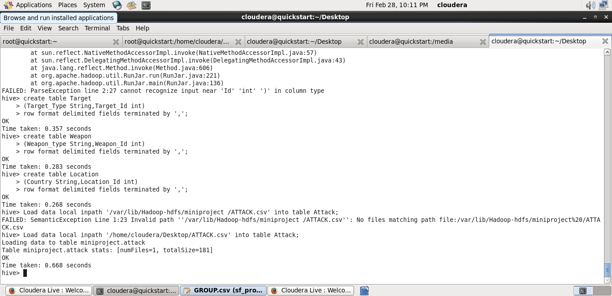
LOADING DATA INTO HIVE:

Slide 12
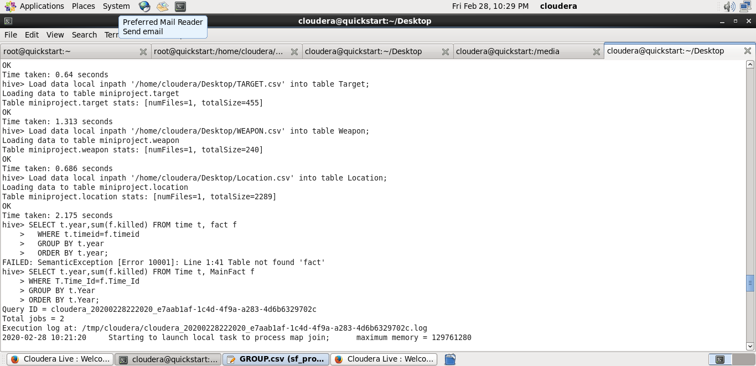
YEAR-WISE DEATH FREQUENCY CAUSED BY TERRORISM

Slide 13
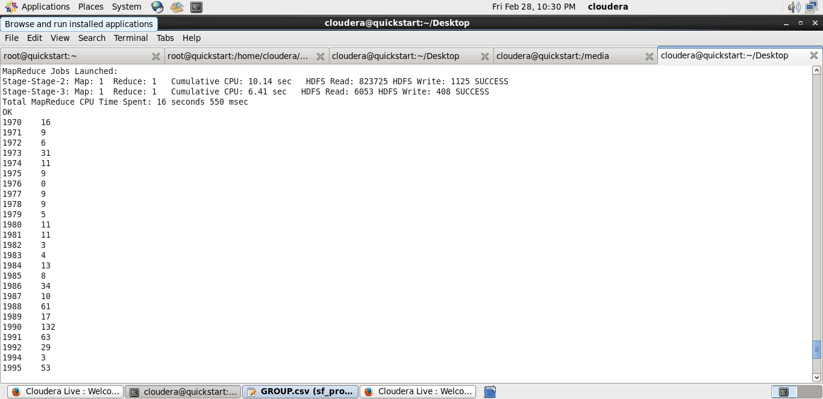
QUERY OUTPUT:

Slide 14
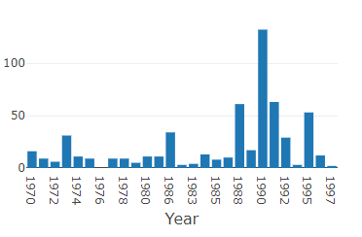
Graphs represents the people killed in different years in terrorist activities:

Slide 15
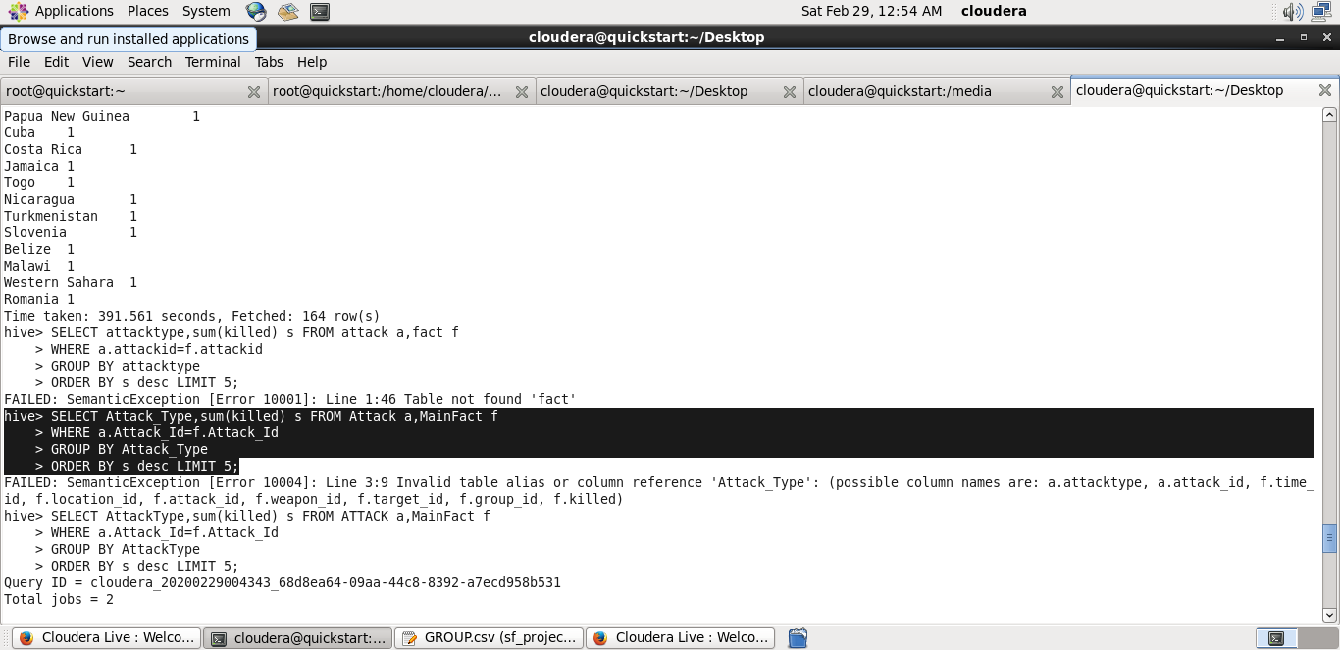
ATTACK TYPE DEATH FREQUENCY CAUSED BY TERRORISM

Slide 16
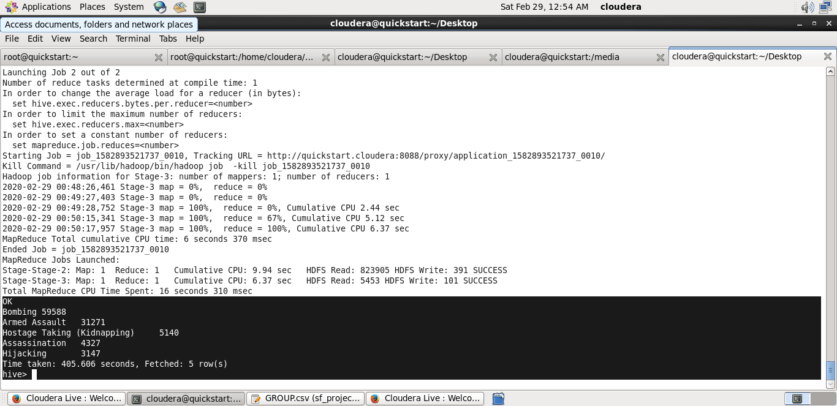
QUERY OUTPUT:

Slide 17
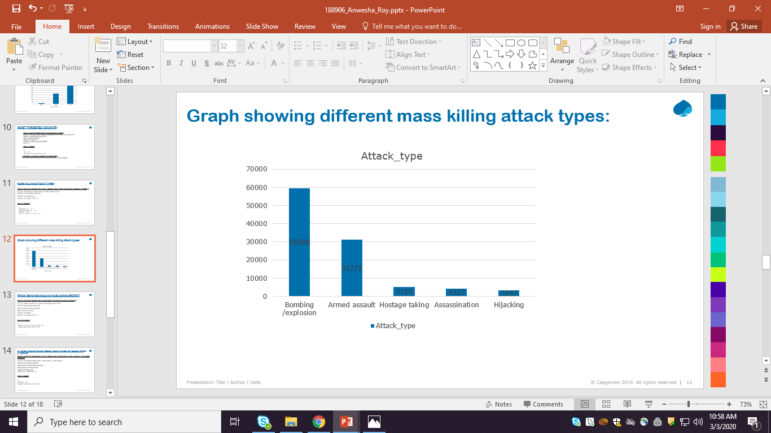
Graphs represents the people killed in different attack types in terrorist activities:

Slide 18
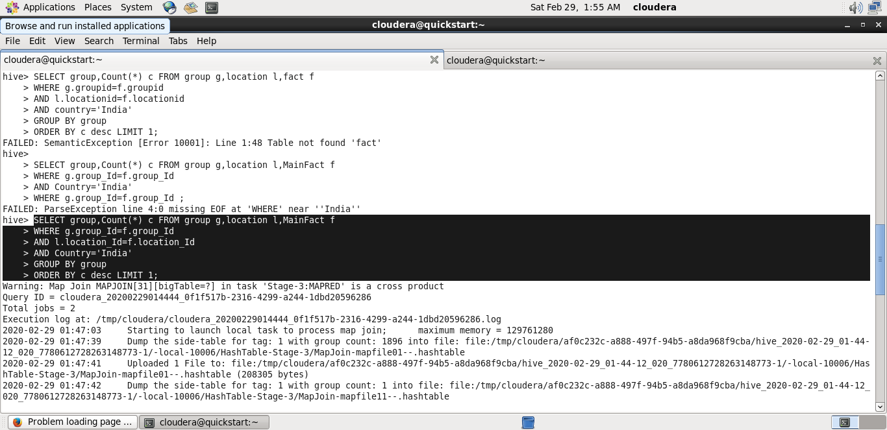
COUNTRY-WISE DEATH FREQUENCY CAUSED BY TERRORISM

Slide 19
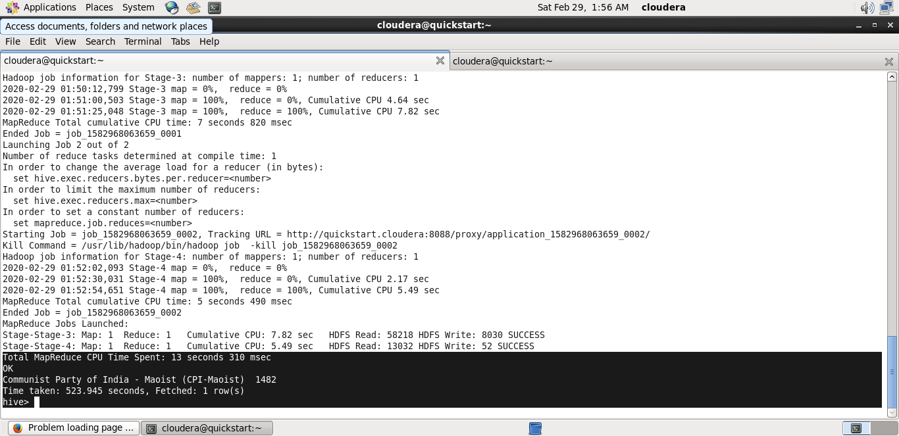
QUERY OUTPUT:

Slide 20
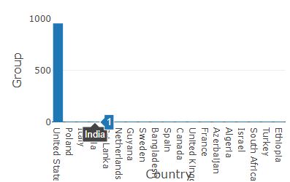
Graphs represents the number of groups in different groups in terrorist activities:

Slide 21
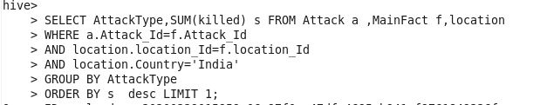
ATTACK TYPE-WISE DEATH FREQUENCY CAUSED BY TERRORISM

Slide 22

QUERY OUTPUT:

Slide 23
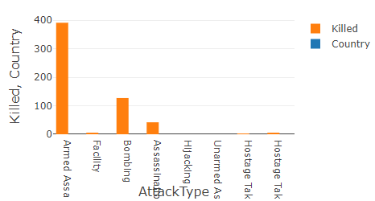
Graphs represents the people killed in different attack type in terrorist activities:

Slide 24

DISTINCT ATTACK TYPES

Slide 25
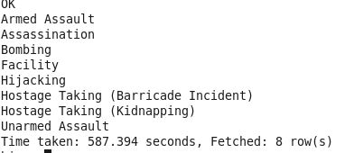
QUERY OUTPUT:

Slide 26
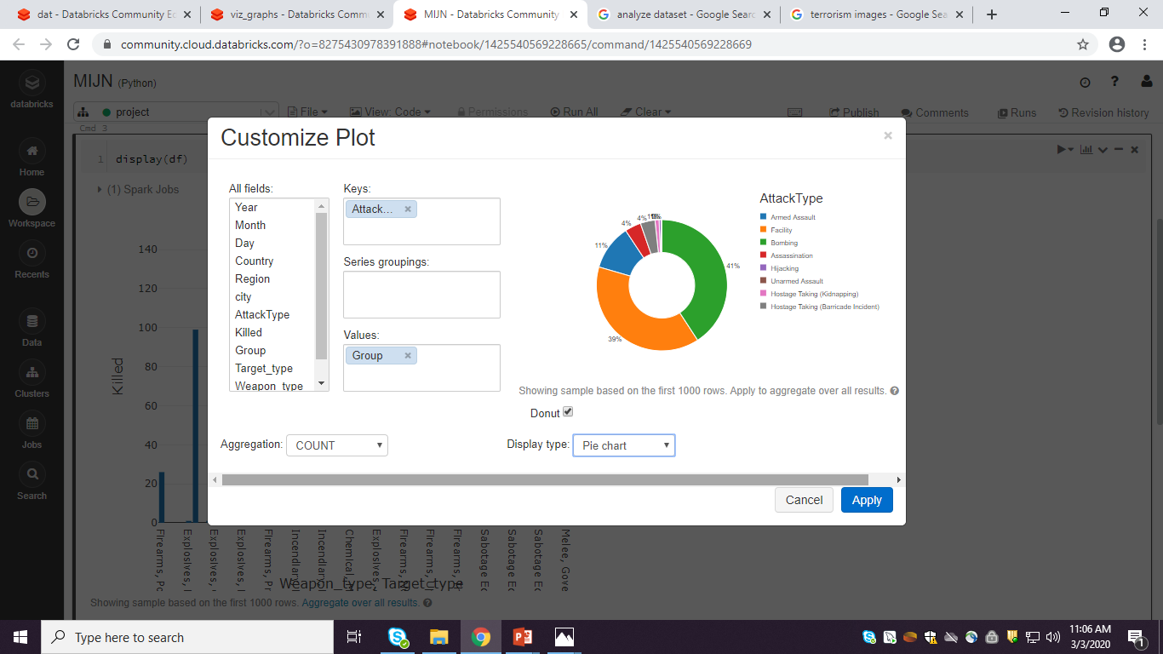
Graphs represents the different group attacktypes in terrorist activities

Slide 27


