Slide 1
CYCLISTIC
A case study of how a bike sharing company could design its marketing strategies aiming to convert its casual riders to annual members.

Slide 2
The Business Task
How do annual members and casual riders use Cyclistic bikes differently?
How can Cyclistic use digital media to influence casual riders to become members?

Slide 3
Data sources used
Historical trip data from amazonAWS.com.
Data made available by Motivate International Inc.
Data of last 12 months, from April 2021 to March 2022.

Slide 4
Details of Data manipulations
“Started_at” and “ended_at” timings are inconsistent: With Ride_ids as follows:
2D97E3C98E165D80
7407049C5D89A13D
53 records deleted from November due to inconsistency in ride lengths.
Removed from dataset of March’22

Slide 5
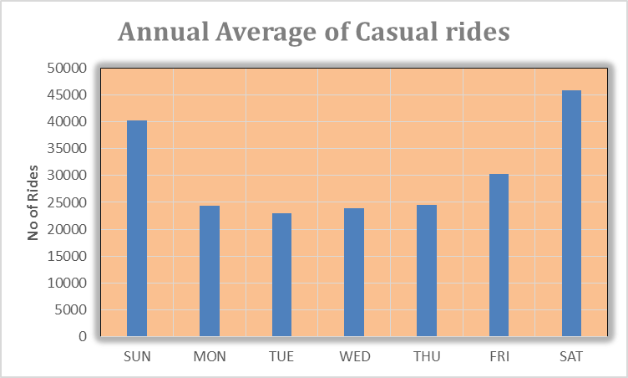
Summary of Analysis
Casual riders prefer to take more rides on weekends.

Slide 6
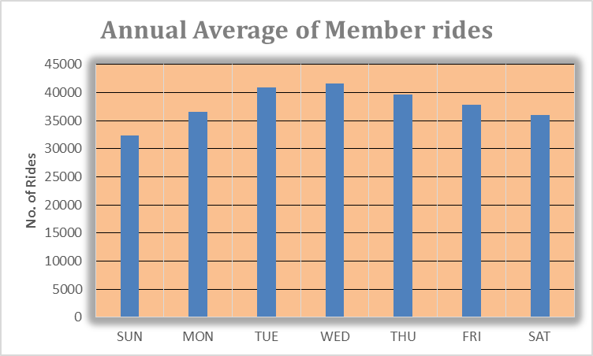
Summary of Analysis
Whereas Members are found in greater numbers on weekdays.

Slide 7
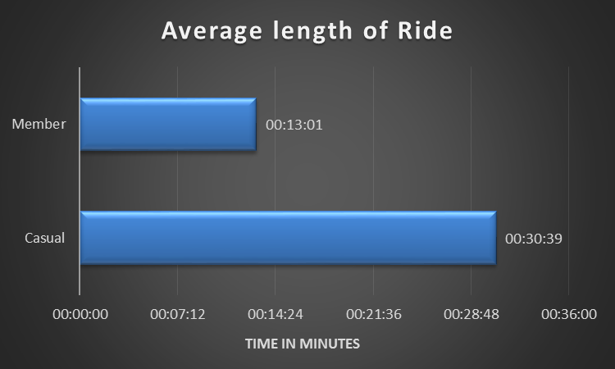
Summary of Analysis
Casual riders ride for longer duration than members on an average.

Slide 8
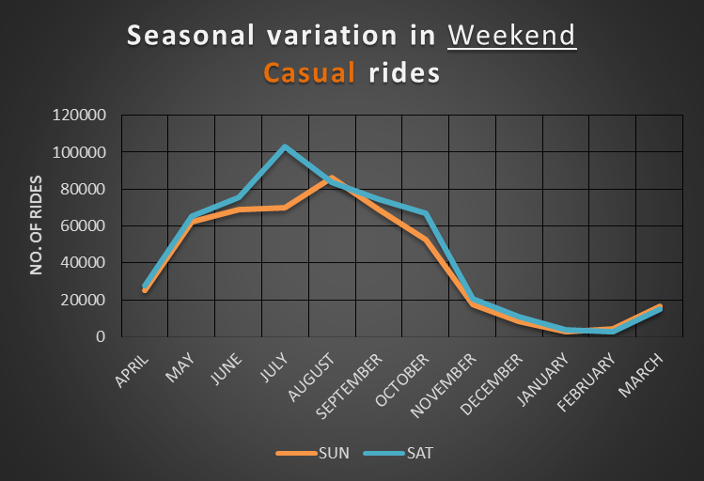
Summary of Analysis
Casual riders do not prefer taking out rides in winter season.

Slide 9
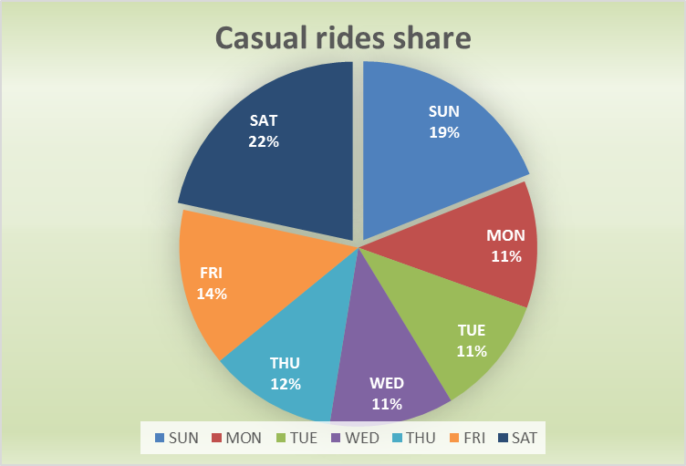
Summary of Analysis
More than 40% of casual riders in a week avail rides on weekends. This suggests that a major section of Casual riders take rides for recreational purposes.

Slide 10
Recommendations
Casual riders could be targeted through in-app promotions of limited edition, discounted membership plans, offering longer ride-length per day in summers.
Bike mounted, eco-friendly tourism can be promoted, along with “weekends only” flexible membership plan.
Winter season sight-seeing on bikes could be promoted to woo casual riders into opting for yearlong membership.

Slide 11
Detailed Month-wise Analysis
April, 2021 to March, 2022

Slide 12
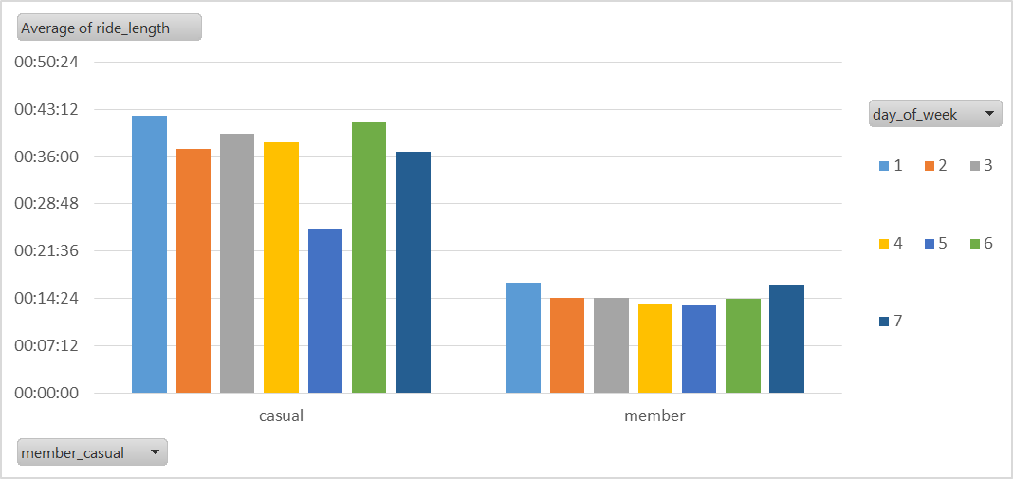
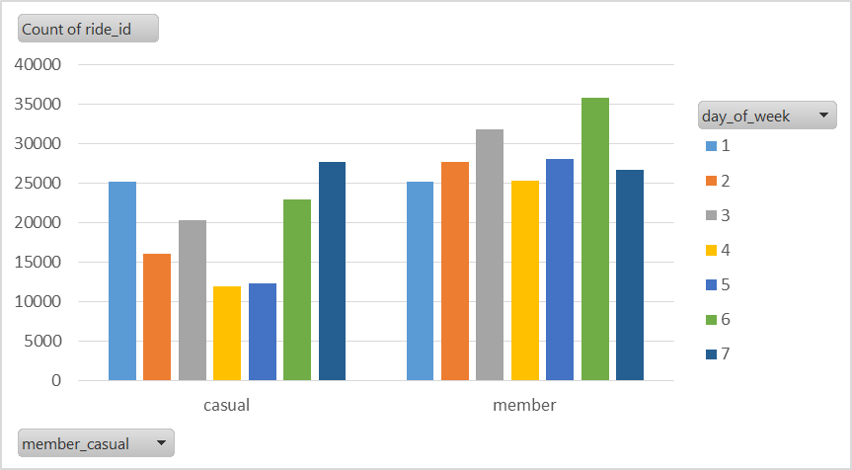
April, 2021
More number of rides are taken by casual riders than members, on weekends.
On an average casual riders ride longer than members.

Slide 13
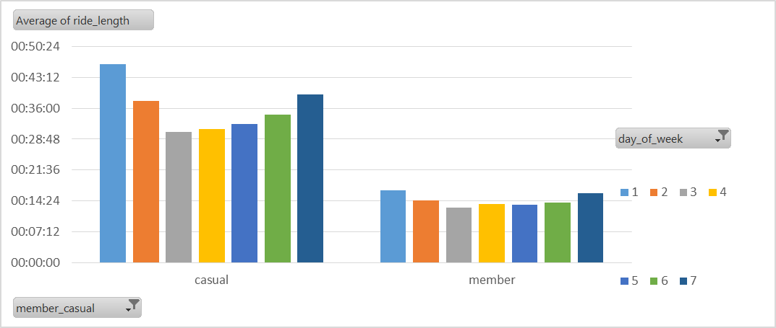
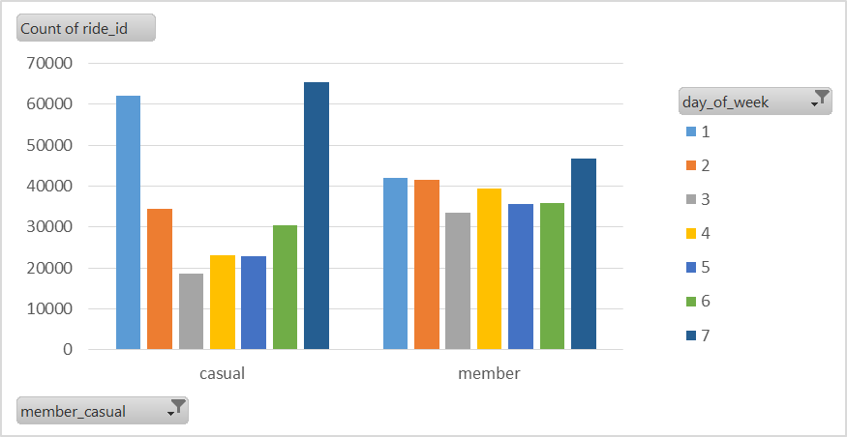
May 2021
Casual riders appear in huge numbers on weekends, even more than that of the members
Casual riders take longer rides than members on any given day.

Slide 14
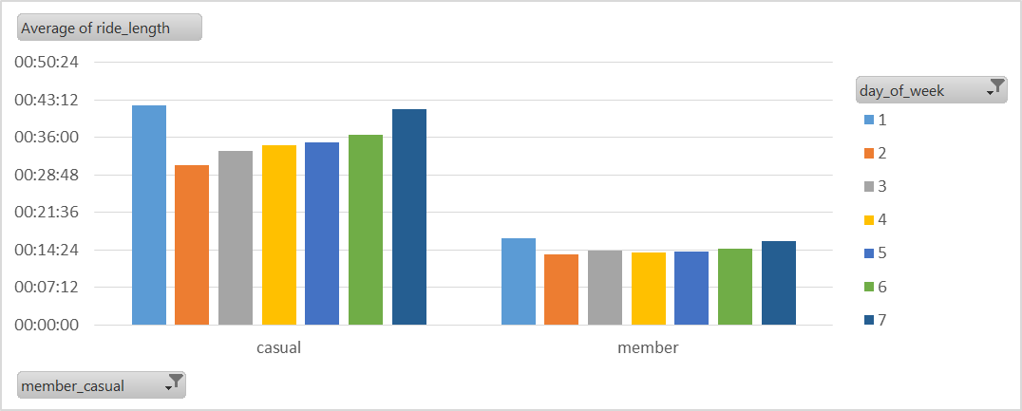
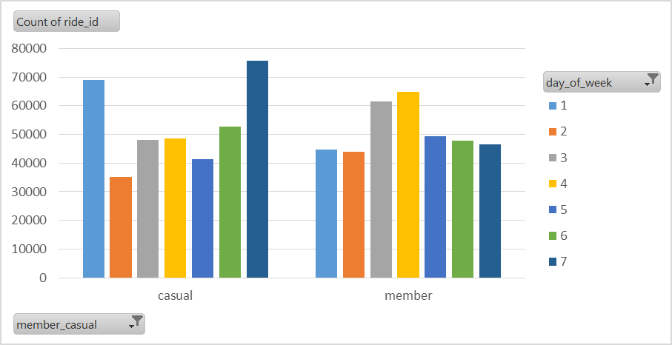
June 2021
Casual riders take longer rides than members on an average, on any given day.
Casual riders appear in much greater numbers than members in weekends.

Slide 15
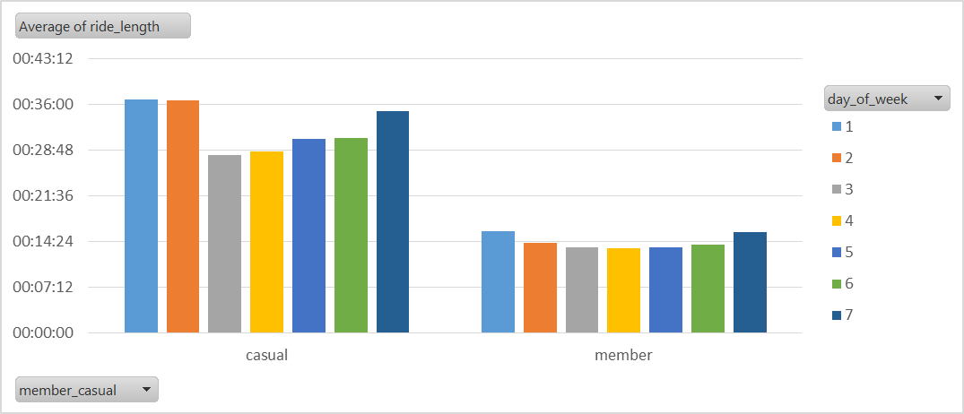
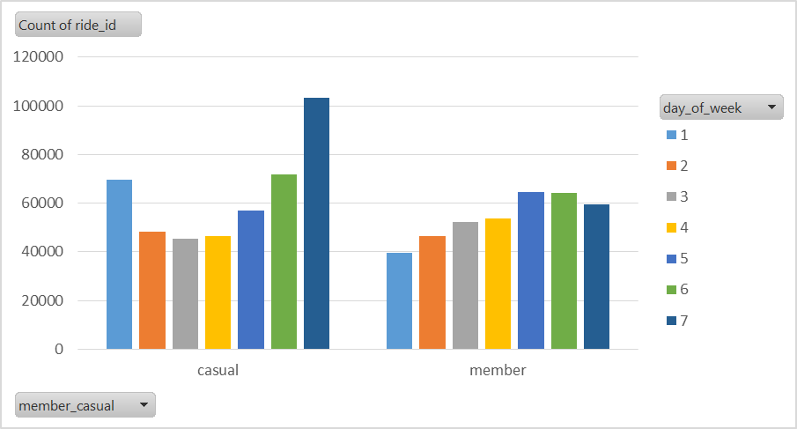
July, 2021
Casual riders ride longer than members on an average.
Casual riders are considerably more than members on weekends, especially Saturdays.

Slide 16
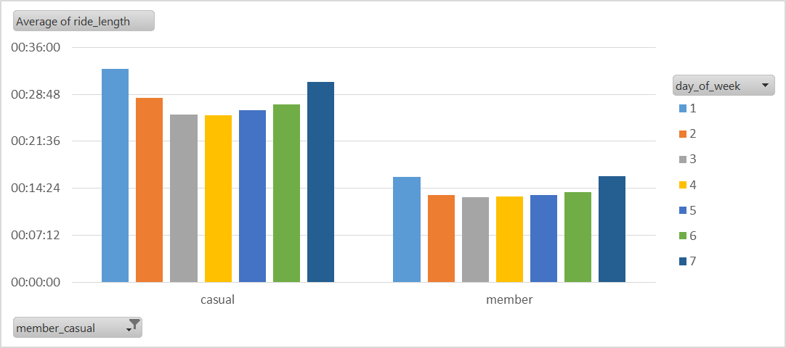
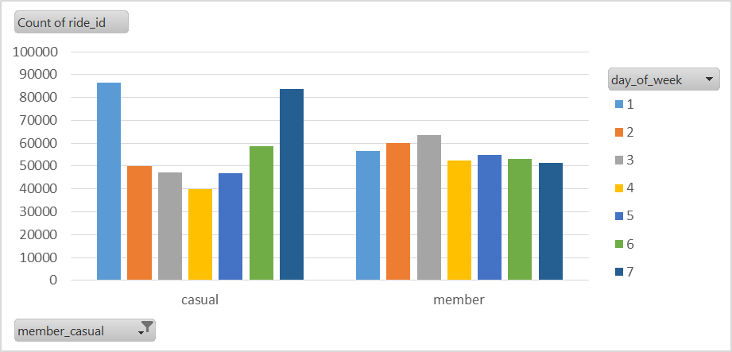
August 2021
Casual riders take more rides than members in this month, especially on weekends.
Casual riders take longer rides than members on any given day.
Casual riders appear in huge numbers on weekends.

Slide 17
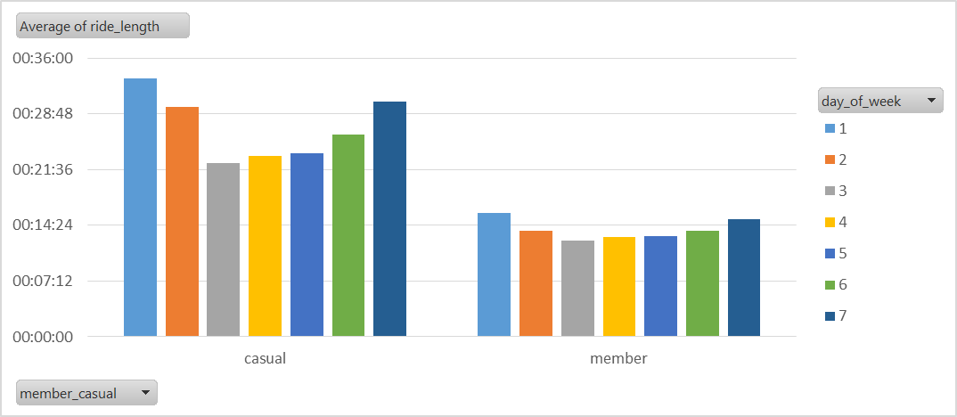
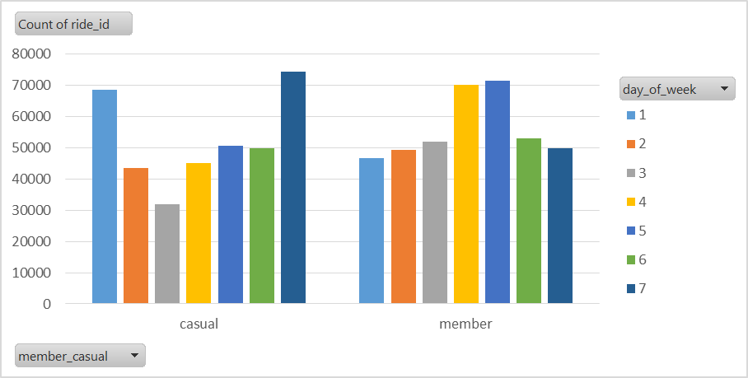
September, 2021
Casual riders take longer rides than members on an average.
Exceptionally higher number of rides taken by casual riders than members on weekends.

Slide 18
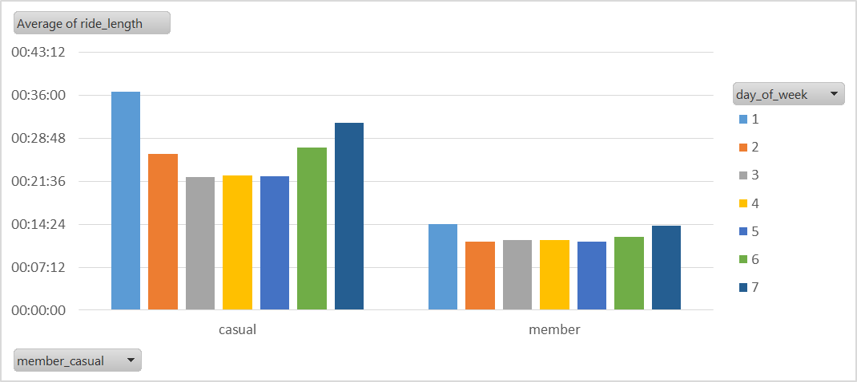
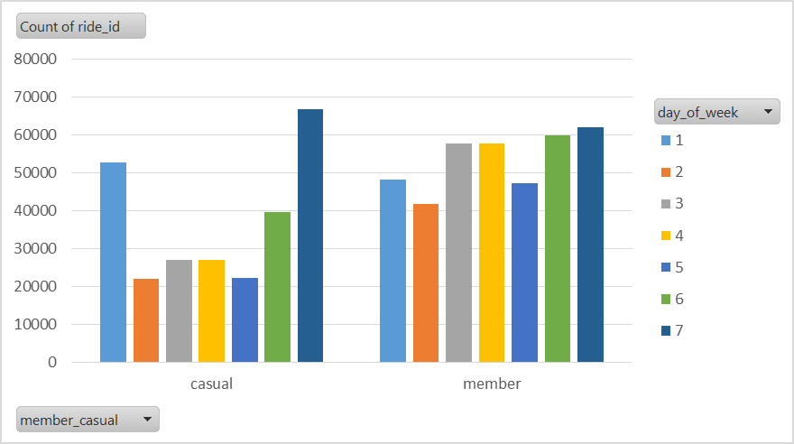
October, 2021
Casual riders ride for longer periods than members on an average.
Casual riders are more concentrated on weekends, and their count surpasses that of the members.

Slide 19
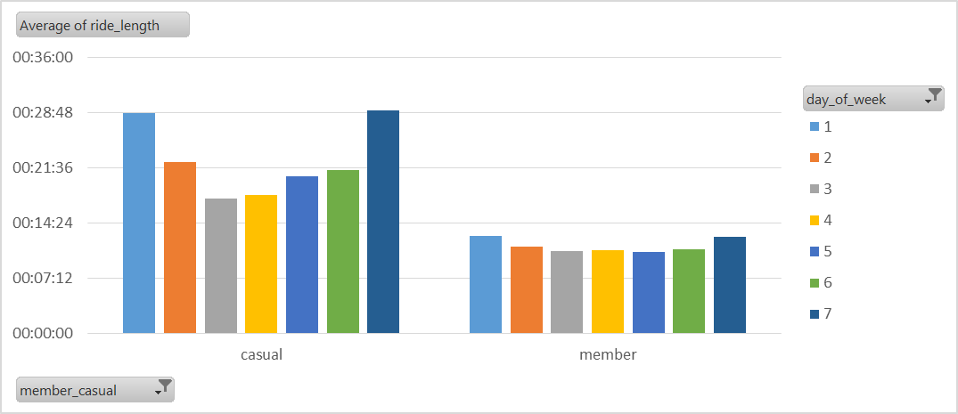
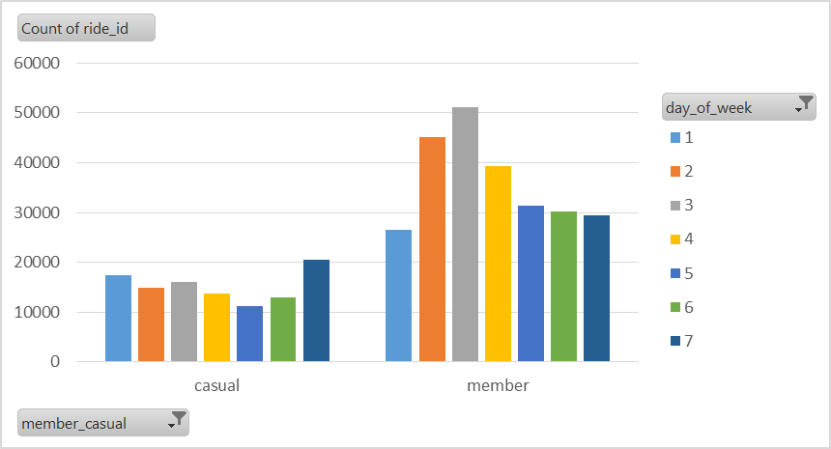
November, 2021
Casual riders take longer rides than members on an average.
Rides taken by members are much greater than casual riders on any given day.

Slide 20
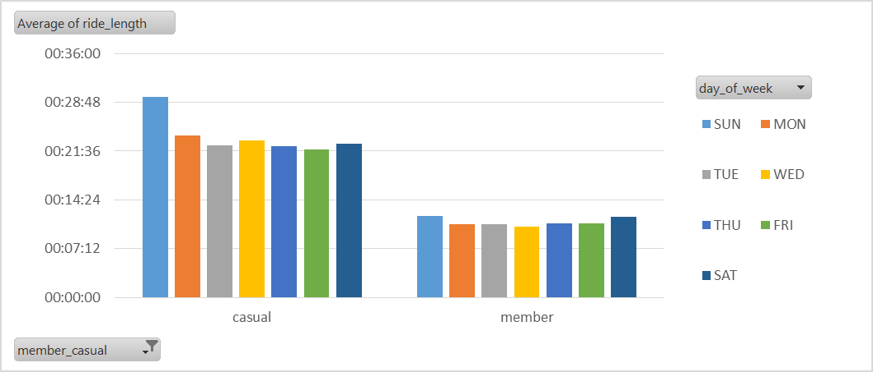
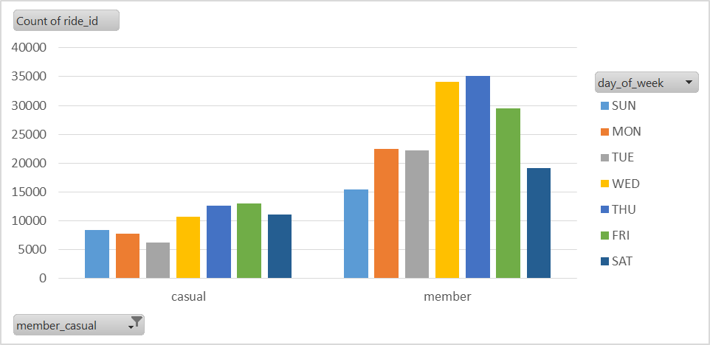
December 2021
Casual riders are most concentrated on Sundays, with longer average ride length.
Casual riders prefer to ride much longer than member riders on any given day.
Majority of riders on any given day are members.
No of riders on Tuesdays is low.

Slide 21
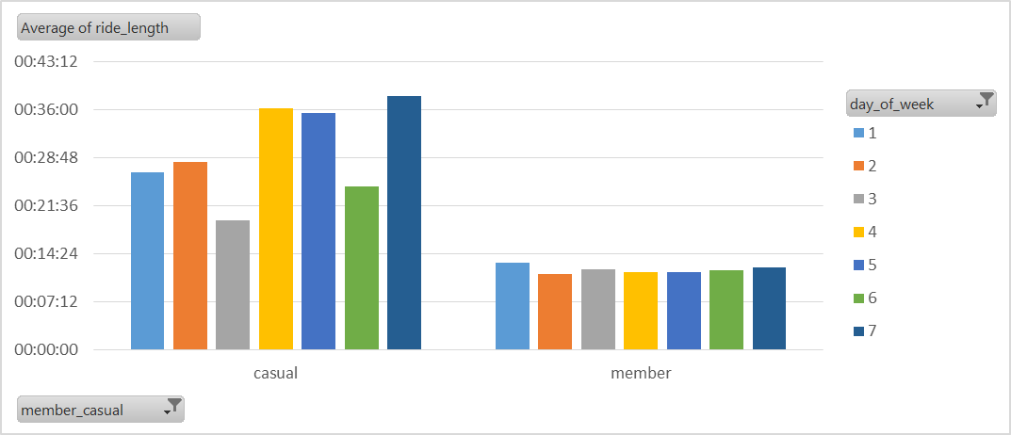
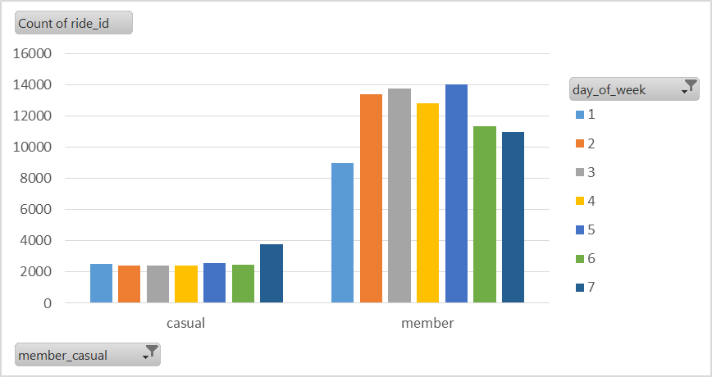
January 2022
Rides taken by Casual riders is much less than that of Members, on any given day.
Casual riders take longer rides than members on an average.

Slide 22
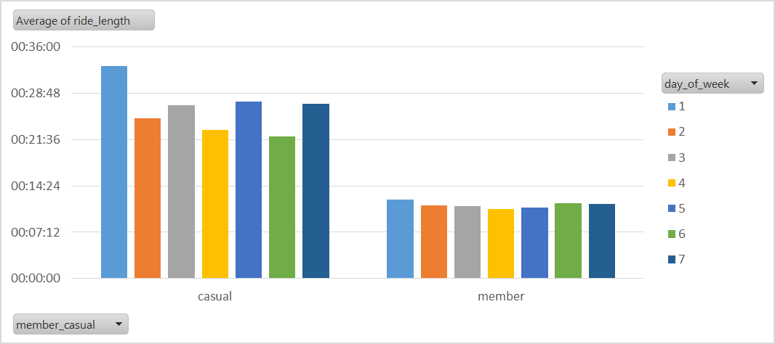
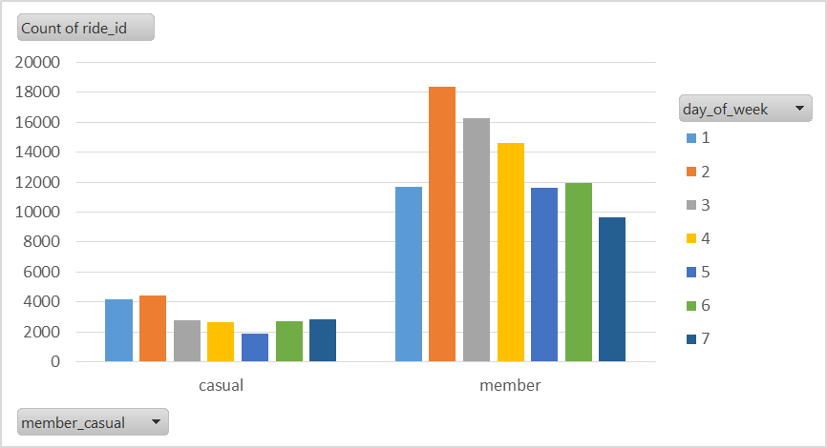
February, 2022
Casual riders ride longer than members on average
Members have taken up to 4 times more rides than casual riders on any given day.

Slide 23
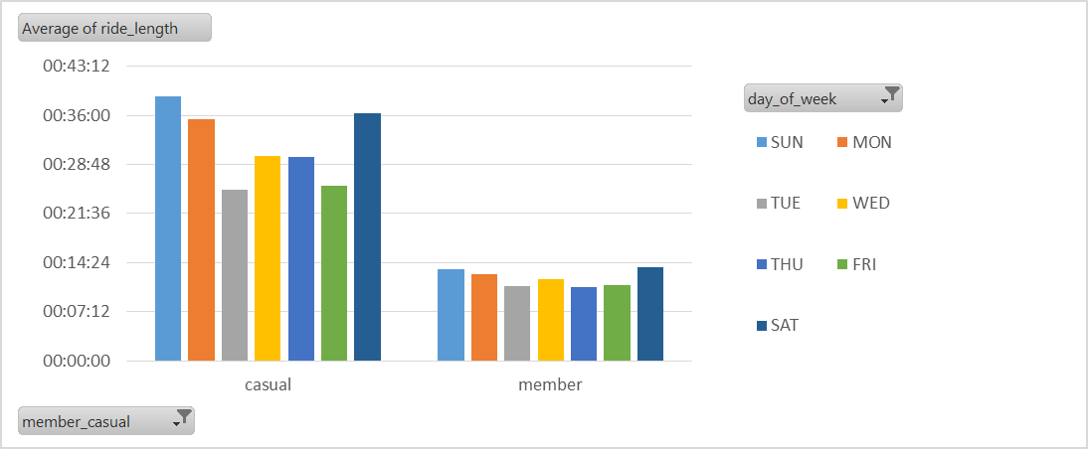
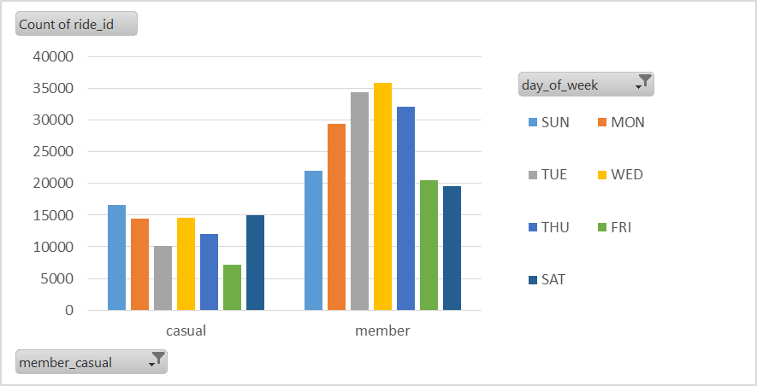
March 2022
Casual riders are more concentrated in weekends and their rides are longer as well.
Member riders are more concentrated in weekdays.
Casual riders ride for much longer periods (on an average) than member riders, on any given day.
Total no of rides is quite low on Fridays.

