Slide 1


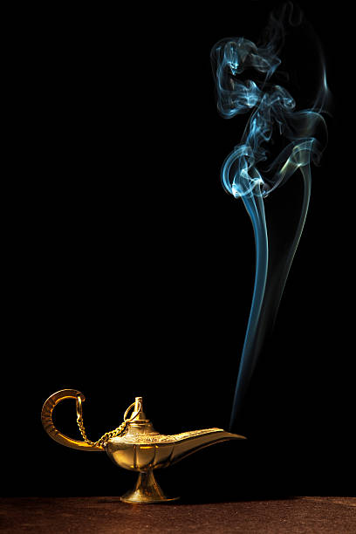
BOSS DETECTOR
Let’s see what Harry is doing now !
You seem to be so workaholic! Good job Harry!
Boss Detector in action!
Fakebook seems fun !!
By :
RAVI MAKAWANA
DIVYARTH SINGH
DEBOSMITA CHAKRABORTY

Slide 2
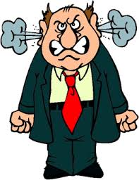


Recap
Face Image
Hide Screen
Recognize
Prerequisites
The software we are using to implement the project is the anaconda.
We have installed all the necessary library packages like sklearn, keras, tensorflow, OpenCV, and numpy.

Slide 3
Recap
Our presentation so far
We had set up the environment.
We had taken videos of a subject who is the boss and taken pics of others too. We had decomposed the videos into images.
We had trained our model using those images.
We had implemented the ‘image_show’ module and train the module.

Slide 4
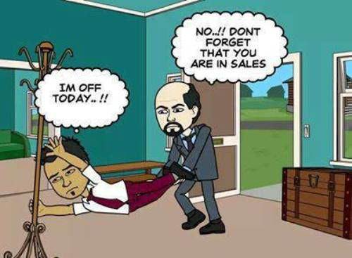
Precap
The ‘camera_reader’ has been implemented.
We have done the pre-processing of the images.
We have tested our code with different entities – sometimes with the boss and sometimes with an entity who is not the boss to check the accuracy.
We have also tested the code with fast moving entities by moderating the speed of the entity.

Slide 5
How our method works:
We have implemented this using tensorflow.
In the first step, we have resized the images using data augmentation which will increase the size of the dataset by randomly flipping, rotating, stretching, etc.
Once the images are pre-processed, we have trained the model. Our model consists of 18 layers. These layers include convolution, activation, dense, pooling, etc. A detailed description have been given later.
We have implemented these steps by using a laptop webcam for capturing the video and using OpenCV. Once the boss gets detected, we are displaying a static image using PYQT5.

Slide 6
Code implementation
How to set up:
Install anaconda or pycharm and all the necessary libraries like pyQt5, sklearn, keras (change to tensorflow if it not done.), OpenCV.
How to run :
First of all, add the images of the boss in the folder data under subfolder ‘boss’ and add images of the others in the folder data under subfolder ‘other’. Try to take the image which covers most of the face.
Once you have the dataset, train the model by running the module boss_train.py.
Model is ready. Now, run the camera_reader.py which will capture video and will use the model to detect the boss.

Slide 7
Terminologies

Slide 8
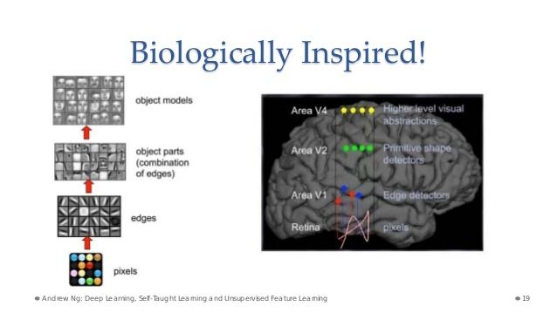
ANN - similarity with the human brain
An ANN is based on a collection of connected units or nodes called artificial neurons (analogous to biological neurons in an animal brain). Each connection (synapse) between neurons can transmit a signal from one to another. Neurons and synapses may also have a weight that varies as learning proceeds, which can increase or decrease the strength of the signal that it sends downstream.

Slide 9
Layers
Pooling layer
It is down sampling layer. This basically takes a filter and a stride of the same length and then applies it to the input volume and outputs the maximum number in every sub-region that the filter convolves around.
Dropout layer
This layer “drops out” a random set of activations in that layer by setting them to zero.

Slide 10
Layers
Fully connected layer
Neurons in a fully connected layer which have connections to all activations in the previous layer.
Image augmentation
It artificially creates training images through different ways of processing or combination of multiple processing, such as random rotation, shifts, shear, and flips, etc.

Slide 11
Layers of the neural network used in our project
____________________________________________________________________________________________________
Layer (type) Output Shape Param # Connected to
=================================================================================
conconvolution2d_1 (Convolution2D) (None, 32, 64, 64) 896 convolution2d_input_1[0][0]
__________________________________________________________________________________________________
activation_1 (Activation) (None, 32, 64, 64) 0 convolution2d_1[0][0]
__________________________________________________________________________________________________
convolution2d_2 (Convolution2D) (None, 32, 62, 62) 9248 activation_1[0][0]
__________________________________________________________________________________________________
activation_2 (Activation) (None, 32, 62, 62) 0 convolution2d_2[0][0]
__________________________________________________________________________________________________
maxpooling2d_1 (MaxPooling2D) (None, 32, 31, 31) 0 activation_2[0][0]
__________________________________________________________________________________________________

Slide 12
(Continuation)
dropout_1 (Dropout) (None, 32, 31, 31) 0 maxpooling2d_1[0][0]
__________________________________________________________________________________________________
convolution2d_3 (Convolution2D) (None, 64, 31, 31) 18496 dropout_1[0][0]
__________________________________________________________________________________________________
activation_3 (Activation) (None, 64, 31, 31) 0 convolution2d_3[0][0]
__________________________________________________________________________________________________
convolution2d_4 (Convolution2D) (None, 64, 29, 29) 36928 activation_3[0][0]
__________________________________________________________________________________________________activation_4 (Activation) (None, 64, 29, 29) 0 convolution2d_4[0][0]
__________________________________________________________________________________________________
maxpooling2d_2 (MaxPooling2D) (None, 64, 14, 14) 0 activation_4[0][0]
__________________________________________________________________________________________________
dropout_2 (Dropout) (None, 64, 14, 14) 0 maxpooling2d_2[0][0]
__________________________________________________________________________________________________

Slide 13
(Continuation)
flatten_1 (Flatten) (None, 12544) 0 dropout_2[0][0]
__________________________________________________________________________________________________
dense_1 (Dense) (None, 512) 6423040 flatten_1[0][0]
__________________________________________________________________________________________________
activation_5 (Activation) (None, 512) 0 dense_1[0][0]
__________________________________________________________________________________________________
dropout_3 (Dropout) (None, 512) 0 activation_5[0][0]
__________________________________________________________________________________________________
dense_2 (Dense) (None, 2) 1026 dropout_3[0][0]
__________________________________________________________________________________________________
activation_6 (Activation) (None, 2) 0 dense_2[0][0]
=================================================================================

Slide 14

ReLU In the context of artificial neural networks, the rectifier is an activation function defined as the positive part of its argument:
Softmax This function will calculate the probabilities of each target class over all possible target classes.

Slide 15
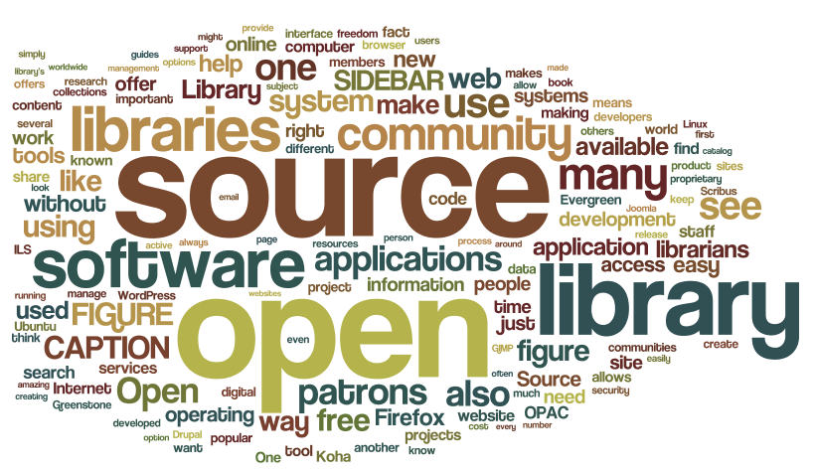
Keras
Definition:
Keras is a high-level neural networks API, written in Python and capable of running on top of TensorFlow, CNTK, or Theano.
Features of Keras :
User friendliness
Modularity
Easy extensibility
Work with Python

Slide 16
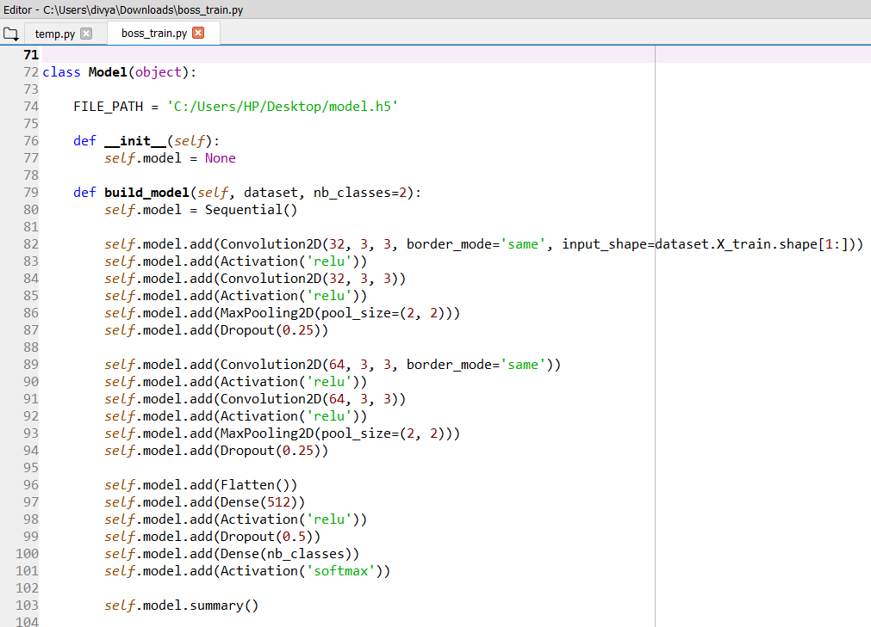
Code Screenshot:

Slide 17
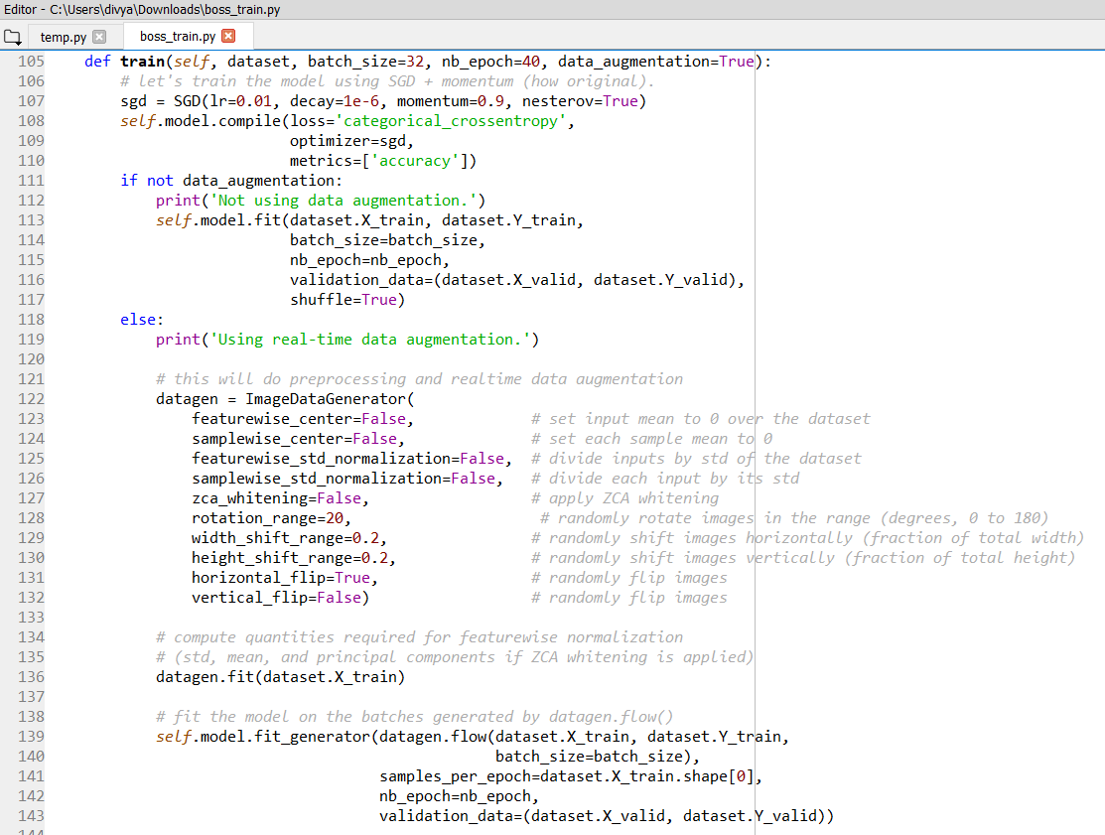
Code Screenshot:

Slide 18
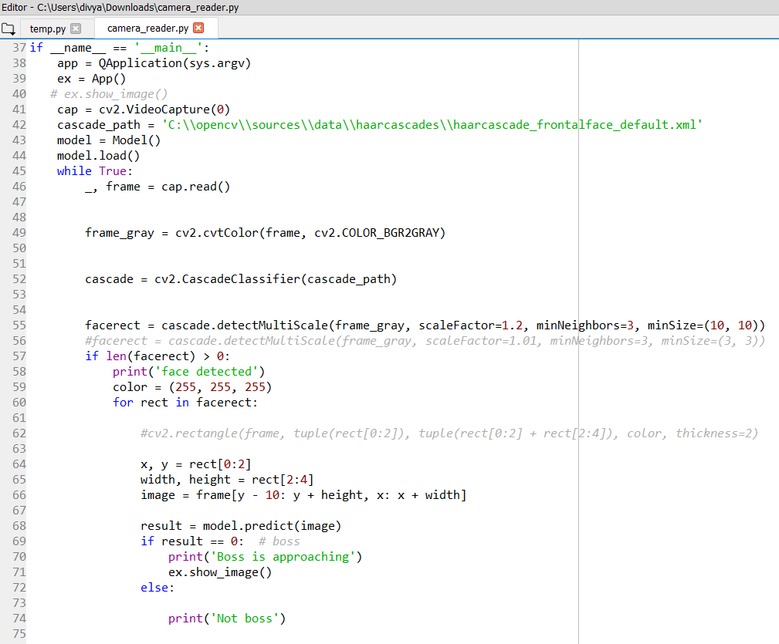
Code Screenshot:

Slide 19
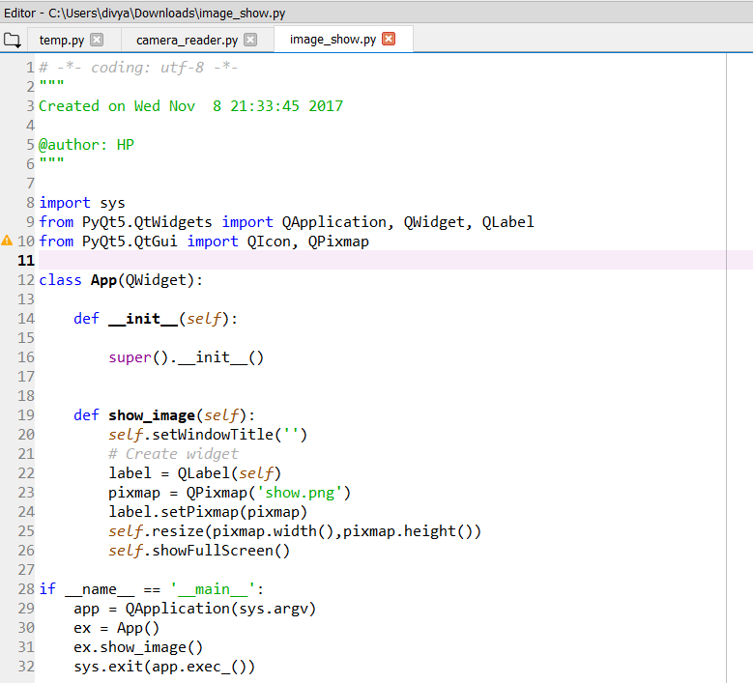
Code Screenshot:

Slide 20
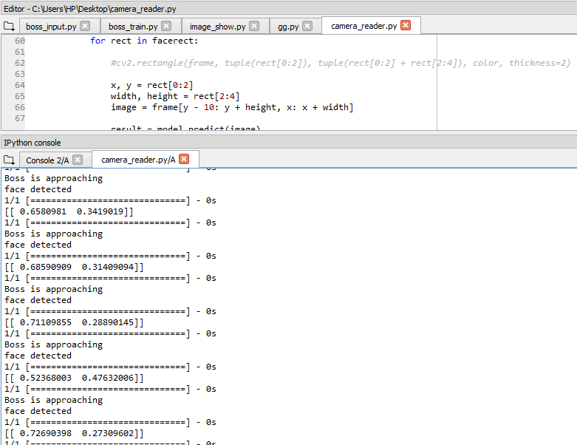
Output:

Slide 21
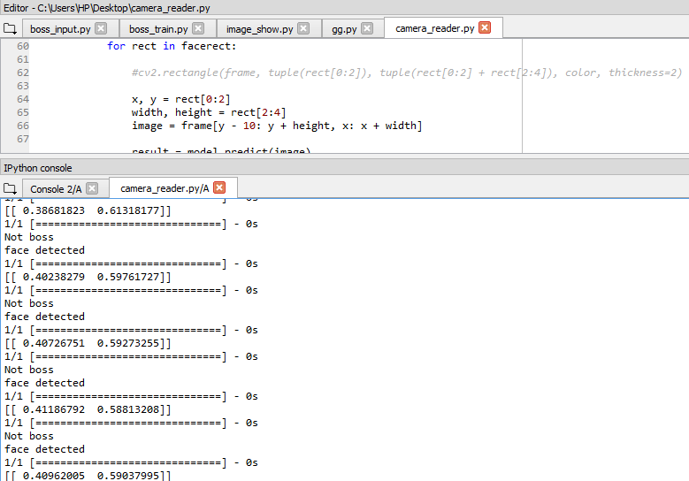
Output:

Slide 22
Roles and Responsibilities
We worked as a team. We divided the module into three parts :
Debosmita Chakraborty: boss_input.py
Ravi Makawana: image_show.py
Divyarth Singh: camera_reader.py
The remaining modules have been implemented as a group (boss_train.py) and the code has been tested using various entities as inputs.

Slide 23
Future scope:
Detecting multiple bosses.
Detecting when the boss is far away from the camera.
Detecting in less brightness.
Enhancing the performance of the application.

Slide 24
What we have learnt so far
We have learned CNN and its various layers like fully connected layer, max pooling, various classifiers like ReLU and softmax.
We have also learned about pyQt5, keras and sklearn.
Other than these, we learned about the testing set and validation set, data augmentation and about cascade classifier which will detect an object from the video stream.

Slide 25
References
The idea has primarily been extracted from http://ahogrammer.com
The research paper ‘A Discriminative Feature Learning Approach for Deep Face Recognition’ by Shenzhen Institutes of Advanced Technology, CAS, China and the Chinese University of Hong Kong, Hong Kong is a good source of learning about deep face recognition.
A good understanding on neural network and deep learning can be obtained from the below mentioned links :
http://neuralnetworksanddeeplearning.com
https://deeplearning4j.org/neuralnet-overview
http://deeplearning.net/ is another good open source for references to software, datasets, tutorials and demos related to deep learning which is also quite helpful for the implementation of the project.

Slide 26
THANK YOU

