Slide 1
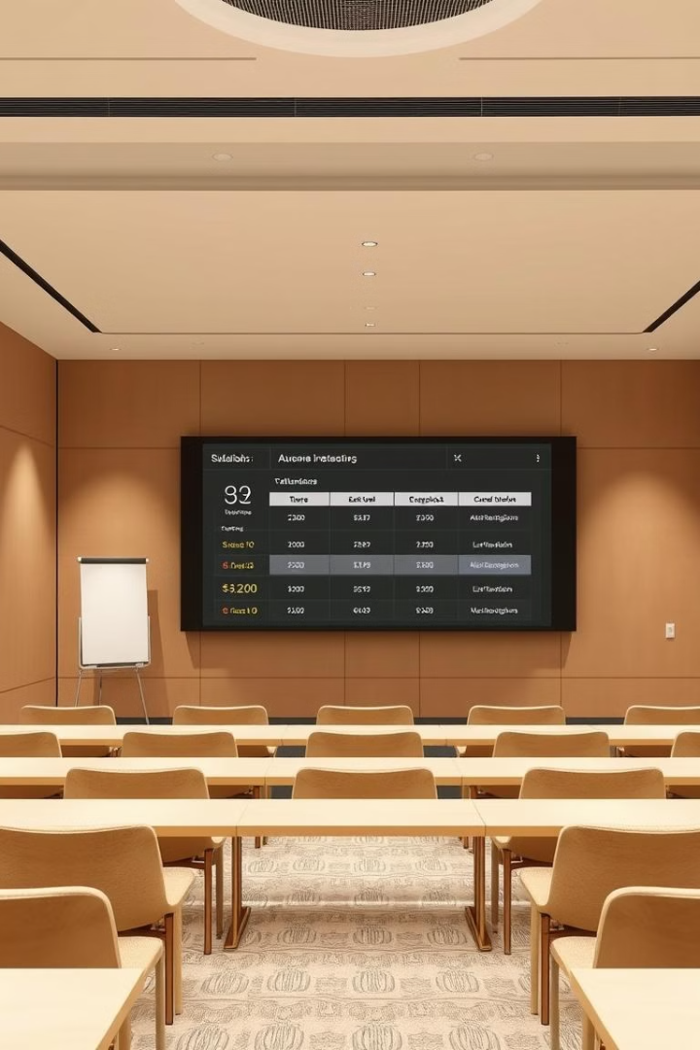

Mahavir Education trust's
shah & anchor kutchhi engineering college
AN AUTONOMOUS INSTITUTE AFFILIATED TO THE UNIVERSITY OF MUMBAI
Student Attendance Management System
SUBJECT : Middleware Technology
Presented by:
Ayush Kenia(29)
Rujuta Pethe (44)
Divya Savla (48)

Slide 2
Aim / Abstract
Aim
Abstract
Develop a web-based system automating student attendance tracking using web services.
Simplify attendance management in educational institutions by replacing traditional methods with an automated system.
Utilizes JAX-WS web services, JSP for UI, and MySQL for data storage.
Ensures accuracy, accessibility, and efficiency in attendance tracking.
Enables student registration, attendance marking, and report generation.
Achieves seamless web service communication through a structured database.

Slide 3








Proposed System
Automated Attendance Management
Web Service Integration
Student Registration
Ensures accessibility and interoperability.
Securely adds students to the database.
Reduces manual efforts and human errors.
Attendance Marking
Report Generation
Teachers can mark student attendance easily.
Provides attendance reports for analysis.
Architecture Overview:
Front-end
Middleware
Back-end
JSP pages interact with users.
JAX-WS processes requests.
MySQL stores student and attendance records.

Slide 4






Front End, Back End, and Server
Server
GlassFish Server 4.0
Back-End
JAX-WS, Servlets, MySQL
Front-End
JSP, HTML, CSS, JavaScript
Front-End
Back-End
Server
JSP (Java Server Pages) for interactive user interface.
JAX-WS Web Services for processing requests.
GlassFish Server 4.0 for deploying the application.
HTML, CSS, JavaScript for UI enhancements.
Servlets handle business logic.
Supports Java EE applications and web services.
MySQL database for storing attendance records.

Slide 5
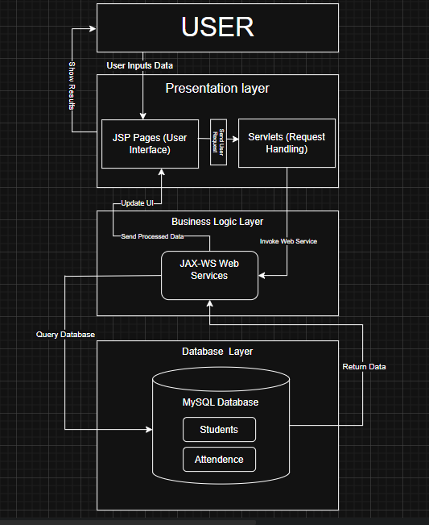
Flow Diagram
Reference Papers:
Research papers on "Automated Attendance Systems" and "Web Service-based Student Management".
IEEE Xplore, Springer, and other scholarly sources on cloud-based attendance tracking.

