Slide 1


Data Wrangling and Acquisition
Created by : Divya Sharma

Slide 2
Introduction to Data Wrangling and Acquisition
Data wrangling and data acquisition are essential skills for any data scientist or analyst. In this section, we'll explore the processes of collecting, cleaning, and preparing raw data for analysis, unlocking valuable insights from complex datasets.

Slide 3
Importance of Data Wrangling in Data Science
1
Data Quality Improvement
2
Efficient Data Exploration
Data wrangling enables cleaning, transforming, and integrating raw data, ensuring the accuracy, completeness, and consistency required for effective data analysis and modeling.
By organizing and structuring data, data wrangling facilitates more efficient exploration, allowing data scientists to quickly understand patterns, trends, and insights hidden within complex datasets.
3
Preparing Data for Analytics
4
Unlocking Business Value
The data wrangling process prepares data for advanced analytics techniques, such as machine learning and predictive modeling, by ensuring data is in the right format and structure.
High-quality, well-structured data enables more accurate and reliable data-driven decision making, ultimately unlocking greater business value and competitive advantages.

Slide 4
Data Sources and Formats
Structured Data
Unstructured Data
Databases, spreadsheets, and CSV files contain data in a tabular, well-organized format, making them easy to process and analyze.
Text documents, emails, social media posts, and multimedia files often lack a predefined structure, requiring more extensive processing to extract meaningful insights.
Real-Time Data
Open Data
Sensor data, log files, and streaming APIs provide a continuous flow of data that needs to be captured, filtered, and transformed in real-time.
Government, research, and non-profit organizations often publish datasets that can be freely accessed and used for analysis and problem-solving.

Slide 5
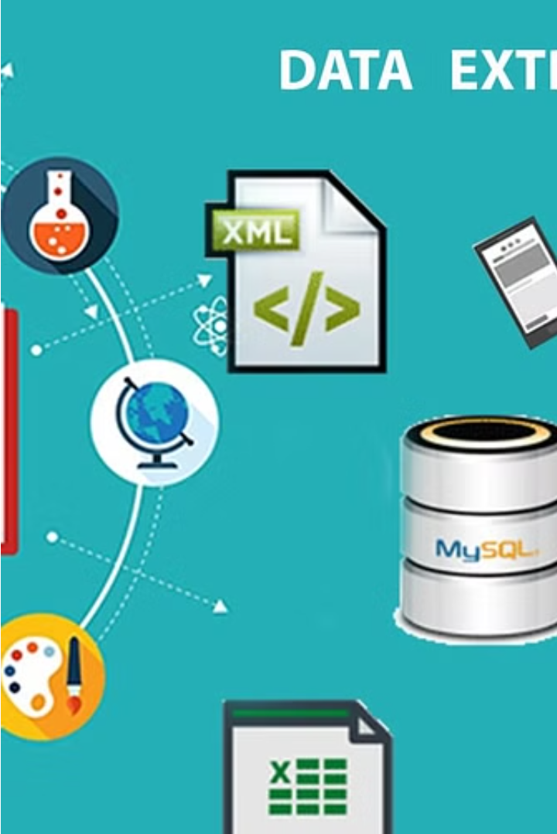
Data Extraction Techniques
Extracting data from various sources is a crucial step in the data science pipeline. This involves techniques like web scraping, API integration, and database querying to gather the necessary data for analysis.
Efficient data extraction methods ensure the completeness and accuracy of the dataset, laying the foundation for effective data wrangling and downstream analysis.

Slide 6
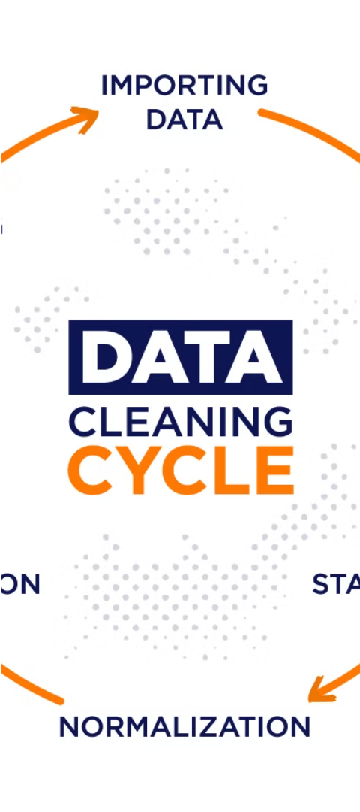
Data Cleaning and Transformation
1
Data Profiling
Analyze the data to understand its structure, quality, and characteristics. This helps identify issues like missing values, outliers, and data types.
2
Data Cleaning
Address data quality issues by removing or correcting errors, inconsistencies, and irrelevant data. This improves the reliability and accuracy of the dataset.
3
Data Transformation
Convert data into a format suitable for analysis. This may involve tasks like aggregation, normalization, or feature engineering to derive new meaningful variables.

Slide 7




Data Integration and Normalization
Unifying Data Sources
Standardizing Formats
Handling Heterogeneity
Combine data from multiple databases, spreadsheets, and other sources into a coherent dataset.
Ensure all data is in a consistent format, resolving any discrepancies in units, scales, or representations.
Reconcile differences in data structures, schemas, and terminology across disparate sources to create a unified view.

Slide 8
Handling Missing and Erroneous Data
Identifying Missing Data
Imputation Strategies
Dealing with Errors
Robust Analysis
Remember to account for the impact of missing or erroneous data on your analysis. Use techniques like sensitivity analysis and cross-validation to ensure the reliability of your findings.
Recognizing gaps or inconsistencies in your dataset is the first step. Employ techniques like data profiling and exploratory analysis to pinpoint missing values, invalid entries, or outliers that require attention.
Once identified, you can use various imputation methods to replace missing data, such as mean/median imputation, regression-based techniques, or more advanced algorithms like k-nearest neighbors.
Erroneous data can come from human input errors, instrument malfunctions, or data processing issues. Implement data validation checks and cleansing routines to flag and correct these problems.

Slide 9
Determining the Outliers
Identify
1
Recognize unusual data points
Analyze
2
Understand the root causes
Address
3
Decide how to handle outliers
Identifying outliers, or data points that fall significantly outside the normal range, is a crucial step in data analysis. By closely examining these anomalies, we can gain valuable insights into the underlying patterns and drivers within the dataset. Once outliers are detected, we can then decide how to appropriately handle them - whether to remove, adjust, or retain them based on the specific context and goals of the analysis.

Slide 10
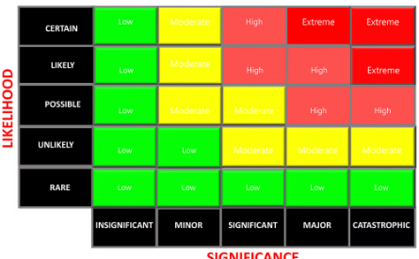
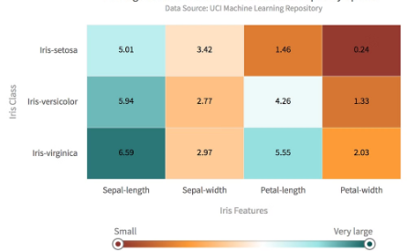

Generating the Heat Map
Visualizing Data Patterns
Identifying Relationships
Customizable Presentation
A heat map is a powerful data visualization tool that uses color-coding to represent the values or frequencies of data points. This allows users to quickly identify trends, outliers, and areas of concentration in a dataset.
By generating a heat map, data scientists can uncover hidden connections and relationships between variables in a dataset. The color gradients reveal the strength and direction of these associations.
Heat maps can be tailored to the specific needs of the analysis, with adjustable color palettes, scales, and annotations to highlight the most relevant insights for stakeholders.

Slide 11
Checking the Skewness of the Data
Analyzing the skewness of the data is a crucial step in understanding its distribution and identifying potential asymmetries. Skewness measures the degree of asymmetry in a dataset, providing valuable insights into the shape and balance of the data.
0.7
1.2
—
Skewness
Kurtosis
Key Metrics
By calculating the skewness and kurtosis of the data, data scientists can determine if the distribution is symmetrical (skewness = 0), left-skewed (skewness < 0), or right-skewed (skewness > 0). This information guides further analysis and the selection of appropriate statistical models and techniques.

Slide 12
Conclusion: The Power of Data Wrangling and Acquisition
Unlocking Insights
1
Mastering data wrangling and acquisition empowers you to uncover hidden patterns, relationships, and opportunities within complex datasets.
2
Informed Decision-Making
With clean, integrated, and trustworthy data, you can make data-driven decisions that drive business success and innovation.
Competitive Advantage
3
Effective data wrangling gives you a strategic edge, allowing you to extract maximum value from your data resources.

Slide 13
THANK_YOU

