Slide 1

Manual calculator
Created by: Divya Sharma

Slide 2
Overview of project:
The manual calculator provides a user-friendly solution for basic and advanced arithmetic calculations. Featuring a compact design and easy-to-navigate interface, this calculator is suitable for students, professionals, and everyday users. With functions ranging from fundamental arithmetic operations to memory management, it offers a versatile and durable tool for diverse mathematical needs. Whether for school, work, or daily tasks, this manual calculator ensures simplicity and reliability in your calculations.

Slide 3
About the project:
Steps to create a project:
we need to setup the python and VS code editor in our system.
After instaling and setup python in our system, will create a .py file and import tikinter.
Now we will design the UI of the calculator by using Tikinter functions.
Now we will define some functions to calculate the values input by the user( described in upcoming slides)
Now will check the code by run and debugging the code in python VS editor

Slide 4
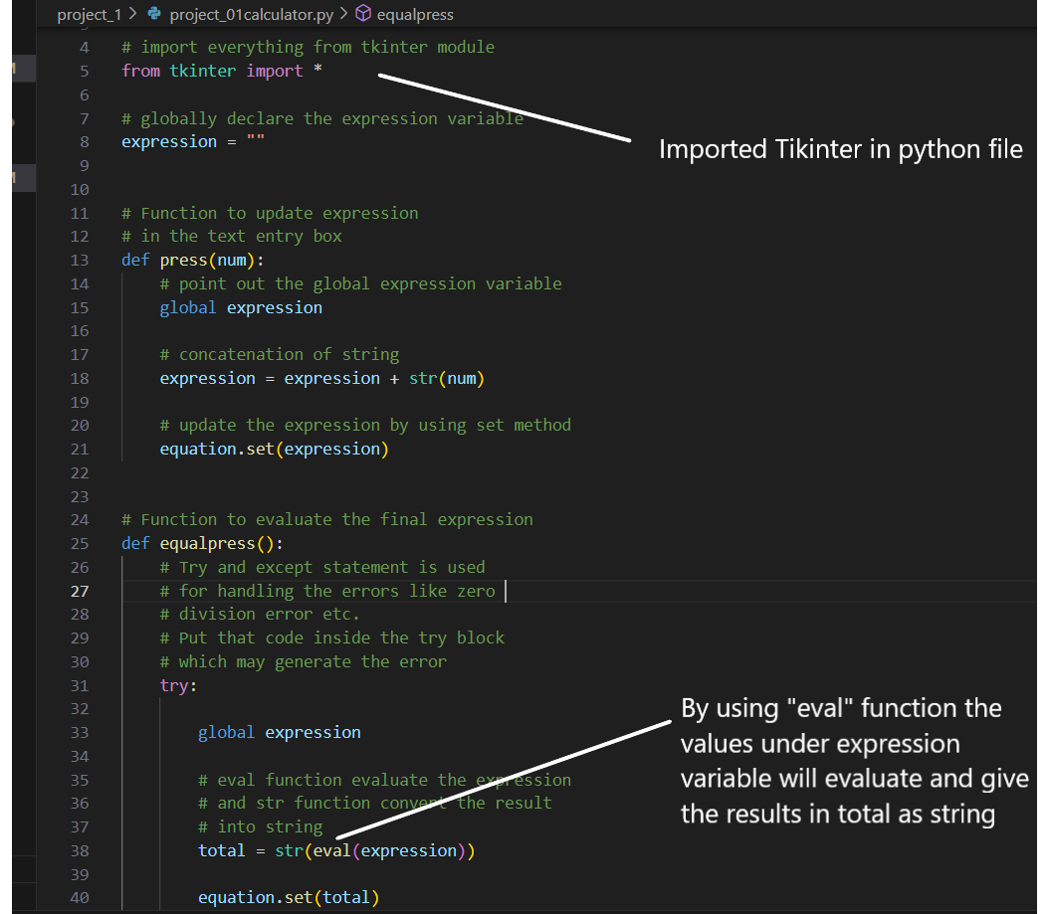

Slide 5
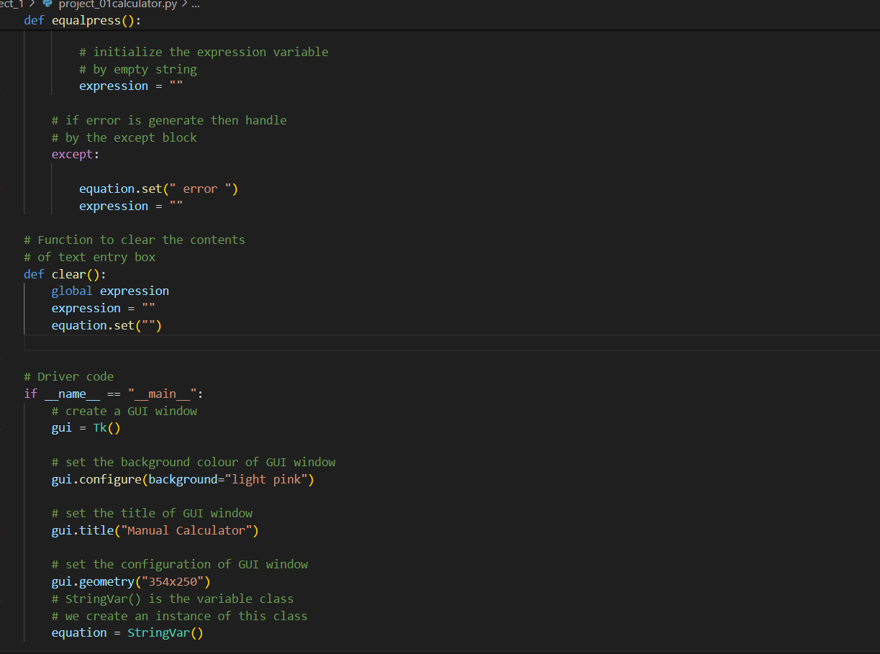
The driver code is responsible for initializing the main application window and other components
↓

Slide 6
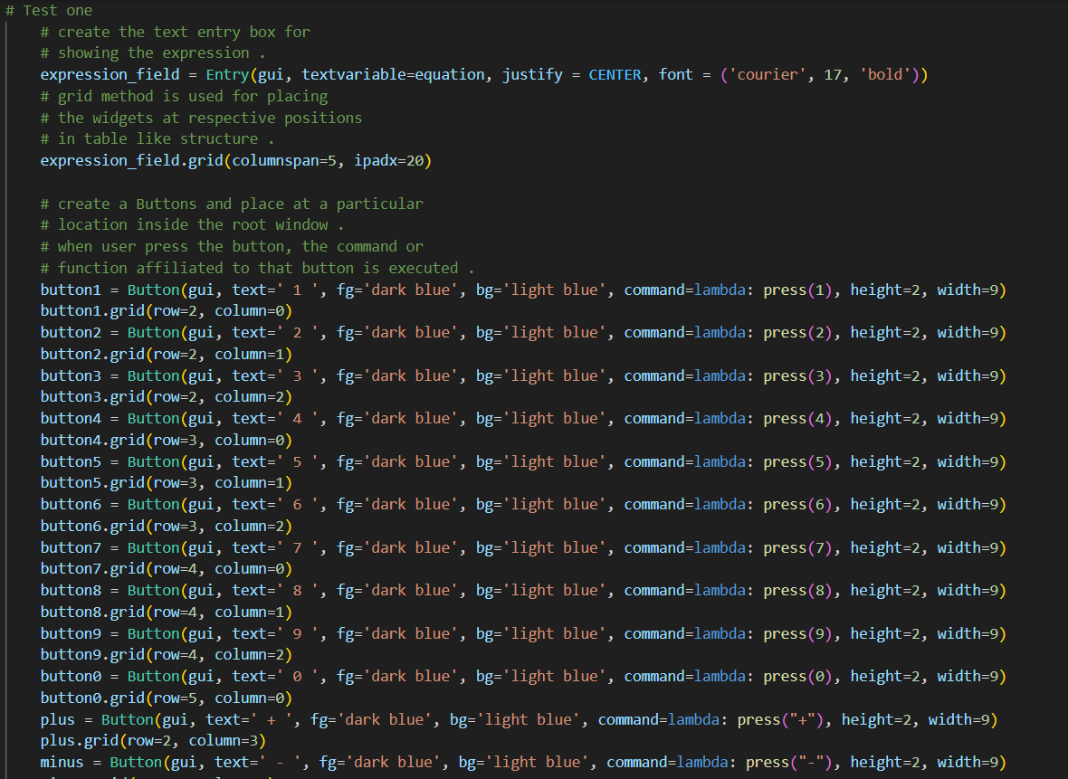
↓
I used justify=CENTER property to get the input at center of the field
→

Slide 7
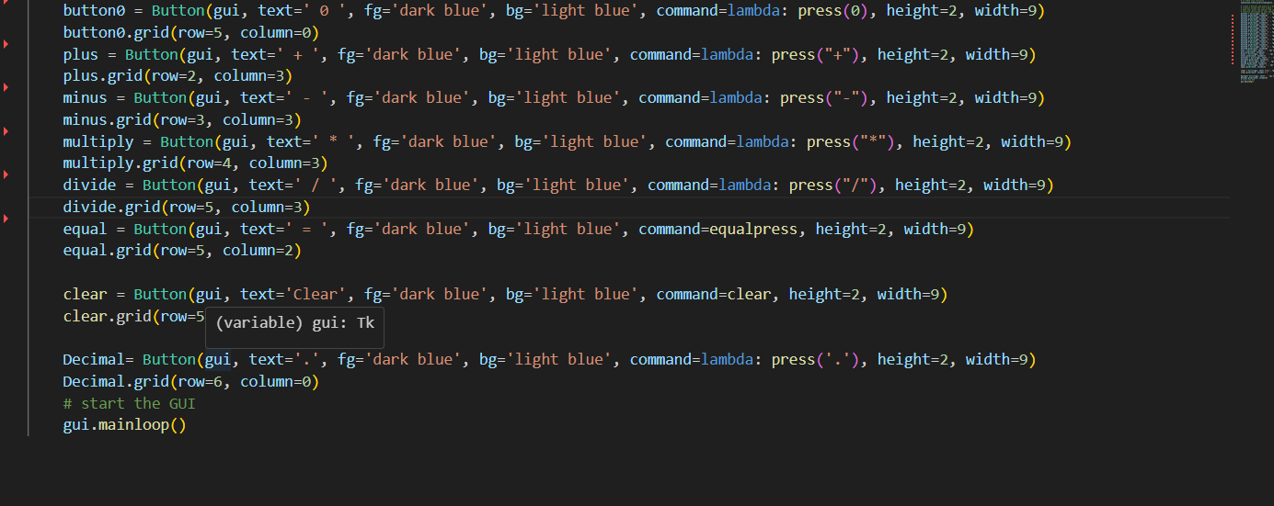

Slide 8
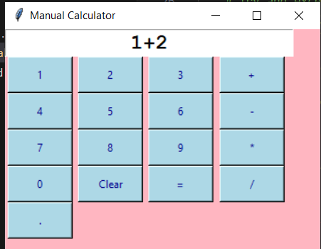
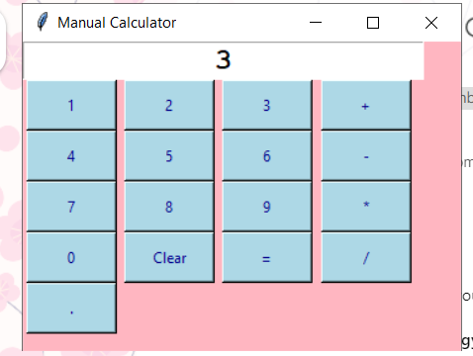
Here we can see the output of my code user given input as 1+2 to add the values showing center aligned, now by pressing “=” we will get the result as “3” at the center of the input field. In this way we can perform multiple airthmatic operation as per the input given by the user. we can also use decimal values to evaluate the input.

Slide 9
Methodology/Software requirements
System requirements OS (Windows 10/11)
Python 3.2 or the latest version
VS code editor
Tkinter GUI using tkinter library
git hub (to submit the code)
git bash

Slide 10
Thank you for watching this PPT

