Slide 1
INTERNSHIP PRESENTATION
Date of Presentation:25-05-2026

Slide 2
Student Details
Student Name : Divyashree
Registration no. : 24ETEC004009
Faculty : Faculty of Engineering and Technology
Department : Electronics and Communication Engineering (ECE)
Programme : Bachelor of Technology (B.Tech)
Batch : 2024–2028

Slide 3
Place of Internship
Cranes Varsity Bengaluru, Karnataka, India.
Name of the Industrial Mentor/s:
Harsha G (Program Manager)

Slide 4
Outline
Introduction to Organisation
Organisational Structure
Business Activity and Product/Service Portfolio
Competencies and Talent Management
My Internship Work
Learning Experience and Relevance
Conclusions
Suggestions for future internship work in the organisation

Slide 5
Introduction to Organisation
• Internship Organization: Cranes Varsity Pvt Ltd
• Provides technical training, internships, and industry-oriented projects.
• Focuses on embedded systems, IoT, VLSI, PCB design, and programming.
• Helps students gain practical exposure to real-world engineering applications.

Slide 6
Organisational Structure
Level | Department / Role
1 | Management Team
2 | Trainers / Mentors
3 | Technical Support Team
4 | Internship Coordinators
5 | Students / Interns

Slide 7
Business Activity and Product / Service Portfolio
• Internship and industrial training programs
• Academic and industry projects
• Workshops on Arduino, IoT, PCB Design, and Embedded Systems
• Technical consulting and skill development

Slide 8
Competencies and Talent Management
• Hands-on technical training
• Team collaboration and communication
• Project planning and documentation
• Mentor guidance and performance evaluation

Slide 9
My Internship Work
Project Title: Smart Automatic Gate Control System using Arduino
Worked on the project Smart Automatic Gate Control System using Arduino.
Designed and implemented an automated gate opening and closing system.
Integrated hardware components such as Arduino Uno, Ultrasonic Sensor, Servo Motor, and LCD Display.
Tested the system under different distance conditions.
Debugged circuit connections and corrected programming errors.
Demonstrated the final working model successfully.

Slide 10
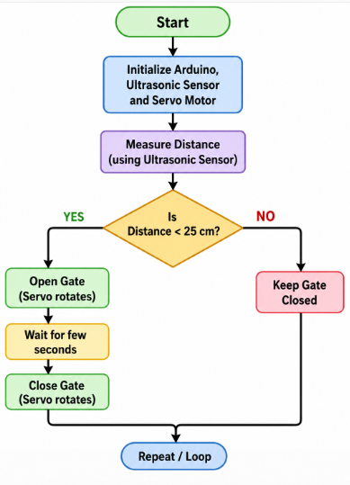
Flowchart

Slide 11
Learning Experience and Relevance
Learned practical implementation of Embedded Systems concepts.
Gained hands-on experience with Arduino programming.
Understood how Ultrasonic Sensors detect objects using sound waves.
Learned how to control a Servo Motor for precise gate movement.
Worked with LCD interfacing to display real-time system status.
Improved knowledge of automation and smart control systems.
Developed troubleshooting and problem-solving skills.

Slide 12
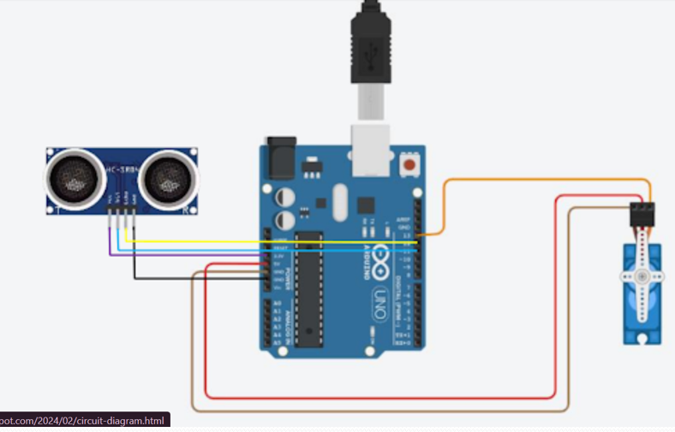
Circuit connections

Slide 13
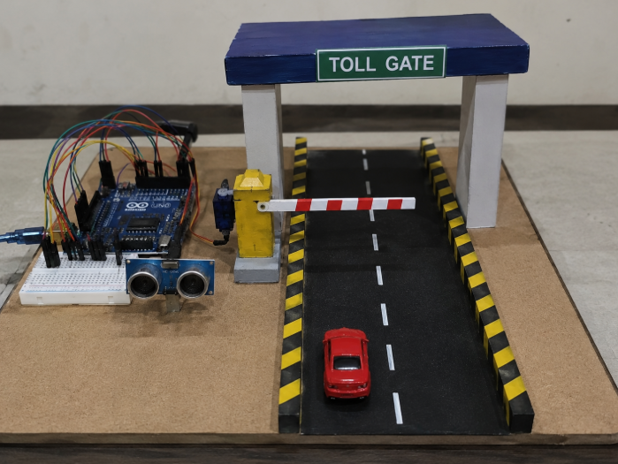

Slide 14
Conclusions
• Successfully developed a working automatic gate control system.
• Reduced the need for manual gate operation.
• Demonstrated practical application of embedded systems.
• Internship provided valuable industry-oriented experience.

Slide 15
Suggestions for future internship work in the organisation
• Provide more advanced projects using IoT and AI.
• Include industrial visits and live demonstrations.
• Extend internship duration for deeper learning.
Conduct additional sessions on PCB design and testing.

Slide 16
References
• Arduino Official Documentation
• Ultrasonic Sensor HC-SR04 Datasheet
• Servo Motor SG90 Datasheet
• Guidance from Industrial Mentor

Slide 17
Acknowledgement
I would like to express my sincere gratitude to all the trainers and mentors for their valuable guidance, support, and encouragement throughout the project work. I also thank my faculty members, friends, and team members for their continuous cooperation and motivation during the successful completion of the project titled “Smart Automatic Gate System using Arduino.”

Slide 18
Thank You

